Slide 1
Metabolic Bone Disorders
Dr Munir Saadeddin, FRCSEd
Associate Professor & Consultant
Orthopedic department
College of medicine
King saud university

Slide 2
Objectives of this lecture
To know about the function of the bone.
To understand why metabolic disorders can happen.
To learn about pathology and clinical picture of common metabolic bone disorders.
To know possible complications of metabolic bone disorders.
To understand principles of management of metabolic disorders.

Slide 3
Orthopedic Surgeons and Bone
Orthopedic surgeons have to deal with all types of bone : healthy or diseased; and that’s why they have to know about bone metabolism
Bones in the body protect vital organs
Bones give support to muscles and tendons
Bone may become weak in certain conditions

Slide 4
Bone is a living structure
There is a continuous activity in bone during all stages of life
There is continuous bone resorption and bone
formation as well as remodeling
That means bone is not only for protection and support but its contents play an important part in blood homeostasis
Many factors are involved in this process

Slide 5
Bone Metabolism
Bone metabolism is controlled by many factors:
Calcium
Phosphorus
Parathyroid gland
Thyroid gland
Estrogen
Glucocorticoid hormones
Intestinal absorption
Renal excretion
Diet
Vitamin D
Sun exposure

Slide 6
Bone Structure
Bone is formed by
Bone matrix : which consists of
40% organic : collagen type1 (responsible for tensile strength)
60% Minerals : mainly Calcium hydroxyapatite, Phosphorus, and traces of other minerals like zinc
Cells in bone : osteoblasts, osteoclasts, osteocytes

Slide 7
Blood Plasma levels
Calcium : 2.2-2.6 mmol/l
Phosphorus : 0.9-1.3 mmol/l
Both absorbed by intestine and secreted by kidney in urine
Alkaline phosphatase : 30-180 units/l
Is elevated in bone increased activity like during growth or in metabolic bone disease or destruction
Vitamin D level : 70-150 nmol/l

Slide 8
Parathyroid Hormone (PTH)
Production levels are related to serum calcium levels
PTH secretion is increased when serum calcium is low
Action of PTH: it increases calcium levels in the blood by
increasing its release from bone
& increase absorption from the intestine
& and increase reabsorption from the kidney ( also increase secretion of phosphorus )

Slide 9
Hyperparathyroidism
Primary : Adenoma of the gland
Secondary : as a result of low calcium
Tertiary : as a result of prolonged or sustained stimulation = hyperactive nodule or hyperplasia

Slide 10
Calcitonin
Is secreted by C cells of thyroid gland
Its secretion is regulated by serum calcium
Its action is to cause inhibition of bone resorption and increasing calcium excretion by this it causes lowering of serum calcium

Slide 11
Bone Strength
Bone strength is affected by mechanical stress which means exercise and weight bearing
Bone strength gets reduced with menopause and advancing age
Reduced bone density on X rays is called Osteopenia
Osteopenia is also a term used to describe a degree of reduced bone density, which if advanced becomes Osteoporosis

Slide 12
Bone Density
Bone density is diagnosed at current time by a test done at radiology department called :
DEXA scan
DEXA is ( Dual Energy X ray Absorbtionometry )
However: increased bone density does not always mean increased bone strength, as sometimes in Brittle bone disease ( which is a dense bone ) is not a strong bone but fragile bone which may break easily

Slide 13
Dexa Scan

Slide 14
Severe Osteoporosis

Slide 15
Disorders to be discussed
Rickets
Osteomalacia
Osteoporosis
Hyperparathyroidism

Slide 16
Rickets & Osteomalacia
- Different expressions of the same disease which is :
Inadequate mineralization
- Rickets affects
: Areas of endochondral growth in children
- Osteomalacia
: All skeleton is incompletely calcified in adults

Slide 17
Rickets & Osteomalacia
* Causes
- Calcium deficiency
- Hypophosphataemia
- Defect in Vitamin D metabolism
nutritional
underexposure to sunlight
intestinal malabsorption
liver & kidney diseases

Slide 18
Rickets: Symptoms and Signs
Child is restless, babies cry without obvious reason
Failure to thrive
Muscle weakness
In severe cases with very low calcium: tetany or convulsions
Joint thickening especially around wrists and knees
Deformity of limbs, mostly Genu varum or Genu Valgum
Pigeon chest deformity, Rickety Rosary, craniotabes

Slide 19
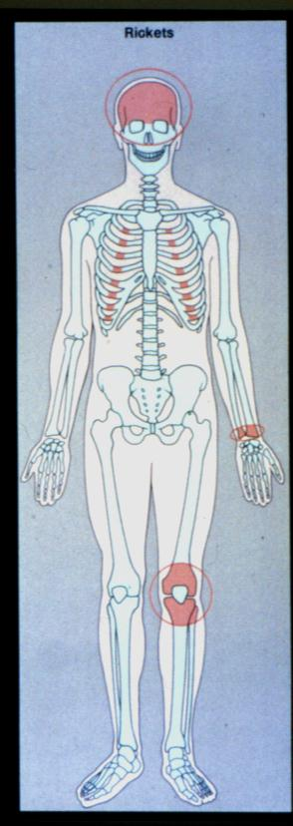

Slide 20
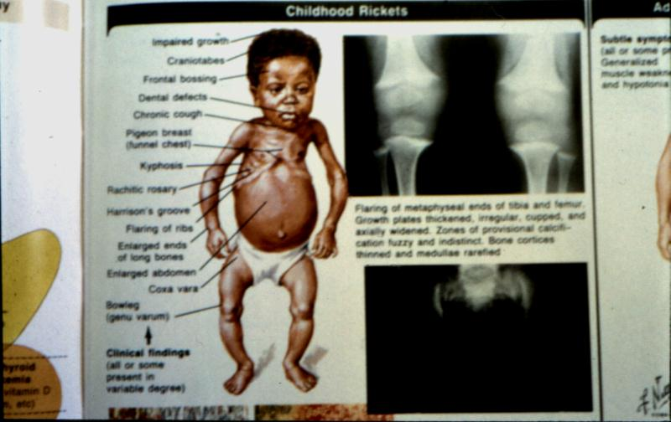

Slide 21
X Ray Findings in Rickets
Growth plate widening and thickening
Metaphysial cupping
Long bones deformities

Slide 22
Growth Plate& Metaphysial Changes

Slide 23
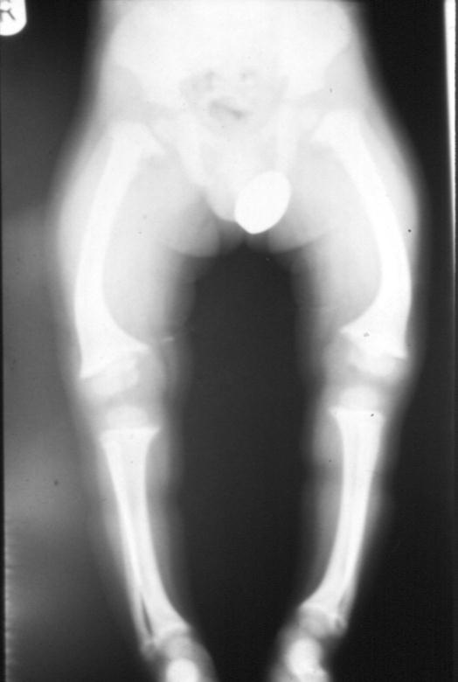
Long Bones Deformities

Slide 24
Rickets & Osteomalacia
Biochemistry
Hypocalcaemia,… Hypocalciuria
High alkaline phosphatase

Slide 25
Osteomalacia
Metabolic Bone Disorder in Adults :
symptoms and signs
Bone pain, mainly backache
Muscle weakness
Reduced bone density
Vertebral changes : Bi-concave vertebra, vertebral collapse , kyphosis
Stress fractures : Loosers zones in scapula, ribs ,pelvis, proximal femur

Slide 26
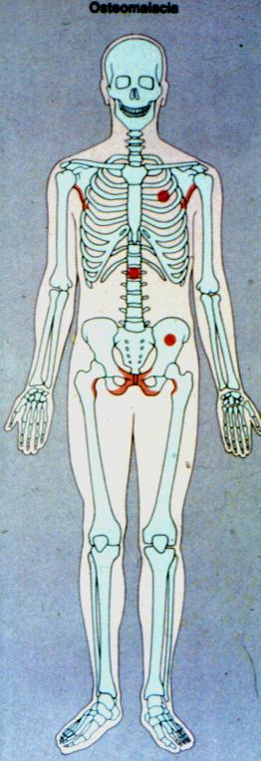

Slide 27
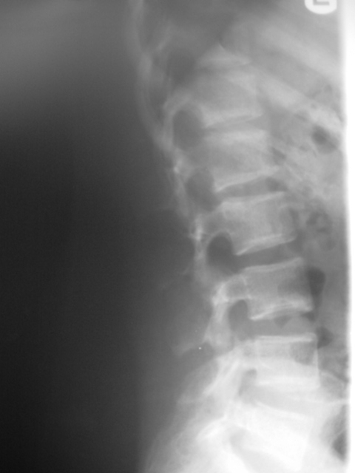

Slide 28
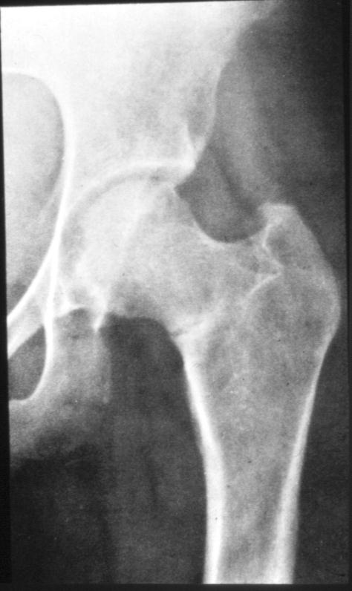

Slide 29
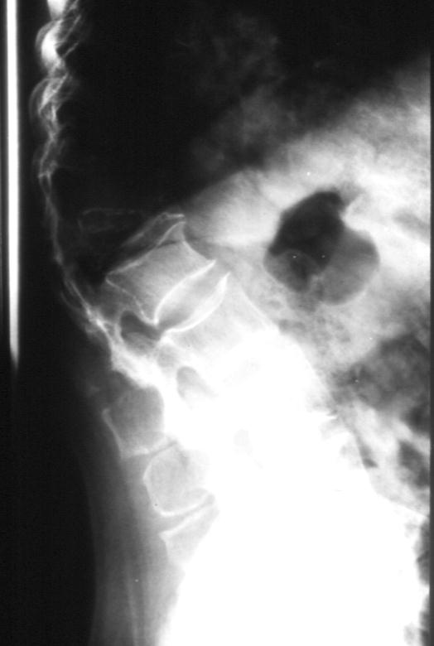

Slide 30
Rickets & Osteomalacia
Treatment
*Vitamin D deficiency
- Rickets adequate Vitamin D replacement
sun exposure
correct residual deformities
- Osteomalacia Vitamin D + Ca
fracture management
correct deformity if needed

Slide 31
Post Rachitic L Genu Valgum, R Genu Varum

Slide 32
Correction Genu Varum

Slide 33
Correct Genu Valgum

Slide 34
Osteoporosis
Decreased bone mass : decreased amount of bone per unit volume ( and this causes reduced density )
Mineralisation is not affected
Mainly post-menopausal and age related

Slide 35
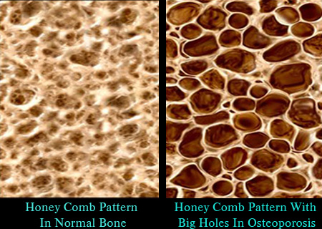

Slide 36
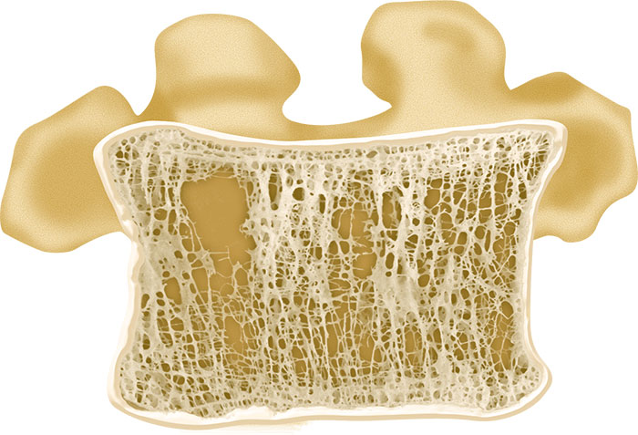

Slide 37
Osteoporosis: Primary and Secondary
Primary Osteoporosis :
Post menopausal
Senile

Slide 38
Post menopausal Osteoporosis
Due to rapid decline in estrogen level
This results in increased osteoclastic activity
Normal bone loss usually 0.3% per year
Post menopausal bone loss 3% per year

Slide 39
Risk Factors in Post menopausal Osteoporosis
Race
Hereditary
Body build
Early menopause
Smoking/ alcohol intake/ drug abuse
? Calcium intake

Slide 40
Senile Osteoporosis
Usually by 7th to 8th decades there is steady loss of at least 0.5% per year
It is part of physiological manifestation of aging
Risk factors in Senile Osteoporosis :
Male menopause
Dietary : less calcium and vitamin D and protein
Muscle weakness
reduced activity

Slide 41
Clinical Features of Osteoporosis
Osteoporosis is a Silent disease
Osteoporosis is Serious due to possible complications :mainly fractures
Osteoporosis does not cause pain usually
Osteoporosis causes gradual increase in dorsal kyphosis
Osteoporosis leads to loss of height
Osteoporosis is not osteoarthritis; but the two conditions may co-exist

Slide 42
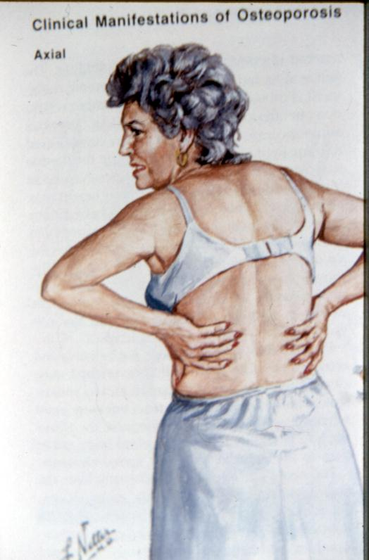

Slide 43
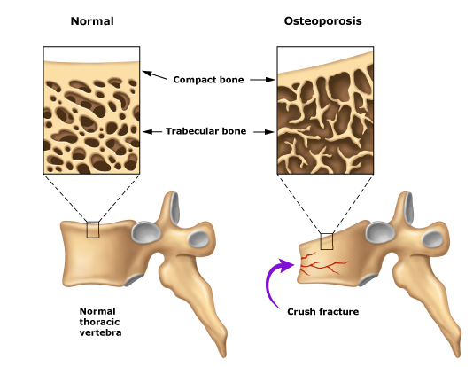

Slide 44
How does kyphosis and loss of height occurs

Slide 45
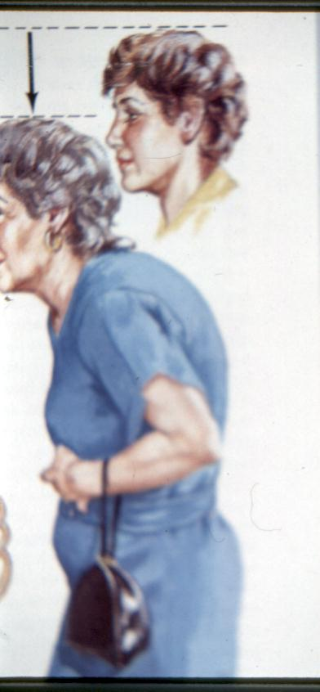

Slide 46
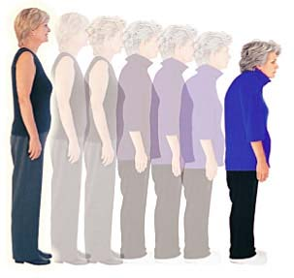

Slide 47
MRI severe osteoporosis

Slide 48
Osteoporotic Fractures
They are Pathological fractures
Most common is osteoporotic compression fracture ( OVC #s )
Vertebral micro fractures occur unnoticed (dull ache)
Most serious is hip fractures
Also common is wrist fractures ( Colles fracture )

Slide 49
Secondary Osteoporosis
Drug induced : steroids, alcohol, smoking, phenytoin,heparin
Hyperparathyroidism, hyperthyroidism, Cushing's syndrome, gonadal disorders, malabsorption, mal nutrition
Chronic diseases : RA, renal failure, tuberculosis
Malignancy : multiple myeloma, leukemia, metastasis

Slide 50
Disuse Osteoporosis
Occurs locally adjacent to immobilised bone or joint
May be generalised in in bed ridden patients
Awareness of and attempts for prevention are helpful

Slide 51
Osteomalacia vs. osteoporosis
Osteomalacia Osteoporosis
Any age Post-menopause, old age
Pt. ill Not ill
General ache Asymptomatic till #
Weak muscles Normal
Looser zones Nil
Alkaline ph increase Normal
PO4 decrease Normal

Slide 52
Prevention of Osteoporosis
Prevention of osteoporosis should start from childhood
Healthy diet, adequate sunshine, regular exercise, avoidance of smoking or alcohol, caution in steroid use
At some time in the past there was a recommendation of HRT ( Hormone replacement Therapy ) for post menopausal women ? And men; but now this is discontinued

Slide 53
Management of Osteoporosis
Drugs
Exercise
Management of fractures

Slide 54
Drug Therapy in Osteoporosis
Estrogen has a definite therapeutic effect and was used extensively as HRT but cannot be recommended now due to serious possible side effects
Adequate intake of calcium and vitamin D is mandatory
Drugs which inhibit osteoclast activities : e.g. Bisphosphonates like sodium alendronate FOSAMAX ( 70 mg Tablet once weekly), BONVIVA
Deusumab = PROLIA (s/c injection every 6 months)= human monoclonal IGG2 antibody
Drugs which enhance osteoblast activities : bone stimulating agents like : FORTEO

Slide 55
Exercise in Osteoporosis
Resistive exercises
Weight bearing exercises
Exercise should be intelligent to avoid injury which may lead to fracture

Slide 56
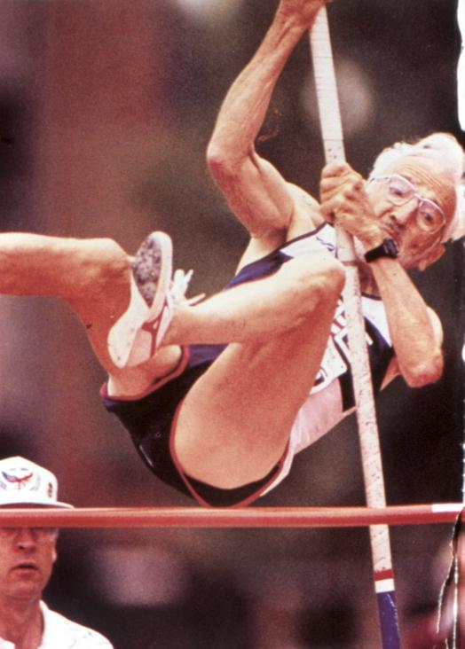

Slide 57
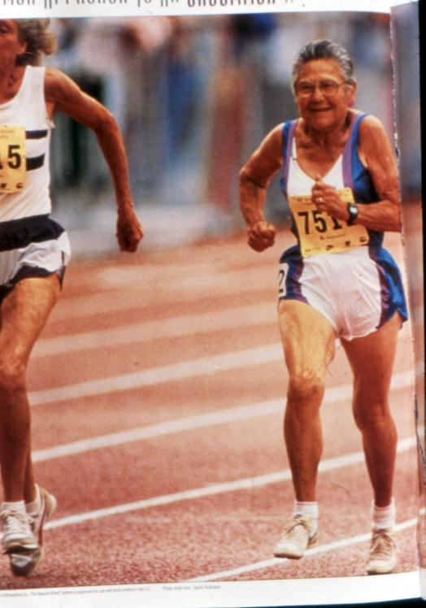

Slide 58
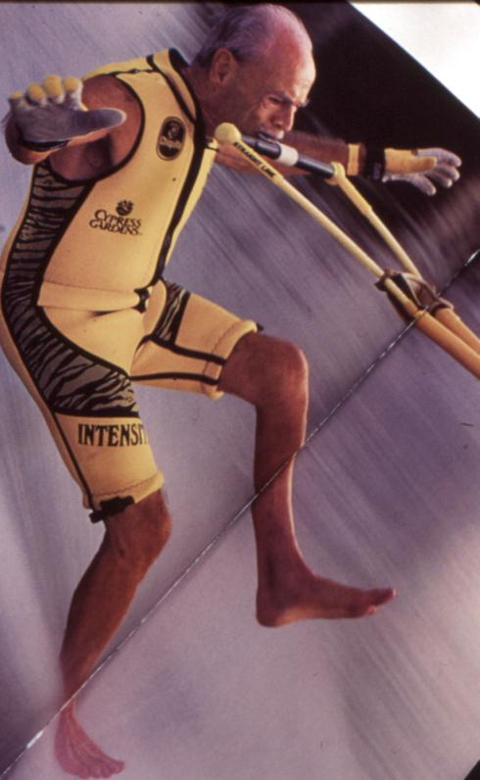

Slide 59
Management of Fractures in Osteoporosis
Use of load shearing implants in fracture internal fixation instead of plating

Slide 61
DHS and screw in fracture neck of femur

Slide 62
Bipolar prosthesis in Fracture Neck of Femur

Slide 63
Colles Fracture

Slide 64
Colles Fracture

Slide 65
Vertebral Osteoporotic Compression Fracture

Slide 66
Management of OVC Fractures
Pain relief
Prevention of further fractures
Prevention of instability
Vertebroplasty
Kyphoplasty

Slide 67
vertebroplasty
Is the injection of bone cement into the collapsed vertebra
The injection is done under X ray control ( image intensifier ) by experienced orthopedist or interventional radiologist
It results in immediate pain relief
It helps to prevent further OVF
Possible complication is leakage of cement into spinal canal (nerve injury ) or venous blood (cement PE )

Slide 68
Kyphoplasty
Is the injection of bone cement into the collapsed vertebra AFTER inflating a balloon in it to correct collapse and make a void ( empty space ) into which cement is injected
It is possible that some correction of kyphosis is achieved
It is safer because cement is injected into a safe void

Slide 69
Vertebroplasty

Slide 70
Kyphoplasty

Slide 71
Balloon Kyphoplasty

Slide 72
Kyphoplasty

Slide 73
Hyperparathyroidism
Excessive PTH secretion : primary, secondary or tertiary
Leads to increased bone resorption , sub periosteal erosions, osteitis manifested by fibrous replacement of bone
Significant feature is hypercalcemia
In severe cases : osteitis fibrosa cystica and formation of Brown tumours

Slide 74
Radiological changes in Hyperparathyroidism
Generalised decrease in bone density
Sub-periosteal bone resorption ( scalloping of metacarpals and phalanges )
Brown tumours
Chondrocalcinosis ( wrist, knee, shoulder )

Slide 75
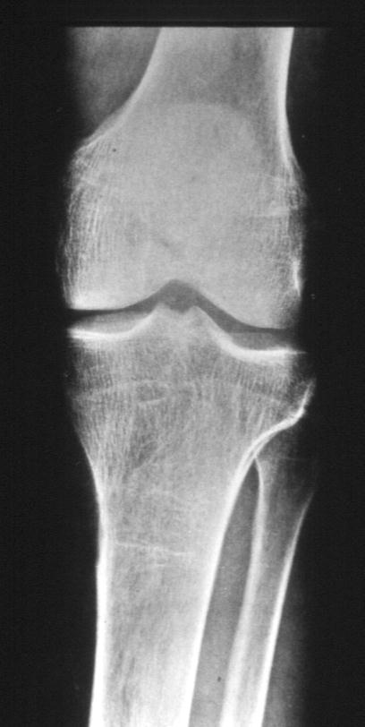

Slide 76
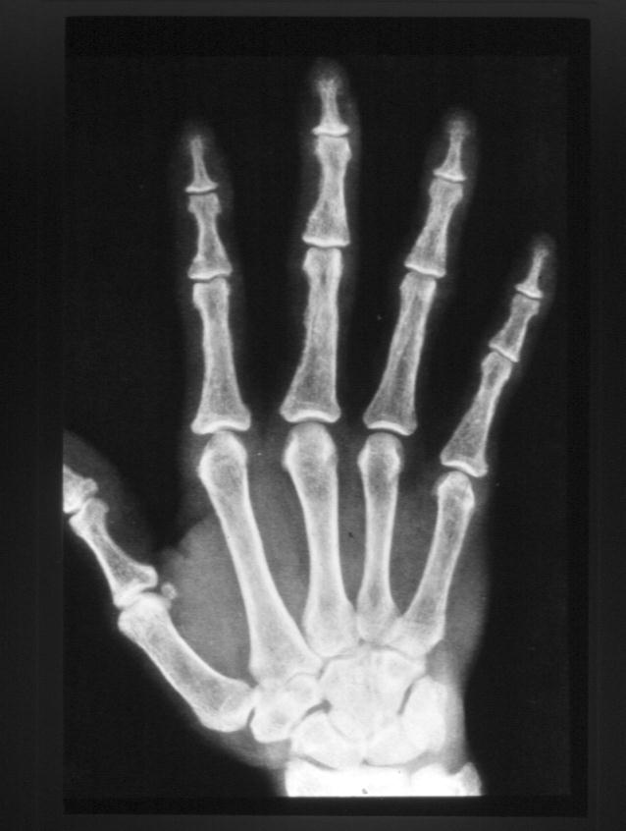

Slide 77
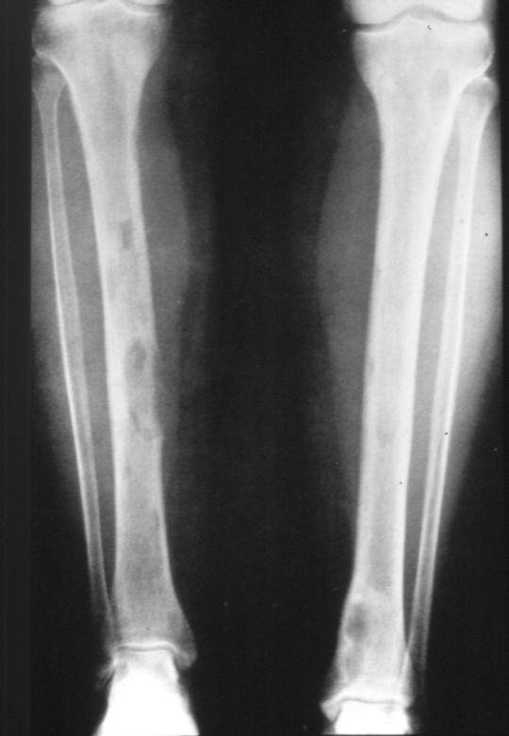

Slide 78
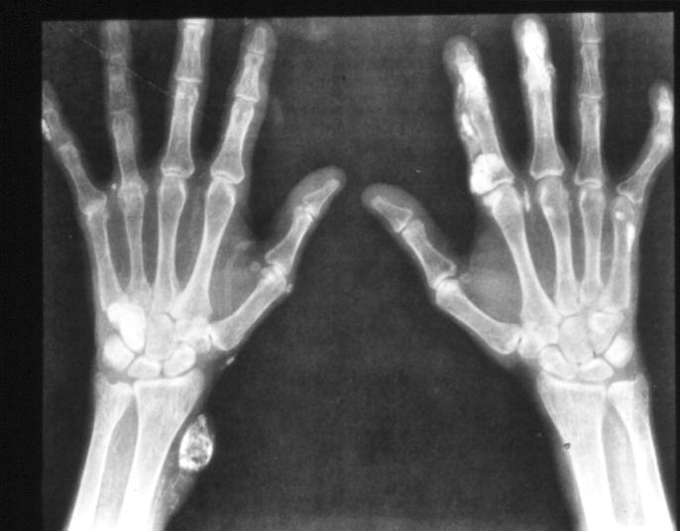

Slide 79
Management of Hyperparathyroidism
By management of the cause :
Primary hyperparathyroidism due to neoplasm ( adenoma or carcinoma ) by excision
Secondary hyperparathyroidism by correcting the cause of hypocalcaemia
Tertiary hyperparathyroidism by excision of hyperactive ( autonomous )nodule
Extreme care should be applied after surgery to avoid hypocalcaemia due hungry bones syndrome

