Slide 1
Breaking Bad News
Mishari Al-Hamid
Sami Al-Amri

Slide 2
Objectives
Definition of bad news.
Role of primary care physicians.
How to breaking bad news
ABCDE technique
Examples of how to break news.
Quizzes

Slide 3
Which of the following is a correct statement regarding family of the patient in breaking bad news?
Do not allow them to join the conversation.
Invite them but only after delivering the bad news
It is recommended to involve them in the meeting of breaking bad news.
All above is correct

Slide 4
W hich of the following habits is a good for preparation before delivering the bad news?
Warn the patient that a bad news are coming
Set a public place to tell the patient the bad news. So, they can’t cry.
Do not make anyone of the patient’s family set with you during telling the news to keep the privacy of the patient.
Let the nurse set with you. So, she/he can witness any harmful thing can
caused by the angry patient

Slide 5
W hen you were telling a mother that her daughter has a fetal congenital heart disease, she started crying. W hat
is the appropriate thing to do?
Tell her that her daughter will be okay to give her a hope.
Stay in silence and give the mother time.
Be empathetic
Say to the mother: “you are an adult. You have to stop crying”

Slide 6
W hich of the following consequences is a expected to happen when the physician delivering bad news in inappropriate way?
Patients may harsh treatments beyond the point where treatment may be expected to be helpful
Can cause psychological harm to the patient
Considered as ethical issue.
All above

Slide 7
What is bad news?

Slide 8
any news that drastically and negatively alters the patient’s view of her or his future
.

Slide 9
Importance of breaking bad news

Slide 10
Bad news can affect
Physician
Patient
Care quality
Stress
Ethical
Psychological
Hopefulness
Disease outcomes
Satisfaction

Slide 11
Bad news can affect
Ability of the patient to coherence information.
Satisfaction on the medical care.
Level of hopefulness.
Patients may harsh treatments beyond the point where treatment may be expected to be helpful
invariably cause psychological harm is unsubstantiated
Notes:
How bad news is discussed can affect the patient’s comprehension of information [32], satisfaction with med- ical care [33, 34], level of hopefulness [35], and subsequent psychological adjustment [36-38]. Physicians who find it difficult to give bad news may subject patients to harsh treatments beyond the point where treatment may be expected to be helpful [39]. The idea that receiving unfa- vorable medical information will invariably cause psycho- logical harm is unsubstantiated [40, 41].

Slide 12
How physicians are adherent to follow technique or training to deliver bad news?
Notes:
informal survey conducted at the 1998 Annual Meeting of the American Society of Clinical Oncology (ASCO), where we queried attendees at a symposium on communication skills. For this symposium several experts in teach- ing aspects of the doctor-patient relationship in oncology formulated a series of questions to assess attendees’ attitudes and practices regarding breaking bad news. Of the 700 persons attending the symposium,

Slide 13
What is the role of family physician in breaking bad news?

Slide 14
family physicians encounter many situations that involve imparting bad news; for example,
Pre-employment assessment has revealed HIV positive results for an adult
Seeking more information after a diagnosis of a cancer by oncologist.
Adolescent’s polydipsia and weight loss prove to be the onset of diabetes

Slide 15
“The life of a sick person can be shortened not only by the acts, but also by the words or the manner of a physician.”
American Medical Association’s first code of medical ethics 1847

Slide 16
Approaches to break bad news
Rabow and Mc phee’s (ABCDE) approach
Baile and Buckman (SPIKES approach)
Other types

Slide 17
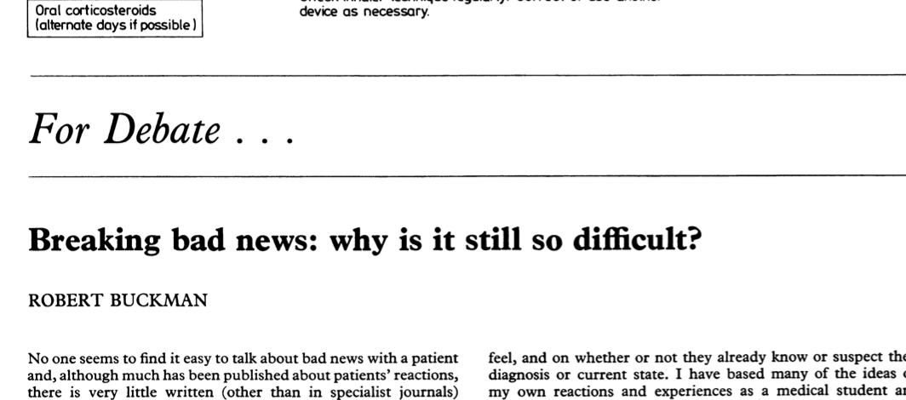

Slide 18
Fear of being blamed.
Fear of the unknown and untaught
Fear of unleashing a reaction
Fear of expressing emotion
Fear of not knowing all the answers
Personal fear of illness and death

Slide 19
How bad is it?
Department of Surgery at Baylor University Medical Center at Dallas
93% of respondents perceived delivering bad news to be a very important skill and 7% a somewhat important skill
only 43% of respondents felt they had the training to effectively deliver such news.
85% felt they needed additional training to be effective when delivering bad news.
59% were residents and 26% were attending's.
73% first delivered bad news while intern.

Slide 20
How to break the bad news

Slide 22
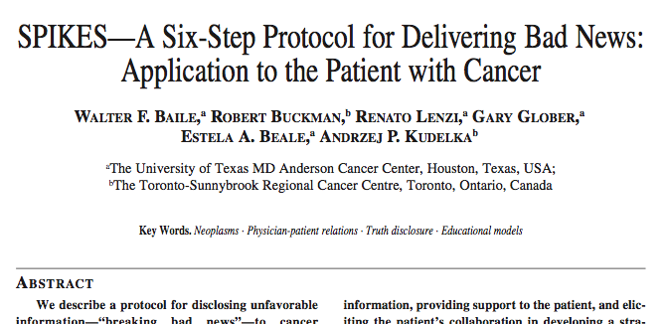

Slide 24
ADVANCE PREPARATION
BUILD A THERAPEUTIC RELATIONSHIP
COMMUNICATE WELL
DEAL WITH PATIENT AND FAMILY REACTIONS
ENCOURAGE AND VALIDATE EMOTIONS

Slide 25
ADVANCE PREPARATION
Arrange for adequate time, privacy and no interruptions (turn pager off or to silent mode).
Review relevant clinical information.
Mentally rehearse, identify words or phrases to use and avoid.
Prepare yourself emotionally.

Slide 26
BUILD A THERAPEUTIC RELATIONSHIP
Determine what and how much the patient wants to know.
Have family or support persons present.
Introduce yourself to everyone.
Warn the patient that bad news is coming.
Use touch when appropriate.
Schedule follow-up appointments.

Slide 27
COMMUNICATE WELL
Ask what the patient or family already knows.
Be frank but compassionate; avoid euphemisms and medical jargon.
Allow for silence and tears; proceed at the patient's pace.
Have the patient describe his or her understanding of the news; repeat this information at subsequent visits.
Allow time to answer questions; write things down and provide written information.
Conclude each visit with a summary and follow-up plan.

Slide 28
DEAL WITH PATIENT AND FAMILY REACTIONS
Assess and respond to the patient and the family's emotional reaction; repeat at each visit.
Be empathetic.
Do not argue with or criticize colleagues.

Slide 29
ENCOURAGE AND VALIDATE EMOTIONS
Explore what the news means to the patient.
Offer realistic hope according to the patient's goals.
Use interdisciplinary resources.
Take care of your own needs; be attuned to the needs of involved house staff and office or hospital personnel.

Slide 30
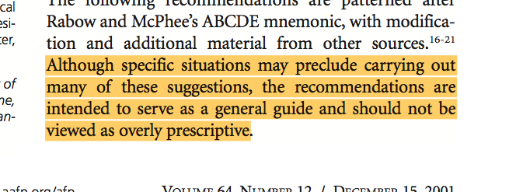

Slide 31
Role play 1
A 57-year-old male schoolteacher recently received a screening colonoscopy. During the procedure, a mass was biopsied. The mass was diagnosed as a poorly differentiated adenocarcinoma. The patient is waiting at the clinic to see her primary care physician to discuss the results.

Slide 32
Role play 2
A 27-year old male came to primary care clinic for pre-mariatal medical assessments. His results showed positive HIV. How to approach him.

Slide 33
What was wrong about the physician?

Slide 34
Thanks!
Any questions ?

