Slide 1
Vitamin D and Osteoporosis
Abdulaziz Alrashed & Qusay almahmoud

Slide 2
Objectives:
Definition of Osteoporosis and Osteomalacia / Rickets.
Highlight on Vitamin D deficiency.
Prevalence in world / Saudi Arabia
Factors that lead to Osteoporosis and Vitamin D deficiency
How patients could be presented
Common fractures with osteoporosis
Vitamin D and Comorbidities

Slide 3
Quiz

Slide 4
Q1: A 10 months Old female, presented to the clinic with bowed legs, dental problems and her growth profile is disturbed, what is the most likely diagnoses?
Osteomalacia.
Rickets.
Osteoporosis.
Hypothyroidism.

Slide 5
Q2: In which age does a person reach his maximum bone mass index?
25
30
35
40

Slide 6
Q3: Which of the following is the best way for adequate vitamin D levels?
Using sunscreens
Exposure to sunlight
Using supplements
Smoking cessation

Slide 7
Q4: Which of the following DEXA values is a diagnostic for osteopenia?
- 1.5 SD
- 2.5 SD
+ 1 SD
+ 3 SD

Slide 8
Q5: What does the T score represent in a DEXA scan?
The comparison of a person's bone density with that of a healthy 30-year-old of the same sex.
The comparison of a person's bone density with that of an average person of the same age and sex
The comparison of a person's bone density with that of a healthy 40-year-old of the same sex.
The comparison of a person's bone density with that of a healthy 20-year-old of the same sex.

Slide 9
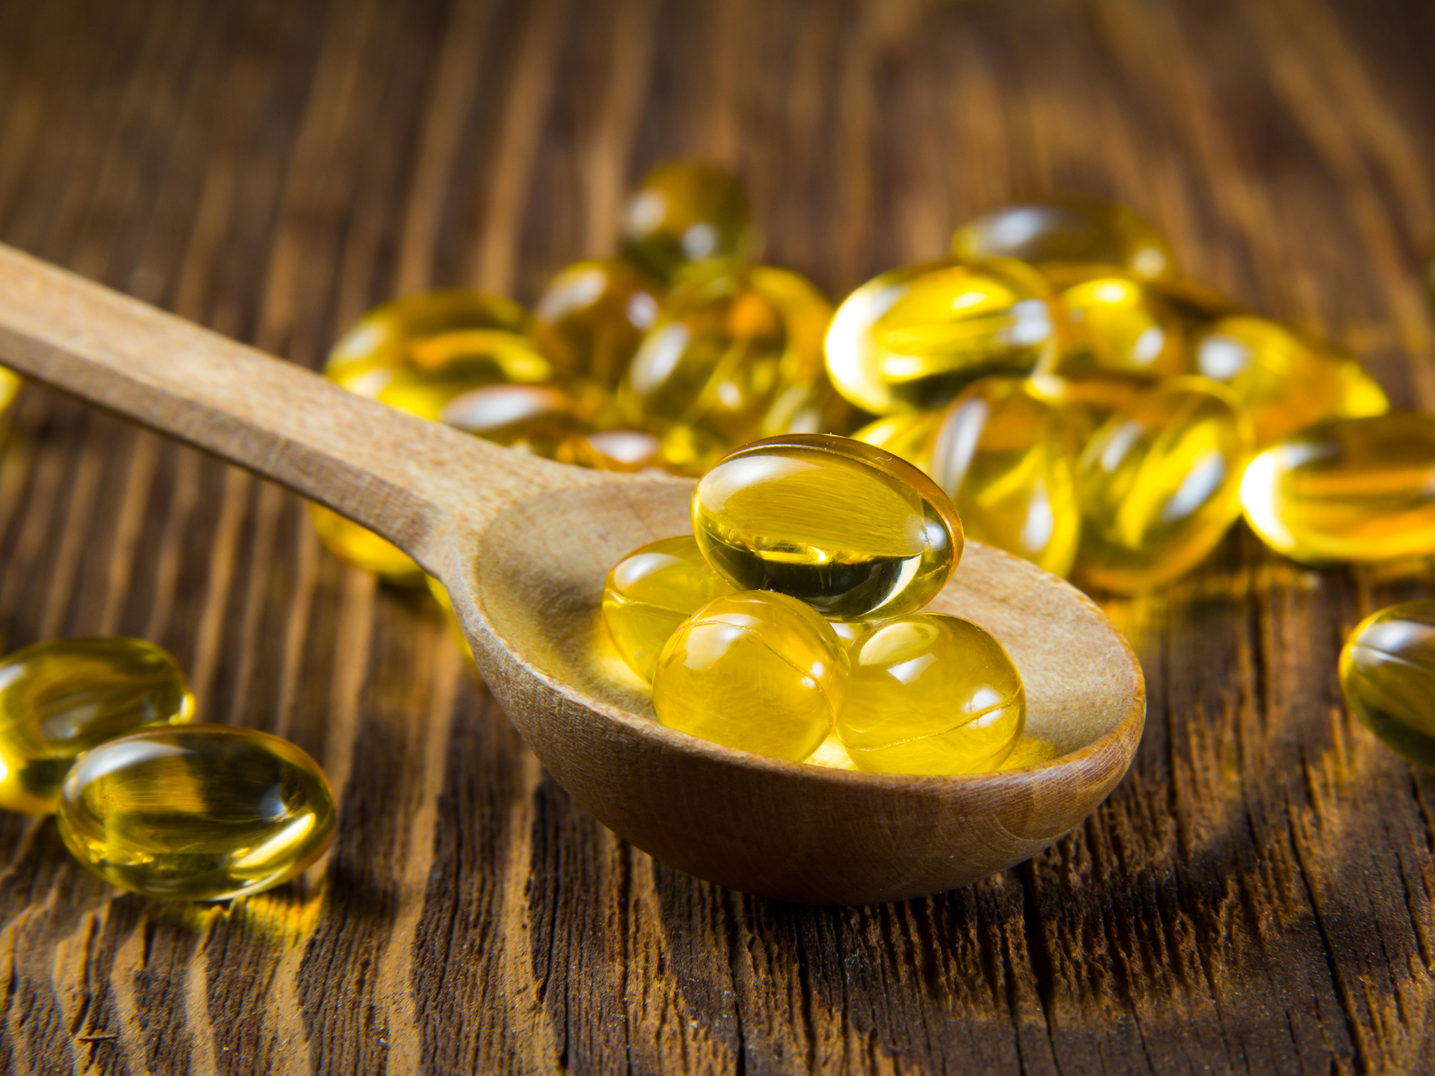
Vitamin D
A fat soluble vitamin.
Important in the maintenance of serum calcium and phosphorus.
Required for the mineralization of epiphyseal cartilage and osteoid matrix in bone formation.

Slide 10
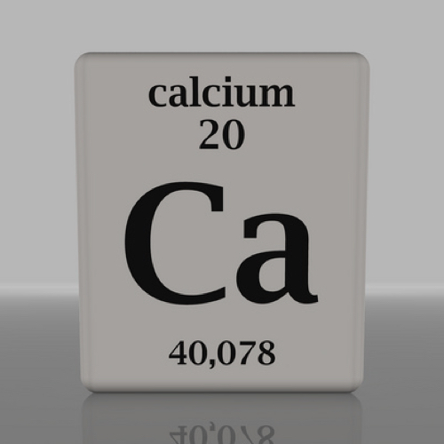
The role of Calcium
One of the building blocks of bone.
Bones are the reservoir of calcium in the body.
When other calcium-dependent organs need it, they get it form the main storehouse.

Slide 11
Pathway

Slide 12
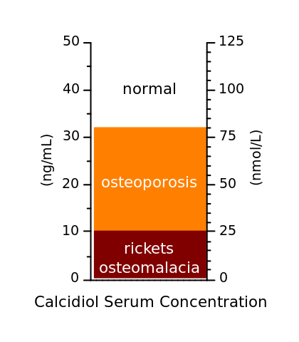
Vitamin D Deficiency
Condition | Level
Normal | 30 – 100 ng/mL 75 - <250 nmol/L
Insufficient | >20 - <30 ng/mL >50 – <75 nmol/L
Deficiency | >10 - <20 ng/mL >25 – <50 nmol/L
Severe deficiency | <10 ng/mL <25 nmol/L

Slide 13
Causes of vitamin D deficiency:
Inadequate exposure to sunlight.
Fat malabsorption.
Chronic liver disease.
Renal failure.
Infants with exclusive breast-feeding without vitamin D supplementation.

Slide 14
Management of vitamin D deficiency
Vitamin D3 45000 IU to 50000 IU weekly for 6 to 8 weeks.
We continue taking D3 45000 to 50000 IU every 2 weeks for 6 to 8 weeks.
We then check vitamin D3 levels.

Slide 15
Requirements:
400 IU for children aged 0-1 year
600 IU/day for children aged 1-18 years.
800 -1000 IU for older than 18 years

Slide 16
Rickets and Osteomalacia
Defective mineralization of osteoid.
Osteoblasts normally produce osteoid, which is then mineralized with calcium and phosphate to form bone.
Due to low levels of vitamin D.

Slide 17
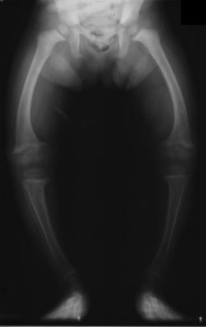
Rickets
Due to low vitamin D in children, usually in children < 1 year of age; presents with:
Pigeon-breast deformity (pectus carinatum)
Frontal bossing (enlarged forehead)
Rachitic rosary – due to osteoid deposition at the costochondral junction.
Bowing of the legs.

Slide 18
Osteomalacia
Low vitamin D in adults.
Results in weak bone with an increased risk of fractures.
Laboratory findings include ↓ Calcium, ↓ Serum phosphate, ↑ PTH, and ↑ alkaline phosphatase.

Slide 19
Prevalence of vitamin D deficiency:
The prevalence of vitamin D deficiency depends upon the definition used (<20 or <30 ng/mL [50 or 75 nmol/L]).
The prevalence of low vitamin D levels may be increasing globally In a review of vitamin D levels in different regions of the world, vitamin D levels below 30ng/mL (75 nmol/L) were prevalent in every region studied, and low vitamin D levels (<10 ng/mL [25 nmol/L]) were more common in South Asia and the Middle East than in other regions .

Slide 20
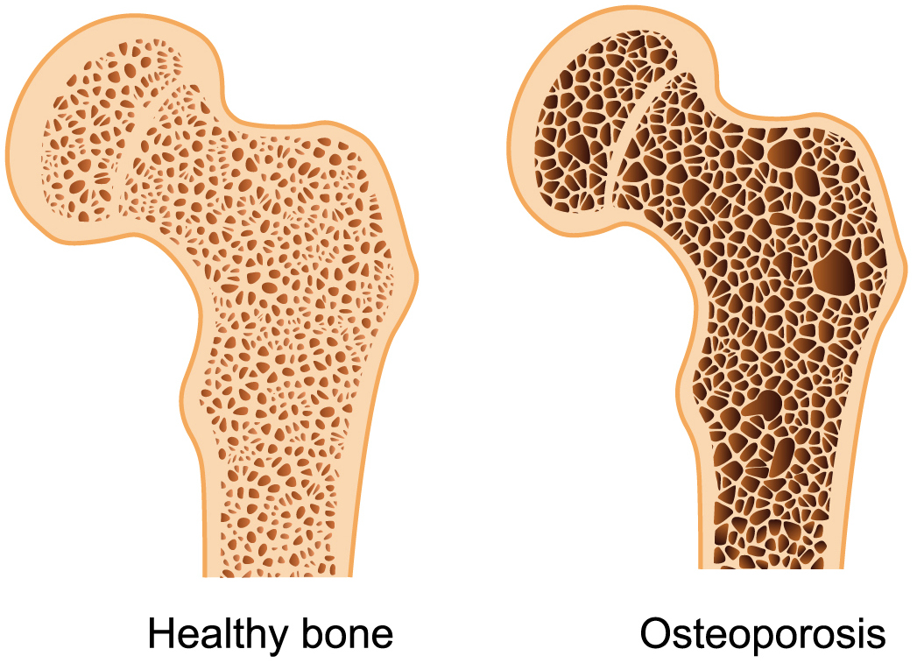
Osteoporosis
The loss of both organic bone matrix (osteoid) and mineralized bone.
Decreased bone mass and density
Decreased thickness of cortical and trabecular bone

Slide 21
Risk factors for osteoporosis:
Cigarette smoking was first identified as a risk factor for osteoporosis more than 20 years ago.
Recent studies have shown a direct relationship between tobacco use and decreased bone density.
How does smoking affect bone health?
Cigarette smoke generates huge amounts of free radical and disturb balance of hormones (like estrogen) that bones need to stay strong.
Increased levels of the hormone cortisol, which leads to bone breakdown.
Smoking also damages blood vessels, so there is poor blood supply.

Slide 22
Physical inactivity
- People who spend a lot of time sitting have a higher risk of osteoporosis than do those who are more active.
- Physical activity prevent osteoporosis is based on evidence that it can regulate bone maintenance and stimulate bone formation and this reducing the overall risk of falls and fractures.
- Most experts recommend exercising for at least 30 minutes three times per week.

Slide 23
Medications:
Steroids
Thyroxine
Phenytoin and Barbiturates
Aromatase Inhibitors and methotrexate
Thiazolidinediones
Chronic Lithium use

Slide 25
Primary osteoporosis -Types
Type 1: postmenopausal (lack of estrogen)
Type 2: Senile
> 70 years old
Progressive decline in osteoblasts and increased activity of osteoclasts.
Decreased physical activity (less stress on bone)

Slide 26
Secondary Osteoporosis:
Cushing's syndrome
Hypopituitarism
Drugs (Heparin, Cortisone)
Malnutrition (e.g., anorexia nervosa)
Space travel

Slide 27
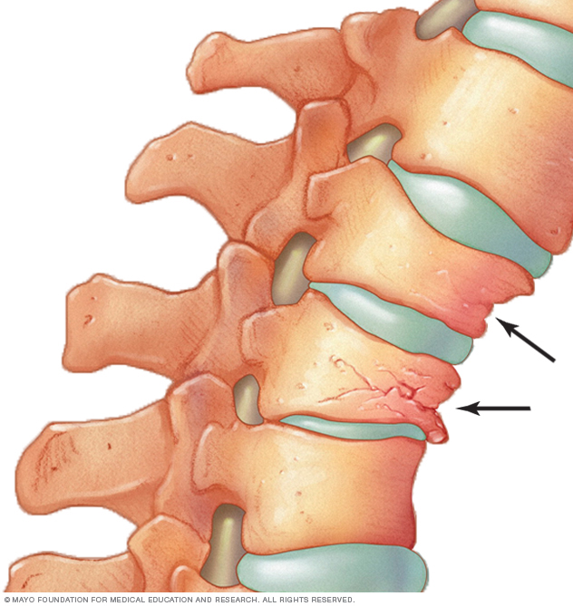
Clinical findings of osteoporosis:
Compression fractures of vertebral bodies.
Dowager’s hump.
Increased risk for Colles fracture of the distal radius.

Slide 28
Prevalence in Saudi Arabia:
In Saudi Arabia, osteoporosis is already a serious issue a report in the eastern region of Saudi Arabia indicates an incidence of postmenopausal osteoporosis (PMO) of 30 percent to 40 percent, with over 60 percent of postmenopausal women already having some degree of osteopenia.

Slide 30
Fractures:

Slide 32
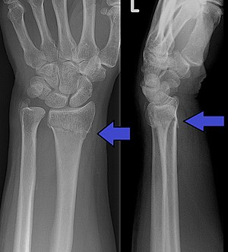

Slide 33
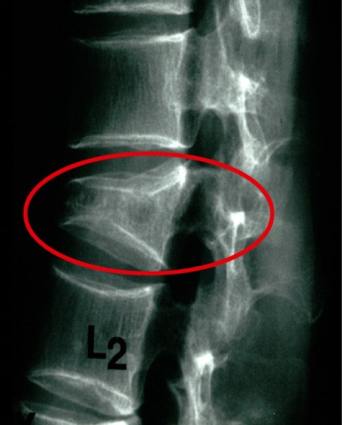

Slide 34
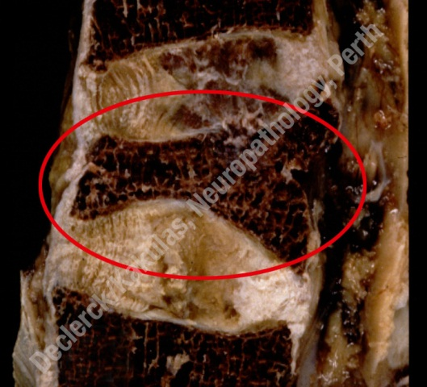

Slide 35
Most osteoporotic vertebral fractures occur at the level of vertebrae T7, T8, T9, T12, L1 and L2

Slide 36
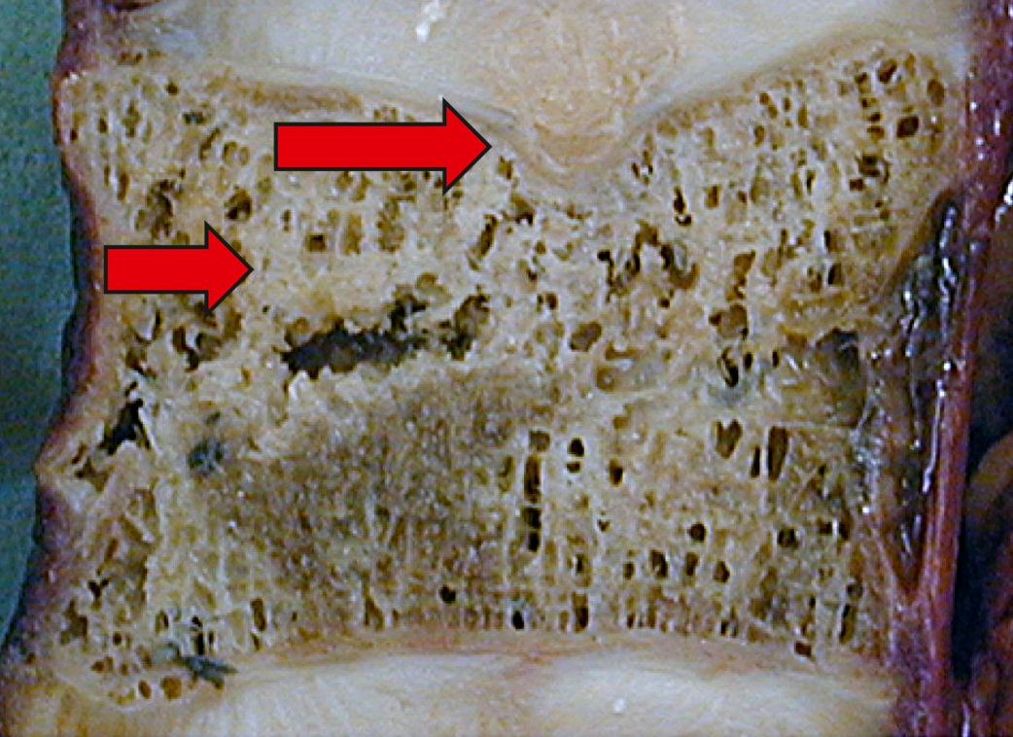
The upper arrow indicates an indentation in the vertebral endplate. The lower arrow shows a fracture in the vertebral body.

Slide 37
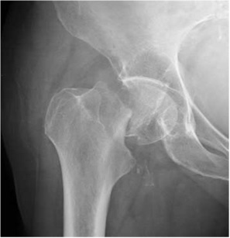

Slide 38
about 10% of people with a hip fracture die within 1 month and about one-third within 12 months. Most of the deaths are due to associated conditions and not to the fracture itself, reflecting the high prevalence of comorbidity.

Slide 39
How do we diagnose osteoporosis?

Slide 40
Xray:
-Not a sensitive modality, as more than 30-50% bone loss is required to appreciate decreased bone density on radiograph.

Slide 41
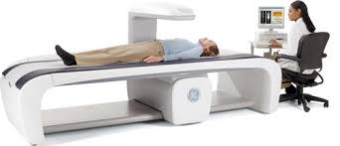
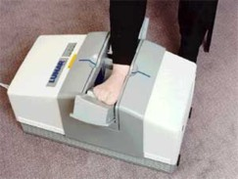
DEXA Scan: The gold standard test.

Slide 42
DEXA Scan Results:
Values are calculated for the lumbar vertebrae and femur.
Bone mineral density is calculated in grams/cm2.
DEXA scores are reported as "T-scores" and "Z-scores.“
The T-score is a comparison of a person's bone density with that of a healthy 30-year-old of the same sex.
The Z-score is a comparison of a person's bone density with that of an average person of the same age and sex.

Slide 43
T-score: comparison by standard deviation (SD) to a young adult population, matched for sex and ethnicity (used for postmenopausal women and men >50 years)
≥ -1.0: normal
< -1.0 to < -2.5: osteopaenia
≤ -2.5: osteoporosis
≤ -2.5 plus fragility fracture: severe osteoporosis
Z-score: compared by SD to an age, sex, and ethnicity population (used for premenopausal women, men < 50 years, and children)< -2.0: below expected range, and a cause should be sought.

Slide 44
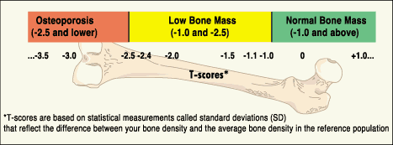

Slide 46
Screening:
1- all women >65.
2-<65 other+ risk factors.

Slide 47
Labs:
Calcium?
Phosphate?
Alkaline phosphatase?
Parathyroid hormone?

Slide 48
Labs:
Calcium>>>>>>N
Phosphate>>>>N
Alkaline phosphatase>>> (if associated with occult fracture)
Parathyroid hormone>>>>N

Slide 49
When to treat?
The National Osteoporosis Foundation recommends treatment for:
Postmenopausal women with T-scores less than -2.0, regardless of risk factors.
Postmenopausal women with T-scores less than -1.5, with osteoporosis risk factors present.
In addition, anyone with a fragility fracture (a fracture from a minor injury) should be treated for osteoporosis. regardless of the DEXA scan results.

Slide 50
Management:
Non-pharmacological
Pharmacological

Slide 51
The first drug to start with is Bisphosphonate
Other choices are: 1- Estrogens (hormone replacement therapy). 2- Calcitonin. 3- Teriparatide. 4- Raloxifene.

Slide 52
Pharmacological therapy
- Bisphosphonates - alendronate or risedronate Binds to hydroxyapatite.
- Denosumab
- Selective estrogen receptor modulator “Tamoxifen and Raloxifine” Side effect?
-Parathyroid hormone (Teriparatide) How should I give it?
- Calcitonin Recommended to be given with Vitamin D and calcium Why?

Slide 53
Bisphosphonates
Alendronate (Fosamax)
70 mg (One Tablet) per week Consider drug discontinuation after 5 years in low-risk patients Side effects: Mild upper gastrointestinal events, esophageal ulcerations, perforations, bleeding events, muscular and joint pains Contraindications: Abnormalities of the esophagus; inability to stand or sit upright for at least 30 minutes;

Slide 54
Teriparatide (Forteo)
A recombinant human parathyroid hormone with bone anabolic activity.
Teriparatide is approved for the treatment of postmenopausal women with severe bone loss, men with osteoporosis who have high risk of fracture, and individuals whose condition has not improved with bisphosphonate therapy.
20 mcg subcutaneous per day for up to 2 years,
Side effects:
Arthralgia, pain, nausea, transient orthostatic hypotension, hypercalcemia, hyperuricemia

Slide 55
Denosumab (Prolia)
Denosumab is a human monoclonal antibody that inhibits the formation and activity of
osteoclasts
60 mg every 6 months, subcutaneous for 3 years
It appears to be a reasonable alternative for persons whose condition does not improve
with bisphosphonates.
Side effects:
Muscular and joint pains; small risk of osteonecrosis of the jaw (especially older women with poor dental hygiene or cancer).
Contraindications:
Hypocalcemia; pregnancy

Slide 56
Raloxifene
Raloxifene, a selective estrogen receptor modulator.
Raloxifene is commonly associated with increased vasomotor symptoms.
It is associated with an increased risk of venous thromboembolism and a
decreased risk of invasive breast cancer.
The best candidates for raloxifene are postmenopausal women with osteoporosis who are unable to tolerate bisphosphonates, have no vasomotor symptoms or history of venous thromboembolism, and have a high breast cancer risk score.

Slide 57
Hormone Therapy
"Hormone therapy has been shown to be safe and effective for symptomatic menopausal women with benefits exceeding risk in healthy women who are under the age of 60 or within 10 years of menopause,"

Slide 58
Osteoporosis Guidelines
The National Osteoporosis Foundation (NOF) recommends that pharmacologic therapy should be reserved for:
Postmenopausal women
Men aged 50 years or older who present with the following:
A hip or vertebral fracture.
T-score of –2.5 or less.
Low bone mass (T-score between –1.0 and –2.5 with a 10-year probability of a hip fracture of 3% or greater.
Notes:
https://www.ncbi.nlm.nih.gov/pmc/articles/PMC4176573/

Slide 59
Surgical therapy
Vertebroplasty and Kyphoplasty

Slide 60
Q1: A 10 months Old female, presented to the clinic with bowed legs, dental problems and her growth profile is disturbed, what is the most likely diagnoses?
Osteomalacia.
Rickets.
Osteoporosis.
Hypothyroidism.

Slide 61
Q1: A 10 months Old female, presented to the clinic with bowed legs, dental problems and her growth profile is disturbed, what is the most likely diagnoses?
Osteomalacia.
Rickets.
Osteoporosis.
Hypothyroidism.

Slide 62
Q2: In which age does a person reach his maximum bone mass index?
25
30
35
40

Slide 63
Q2: In which age does a person reach his maximum bone mass index?
25
30
35
40

Slide 64
Q3: Which of the following is the best way for adequate vitamin D levels?
Using sunscreens
Exposure to sunlight
Using supplements
Smoking cessation

Slide 65
Q3: Which of the following is the best way for adequate vitamin D levels?
Using sunscreens
Exposure to sunlight
Using supplements
Smoking cessation

Slide 66
Q4: Which of the following DEXA values is diagnostic for osteopenia?
- 1.5 SD
- 2.5 SD
+ 1 SD
+ 3 SD

Slide 67
Q4: Which of the following DEXA values is diagnostic for osteopenia?
- 1.5 SD
- 2.5 SD
+ 1 SD
+ 3 SD

Slide 68
Q5: What does the T score represent in a DEXA scan?
The comparison of a person's bone density with that of a healthy 30-year-old of the same sex.
The comparison of a person's bone density with that of an average person of the same age and sex
The comparison of a person's bone density with that of a healthy 40-year-old of the same sex.
The comparison of a person's bone density with that of a healthy 20-year-old of the same sex.

Slide 69
Q5: What does the T score represent in a DEXA scan?
The comparison of a person's bone density with that of a healthy 30-year-old of the same sex.
The comparison of a person's bone density with that of an average person of the same age and sex
The comparison of a person's bone density with that of a healthy 40-year-old of the same sex.
The comparison of a person's bone density with that of a healthy 20-year-old of the same sex.

Slide 70
References:
Vitamin D deficiency. N Engl J Med. 2007 Jul 19;357(3):266-81.
Saudi Med J. 2015 Oct; 36(10): 1149–1150.
Iofbonehealth.org
Saudi Med J. 2013 Aug;34(8):814-8.
Holick MF, Chen TC. Vitamin D deficiency: a worldwide problem with health consequences. Am. J. Clin. Nutr. 2008;87(4):1080S–1086S.
https://www.nof.org/patients/fracturesfall-prevention/

Slide 71
Thank YOU

