Slide 1
Approach to a patient with back pain
Abdulmajeed alkharashi
Saud alshaye

Slide 2
Objectives
Common causes
Diagnosis including history, Red Flags, Examination
Brief comment on Mechanical, Inflammatory, Root nerve compression, Malignancy
Role of primary health care in management
When to refer to specialist
Prevention and Education

Slide 3
questions
The two most affected nerve roots in Radiculopathy?
L4 and L5.
L5 and S1.
S1 and S2.
L4 and S2.

Slide 4
questions
Patient came to the clinic complaining of low back pain, in examination the big toe extension is weak, which nerve root you think is involved?
L3
L4
L5
S1

Slide 5
Questions
Which one of the following is do you think is appropriate to referral ?
Fracutres
Caude equina
A+B
Undiagnosed back pain
All of the above

Slide 6
What is the most likely diagnosis?
Disc herniation
Vertebral fracture
Spondylolisthesis
Ankylosing spondylitis

Slide 7
Introduction
In USA it is the commonest cause of limitation of activity in those under the age of 45.
Approximately 85–90% of the population will experience back pain at some stage of their lives.
In Saudi Arabia Seven studies were cross-sectional and found a prevalence and pattern ranging from 53.2% to 79.17%.
Notes:
The main cause of back pain presenting to the doctor is dysfunction of the intervertebral joint.

Slide 8
Common causes of back pain

Slide 9
Soft tissue injuries
Most episodes of low back pain are caused by damage to the soft tissues supporting the lower spine, including muscles, tendons, and ligaments.
There are two common types of soft tissue injuries in the low back:
Muscle strain occurs when fibers in a muscle begin to tear from being overstretched or overused (commonly called a pulled muscle).
Lumbar sprain occurs when ligaments are overstretched or torn. Ligaments are tough, fibrous tissues that connect bones together.

Slide 10
Muscle strain
Causes:
Sport injuries
Muscle fatigue
Excessive loads or poor lifting.
Sitting postures.
Localized back pain, with no radiation into your buttock or leg.
Back muscle tenderness and/or spasm.
Protective back stiffness
Sudden back pain onset.
Clinical presentations:
Notes:
In fact, back muscle pain is the most common source of back pain. The good news is, that it is also one of the quickest to heal and rehabilitate.

Slide 11
RICE
Activity modification
Pain reliever(NSAIDs)
Muscle relaxant
Management:
Notes:
Most cases of a pulled back muscle are treated using standard self-care or non-invasive treatments.

Slide 12
Degenerative Spinal Disorders(spondylosis)
Degeneration: “deterioration of a tissue or an organ in which its function is diminished or its structure is impaired”
Degenerative disc disease.
Facet osteoarthrosis.
Types:

Slide 13
Risk factors:
1- Non-Modifiable :
Age-related.
Genetic predisposition
2- Modifiable:
Smoking.
Obesity.
Previous injury, fracture
Subluxation
Deformity.
Intervertebral disc degeneration is an age-related phenomenon that occurs in over 80% of people who live for more than 50 years and in most cases it is asymptomatic
Apley’s

Slide 14
Clinical presentations:
1- Mechanical pain: due to joint degeneration or instability.
Activity related-not present at rest.
Associated with movement:
Sitting, bending forward (flexion): apply pressure on the disc “discogenic pain”.
Standing, bending backward (extension): apply pressure on the facet joints “Facet syndrome”
2- Neurologic symptoms: due to neurologic impingement:
Can present even at rest.
Notes:
Depend on the site

Slide 15
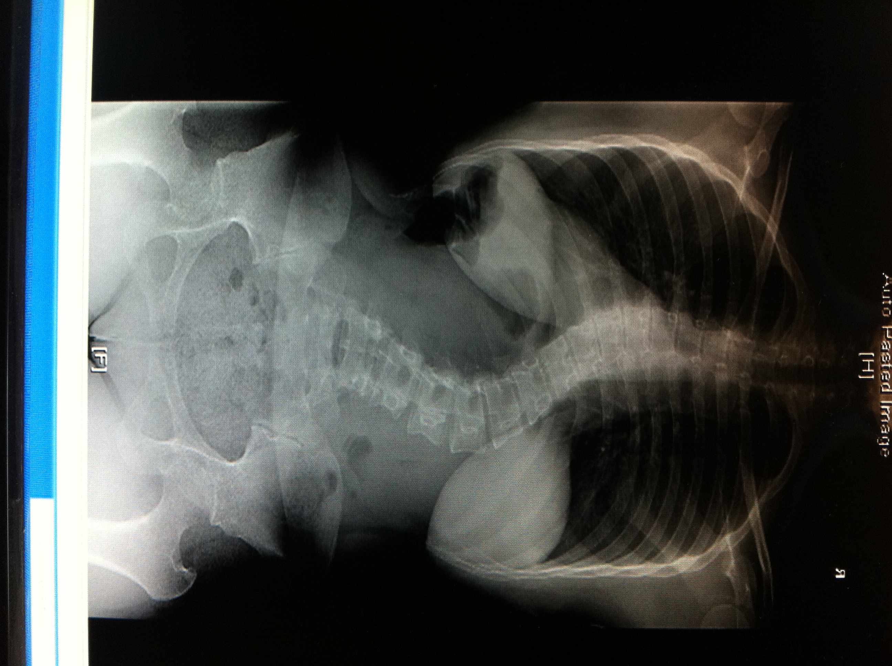
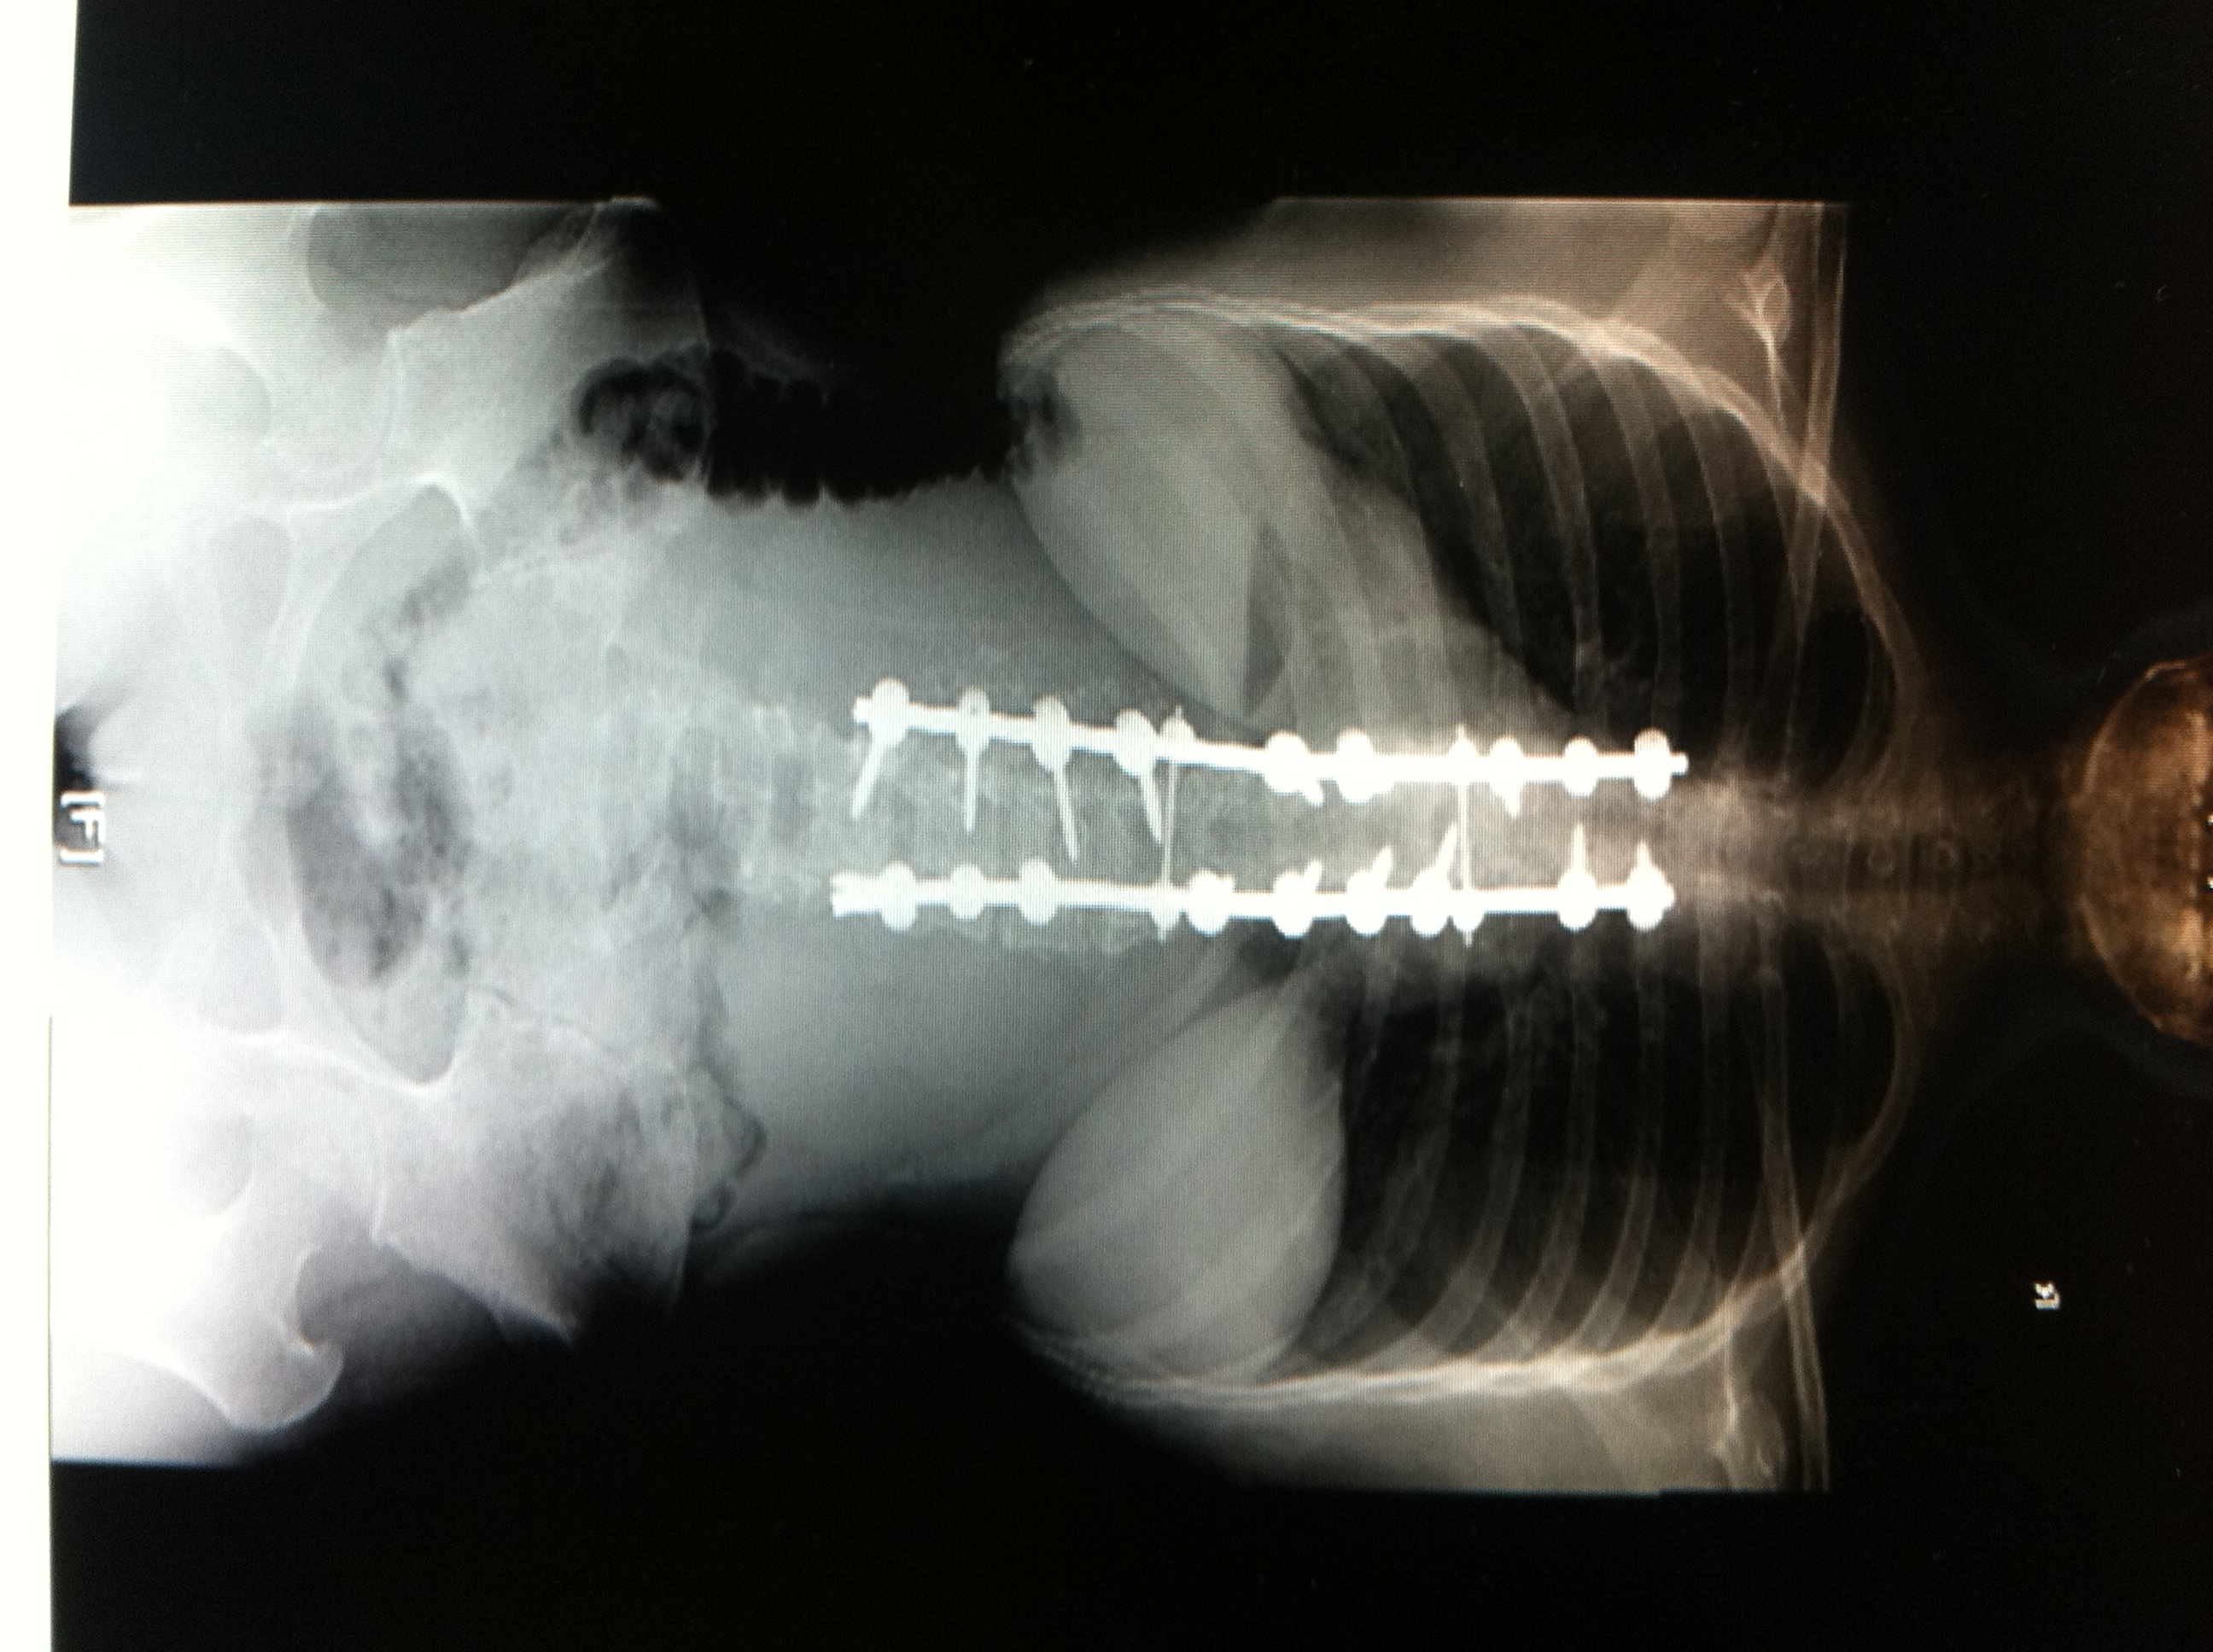
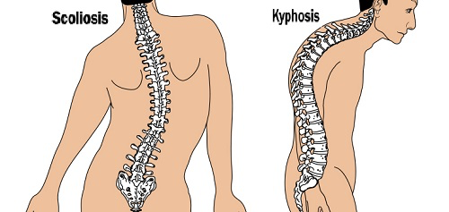
Deformities
Scoliosis:
Abnormal lateral curvature of the spine
Usually idiopathic
Kyphosis:
Anterior wedging
Of at least three adjacent vertebral bodies
Notes:
Management depend on age and degree.

Slide 16
Spondylolisthesis
Spondylolisthesis is a condition in which one bone in your back (vertebra) slides forward over the bone below it.
defective joint ”congenital”
Trauma
fracture
joint damaged by an infection or arthritis.
Causes:
Notes:
Onset of back pain is due to concurrent disc degeneration

Slide 17
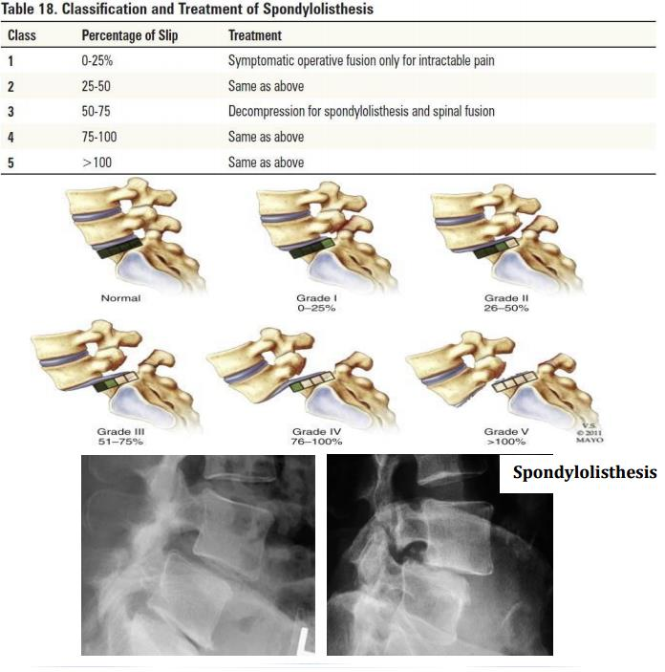
Grades and management:

Slide 18
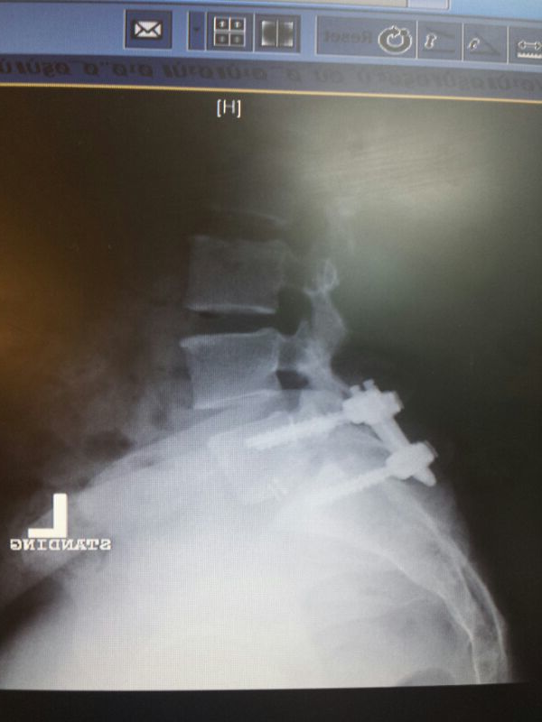

Slide 19
When to suspect nerve root compression
Presence of weakness, numbness, loss of sensation.
Back pain that radiates.

Slide 20
Spinal stenosis
Causes:
1-disc herniation
2-tumors
3-Spondylolisthesis
etc

Slide 21
Disc herniation
Tear in annulus fibrosus allows protrusion of nucleus pulposus
Central
Posterolateral
lateral disc herniation
most commonly at L5-S1 > L4-5 > L3-4.
Types:
Clinical presentations:
Back pain
Radiculopathy(sciatica)

Slide 22
Tumors
Important to identify malignant disease as early as possible because of the effect of a delayed diagnosis on treatment and prognosis.
More than one nerve root may be involved
The neurological signs will be progressive.
Age >50 years.
history of malignancy, six main primary malignancies that metastasize to the spine from (prostate, breast, lung, thyroid, kidney and melanoma).
Symptoms include:-
Gradually Worsening back pain.
Limb paresthesia or weakness.
Fever, weight loss.

Slide 23
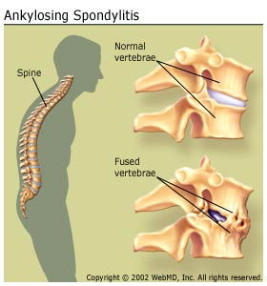
Ankylosing spondylitis
Spine fusion
Many genes can cause it but the major gene that causes this disease is HLA-B27.
Age <40
Improved with exercise
Pain at night and morning stiffness

Slide 24
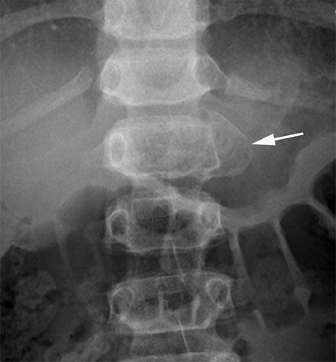
Vertebral Fractures
Causes:
1-truma
2-pathological causes(infections,tumors,osteoprosis)
Most common is TB and Brucellosis.
History of contact with TB patient, raw milk ingestion.
Potentially treatable diseases once diagnosis is established and antimicrobials administered.
Disability, Deformity or nerve compression are indications of surgery.
Spinal infections

Slide 25
￼Mechanical & Inflammatory Back Pain
 | Inflammatory back pain | Mechanical back pain
Age Of Onset | < 40 Years | Any Age
Type Of Onset | gradual | Acute
Symptoms Duration | > 3 Months | < 4 Weeks
Morning Stiffness | > 30 Minuets | < 30 Minuets
Timing | Night, Early Morning | End Of Day, Following Activity
Effect Of Exercise | Improvement | Exacerbation
Sacroiliac Joint Tenderness | Frequent | Absent
Back Mobility | Loss In All Planes | Abnormal Flexion
Radiation | More Localized, Bilateral | Tends To Be Diffuse, Unilateral
Nature Of The Pain | Aching, Throbbing | Deep Dull Ache, Sharp If Root Compression

Slide 26
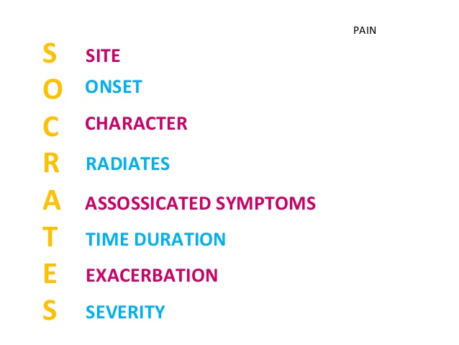
History
Key questions
site
Onset
Can you describe the nature of your back pain?
Aching throbbing pain = Inflammation
Intense sharp or stabbing = Radicular pain (e.g. Sciatica)
Was your pain brought on by an injury?
Is it worse when you wake in the morning or later in the day?
Night, early morning = Inflammatory back pain
End of day, following activity = Mechanical pain

Slide 27
How do you sleep during the night?
What effect of the rest or activity on the pain?
provoked by activity and relieved by rest suggests mechanical dysfunction.
worse at rest and relieved by moderate activity suggests inflammation.
Is the pain worse when sitting or standing?
Pain aggravated by standing or walking is suggestive of spondylolisthesis.
Pain aggravated by sitting and improved with standing indicates a discogenic problem.

Slide 28
Is the pain continues or intermittent?
Continuous pain, present day and night, is suggestive of neoplasia or infection.
Do you have a history of psoriasis, diarrhea, penile discharge, eye trouble or severe pain in your joints?
The inflammatory disorders must be kept in mind.
Most common inflammatory disease that affect the back is spondyloarthropathies.

Slide 29
10) Do you have any urinary symptoms?
Possibility of urinary tract infection must be considered.
Especially in pregnant women with low back pain.

Slide 30
Red flags
TUNA FISH
Trauma
Unexplained weight loss
Neurological Symptoms (Cauda Equina Syndrome)
Age>50
Fever
IVDU
Steroid Use
History of cancer (prostate, renal, breast, lung)

Slide 31
Cauda Equina Syndrome
Clinical presentations:
Saddle anesthesia (S2-S5)
Urinary retention
fecal incontinence
decreased rectal tone
Weakness and reduced deep tendon reflex (knee or ankle).

Slide 32
examination
First: standing/walking position:
A. Inspection :
Expose the trunk and lower limbs properly.
Any deformity(Scoliosis, Kyphosis)
Muscle wasting
Swelling
skin changes(scars, hairy tuft, “café au lait” spots).
shoulders & pelvis level.
Gait:
1. Abnormal types: Antalgic, Trendelenburg, waddling.
2. Heel and toe walking: unable to heel walk= L4 weakness, unable to toe walk= S1 weakness .

Slide 33
examination
B. Feel:
Palpate spinous processes for tenderness, steps or gaps.
Soft tissues: temperature, tenderness.
C. Move:
Start with active ROM in all 6-directions
1. Flexion. Record as such: able to touch toes/shins/knee/thighs.
2. Extension: (30°)
3. Lateral bending: (30°)
4. Rotation: (40°)
Note if painful/painless.
Attempt passive ROM if active ROM is limited and painless, record.

Slide 34
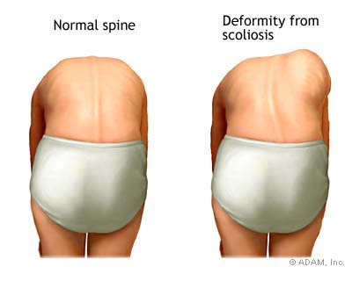
examination
D. Special test :
1-Adams Forward bending test: if rib hump present so it’s a positive test(Scoliosis)
2- Trendelenburg test
Rib hump

Slide 35
examination
Second: Supine position
A. Inspection:
Any muscle waisting in the lower limbs.
B. Feel:
Chlength eck for Leg discrepancy (ASIS to medial malleolus).

Slide 36
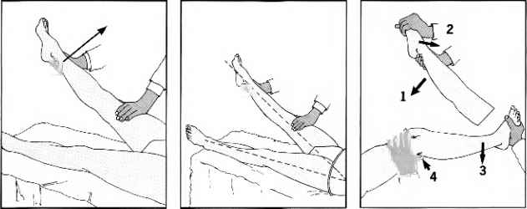
examination
C. Special tests:
Straight leg raising test (SLRT):
If the patient experiences pain when the straight leg is at an angle of between 30 and 70 degrees, then the test is positive
A positive test is reproduction of sciatica .
The pain is aggravated with dorsiflexion
and relieved with knee flexion.

Slide 37
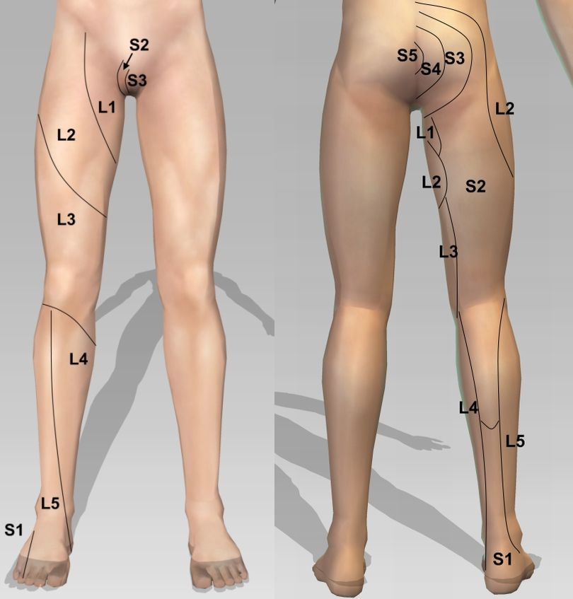
examination
Neurologic and Root nerves examination:
1- L1:
Motor → Hip flexion(psoas major)
Sensation→ around the groin and hip area
Reflex → cremasteric relfex (L1,L2) (males only)
2- L2:
Motor → Hip flexion
Sensation→ anterior thigh
Reflex → knee jerk (L2,L3, L4)

Slide 38
examination
Neurologic and Root nerves examination:
3- L3
Motor → extension of knee
Sensation→ around the knee
Reflex → knee jerk (L2,L3, L4)
4- L4
Motor → ankle dorsiflexion and foot inversion, walking on heels (ankle dorsiflexion),
Sensation→ medial aspect of leg
Reflex → knee jerk (L2,L3, L4)

Slide 39
examination
Neurologic and Root nerves examination:
5- L5
Motor: extension of great toe (extensor hallucis longus)
Sensation → dorsum of the foot and the lateral aspect of the leg
Reflex → nil
6- S1
Motor: walking on toes (ankle planter flexion), foot eversion
Sensation → sole of the foot
Reflex → ankle jerk (S1, S2)

Slide 40
examination
Vascular examination:
Pedal pulses (DP & PT).
Capillary refill

Slide 41
Video about back examination
https://www.youtube.com/watch?v=CJVGpciEMoI

Slide 42
Role of primary health care in management
initial evaluation.
initial management of simple cases.
referal of complicated cases.
prevention and education

Slide 43
When to refer ?
Cauda Equina Syndrome - EMERGENCY referral.
Severe unremitting worsening of pain
Significant trauma – consider fractures
Weight loss, fever, history of cancer
Widespread neurological signs

Slide 44
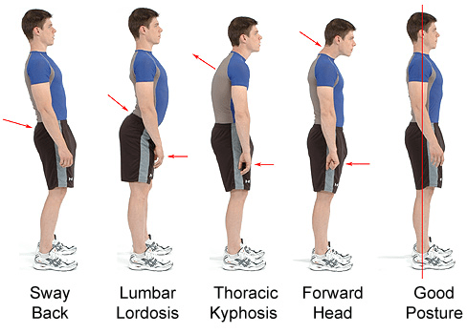
Prevention and education
Losing weight – too much upper body weight can strain the lower back.
Posture: How you sit, stand and lie down can have an important effect on your back. The following tips should help you maintain a good posture.
Standing: Stand upright, with your head facing forward and your back straight. Balance your weight evenly on both feet and keep your legs straight

Slide 45
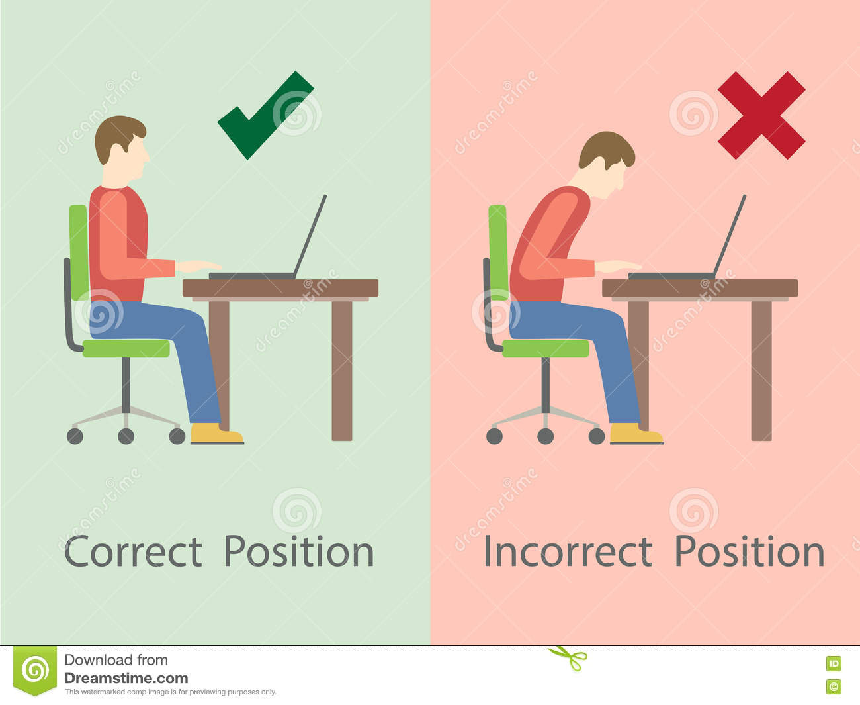
Sitting and driving:
Sit up with your back straight and your shoulders back. Your knees and hips should be level and your feet should be flat on the floor.

Slide 46
Sleeping:
Your mattress should be firm enough to support your body while supporting the weight of your shoulders and buttocks, keeping your spine straight.
Lifting and carrying:
One of the biggest causes of back injury is lifting or handling objects incorrectly.
Think before you lift:
can you manage the lift?
Push rather than pull – if you have to move a heavy object across the floor, it is better to push it rather than pull it.

Slide 47
Exercise:
Exercise is both an excellent way of preventing back pain and of reducing it, but should seek medical advice before starting an exercise programs if you've had back pain for six weeks or more.

Slide 48
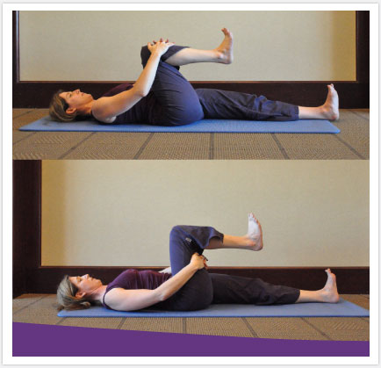
Knee to Chest : Lie flat on your back with toes pointed to the sky. Slowly bend your right knee and pull your leg up to you chest. Wrap your arms around your thigh, knee or shin, and gently pull the knee towards your chest. Hold for 20 seconds and slowly extend the leg to starting position. Repeat three times each leg.

Slide 49
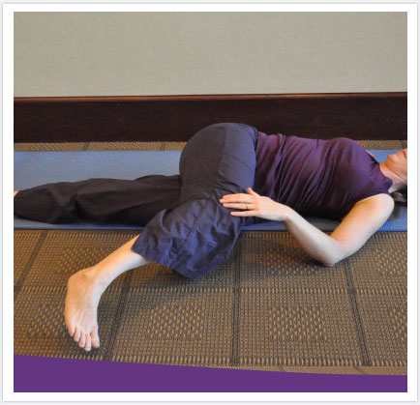
Lying Knee Twist: Lie on your back with your legs extended straight out. Bend the right knee up and cross it over the left side of your body. Hold in a position that allows you to feel a gentle stretch through the back and buttocks muscles for 20 seconds.

Slide 50
questions
The two most affected nerve roots in Radiculopathy?
L4 and L5.
L5 and S1.
S1 and S2.
L4 and S2.

Slide 51
questions
Patient came to the clinic complaining of low back pain, in examination the big toe extension is weak, which nerve root you think is involved?
L3
L4
L5
S1

Slide 52
Questions
Which one of the following is do you think is appropriate to referral ?
Fracutres
Caude equina
A+B
Undiagnosed back pain
All of the above

Slide 53
What is the most likely diagnosis?
Disc herniation
Vertebral fracture
Spondylolisthesis
Ankylosing spondylitis

Slide 54
Any questions?

