Slide 1
Sexually Transmitted infection
Omar alfarhan
Naif alhazmi
Dr. Haitham alsaif

Slide 2
Objectives
1.List of common sexually transmitted infections.
2. Method to take a sexual history and risk factors.
3. Discussion about the differential diagnosis of:
  • Vaginal and urethral discharge. •
  Ulcerative and non-ulcerative genitalia. •
  Pelvic pain and dysuria
4. List of the possible sexually transmitted infections among heterosexual and homosexual person
5. Investigation, diagnosis and management of sexually transmitted infections.
6. Methods of prevention
7. Complications of sexually transmitted disease.
8. Dermatological pictures of different sexually transmitted infection

Slide 3
MCQs
Q1: what is the incubation period for Chlamydia trachomatis?
  1-3 weeks
  2-14 days
  5 days
  1-2 weeks
Q2: which of the following test can be used to diagnosis chlamydia and gonorrhoea?
  serum rapid plasma reagin (RPR) test
  venereal disease research laboratory (VDRL) test
  nucleic acid amplification tests (NAAT)
  enzyme-linked immunosorbent assay (ELISA)
Q3: which stage of syphilis infection is consider as highly infectious stage?
  Primary
  Secondary
  Tartary
  A & B
Q4: which stage of syphilis infection can develop nephrotic syndrome?
  Primary
  Secondary
  Tartary
  A & B

Slide 4
mCQS
Q5: Which of the following can cause CHANCROID ?
  HAEMOPHILUS DUCREYI
  TREPONEMA PALLIDUM
  CHLAMYDIA TRACHOMATIS
  NEISSERIA GONORRHOEA
Q6: In which Disease we can use Tzanck smear for investigation ?
  HERPES SIMPLEX VIRUS
  HUMAN PAPILLOMAVIRUS
  TRICHOMONIASIS
  CHANCROID

Slide 5
Case
A 27-year-old man notes a painless penile ulcer. He has recently started a new relationship. He is otherwise asymptomatic, as is his partner. On examination, the ulcer is indurated and the inguinal lymph nodes are rubbery and moderately enlarged.
Key points
DDX

Slide 6
Case
A 27-year-old man notes a painless penile ulcer. He has recently started a new relationship. He is otherwise asymptomatic, as is his partner. On examination, the ulcer is indurated and the inguinal lymph nodes are rubbery and moderately enlarged.
Key points
DDX

Slide 7
How to approaches patient with STI ?
Assure privacy and confidentiality
Manage communication
History must cover the 5Ps:
  Past STIs
  Partners
  Practices
  Prevention of STIs and HIV
  Pregnancy history and plans

Slide 8
Managing communication
Male Sexual history & risk factor
Female Sexual history & risk factor

Slide 9
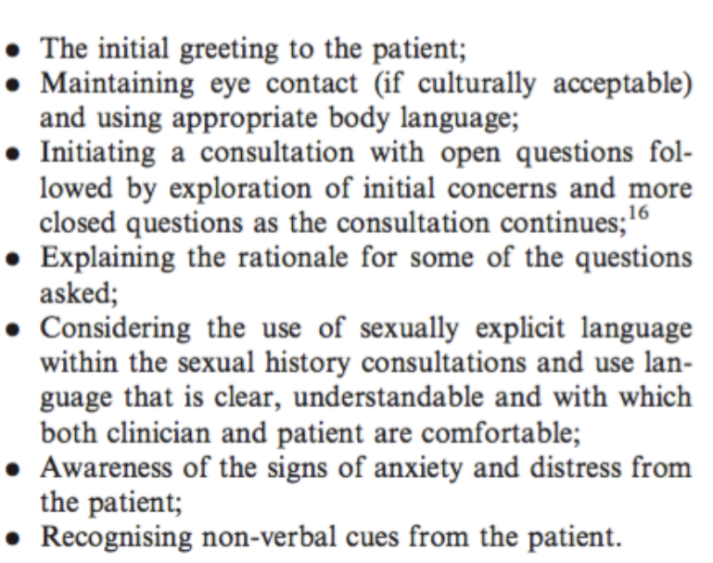
Managing communication

Slide 10
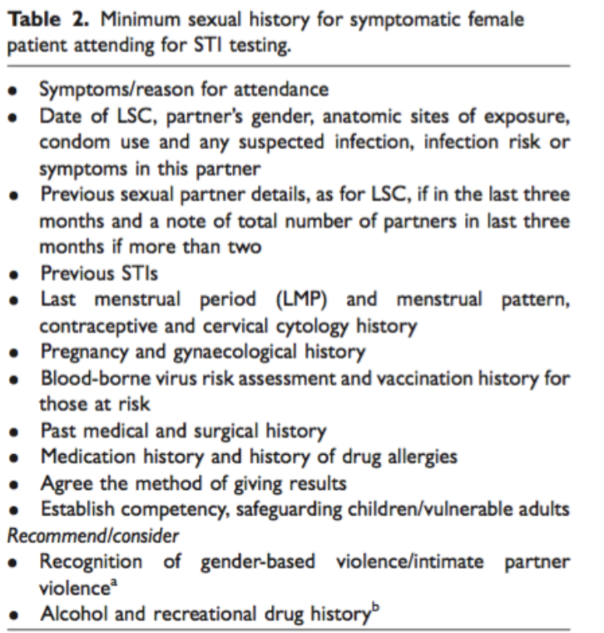
Sexual history in female patient

Slide 11
Common Sexually Transmitted Infections
Bacterial
Chlamydia “ Chlamydia trachomatis “
Gonorrhoea “ Neisseria gonorrhoea “
Syphilis “ Treponema pallidum “
Chancroid “ Haemophilus ducreyi “
Viral
Herpes simplex
Hepatitis
HIV
Human Papillomavirus
molluscom contagiusom
Parasitic
Trichomoniasis

Slide 12
Chlamydia trachomatis
Info:
  It’s the most common bacterial STI in KSA
  It affects both men and women
  It has an incubation period of 1-3 weeks
  Many infected individuals are asymptomatic
Mode of transmission:
  Sexual Intercourse
  transmission to extra-genital sites (rectum, pharynx, and conjunctiva)
  perinatal transmission typically occurs via exposure to mother’s infected cervix
Risk factors:
  Age (under 25 years)
  New sex partner or multiple sex partner
  Sexual activity with infected partner
  Condom not used
  History of prior STD

Slide 13
Clinical presentation of Chlamydial infection
Male (asymptomatic in 50%) but could come with:
Female (asymptomatic in 70%) but could come with:
Dysuria
urethral discharge or penile discharge clear-to-whitish
For severe infections, symptoms include fever, nausea, and vomiting.
Mild to severe scrotal pain & feels warm ( in ascending infections that cause epididymitis)
Symptoms and signs of rectal infection are rare, but when present may include mucopurulent rectal discharge or tenesmus.
Dysuria and pelvic pain.
vaginal discharge “ odourless cloudy or yellow discharge “
fever, chills, myalgias, nausea, vomiting and pelvic or abdominal pain. (in ascending the upper urogenital tract )
postictal or intermenstrual Pain
In rare cases it can cause fever and RUQ abdominal pain secondary to a pericapsular hepatic infection.
The cervix may bleed easily when rubbed with a Dacron swab.

Slide 14
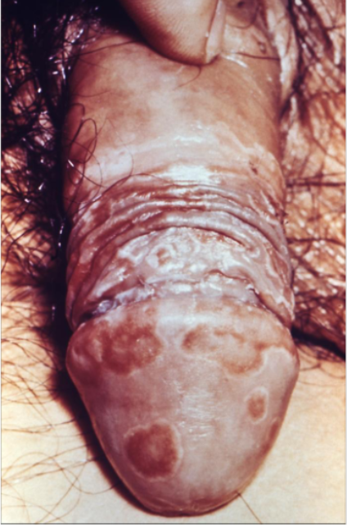
Chlamydia Trachomatis male

Slide 15
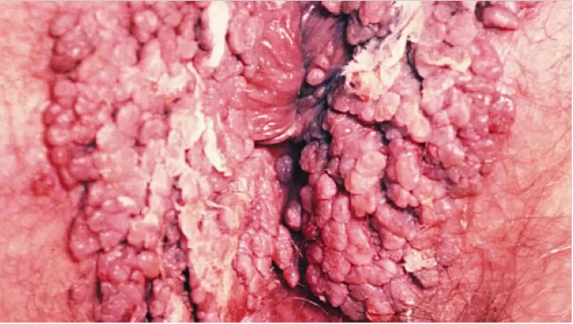
Chlamydia Trachomatis female

Slide 16
Investigations
nucleic acid amplification tests (NAAT) as test-of choice;
  “initial test” high sensitivity 85% and specificity ( 94 % to 99% )
  Non invasive and acceptable test.
  can detect chlamydia and gonorrhoea in same specimen
  can be used with large range of sample types, including urine specimens, endocervical swabs, urethral swabs, and vulvovaginal swabs.
  preferred sample types are vaginal swabs, which can be self collected, in women and first-catch urine in men.
cell culture
  Requires invasive sample (vaginal, endocervical, or penile urethral swab).
  High specificity (close to 100%). Sensitivity varies depending on laboratories (70% to 90%).
  Reserved for legal cases only; however, this may change when guidelines are updated.

Slide 17
Management
Management:
**Investigation and treatment Consider all partners with sexual contact within past 60 days**
Treatment for chlamydia:
for men and NON-pregnant women
  azithromycin: orally as a single dose
  OR
  doxycycline: orally twice daily for 7 days.
In pregnancy:
  1st line: azithromycin: orally as a single dose
  2nd line: amoxicillin oral 3 times daily for 7 days

Slide 18
Neisseria gonorrhoea
Info:
  Very common infection especially among young people 15-24 years.
  Incubation period is 2-14 days (most symptoms present between 2-5 days).
  Symptomatic in men, more complication in women
  Disseminated Gonococcal infection “rare”
Modes of transmission:
  Sexual contact
  Mother to baby during childbirth.
Risk factors:
  Age (15-24 years)
  Black ancestry
  MSM
  History of STD
  New sex partner or multiple sex partner
  Condom not used

Slide 19
Clinical presentation of Neisseria gonorrhoea
Male (asymptomatic in 10%)
Women (Asymptomatic in 50%):
  Mucopurulent or purulent urethral discharge (Yellow , greenish or whitish)
  Urethritis
  urethral pruritus
  Dysuria
  Vaginal discharge (Yellow , greenish or whitish)
  Pelvic pain or lower abdominal pain
  Fever
  Dysuria
  Vaginal bleeding (between period or after intercourse)

Slide 20
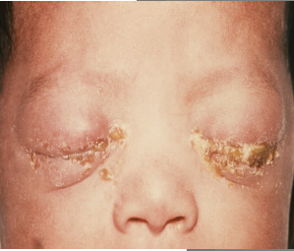
Clinical presentation of Neisseria gonorrhoea
Rectal manifestation (both women and men):
  Common in MSM
  Anal pruritus and mucopurulent discharge
  Bowel movement
  Rectal pain
  Tenesmus
  Rectal bleeding (MSM)
Infant or neonate:
  Conjunctival infection (seen in neonates born to infected mothers)

Slide 21
disseminated gonococcal infection (DGI)
occurs when infection with N gonorrhoeae is left untreated. It commonly causes skin and synovium infections.
  papules that progress into haemorrhagic pustules, bullae, petechiae, or necrotic lesions on the extremities
  slight joint pain; or severe polyarthritis,
Rare complications include endocarditis, meningitis, myocarditis, and perihepatic abscesses.
Patients with DGI often do not necessarily present with urogenital symptoms.

Slide 22
Neisseria gonorrhea
Gonococcal Penile Lesion:
Gonococcal Skin Lesions

Slide 23
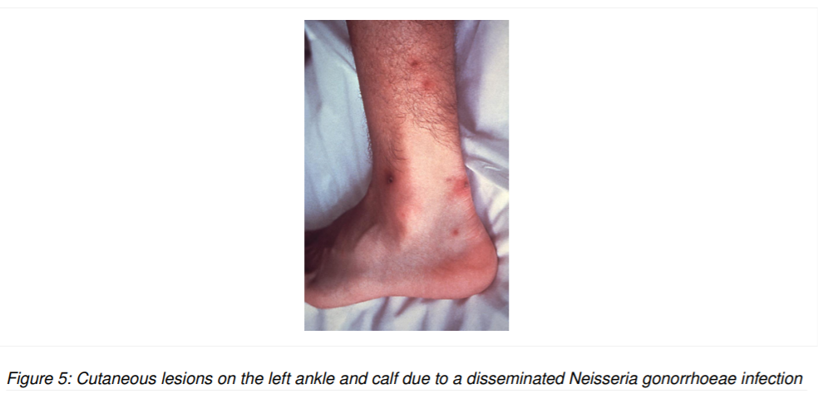

Slide 24
Neisseria gonorrhoea
Investigation
** don’t forget Screening partner and role out other infection **
  nucleic acid amplification tests (NAATs) for urine*, urethral, cervical, and vaginal specimens.
  Gram stain and culture (urine sediment and urethral discharge)
    first catch urine sample
    Showing poly-morphonuclear cells and gram-negative diplococci
  Urine analysis: (if there is no urethral discharge)
To role out HIV, syphilis and chlamydia:
  HIV: EIA test syphilis: RPR & VDRL chlamydia: (NAATs) tests

Slide 25
Neisseria gonorrhea management
Treatment:
  uncomplicated gonorrhea
    1st line : IM ceftriaxone + oral azithromycin
    2nd line : IM gentamicin + doxycycline
  Complicated gonorrhea( disseminated gonococcal infection)
    pelvic inflammatory disease (mots imp one ) – ceftriaxone and doxycycline
    meningitis and endocarditis – admitted patient + IV ceftriaxone + oral azithromycin
  Pregnant and neonates
    Pregnant - IM ceftriaxone + oral azithromycin
    Neonates – IV or IM ceftriaxone

Slide 26
Syphilis
Info:
  Caused by the spirochaetal bacterium Treponema pallidum , subspecies pallidum .
  Syphilis is divided into stage (primary, secondary, latent, and tertiary)
  There are different signs and symptoms associated with each stage.
Modes of transmission:
  Sexual
  vertical (from an infected mother to her unborn baby),
  rarely by blood Transfusion
Risk Factor:
  Sexual contact with infected person
  MSM
  Commercial sex worker (in foreigner country)
  Multiple sex partner
  People with HIV and other STD

Slide 27
Primary Syphilis
Highly infectious stage
2-3 weeks after infection.
In this stage a person generally has sores around the genitals, anus, and mouth.
These sores are usually firm , round , and painless.
Chancre on vulva, vagina, or cervix:
  The lesion starts as a papule and rapidly forms an ulcer that is typically non-exudative with a clean base.
Regional non-tender lymphadenopathy may be present.

Slide 28
Primary Syphilis ( chancre )

Slide 29
Secondary Syphilis
(Resolve spontaneously)
About 33% of those who do not treat well the primary syphilis will develop this stage.
S&S include
  generalized maculopapular rash: palms, soles, trunk, limbs
  swollen lymph nodes , and fever.
  Snail track ulcer on buccal mucosa
  Condylomata-lata: anogenital, broad-based fleshy grey lesions
serological tests usually positive
Vasculitis ( secondary to syphilis ) cause nephrotic syndrome , glomerulonephritis and hepatitis

Slide 30
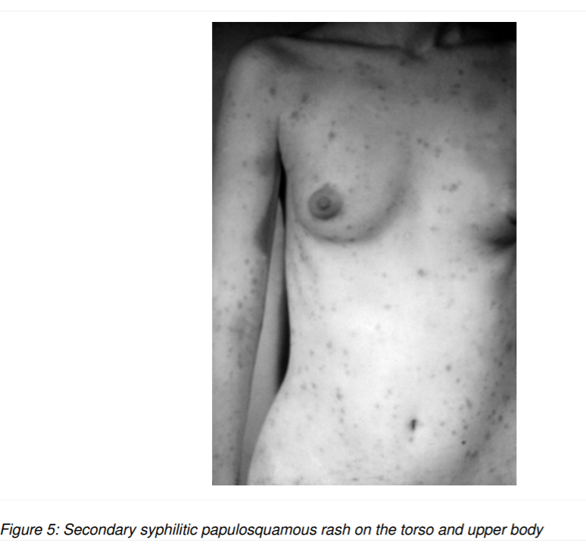
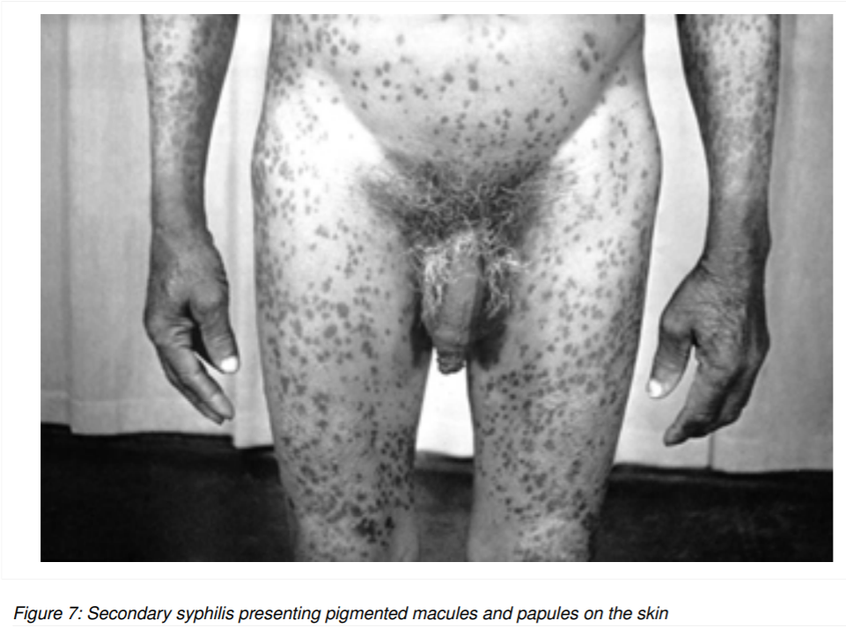

Slide 31
Latent Syphilis
Latent Syphilis
  having serologic proof of infection without signs and symptoms of the disease.
• It can be :
  Early: Less than 2 years after secondary syphilis
  Late: More than 2 years after secondary syphilis (not as contagious as early latent phase).

Slide 32
Tertiary syphilis
Final stage of syphilis. (years)
Associated with severe medical problems.
may involve any organ system:
  neurological: tabes dorsalis, general paresis and Romberg sign and brain involvement
  cardiovascular: aortic aneurysm, dilated aortic root, regarge and heart failure
  vulvar gumma (granulomatous lesion): nodules that enlarge, ulcerate and become necrotic (rare) found in skin and visceral organ

Slide 33
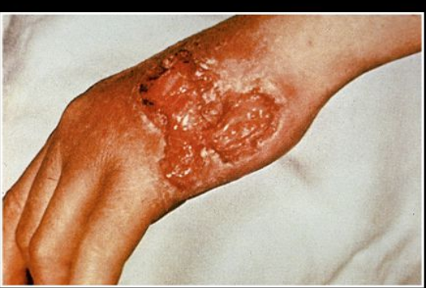

Slide 34
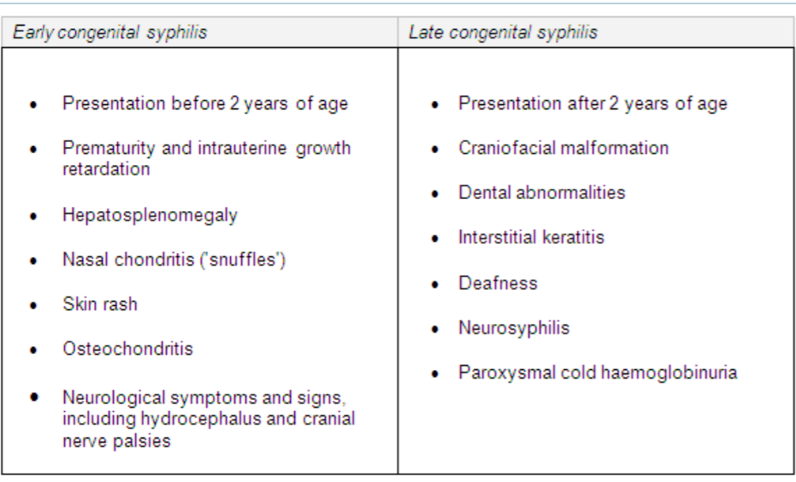
Congenital syphilis

Slide 35
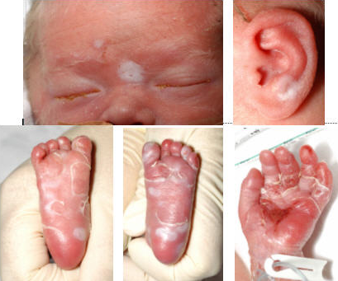
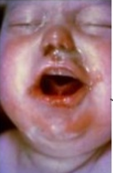

Slide 36
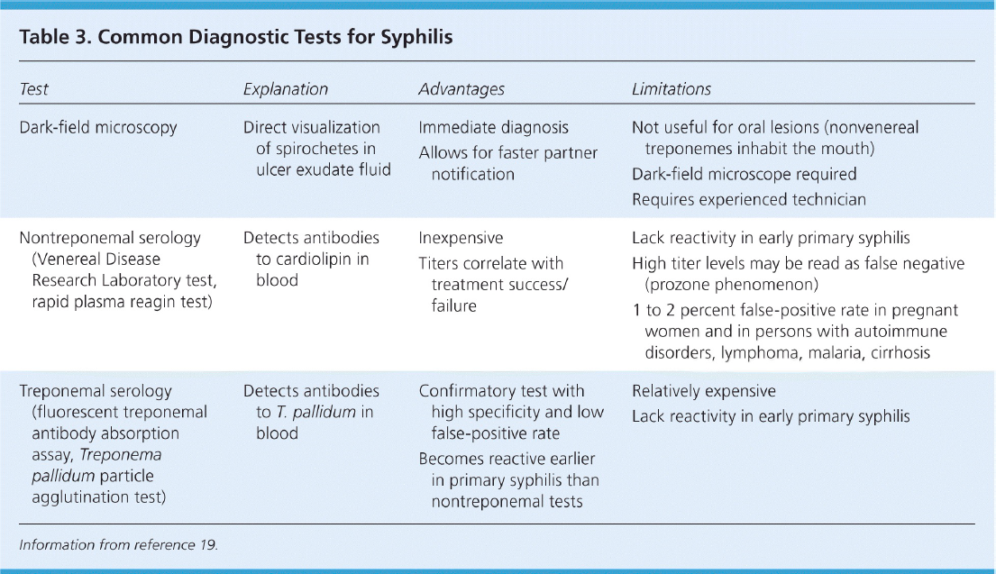

Slide 37
Treatment
IV penicillin G all stage / IM penicillin G all stage except neurosyphilis
No sexual activity for 2 weeks or until the end of treatment
If he has allergy from penicillin ( not pregnant ) use oral doxycycline
Treatment for pregnant lady ?
  Penicillin G even the patient has allergy from penicillin + corticosteroid to prevent reaction
  The same in congenital syphilis

Slide 38
herpes simplex virus
Info:
  It is a life long infection with outbreaks and remissions.
  herpes type 1 : oral herpes ( incubation 2-12 d ) Typically “cold sores”

Slide 39
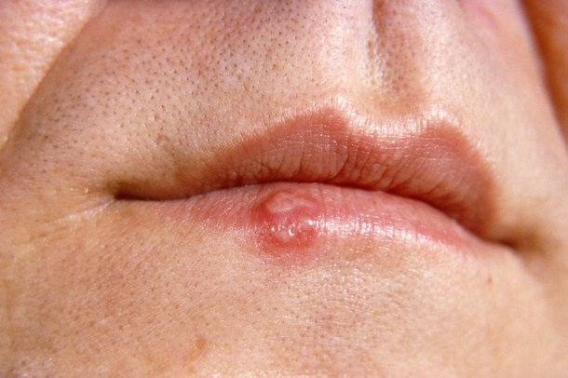
Cold sores are small blisters that develop on the lips or around the mouth. They're caused by the herpes simplex virus and usually clear up without treatment within 7 to 10 days.
You may not have any symptoms when you first become infected with the herpes simplex virus. An outbreak of cold sores may happen some time later.
Cold sores often start with a tingling, itching or burning sensation around your mouth. Small fluid-filled sores then appear, usually on the edges of your lower lip.

Slide 40
herpes simplex virus
Info:
  It is a life long infection with outbreaks and remissions.
  herpes type 1 : oral herpes ( incubation 2-12 d ) Typically “cold sores”
  herpes type 2 : genital herpes ( 4-7 d after sexual contact ) women more than men
    presentation:

Slide 41
herpes simplex virus
Info:
  It is a life long infection with outbreaks and remissions.
  herpes type 1 : oral herpes ( incubation 2-12 d ) Typically “cold sores”
  herpes type 2 : genital herpes ( 4-7 d after sexual contact ) women more than men
    presentation:
      Gingivostomatitis: entire buccal mucosa involved with erythema and edema of gingiva
      Vulvovaginitis: edematous, erythematous, extremely tender, profuse vaginal discharge
      Urethritis: watery discharge in males
  Disseminated HSV in immunocompromised
  Neonatal HSV ( vertical transmission )

Slide 42
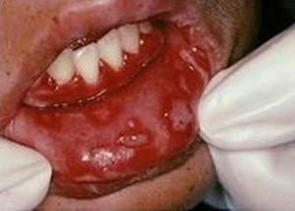
Gingivostomatitis

Slide 43
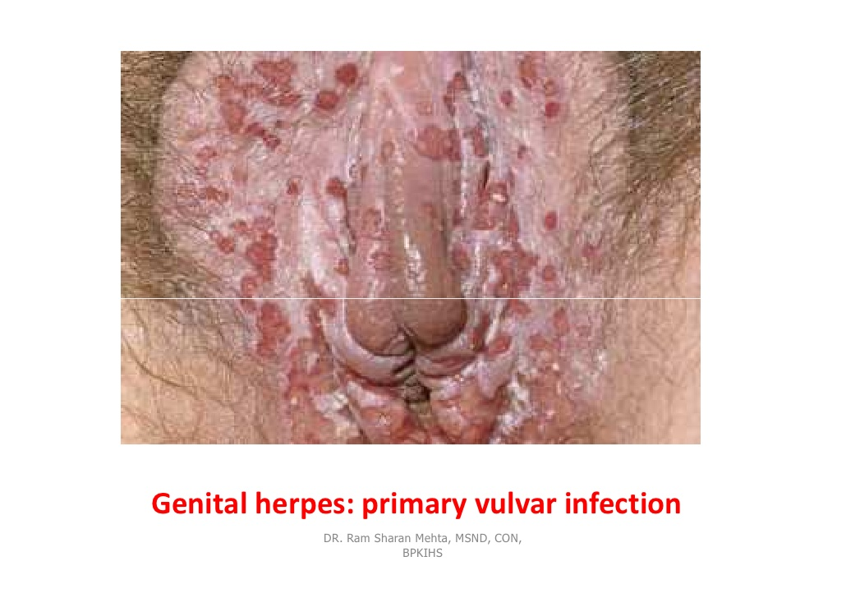
Vulvovaginitis

Slide 44
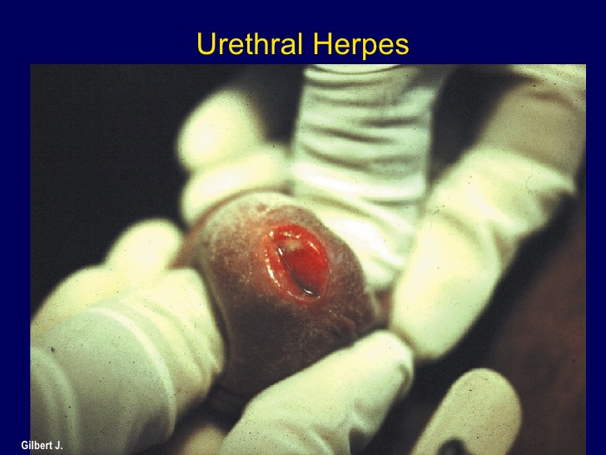
Urethritis

Slide 45
herpes simplex virus
Mode of transmission:
  Type 1: oral to oral / oral sex
  Type 2: sexual
Risk factors:

Slide 46
herpes simplex virus
Mode of transmission:
  Type 1: oral to oral / oral sex
  Type 2: sexual
Risk factors:
  Sexual behavior
  HIV infection
  Immunosuppression medication
  lack of condom use

Slide 47
herpes simplex virus
HSV - 1
HSV - 2
majority is asymptomatic
High fever
Sore throat
Painful ulcer ( pharyngeal and oral )
Generalized muscle pain
Cervical lymphadenopathy
Tender inguinal lymphadenopathy.

Slide 48
herpes simplex virus
HSV - 1
HSV - 2
majority is asymptomatic
High fever
Sore throat
Painful ulcer ( pharyngeal and oral )
Generalized muscle pain
Cervical lymphadenopathy
Tender inguinal lymphadenopathy.
Women
  Genital pain
  Discharge and dysuria
  Ulcerative lesion ( vulva, perineum, buttocks, cervix, and vagina
  Fever
  Neuralgia
Men
  Vesicles on the penis shaft or glans
  Urethritis
Both
  Proctitis with Discharge
  Rectal pain
  Tenesmus and constipation

Slide 49
herpes simplex virus
Investigations:

Slide 50
herpes simplex virus
Investigations:
  Tzanck smear w/ Giemsa stain shows multinucleated giant epithelial cells.
  Dacron Swab from base of genital lesion can be tested by:
    viral culture
    herpes simplex virus (HSV) antigen detection
    polymerase chain reaction (PCR) of HSV DNA
    Serologic testing for antibody for current or past infection if necessary

Slide 51
herpes simplex virus
Management:
HSV-1: oral disease, immunocompetent:
  1st line: oral Acyclovir, valacyclovir, or famcyclovir + symptomatic treatment for pain.
  2nd line: topical antiviral + symptomatic treatment.

Slide 52
herpes simplex virus
Management:
HSV-1: oral disease, immunocompetent:
  1st line: oral Acyclovir, valacyclovir, or famcyclovir + symptomatic treatment for pain.
  2nd line: topical antiviral + symptomatic treatment.
HSV-2: genital disease, immunocompetent:
  oral Acyclovir, valacyclovir, or famcyclovir + symptomatic treatment for pain.
  herpes genitalis, look for and treat any other STIs
  pregnancy; Acyclovir for symptomatic women, Suggested C/S if active genital lesions

Slide 53
human papillomavirus
Info
  >200 subtypes, of which >30 are genital subtypes.
  HPV types 6 and 11 are classically associated with anogenital warts/ condylomata acuminate.
  HPV types 16 and 18 are the most oncogenic (cervical cancer).
  HPV types 16, 18, 31, 33, 45, 52, and 58 can cause anal cancer.
Clinical Presentation
  **Most are asymptomatic (genital warts, cervical dysplasia)**
  Male:
Cauliflower lesions (condylomata acuminata) on skin/mucosa of penile/ anal area
  Female:
  Cauliflower lesions and/or pre-neoplastic/neoplastic lesions on cervix/vagina/vulva
Investigations:
  Potential biopsy of suspicious lesions
  Female: screening for cervical dysplasia through regular Pap smears

Slide 54
Cauliflower-like appearance of condylomata acuminata HPV

Slide 55
Cauliflower-like appearance of condylomata acuminata HPV

Slide 56
HPV warts female

Slide 57
human papillomavirus
Prevention:
  Bi-valent vaccine
  quadrivalent vaccine “Gardasil”
  nonavalent vaccine

Slide 58
human papillomavirus
Prevention:
  Bi-valent vaccine (16 &18)
  quadrivalent vaccine “Gardasil”
  nonavalent vaccine

Slide 59
human papillomavirus
Prevention:
  Bi-valent vaccine (16 &18)
  quadrivalent vaccine (6,11,16 &18) “Gardasil”
  nonavalent vaccine

Slide 60
human papillomavirus
Prevention:
  Bi-valent vaccine (16 &18)
  quadrivalent vaccine (6,11,16 &18) “Gardasil”
  nonavalent vaccine (6,11,16,18, 31, 33, 45, 52, and 58)

Slide 61
Treatment ??

Slide 62
Treatment ??
  There is no treatment for the virus itself. However, there are treatments for the health problems that HPV can cause: Genital warts can be treated by healthcare provider or with prescription medication. If left untreated, genital warts may go away, stay the same, or grow in size or number.

Slide 63
Trichomoniasis
Info
  Parasitic Infection Caused By Trichomonas vaginalis
  Most common curable STD.
  Affects women more than men
Modes of transmission :
  Sexual contact
  Mother to child
Clinical presentation:
  Men “Usually asymptomatic”
    Urethral Discharge
    Frequency
  Women
    Vaginal discharge (Yellow-green,malodourous, frothy yellowish)
    Small hemorrhagic areas on the cervix (Strawberry cervix)

Slide 64
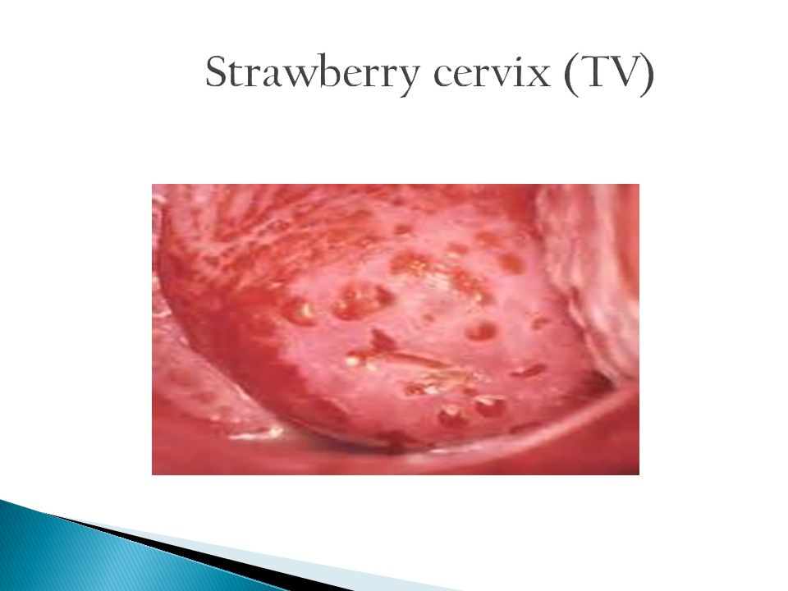

Slide 65
Trichomoniasis
Investigation
  nucleic acid amplification tests ( NAAT ) – Gold standards
  Culture – need 7 days
Treatment:
  Treat even if asymptomatic
  Metronidazole
  Symptomatic pregnant women??

Slide 66
Trichomoniasis
Investigation
  nucleic acid amplification tests ( NAAT ) – Gold standards
  Culture – need 7 days
Treatment:
  Treat even if asymptomatic
  Metronidazole
  Symptomatic pregnant women should be treated with 2 g metronidazole once

Slide 67
Chancroid
Info:
  Caused by Haemophilus ducreyi
  It is more commonly seen in heterosexual men than in women, uncircumcised males
  3–7 days after sexual intercourse.
  Cases are most probably related to foreign travel. ( Africa ).
Modes of transmission:
  Sexual contact
Signs and Symptoms:
  Soft painful ulcers on the genitals
  painful swollen lymph glands ( inguinal lymphadenopathy )
  The site of most infections in men is the foreskin.

Slide 68
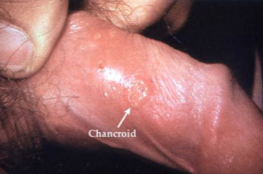

Slide 69
Haemophilus ducreyi ( Chancroid )

Slide 70
Chancroid
Investigation:
  Culture
  PCR
  clinical features are typical + rolling out other STIs (particularly syphilis and HSV)
Management:
  Azithromycin
  Ceftriaxone intramuscularly (IM)
  Ciprofloxacin 3 days
  Erythromycin 7 days ( pregnancy or lactating women )
and **Prevents transmission to others**

Slide 71
Who is at risk of STD ?

Slide 72
Risk factors:
  Sexually active males and females <25 yr old
  Unprotected sex, sexual contact with a known case of STI
  New sexual partner or >2 sexual partners in the past 12 mo
  Street involved, homeless, and/or substance abuse
  Travel
  Alcohol
  Sexual abuse
  Prior STI
  Homosexual
  People who have come from areas of high HIV prevalence
  Early onset of sexual activity.

Slide 73
Methods of prevention
1. Identification of high-risk patients opportunistically in general practice, e.g. at new patient checks, when attending for travel advice.
2. Discussions and consultations with those at high risk, structured on the basis of behaviour changes and other preventive measures aimed at educating them about sexual health.

Slide 74
1- Sexual Behaviour:
  Reduce number of sex partners, Use of condoms.
2- Vaccinations:
  For Hepatitis B and HPV.
3- Screening:
  e.g. Chlamydia screening.

Slide 75
Complications of sexually transmitted disease

Slide 76
Complications of sexually transmitted disease
1) N. Gonorrhoeae and Chlamydia trachomatis:
  Males: Urethral strictures, Epididymitis.
  Females: PID*, Ectopic pregnancy.
  Males and Females: Infertility, Arthritis, Increased risk of acquiring and transmitting HIV.
2) Human Papilloma Virus:
  Females: Vulvar/Vaginal/Cervical cancer.
  Males and Females: Rectal cancer.

Slide 77
Complications of sexually transmitted disease
3) Herpes Simplex Virus (HSV-1 and HSV-2):
  Genital pain, Urethritis, Cervicitis.
  Increased risk of acquiring and transmitting HIV.
4) Treponema pallidum (Syphilis):
  Chronic neurologic and cardiovascular sequelae.
  Increased risk of acquiring and transmitting HIV.
5) HIV/AIDS:
  Tuberculosis, Cytomegalovirus, Toxoplasmosis.
  Kaposi’s sarcoma.

Slide 78
MCQs
Q1: what is the incubation period for Chlamydia trachomatis?
  1-3 weeks
  2-14 days
  5 days
  1-2 weeks
Q2: which of the following test can be used to diagnosis chlamydia and gonorrhoea?
  serum rapid plasma reagin (RPR) test
  venereal disease research laboratory (VDRL) test
  nucleic acid amplification tests (NAAT)
  enzyme-linked immunosorbent assay (ELISA)
Q3: which stage of syphilis infection is consider as highly infectious stage?
  Primary
  Secondary
  Tartary
  A & B
Q4: which stage of syphilis infection can develop nephrotic syndrome?
  Primary
  Secondary
  Tartary
  A & B

Slide 79
MCQs
Q1: what is the incubation period for Chlamydia trachomatis?
  1-3 weeks
  2-14 days
  5 days
  1-2 weeks
Q2: which of the following test can be used to diagnosis chlamydia and gonorrhoea?
  serum rapid plasma reagin (RPR) test
  venereal disease research laboratory (VDRL) test
  nucleic acid amplification tests (NAAT)
  enzyme-linked immunosorbent assay (ELISA)
Q3: which stage of syphilis infection is consider as highly infectious stage?
  Primary
  Secondary
  Tartary
  A & B
Q4: which stage of syphilis infection can develop nephrotic syndrome?
  Primary
  Secondary
  Tartary
  A & B

Slide 80
mCQS
Q5: Which of the following can cause CHANCROID ?
  HAEMOPHILUS DUCREYI
  TREPONEMA PALLIDUM
  CHLAMYDIA TRACHOMATIS
  NEISSERIA GONORRHOEA
Q6: In which Disease we can use Tzanck smear for investigation ?
  HERPES SIMPLEX VIRUS
  HUMAN PAPILLOMAVIRUS
  TRICHOMONIASIS
  CHANCROID

Slide 81
Case
A 27-year-old man notes a painless penile ulcer. He has recently started a new relationship. He is otherwise asymptomatic, as is his partner. On examination, the ulcer is indurated and the inguinal lymph nodes are rubbery and moderately enlarged.
Key points
DDX

