Slide 1
Screening and Prevention
Done by : Mohammed AlRuwaite & Muath AlBattah

Slide 2
Q1/ Which one of the following is not on Wilson-Jungner criteria?
Natural history of illness is well understood
Detectable at early age
Acceptable to the population
Test has to be highly specific

Slide 3
Q2/ Pan-retinal photocoagulation in diabetic retinopathy is considered what type of prevention?
Primary prevention
Secondary prevention
Tertiary prevention
None of the above

Slide 4
Q3/ Which one of the following tests is not of use for colorectal carcinoma screening?
Colonoscopy
Faecal occult blood (FOB)
The fecal immunochemical test (FIT)
None of the above

Slide 5
Objectives
To Define screening / prevention and its uses in family practice
To understand the Criteria for screening tests
To identify Screening types and targeted people for each type with examples.
To explain pros and cons of screening .
To identify appropriate approaches for prevention and screening of common problems in primary care .
To justify the rational for selection of a screening test with practical case /condition, examples like for CA. breast, Ca. colon, Ca. prostate

Slide 6
Screening
it is the ability to diagnose and treat a potentially serious condition at an early stage when it is still treatable. (pt asymptomatic)
Ie : An ideal screening test must pick up all those who have the disease (have high sensitivity) and must exclude those who do not (high specificity)

Slide 7
Screening types
Mass screening: applied on a large unselected group or an entire population, test should be cheap, fast, and reliable.
High risk group screening: applied on a specific group with a known high risk for the screened disease.
Notes:
Mass screening examples :mammogram, visual defects in school children…..

Slide 8
When to screen?

Slide 9
The Wilson–Jungner criteria:
The condition being screened for is an important health problem
Natural history of the condition is well understood
There is a detectable early stage
Treatment at early stage is of more benefit than at late stage
There is a suitable test to detect early stage disease
The test is acceptable to the target population
Intervals for repeating the test have been determined
Adequate health service provision has been made for the extra clinical workload resulting from screening
Risks, both physical and psychological, are < benefits
Costs are worthwhile in relation to benefits gained

Slide 10
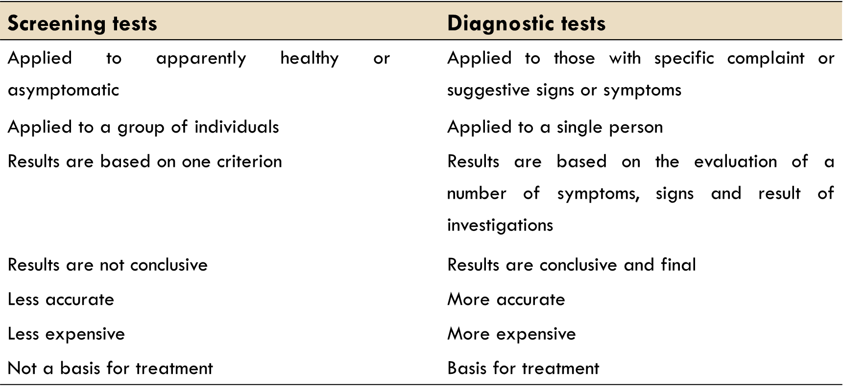
SCREENING VS DIAGNOSTIC TESTS

Slide 11
Advantages/disadvantages of screening

Slide 12
Advantages | Disadvantages
Improved prognosis for some cases detected by screening Less radical treatment for some early cases Reassurance for those with negative test results Increased information on natural history of disease and benefits of treatment at early stage | Longer morbidity in cases where prognosis is unaltered Overtreatment of questionable abnormalities False reassurance for those with false-negative results Anxiety and sometimes morbidity for those with false-positive results Unnecessary intervention for those with false-positive results Hazards of some screening tests Diversion of resources to the screening programme

Slide 13
Prevention In all disease, the goal is prevention.
Prevention, consists of methods or activities that seek to reduce or deter specific or predictable problems, protect the current state of well-being, or promote desired outcomes or behaviors.

Slide 14
Prevention types
1- Primary prevention Prevention of disease occurrence.
(health education, vaccination etc….)
2- Secondary prevention Controlling disease in early form
(e.g. carcinoma in situ, treating acute MI)
3- Tertiary prevention Prevention of complications once the disease is present
(e.g. DM complications, rehabilitation)

Slide 15
Appropriate screening and prevention of common problems in primary care

Slide 16
Common conditions to be screened for in primary care include?...
- Hypertension
- Diabetes mellitus
- Breast Cancer
- Colon Cancer
- Prostate Cancer
- CVD risk assessment
- Etc…

Slide 17
Diabetes mellitus def: a chronic syndrome of impaired carbohydrate, protein and fat metabolism owing to insufficient secretion of insulin or to target tissue insulin resistance.
A very common disease in KSA (23.7%*) of adults aged 30-70 years of age.
A disease with debilitating complications (DR, ESRD, amputations, CAD.)
Potentially preventable, and complications can be avoidable.
Patients with Impaired Glucose Tolerance may benefit from intervention such as lifestyle modifications or pharmaceutical agents.
Notes:
*Naeem, Zahid. “Burden of Diabetes Mellitus in Saudi Arabia.” International Journal of Health Sciences 9.3 (2015): V–VI. Print.

Slide 18
Prevention of DM - Type1 DM can’t be prevented? - Type 2 might be prevented if caught early (IGT) with lifestyle modifications(diet and exercise) and/or drugs (metformin). As for the complications of DM, renal, cardiovascular and neurological complications maybe prevented or
Screening for DM
The U.S. Preventive Services Task Force recommends screening for abnormal blood glucose and type 2 diabetes in adults 40 to 70 years of age who are overweight or obese, and repeating testing every 3 years if results are normal.
Screen all adults who are overweight ( BMI ≥ 25 kg/ m2) and have additional risk factors.
Not recommended for t1 DM.

Slide 19
Hypertension
Also common in KSA (26.1%) of adults aged 30-70 years of age, It is the most commonly diagnosed condition at outpatient office visits.
High blood pressure is a major risk factor to heart failure, heart attack, stroke, and chronic kidney disease.
An important feature of hypertension is that it remains asymptomatic until target tissue damage has already happened, hence the importance of screening programs.
Notes:
*Hypertension in Saudi Arabia.
Mansour M. Al-Nozha, Moheeb Abdullah, Mohammed R. Arafah, Mohamed Z. Khalil, Nazeer B. Khan, Yaqoub Y. Al-Mazrou, Mohammed A. Al-Maatouq, Khalid Al-Marzouki, Akram Al-Khadra, Mohammed S. Nouh, Saad S. Al-Harthi, Maie S. Al-Shahid, Abdulellah Al-Mobeireek
**in united states

Slide 20
Screening for HTN (USPTF)
Annual screening for adults aged 40 years or older and for those who have high-normal blood pressure (130 to 139/85 to 89 mm Hg), those who are overweight or obese, and African Americans.
Adults aged 18 to 39 years with normal blood pressure (<130/85 mm Hg) who do not have other risk factors should be rescreened every 3 to 5 years.
The USPSTF recommends rescreening with properly measured office blood pressure and, if blood pressure is elevated, confirming the diagnosis of hypertension with ABPM.
Notes:
Usptf : united states prevenitive task force
Abpm : ambulatory blood pressure monitor(24hr pt takes the device home)

Slide 21
Colorectal carcinoma.
Most common cancer in Saudi males and 3rd most common in Saudi females
Late diagnosis is the major cause for the low survival rate
Can be detected early and be easily managed thus screening and early diagnosis is critical especially in high risk individuals
Who are the high risk idividuals?
- Family history
- Ulcerative colitis
- Previous colorectal cancer
Role of prevention?

Slide 22
Screening for colorectal carcinoma
Screening options for colorectal carcinoma include:
- Faecal occult blood (FOB) (should be screened annually if age is <70)
- The fecal immunochemical test (FIT)
- Flexible Sigmoidoscopy (every 5 years or 10 with annual FIT or FOB)
- Colonoscopy
Notes:
If FOB is + then repeat the test again, if still + then do a colonoscopy
Colonoscopy is indicated if any of the previous tests were + or every 10 years

Slide 23
Breast cancer
Breast cancer is the most common cancer in women worldwide and it is the most common cause of death in women aged 35-55.
The incidence of breast cancer noticeably begins to increase after the age of 25 years and continues to increase until ages 75 to 79 years
For women of all ages at average risk, screening was associated with a reduction in breast cancer mortality of approximately 20%

Slide 24
Screening for breast cancer
Screening for breast cancer can be done by two methods:
1- physical examination
2- Mammography
Age to start mammography screening should be after 40, and for women aged 50 and above it should be done annually(indication for stopping the screeing is when life expectancy is below 10 years)
For high risk women who have family history of breast cancer and BRCA gene mutation screening should start at the age of 25 years.
Notes:
(lump or thickeninig, change in skin texture dimpling, rash or redness of the nipple/areola, nipple inversion, discharge, swelling of the axillary area)

Slide 25
Interactive case
A 57 year old woman came to your clinic after noticing several lumps in her left breast and armpit, nipple and skin dimpling.
what would you do?
What is the role of screening and prevention in this case?

Slide 26
Q1/ Which one of the following is not on Wilson-Jungner criteria?
Natural history of illness is well understood
Detectable at early age
Acceptable to the population
Test has to be highly specific

Slide 27
Q2/ Pan-retinal photocoagulation in diabetic retinopathy is considered what type of prevention?
Primary prevention
Secondary prevention
Tertiary prevention
None of the above

Slide 28
Q3/ Which one of the following tests is not of use for colorectal carcinoma screening?
Colonoscopy
Faecal occult blood (FOB)
The fecal immunochemical test (FIT)
None of the above

Slide 31
Questions?

Slide 32
Refrences:
Oxford Handbook of General Practice, 4th edition
NICE guidelines
https://www.cdc.gov/cancer/colorectal/basic_info/screening/tests.htm
https://jamanetwork.com/journals/jama/fullarticle/2463262
*Naeem, Zahid. “Burden of Diabetes Mellitus in Saudi Arabia.” International Journal of Health Sciences 9.3 (2015): V–VI. Print.

Slide 33
Thank You

