Slide 1
Home Health Care Service in KSUMC
Dr Abdulaziz Al Odhayani
Assistant Professor, Family Medicine and HHC Consultant

Slide 2
What's HHC?
It’s a provision of clinically-appropriate home health care services as an integral component of medical, rehabilitative, social , respite care, hospice and palliative care services.
It enhances a comprehensive care and short- term or long-term care needs of enrolled patients.

Slide 3
Why do we need the HHC program?
KSUMC as academic and scientific leader and reference.
Home is the best environment to provide health care when appropriate.
Increasing the Hospital cost due to preventable events.
Proper utilization of resources
Increasing number of : bedridden, oncology, elderly, wound care patients and others.
Special privileges for KSU staff and relatives
Difficult accessibility to KSUMC health care: e.g.: long waiting appointment

Slide 4
Proven Effectiveness
Evidence shows effective HHC in:
Decreases the hospital expense and cost
Decrease the hospital re-admission
proper bed utilization
Improve the quality of patients care
Good End of life care and support
Improved patient's satisfaction toward the KSUMC health System.
Proper utilization of KSUMC resources

Slide 5
Target population
Over stages!
Stage 1
KSU staff and relatives
Oncology patients who need special care
Wound care patients
Short-term care Home service (<3 weeks)

Slide 6
Stage 2
Bedridden patients
Stroke patients with disabilities
Pediatrics with special care
Patients with mechanical disabilities
Patients who has difficulties in accessing the proper care: e.g Insulin adjustment care
Including 5 km around KSU

Slide 7
Stage 3
Includes all HHC eligible patients in KSUMC catchment area

Slide 8
HHC Team Members
Head of HHC Unit/program
Physicians
Registered nurses
Occupational specialist
Nutritionists
Respiratory therapists
Physiotherapist
Social workers
Health educators

Slide 9
HHC Services examples
Special Procedures
Intake and Output (I&O) Catheter Care
Ostomy Care
Collecting Specimens
Non-Sterile Dressing Medications
Nutrition- NG tubes and feeding
Maintaining Mobility
Positioning
Transfers/Ambulation
Range of Motion Exercises
Personal Care Procedures
Bathing
Oral Care
Toileting
Vital Signs
Home modification and maintenance
Counselling, support, information and advocacy
Need Assessment of service users
Coordination of services: Emergency coordination, OPD coordination, and access to treating physicians
Pain management

Slide 10
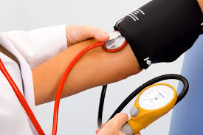
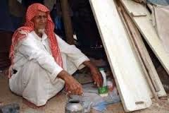
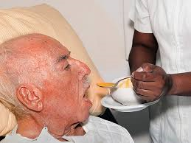
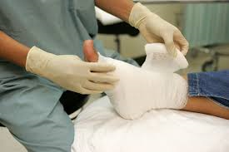
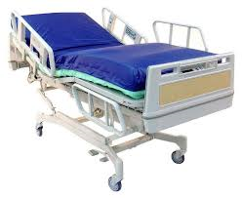
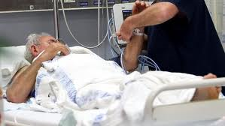
A &Q

