Slide 1
Prescribing in Family Practice
Dr Syed Irfan Karim
Assistant Professor & Consultant Family Medicine
Deputy Director Family Med. Residency Training Program
Dept. of Family & Com. Medicine
College of Medicine
King Saud University

Slide 2
Who is a good prescriber?

Slide 3
Who is a good prescriber?
One, who ensures that diagnosis is correct.
Makes a positive & correct decision that drug is needed.
Chooses a drug appropriate to patients need.
Who consults patient and ensures his/her informed consent.
Who explains patient’s role and secures his/her
co-operation.
Who terminates treatment when no longer needed.

Slide 4
Is it always Necessary to Prescribe ?
Diagnosis is still in doubt ?
Value of treatment is debatable (in doubt) ?

Slide 5
Why so irrational ?
Increased cost of un-necessary prescription to the health care system.
Harmful prescribing fails to meet acceptable standards.
Chances of poly-pharmacy – effecting vulnerable groups like elderly.

Slide 6
Why Family Medicine/PHC and Rational Use of Drugs?
Barbara Star Field Study related to the practice of Family Medicine and health outcome indicators’ of a country.

Slide 7
The studies showed relationship b/w more & better primary care & most health outcomes studied.
Evidences shows a positive impact of primary care on prevention of illness & death.
Primary care (in contrast to specialty care) is associated with a more equitable distribution of health in populations.

Slide 8
How we can improve prescribing Habits
There is no such thing as
GOOD MEDICINE or BAD MEDICINE
“A good prescribing is the prescribing based on the best available evidence & current guidelines “

Slide 9
When should we prescribe ?
or
QUALITIES OF BEST PRESCRIPTION EVER WRITTEN ?

Slide 10
How to prescribe Rationally
Is a drug really required ?
Will it work ?
Will it harm ?
Is it the cost –effective choice ?
Have all alternatives been considered ?
Is the likely risk-benefit ratio acceptable ?

Slide 11
Is there any Social reasons for prescribing

Slide 12
Social reasons for inappropriate prescribing
Any pressure of pharmaceutical advertising.
Patient’s demand.
Habit , peer group recommendation & ignorance.
To avoid confrontation .
Because of medico legal worries.
To play for time until true picture becomes clearer or natural recovery occurs.
To hasten the conclusion of consultation.

Slide 13
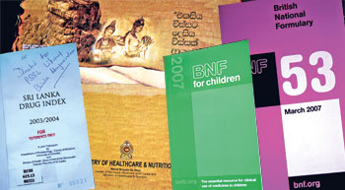
Evidence – Based Prescribing
Failure to do this may:-
Cause patients to suffer unnecessary side effects of ineffective drugs.
Deprive patients the chance to benefit from effective treatments.
Waste valuable resources.

Slide 14
Advantages of Generic
Prescribing
Reduced cost
Professional convenience; everyone knows it
Convenient to the patient
Convenient to the pharmacist

Slide 15
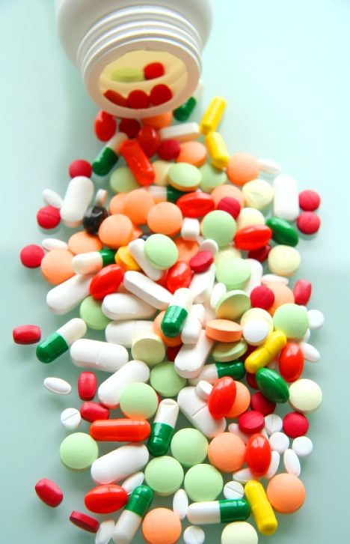
Reason for not Prescribing Generically
Drugs with a low therapeutic index e.g. Lithium, Carbamazepine, Phenytoin (small difference in plasma concentration can be significant)
Modified release formulations, difficult
to standardize e.g. Diltiazem, Nifedipine.
Formulations containing > 2 drugs.

Slide 16
What is a Placebo medication

Slide 17
What is a Placebo medication
A harmless pill, medicine, or procedure prescribed more for the psychological benefit to the patient than for any physiological effect.

Slide 18
Ethical reasons to favor placebo
It is effective – does mechanism matters if results are satisfactory.
Sometimes reassuring.
Helps morale in chronic & incurable diseases.
No significant toxicity.

Slide 19
Ethical reasons against placebo
It is a deception and abuse of a relationship of mutual trust.
It may create an ill-feeling if the deception is uncovered.
It may delay the true diagnosis.
It re-inforce a sick role.

Slide 20
Placebo side effects
It has been reported that40% can also experience side effects like ;
Headache
Anorexia
Diarrhea
Dry mouth
Palpitations
Vertigo.

Slide 21
Risks of self medication
Always risk of drug interaction with prescribed medicine.
Increased risk of self-medication side effects.
Taking wrong preparation & wrong formulations.
Less chances to offer any opportunistic health promotion advice .

Slide 22
Prevention of Adverse Drug Reactions
Never use a drug unless there is a good indication.
Do not use a drug in pregnancy, unless the need for it is imperative.
Ask if there is H/O allergy/idiosyncracy.
Consider possible drug interaction.
Age and hepatic or renal impairment may require much smaller doses.

Slide 23
Prevention of Adverse Drug Reactions Cont..
Prescribe as few drugs as possible.
Give clear instructions, especially in elderly.
Be particularly alert for adverse reactions or unexpected events, when prescribing new drugs.
Fill the required form in case of suspected adverse reaction.
Warn the patient if serious adverse reactions are liable to occur.

Slide 24
Delayed Drug Effects
Some adverse reactions may become manifest months or years after treatment e.g. chloroquine retinopathy.

Slide 25
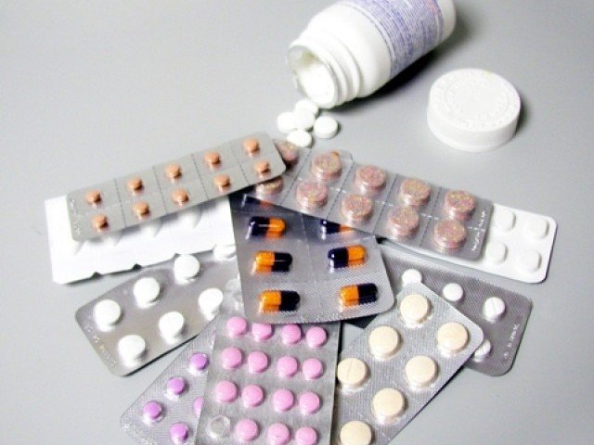
Principles for antibiotic selection
Allow for a number of variables:
H/o allergy / sensitivity
State of renal and hepatic function
Increasing resistance
New information on side effects
Age of patient & duration of therapy
Dosage and route of administration

Slide 26
Principles for antibiotic selection Cont…..
Site, type and severity of infection
Individual response
If female, whether pregnant, breast feeding or on oral contraceptives
Likely organism and antibacterial sensitivity ?

Slide 27
Special Problems in Prescribing
Delayed drug effect.
In elderly.
In children.
In hepatic impairment.
In renal impairment.
In pregnancy.
In breast feeding.
In palliative care.
Drug inter-actions.

Slide 28
Prescribing for Elderly
Limit range of drugs.
Reduce dose.
Review regularly.
Simplify regimens.
Explain clearly.
Repeats and disposal.

Slide 29
Prescribing for Children
Special care needed in neonates
Avoid injections if possible
Actions of drugs and their pharmacokinetics may be different than adults
Suitable formulations may not be available for children
Drugs are not extensively tested in children

Slide 30
Prescribing in Hepatic Impairment
Impaired drug metabolism
Hypoproteinaemia
Reduced clotting
Hepatic encephalopathy
Fluid overload
Hepato-toxic drugs

Slide 31
Prescribing in Renal Impairment
A. Reduced renal excretion of a drug
B. Increased sensitivity to some drugs even if elimination is not impaired
. C. Many side effects are tolerated poorly
D. Some drugs become ineffective

Slide 32
Prescribing in Pregnancy
Particular care is needed in prescribing for women in child bearing age or men trying to father a child.
First trimester – congenital malformations
Second and third trimester – effect on the growth or the functional status of fetus, including toxic effect on fetal tissues.
Shortly before term or during labour – possible adverse effect on labour or neonate, after delivery.

Slide 33
Prescribing in Breast-feeding
Avoid drugs (if possible) which:
Cause inhibition of sucking reflex (e.g. phenobarbital).
Suppress lactation (e.g. bromocriptine)
Appear in a significant quality in the milk (e.g. fluvastatin).
If not sure, look up at the therapeutic guidelines from a reputable source (e.g. BNF).

Slide 34
Prescribing in Palliative Care
The importance of pain relief and other symptoms are more important than sticking to the usual drugs or dosages.
Oral medications are preferable, if possible.
As few drugs as possible should be prescribed.
4. Doctor – patient relationship is usually more effective than the drug.

Slide 35
Drug Interactions
A Family Physician is not expected to know all the possible drug interactions, but awareness of some important categories is imperative:
Anti-convulsants
Oral contraceptives
Warfarin

Slide 36
Factors Related to Poor Compliance
Purpose of medicine not clear to patient.
Perceived lack of efficacy of medicine.
Real or perceived adverse effects by the patient.
Lack of understanding between the doctor and the patient.
Instructions for administration not clear.
Unpleasant taste.
Complicated regimen – poly-pharmacy.
Physical difficulty in taking medicines.
Medicines too costly.

Slide 37
Practice Formulary
An effective way to limit prescribing and costs of prescribing:
Essential features:
Evidence of efficacy
Evidence of safety
Cost-effectiveness
Local policy

Slide 38
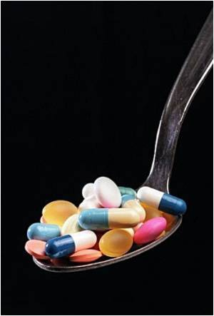
Conclusion
● While prescribing, apply the saying ‘think before you ink’ – by prescribing this drugs are you going to do more harm or more good?
● Factors related to compliance of medications by the patient must be considered.
● Cost-effective and generic prescribing is generally preferable.
● Prescribing in special circumstances requires special attention.

Slide 39
Thank You

