Slide 1
Change In Bowel Habits
Sultan Al-otaibi, Alwaleed Alsuliman and Abdullah Alsultan

Slide 2
Seminar's Objectives
Define constipation and diarrhea.
Discuss the definition, etiology and classification of irritable bowel syndrome (IBS)
Explain how to diagnose IBS
List the alarm symptoms and differential diagnosis
Provide a comprehensive management plan and follow up for patients with IBS
Recognize when to refer to a specialist
A role play of a focused abdominal examination

Slide 3
Quiz
1- what causes Irritable bowel syndrome ?
A- Nervous system.
B- Microflora changes.
C- Severe infections.
D- A,B,C
2- Diarrhea is the first cause of death in children below 5 years old ?
A- True. B- False

Slide 4
Quiz
3-which of the following is alarming symptoms?
A-backache
B-rectal bleeding
C-urinery symptoms
D-mucous in stool
4-Laxatives are the first line of treatment in IBS diarrhoea predominant:
A- true. B- false.

Slide 5
Definitions
Diarrhea : the passage of three or more loose or liquid stools per day (or more frequent passage than is normal for the individual)
Clinical types:
acute watery diarrhea – lasts several hours or days
acute bloody diarrhea
persistent diarrhea – lasts 14 days or longer

Slide 6
Cont. Definitions
Constipation : infrequent bowel movements, usually less than 3 stools per week.
Other complaints : Hard Stool - Straining - Abdominal pain and bloating - sensation of incomplete bowel evacuation
Causes : Diet - Medications ( Antispasmodics, Anticholinergics ) - Diabetes - Hypothyroidism

Slide 8
Irritable Bowel Syndrome
Definition : group of symptoms that occur together, including repeated pain in your abdomen and changes in your bowel movements, which may be diarrhea, constipation or both.
IBS Classifications :
IBS-C : more than a quarter of your stools are hard or lumpy, and less than a quarter of your stools are loose or watery
IBS-D : more than a quarter of your stools are loose or watery, and less than a quarter of your stools are hard or lumpy
IBS-M

Slide 9
Etiology : The precise cause of IBS isn't known. Multiple factors play a role in IBS.
1- Nervous system
2- Muscle contractions in the intestine.
3- Inflammation in the intestines.
4- Severe infection.
5- Changes in microflora.
Complications : Mood disturbance and Poor quality of life
Many people with moderate to severe IBS report poor quality of life. Research indicates that people with IBS miss three times as many days from work as do those without bowel symptoms

Slide 10
Initial assessment
Abdominal pain or discomfort
Bloating
Change in bowel habit.

Slide 11
Diagnosis criteria: (NICE)
abdominal pain or discomfort that is either relieved by defection or associated with altered bowel frequency or stool form. This should be accompanied by at least 2 of the following 4 symptoms:
altered stool passage (straining, urgency, incomplete evacuation)
abdominal bloating (more common in women than men)
symptoms made worse by eating
passage of mucus.
Other features such as lethargy, nausea, backache and bladder symptoms are common in people with IBS, and may be used to support the diagnosis

Slide 12
Rome IV Ibs Criteria
According to the Rome IV criteria, IBS is defined as recurrent abdominal pain, on average, at least 1 day/week in the last three months, associated with two or more of the following criteria:
Related to defecation
Associated with a change in stool frequency
Associated with a change in stool form (appearance)

Slide 13
Alarming symptoms
Age
symptoms and sings indicating malignancy: abdominal mass, unintentional weight loss, Anemia, rectal bleeding, family history
Fever
signs and symptoms of IBD
related to certain food

Slide 14
Differential diagnosis
Colonic carcinoma
Coeliac disease
Inflammatory bowel disease(Crohn’s disease or UC)
Pelvic inflammatory disease
Endometriosis
GI infection
Thyrotoxicosis

Slide 15
INVESTIGATION
In people who meet the IBS diagnostic criteria, the following tests should be undertaken to exclude other diagnoses:
full blood count (FBC)
erythrocyte sedimentation rate (ESR) or plasma viscosity
c-reactive protein (CRP)
antibody testing for coeliac disease (endomysial antibodies [EMA] or tissue transglutaminase [TTG])

Slide 16
The following tests are not necessary to confirm diagnosis in people who meet
the IBS diagnostic criteria:
ultrasound
rigid/flexible sigmoidoscopy
colonoscopy; barium enema
thyroid function test
faecal ova and parasite test
faecal occult blood
hydrogen breath test (for lactose intolerance and bacterial overgrowth
CA125 measured (for ovarian cancer)

Slide 17
management of IBS

Slide 18
management of irritable bowel syndrome (IBS) can be frustrating, both for people presenting with IBS symptoms and for clinicians. Both parties need to understand the limitations of current knowledge about IBS and to recognise the chronic nature of the condition.
People with IBS should be given information that explains the importance of self‑help in effectively managing their IBS.
This should include information on general lifestyle, physical activity, diet and symptom‑targeted medication.

Slide 19
IBS
Dietary and lifestyle
Pharmacological
Psychological

Slide 20
Dietary and lifestyle advice
make the most of their available leisure time and to create relaxation time.
Have regular meals and take time to eat.
Avoid missing meals or leaving long gaps between eating.
Drink at least 8 cups of fluid per day, especially water

Slide 21
High-fiber diet: Fiber-rich foods are nutritious and help prevent constipation.
Low-fiber diet: While fiber can help some people with IBS, increasing fiber intake can worsen symptoms if you frequently have gas and diarrhoea.
And remember soluble fibers are better for IBS patients.
Low-fat diet in people with mixed IBS
Low FODMAP diet in IBS-D
probiotics: which increase growth of “good” bacteria and to some extent relieve IBS symptoms it should be taken for 4 weeks

Slide 22
Pharmacological therapy
Decisions about pharmacological management should be based on the nature and severity of symptoms.
The recommendations made below assume that the choice of single or combination medication is determined by the predominant symptom(s).
antispasmodic as required for pain relieve (dicyclomine and hyoscyamine)

Slide 23
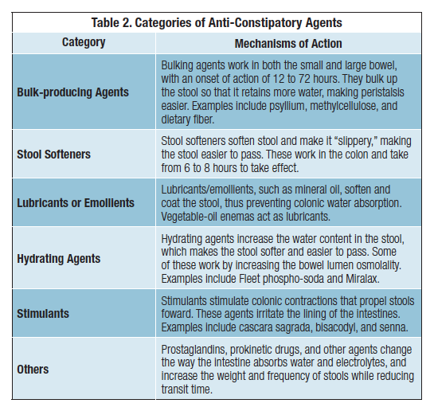
constipation (IBS-C) : Laxatives should be considered for the treatment of constipation in people with IBS.

Slide 24
Consider linaclotide for people with IBS only if:
optimal or maximum tolerated doses of previous laxatives from different classes have not helped and
they have had constipation for at least 12 months.
Follow up people taking linaclotide after 3 months.

Slide 25
Diarrhoea (IBS-D) : Loperamide should be the first choice of antimotility agent for diarrhoea in people with IBS.
People with IBS should be advised how to adjust their doses of laxative or antimotility agent according to the clinical response.
The dose should be titrated according to stool consistency, with the aim of achieving a soft, well‑formed stool (corresponding to Bristol Stool Form Scale type 4).

Slide 27
Consider tricyclic antidepressants (TCAs) as second‑line treatment for people with IBS if laxatives, loperamide or antispasmodics have not helped.
Consider selective serotonin reuptake inhibitors (SSRIs) for people with IBS only if TCAs are ineffective.

Slide 28
Psychological interventions
Referral for psychological interventions (cognitive behavioural therapy [CBT], hypnotherapy and/or psychological therapy) should be considered for people with IBS who do not respond to pharmacological treatments after 12 months and who develop a continuing symptom profile (described as refractory IBS).

Slide 29
When to Refer to a specialist?
Refer when there is:
More than minimal rectal bleeding
Weight loss
Unexplained iron deficiency anemia
Nocturnal symptoms
Family history of Colorectal cancer IBD Celiac disease

Slide 30
Follow up
Agreed between physician and patient.
Depends on response of the person’s symptoms to intervention.
‘Red flag’ symptoms should be ruled out and further investigation and/or referral to secondary care if present.

Slide 31
1- what causes Irritable bowel syndrome ?
A- Nervous system.
B- Microflora changes.
C- Severe infections.
D- A,B,C
2- Diarrhea is the first cause of death in children below 5 years old ?
A- True.
B- False

Slide 32
3-which of the following is alarming symptoms?
A-backache
B-rectal bleeding
C-urinery symptoms
D-mucous in stool
4-Laxatives are the first line of treatment in IBS diarrhoea predominant:
A- true.
B- false

