Slide 1
Upper Respiratory Tract Diseases
Supervised by: Dr Haithum Alsaif
Done by: Feras alsuwaida, abdulaziz almanie, nasser alqahtani

Slide 2
Objectives
❖ Rhinosinusitis, Pharyngitis, and Otitis Media
▪ Etiology
▪ Risk factors
▪ Relevant microbiology & virology
▪ Important of historical clues and clinical findings
▪ How to differentiate between viral & bacterial etiology
▪ Diagnostic tests and imaging
▪ Management (symptomatic, antibiotic choice, antiviral therapy)
▪ Prevention and complications
❖ Allergic rhinitis
▪ Definition & classification
▪ Assessment of severity & triggers
▪ Allergy testing
▪ Allergic rhinitis treatment

Slide 3
Questions
Which type of influenza virus is capable of infecting animals:
A. Type A.
B. Type B.
C. Type C.
D. All of the above.
Which food allergy you should ask about before giving influenza vaccine:
A. Peanuts.
B. Sesame seeds.
C. Eggs.
D. Milk products.
Which of the following conditions is associated with allergic rhinitis :
A. COPD.
B. Asthma.
C. Dermatitis.
D. Bronchiectasis.

Slide 4
Cont..
What is the most common organism associated with Pharyngitis
A. Group A streptococcus (GAS).
B. Chlamydia pneumoniae.
C. Mycoplasma pneumoniae.
D. Neisseria gonorrhoeae.
What is a common side effect of antibiotic treatment in otitis media?
A. Diarrhea.
B. Vomiting.
C. Otorrhea.
D. Drug eruption.

Slide 5
Rhinosinusitis

Slide 6
Sinuses
Healthy sinuses are filled with air.
The mucus produced by the sinuses usually drains into the nose through small channels.
When the sinus linings become inflamed, these channels become blocked.
After they become blocked and filled with fluid, germs can grow and cause an infection.

Slide 7
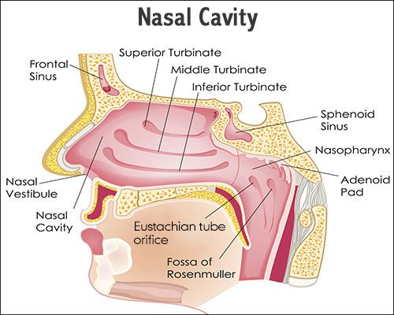
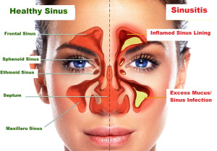
Rhinosinusitis
Sinusitis and Rhinosinusitis refer to inflammation in the nasal cavity and paranasal sinuses.
Clinical features of Rhinosinusitis:
Headache.
Pain. (Increase when lying down or bending over)
Obstruction.
Discharge.
Loss of smell.
Fever.
Fatigue.
Earache.
Dental issues.

Slide 8
Etiology
Infectious:
Viral
(influenza caused by influenza viruses & common cold caused by other viruses).
Bacterial
(Streptococcus pneumoniae, Haemophilus influenzae).
Fungal
(Aspergillus , Curvularia).
Non-Infectious:
Nasal obstruction
nasal polyps, Tumors, mucous plug, septal deviation.
Primary ciliary dyskinesia
Patients with immune deficiency or hyper inflammatory disease such as Wegner's disease.
Cystic fibrosis .

Slide 9
Types of influenza viruses
Family of Influenza virus is Orthomyxoviridae.
Influenza type A is antigenically highly variable and is responsible for most cases of epidemic influenza.
Influenza type B may exhibit antigenic changes and sometimes causes epidemics.
Influenza type C is antigenically stable and causes only mild illness in immunocompetent individuals, no epidemic & not in the vaccine. ( usually no fever )

Slide 10
What are other viruses’ families that can cause common cold?
Rhinoviruses.
Coronaviruses.
Adenoviruses.
Human respiratory syncytial virus(in adults).
Parainfluenza viruses.

Slide 11
Common cold and influenza
They are caused by different viruses.
influenza flu is worse than the common cold, and symptoms are more common and intense.
Colds are usually milder than the flu. People with cold are more likely to have a runny or stuffy nose. Cold generally do not result in serious health problems, such as pneumonia, bacterial infections, or hospitalizations. Flu can have very serious associated complication.
The typical incubation period for influenza is 1-4 days (average: 2 days).

Slide 12
Spread of influenza
Person to Person
Contact with contaminated items.
Droplet infection.
People with flu can spread it to others up to about 6 feet away. Most experts think that flu viruses spread mainly by droplets made when people with flu cough, sneeze or talk. These droplets can land in the mouths or noses of people who are nearby or possibly be inhaled into the lungs. Less often, a person might also get flu by touching a surface or object that has flu virus on it and then touching their own mouth or nose.
Patients may be able to pass on the flu to someone else before they know they are sick, as well as while they are sick.
Notes:
Most healthy adults may be able to infect other people beginning 1 day before symptoms develop and up to 5 to 7 days after becoming sick. Children may pass the virus for longer than 7 days. Symptoms start 1 to 4 days after the virus enters the body. That means that you may be able to pass on the flu to someone else before you know you are sick, as well as while you are sick. Some people can be infected with the flu virus but have no symptoms. During this time, those persons may still spread the virus to others.

Slide 13
What are the diagnostic tests for influenza?

Slide 14
When should you suspect & test for MERS-CoV for someone with acute Rhinosinusitits?
A. History of exposure to a confirmed or suspected MERS CoV in the 14 days prior to onset of symptoms.
B. History of contact with camels or camel products in the 14 days prior to onset of symptoms.
C. Unexplained acute febrile (≥38°C) illness, AND body aches, headache, diarrhea, or nausea/vomiting, with or without respiratory symptoms, AND leucopenia (WBC).

Slide 15
How to differentiate between bacterial & viral rhinosinusitis?
The following clinical presentations (any of 3) are recommended for identifying patients with acute bacterial rhinosinusitis:
Onset with persistent symptoms or signs compatible with acute rhinosinusitis, lasting for ≥10 days without any evidence of clinical improvement;
Onset with severe symptoms or signs of high fever (≥39_C [102_F]) and purulent nasal discharge or facial pain lasting for at least 3–4 consecutive days at the beginning of illness
; or
Onset with worsening symptoms or signs characterized by the new onset of fever, headache, or increase in nasal discharge following a typical viral upper respiratory infection (URTI) that lasted 5–6 days and were initially improving (‘‘double sickening’’).

Slide 17
Viral Rhinosinusitis complicated by bacterial infection
Only about 0.5 to 2.0% of VRS episodes are complicated by bacterial infection.
Antecedent viral infection can promote ABRS by obstructing sinus drainage during the nasal cycle promoting growth of bacterial pathogens that colonize the nose and nasopharynx,

Slide 18
Bacterial Rhinosinusitis based on duration
Acute Sinusitis
Chronic sinusitis
Recurrent acute sinusitis
Between 4 weeks and 12 weeks.
More than 12 weeks.
Diagnosed when infection occurs 2-4 times per year.
Less than 4 Weeks.
Subacute Sinusitis
Sinusitis
Usually starts with cold like symptoms such as a runny, stuffy nose and facial pain.

Slide 19
Role of imaging in acute rhinosinusitis
Radiographic imaging of the paranasal sinuses is unnecessary for diagnosis in patients who already meet clinical diagnostic criteria.
Clinicians should not obtain radiographic imaging for patients presenting with uncomplicated acute rhinosinusitis (ARS) to distinguish ABRS from VRS, unless a complication (Orbital, intracranial or soft tissue involvement) or alternative diagnosis (malignancy) is suspected.
Radiographic imaging may also be obtained when the patient has modifying factors or comorbidities that predispose to complications, including diabetes, immune-compromised state, or history of facial trauma or surgery.

Slide 20
Cont..
CT imaging of the sinuses is appropriate when a complication of ABRS is suspected based on severe headache, facial swelling, cranial nerve palsies, or forward displacement or bulging of the eye (proptosis);
CT findings that correlate with ABRS include opacification, air-fluid level, and moderate to severe mucosal thickening.
Complications of ABRS are best assessed using iodine contrast-enhanced CT or gadolinium based MR imaging to identify extra-sinus extension or involvement.

Slide 21
Management of viral and bacterial rhinosinusitis symptomatically
For symptomatic relief of ABRS and VRS Clinicians may recommend rest, fluid, analgesics, topical intranasal steroids, and/or nasal saline irrigation for symptomatic relief of VRS.
Treatment of complications (antibiotics for secondary bacterial infection, treatment of exacerbations of COPD or asthma).

Slide 22
Besides symptomatic management, how would you initially approach a bacterial rhinosinusitis?
Initial management of ABRS Clinicians should either offer watchful waiting (without antibiotics) or prescribe initial antibiotic therapy for adults with uncomplicated ABRS.
Watchful waiting should be offered only when there is assurance of follow-up, such that antibiotic therapy is started if the patient’s condition fails to improve by 7 days after ABRS diagnosis or if it worsens at any time.
If a decision is made to treat ABRS with an antibiotic agent, the clinician should prescribe amoxicillin with or without clavulanate as first-line therapy for 5 to 10 days for most adults.

Slide 23
Case
24 years old male diagnosed with a bacterial rhinosinusitis, he received amoxicillin for 8 days but there is no improvement in his symptoms.
What is your management plan?

Slide 24
Failure of treatment for acute bacterial rhinosinusitis
If the patient worsens or fails to improve with the initial management option by 7 days after diagnosis or worsens during the initial management, the clinician should reassess the patient to confirm ABRS, exclude other causes of illness, and detect complications. If ABRS is confirmed in the patient initially managed with observation, the clinician should begin antibiotic therapy. If the patient was initially managed with an antibiotic, the clinician should change the antibiotic.

Slide 25
Who are the candidates for antiviral therapy?
Children aged younger than 2 years.
Adults aged 65 years and older;
Persons with chronic pulmonary (including asthma), cardiovascular (except hypertension alone), renal, hepatic, hematological (including sickle cell disease), and metabolic disorders (including diabetes mellitus), or neurologic and neurodevelopment conditions (including disorders of the brain, spinal cord, peripheral nerve, and muscle, such as cerebral palsy, epilepsy [seizure disorders], stroke, intellectual disability [mental retardation], moderate to severe developmental delay, muscular dystrophy, or spinal cord injury);

Slide 26
Cont..
Persons with immunosuppression, including that caused by medications or by HIV infection;
Women who are pregnant or postpartum (within 2 weeks after delivery);
Persons aged younger than 19 years who are receiving long-term aspirin therapy;
Persons who are morbidly obese (i.e., body mass index is equal to or greater than 40); and
Residents of nursing homes and other chronic care facilities.
Oral oseltamivir is preferred for treatment of pregnant women

Slide 27
Prevention
Vaccination is the best way to primarily prevent influenza
Good Health Habits:
Avoid close contact: with sick people
Stay home when you are sick: prevent spread
Cover your mouth and nose.
Clean your hands.
Avoid touching your eyes, nose or mouth.

Slide 28
Influenza vaccine recommendation
All persons aged 6 months and older are recommended for annual vaccination, with rare exception.
(Children younger than 6 months are too young to get a flu shot. People with severe, life-threatening allergies to flu vaccine or any ingredient in the vaccine. This might include gelatin, antibiotics, or other ingredients ).

Slide 29
What is the frequency of influenza vaccination?
Yearly.

Slide 30
How many doses of influenza vaccine you give to the child when you immunize him for the first time?
Children six months to eight years of age who have not received influenza vaccination before require two doses for the first season
The first dose should be given as soon as vaccine becomes available.
The second dose should be given at least 28 days after the first dose
If your child needs the two doses, begin the process early.

Slide 31
How many strains does the influenza vaccine contain?
3-4 strains. it changes from season to season, with one or more vaccine strains replaced annually to provide protection against viruses that are anticipated to circulate during the upcoming season.

Slide 32
When should the influenza vaccine be offered?
You should get a flu vaccine before flu begins spreading in your community.
It takes about two weeks after vaccination for antibodies to develop in the body that protect against flu, so make plans to get vaccinated early in fall, before flu season begins

Slide 33
Which food allergy you should ask about before giving influenza vaccine?
Egg.

Slide 34
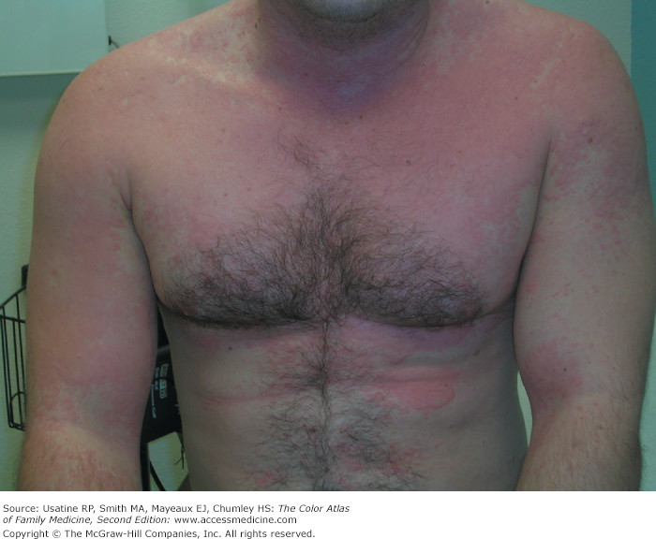
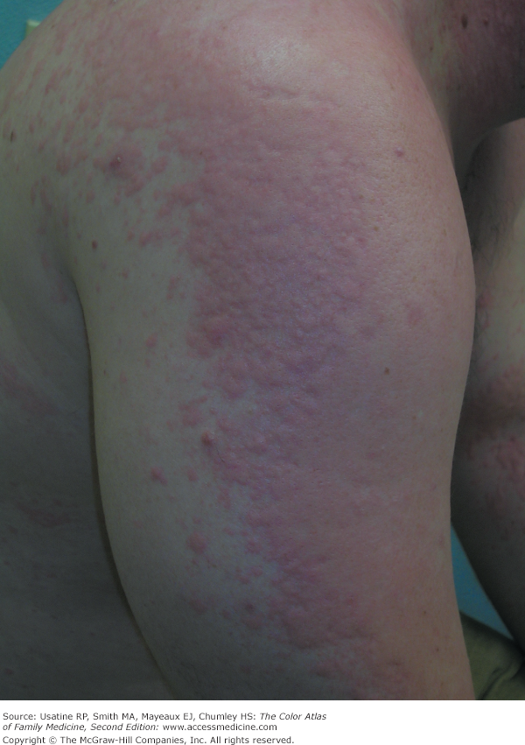

Slide 35
ACIP recommendations regarding persons with egg allergy and influenza vaccination
Persons with a history of egg allergy who have experienced only hives after exposure to egg should receive any of the recommended influenza vaccines appropriate for the recipient’s age and health status. Persons who have had reactions to egg involving symptoms other than hives (e.g., angioedema, respiratory distress, lightheadedness, recurrent emesis) or who required epinephrine or another emergency medical intervention may receive the cell culture–based or recombinant influenza vaccines appropriate for the recipient’s age and health status.

Slide 36
Contraindications to influenza vaccine
Infants younger than 6 months of age.
People who have experienced a severe (life threatening) allergy to a prior dose of a seasonal influenza vaccine (IIV).
People who have a severe allergy to a component of the IIV vaccine.
Health care providers should consult the package insert for vaccine components.
Notes:
Influenza inactivated vaccine ( IIV )

Slide 37
Allergic rhinitis

Slide 38
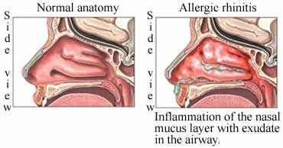
Allergic rhinitis
Definition:
Disease caused by an IgE-mediated inflammatory response of the nasal mucous membranes after exposure to inhaled allergens. Symptoms include rhinorrhea (anterior or posterior nasal drainage), nasal congestion, nasal itching, and sneezing.
Notes:
Th e nasal mucosa is at the entrance to the respiratory tract. It is made up of ciliated epithelium and produces a mucus blanket. Allergic rhinitis primarily occurs in atopic individuals. Atopy is a general increased sensitivity to the production of Immunoglobulin E in response to smallamounts of allergens-typically specific proteins

Slide 39
Classification of allergic rhinitis
AR may be classified by:
(1) the temporal pattern of exposure to a triggering allergen, such as seasonal (eg, pollens), perennial/ year-round (eg, dust mites), or episodic (environmental from exposures not normally encountered in the patient’s environment, eg, visiting a home with pets);
(2) frequency of symptoms.
(3) severity of symptoms.
Classifying AR in this manner may assist in choosing the most appropriate treatment strategies for an individual patient.

Slide 40
WHO CLASSIFICATION OF ALLERGIC RHINITIS
Mild
✓ Normal sleep
✓ No impairment of daily activities, sport, leisure
✓ Normal work and school
✓ No troublesome symptoms
Moderate – Severe :
✓ Abnormal sleep
✓ Impairment of daily activities, sport, leisure
✓ Abnormal work and school
✓ Troublesome symptoms

Slide 41
In order to assess the severity of AR
AR severity can be classified as
1- being mild (when symptoms are present but are not interfering with quality of life) or
2- more severe (when symptoms are bad enough to interfere with quality of life).
Asking the patient about factors that may lead to a more severe AR which include
Notes:
exacerbation of coexisting asthma; sleep disturbance; impairment of daily activities, leisure, and/or sport; and impairment of school performance or work.

Slide 42
Common triggers of allergic rhinitis
Aeroallergens:
Seasonal allergic rhinitis (SAR, hay fever) triggers vary based on location and climate
Common triggers in United States include:
grasses (timothy, Bermuda)
outdoor mold spores (Alternaria, Aspergillus, Cladosporium peak in summer, fall)
weeds (ragweed)
trees (birch, oak, maple, mountain cedar are common triggers)
Perennial rhinitis - common triggers include:
dust mite
indoor molds
animal dander
pollen in some climates
occupational allergens

Slide 43
Conditions associated with allergic rhinitis
-Asthma.
-Eczema (contact dermatitis).
-Allergic conjunctivitis.

Slide 44
When should we order allergy testing?
We should order allergy testing for patients with a clinical diagnosis of AR who do not respond to empiric treatment, or when the diagnosis is uncertain, or when knowledge of the specific causative allergen is needed to target therapy.
Notes:
Blood tests

Slide 45
Treatment for AR
1- Non-pharmacological:
avoidance of known allergens or you may advise environmental controls (eg, removal of pets, the use of air filtration systems, bed covers).
2- Pharmacological therapy:
ORAL ANTIHISTAMINES
Clinicians should recommend oral second-generation/less sedating antihistamines for patients with AR and primary complaints of sneezing and itching e.g. certizine , levocetrizine.
TOPICAL STEROIDS (intra-nasal steroid : for patients with a clinical diagnosis of AR whose symptoms affect their quality of life. ex: triamcinolone , budesonide , fluticasone)

Slide 46
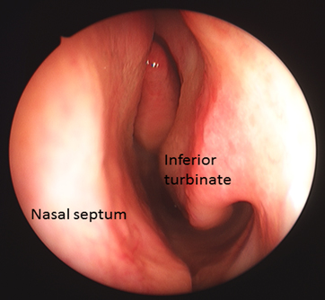
Cont..
INTRANASAL ANTIHISTAMINES for patients with seasonal, perennial, or episodic ex: olopatadine , azelastine
ORAL LEUKOTRIENE RECEPTOR ANTAGONISTS (LTRAs) only AR and asthma patients may benefit from this medication
If the treatment fails or inadequate then refer the patient for:
Immunotherapy or surgical inferior turbinate reduction.

Slide 47
Sore throat
A sore throat refers to pain, itchiness, or irritation of the throat. Patients may have difficulty swallowing food and liquids, and the pain may get worse when they try to swallow.
Pharyngitis is defined as rapid onset of sore throat and pharyngeal inflammation and it is classified into:
Pharyngitis
Nasopharyngitis
Retropharyngeal Abscess
Tonsillitis:
Peritonsillar Abscess
Notes:
often associated
with acute rhinosinusitis as part of an upper respiratory tract infection

Slide 48
Infectious Etiology
The majority of pharyngitis is viral (50-80%) with 15-30% in children and 10% in adults due to GAS. (also called streptococcus pyogenes).
Viral
infuenza virus, parainfuenza virus, rhinovirus,
coronavirus, adenovirus, respiratory syncytial virus, Epstein-Barr virus, coxsackievirus, herpes simplex virus, cytomegalovirus, enteroviruses, HIV primary infection syndrome
Bacterial
group A β-hemolytic streptococcus (GAS)
(Most common), Chlamydia pneumoniae, Mycoplasma pneumoniae, Neisseria gonorrhoeae, Haemophilus in uenzae type b, Corynebacterium diphtheriae, Group C streptococcus, Group G streptococcus, Arcanobacterium haemolyticum, Fusobacterium necrophorum, Treponema pallidum, Francisella tularensis, Yersinia enterocolitica, Yersinia pestis, Chlamydophila psittaci

Slide 49
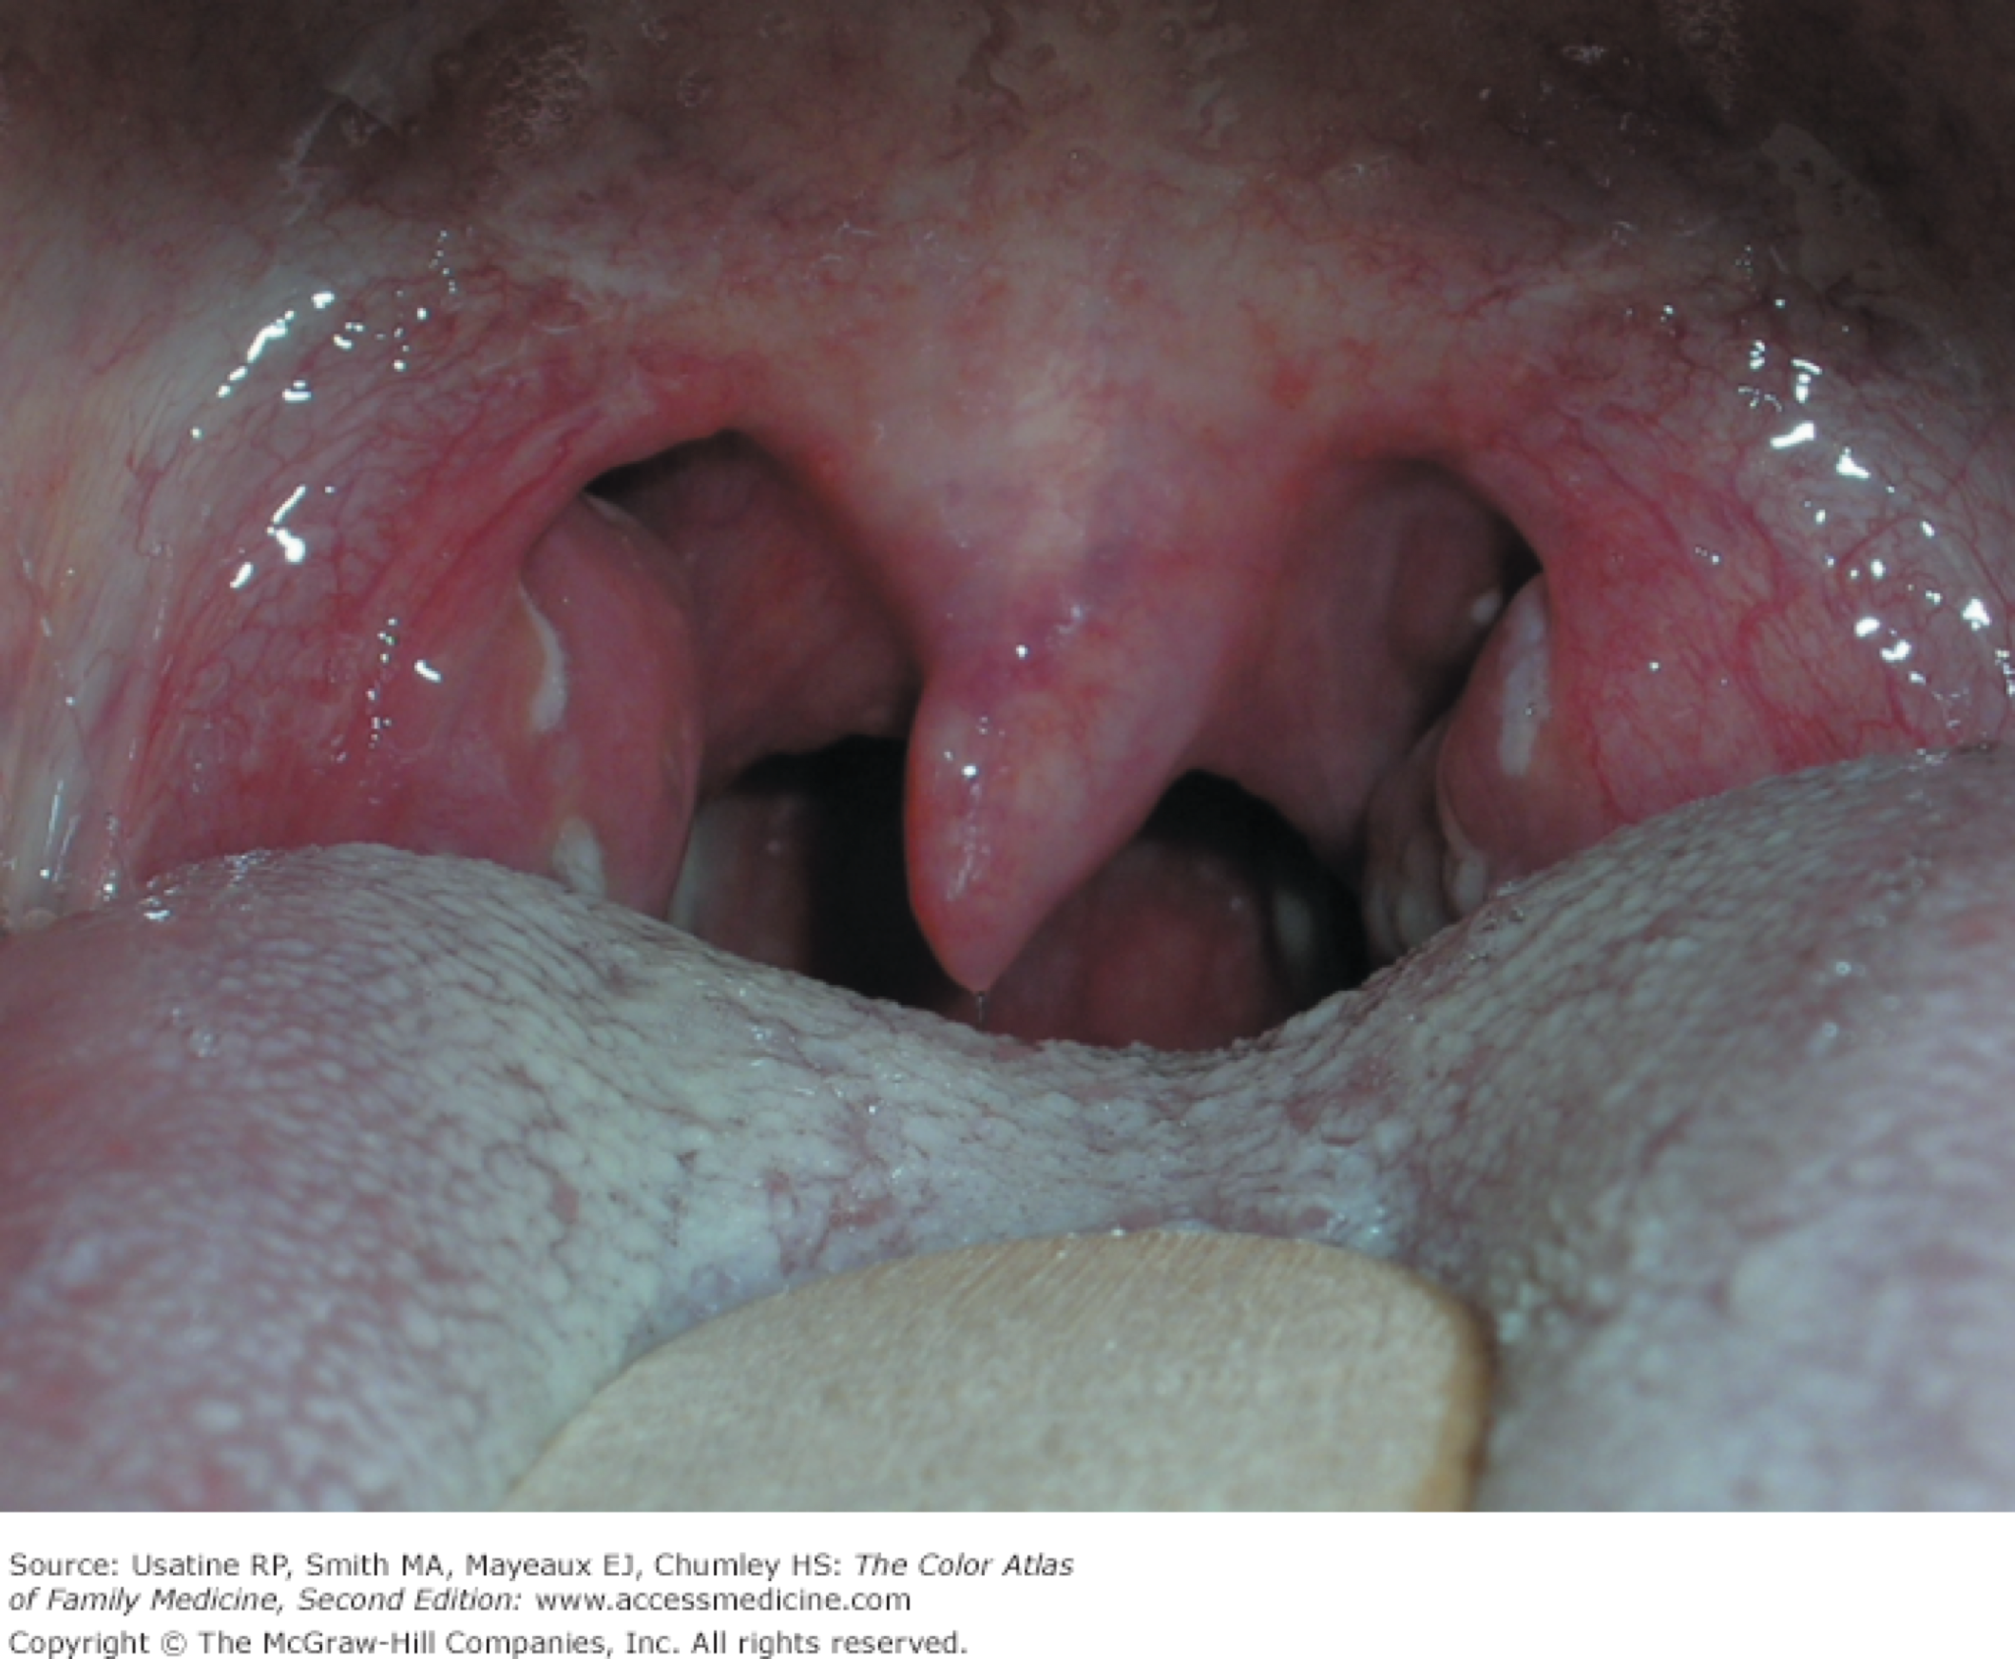
Which age group is primarily affected by GABHS pharyngitis?
Children 5-15.

Slide 50
Non-infectious etiology
Post-nasal drainage due to allergic rhinitis
Sinusitis
Gastroesophageal reflux disease
Acute thyroiditis
Persistent cough

Slide 51
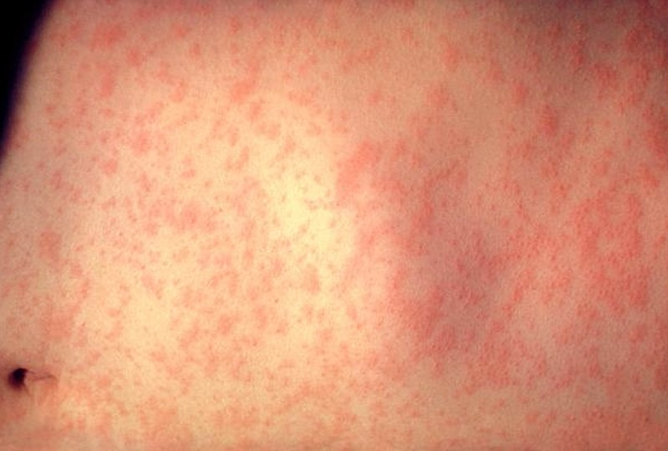
Symptoms and findings suggestive of viral etiology of pharyngitis
Conjunctivitis
Coryza (inflammation of the mucus membranes of the nose)
Cough
Diarrhea
Hoarseness
Discrete ulcerative stomatitis
Viral exanthema

Slide 52
Alarming symptoms
Drooling
Respiratory distress
Inability to open mouth fully (trismus) Muffled voice
Stiff neck
Erythema of neck
History of recent foreign body impaction or oropharyngeal procedure (trauma)
Recent cocaine smoking
Weight loss, fevers, night sweats
Notes:
fever in babies and young children can result in serious complications such as seizures. A stiff neck together with a sore throat are signs of meningitis. Drooling difficulty swallowing

Slide 53
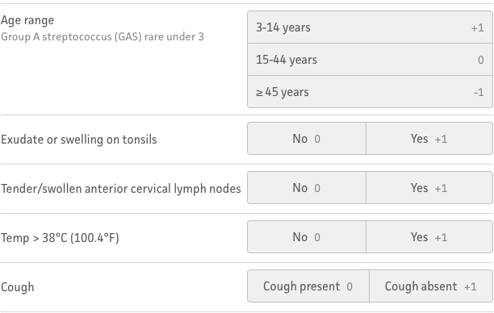
Clinical exam­ination to diagnose group A beta-hemolytic streptococcal pharyngitis
Centor Score (Modified/McIsaac) for Strep Pharyngitis
Can’t be used in <3 years old.
Symptoms onset <3 days.

Slide 54
Test for GABHS Pharyngitis
Throat Culture. Culture of a throat swab on a sheep- blood agar plate has been the standard for the documentation of the presence of GAS pharyngitis
Rapid antigen detection test )RADTs(. A major disadvantage of throat cultures is the delay (overnight or longer) in obtaining results. RADTs have been developed for the identification of GAS pharyngitis directly from throat swabs
A negative RADT should be accompanied by a follow-up or back-up throat culture in children and adolescents, while this is not necessary in adults under usual circumstances

Slide 55
Symptomatic treatment
Symptomatic treatment includes:
Paracetamol
NSAIDs ( be aware of GI and renal side effects, aspirin should be avoided in children)
Corticosteroids (short course for selected cases of adults with centor criteria 3-4 with bacterial pharyngitis)

Slide 56
Antibiotic therapy
Penicillin or amoxicillin is the recommended drug of choice for those non-allergic to these agents (strong, high).
Treatment of GAS pharyngitis in penicillin-allergic individuals should include a first generation cephalosporin (for those not anaphylactically sensitive) for 10 days, clindamycin or clarithromycin for 10 days, or azithromycin for 5 days (strong, moderate).

Slide 57
Complications
Rheumatic fever and its complications including:
60% develop chronic rheumatic heart disease (70% mitral valve; 40% aortic; 10% tricuspid; 2% pulmonary). Likelihood correlates with severity of initial disease Recurrence may occur after further streptococcal infection or be precipitated by pregnancy or combined hormonal contraception
Scarlet fever:
Acute glomerulonephritis

Slide 58
Chronic GABHS carriers
We recommend that GAS carriers do not ordinarily justify efforts to identify them nor do they generally require antimicrobial therapy because GAS carriers are unlikely to spread GAS pharyngitis to their close contacts and are at little or no risk for developing suppurative or non-suppurative complications (e.g. acute rheumatic fever).

Slide 59
Contacts of GABHS Pharyngitis
Diagnostic testing or empiric treatment of asymptomatic household contacts of patients with acute streptococcal pharyngitis is not routinely recommended

Slide 60
Otitis media (OM)

Slide 61
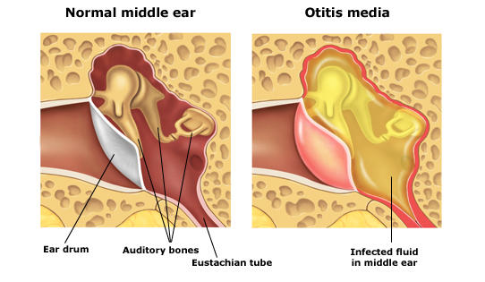
Otitis media (OM)
Acute otitis media is diagnosed in patients with acute onset, presence of middle ear effusion, physical evidence of middle ear inflammation.
-children before school age is most common group affected.

Slide 62
Otitis media (OM)
The 3 most common organisms causing OM
Streptococcus Pneumoniae
Haemophilus Influenzae
Branhamella Catarrhalis
Symptoms associated with OM
Otalgia
Otorrhea
loss of appetite
Irritability
Vomiting
Deafness
Fever
Headache

Slide 63
Diagnosis of OM
An AOM diagnosis requires :
-Moderate to severe bulging of the tympanic membrane
- New onset of otorrhea not caused by otitis externa
- Or mild bulging of the tympanic membrane associated with recent onset of ear pain (less than 48 hours) or erythema.

Slide 64
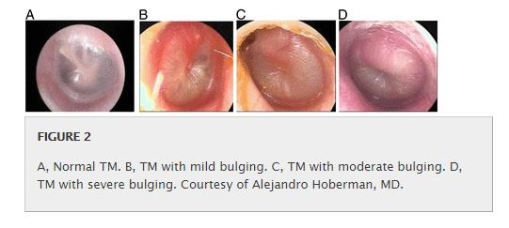

Slide 66
Risk factors of OM
Pediatrics:
Age (younger)
No breastfeeding
Pacifier use
Gastroesophageal reflux
Attending group day care
All age groups:
Allergies
Craniofacial abnormalities
Exposure to environmental smoke or other respiratory irritants
Family history of recurrent acute otitis media
Immunodeficiency
Upper respiratory tract infections

Slide 67
OM with effusion (OME)
OME is defined as middle ear effusion in the absence of acute symptoms.
Which instruments can help diagnose OM & OME?
Pneumatic otoscopy is a useful technique for the diagnosis of AOM and OME

Slide 68
Treatment of OM
1- Symptomatic treatment.
Analgesics e.g Ibuprofen and acetaminophen are recommended for symptoms of ear pain, fever, and irritability.
2- Treatment with antibiotic.

Slide 69
Conditions which should be treated with antibiotic !
1-Children six months or older with otorrhea or severe signs or symptoms (moderate or severe otalgia, otalgia for at least 48 hours, or temperature of 102.2°F [39°C] or higher): antibiotic therapy for 10 days.
2-Children six to 23 months of age with bilateral acute otitis media without severe signs or symptoms: antibiotic therapy for 10 days

Slide 70
We have a choice whether to start antibiotic therapy :or observation in the following conditions
1-Children six to 23 months of age with unilateral acute otitis media without severe signs or symptoms.
2-Children two years or older without severe signs or symptoms

Slide 71
If observation was chosen, what are the mechanisms that must be in place to ensure appropriate treatment if symptoms persist for more than 48 to 72 hours?
1-Repeat ear examination for signs of otitis media
-If otitis media is present, initiate or change antibiotic therapy
-If symptoms persist despite appropriate antibiotic therapy,
consider intramuscular ceftriaxone (Rocephin), clindamycin, or tympanocentesis

Slide 72
Antibiotic selection for OM :
High-dose amoxicillin is the antibiotic of choice for OM.
Oral cephalosporins, such as cefuroxime (Ceftin), may be used in children who are allergic to penicillin.
a common side effect to antibiotic treatment of OM is diarrhea.

Slide 73
If symptoms persist 48-72 hours after initiating therapy :
1- Re-examination: If a bulging, inflamed tympanic membrane is observed, therapy should be changed to a second-line agent
a- For children initially on amoxicillin, high-dose amoxicillin/clavulanate is recommended.
b- For children initially on oral cephalosporin, intramuscular ceftriaxone, clindamycin, or tympanocentesis may be considered.

Slide 74
Tympanostomy:
Tympanostomy tubes can be considered for recurrent OM in the following :
three or more episodes in six months, or four episodes within 12 months with at least one episode during the preceding six months.

Slide 75
Strategies for Preventing Recurrent Otitis Media:
-Check for undiagnosed allergies leading to chronic rhinorrhea
-Eliminate bottle propping and pacifiers.
-Eliminate exposure to passive smoke.
-Routinely immunize with the pneumococcal conjugate and influenza vaccines.
-Use xylitol gum in appropriate children (two pieces, five times a day after meals and chewed for at least five minutes).

Slide 76
Important complications of OM
-Anatomic damage
- Hearing loss
-Language delay
-Periauricular abscess
-Facial nerve paresis
-Labyrinthitis
-Labyrinthine fistula
-Temporal abscess
-Intracranial abscess
-Meningitis
-Sigmoid sinus thrombosis
-Cerebrospinal fluid (CSF) leak
Mastoiditis (most common serious complication of AOM in children)

Slide 77
Questions
Which type of influenza virus is capable of infecting animals:
A. Type A.
B. Type B.
C. Type C.
D. All of the above.
Which food allergy you should ask about before giving influenza vaccine:
A. Peanuts.
B. Sesame seeds.
C. Eggs.
D. Milk products.
Which of the following conditions is associated with allergic rhinitis :
A. COPD.
B. Asthma.
C. Dermatitis.
D. Bronchiectasis.

Slide 78
Cont..
What is the most common organism associated with Pharyngitis
A. Group A streptococcus (GAS).
B. Chlamydia pneumoniae.
C. Mycoplasma pneumoniae.
D. Neisseria gonorrhoeae.
What is a common side effect of antibiotic treatment in otitis media?
A. Diarrhea.
B. Vomiting.
C. Otorrhea.
D. Drug eruption.

Slide 79
References
Oxford GP handbook
AFP journal
IDSA guidelines
MOH MERS CoV guidelines

Slide 80
Thank you

