Slide 1
Approach to Obese patient

Slide 2
Objectives
Define obesity and classify the degree of obesity “BMI, Waist circumference and Waist to Hip ratio”.
Highlight the prevalence of obesity in Saudi Arabia.
Discuss how to prevent obesity in the community.
Discuss the common causes of obesity in the community.
Morbidity “common health problems due to obesity”
Discuss the evidence based approach to decrease weight “Exercise, Dieting, Drug treatment, and Bariatric Surgical Intervention”.
Role of health team, medical students and school health in dealing with obesity in the community

Slide 3
Quiz
What is the cause of Obesity?
Unhealthy diet.
Genetics.
Low physical activity.
All of the above.

Slide 4
Quiz
Which of the following records considered as morbid obesity?
BMI of 26.9 kg/m2
BMI of 34 kg/m2
BMI of 41.5 kg/m2
BMI 39.7 kg/m2

Slide 5
Quiz
Which of the not considered a secondary approach?
Surgery
Exercise
Medication
Self induced vomiting

Slide 6
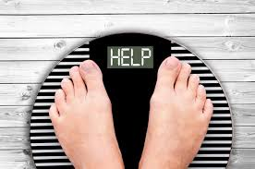
Obesity
Excessive fat accumulation in the body and major risk factor for many chronic illness

Slide 7
How to measure it
You can use:
BMI
Waist circumference
Waist to hip ratio

Slide 8
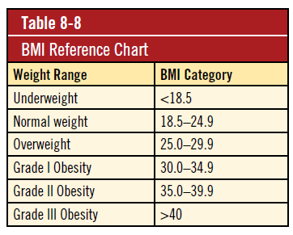
BMI
The best measure of obesity is body mass index (BMI).
BMI = (weight in kg ÷ (height in m)2)
“Class III = Morbid obesity”

Slide 9
Waist Circumference
An alternative measure.
Halfway between the superior iliac crest and the rib cage.
Used in addition to BMI to aid assessment of health risks.
If you are a woman:
your risk is increased at 80 cm or more
your risk is high at 88 cm or more
If you are a man:
your risk is increased at 94 cm or more
your risk is high at 102 cm or more
For every 1 cm increase in waist circumference, the RR of a CVD event increase by 72%.

Slide 10
Waist to Hip ratio
This is calculated as waist measurement divided by hip measurement (W/H).
For example, a person with a 25" waist and 38" hips has a waist-hip ratio of about 0.66.
Out of the previous methods of classifications of obesity, waist-hip ratio was found to have the strongest correlation with total and cardiovascular disease mortality

Slide 11
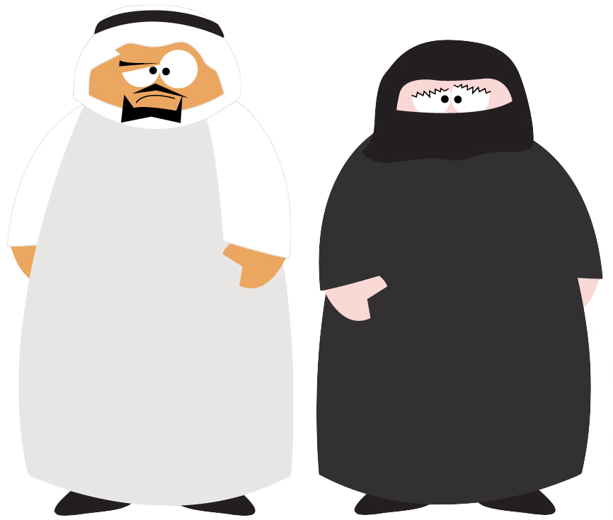
Saudi Arabia

Slide 12
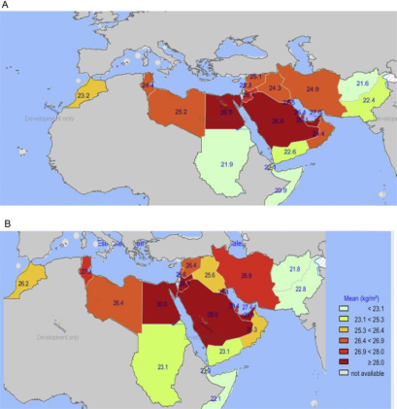
The prevalence in KSA
Males
According to WHO , the prevalence in KSA is 24% male , 36% female.
Another study done in KSA 2014 :
Male 24%
Female 33.5%
Females

Slide 13
Causes of Obesity
Genetics
Multiple factors including genetic makeup, environment and behavior can cause weight gain and obesity which can lead to progressive weight gain including unsuccessful weight loss despite effort with diet and exercise
Environmental
Behavior

Slide 14
Causes of Obesity
Most common causes according to MOH are as following:
family history
Diet or food style either for individual or families
Sedentary lifestyle.
Some medications such as: TCAs.
Sleep disturbance
Low education
Aging or being older
Marital status
Pregnancy
some diseases like: Cushing's syndrome, hypothyroidism and other medical conditions which leads difficulties in daily activities like osteoarthritis.

Slide 15
How to Prevent Obesity ?

Slide 16
Obesity Comorbidities
DM : T2DM
Dyslipidemia : Reduction in serum (HDL) cholesterol of about 5%.
Heart diseases:
Coronary disease.
Heart failure.
MI.
Atrial fibrillation/flutter.
Skin changes:
Stretch marks (striae)
Acanthosis nigricans.
Hirsutism.

Slide 17
Obesity Comorbidities
Colon CA.
Gallstones.
Sleep apnea.
Gout and gouty arthritis.
Osteoarthritis “Knee”
Psychological complications “suicide”

Slide 18
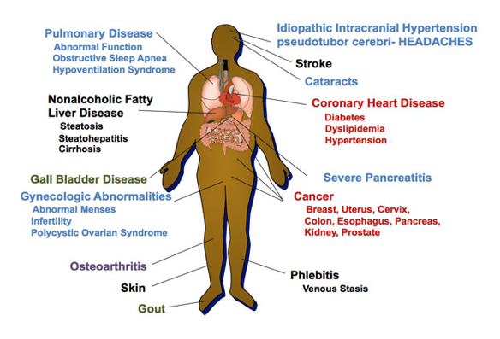
Obesity Comorbidities

Slide 19
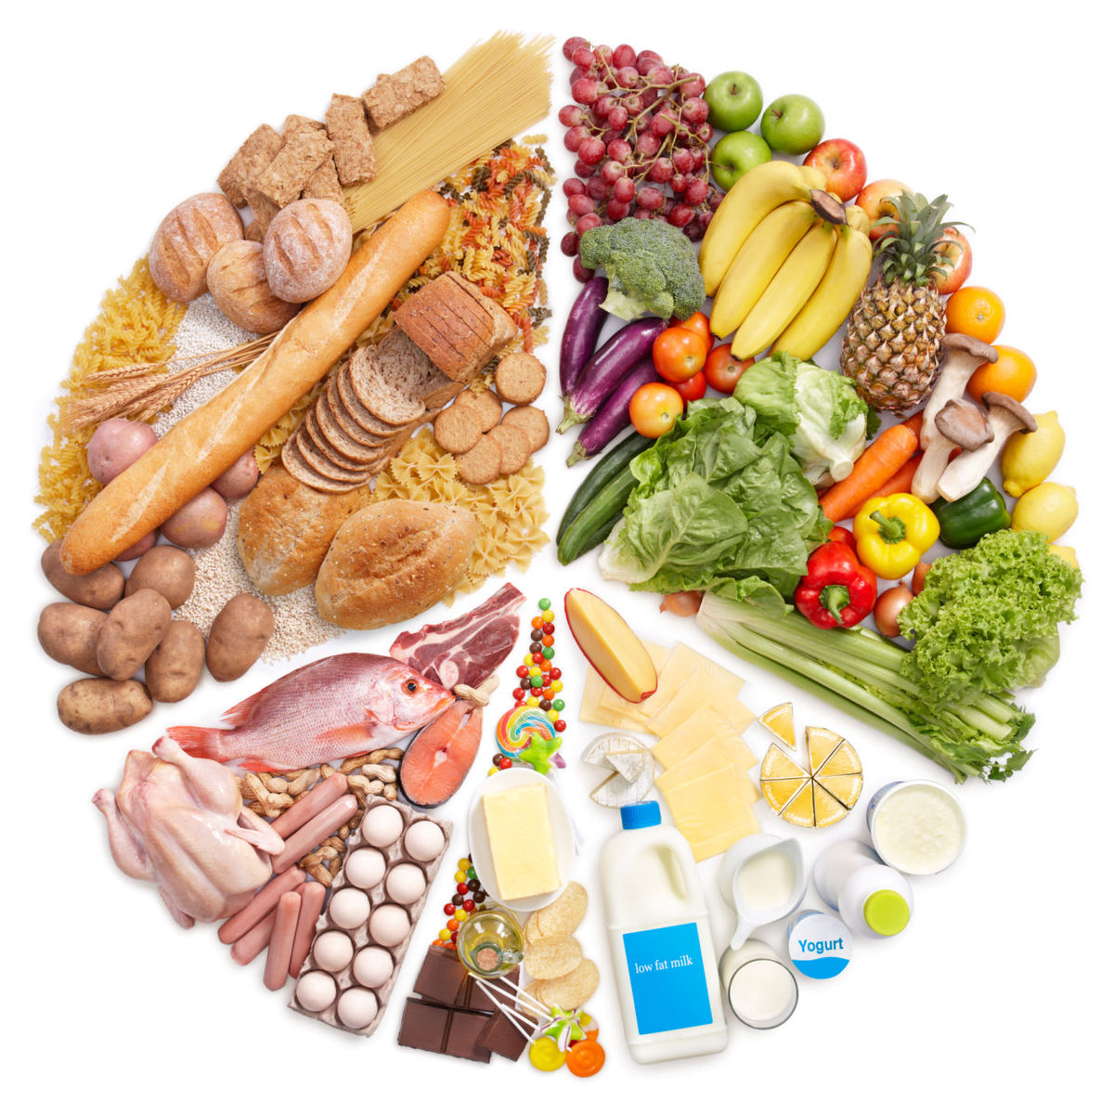
Primary Prevention
Focusing on healthy lifestyle behaviors related to maintaining normal weight.
Healthy diet contains:
Fruits, vegetables, legumes (e.g. lentils, beans), nuts and whole grains.
Less than 10% of total energy intake from free sugars.
Less than 30% of total energy intake from fats.
Unsaturated fats (e.g. found in fish, nuts) are preferable to saturated fats (e.g. found in fatty meat, butter, cheese).
Industrial trans fats (found in processed food, fast food, snack, frozen pizza) are not part of a healthy diet.
Less than 5 g of salt/day and use iodized salt.

Slide 20
Primary Prevention
Exercising and active life style:
Walk and exercise for 30 minute or more, 5 days a week.
Get enough sleep at night.
Cessation of smoking.
Avoid social and psychological stresses.
Long term observation for what you eat and drink.

Slide 21
5‑2‑1‑0 message
Encourage intake of daily 5 rations of fruits and vegetables
Include at least 1 hour or more of active play every day
5
1
2
0
Encourage eating with the child in a sociable atmosphere , separate eating from other activities and keep recreational screen time to <2 hour
Skip sugar‑sweetened beverages and drink more water every day

Slide 22
Primary Prevention
For children :
Change family eating habits and activity levels.
Reduce time spent in front of TV , computer and mobiles.
Avoid using food as a reward.

Slide 23
Assessing Weight History
Age of onset
Family history
Any history or symptoms of eating disorder (binge eating)
Unhealthy weight loss (misuse of laxatives, self-induced vomiting)
Is weight stable and for how long
What have been the maximum and minimum weight
Any attempt to lose weight what was it and did it work
If not ask why
If yes ask did you maintain
Does they understand the triggers
Any medication to lose wight
Any surgry to lose weight
Have they seen a professionals for weight loss

Slide 24
The 5As Approach
Ask and assess __ current lifestyle behavior and body mass index, comorbidities and other factors related
Advise __ promote the benefits of healthy lifestyle and explain the benefits of weight management
Assist __ develop a weight management program that includes lifestyle interventions tailored to the individual and plan for review and monitoring
Arrange __ regular follow-up visits, referral as required and support

Slide 25
How to Treat?
Lifestyle Modification
Pharmacotherapy
Surgery

Slide 26
Secondary prevention
Exercise:
Weight loss is greater in diet plus exercise regimens than in diet-only regimens. Exercise regimens alone, without reduced-calorie diets, are not effective for weight loss.
Moderate physical exercise is introduced with 3 sessions per week, 30 minutes per session, then later increased, as tolerated.
Example:
walking at 3 miles per hour (350 kcal/hour).
bicycling on level ground at 10 to 12 miles per hour (600 kcal/hour).

Slide 27
Secondary prevention
Dieting:
At 6-month follow-up, the low-carbohydrate/high-protein diet has been found to produce greater weight loss than the low-fat diet, and patients seemed to prefer the low-carbohydrate/high-protein diet.
Adherence to the diet (i.e., compliance) and the reliability of patient reporting of caloric intake have been problematic in studies on dietary intervention.
Reduce consumption of junk food
Eat 500 to 1,000 fewer calories each day.

Slide 28
Secondary prevention
Psychological/behavioral interventions
Psychological interventions should be part of any weight management program.
It should be adjusted to circumstances of the individuals or their families.

Slide 29
Secondary prevention
Drug treatment:
When to use?
Failure of diet and exercise
BMI > 30
BMI > 27 and associated with medical problems related to obesity
Orlistat have modest effectiveness (about 5% loss in body weight) when combined with diet and exercise alone, but mild gastrointestinal side effects are common.

Slide 30
Secondary prevention
Drugs:
Primary options:
Orlistat: Patients usually complained from oily stools and fecal incontinence.
Secondary options:
Lorcaserin.
Liraglutid
Naltrexone/bupropion hydrochloride
Tertiary options (not preferable):
Phentermine.

Slide 31
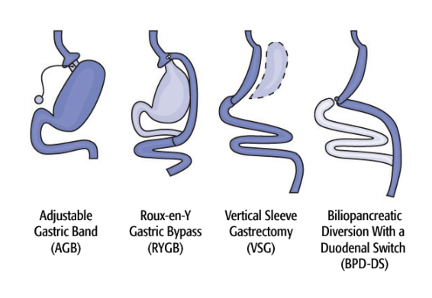
Secondary prevention
Indications for surgery:
Failure of conservative treatment
BMI > 40 (morbidly obese)
BMI ≥35 kg/m2 with obesity-related comorbidity (e.g., hypertension, diabetes, sleep apnea, GORD) may be candidates for most bariatric procedures.
Adjustable Gastric Banding is the most commonly used surgery

Slide 32
Tertiary prevention
TREATMENT OF COMPLICATIONS :
• Slowing the progression to more severe form of obesity
• Reducing the likelihood of associated musculoskeletal, metabolic, or vascular disorders (e.g., osteoarthritis, diabetes, or cardiovascular disease).

Slide 33
Our Role

Slide 34
The Health Team
The physical activity and eating behaviors that affect weight are influenced by many sectors of society, including families, community organizations, health care providers, faith-based institutions, businesses, government agencies, the media, and schools.
The involvement of all of these sectors will be needed to reverse the epidemic.

Slide 35
The Health Team and medical students
Health professionals have an important role in promoting preventive measures and encouraging positive lifestyle Behaviors “ awareness of the population” ..
Also have a role in counseling patients about safe and effective weight loss and weight maintenance programs.

Slide 36
At Schools
Schools cannot solve the obesity epidemic on their own as well .
School can also help address obesity by providing:
Screening
Health information
Referrals to students
The Role of Schools in Obesity Prevention:
More nutritious food
Physical activity
Health services.
Health education

Slide 37
Quiz
What is the cause of Obesity?
Unhealthy diet.
Genetics.
Low physical activity.
All of the above.

Slide 38
Quiz
Which of the following records considered as morbid obesity?
BMI of 26 kg/m2
BMI of 30 kg/m2
BMI of 41 kg/m2
BMI 38 kg/m2

Slide 39
Quiz
Which of the not considered a secondary approach?
Surgery
Exercise
Medication
Self induced vomiting

Slide 40
Our Massage
The best measure of obesity is body mass index (BMI).
The prevalence in KSA is high among both genders.
Obesity is a multifactorial condition “ Genetic, environment and behavior”.
Obesity is associated with comorbidities “ DM,HTN..etc”.
The prevention and management start by diet and physical activity.
The involvement of all of society sectors will be needed to reverse the epidemic.

Slide 41
References
Oxford handbook of general practice
Obesity Saudi Guidelines :
http://www.saudijobesity.com/article.asp?issn=2347-2618;year=2013;volume=1;issue=1;spage=18;epage=30;aulast=Al-Shehri
http://bestpractice.bmj.com/best-practice/monograph/211/treatment/details.html#expsec-5
https://www.ncbi.nlm.nih.gov/pmc/articles/PMC4193060/
WHO website

Slide 42
THANK YOU...

