Slide 1
Diabetes Mellitus
Dr Abdullah Alrasheed MBBS, SBFM, DM (UniSyd)
Assistant Professor and Consultant in
Family Medicine, and Diabetes Management
King Saud University, Riyadh, Saudi Arabia.

Slide 2
Diabetes
What is the definition of diabetes?
A group of metabolic disorders that share the phenotype of hyperglycemia.

Slide 3
Genetic predisposition
Insulin Resistance
(Hyperinsulinemia)
β Cell
Defect
IGT
Type 2 Diabetes
Usually 50% of β cells are functioning at time of diagnosis

Slide 4
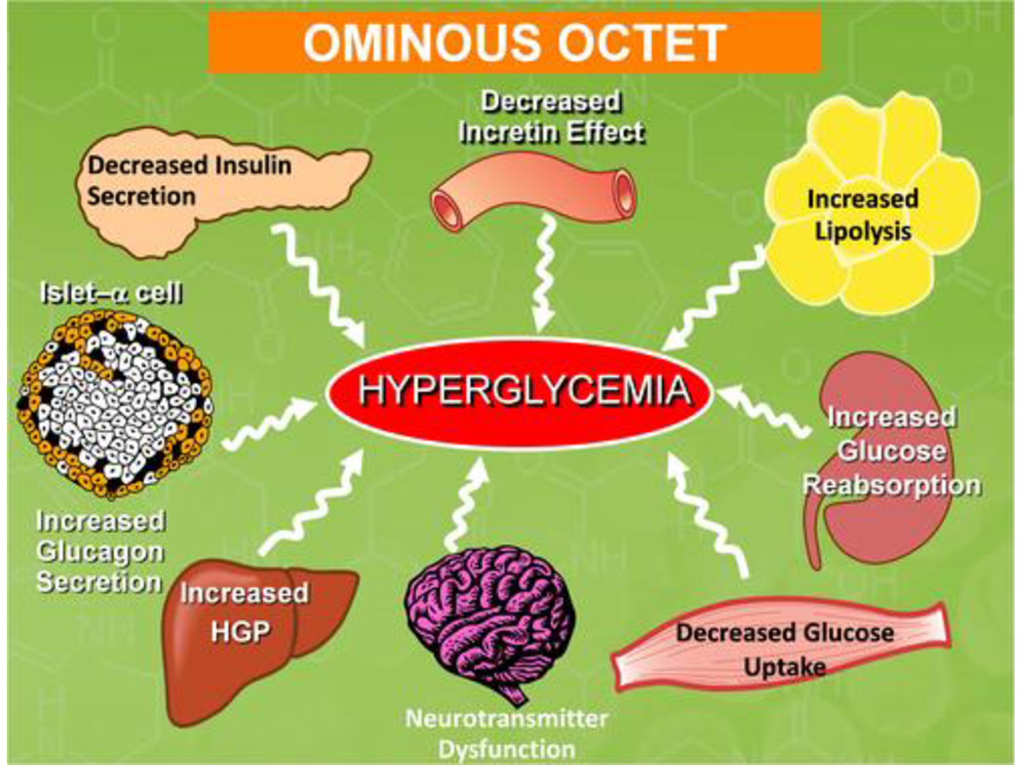

Slide 5
CLASSIFICATION
Type 1 diabetes (absolute insulin deficiency)
Type 2 diabetes (insulin resistance with relative insulin def.)
Gestational diabetes mellitus
Other types (genetic or secondary types)

Slide 6
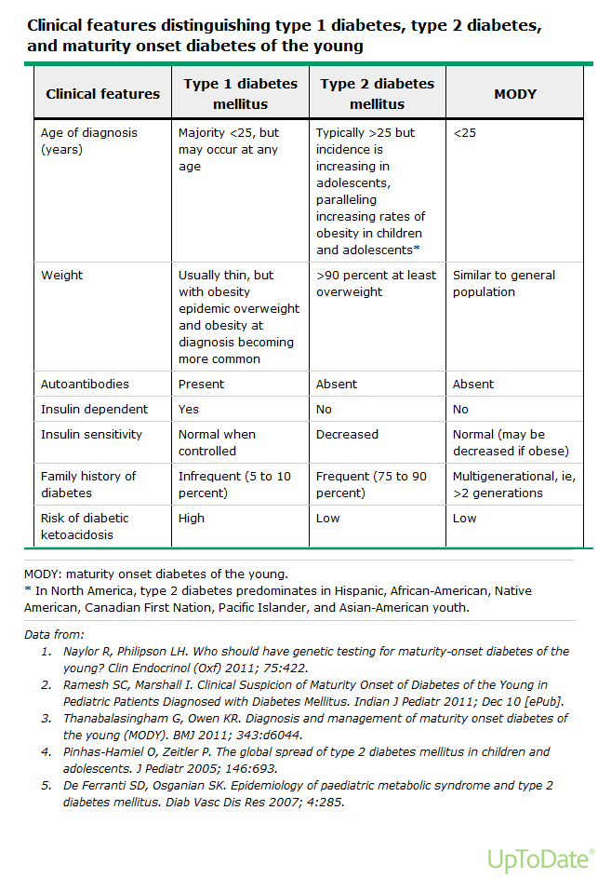
Clinical features type 1 diabetes, type 2 diabetes and MODY.

Slide 7
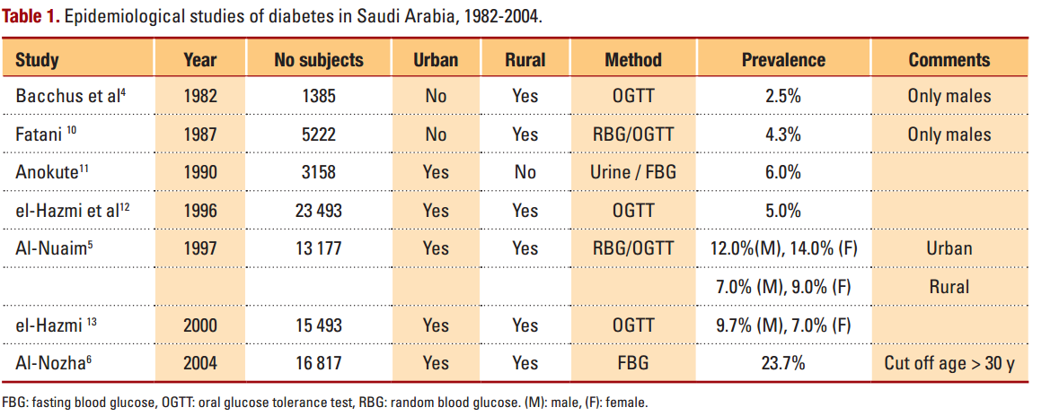
Prevalence of DM in Saudi Arabia
Elhadd TA, Al-Amoudi AA, Alzahrani AS. Epidemiology, clinical and complications profile of diabetes in Saudi Arabia: a review. Annals of Saudi medicine. 2007 Jul 1;27(4):241.

Slide 8
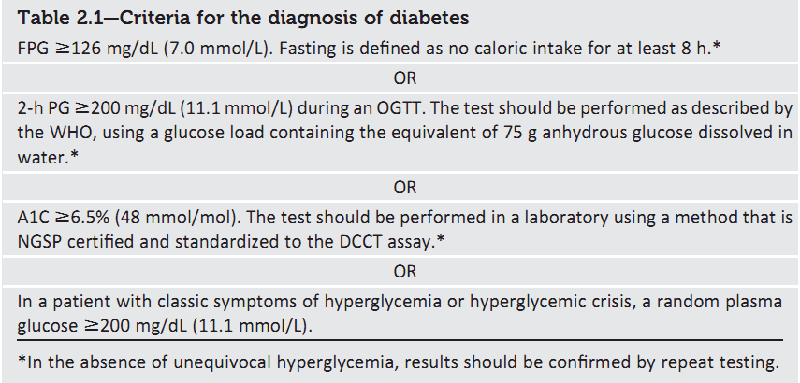
Diagnosis

Slide 9
No clear clinical diagnosis?
Immediately repeat the same test using a new blood sample.
Different tests above diagnostic threshold?
Diagnosis confirmed.
Discordant results from two separate tests?
Repeat the test with a result above diagnostic cut-point.

Slide 10
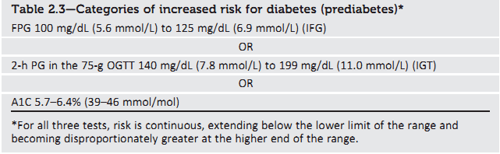
Prediabetes
To test for prediabetes, all these tests are equally appropriate.

Slide 11
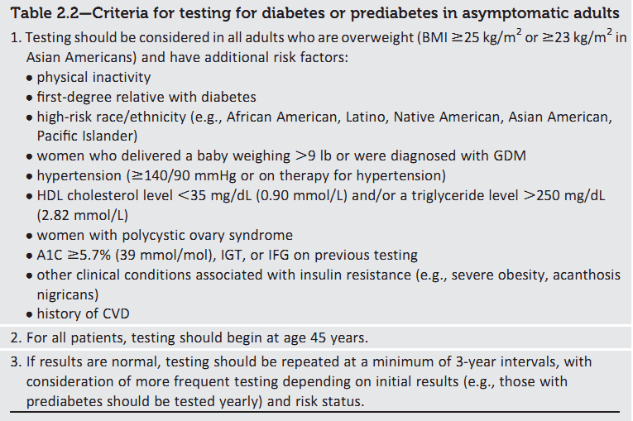
Screening for diabetes

Slide 12
Screening for and diagnosis of GDM
One-step strategy
Perform a 75-g OGTT, at 24–28 weeks of gestation in women not previously diagnosed with overt diabetes.
Any of the following plasma glucose values are met or exceeded:
Fasting: 92 mg/dL (5.1 mmol/L)
1 h: 180 mg/dL (10.0 mmol/L)
2 h: 153 mg/dL (8.5 mmol/L)
Two-step strategy
Step 1: a 50-g GLT (nonfasting), with plasma glucose measurement at 1 h, at 24–28 weeks of gestation in women not previously diagnosed with overt diabetes.
If the plasma glucose level measured 1 h after the load is ≥140 mg/dL* (7.8 mmol/L), proceed to a 100-g OGTT.

Slide 13
Step 2: The 100-g OGTT (fasting).
At least two of the following four plasma glucose levels are met or exceeded:
Carpenter/Coustan or NDDG
Fasting 95 mg/dL (5.3 mmol/L) 105 mg/dL (5.8 mmol/L)
1 h 180 mg/dL (10.0 mmol/L) 190 mg/dL (10.6 mmol/L)
2 h 155 mg/dL (8.6 mmol/L) 165 mg/dL (9.2 mmol/L)
3 h 140 mg/dL (7.8 mmol/L) 145 mg/dL (8.0 mmol/L)

Slide 14
GDM
With one-step strategy, the incidence of GDM will 5–6% to 15–20%.
Note that 80–90% of women with GDM could be managed with lifestyle therapy alone.
Screen women with GDM for persistent diabetes at 6–12 weeks postpartum using OGTT.
Women with a history of GDM should have lifelong screening at least every 3 years.

Slide 15
Prediabetes
Persons with an A1C of 5.7–6.4%, IGT, or IFG should be counseled on lifestyle changes.
Three large studies of lifestyle intervention has shown sustained reduction in the rate of conversion to type 2 diabetes,
43% reduction at 20 years in the Da Qing study.
43% reduction at 7 years in the Finnish Diabetes Prevention Study (FDPS).
34% reduction at 10 years in the U.S. Diabetes Prevention Program Study (DPPS) .
A consensus panel felt that Metformin should be the choice of drug considered .

Slide 16
When to add Metformin in pre-diabetes?
In addition to lifestyle counseling, Metformin is considered in IFG plus:
Hypertension
Low HDL cholesterol
Elevated triglycerides
Family history of diabetes (first-degree relative)
Obese
HX of GDM
Under 60 years of age

Slide 17
Approach to Management
Diabetes management is a team work
Individualize management
Set Target goals
  Glycaemic Targets
  BP goals
  Lipid goals
Education
Is associated with increased use of primary and preventive services and lower use of acute, inpatient hospital services.

Slide 18
PHYSICAL EXAMINATION
Height and Weight (BMI)
Blood Pressure (2 readings)
Fundus Examination ( Hard and soft exudates, new vessel formation, macular oedema….)
Cardiac examination
Lower Limbs:
■ Skin Examination
■ Evaluation of pulses
■ Foot Examination
■ Neurologic Examination

Slide 19
LABORATORY EVALUATION
FPG and 2 hr PP
Midstream Urine (for Ketones, protein, pus cells,…)
Urea and Creatinine
Lipid Profile (total cholesterol, LDLc, HDLc and triglycerides)
HbA1C (every 3 m for insulin / every 6 m for controlled)
Test for Microalbuminuria or
Albumin to creatinine ratio / 24 hr urine collection for protein / Creatinine Clearance
ECG
Chest X-Ray

Slide 20
Yearly Check Up:
Investigations
HbA1C
Urea and Creatinine
Lipid Profile (Cholesterol, Triglyceride, LDL-C and HDL-C)
Albumin to creatinine ratio / 24 hour urine collection for protein (Microalbuminuria 30 -<300 mg while Macroalbuminyria ≥ 300 mg).
Check :
Eye: Fundus Examination / eye referral
Feet : Visual inspection and Neurovascular status

Slide 21
Current Treatment Goals for Glycaemic Control
 | ADA¹ | ACE²
HbA1c | < 7.0% (general goal) | ≤ 6.5%
Preprandial plasma glucose | 70–130 mg/dL (3.9–7.2 mmol/L) | < 110 mg/dL (< 6.1 mmol/L)
Postprandial plasma glucose | < 180 mg/dL (< 10.0 mmol/L) | < 140 mg/dL (< 7.8 mmol/L)
ACE=American College of Endocrinology; ADA=American Diabetes Association; HbA1c=hemoglobin A1c;
Adapted from: ¹ADA / EASD consensus statement: Nathan DM, et al. Diabetes Care. 32:193–203;
²American Association of Clinical Endocrinologists, American College of Endocrinology. Endocr Pract. 2002; 8 (Suppl 1): 5–11;
Notes:
21
Current Treatment Goals for Glycemic Control
This slide reviews the treatment guidelines for diabetes recommended by the American Diabetes Association (ADA), the American College of Endocrinology (ACE), and the International Diabetes Federation (IDF).
In terms of HbA1c, the ADA recommends a goal of <7.0%¹. The ADA / European Association for the Study of Diabetes consensus guidelines point out that this goal is not appropriate or practical for some patients, and clinical judgment based on the potential benefits of and risks for a more intensified regimen needs to be applied for every patient. Factors such as life expectancy, risk for hypoglycemia, and the presence of cardiovascular disease need to be considered for every patient before intensifying the therapeutic regimen¹.
In contrast, ACE and IDF recommend a goal of <6.5% for all patients (ACE: upper limit of normal = 6.0%). Both groups base their recommendation on the epidemiologic analysis of the UK Prospective Diabetes Study data² which showed that the risk for both microvascular and macrovascular complications of diabetes increased at HbA1c values ≥6.5%.^{3,4}
For preprandial glucose, the ADA recommends a therapeutic target of 5.0–7.2 mmol/L
(90–130 mg/dL), whereas ACE and IDF suggest using <6.0 mmol/L (<110 mg/dL) as the target.^{1,3–4}
The ADA and IDF recommend that patients test their postprandial glucose (PPG) levels 1–2 hours after a meal. The ADA advises that PPG values not exceed a peak value of 10.0 mmol/L
(180 mg/dL), while the IDF recommends <8.0 mmol/L (<145 mg/dL).^{1,4} ACE suggests that PPG measurements be taken 2 hours after a meal and that the value should be <7.7 mmol/L
(<140 mg/dL).³ ACE and IDF base their recommendations on the increased cardiovascular risk associated with glucose values above these levels, as well as the fact that in the nondiabetic population, PPG levels rarely exceed 7.7 mmol/L (140 mg/dL).^{3,4}
References
Nathan DM, et al. Medical management of hyperglycemia in type 2 diabetes: a consensus algorithm for the initiation and adjustment of therapy. Diabetes Care. 2009; 32:193–203.
Stratton IM, et al. Association of glycaemia with macrovascular and microvascular complications of type 2 diabetes (UKPDS 35): prospective observational study. BMJ. 2000; 321: 405–412.
American Association of Clinical Endocrinologists, American College of Endocrinology. American College of Endocrinology Consensus Statement on Guidelines for Glycemic Control. Endocr Pract. 2002; 8(suppl 1):
5–11.
International Diabetes Federation. Global Guidelines for Type 2 Diabetes. Brussels: International Diabetes Federation; 2005.

Slide 22
Glycemic Targets
Blood Glucose Targets for Non-Pregnant Adults With Diabetes
A1C <7.0% (53 mmol/L)
Preprandial capillary PG 80-130 mg/Dl (4.4-7.2 mmol/L)
Peak postprandial capillary PG <180 mg/dL (10.0 mmol/L)
Pregnant Adults With Diabetes
Fasting =<95 mg/dL (5.3 mmol/L)
Two-hour postprandial =<120 mg/dL (6.7 mmol/L)

Slide 23
HbA1C values are influenced by red cell survival:
Falsely high values in patients with iron, vitamin B12, or folate deficiency anemia.
Falsely low values in patients with hemolysis or anemia and those treated for iron, vitamin B12, or folate deficiency, and patients treated with erythropoietin.

Slide 24
Life Style Modification
For all patients, advise for
Weight Management (in overweight/obese
patients can improve insulin sensitivity targeting a loss of 7% of body weight )
Exercise (walking 150 mins / week)
Diet (Provided by a Dietitian)
Can reduce HbA1C by 1-2%
Problems
  Poor adherence over time

Slide 26
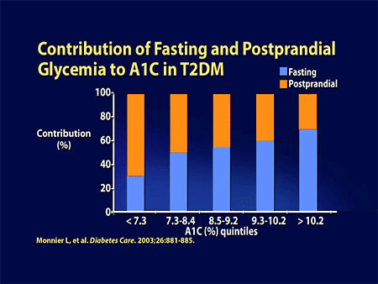

Slide 27
Effects on fasting vs post-prandial BGLs
Mainly post-prandial control | Mainly fasting control
SU | Metformin
DPP-4i | TZDs
SGLT-2i | Long Acting GLP-1
Acarbose | Basal insulin
Short acting GLP-1
Prandial insulin
Don’t just choose things from one column

Slide 28
Life Style +Metformin
A1C > 7 %
Add on Oral Medication
Sulphonylurea
Glibenclamide
Gliclazide MR
DPP4 inhibitor
Sitagliptin (Januvia)
100 mg OD
TZD
Pioglitazone
15 -30 mg OD
Acarbose
PP Hyperg
50-100 mg TDS
Hypoglycemia
Weight gain
?Durability
?Long term risks
Weight gain
Fluid retention
Fractures
Flatulence
Diarrhoea

Slide 29
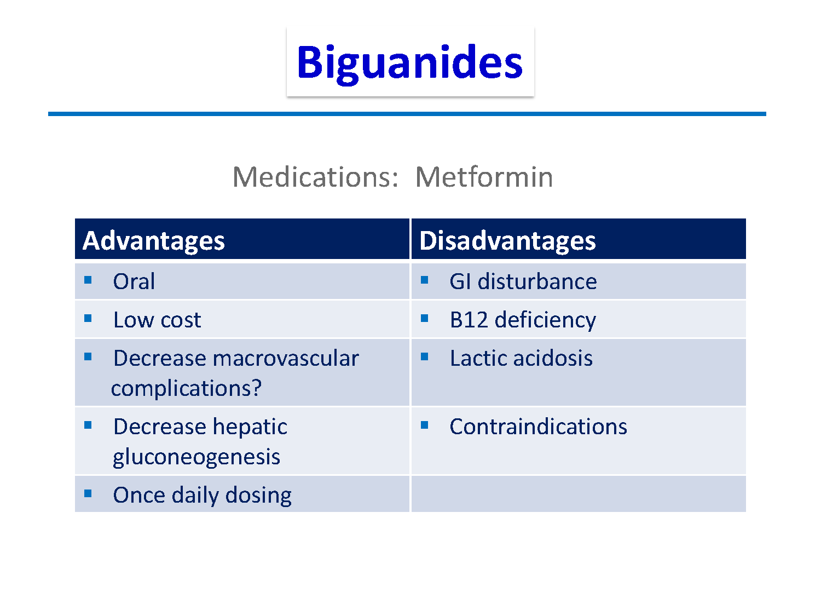

Slide 30
Metformin
Effective & well validated therapy
Choice as initial therapy
Acts by reducing hepatic glucose production (main)
Other
  Reduces appetite & may delay absorption
  Improves peripheral insulin sensitivity
No hypoglycemia and mild weight loss
Side effects : B12 deficiency , GI , lactic acidosis.
C/I ,, What??
Start with 500 mg once or twice per day with meals and increase every few days till reach maximum dose of 2 gm per day.

Slide 31
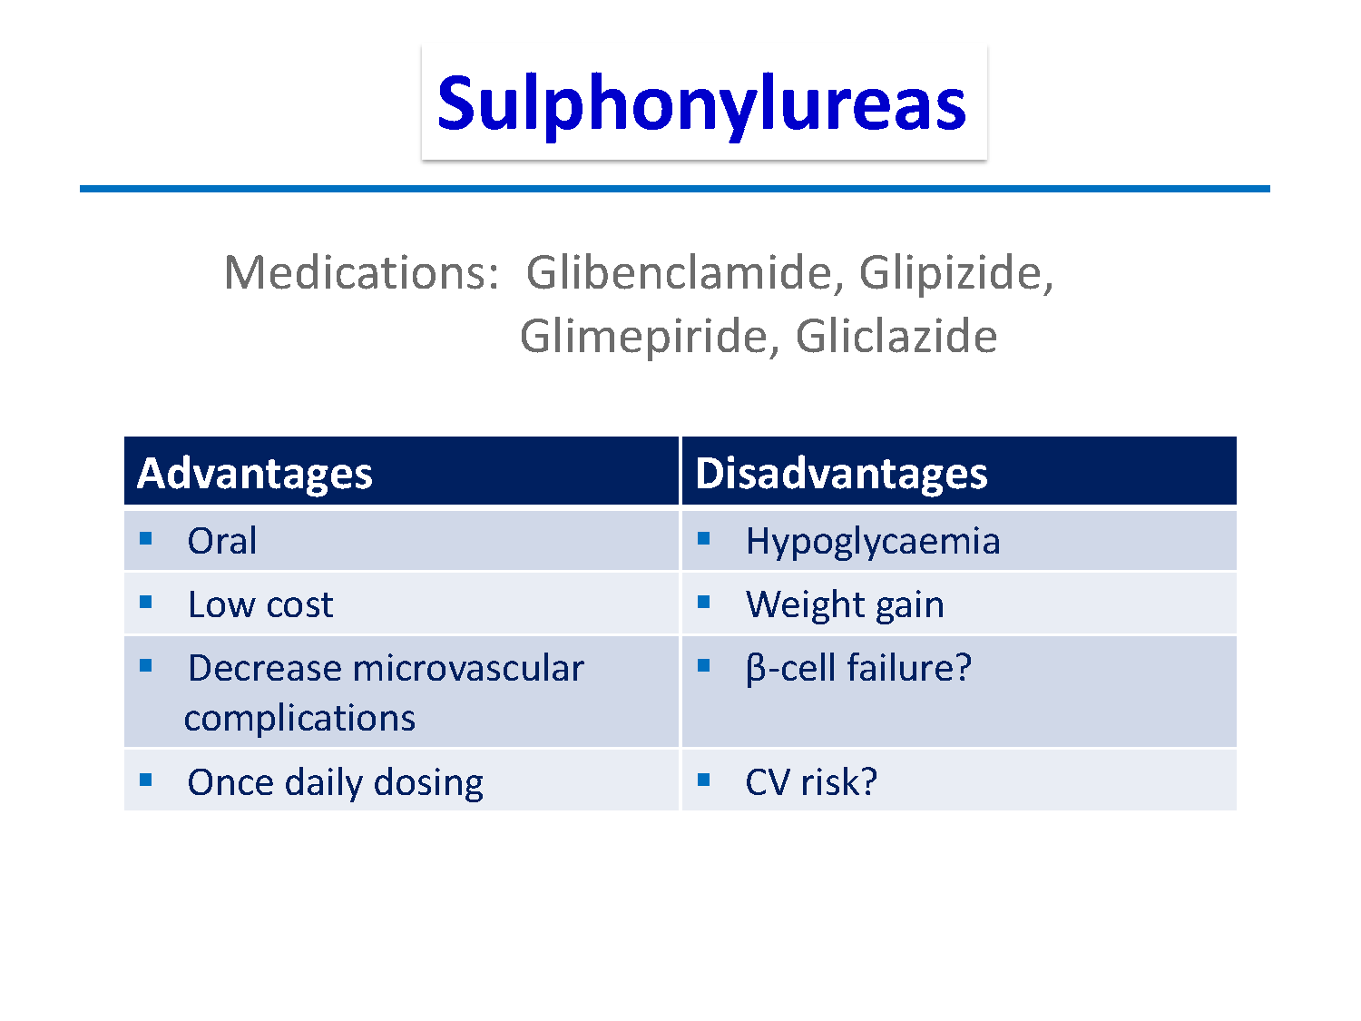

Slide 32
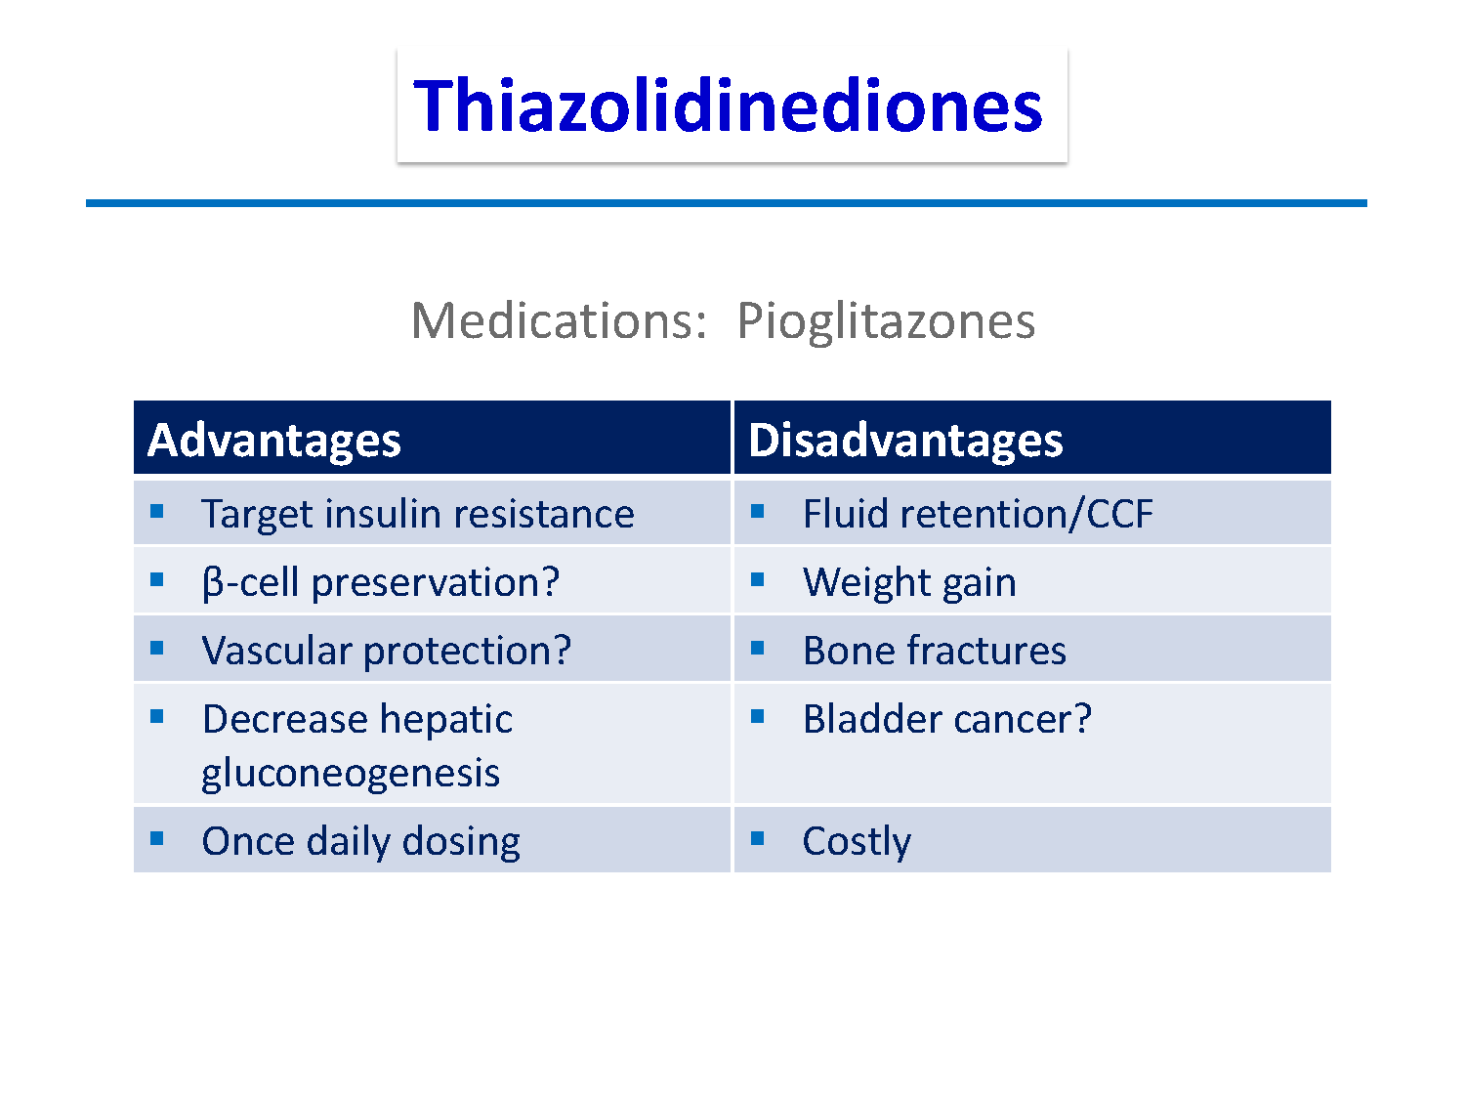

Slide 33
Oral Medication in Type 2 DM
Thiozolidinediones (TZD):
● PIOGLITAZONE (15 – 30 mg)
Reduce insulin resistance
Promotes glucose uptake by skeletal muscles and adipose tissue
Inhibits hepatic gluconeogenesis
Used in combination with metformin and sulphonylurea
Periodic monitoring of liver enzymes
Not given in patients with heart failure
Recently, Debate about increase incidence of Cancer bladder ??

Slide 34
INCRETINS

Slide 35
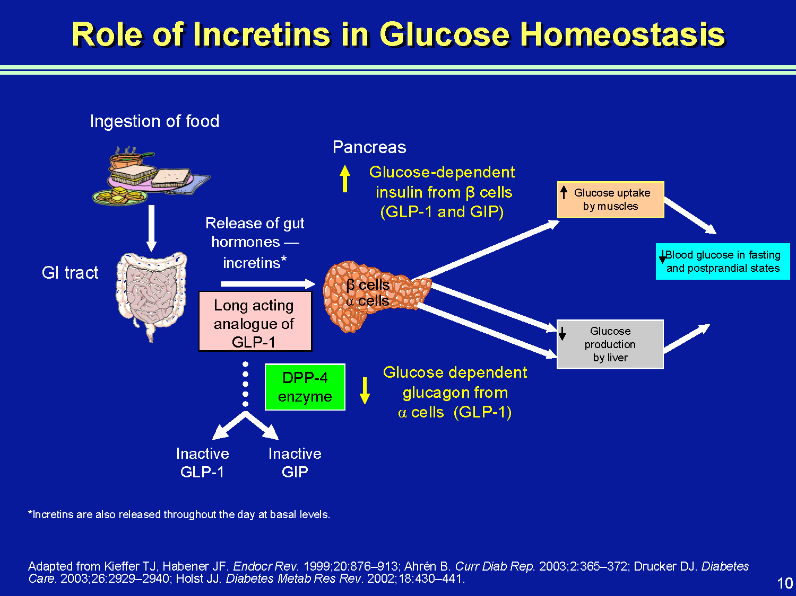

Slide 36
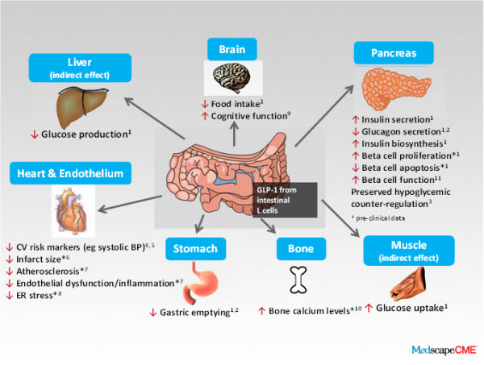
Physiological effects of GLP-1
Bunck MC, et al. Diabetologia. 2010;53 (Suppl 1):S338.

Slide 37
INCRETINS
The incretin system is impaired in patients with T2DM, which, as a consequence of its insulinotropic actions, contributes to fasting and postprandial hyperglycemia.
The impairment of GLP-1 secretion varies directly with the degree of insulin resistance; those who are more insulin resistant have a lower rise in GLP-1 in response to a meal.

Slide 38
Glucagon-like Peptide-1 (GLP-1)
GLP-1 is secreted throughout the day by intestinal mucosa in response to oral glucose in the gut.
GLP-1 causes anabolic actions on the synthesis of insulin in beta cells by stimulating all steps of insulin biosynthesis.
GLP-1 provides continued and augmented release of insulin for secretion in response to glucose without overproduction that could lead to hypoglycemia.
GLP-1 also acts on islet alpha cells, causing strong inhibition of postprandial glucagon secretion.
GLP-1 slows gastric emptying and acts on brain to promote early satiety with reduced food intake

Slide 39
Dipeptidyl Peptidase-4 (DPP-4)
Within minutes of secretion or exogenous administration, GLP-1 is rapidly degraded by dipeptidyl peptidase-4 (DPP-4).
DPP-4 is found in many body tissues, including liver, renal, and intestinal brush- border membranes; lymphocytes; and endothelial cells.

Slide 40
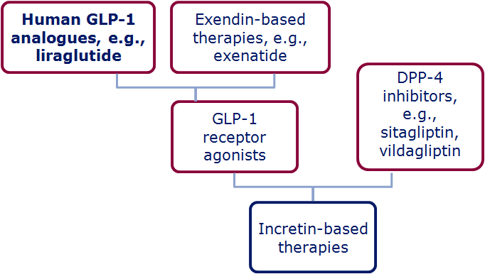
The family of incretin-based therapies
Wick & Newlin. J Am Acad Nurse Pract 2009;21:623–30; White. J Am Pharm Assoc 2009;49(Suppl. 1):S30–40
Notes:
The family of incretin-based therapies
Incretin-based therapies can be broadly divided into:
DPP-4 inhibitors (i.e. sitagliptin, vildagliptin)
GLP-1 receptor agonists (Exenatide, lirgalutide)
Within this second category however, the GLP-1R agonists can be classed as either:
Exendin-based therapies (exenatide, exenatide LAR) which have ~50% sequence identity to human GLP-1
Human GLP-1 analogues (liraglutide) which have share a much higher percentage of amino acids with human GLP-1 (97%)

Slide 41
Medication
Liraglutide: GLP-1 analog, SC, 0.6,1.2 -1.8 mg once daily
For overweight / obese type 2 patients Combined with Metformin +/- Pioglitazone
Sitagliptin (Januvia), (DPP-4) inhibitor, 100 mg OD
Other DPP-4 inhibitors, Vildagliptin, Saxagliptin
Type 2 diabetes only
Monotherapy or with Metformin or TZD
Weight neutral
Does not cause hypoglycemia

Slide 42
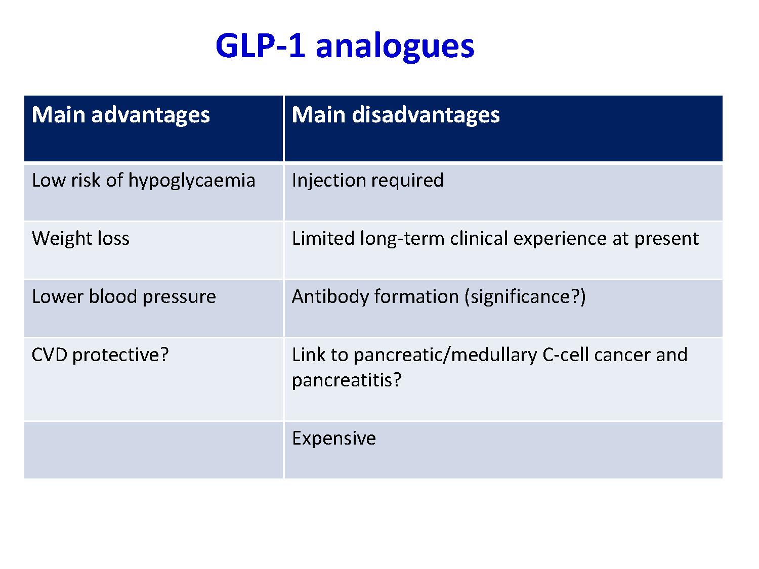

Slide 43
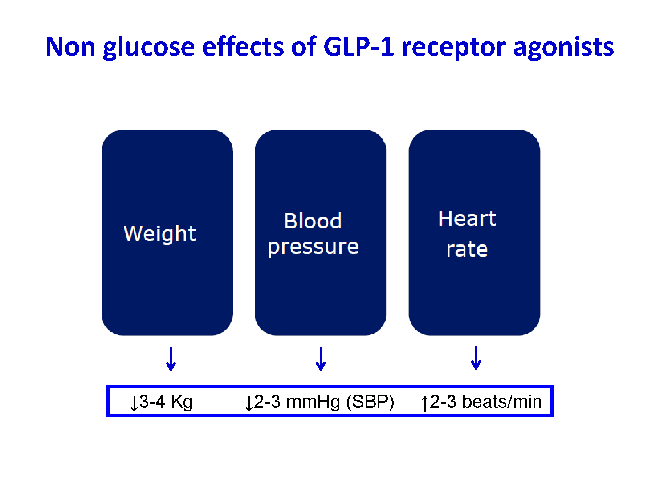

Slide 44
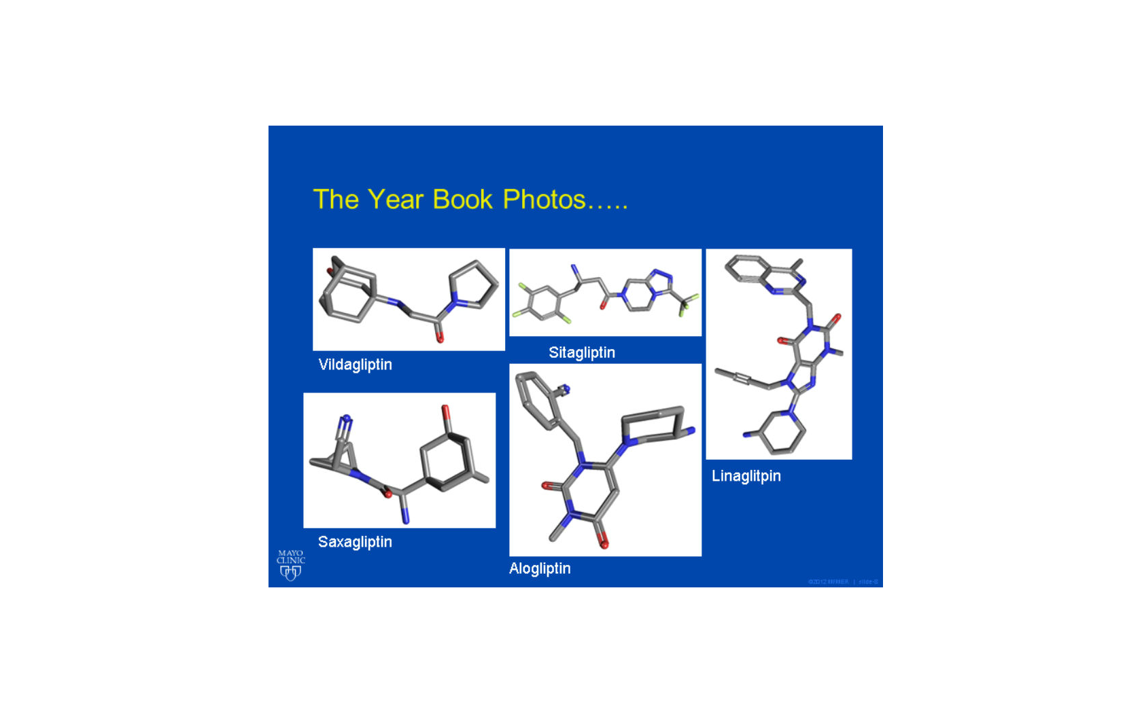
DPP 4 inhibitors

Slide 45
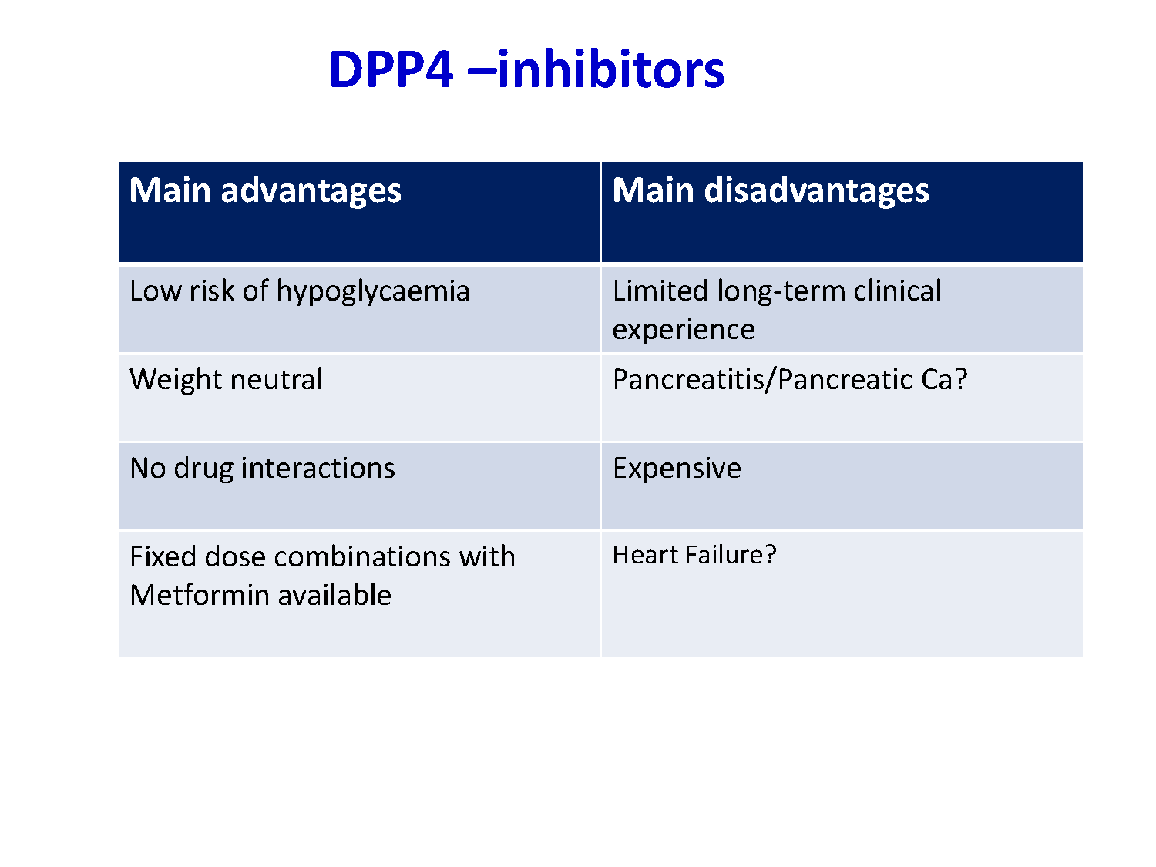

Slide 46
Which antidiabetic Drugs are contraindicated or should be only very cautiously when the following Co-Morbidity is present?
Chronic Kidney Failure: Metformin, Acarbose,Sitagliptin,
Insulin & SUs (reduced dosage)
Heart Failure: TZDs
Osteoporosis: TZDs
Myocardial Infarction: Hypoglycemias should be avoided
when Insulin or SUs are taken.
Elderly people (>70 years): Hypoglycemias should be avoided
when Insulin or SUs are taken.

Slide 47
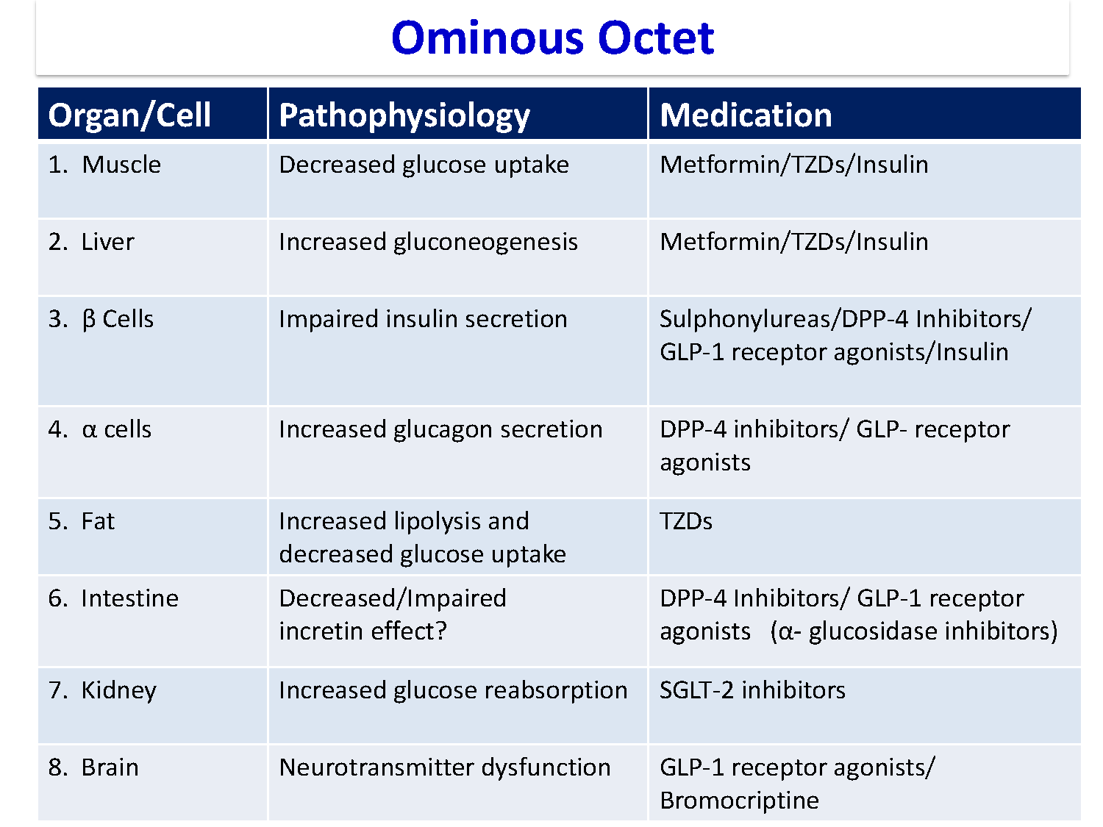

Slide 48


Slide 49
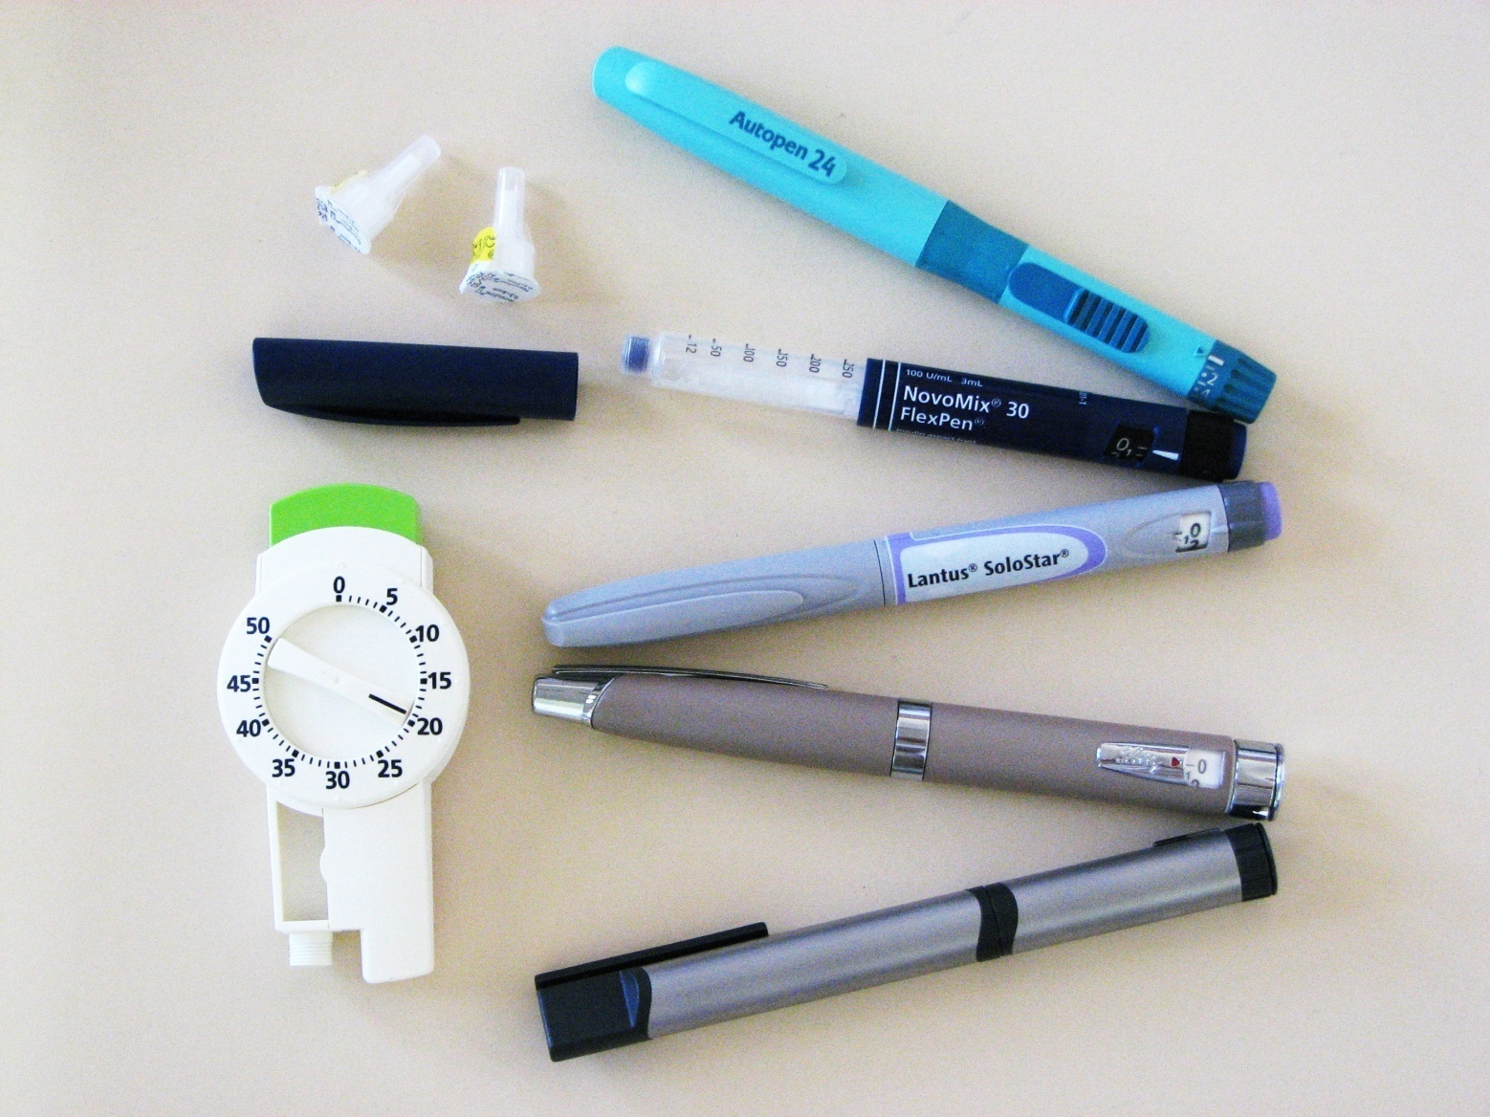

Insulin

Slide 50
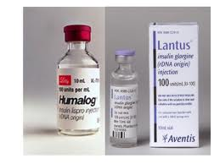
1982 – Human insulin approved
1996 – First rapid acting insulin analogue approved
2004 – First long acting insulin analogue approved

Slide 51
Insulin
Powerful agent
Necessary in 20-30%
Inexpensive
Weight gain
Hypoglycaemia
High level of patient fear

Slide 52
INSULIN AS INITIAL THERAPY
IF
Glycated hemoglobin (A1C) >9.5 percent (80.3 mmol/mol),
Fasting plasma glucose >250 mg/dL (13.9 mmol/L),
Random glucose consistently >300 mg/dL (16.7 mmol/L),
Ketonuria, or
Unplanned weight loss with hyperglycemia

Slide 53
A brief period (two to four weeks) of intensive insulin treatment at the onset of type 2 diabetes may be beneficial by:
Inducing near normoglycemia with intensive insulin therapy (insulin secretion and sensitivity improve).
Better glycemic control that can then be maintained with diet and exercise for many months or even years thereafter

Slide 54
Indication of Insulin in Type 2 DM
If HbA1c is ≥ 9 %
After maximum metformin and suphonylurea
You should consider adding Insulin and taper the Sulphonylurea.

Slide 55
TREATMENT REGIMENS OF TYPE 1 DM
Conventional Insulin Therapy
Two injections of NPH and Regular Insulin
Mixed Insulin
Two injections of 70/30 or 60/40 or 50/50
Multiple Insulin Injections
1 or 2 injections of NPH plus 3 injections of Regular or Rapid Insulin.
One injection of Glargine or Detemir plus 3 injections of rapid insulin(Lispro /Aspart).

Slide 56
INSULIN GLARGINE (LANTUS)
The first clear long-acting insulin
Acidic (pH of 4) when injected it is neutralized by the body, causing Glargine crystals to be precipitated and slowly absorbed.
It is taken once a day
Being acidic, cannot be mixed with other insulin

Slide 57
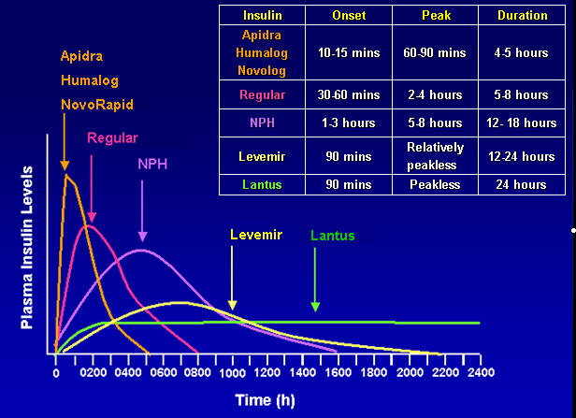

Slide 58
Basal-Bolus Insulin TreatmentWith Insulin Analogues
Lispro, or Aspart
μU/mL
100
B
L
D
Glargine
80
60
40
Normal pattern
20
0600
0800
1200
1800
2400
0600
Time of day
B=breakfast; L=lunch; D=dinner

Slide 59
Glargine / Lispro
Avoids fasting hyperinsulinaemia and hypoglycemia
Can mimic pancreatic ß-cell insulin secretion
36% had hypoglycemia vs
50% on NPH.
Dose: Glargine 50% and
Lispro 50%

Slide 61
Initiation and adjustment of insulin regimens (Multiple injections)
Long acting insulin (Glargine) at bedtime 10 U or 0.2 U/Kg
Check FG, increase by 2 U every 3-4 days until FG 80 – 130 mg/dl
If hypoglycaemia occurs, or FG < 70 mg/dl reduce bedtime by 4 units or 10 % which is greater.
If FG in range, check 2 hrs after breakfast, lunch and dinner and add rapid (Aspart) insulin. Begin with 4 U before each. Adjust by 2 U every 3-4 days Untill 2hpp < 180 mg/dl .
Usually the dose of rapid insulin is near equal or higher than dose of Long acting insulin

Slide 62
Insulin administration
Do not mix Glargine with other insulin products.
Insulin site should be clean, but wiping with alcohol is not needed.
Syringe reuse acceptable but meticulous attention to
cleanliness is needed.
Insulin pens improve the dose accuracy.
Injection site rotation reduces the lipoatrophy.
Abdomen region has a faster absorption rate than the Arm, which is faster than the leg.

Slide 63
Antihyperglycemic agents and Renal Function
CKD Stage:
5
4
3
2
1
eGFR (mL/min/1.73 m²):
<15
15–29
30–59
60–89
≥ 90
Alpha-glucosidase Inhibitor
Acarbose
Not recommended
25
Metformin
30
60
Biguanide
Alogliptin
6.25 mg
12.5 mg
Not recommended
30
50
Linagliptin
15
DPP-4 inhibitors
Saxagliptin
15
2.5 mg
50
Sitagliptin
25 mg
30
50 mg
50
Albiglutide
50
GLP-1R agonists
Dulaglutide
50
Exenatide (BID/QW)
30
50
Liraglutide
30
50
Gliclazide/Glimepiride
15
30
Insulin Secreta-gogues
Glyburide
30
50
Repaglinide
Canagliflozin
25
45
100 mg
60*
SGLT2 inhibitors
Dapagliflozin
60
Empagliflozin
45
45
60*
Thiazolidinediones
30
Contraindicated
Not recommended
Caution and/or reduce dose
11/2016
* = do not initiate if eGFR <60 ml/min
Safe
Adapted from: Product Monographs as of March 2016 Harper W et al. Can J Diabetes 2015;39:440.
No dose adjustment but close monitoring of renal function

Slide 64
Antiplatelet agents
Consider Aspirin therapy (75–162 mg/day) as a primary prevention strategy in those with type 1 or type 2 diabetes at increased cardiovascular risk (10-year risk 10%).
This includes most men 50 years of age or women 50 years of age who have at least one additional major risk factor (family history of CVD, hypertension, smoking, dyslipidemia, or albuminuria).

Slide 65
Statins and Diabetes
Diabetics < 40 years with no CV risk factors, No statin.
Statin therapy should be added to lifestyle therapy, for diabetic patients with no additional atherosclerotic CV disease risk factors 40-75 years (A).
For patients with diabetes aged 40–75 years with additional atherosclerotic cardiovascular disease risk factors, consider using high-intensity statin and lifestyle therapy. (B)

Slide 66
Ezetimibe and Statin
The addition of Ezetimibe to moderate-intensity statin has been shown to provide additional CV benefit compared with moderate-intensity statin alone and may be considered for patients with a recent acute coronary syndrome with LDL cholesterol > 50 mg/dL (1.3 mmol/L) or for those patients who cannot tolerate high intensity statin therapy. (A)
(IMPROVE-IT)

Slide 67
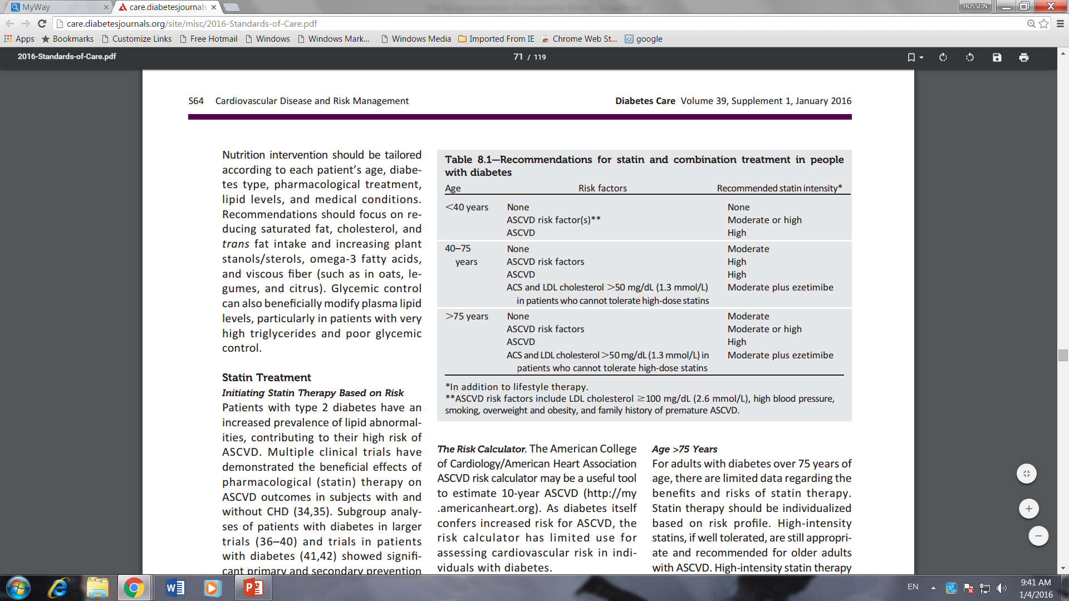

Slide 68
Statin and Fibrate
Combination therapy (statin/fibrate) has not been shown to improve atherosclerotic cardiovascular disease outcomes and is generally not recommended. (A)
Statin and Fenofibrate may be considered for men with both triglyceride level ≥ 204 mg/dL (2.3 mmol/L) and HDL cholesterol level < 34 mg/dL (0.9 mmol/L). (B)

Slide 69
Vaccination for patients with diabetes
Influenza vaccination yearly
Pneumococcal vaccination, repeating the pneumococcal vaccine once after age 65 years if the initial vaccination was prior to age 65.
The hepatitis B vaccination should be given to unvaccinated adults with diabetes mellitus who are ages 19 to 59 years.

Slide 70
Targets in DM
BP < 140 / 90
HbA1C ≤ 7 % (European Diab. Soc. ≤ 6.5 %)
LDL-C < 100 mg/dl (2.6 mmol/L)
HDL-C > 40 mg/dl (males)
> 50 mg/dl (females)
TG < 150 mg/dl (1.7 mmol/L)

Slide 71
Target in DM
May 27, 2009 — A new meta-analysis suggests that intensively controlling blood glucose levels (HbA_{1c}) to < 7.0%, significantly reduces the risk of (MI) and (CHD) events and has no effect on all-cause mortality and Stroke. The findings include UKPDS, ADVANCE, VADT, ACCORD, and PROACTIVE studies.
The concerns stemmed particularly from the (ACCORD) and (ADVANCE) and (VADT) which showed no significant response on Macrovascular outcomes.
ACCORD, on the other hand, was stopped early because of an increased risk of death in patients who underwent intensive blood glucose lowering.

Slide 72
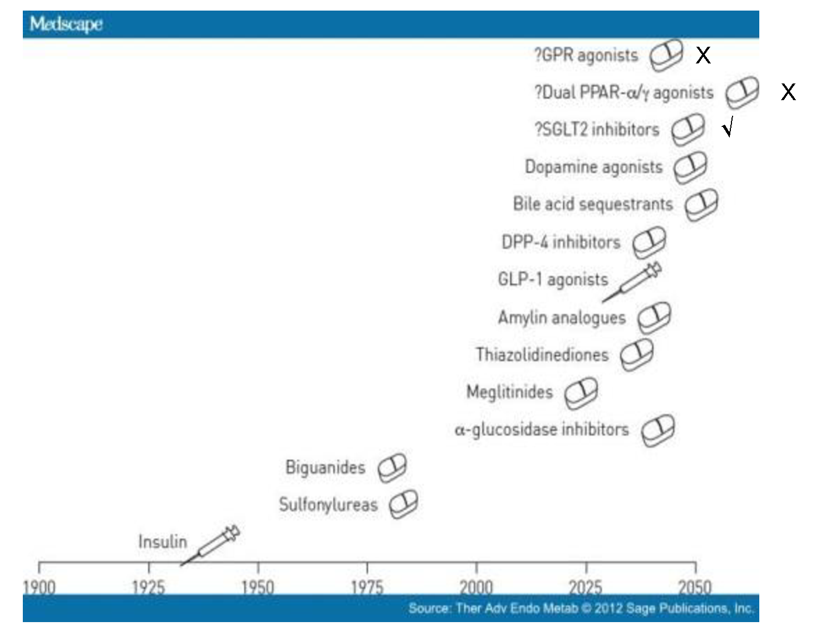

Slide 73
Reference

