Slide 1
Domestic Violence
Dr. Haytham AlSaif
MBBS,MPH,SBFM,ABFM.

Slide 2
Objectives
Differentiate intimate partner violence (IPV) from domestic violence (DV).
Epidemiology of DV in Saudi Arabia.
Identify different types of violence
Identify different victims of domestic violence
Recognize sign and symptoms of violence
Identify risk factors in domestic violence
List bio-psycho-social consequences of domestic violence
Outline resources of victim support in Saudi Arabia

Slide 3
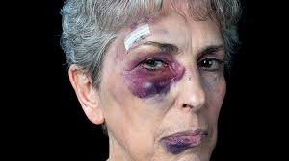
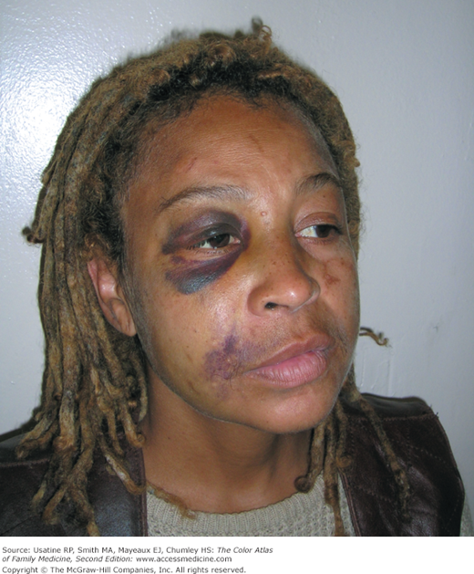
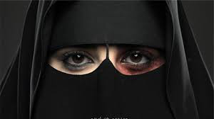
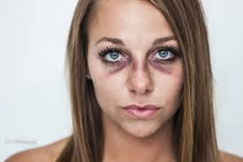

Slide 4
Define domestic violence and intimate partner violence

Slide 5
Definitions
Intimate Partner Violence (IPV)
Behavior by an intimating partner that causes physical, sexual or psychological harm, including acts of physical aggression, sexual coercion, psychological abuse and controlling behaviors.
Domestic Violence (DV)
All behaviors/actions within the family result in mental or physical injury (or death) to another member of the family

Slide 6
Terminology
It’s better to use the term “survivor” than “victim” when speaking about DV cases.
‘Victim’ implies passivity while women are actually active in trying to defend themselves and their children and seeking ways to survive.

Slide 7
Who is reporting DV in KSA?

Slide 8
Who is reporting DV in KSA?
Parents | 27.1%
Other | 22%
police | 10.7%
neighbors | 9%
Other family members | 8,7%
relatives | 7.7%
Victims themselves | 7.4%
Hospitals | 4.9%
Didn’t answer | 2.6%
Total | 100%
العنف الأسري في المجتمع السعودى أسبابه وآثاره الإجتماعية

Slide 9
Name the Common forms of domestic violence in KSA*

Slide 10
Common forms of domestic violence in KSA*
1-Psychological/emotional abuse | 6-Neglect (in children)
2-Social abuse
3-Financial abuse
4-Physical abuse
5-Sexual abuse
١-العنف الأسري في المجتمع السعودى أسبابه وآثاره الإجتماعية
2-Prevalence and Risk Factors of Domestic Violence Against Women Attending a Primary Care Center in Riyadh, Saudi Arabia
*Ranked from most to least common

Slide 11
Name the Risk Factors of Domestic violence in KSA*?

Slide 12
Risk Factors of Domestic violence in KSA*
Drug & alcohol abuse.
Unemployment.
Low educational level.
Low income.
Child living with one parent+ step parent.
Child Living with one parent.
العنف الأسري في المجتمع السعودى أسبابه وآثاره الإجتماعية
Violence against wives: a silent suffering in northern Saudi community
*Ranked from most to least common

Slide 13
Risk Factors of Domestic violence in KSA*
Father married to >1 wife.
Crowded house.
Suspicion on wife’s fidelity.
Conflicts (financial…etc)
Violent & explicit content in the media.
Culture (male predominance).
History of abuse during childhood.
Psychiatric illness.
العنف الأسري في المجتمع السعودى أسبابه وآثاره الإجتماعية
Violence against wives: a silent suffering in northern Saudi community
*Ranked from most to least common

Slide 14
Which family members are vulnerable the most to DV in KSA?

Slide 15
Which family members are vulnerable the most to DV in KSA?
Daughters.
Sons.
The Mother.
Husband’s mother.
Elderly in the family.
Wife’s mother.
The Father.
Husband’s siblings.
Wife’s siblings.
العنف الأسري في المجتمع السعودى أسبابه وآثاره الإجتماعية
*Ranked from most to least common

Slide 16
Who is committing the DV in KSA?

Slide 17
Who is committing the DV in KSA?
The father/husband.
Brothers.
Father’s wife.
Mother’s husband.
The mother/wife.
Other relatives.
Daughters.
العنف الأسري في المجتمع السعودى أسبابه وآثاره الإجتماعية
*Ranked from most to least common

Slide 18
What is the last year’s and lifetime Prevalence of IPV in PCC in KSA, USA & Globally

Slide 19
Prevalence of IPV in PCC in KSA, USA & Globally
Studies reported different prevalence proportions.
This is due to different methodologies, populations, sampling technique and sample size.
IPV is underreported.
Prevalence of IPV during the past year in KSA is 12-20%
 | KSA | Global | USA
Lifetime prevalence of IPV | 34-58%. | 15 -71% | 20-30%

Slide 20
To whom does victims of DV report in KSA?
Notes:
Can be deleted

Slide 21
To whom did victims of DV report in KSA?
to their families.
to their husbands’ families.
to their friends.
to the police or to a judge.
to a family physician, or to women protection agency.
Notes:
Can be deleted

Slide 22
What are the Reactions of women after DV in KSA?*

Slide 23
Reaction of women after DV in KSA?*
Seeking separation or divorce (55.9%)
Doing nothing (40.6%)
Visit a doctor (7.0%)
Did not visit a doctor while needed (7.0%)
Left home (3.5%)
Contact human rights (3.5%)
Call police (2.8%)
Other action (1.4%)
*ranked from most to least common.
Prevalence and Risk Factors of Domestic Violence Against Women Attending a Primary Care Center in Riyadh, Saudi Arabia

Slide 24
What are the medical Consequences of DV?

Slide 25
Consequences of DV
Medical problems (71.5%)
For eg: Chronic pain، fatigue.
Psychiatric problems (57.6%)
For eg: depression, anxiety disorders, antidepressant use, suicidal behavior.
Gynecologic & obstetric problems (22.2%)
For eg: abortion, per vaginal bleeding.
Physical injuries (15.4%)
For eg: contusions, fractures, scars.
Prevalence and Risk Factors of Domestic Violence Against Women Attending a Primary Care Center in Riyadh, Saudi Arabia

Slide 26
Consequences of DV in adolescents
physical and sexual assault are associated with:
poor self-esteem.
alcohol and drug abuse.
eating disorders.
Obesity.
Depression.
teen pregnancy.
anxiety.
Suicidality.
risky sexual behaviors.
Addressing domestic violence in primary care: what the physician needs to know

Slide 27
Consequences of DV in KSA
Violence exacerbated medical problems (31.7%)
Violence needed treatment (19.0%)
Violence needed admission (6.4%)
Prevalence and Risk Factors of Domestic Violence Against Women Attending a Primary Care Center in Riyadh, Saudi Arabia

Slide 28
Female victims of DV & health & social services
More likely to seek health services.
Have poor overall physical and mental health.
Unfortunately their health needs are not addressed sufficiently by current health and social service systems.
Addressing domestic violence in primary care: what the physician needs to know

Slide 29
Why DV is missed?

Slide 30
Why DV is missed?
Women may not disclose abuse to doctors especially if they are males.
Women think that addressing DV is not part of physicians job.
Physicians lack knowledge, expertise, training, resources, and time.
Physician Feels powerless to offer a solution.
Physician Fear of offending the woman and of opening her wound.
Negative cultural & social attitudes.
Institutional constraints.

Slide 31
What are the Signs and symptoms suggestive of abuse

Slide 32
Signs and symptoms suggestive of abuse
Injuries that point to a defensive position over the face (bruises and marks on the inside of the forearms, back).
Injuries to the chest and stomach, reproductive organs, and anus.
The illness or injuries do not match the cause given.
Delay in requesting medical care.
Injuries and bruises of various colors, indicating injuries occurring regularly over a period of time.
Repeat injuries, someone who is ‘accident prone’.

Slide 33
Signs and symptoms suggestive of abuse
Injuries during pregnancy.
Repeated reproductive health problems: repeat miscarriage, early delivery, sexually transmitted diseases.
Behavioral signs: multiple visits, lack of commitment to appointments, not displaying emotion, crying easily, or poor eye contact.

Slide 34
Impact with a bat will result in an area of central clearing surrounded by two parallel lines. The blood directly beneath the area of impact is forced upward and outward around a linear object, resulting in rupture of the vessel outside the area of impact.

Slide 35
Blows from a belt can exhibit several different patterns. If the belt impacts on edge, a linear contusion will be produced. If the belt impacts more on its side, a wider contusion may be imprinted. Woven belts will leave a mirror image of the weave imprinted on the skin.

Slide 36
The hand is the most common ‘weapon’ of domestic violence. The slap mark present on this patient’s cheek shows areas of central clearing from impact with the extended fingers.

Slide 37
Injuries that are associated with falls would include contusions and abrasions to the bony surfaces of the body, including: extensor surfaces of the arms, elbows, knees and shins.

Slide 39
Partner’s behavior
Extreme and irrational jealousy or possessiveness.
Attempts to control time spent with the healthcare providers.
Speaking on behalf of the patient.
Insisting on staying close to the patient, who hesitates to speak before the partner.

Slide 40
Addressing DV during consultation
women are ready to talk about abuse when asked.

Slide 41
What is the physician’s role in DV?

Slide 42
Family physician role in DV
Identify DV.
Assess the patient and her family level of safety.
Provide ongoing medical care & non-judgmental support.
Ensuring privacy and confidentiality.
It is advisable not to discuss DV when children or the partner are present.

Slide 43
Family physician role in DV
Counseling about the nature and course of DV.
Educating the patient about the range of available support services.
Documenting findings.
Refer for further management or assistance.
Prevent further incidents of abuse.

Slide 44
What should the physician be equipped with?
Proper knowledge.
Communication skills.
Awareness of the resources available in the community.

Slide 45
Screening tools for IPV
HITS (Hurt, Insult, Threaten, Scream).
WAST (Woman Abuse Screening Tool)

Slide 46
HITS (Hurt, Insult, Threaten, Scream)
How often does your partner physically hurt you?
How often does your partner insult or talk down to you?
How often does your partner threaten you with physical harm?
How often does your partner scream at you?
Scoring: never = 1 point, rarely = 2 points, sometimes = 3 points, fairly often = 4 points, frequently = 5 points. A score of greater than 10 points is a positive screen

Slide 47
WAST (Woman Abuse Screening Tool)
In general, how would you describe your relationship? No tension, some tension, a lot of tension?
Do you and your partner work out arguments with no difficulty, some difficulty, or great difficulty?
Do arguments ever result in you feeling down or bad about yourself?
Do arguments ever result in hitting, kicking, or pushing?
Do you ever feel frightened about what your partner says or does?
Does your partner ever abuse you physically?
Does your partner ever abuse you emotionally?
Does your partner ever abuse you sexually?
The physician performs scoring subjectively, using clinical judgment

Slide 48
How to address DV during the consultation?

Slide 49
How to address DV during the consultation
Use introductory statements: ‘violence is so common around here, that we started asking everyone about it’
Then a A funneling technique:
1-moving from the broad less-threatening questions :‘married couples may disagree; how do you resolve conflicts at home’
2-to asking about specific behaviors ‘are you being hit’.

Slide 50
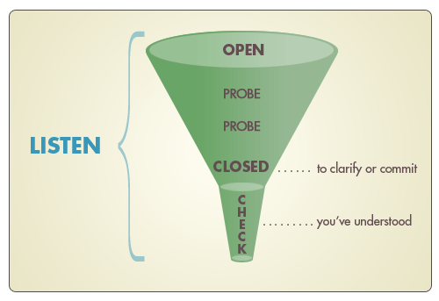

Slide 51
How to address DV during the consultation
ask in a non-judgmental way:
for eg, avoid asking ‘what have you done for him to hit
You’.
avoid use of emotionally charged words like ‘violence’ or ‘abuse’.
Observe the patient’s non-verbal cues.
Don’t pressure her to leave the relationship.

Slide 52
What if she discloses abuse?

Slide 53
What if she discloses abuse?
The initial response is to show empathy: ‘I am sorry this is happening to you’.
Acknowledge the difficulty to share the information: ‘this must be hard on you to talk about it’.
Express validation while alleviating guilt: ‘no one deserves to be hit or treated badly, it is not your fault’.
Offer help and assurance of continuous assistance in the future: ‘you are not alone in this, we can help you take care of your health and support you while going through this problem’.

Slide 54
What if she discloses abuse?
ask open-ended questions to assess the safety of the patient.
Violence tends also to escalate during life changes like pregnancy, separation, divorce or unemployment.
If any of the danger indicators are present*, the physician should discuss a safety plan with the survivor, even when survivors deny danger.
*see next slide.

Slide 55
What are the Indicators of Danger/red flags?

Slide 56
Indicators of Danger/red flags
History of threats of murder or suicide ideation.
Attempts of suicide or homicide.
Increased severity or frequency of the perpetrator’s fits of anger.
Use of weapons or tools in the assault or an attempted strangulation.
Alcohol or substance abuse.
If the survivor acknowledges a fear for life.

Slide 57
Safety Plan
Calling Police, or (Ministry Of Labor & Social Development) MLSD hotline.
hiding money, a bag with extra clothes, having important documents in a safe place outside the home in the event of an urgent escape.
Agreeing on a safe place to escape to (relatives, neighbors ), ask: ‘If you decided to leave, where you could go?’
a signal to alert neighbors to request their help.

Slide 58
Safety Plan
When the perpetrator is around, stay away from rooms with weapons, such as the kitchen, or with hard surfaces, such as a bathroom.
The safety plan is to be revisited on later visits and modified according to situation.

Slide 59
Counseling
Counseling improves the patient’s self-esteem and self-worth and assists the decision-making process.
Providers are not supposed to encourage survivors to leave the relationship.
Counseling of couples is to be avoided when active violence, intimidation, fear, or control is present in the relationship.
physicians should also resist the repeated demands from the survivor to confront the perpetrator as this may endanger the patient and the physician.

Slide 60
Why Survivors don’t Leave The Abuser?
Believe that the abuse will stop one day.
Believe they deserve it.
Fear of losing contact with children.
Financial dependence.
Lack of an alternative place to go to.
Social pressure.

Slide 61
The physician has to make sure that his feelings and past experiences doesn’t interfere with his judgment in DV cases.

Slide 62
What should be included in the Documentation of a DV case?

Slide 63
Documentation
The occurrence, nature, and time of abuse and the perpetrator identity when possible.
Findings from the physical examination with an accurate recording of injuries: nature, shape, and color.
-If possible, photographs of any physical injuries may be obtained if the patient permits.
-The photographs must include the patient’s face or identifying features with the injury to be useful as evidence.
-If a camera is not available, the physician should make a sketch of the injuries or use body maps to record injuries.

Slide 64
Documentation
The laboratory or radiological studies ordered, the medications prescribed, and the referral when done.
Comments on comorbidities; pregnancy, if present; and degree of disability.

Slide 65
Follow up
Check for barriers to access and discuss solutions.

Slide 66
What if she denied violence?
You should respect the patient’s decision not to disclose violence even when there is clinical suspicion of its presence.
It is better to acknowledge the relation of the complaints to violence: ‘sometimes patients having symptoms like yours turn out to be abused’.
express readiness to discuss DV in future visits whenever the patient wishes.

Slide 67
What if she denied violence?
Providing education about the impact of violence on the health of survivors and children witnessing it.
Providing a list of resources and organizations offering support to abused women.
A close follow-up visit is warranted.

Slide 68
Multidisciplinary Approach
Physicians.
social workers.
Psychologists/psychiatrists.
community resources (police, MLSD).

Slide 69
Leaflets about DV in Patients’ waiting area

Slide 70
Child Abuse in USA
Child abuse is the 3rd leading cause of death in children between one and four years of age.
20% of child homicide victims had a contact with a health care professional within a month of their death.

Slide 71
Child Abuse
There is an increased risk of abuse in children with disabilities.
When a sexually transmitted infection (STI) is detected in a child, evaluation for sexual abuse is mandatory.

Slide 72
Child Abuse history
Physicians must evaluate the consistency of a caregiver’s history with other findings from the history or physical examination.
Pregnancy history, including whether the pregnancy was planned or unplanned

Slide 73
Historical components that suggest intentional trauma
No explanation or vague explanation for a significant injury.
Significant delay in seeking medical attention.
An important detail of the history changes dramatically over time.
Explanation is inconsistent with the pattern, age, or severity of the injury.
History does not explain the injuries identified.
Explanation is inconsistent with the child’s physical or developmental capabilities.
Different witnesses provide markedly different explanations for the injury.

Slide 74
Physical Examination for Suspected Child Abuse
Low weight might be suggestive of neglect.
bruises on the torso, ear, or neck (TEN) in a child four years or younger.
Bruises of any region in a child younger than four months.
bruises at different stages of resolution.
burn injuries.
Palpation for tenderness, especially of the neck, torso, and extremities.

Slide 75
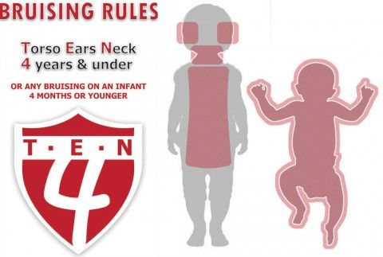

Slide 77
Sometimes in child abuse cases, you need to admit the child to provide a safe place for the child.

Slide 80
Thank you

Slide 81
Appendix: a suggested approach to a victim of IPV
Introductory statement:
‘violence is so common around here, that we started asking everyone about it’
‘In general, how would you describe your relationship? No tension, some tension, a lot of tension?’

Slide 82
a suggested approach to a victim of IPV
Ask about disagreements and arguments:
‘married couples may disagree; how do you resolve conflicts at home’.
Do you and your partner work out arguments with no difficulty, some difficulty, or great difficulty?

Slide 83
a suggested approach to a victim of IPV
Ask directly:
‘does you husband…’
Type of abuse | insult | scream | threat | hit | Sexual
Yes/no
frequency

Slide 84
a suggested approach to a victim of IPV
Ask about risk factors:
Drugs & alcohol abuse.
Unemployment.
Low income.
Low educational level.

Slide 85
Red Flags
Suicide ideation or attempts.
Homicide threats or attmepts.

Slide 86
Don’t forget
Be empathetic.
Don’t be judgmental.
Reassure the patient that physicians can help in cases of domestic violence.
Reassure the patient about privacy & confidentiality.
Take her consent for involving police, social worker, or calling DV hotline.

Slide 87
Management
Calling domestic violence hotline (1919).
Offering involvement of social worker, and/or police.
Offering referral to a psychologist/psychiatrist.

