Slide 1
CHANGES IN BOWEL MOVMENTS (IBS)
1-Abdulelah alqahtani
2-Abdulmajeed almutairi
3- Fahad alamri

Slide 2
OBJECTIVES:
Define constipation and diarrhea
Discuss the definition , etiology and classification of IBS
Explain how to diagnose IBS
List the alarm symptoms and differential diagnosis
Provide a management plan and follow up
Recognize when to refer to specialist

Slide 3
MCQ
People with irritable bowel syndrome may suffer from either constipation only or diarrhea only
True
False

Slide 4
MCQ
Once other disease condition have been ruled out, a person can be considered for the diagnosis of irritable bowel syndrome if the symptoms were present for the last
One week
One fortnight
One month
Three months

Slide 5
MCQ
Which of the following is not recognized as a symptom that supports the diagnosis of IBS according to the Rome criteria?
Altered stool frequency
Mucorrhea
Abdominal bloating or subjective distention
Frequent nausea

Slide 6
MCQ
Which of the following symptoms indicates a need for laboratory testing or diagnostic imaging in patients with IBS younger than 50 years?
Iron deficiency anemia
Abdominal pain
Amenorrhea
Hypokalemia

Slide 7
bowel movement Disorders
Diarrhea
Passage of loose or watery stools, typically at least three times in a 24-hour period
Constipation
Stool frequency of less than three per week
Irritable Bowel Syndrome

Slide 8
DIARRHEA
Diarrhea is defined by the World Health Organization as having three or more loose or liquid stools per day, or as having more stools than is normal for that person
* Diarrhea is a symptom, not a disease
Acute diarrhea : is defined as an abnormally frequent discharge of semisolid or fluid fecal matter from the bowel, lasting less than 14 days, by World Gastroenterology Organization.

Slide 9
diarrhea
Acute:
: is defined as an abnormally frequent discharge of semisolid or fluid fecal matter from the bowel, lasting less than 14 days, by World Gastroenterology Organization
Chronic :
more than 4 weeks.

Slide 10
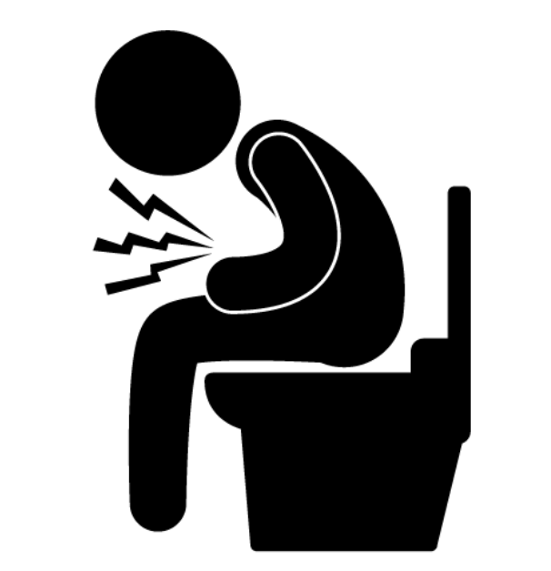
Causes of diarrhea
Infection:
Most common cause of acute diarrhea is viral infection (rotavirus and the Norwalk virus are the most common).
Malabsorption
Lactose intolerance: People who have difficulty digesting lactose have diarrhea after eating dairy products
inflammatory bowel disease
Medication : antibiotics
Irritable bowl syndrome (Ibs)

Slide 11
Constipation
Constipation is a symptom, not a disease.
Different patients have different perceptions of symptoms. Some patients regard constipation as straining, while for others, it means hard, pellet-like
stools or an inability to defecate when desired, or infrequent defecation.
Being constipated means your bowel movements are tough or happen less often than normal.

Slide 12
Causes of Constipation
Constipation may result from several causes :
Poor diet - Inadequate fluid intake
- Caffeine and alcohol - Medications
- Intestinal obstruction - Mechanical problems of the anus and rectum
Or psychological factors like : stress – anixity – fear …

Slide 13
Irritable bowel syndrome
Irritable bowel syndrome (IBS) : Idiopathic Syndrome of Intrinsic Bowel; motility dysfunction and can have both diarrhea ,constipation or both.
characterized by recurrent abdominal pain or discomfort at least three days per month in the last three months with two or more of the following: improvement with defecation, onet associated with a change in frequency of stool, or onset associated with a change in form (appearance) of stool.
Present in 10-20% of the population
Twice as common in women compared to men
Most commonly affects people between 20-30 years

Slide 14
Inflammation
Genetics
Motility
Postinfecious
Microflora Alterations
Sensitivity
Psychosocial
Etiology

Slide 15
Etiology
It's not known exactly what causes irritable bowel syndrome, but a variety of factors play a role.
- contractions may be stronger and last longer than normal, causing gas, bloating and diarrhea. Or the opposite may occur
- Abnormalities in your gastrointestinal nervous system also may play a role
Triggers vary from person to person
Food :is not yet clearly understood, but many people have more severe symptoms when they eat certain things.
Stress
Hormones : women are twice as likely to have IBS

Slide 16
Classification of IBS
Four bowel patterns may be seen with irritable bowel syndrome:
- IBS-D :(diarrhea predominant)
-IBS-C : (constipation predominant)
-IBS-M :(mixed diarrhea and constipation)
-IBS-U :(unclassified; the symptoms cannot be categorized into one of the above three subtypes)

Slide 17
Diagnosis
It is Difficult.
It Needs to balance between few and many investigations.
Red flag symptoms should be ruled out.
The Diseases that causing similar symptoms should ruled out.

Slide 18
Rome IV Ibs Criteria
According to the Rome IV criteria, IBS is defined as recurrent abdominal pain, on average, at least one day per week in the last three months, associated with two or more of the following criteria:
Related to defecation
Associated with a change in stool frequency
Associated with a change in stool form (appearance)

Slide 19
Diagnosis (NICE Guidelines)
Irritable bowel syndrome should be considered if an adult presents with abdominal pain or discomfort, bloating or a change in bowel habit for at least 6 months.
A diagnosis should be considered only if the person has abdominal pain or discomfort that is either relieved by defecation or is associated with altered bowel frequency or stool form. This should be accompanied by at least 2 of the following 5 symptoms:
altered stool passage (straining, urgency, incomplete evacuation)
abdominal bloating (more common in women than men), distension, tension or hardness
symptoms made worse by eating
passage of mucus.
Lethargy, nausea, backache and bladder symptoms are also common in people with irritable bowel syndrome, and may be used to support the diagnosis.

Slide 20
Alarming Symptoms !!!
Unintentional and unexplained weight loss.
Rectal bleeding.
A family history of bowel or ovarian cancer.
In people aged over 60, a change in bowel habit lasting more than 6 weeks with looser and/or more frequent stool.
Anemia.
Abdominal masses.
Rectal masses.

Slide 21
Physical Examination
anaemia
abdominal masses
rectal masses

Slide 22
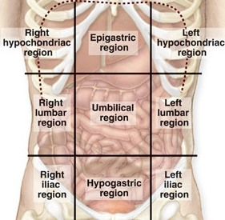
Abdominal examination
Inspection
Bloatness
Palpitation
Organmegaly
masses
Rectal
Percussion
Auscultation
Bowel movements

Slide 23
investigations
inflammatory markers for inflammatory bowel disease.
In addition, women with symptoms that suggest ovarian cancer should have their serum CA125 measured.
When the above have been excluded, the following tests should be done to exclude other diagnoses:
full blood count
erythrocyte sedimentation rate (ESR) or plasma viscosity
C reactive protein (CRP)
antibodies for coeliac disease (endomysial antibodies [EMA] or tissue transglutaminase [TTG]).

Slide 24
investigations
The following tests are not necessary to confirm diagnosis in people who meet the diagnostic criteria for irritable bowel syndrome:
ultrasound
rigid/flexible sigmoidoscopy
colonoscopy, barium enema
thyroid function test
faecal ova and parasite test
faecal occult blood
hydrogen breath test (for lactose intolerance and bacterial overgrowth).

Slide 25
Management
Education
Patients need “Basic” and “Beyond Basic” education regarding IBS
Help seeking behavior need to be modified to decrease costs spent on acute attacks.
Dealing with symptoms
What are the worrying symptoms?
When to seek help?

Slide 26
Management
Life style:
Diet:
- Reduce stress, increase leisure and relaxation time
- Increase physical activity
Regular meals
Decrease caffeine
Increase fiber?
Probiotics
If persistent → specific food avoidance

Slide 27
Management
Pharmacological:
Psychological: Mainly in refractory IBS
Antispasmodics (otilonium, hyoscine)
Constipation→ laxatives (osmotic, linaclotide)
Diarrhea → antimotility (loperamide)
TCAs (amitriptyline) or SSRIs
Cognitive behavioral therapy (CBT)
Hypnotherapy
Psychotherapy

Slide 28
Management
In general:
Does not affect quality of life → Diet and life style changes only
Effects quality of life → Diet, life style changes and pharmacological therapy

Slide 29
Follow up
Agreed between physician and patient.
Depends on response of the person’s symptoms to intervention.
‘Red flag’ symptoms should prompt further investigation and/or referral to secondary care.

Slide 30
When to Refer to a specialist?
Refer when there is:
More than minimal rectal bleeding
Weight loss
Unexplained iron deficiency anemia
Nocturnal symptoms
Family history of Colorectal cancer IBD Celiac disease

Slide 31
MCQ
People with irritable bowel syndrome may suffer from either constipation only or diarrhea only
True
False

Slide 32
MCQ
Once other disease condition have been ruled out, a person can be considered for the diagnosis of irritable bowel syndrome if the symptoms were present for the last
One week
One fortnight
One month
Three months

Slide 33
MCQ
Which of the following is not recognized as a symptom that supports the diagnosis of IBS according to the Rome criteria?
Altered stool frequency
Mucorrhea
Abdominal bloating or subjective distention
Frequent nausea

Slide 34
MCQ
Which of the following symptoms indicates a need for laboratory testing or diagnostic imaging in patients with IBS younger than 50 years?
Iron deficiency anemia
Abdominal pain
Amenorrhea
Hypokalemia

Slide 35
Thank You
For Your Attention
Notes:
https://pixabay.com/en/typewriter-book-notebook-paper-801921/

