Slide 1
OSTEOPOROSIS
STUDENT LED SEMINAR

Slide 2
DEFINITIONS
Osteoporosis: Characterized by low bone mass (osteopenia), micro-architectural disruption, and increased skeletal fragility resulting in an increased risk of fracture DESPITE normal mineralization.
Primary: Disease of post-menopausal women and elderly men.
Secondary: Due to an obvious cause: steroid use, immobilization, hyperthyroidism, Vit D deficiency.
Rickets: Deficient mineralization of bone and cartilage that occurs BEFORE closure of growth plates.
Osteomalacia: Deficient mineralization of bone that occurs AFTER closure of growth plates.

Slide 3
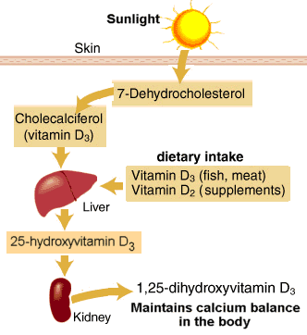
VITAMIN D

Slide 4
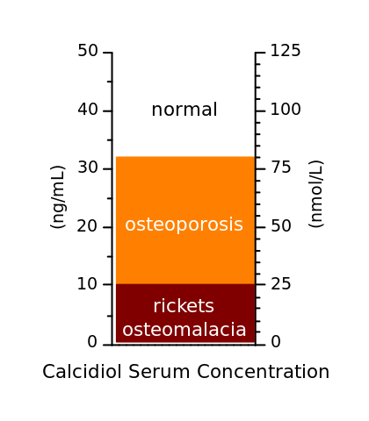
VITAMIN D DEFICIENCY
Normal Range 75–250 nmol/L
Insufficient 25–74 nmol/L

Slide 5
VITAMIN D DEFICIENCY CONT.
Risk factors for vitamin D deficiency:
Decreased sun exposure
Malnutrition
Obesity
Darker skin color
Malabsorption e.g. celiac, IBD, short bowel syndrome
Urban living conditions (due to pollution)

Slide 6
CONSEQUENCES OF VITAMIN D DEFICIENCY
Rickets
Osteomalacia
Osteoporosis
Depression
Muscle aches and weakness, especially in the limb girdles
Periodontitis
Pre-eclampsia

Slide 7
PREVALENCE OF OSTEOPOROSIS
Worldwide, it is estimated that 200 million people have osteoporosis.
In the United States in 2010 about 8 million women and one to 2 million men had osteoporosis.
In the developed world, 2% to 8% of males and 9% to 38% of females are affected
There are 8.9 million fractures worldwide per year due to osteoporosis.
USA spends an estimated 19 billion USD annually for related healthcare costs.

Slide 8
PREVALENCE OF OSTEOPOROSIS
In Saudi Arabia, osteoporosis is already a serious issue.
A report in the eastern region of Saudi Arabia indicates an incidence of postmenopausal osteoporosis (PMO) of 30 percent to 40 percent, with over 60 percent of postmenopausal women already having some degree of osteopenia.

Slide 9
RISK FACTORS OF OSTEOPOROSIS
Nonmodifiable:
Age. (Most important risk factor)
Female gender
Manopause
Family history
Small frame/low body weight
History of broken bones
Modifiable:
Low Ca/Vitamin D
Sedentary lifestyle
Smoking
Alcohol use

Slide 10
RISK FACTORS OF OSTEOPOROSIS
Medical diseases:
Premature menopause
Malabsorption
Chronic liver disease
IBD
Medications:
Steroids
L-Thyroxine
Phenytoin and Barbiturates
Thiazolidinediones
Chronic Lithium use

Slide 11
FRAX

Slide 13
MeCQs ?
What are the most common fractures you may see in osteoporosis patient ?
a- Skull
b- vertebra
c- tibial tuberosity
d- metatarsal
e- nasal
f- mandibular
g- true rib
h- false rib
i- phalanx
j- wrist
k- scapula
l- ethmoid
m- coccyx
n- sacrum
o- hip
p- temporal
q- humerus
r- elbow
s- eye orbit
t- clavicle
u- hard palate
v- ASI
x- nasal cartilage
y- everywhere
z- no fracture

Slide 14
HOW OSTEOPOROSIS PATIENT PRESENT ?
Osteoporosis is a silent disease, potentially lethal (brother of HTN).
Pathway of presentation: Reduced bone strength Fragile bones
minor trauma Fracture.
Other common presentation: height shrinking, bent or stooped posture.
Consider Back Pain as a sign of osteoporosis, caused by collapsed or fractured vertebrae.
Can present with pain after minimal trauma, falls and lifting heavy objects.

Slide 15
COMMON FRACTURES WITH OSTEOPOROSIS

Slide 16
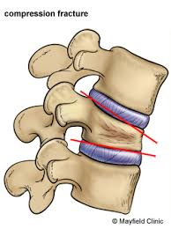
SPINAL FRACTURES
Called compression or wedge fracture
Can be caused by lifting heavy or light objects, bending forward.
Cause kyphosis

Slide 17
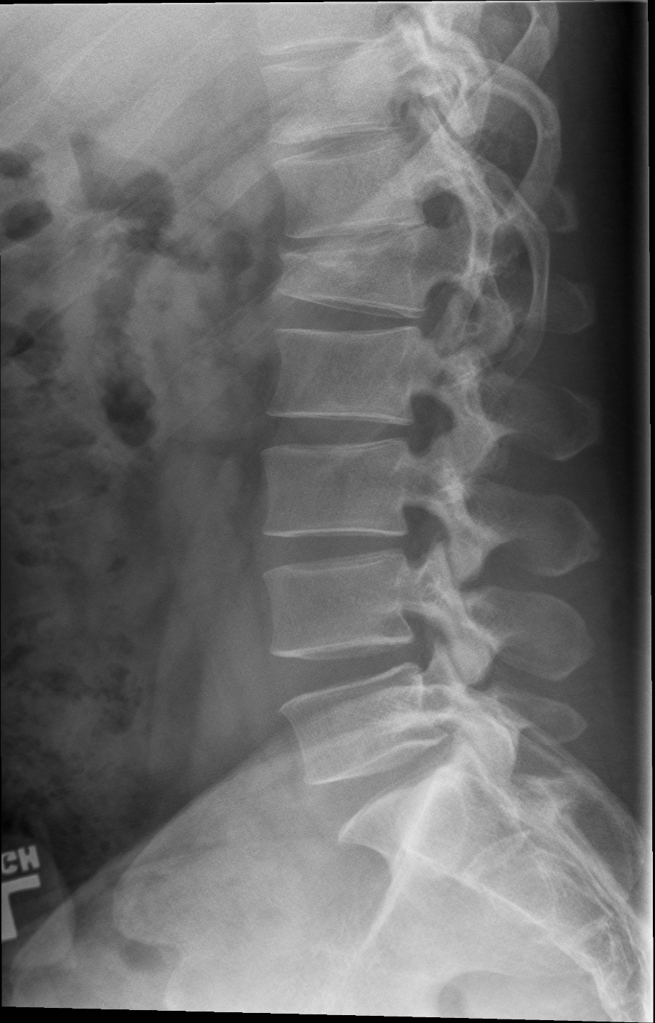
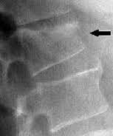

Slide 18
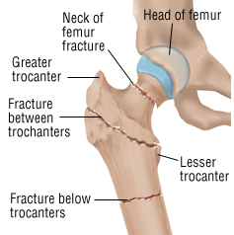
HIP FRACTURES
Majority caused by falling down.
The most devastating fracture and has huge impact on quality of life.
Risk factor for other condition: DVT
Increase in Mortality rate up to 50% in the following year after the fracture.
Types:
1- Femoral neck fracture
2-Intertrochanteric hip fracture

Slide 19
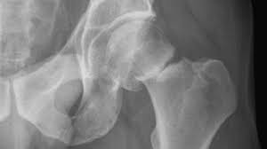
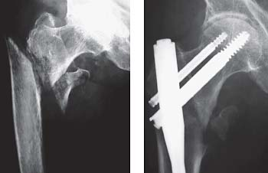

Slide 20
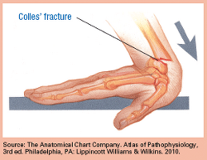
WRIST AND FOREARM FRACTURES
Colles’ Fracture: fracture of the distal end of the radius
Most commonly caused by fall on a stretched hand
Scaphoid fracture is less commonly in patient with osteoporosis

Slide 21
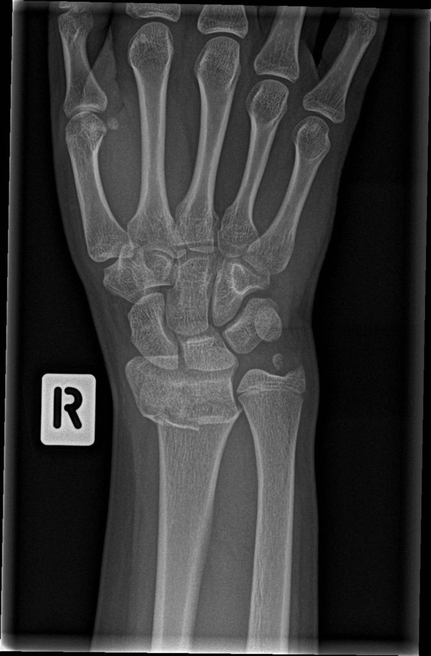
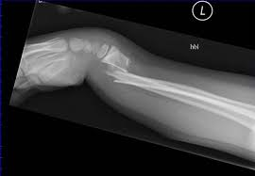

Slide 22
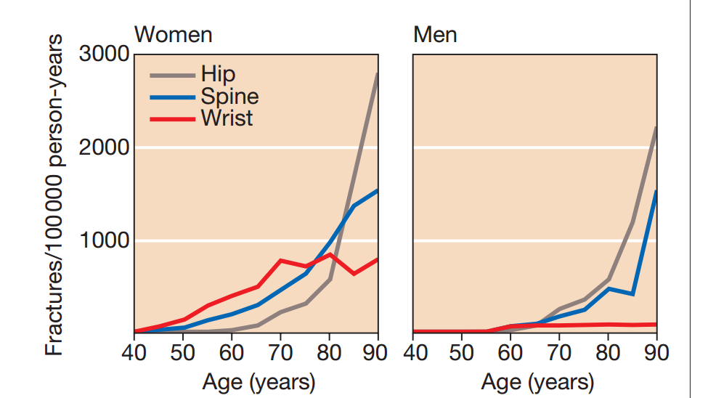

Slide 23
VITAMIN D AND COMORBIDITIES
Cardiovascular System
Hypertension
Obesity
Diabetes

Slide 24
CVS
From the data of the National Health and Nutrition Examination Study (NHANES) 2001 to 2004, the prevalence of coronary heart disease (angina, myocardial infarction) ,heart failure and peripheral arterial diseases was more common in adults with 25-hydroxycholecalciferol levels <20 ng/mL compared with ≥30 ng/mL.

Slide 25
CVS
In one of the largest trials, there was no beneficial effect on cardiovascular or metabolic risks after increasing baseline 25-hydroxycholecalciferol levels from 23 to well above 40 ng/mL (58 to 100 nmol/L).

Slide 26
HYPERTENSION
In Observational studies, normotensive and hypertensive individuals, there is an inverse association between 25-hydroxycholecalciferol concentration and blood pressure.
In meta-analysis of 10 trials , there was a nonsignificant reduction in systolic blood pressure (weighted mean difference -1.9 mm Hg) with vitamin D supplementation, but no effect on diastolic blood pressure.

Slide 27
OBESITY
The prevalence of Vitamin D deficiency was considered high in obese adolescents.
In several studies, obesity was associated with low 25-hydroxycholecalciferol concentration.

Slide 28
DIABETES MELLITUS TYPE 2
In several cross-sectional studies, type 2 diabetes and conditions known to be part of the metabolic syndrome were associated with a poor vitamin D status. However, in a systematic review of three longitudinal cohort studies, the association was not consistent. From the data of two cohorts, there was an association between higher vitamin D concentrations and lower risk for developing diabetes .
In a meta-analysis of eight trials evaluating the effect of vitamin D supplementation on glycaemia, there was no effect of supplementation on glycaemia or incident diabetes.

Slide 29
OSTEOPOROSIS INVESTIGATIONS

Slide 30
CASE SCENARIO
65 years old woman came to your clinic for routine check up. She were ok despite some abdominal bloating after eating. In completing the appropriate screening tests, you order (DXA) to evaluate whether the patient has osteoporosis. DXA results reveal a T-score of −3.0 at the total hip and −2.7 at the femoral neck. Osteoporosis was diagnosed, you requested Blood tests which came as the following
Calcium: 8.2 mg/dL LOW
25,OH vitamin D: 12 ng/mL (optimal > 25) LOW
Liver enzymes including alkaline phosphatase: normal
WBC: 7700/µL
Hg: 10.3 g/dL LOW
HCT: 32 g/dL LOW
MCV 68 LOW
PLT: 255,000/µL
What do you think her problem? Is it primary or secondary?

Slide 31
LABORATORY
What is the aim of conducting such invistgation?
What are the lab results that interest you and why?
Ca
PO4
Vitamin D
Creatinine
TSH
PTH if low what would you request further?
CBC
Alkaline Phosphatase

Slide 32
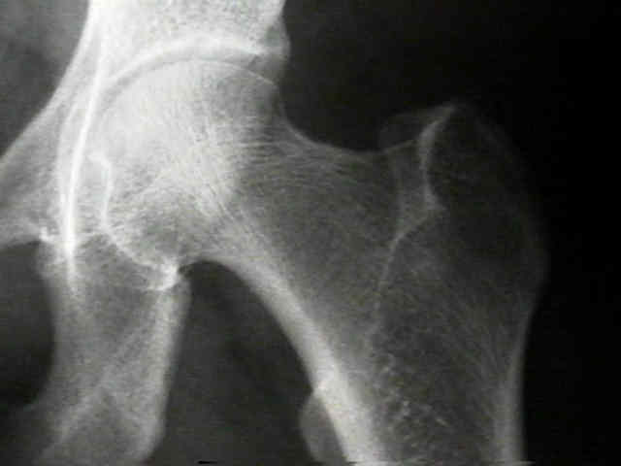
X-RAY
X-ray is an obsolete modality to diagnose or screen osteoporosis
No positive findings unless that you lost almost 50% of your bone density

Slide 33
DEXA
DEXA (dual-energy x-ray absorptiometry) scan is the gold standard
Sites selected are femoral neck and lumbar spine.
Compare the bone mineral density (BMD) of bone with a standard control, which is the bone density of a healthy 30-year-old person (T-score).
T-score and Z-score express Stander Deviation gap between control and patient.
(T-scores) are used in all postmenopausal and perimenopausal women, and in men over age 50.
In all other patients (including premenopausal women), z-scores are used.
Z-score is the result of comparing BMD of the patient with healthy matched individual(control)

Slide 34
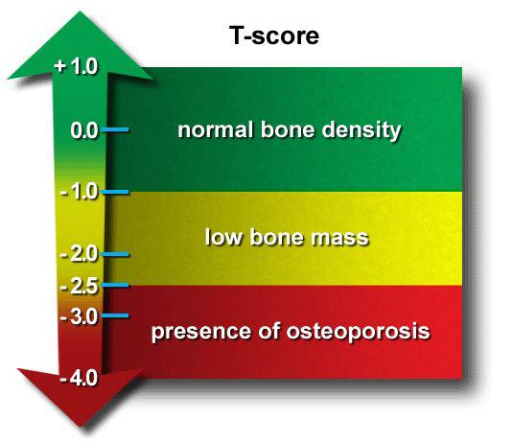
Z-score below < -2 indicates bone deficit that prompt searching the reason

Slide 35
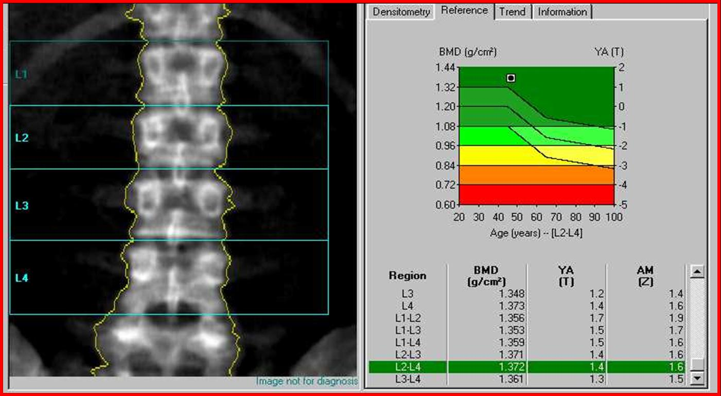

Slide 36
65 years old woman came to your clinic for routine check up. She were ok despite some abdominal bloating after eating. In completing the appropriate screening tests, you order (DXA) to evaluate whether the patient has osteoporosis. DXA results reveal a T-score of −3.0 at the total hip and −2.7 at the femoral neck. Osteoporosis was diagnosed, you requested Blood tests which came as the following
Calcium: 8.2 mg/dL LOW
25,OH vitamin D: 12 ng/mL (optimal > 25) LOW
Liver enzymes including alkaline phosphatase: normal
WBC: 7700/µL
Hg: 10.3 g/dL LOW
HCT: 32 g/dL LOW
MCV 68 LOW
PLT: 255,000/µL
What do you think her problem? Is it primary or secondary?

Slide 37
Although most women with osteoporosis will have primary osteoporosis, her hypocalcemia and low vitamin D levels suggest that this woman’s osteoporosis is due to a secondary cause. The GI symptoms and the iron deficiency anemia suggest that her hypovitaminosis D and low calcium is due to intestinal malabsorption

Slide 38
MANAGEMENT

Slide 39
What is the drug of choice for management of adrenal glucocorticoid-induced osteoporosis?
A-Alendronate
B-Calcitonin
C-Estrogen
D-Ketoconazole

Slide 40
OBJECTIVES TO BE COVERED
Management of osteoporosis and osteopenia
Role of medications
Role of vitamin D and Ca
Vitamin deficiency during pregnancy
Prevention and advice

Slide 41
1-MANAGEMENT OF OSTEOPOROSIS AND OSTEOPENIA
What do we mean by osteoporosis and osteopenia ?
Osteoporosis: is a disease in which there is a reduction in trabecular bone mass resulting in a porous bone
Osteopenia: is the stage before osteoporosis(T score=-1 - -2.5)

Slide 42
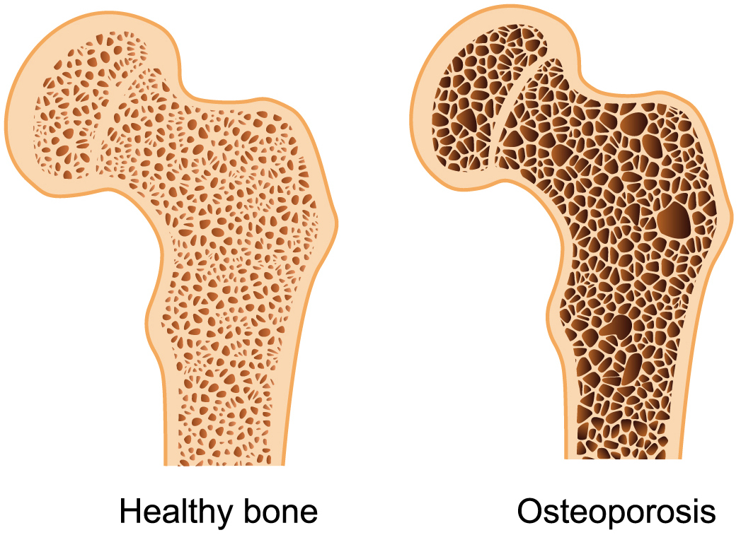
1-MANAGEMENT OF OSTEOPOROSIS AND OSTEOPENIA

Slide 43
1-MANAGEMENT OF OSTEOPOROSIS AND OSTEOPENIA
The management could be divided into two parts
Non-pharmacological therapy
Pharmacological therapy

Slide 44
1-MANAGEMENT OF OSTEOPOROSIS AND OSTEOPENIA
Non-pharmacological therapy
Diet: -Adequate calorie intake
-enough of Vit D and Ca
Exercise: weight-bearing exercises
Smoking cessation: because smoking accelerates bone loss
Eliminate or reduce alcohol
Avoid drugs that affect the bone (glucocorticoids)

Slide 45
1-MANAGEMENT OF OSTEOPOROSIS AND OSTEOPENIA
2. Pharmacological therapy
Who needs Pharmacological therapy?
1-Postmenopausal women with established osteoporosis(T score=-2.5 or less)
2-high-risk postmenopausal women (T score=-1.0 to -2.5)

Slide 46
2-ROLE OF MEDICATIONS
What medications do we use for osteoporosis?
Bisphosphonates:
2) Selective estrogen receptor modulator(raloxifine):
-first-line of treatment
-Example:alendronate .. drug of choice for management of adrenal glucocorticoid-induced osteoporosis
-MOA: decrease the activity of osteoclast and increase their apoptosis
-Watch out for jaw osteonecrosis
-Used if bisphosphonates are not tolerated or counterindicated
-it does not increase the risk of endometrial or breast cancer

Slide 47
2-ROLE OF MEDICATIONS
3)calcitonin:
used as a nasal spray
4)PTH therapy (teriparatide)
-given subcutaneously
-given once daily and not continuously why?
-used for less than 2 years (risk of osteosarcoma)
5)Denusomab:
Monoclonal antibody that decreases osteoclast activation

Slide 48
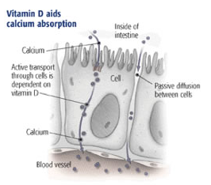
3-ROLE OF VITAMIN D AND CA
Ca : building block of bones
Vitamin D : Help in absorbing Ca.
They work together to maintain your bones health.

Slide 49
3-ROLE OF VITAMIN D AND CA
Ca: Normal serum calcium level=8.5-10.5 mg/Dl
Ca
Bone
99%
Blood
1%
Complexed
10%
Bound
40%
Non-Bound
60%
free
50%

Slide 50
3-ROLE OF VITAMIN D AND CA

Slide 51
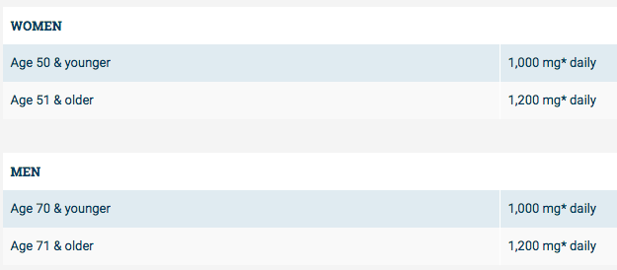
3-ROLE OF VITAMIN D AND CA
Optimal intake of calcium:
From national osteoporosis foundation

Slide 52
3-ROLE OF VITAMIN D AND CA
Vitamin D:
-Provides Ca and phosphate to ECF for bone mineralization.
-deficiency can cause rickets or osteomalacia.

Slide 53
3-ROLE OF VITAMIN D AND CA
Optimal intake of Vitamin D:
From national osteoporosis foundation

Slide 54
4-VITAMIN DEFICIENCY DURING PREGNANCY
Why do you we care about Vitamin D level during pregnancy?
1- The woman’s body needs vitamin D to maintain proper levels of Ca and phosphorus, which help build the baby's bones and teeth
2-Pregnancy is a negative Ca balance state
3-deficiency might cause abnormal bone growth, fractures, or rickets in newborns.
4-It may have an association to gestational diabetes

Slide 55
4-VITAMIN DEFICIENCY DURING PREGNANCY
How much of vitamin D does a pregnant lady need?
600 international units (IU) of vitamin D or 15 micrograms (mcg) each day.

Slide 56
5-PREVENTION AND ADVICE
1-Adequate dietary intake of Ca :
(1200-1300 mg per day) either from dairy food (yoghurt-fish) or supplements
2-Vitamin D deficiency and sunlight :
we need significant sunlight exposure to the face,arms and hands(15-30 mins a day up to 50 mins in winter)or simply take supplements

Slide 57
5-PREVENTION AND ADVICE
3-Exercise:
Moderate exercises against gravity (brisk walking for 30 mins four times a week)
4-Lifestyle modifications:
Stop smoking..limit alcohol
5-Adequate nutrition:
Keep BMI<18

Slide 58
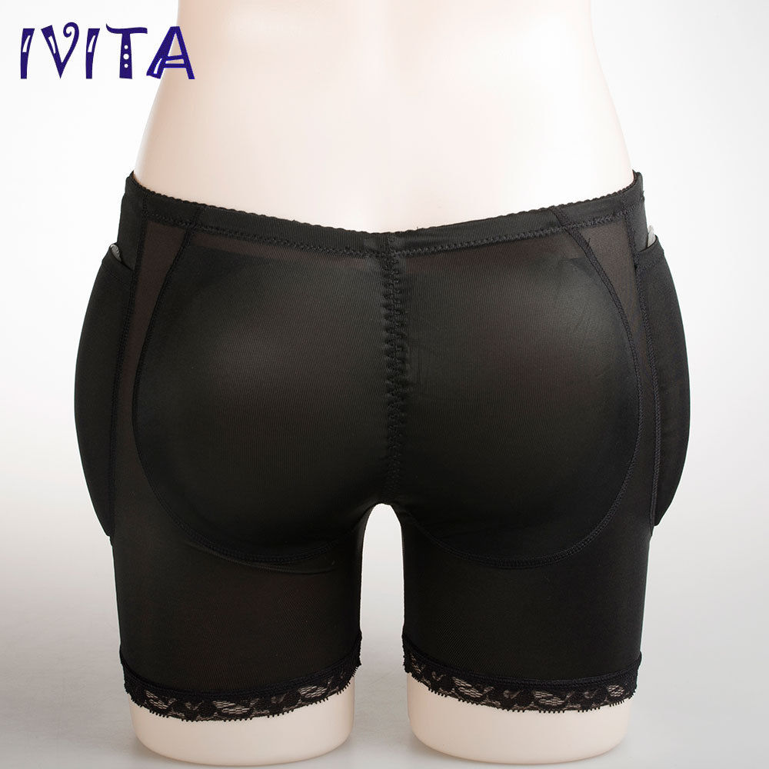
5-PREVENTION AND ADVICE
6-Prevent falls:
By 1) avoiding sedative medications
2) Wear low-heeled shoes
3) Wearing hip protectors for protection

Slide 59
REFERENCES
NICE guidelines
MURTAGH’S General practice
OXFORD HANDBOOK OF GENERAL PRACTICE
Roger Bouillon, MD, PhD, FRCP. (Mar 09, 2016). Vitamin D and extraskeletal health
Davidson Principles and Practice of Medicine, 22nd edition

