Slide 1
Common Psychiatric Problems in Primary Care
Supervised by: Dr. Yousef Alturki
IBRAHIM ALNAJASHI
MOHAMMAD ALKHARRAZ
ABDULRAHMAN ABU SITTAH

Slide 2
Objectives
To understand the prevalence of anxiety, depression , and somatic symptom disorder in Saudi Arabia
To understand the etiology of anxiety, depression and somatic symptom disorder
To understand the clinical features and management of anxiety in family medicine setting
To understand the clinical features and management of depression in family medicine setting
To understand the clinical features and management of psycho-somatic illness in family medicine setting
To have knowledge le of counseling and psychotherapy in the management of common psychiatric problems in family medicine
To understand appropriate time to consult a psychiatrist

Slide 3
Q1
Which one of the following symptom must be present to diagnose Depression?
Weight loss
Sleep disturbance
Anhedonia
Loss of appetite

Slide 4
Q2
A 20-year-old college student presented with repeated bouts of palpitation, sweating, and excessive worries when he uses public transport. The most likely diagnosis is
Generalized anxiety disorder
Posttraumatic disorder
Agoraphobia with panic attacks
Social phobia

Slide 5
Q3
which of the following is a risk factor for Somatic symptom disorder “SSD”?
Male
Female
High socioeconomic status
High education level

Slide 6
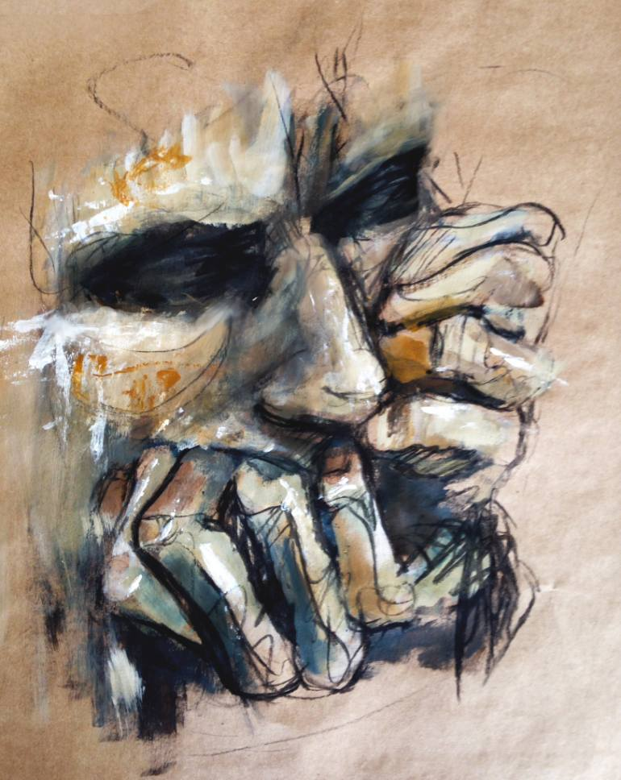

Anxiety

Slide 7
Subjective feeling of worry, fear, and apprehension accompanied by autonomic symptoms (such as palpitation, sweating), caused by anticipation of threat/danger.

Slide 8
Prevalence in Saudi Arabia
In a study done on 822 male patients that attended Primary Health Care Centers, Eastern Saudi Arabia: The overall prevalence of anxiety was 22.3% with 17.0% of the attendees having mild degree of anxiety.

Slide 10
Etiology
The first consideration is the possibility that anxiety is due to a known or unrecognized medical condition.
Substance-induced anxiety disorder (over-the-counter medications, herbal medications, substances of abuse) is a diagnosis that often is missed.
Genetic factors significantly influence risk for many anxiety disorders.
Environmental factors such as early childhood trauma can also contribute to risk for later anxiety disorders.
Some individuals appear resilient to stress, while others are vulnerable to stress, which precipitates an anxiety disorder.

Slide 11
Anxiety classification
Panic Disorder
Phobias (Agoraphobia , Social phobia , Specific phobia)
Generalized Anxiety Disorder ( GAD)
OCD

Slide 12
Panic Disorder
Recurrent panic attacks, at least some of which are not triggered or expected, and one month or more of either worry about future attacks/consequences, or a significant maladaptive change in behavior related to the attacks, such as avoidance of the precipitating circumstances

Slide 13
Generalized Anxiety Disorder ( GAD)
Excessive worry and anxiety that are difficult to control, cause significant distress and impairment, and occur on more days than not.

Slide 14
Generalized anxiety disorder: case history
A 23 year old female medical student presents to the outpatient family medicine department complaining of excessive worry for the past 8 months. She says that she is worried about her grades and about her future medicine career. She also reports being excessively worried about getting married having children, as she is afraid she might not be able to be a mother and a physician at the same time. She has also been worrying about her friend because she has just graduated from the college of science did not find a job. This excessive worry has detrimentally affected her GPA and social functioning. She now finds it difficult to concentrate in her daily life.

Slide 15
She also complains of muscle tension, sleep disturbances, fatigue, restlessness, irritability, and poor concentration.
She is healthy and takes no medications. She has never been diagnosed with a psychiatric illness. She also denies any substance use.

Slide 16
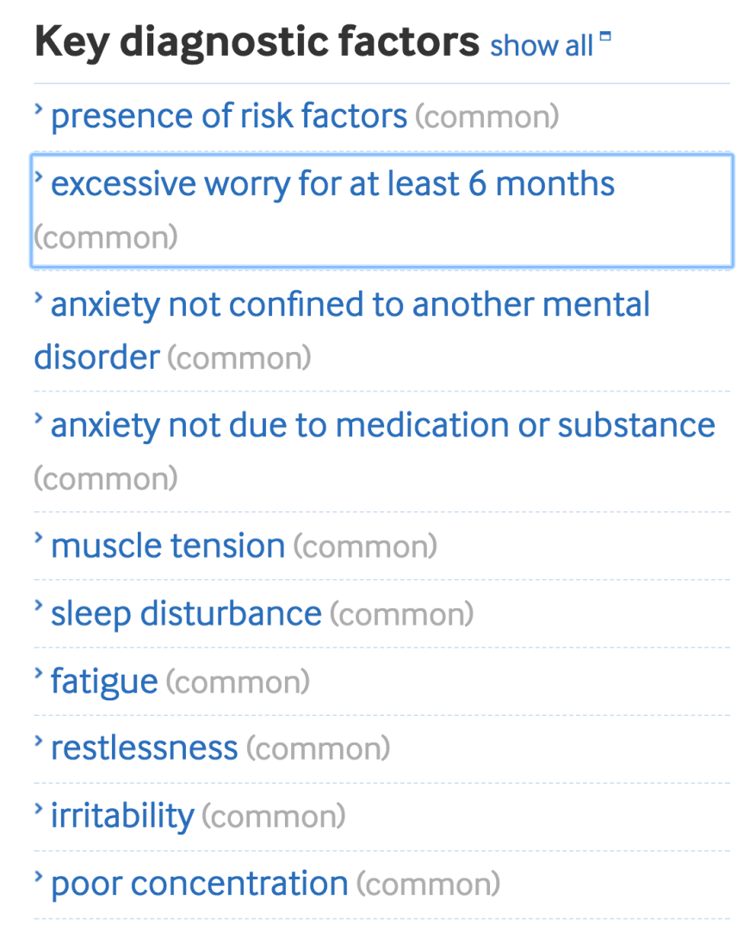
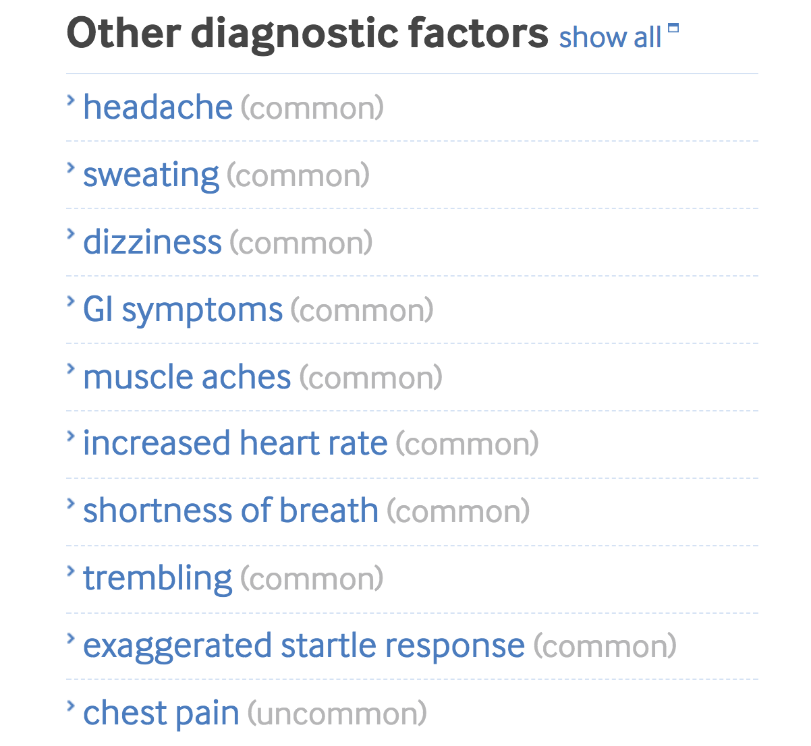
Generalized anxiety disorder: clinical features (>6 months)

Slide 17
Generalized anxiety disorder management
Pharmacotherapy and Cognitive Behavioral Therapy are first line treatment (you can either give meds, or do CBT)
They are equally effective
Pharmacotherapy: SSRI (paroxetine), SNRI (venlafaxine)
CBT: good options for patients who don’t want meds or can’t tolerate them
If the patient is not getting better with your meds, consult psychiatry.

Slide 18
Phobias
It is anxiety related to specific situations or objects.
Patients avoid these objects or situations, become anxious when they anticipate having to meet them and/or endure them with intense distress.
Common phobias are spiders, people and social situations, flying, open spaces, confined spaces, heights, cancer, thunderstorms, death and heart disease.

Slide 19
Obsessive Compulsive Disorder (OCD)
Recurrent and persistent intrusive ideas, thoughts, impulses or images that are usually resisted by the patient.
Repetitive, purposeful and intentional behaviors conducted in response to an obsession to prevent a bad outcome for the patient. It impact daily life.

Slide 20

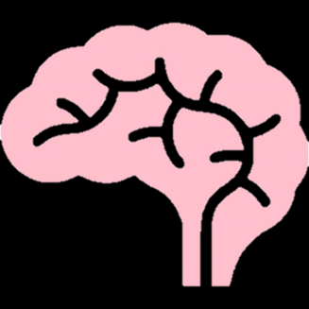
Depression

Slide 21
Is a mood disorder that causes a persistent feeling of sadness and loss of interest.

Slide 22
Global Prevalence
Females are more prone to have depression compared to males 2:1.
Depression is more common in younger adults.
Depression is estimated to affect 350 million people worldwide (WHO 2012).
In a study done on 822 male patients that attended Primary Health Care Centers, Eastern Saudi Arabia: The overall prevalence of depression was 32.8% with mild depression accounting for 22.9%.

Slide 23
Prevalence of Depression in Saudi
Cross-sectional study was conducted in three large primary care centers in Riyadh .They used Arabic version of PHQ-2 and PHQ-9. Patients included in the survey analysis were 477. The study found the point-prevalence of screened depression (showing signs of depression) to be 49.9% among the adult visitors to primary healthcare.

Slide 24
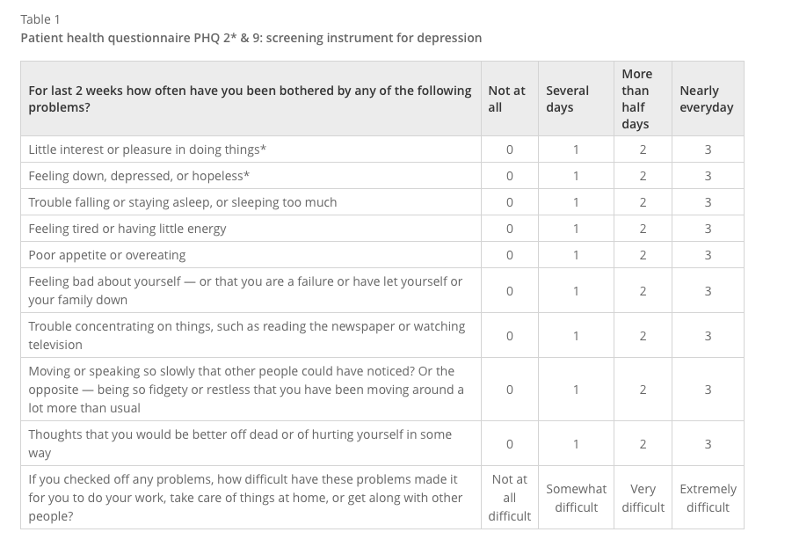
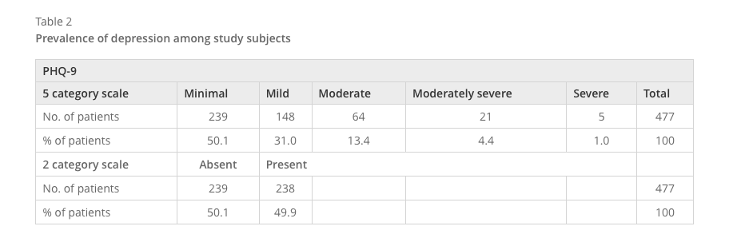

Slide 25

Causes of Depression
Genetical
Biological
Psychological

Slide 26
Causes of Depression
Mental, Physical or Sexual Abuse.
Major events: Death or loss of loved one.
Social Isolation due to Other mental illnesses.
Co-exists with a Major illness or may be triggered by it.
Certain Medications (isotretinoin , interferon-alpha, and corticosteroids).
The Abuse Substance, nearly 30% of them have major or clinical depression.

Slide 27
Major Depressive Disorder
≥ 5 of the previous symptoms have been present during the same 2-week period and represent a change from previous functioning; at least one of the symptoms is either no.1 or no.2:
Significant distress or impairment in functioning.
The symptoms do not meet criteria for a mixed episode.
Not due to substance abuse , a medication or a medical condition(e.g., hypothyroidism)

Slide 28
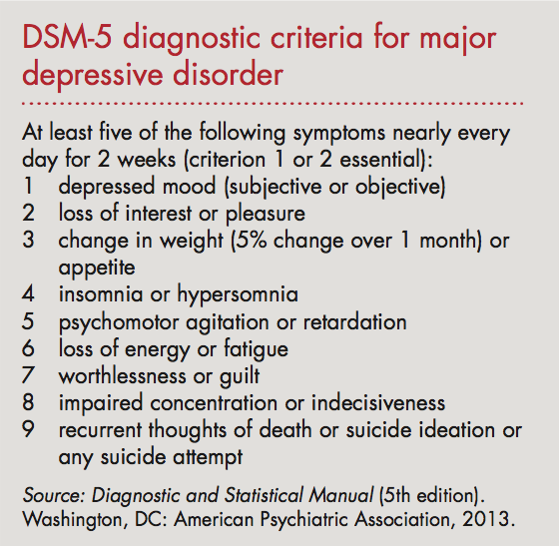

Slide 29
Dysthymic Disorder (Persistent depressive disorder)
Dysthymic disorder is a chronic depressed mood that lasts most of the day and presents on most days.
≥ 2 years history of chronic low mood.
No remission periods more than two months.

Slide 30
Post-partum Depression
About 10 - 15 % recently delivered women develop disabling depression within 6 weeks of childbirth .
Which if not treated may continue for six months or more and cause considerable family disruption.
It is associated with increasing age, mixed feelings about the baby, physical problems in the pregnancy and prenatal period, family distress and past psychiatric history.

Slide 31
Depression: case
29 year old female presents to the family medicine clinic complaining of depressed mood of 3 months duration. She reports feeling worthless and living without a purpose. She has also lost interest in her hobbies such as stamp collection. She isn’t interested in going out with her friends or seeing her family anymore. Her employer sent her a warning because the has been absent for many days since this problem begun. She also reports having marital problems because she has lost interest in having sex lately. She thinks life is not worth it and wishes if she could just die; but denies any suicidal thoughts.
BMI 35, diagnosed with obesity and advised to loose weight 3 months ago. No significant PMH.

Slide 32
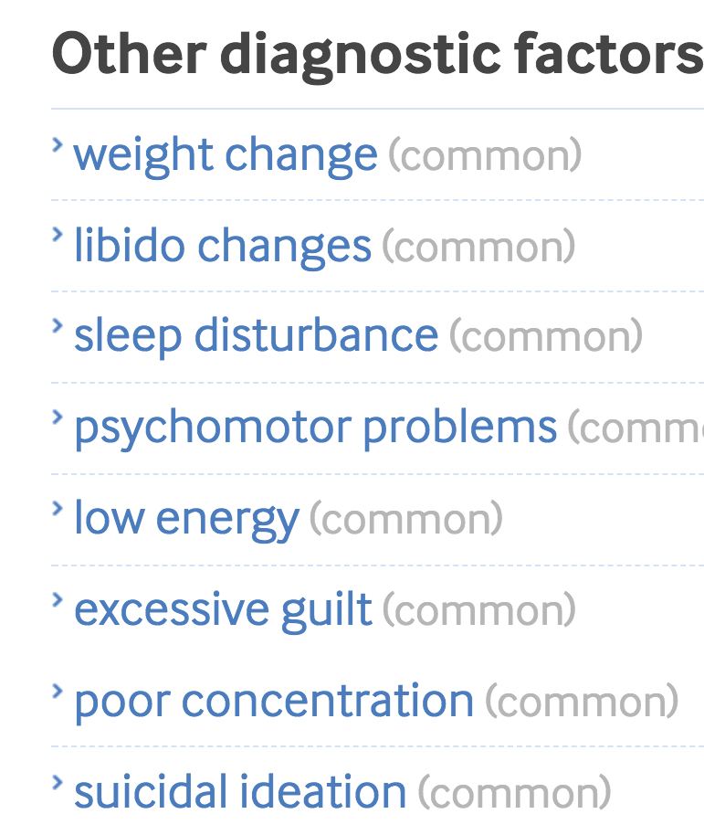
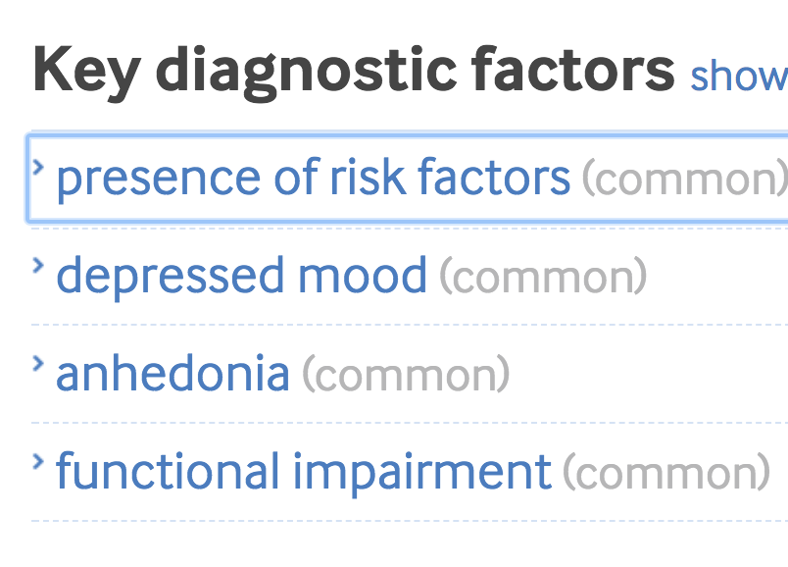
Depression: features (>2 weeks)

Slide 33
Depression: management
Severe (ex: suicidal): hospitalization & refer to psychiatrist
Not severe, not pregnant: antidepressants (SSRI: fluvoxamine)
Pregnant: antidepressants are avoided. Electroconvulsive therapy (ECT) may be used.
  Sometimes, the symptoms of depression can be more dangerous to the fetus than the side effects of the drugs. Therefore, they might be given, although this decision should be made by a specialist.

Slide 34
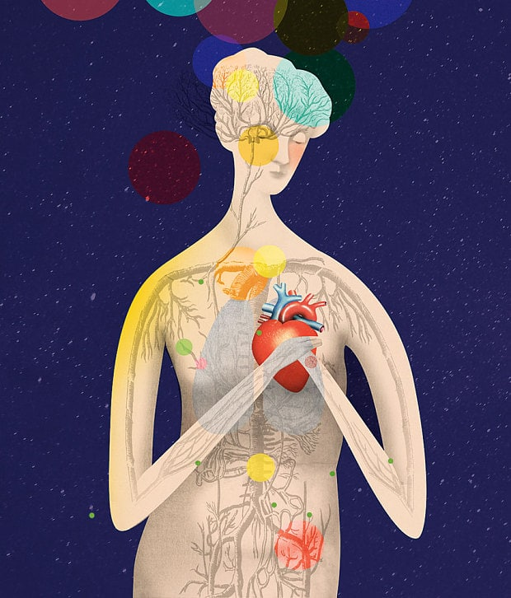

Somatization

Slide 35
A nonspecific physical symptoms that cannot be fully explained by a known medical condition after appropriate investigation.
In addition, the symptoms may be caused or exacerbated by anxiety, depression.
It is common for somatization, depression, and anxiety to all occur together.

Slide 36
Global Prevalence
Women > men (5 – 10 : 1).
The lifetime prevalence in the general population is about 2%
More common in patients who bottle up their emotions and are less assertive

Slide 37
Prevalence in Saudi
A study done in Aseer, Saudi Arabia in 2008 out of a sample size of 224 about half of the sample had one or more psychological disorders. The prevalence of Somatic Symptom Disorders was 16%.
A study done on Patients attending the Primary Health care Clinics in 2002, Saudi Arabia. Out of a sample size of 431 the prevalence of somatic symptom disorder was 19.1%.

Slide 38
Prevention of SSD

Slide 39
Primary Prevention
There are no demonstrated primary prevention measures.
Preventing child abuse and developmental trauma would eliminate a key known environmental risk factor for somatic symptom disorder .
Facilitating emotional processing skills during childhood may prevent somatic symptom disorder in response to awareness of physical symptoms.

Slide 40
Secondary Prevention
Limiting tests and procedures
Encouraging graded physical exercise
Encouraging a gradual increased participation in general activities of daily living (work, home, school)

Slide 41
Psychotherapy
Is a therapy used to treat people with a mental disorder by teaching them strategies and giving them tools to deal with stress and unhealthy thoughts and behaviors.

Slide 42
Cognitive Behavioral Therapy (CBT): is one of psychotherapy types and it aims to change a person's thinking to be more adaptive and healthy. Behavioral therapy focuses on a person's actions and aims to change unhealthy behavior patterns.
Cognitive behavioral therapy can be applied to treat many mental disorders such as:
Depression.
Anxiety disorder.
Somatoform disorders.

Slide 43
Counseling
counseling helps patients to solve stressful problems by decision making with an expert physician.
It opens the door for the best referral if needed
helping the patient to choose decision among alternative courses of actions

Slide 44
When to refer a patient to a psychiatrist?
Suicidality
Psychotic symptoms
Diagnostic questions
Developmental problems (children/adolescents)
Management review
Psychopharmacology assessment/advice
Substance abuse/addiction
Signs of dementia
Sleep problems
Sexual dysfunction
Abnormal bereavement
Family dysfunction

Slide 45
Q1
Which one of the following symptom must be present to diagnose Depression?
Weight loss
Sleep disturbance
Anhedonia
Loss of appetite

Slide 46
Q2
A 20-year-old college student presented with repeated bouts of palpitation, sweating, and excessive worries when he uses public transport. The most likely diagnosis is
Generalized anxiety disorder
Posttraumatic disorder
Agoraphobia with panic attacks
Social phobia

Slide 47
Q3
which of the following is a risk factor for Somatic symptom disorder “SSD”?
Male
Female
High socioeconomic status
High education level

Slide 48
Take home massege
anxiety, depression , and somatic symptom disorder are common psychiatric diseases in Saudi Arabia
Depression is more common in younger adults
Panic attacks are Sudden self-limited attacks of intense anxiety
SSD is a syndrome of physical symptoms that cause substantial distress or psychosocial impairment

Slide 49
References
Manual of psychiatry
John Murtagh's General Practice - 6th Edition (2015
http://www.lifesciencesite.com/lsj/life0903/017_9353life0903_128_133.pdf
https://www.ncbi.nlm.nih.gov/pmc/articles/PMC4744283/
http://ijp.sagepub.com/lookup/pmid?view=long&pmid=12489702
https://www.ncbi.nlm.nih.gov/pmc/articles/PMC3377053/
http://www.who.int/mental_health/management/depression/who_paper_depression_wfmh_2012.pdf
http://bmcpsychiatry.biomedcentral.com/articles/10.1186/1471-244X-14-190
DSM 5

Slide 50
THANK YOU

