Slide 1
MATERNAL AND CHILD HEALTH
PROF.MOHAMMED RUKBAN
SAUD ALGHAMDI
MOHAMMED ALDAMMAS
TAWFEEQ ALANDEJANI

Slide 2
OBJECTIVES
Health behaviors and health systems indicators that affect the health, wellness, and quality of life of women, children, and families.
Factors can affect pregnancy and childbirth, including: Preconception health status, Age, Access to appropriate preconception and interconception health care, Poverty
Health risks may include: Hypertension and heart disease, Diabetes, Depression, Genetic conditions, Sexually transmitted diseases (STDs), Tobacco use and alcohol Abuse, Inadequate nutrition, Unhealthy weight
Social and Physical Determinants of Maternal Health
Social and Physical Determinants of Infant and Child Health
How to improve the health and well-being of women, infants, children, and families.

Slide 3
Which one of the following is the major cause of maternal mortality in Saudi Arabia ?
Infection
Hemorrhage
High blood pressure
Unsafe abortion
Which one of the following vaccines should be given immediately after birth ?
Hepatitis B
Varicella
Hepatitis A
IPV
Which of the following factors can't affect pregnancy and childbirth?
A. Preconception
B. health status
C. Age
D. Exclusive breastfeeding for six months (0–5 months)

Slide 4
Urine sample for infection and to confirm your pregnancy IS CONSIDERED WHICH OF THE FOLLOWINGS ?
A- PRENATAL CARE
B- PERI NATAL CARE
C- POST NATAL CARE
D- NONE OF THE ABOVE
Gestational Diabetes mellitus IS DEFFINED AS ?
A-is when a woman without diabetes, develops high blood sugar levels after pregnancy
B-is when a woman with diabetes, develops high blood sugar levels during pregnancy
C-is when a woman without diabetes, develops high blood sugar levels during pregnancy
D-is when a woman without diabetes, develops high blood sugar levels before pregnancy

Slide 5
Maternal health

Slide 6
What is Maternal health
Maternal health refers to the health of women during pregnancy, childbirth and the postpartum period.

Slide 8
Maternal and child health indicators :

Slide 9
Maternal and child health indicators :
Definition: Health indicators are variables that reflect the state of health of persons in a community. (Oxford Dictionary of Epidemiology)
They inform about the quality of health care, and access of health care, and they are considered as quantitative measures.

Slide 10
Health indicators could be used to:
Assess the health care needs.
Compare health status of different areas or groups of people over time, one country with other countries or worldwide.
Monitoring and evaluation of health services, activities and programs-access, quality, effectiveness and equality.

Slide 11
Maternal Health Indicators
Maternal mortality ratio
Under-five child mortality, with the proportion of newborn deaths
Children under five who are stunted
Proportion of demand for family planning satisfied
Antenatal care coverage (at least four times during pregnancy)
Skilled attendant at birth
Exclusive breastfeeding for six months (0–5 months)

Slide 12
Maternal mortality ratio
It is the number of maternal deaths per 100,000 live births during a specified time period usually 1 year.
All maternal deaths occurring within a reference period
(usually 1 year) x100,000 ______________________________________________________ Total number of live births occurring within the reference period

Slide 14
Factors can affect pregnancy and childbirth

Slide 15
Factors can affect pregnancy and childbirth
Preconception
health status
Age
Access to appropriate preconception
interconception health care
Poverty

Slide 16
1-Preconception and interconception health care
Preconception health care :
Is the medical care of a woman or man receives from the doctor or other health professionals that aimed to increase the chance of having a healthy baby.
Inter-conceptional health care:
interconception health involves helping a woman understand the importance of being healthy between pregnancies and the need to wait at least 18 months before becoming pregnant again to help optimize birth outcome.

Slide 17
Preconception Health Care (Case)
Sarah is a 30-year old women . she smokes 10 cigarettes a day. She came to the Primary Care Clinic at KKUH for consultation about getting pregnant for the first time. On examination : Her BP was 160/90mmhg and Her BMI was 32.
# What is the role of family physician here and how would you manage this patient?

Slide 18
2- Preconception health status
A)Maternal behaviors like : Tobacco use , alcohol use , failure to consume adequate folic acid. ( lead to POOR BIRTH OUTCOMES )
B)Other conditions like : unintended pregnancy , experiencing physical abuse , experiencing high levels of stress.( lead to POOR PREGNANCY OUTCOMES )
C)Certain maternal health conditions like: Diabetes , hypertension , obesity. ( lead to poor infant outcomes and have a long-term negative impact on a woman’s health )

Slide 19
3- Age
The chances of surviving the first year of life were better for infants born to mothers aged 20-34 years than for those born to mothers of other ages.
The most favorable survival rates were among first births to mothers aged 20-24 and among first and second births to mothers aged 25-29.
Your risk of pregnancy complications, such as high blood pressure and gestational diabetes, increases after 35 and continues to rise in your 40s. The odds of genetic problems also jump as you get older: At 40, your chance of conceiving a child with Down syndrome is one in 100; at 45 it's one in 30.

Slide 20
4-Access to appropriate preconception
1- Talking to a health-care provider before becoming pregnant at least 6 months.
Why?
Because a woman might have a subsequent pregnancy, services in the postpartum period
(e.g., Accessing services such as the Special Supplemental Nutrition Program for Women, Infants, and Children.) So the women can maintain or regain good health

Slide 21
5- Poverty
The findings in analysis of NMIHS indicate that, for infants born to women living in poverty in the United States in 1988, overall excess mortality risk was approximately 60% compared with infants born to women living above the poverty level.
hose living in poverty were more likely to smoke, to have poorer dietary habits, lower levels of education, and engage in higher risk and health-demoting practices

Slide 22
MATERNAL HEALTH
Prenatal care
Prenatal care
Perinatal care
Postnatal care

Slide 23
Prenatal care
It Is the care of woman who want to be pregnant.
Duration : 6-12 months – 8week of pregnancy
Your job here as a Family physician is ??
Perinatal care
Taking care of the pregnant woman's and prepare her for safe delivery
Duration; from the Dx of pregnancy until delivery
Your job here as a Family physician is ??
Postnatal care
Is to insure that there is no complication after delivery

Slide 24
Routine Prenatal Tests: PRENATAL
Urine sample for infection and to confirm your pregnancy.
Blood pressure, weight, and height.
Prenatal blood tests
Gonorrhea and chlamydia cultures, and Pap test to screen for cervical cancer.
Ultrasound test.
Complete physical exam, including a pelvic exam.

Slide 25
High risk Factor in maternal and child health
HTN
Heart Disease
GDM
Tobacco &alcohol use
STDs
Nutrition
Unhealthy weight
Genetic factor
Post partum depression

Slide 26
Hypertension
MOST COMMON !!
complicating 2-3% of pregnancies
preeclampsia : BP and signs of damage to another organ system (HEART FAILURE) , usually after 20 weeks of pregnancy
WHY IS HYPERTENSION A PROBLEM DURING PREGNANCY ??
Decreased blood flow to the placenta
Premature delivery
PLACENTAL ABRUPTION

Slide 27
Gestational Diabetes mellitus
is when a woman without diabetes, develops high blood sugar levels during pregnancy
blood sugar usually returns to normal soon after delivery. But you're at risk for type 2 diabetes.
RISK FACTORS :
Age greater than 25
Family history
Excess weight (30 or higher BMI)
Complication;
Mother : Future DM, preeclampsia
Baby : birth weight, Preterm birth with respiratory distress syndrome

Slide 28
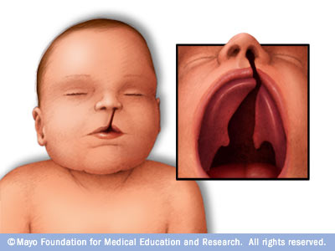
Tobacco Use And Alcohol Use
Approximately 10% of women reported smoking during the last 3 months of pregnancy.
hard to get pregnant
Miscarriage
problems with the placenta
Risk for Sudden Infant Death Syndrome (SIDS)

Slide 29
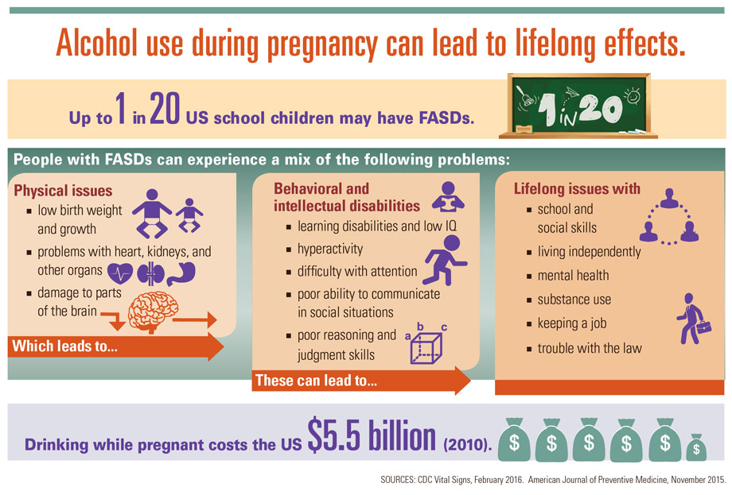

Slide 30
STDs
1-HIV/AIDS
It recommends that all women who are pregnant or planning to get pregnant should get tested for HIV as early as possible.
If a woman is treated for HIV early in her pregnancy, the risk of transmitting HIV to her baby can be 1% or less.
2-Herpes
Herpes is safe in pregnant women until she get ready to deliver.
Herpes lesions on genitals are highly contagious and infect the baby during labor
3-syphilis
May be transmitted to baby by infected mother.
It be linked to premature birth, stillbirth ,death in some cases
4-Gonorrhea
The risk in pregnancy :miscarriage, preterm birth
The risk before and after pregnancy if untreated : cause pelvic inflammatory disease
Gonorrhea in newborns most commonly affects the eyes

Slide 31
Poor nutrition
Malnutrition
Micro nutrition
Mother
Baby
Iron : Preterm birth
Neurological dysfuction
risk of death from bleeding
during childbirth
Vit A: night blindness
Folate : neutral tube defect
Calcium : poor skeletal development
Iron: low birth weight

Slide 32
Other conditions
Hepatitis
Unhealthy weight
Genitic conditions
Postpartum depression

Slide 33
If you are a family physician where would you classify the followings in maternal health care ?
Prenatal care
Follow up after delivery (BP , sugar)
PREGNANCY TEST
HTN
Heart Disease
GDM
Tobacco &alcohol use
STDs
Nutrition
Unhealthy weight
Genetic factor
Post partum depression
Perinatal care
Postnatal care

Slide 34
Case
36 y/o pregnant women in the second trimester come to your office complaining that she has a very ugly lesions in her genital area, and she was afraid that these lesions can affect her pregnancy or her child, what would you do in this case as her family physician ?

Slide 35
Social and Physical Determinants of Child Health

Slide 36
Social and Physical Determinants of Child Health
Definition: It’s a range of biological, social, environmental, and physical factors have been linked to maternal, infant, and child health outcomes.

Slide 37
Biological :
Birth Weight: low birth weight (< 2.5 kg) & high birth weight (> 4 kg) .
Age of The Mother : <19 years) or >over 30 years .
Repeated pregnancies : risk of miscarriage
Birth Spacing: < 1 year = 2-4 times risk of mortality
Multiple Births: more risk due to low birth weight
Family Size: 3 or more children, more frequent/prolonged illness

Slide 38
Socio-economic Factors :
Low income countries Rural areas
Low education Nutrition
Health care quality
Environmental conditions
Violence
Milk formula (Breast feeding)

Slide 39
Culture
Religion
Customs
Early marriages
Sex of child
Quality of mothering Traditions affecting
Cleanliness, Eating, Clothing.
Child care

Slide 40
Infant Mortality Rate (IMR) :
Infant mortality refers to deaths of young children, typically those less than one year of age. It is measured by the infant mortality rate (IMR), which is the number of deaths of children under one year of age per 1000 live births. The Under-Five Mortality Rate is also an important statistic considering the Infant Mortality Rate has a strict limit on focusing on children only under one year of age.
Perinatal mortality is late fetal death (22 weeks gestation to birth), or death of a newborn up to one week postpartum.
Neonatal mortality is newborn death occurring within 28 days postpartum.
Post neonatal mortality is the death of children aged 29 days to one year. The major contributors to postneonatal death are malnutrition, infectious disease, troubled pregnancy, Sudden Infant Death Syndrome and problems with the home environment.

Slide 41
IMR : cont…

Slide 42
How to improve maternal and child health
approximately 830 women die every day from causes related to pregnancy and childbirth.
5.9 million children under age five died in 2015, 16000 every day.
With quality health care, many of these deaths could be prevented.

Slide 43
How to improve Maternal health
First 24 hours : assessment of vaginal bleeding, uterine contraction, temperature and heart rate should be done routinely during the first 24 hours
Breastfeeding should be assessed
women should be asked about their emotional wellbeing, what family and social support they have
After 10–14 days, all women should be asked about postpartum depression
All women should be asked about sexual intercourse and possible dyspareunia as part of an assessment of overall well-being 2–6 weeks after birth
Iron and folic acid supplementation should be provided for at least 3 months after delivery.

Slide 44
How to improve infancy health
Promote early and exclusive breastfeeding (EBF):
Evidence shows EBF reduces the risks of mortality and morbidity and improves post-neonatal outcomes
Preterm and low-birth-weight babies should be identified as soon as possible and should be provided special care.
A full clinical examination should be done 1 hour after birth. This includes giving vitamin K prophylaxis and hepatitis B vaccination (within 24 hours).

Slide 45
Postnatal Care Highlights
Provide postnatal care in first 24 hours for every birth:
Delay facility discharge for at least 24 hours.
Visit women with home births within the first 24 hours.
Provide every mother and baby four postnatal visits on : First day (24 hours), Day 3 (48–72 hours) , Between days 7–14 and the Sixth week.

Slide 46
How to improve maternal and child health
Vaccinations :
● Before pregnancy: measles, rubella
● During pregnancy: Tdap vaccine to protect against whooping cough
● For infants: hepatitis B, TB, Chickenpox
● Flu shot could be taken during or before pregnancy.

Slide 48
video :
https://www.youtube.com/watch?v=R7Mm_l4762Q&pbjreload=10

Slide 49
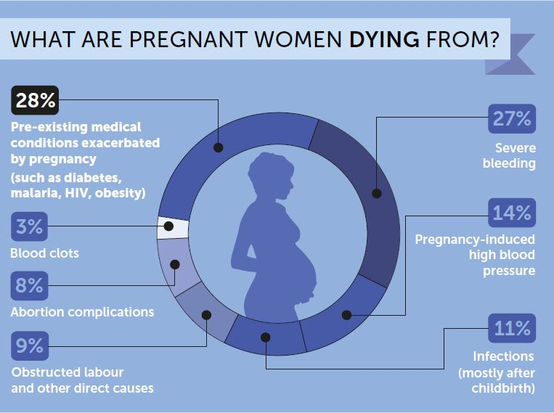

Slide 50
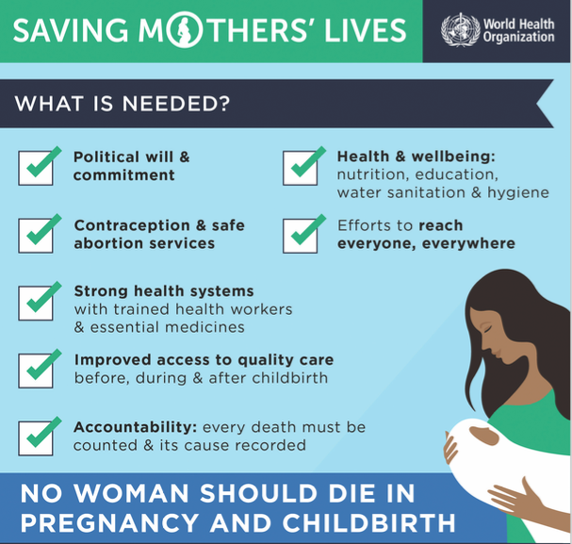

Slide 51
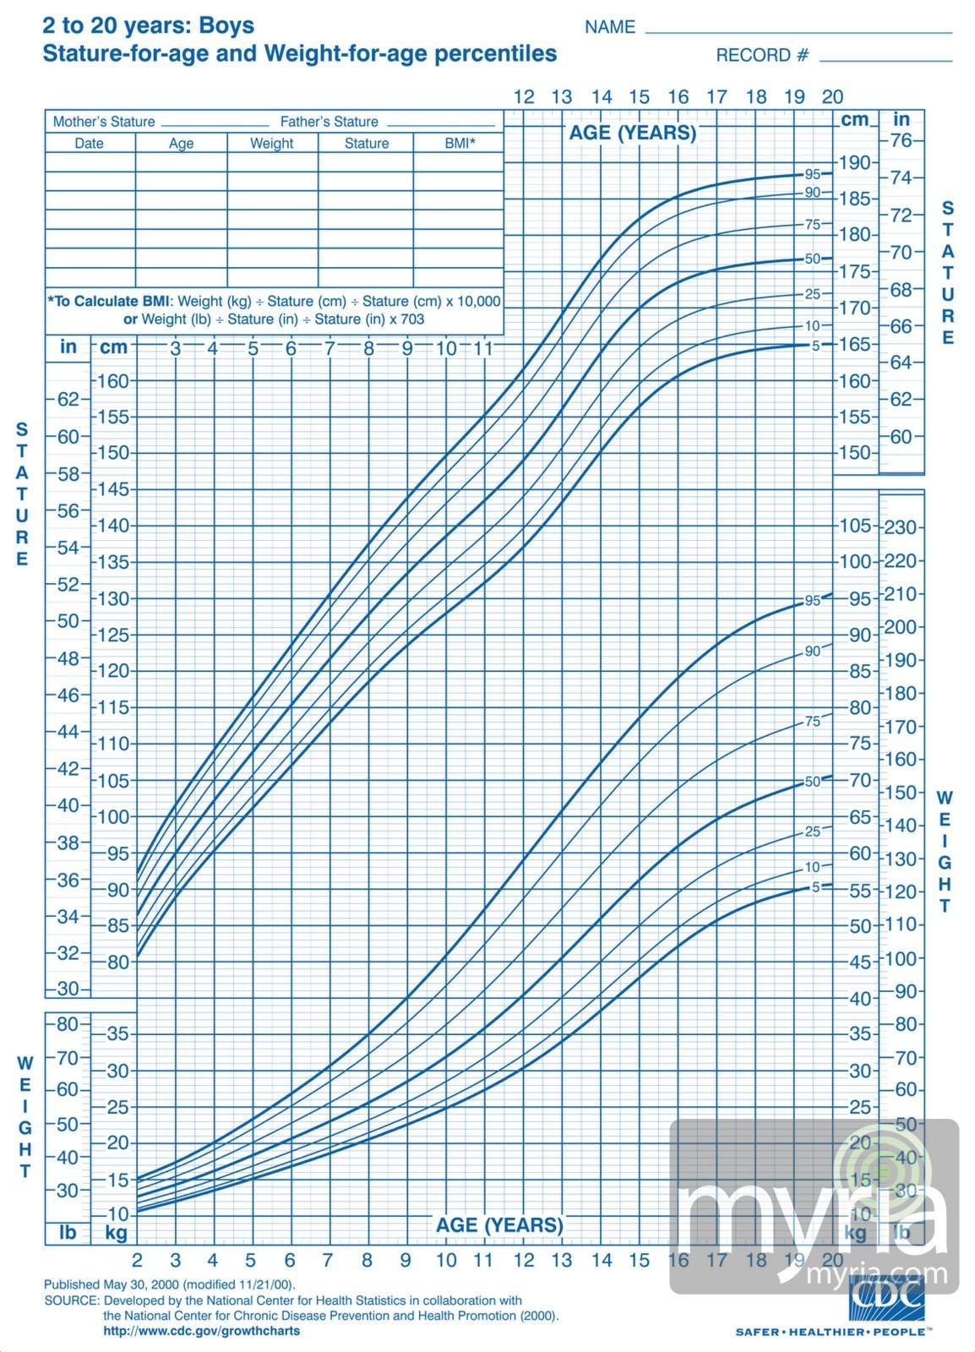
Milstones :
A growth chart is used by pediatricians and other health care providers to follow a child's growth over time.
Growth charts have been constructed by observing the growth of large numbers of normal children over time.

Slide 52
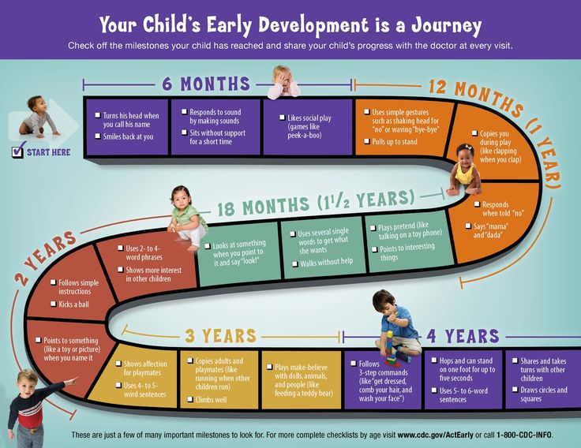
Child growth :

Slide 53
Weaning food :

Slide 54
Child Care :
Child care or childcare, child minding, daycare, or preschool is the caring for and supervision of a child or children, usually from age six weeks to age thirteen. Child care is the action or skill of looking after children by a day-care center, babysitter, or other providers.
WHY ?

Slide 55
Which one of the following is the major cause of maternal mortality in Saudi Arabia ?
Infection
Hemorrhage
High blood pressure
Unsafe abortion
Which one of the following vaccines should be given immediately after birth ?
Hepatitis B
Varicella
Hepatitis A
IPV
Which of the following factors can't affect pregnancy and childbirth?
A. Preconception
B. health status
C. Age
D. Exclusive breastfeeding for six months (0–5 months)

Slide 56
Urine sample for infection and to confirm your pregnancy IS CONSIDERED WHICH OF THE FOLLOWINGS ?
A- PRENATAL CARE
B- PERI NATAL CARE
C- POST NATAL CARE
D- NONE OF THE ABOVE
Gestational Diabetes mellitus IS DEFFINED AS ?
A-is when a woman without diabetes, develops high blood sugar levels after pregnancy
B-is when a woman with diabetes, develops high blood sugar levels during pregnancy
C-is when a woman without diabetes, develops high blood sugar levels during pregnancy
D-is when a woman without diabetes, develops high blood sugar levels before pregnancy

Slide 57
REFRENCES:
Centers for Disease Control and Prevention
منظمة الصحة العالمية
World Health Organization
Thank you !

