Slide 1
Prevention and screening
Done by
Qasem Alsultan
Omer Alomer
Omer Alayed

Slide 2
objectives
To Define screening / prevention and its uses in family practice
To understand the Criteria for screening tests
To identify Screening types and targeted people for each type with examples.
To identify appropriate approaches for prevention and screening of common problems in primary care .
To explain pros and cons of screening .
To justify the rational for selection of a screening test with practical case /condition, examples like for CA. breast, Ca. colon, Ca. prostate

Slide 3
MCQ
Q1: WHICH ONE OF THE FOLLOWING IS CONSEDRED AS TERTIARRY PREVENTION:
educational programs.
palliative therapy.
lifestyle modification.
fecal occult blood test.

Slide 4
MCQ
Q2: 30 Years old male. On screening his BP was 135\85. Which one of the following statements is correct?
A)Screen him again after 3 years.
B)Life style modification and screen him every year.
C)Start treatment with ACE Inhibitor.
D)Do Nothing.

Slide 5
MCQ
Q3: screening tests fall under which one of the following:
A) primordial prevention
B) primary prevention
C) secondary prevention
D) tertiary prevention

Slide 6
MCQ
Q4: 55 Years old male underwent Flexible Sigmoidoscopy for colon cancer screening. The result was Negative. When is the proper time to Rescreen the patient?
A) After 3 Years.
B) Every Year.
C) After 5 Years.
D) After 10 Years.

Slide 7
MCQ
Q5: 19 years old educated female with strong family history of breast cancer came to the clinic worried and asking you when she should start the mammogram screening?
A)Age of 60
B)Age of 50
C)Age of 25
D)Age of 40

Slide 8
Interactive Case
This is 72 years old, heavy smoker male presents to primary clinic complaining of “blood in the stools”
Are there any questions in the Hx you want to ask patient about ?
Physical Examination ?
How would you diagnose this case?
What is the most likely diagnosis?
Do you think that the screening of this patient would change the prognosis? How?
What are the screening tests that could be used to prevent the progression of this disease?

Slide 9
What is screening?
To look for diseases in a group of asymptomatic people to identify these diseases in its early stages.
an early disease detection OR secondary prevention

Slide 10
advantages Of Screening
-Improved prognosis for some cases detected by screening.
-Less radical treatment for some early cases.
-Reassurance for those with negative test results.
-Increased information on natural history of disease and benefits of treatment at early stage.
-Economic saving on future treatment.

Slide 11
Disadvantages Of Screening
-Longer morbidity in cases where prognosis is unaltered.
-False reassurance for those with false-negative results.
-Anxiety, Unnecessary intervention and sometimes morbidity for those with false-positive results.

Slide 12
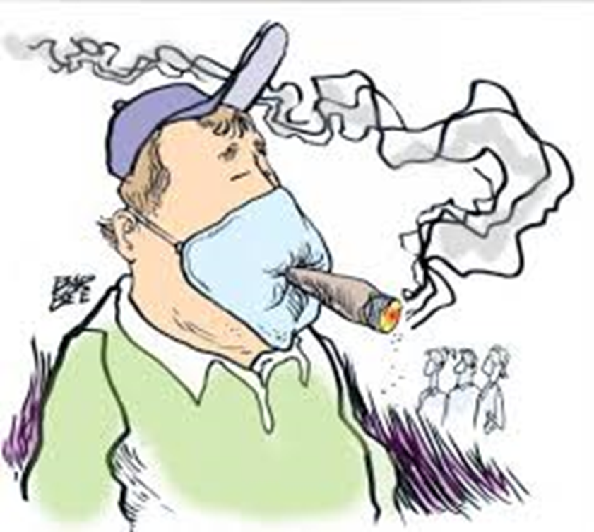
what is prevention?

Slide 13
What is prevention?
Averting and eliminating diseases and minimizing the impact of diseases.
The action of stopping something from happening

Slide 14
What is Family Physicians Role in Screening ?
A family physicians is the one who provides an anticipatory care approach for precluding problems .
This specialty puts all efforts to offer all appropriate forms of prevention within the consultation and the organizational framework of primary care .

Slide 15
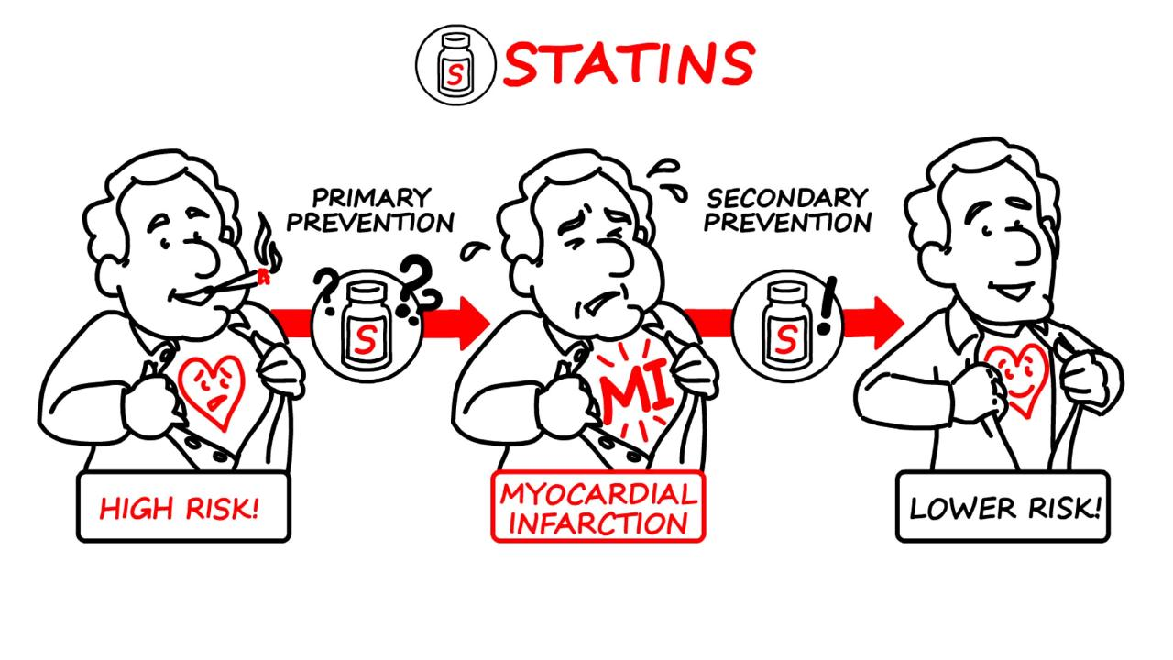
Prevention Types:
1. Primary prevention
2. Secondary prevention
3. Tertiary prevention

Slide 16
Primary prevention
Primary prevention aims to prevent disease or injury before it ever occurs.
This is done by:
A) preventing exposures to hazards that cause disease or injury
B) altering unhealthy or unsafe behaviors that can lead to disease or injury.
C) increasing resistance to disease or injury WHENEVER exposure occur.
Notes:
Prevention of disease occurrence

Slide 17
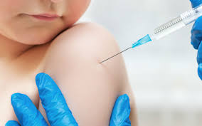
Primary prevention (Cont.)
Examples:
- Sanitation of the environment.
- Education about healthy and safe habits (e.g. eating well, exercising regularly, not smoking)
- Vaccination

Slide 18
Secondary prevention
To reduce the impact of a disease or injury that has already occurred.
This is done by:
A) Detecting and treating disease or injury as soon as possible to halt or slow its progress
B) Encouraging personal strategies to prevent re-injury or recurrence
Notes:
Controlling disease in early form.

Slide 19
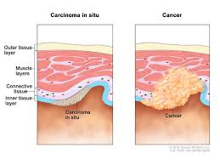
Secondary prevention (Cont.)
Examples:
- Carcinoma in situ
Notes:
A group of abnormal cells that remain in the place where they first formed. They have not spread. These abnormal cells may become cancer and spread into nearby normal tissue. Also called stage 0 disease.

Slide 20
Tertiary prevention
Prevention of complications once the disease is present. The goal is to improve the quality of life and prevent disabilities.
This is done by:
Helping people manage long-term, often-complex health problems and injuries (e.g. chronic diseases, permanent impairments) .

Slide 21
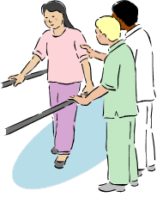
Tertiary prevention (Cont.)
Examples:
- Stroke rehabilitation program.
-DM

Slide 22
The Wilson–Jungner criteria for screening
All screening tests should meet the following criteria before they are introduced to the target population:
• The condition being screened for is an important health problem
• Natural history of the condition is well understood
• There is a detectable early stage
• Treatment at early stage is of more benefit than at late stage
• There is a suitable test to detect early stage disease

Slide 23
The Wilson–Jungner criteria (Cont.)
• The test is acceptable to the target population
• Intervals for repeating the test have been determined
• Adequate health service provision has been made for the extra clinical workload resulting from screening
• Risks, both physical and psychological, are < benefits
• Costs are worthwhile in relation to benefits gained

Slide 24
Common Screening Conditions in the primary care
Hypertension Screening.
Cervical Cytology 21-65
Developmental surveillance.
Mammography
Serum lipid estimation. +35
Screening psychiatric illness.
Prostate Cancer screening
Colorectal cancer 50-75
Diabetes 40-70
Osteoporosis +65
CVD risk assessment

Slide 25
What are common conditions or diseases
Where we can apply screening & Preventive?

Slide 26
Diabetes Mellitus
Diabetes mellitus is one of the most common diagnoses made by family physicians.
Uncontrolled diabetes can lead to blindness, limb amputation, kidney failure, and vascular heart disease.
Lifestyle and pharmacologic interventions decrease progression to diabetes in patients with impaired fasting glucose or impaired glucose tolerance.

Slide 27
DM
The U.S. Preventive Services Task Force recommends screening for abnormal blood glucose and type 2 diabetes in adults 40 to 70 years of age who are overweight or obese, and repeating testing every 3 years if results are normal.
Screen all adults who are overweight ( BMI ≥ 25 kg/ m2) and have additional risk factors.
Screening for type 1 diabetes is not recommended

Slide 28
Colorectal Cancer
Most common cancer in Saudi males and 3rd in Saudi females.
25-30% of patients present with distant metastasis
Low survival rates due to late diagnosis
It’s an important health problem, where early diagnosis is critical.

Slide 29
Colorectal Cancer
Screening in persons at average risk should begin at 50 years of age; the U.S. Preventive Services Task Force recommends against routine screening after 75 years of age.
Options for screening include :
high-sensitivity fecal occult blood testing annually.
flexible sigmoidoscopy every five years with high-sensitivity fecal occult blood testing every three years.
colonoscopy every 10 years

Slide 30
Breast Cancer
The major form of Cancer among women
Among 20% of female cancer deaths , it is the most common cause of death in women aged 35-54.
It’s an important health problem, where early diagnosis is critical.

Slide 31
Breast cancer
Mammography is the only screening test shown to reduce breast cancer–related mortality.
screening should be offered at least biennially to women 50 to 74 years of age.
For women with an estimated lifetime breast cancer risk of more than 20 percent or who have a BRCA mutation, screening should begin at 25 years of age.

Slide 32
Hypertension
Common
Usually asymptomatic.
Dangerous itself, but also a risk factor for CVD
Usually found during routine BP screening or incidentally.

Slide 33
HTN
The USPSTF recommends screening for high blood pressure in adults aged 18 years or older.
Adults 40 years or older should have their blood pressure measured at least annually.
Adults between 18 and 39 years should also be screened at least annually if they have risk factors for hypertension (eg, obesity) or if their previously measured blood pressure was 130-139/85-89 mmHg
Adults between 18 and 39 years whose latest blood pressure was <130/80 mmHg and have no risk factors for hypertension should be screened at least every three years.

Slide 34
summery

Slide 35
MCQ
Q1: WHICH ONE OF THE FOLLOWING IS CONSEDRED AS TERTIARRY PREVENTION:
educational programs.
palliative therapy.
lifestyle modification.
fecal occult blood test.

Slide 36
MCQ
Q2: 30 Years old male. On screening his BP was 135\85. Which one of the following statements is correct?
Screen him again after 3 years.
Life style modification and screen him every year.
Start treatment with ACE Inhibitor.
Do Nothing.

Slide 37
MCQ
Q3: screening tests fall under which one of the following:
primordial prevention
primary prevention
secondary prevention
tertiary prevention

Slide 38
MCQ
Q4: 55 Years old male underwent Flexible Sigmoidoscopy for colon cancer screening. The result was Negative. When is the proper time to Rescreen the patient?
After 3 Years.
Every Year.
After 5 Years.
After 10 Years.

Slide 39
MCQ
Q5: 19 years old educated female with strong family history of breast cancer came to the clinic worried and asking you when she should start the mammogram screening?
Age of 60
Age of 50
Age of 25
Age of 40

Slide 40
Any questions ? *Note: the doctor mentioned that you have to know how to differentiate between the diagnostic and screening test it might comes as a scenario.

Slide 41
Thank you

Slide 42
References
http://www.colorectal-cancer.ca/en/screening/fobt-and-fit/
http://www.aafp.org/afp/2016/0115/p103.html
Oxford Hand Book Of General Practice 4TH Edition
http://healthvermont.gov/adap/prevention/prevention_fact.aspx#Definition
https://en.oxforddictionaries.com/definition/prevention
http://www.emro.who.int/about-who/public-health-functions/health-promotion-disease-prevention.html
https://www.iwh.on.ca/wrmb/primary-secondary-and-tertiary-prevention
https://medlineplus.gov/healthscreening.html
https://www.uptodate.com/contents/search
Team 433

