Slide 2
Adolescents Health
Done by:
Abdullah Alhamoudi - 434102688
Faisal Abanumay - 434100743
Abdulmajeed Alashaikh - 434100729

Slide 3
Lecture objectives
Define adolescent age: World health organization definition.
Understand adolescent’s physiological and behavioral characteristics.
Recognize the importance of adolescent health.
Determine adolescent health problems: physical, psychological and social problems.
Recognize common adolescent health problems in Saudi Arabia: Retrieved from available evidence-based studies.
Understand the comprehensive approach to common adolescent health problems in primary health care.
Understand the role of family, school and community in adolescent health care.

Slide 4
Q1. Adolescence age is between:
a)7-18
b)10-23
c)10-19
d)20-26

Slide 5
Q2. What is the adolescent population in Saudi Arabia?
a)10%
b)25%
c)30%
d)50%

Slide 6
Q3. What is the leading cause of death in adolescents?
a)HIV
b)Injuries
c)Cancer
d)Suicide

Slide 7
Q4. What is the most common mental health problem in adolescence?
a)Anxiety
b)Schizophrenia
c)Depression
d)Bipolar

Slide 8
Adolescence
Adolescence (from Latin adolescere, meaning "to grow up")

Slide 9
WHO Definition
Adolescence, transitional phase of growth and development between childhood and adulthood. The World Health Organization (WHO) defines an adolescent as any person between ages 10 and 19. This age range falls within WHO’s definition of young people, which refers to individuals between ages 10 and 24.
Notes:
https://www.britannica.com/science/adolescence

Slide 10
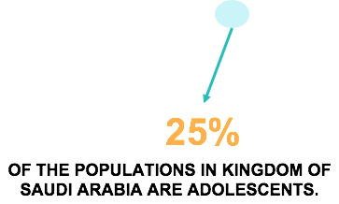
Adolescents population in Saudi Arabia

Slide 11
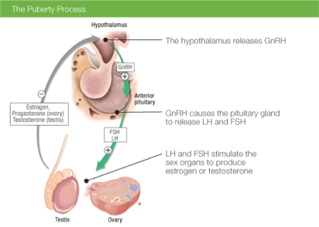
Puberty and Hormonal Changes
● Hypothalamus releases GNRH to anterior pituitary to stimulate
● Anterior pituitary then releases LH & FSH to testis and ovaries
● Sex steroid synthesis
● Sexual maturation

Slide 12
Physical changes during adolescence
For girls, you might start to see early physical changes from about 10 or 11 years, but they might start as young as 8 years or as old as 13 years. Physical changes around puberty include:
breast development
changes in body shape and height
growth of pubic and body hair
the start of periods (menstruation).
Notes:
http://raisingchildren.net.au/articles/physical_changes_teenagers.html

Slide 13
For boys, physical changes usually start around 11 or 12 years, but they might start as young as 9 years or as old as 14 years. Physical changes include:
growth of the penis and testes (testicles)
changes in body shape and height
erections with ejaculation
growth of body and facial hair
changes to voice.

Slide 14
behavioral changes during adolescence
At the same time, adolescents are developing and consolidating their sense of self.
With this increasing self-identity, they will concern about other people’s opinions.
Also, adolescents want greater independence and responsibility.
They increasingly want to assert more autonomy over their decisions, emotions and actions and to disengage from parental control.
Their social and cultural environment importantly affects how adolescents express this desire for autonomy .
h
Notes:
ttp://apps.who.int/adolescent/second-decade/section2/page5/adolescence-psychological-and-social-changes.html

Slide 15
IMPORTANCE OF ADOLESCENT HEALTH
Adolescents are at risk for smoking, alcohol intake and drug abuse.
They should be taught about their ill effects .
Smoking can cause cancers, infertility, hypertension, heart disease and premature death. So, drugs are like poisons for everyone.

Slide 16
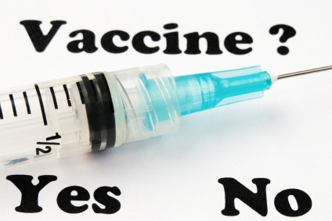
ADOLESCENT HEALTH cont..
Adolescents have significant needs for health services. Adequate care and support should be given to them so that they enter into their adulthood in good mental and physical health.
Vaccination of teenage girls against Rubella, cancer cervix (Gardasil, Cervarix) is advised .Hepatitis B, Chickenpox vaccination should be offered to both boys and girls.

Slide 17
Adolescent health problems

Slide 18
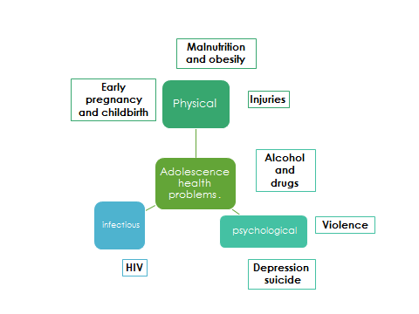

Slide 19
Early pregnancy
Birth rates
11% of all births worldwide are still to girls aged 15 to 19 years old. The majority of these births (95%) occur in low- and middle-income countries.
Health effects
The leading cause of death for 15– 19-year-old girls globally is complications from pregnancy and childbirth.
Economic and social consequences.
A girl with little or no education has fewer skills and that will affect their opportunities to find a job.
What are the ways that can reduce girls getting pregnant and giving birth at too young age?
Reducing marriage before the age of 18.
increasing the use of contraception by adolescents at risk of unintended pregnancy.
increasing use of skilled antenatal, childbirth and postnatal care among adolescents.

Slide 20
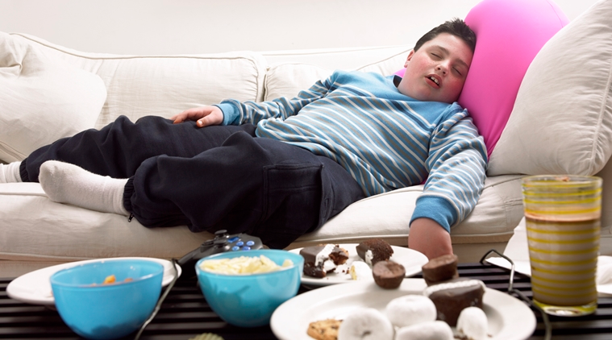
Malnutrition and Obesity
Many boys and girls in developing countries enter adolescence undernourished, making them more vulnerable to disease and early death.
The number of adolescents who are overweight or obese is increasing in low, middle and high-income countries.

Slide 21
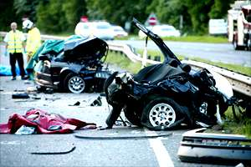
Injuries
Injuries are a leading cause of death and disability among adolescents.
Transportation is the largest source of these injuries.
Other major causes involve drowning, poisonings, fires, Sport injury are the most common
• In 2012:
120,000 adolescents died as a result of road traffic accidents
60 000 died drowning

Slide 22
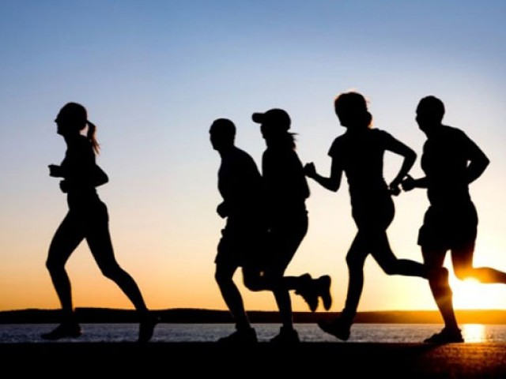
Exercise and nutrition
Physical Activity:
Regular physical activity can help children and adolescents improve cardiorespiratory fitness, build strong bones and muscles, control weight, reduce symptoms of anxiety and depression, and reduce the risk of developing health conditions such as: Heart disease
Iron deficiency anaemia is the leading cause of years lost to death and disability in 2015.
Iron and folic acid supplements are a solution that also helps to promote health before adolescents become parents.
Regular deworming in areas where intestinal helminths such as hookworm are common is recommended to prevent micronutrient (including iron) deficiencies.
Notes:
https://www.cdc.gov/healthyschools/physicalactivity/facts.htm

Slide 23
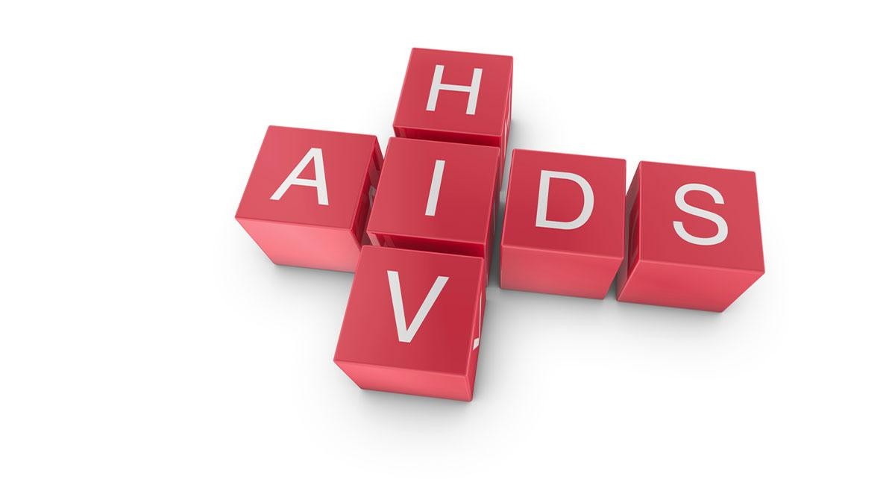
HIV
More than 2 million adolescents are living with HIV.
Although the overall number of HIV-related deaths is down 30% since the peak in 2006 estimates suggest that HIV deaths among adolescents are rising.
How we can Prevent it?
Avoid prohibited relationships
Clean needles for those who inject drugs
Notes:
2. HIV
How can Young people protect themselves?
1) being able to obtain condoms to prevent sexual transmission of the virus
2) clean needles and syringes for those who inject

Slide 24
Mental Health
Worldwide 10-20% of children and adolescents experience mental disorders.
Depression is the third leading cause of illness and disability among adolescents, and suicide is the third leading cause of death in older adolescents (15–19 years).
If untreated, these conditions severely influence children’s development, their educational attainments and their potential to live fulfilling and productive lives
Causes that can increase the risk of developing mental health problems:
Violence
Poverty
humiliation
feeling devalued
Notes:
3. How can you promote good mental health?
1)Building life skills.
2)Providing psychosocial support in schools and other community settings.
3)Programmes to help strengthen ties between adolescents and their families.

Slide 25
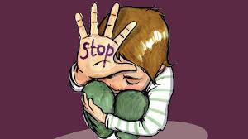
Violence
An estimated 180 adolescents die every day as a result of interpersonal violence.
Around 1 of every 3 deaths among adolescent males of the low- and middle-income countries in the WHO Americas Region is due to violence.
Globally, some 30% of girls aged 15 to 19 experience violence by a partner.

Slide 26
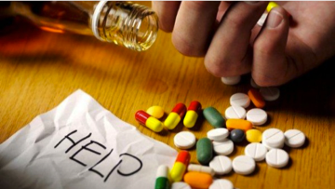
Alcohol And Drugs
Alcohol:
Harmful drinking among adolescents is a major concern in many countries.
It reduces self-control and increases risky behaviours, such as unsafe sex or dangerous driving.
It is a primary cause of injuries (including those due to road traffic accidents), violence (especially by a partner) and premature deaths.
It can also lead to health problems in later life and affect life expectancy.
Drugs:
Drug use among 15–19 year olds is also an important global concern. Drug control may focus on reducing drug demand, drug supply, or both, and successful programmes usually include structural, community, and individual-level interventions.

Slide 27
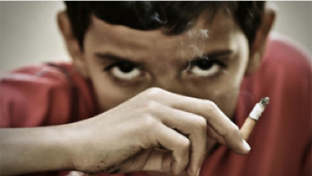
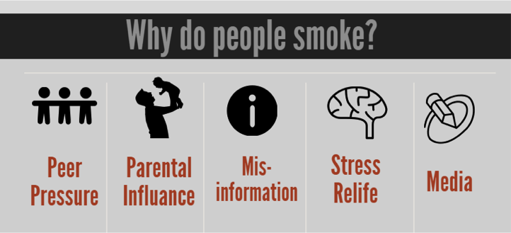
Tobacco Use
The vast majority of people using tobacco today began doing so when they were adolescents.
At least 1 in 10 younger adolescents (aged 13 to 15) uses tobacco.

Slide 28
Adolescent health problems in Saudi Arabia
https://www.ncbi.nlm.nih.gov/pmc/articles/PMC3883599/

Slide 29
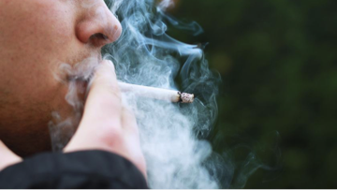
CIGARETTE SMOKING
12.7% among the study sample, the habit is more common in males (19.0%) than females (4.0%)
MENTAL HEALTH PROBLEMS:
That most important problems were:
1.Anxiety (13.5%)
2.Somatic disorders (12.2%)
3.Obsession (10.8%)
4.Aggression (8.1%)
5.Delinquency and depression (4.1%).

Slide 30
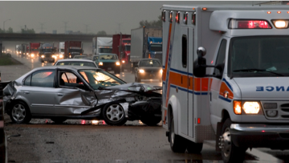
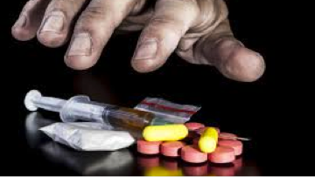
CAR ACCIDENT
Adolescents males who drive car 45% of them had a car accident.
DRUG USE
The prevalence of drug use in this survey was 6.4% (10.6% in males and 0.8% in female study subjects), volatile substance was commonly abused among adolescents.

Slide 31
Approach to common adolescent health problems
we should take care about Environmental factors, including family, peer group, school, neighborhood, and social cause, because they can either support or refute young people’s health.

Slide 32
Mental health:
Building life skills in children and adolescents and providing them with psychosocial support can help promote good mental health and reduce violence.
Smoking
Prohibiting the sale of tobacco products to minors.
Increasing the price of tobacco products.
Banning smoking advertising.
Ensuring smoke-free environments.
Counseling and explain the dangers of using illegal drug.(role of family,school and community)

Slide 33
Injury and Car Accident:
Young drivers need advice on driving safely.
Forbidding adolescents aged less than 18 years from driving.
Obesity and physical inactivity:
Providing access to healthy foods and opportunities to engage in physical activity.
Developing healthy eating and exercise habits at adolescents are foundations for good health in adulthood.

Slide 34
Role of family, school, and community in adolescent health care

Slide 35
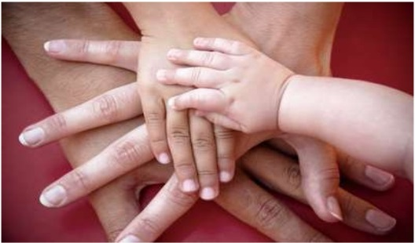
Role of family
Adolescents who have good communication and are bonded with an adult are less likely to engage in risky behaviors.
Parents supervision and involved with their adolescents' activities are promoting a safe environment.
The children of families living in poverty are more likely to have health conditions and poorer health status, as well as less access to and utilization of health care.

Slide 36
Role of School
School environment and behavior of teachers play a major role in character building and personality development of adolescents.
School health clinics for health education & counseling has important role.
The school social environment affects student’s attendance, academic achievement, and behavior.
A safe and healthy school environment protects against risky behaviors.

Slide 37
Role of community
Antismoking program should be established, including prohibition of the sale and use of cigarettes in public places.
Application of firm traffic laws forbidding adolescents aged less than 18 years from driving.
Raising awareness of health issues for young people among the general public and special groups.
Supervision over media content because, adolescents who are exposed to media portrayals of violence, sexual content, smoking, and drinking are at risk for adopting these behaviors.

Slide 38
Take Home Message
Adolescence is a very critical stage in one’s life. It’s where biological, physiological, and psychological maturation happens.
Taking risks at this age without thinking of the consequences is common. Which may lead to serious illnesses, disabilities, and death.
Unintentional injuries are the leading cause of death among adolescents, and in most cases they’re preventable.
The health problems in adolescents globally are to some extent similar to those in Saudi Arabia. Such as the widespread of smoking, obesity, injuries, mental problems, physical inactivity..

Slide 39
Q1. Adolescence age is between:
a)7-18
b)10-23
c)10-19
d)20-26

Slide 40
Q2. What is the adolescent population in Saudi Arabia?
a)10%
b)25%
c)30%
d)50%

Slide 41
Q3. What is the leading cause of death in adolescents?
a)HIV
b)Injuries
c)Cancer
d)Suicide

Slide 42
Q4. What is the most common mental health problem in adolescence?
a)Anxiety
b)Schizophrenia
c)Depression
d)Bipolar

Slide 43
References:
https://www.britannica.com/science/adolescence
http://raisingchildren.net.au/articles/physical_changes_teenagers.html
http://apps.who.int/adolescent/second-decade/section2/page5/adolescence-psychological-and-social-changes.html
https://www.cdc.gov/healthyschools/physicalactivity/facts.htm
http://www.who.int/mediacentre/factsheets/fs345/en/
https://www.ncbi.nlm.nih.gov/pmc/articles/PMC3883599/

Slide 45
THANK YOU

