Slide 1
Obesity
How to approach?
Mohammed Alsubaie
Anas Alzahrani
Abdulaziz Altawil
Dr.Ali Alhazmi
Assistant Professor
Consultant Family and Community Physician

Slide 2
Objectives
Define obesity and classify the degree of obesity “BMI, Waist circumference and Waist to Hip ratio”.
Highlight the prevalence of obesity in Saudi Arabia.
Discuss how to prevent obesity in the community.
Discuss the common causes of obesity in the community.
Morbidity “common health problems due to obesity”
Discuss the evidence based approach to decrease weight “Exercise, Dieting, Drug treatment, and Bariatric Surgical Intervention”.
Role of health team, medical students and school health in dealing with obesity in the community

Slide 3
Quiz
What is the cause of Obesity?
A) Unhealthy diet.
B) Genetics.
C) Low physical activity.
D) All of the above.
Which of the following records considered as morbid obesity?
A) BMI of 26 kg/m2
B) BMI of 30 kg/m2
C) BMI of 41 kg/m2
D) BMI 38 kg/m2

Slide 4
Quiz
Which of the following is the best to start with in managing Obesity?
A) Diet
B) Drugs
C) Exercise
D) A+C
What is the prevalence of Obesity among Female in KSA?
A) 36%
B) 15%
C) 45%
D) 24%

Slide 5
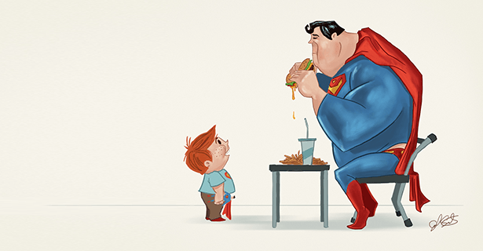
Obesity?

Slide 6
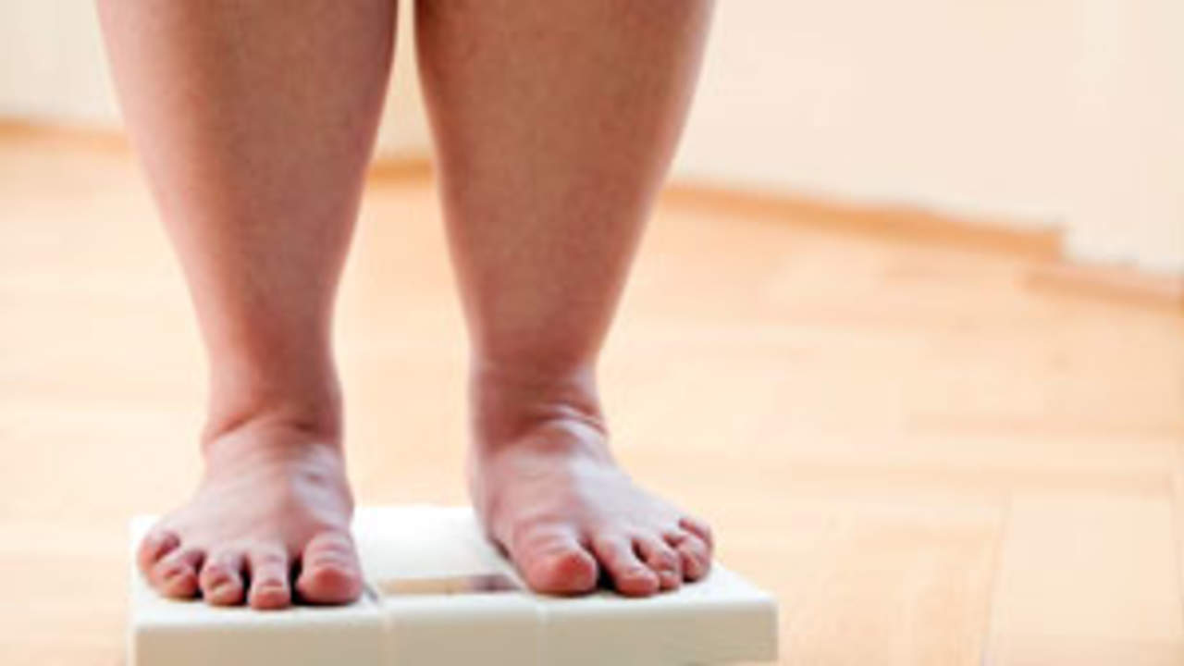
Obesity
Simply, abnormal or excessive fat accumulation that presents a risk to health.
Overweight and obesity are major risk factors for a number of chronic diseases.

Slide 7
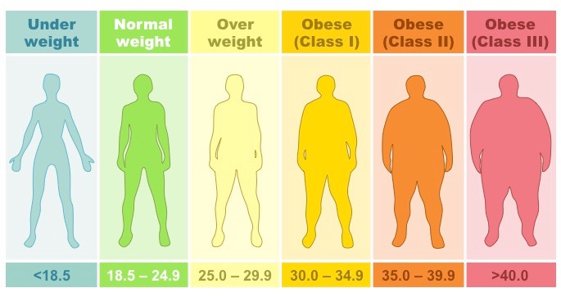
BMI
The best measure of obesity is body mass index (BMI).
BMI = (weight in kg ÷ (height in m)2)
“Class III = Morbid obesity”

Slide 8
Waist circumference
An alternative measure .
Halfway between the superior iliac crest and the rib cage.
Used in addition to BMI to aid assessment of health risks.
If you are a woman:
your risk is increased at 80 cm or more
your risk is high at 88 cm or more
If you are a man:
your risk is increased at 94 cm or more
your risk is high at 102 cm or more
For every 1cm increase in waist circumference, the RR of a CVD event increase by 72%.

Slide 9
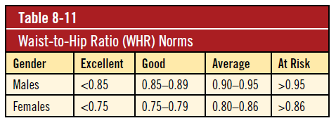
Waist to Hip ratio
This is calculated as waist measurement divided by hip measurement (W/H). For example, a person with a 25" waist and 38" hips has a waist-hip ratio of about 0.66.

Slide 10
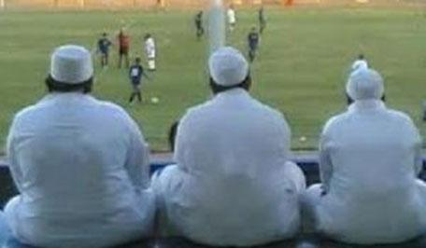
Saudi Arabia !!

Slide 11
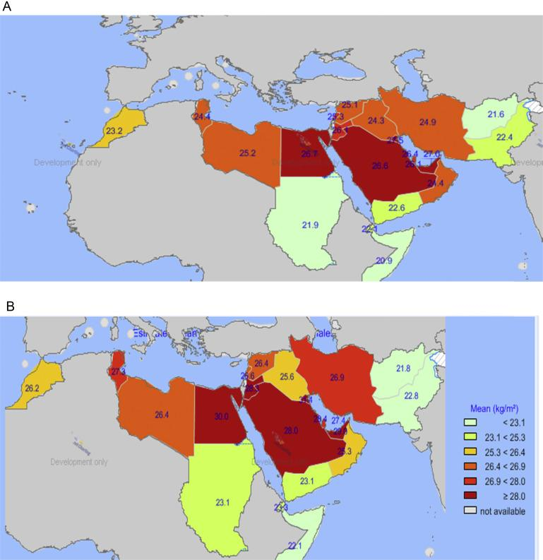
The prevalence in KSA
According to WHO , the prevalence in KSA is 24% male , 36% female.
Another study done in KSA 2014 :
Male 24%
Female 33.5%
A male , B female

Slide 13
Causes of Obesity
Most common causes according to MOH are as following:
family history
Diet or food style either for individual or families
Sedentary life style.
some diseases like: Cushing's syndrome, hypothyroidism and other medical conditions which leads difficulties in daily activities like osteoarthritis.
Some medications such as: TCAs.
Sleep disturbance
Low education
Aging or being older
Marital status
Pregnancy

Slide 14
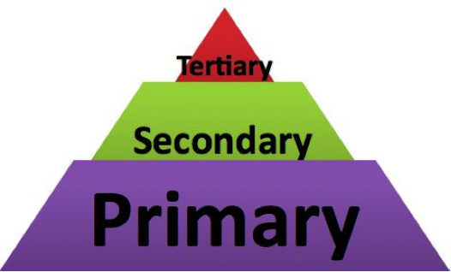
How to prevent Obesity?

Slide 15
5‑2‑1‑0 message
Follow the 5‑2‑1‑0 message every day:
5 = Encourage intake of daily 5 rations of fruits and vegetables
2 = Encourage eating with the child in a sociable atmosphere , separate eating from other activities and keep recreational screen time to <2 hour
1 = Include at least 1 hour or more of active play every day
0 = Skip sugar‑sweetened beverages and drink more water every day.

Slide 16
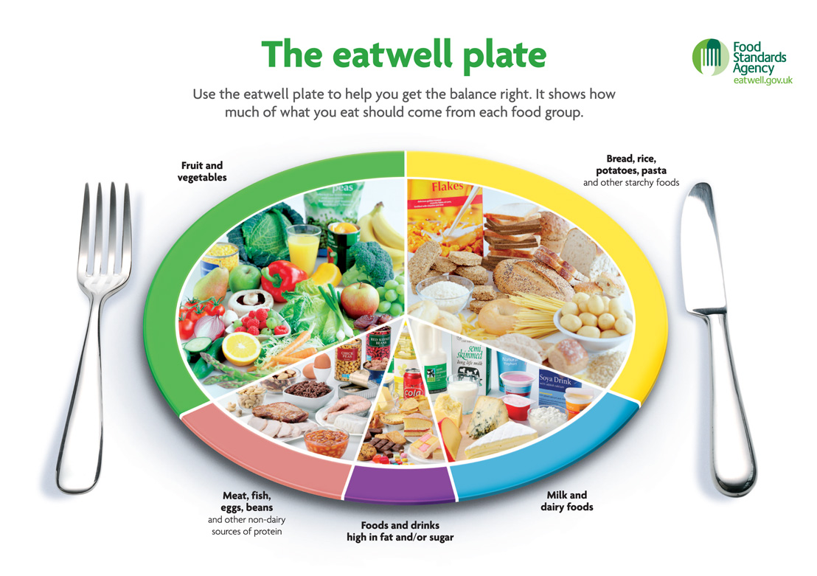
1- Focusing on healthy life style behaviors related to maintaining normal weight.
Primary Prevention

Slide 17
Healthy diet contains:
Primary Prevention
Fruits, vegetables, legumes (e.g. lentils, beans), nuts and whole grains.
Less than 10% of total energy intake from free sugars.
Less than 30% of total energy intake from fats.
Unsaturated fats (e.g. found in fish, nuts) are preferable to saturated fats (e.g. found in fatty meat, butter, cheese).
Industrial trans fats (found in processed food, fast food, snack, frozen pizza) are not part of a healthy diet.
Less than 5 g of salt/day and use iodized salt.

Slide 18
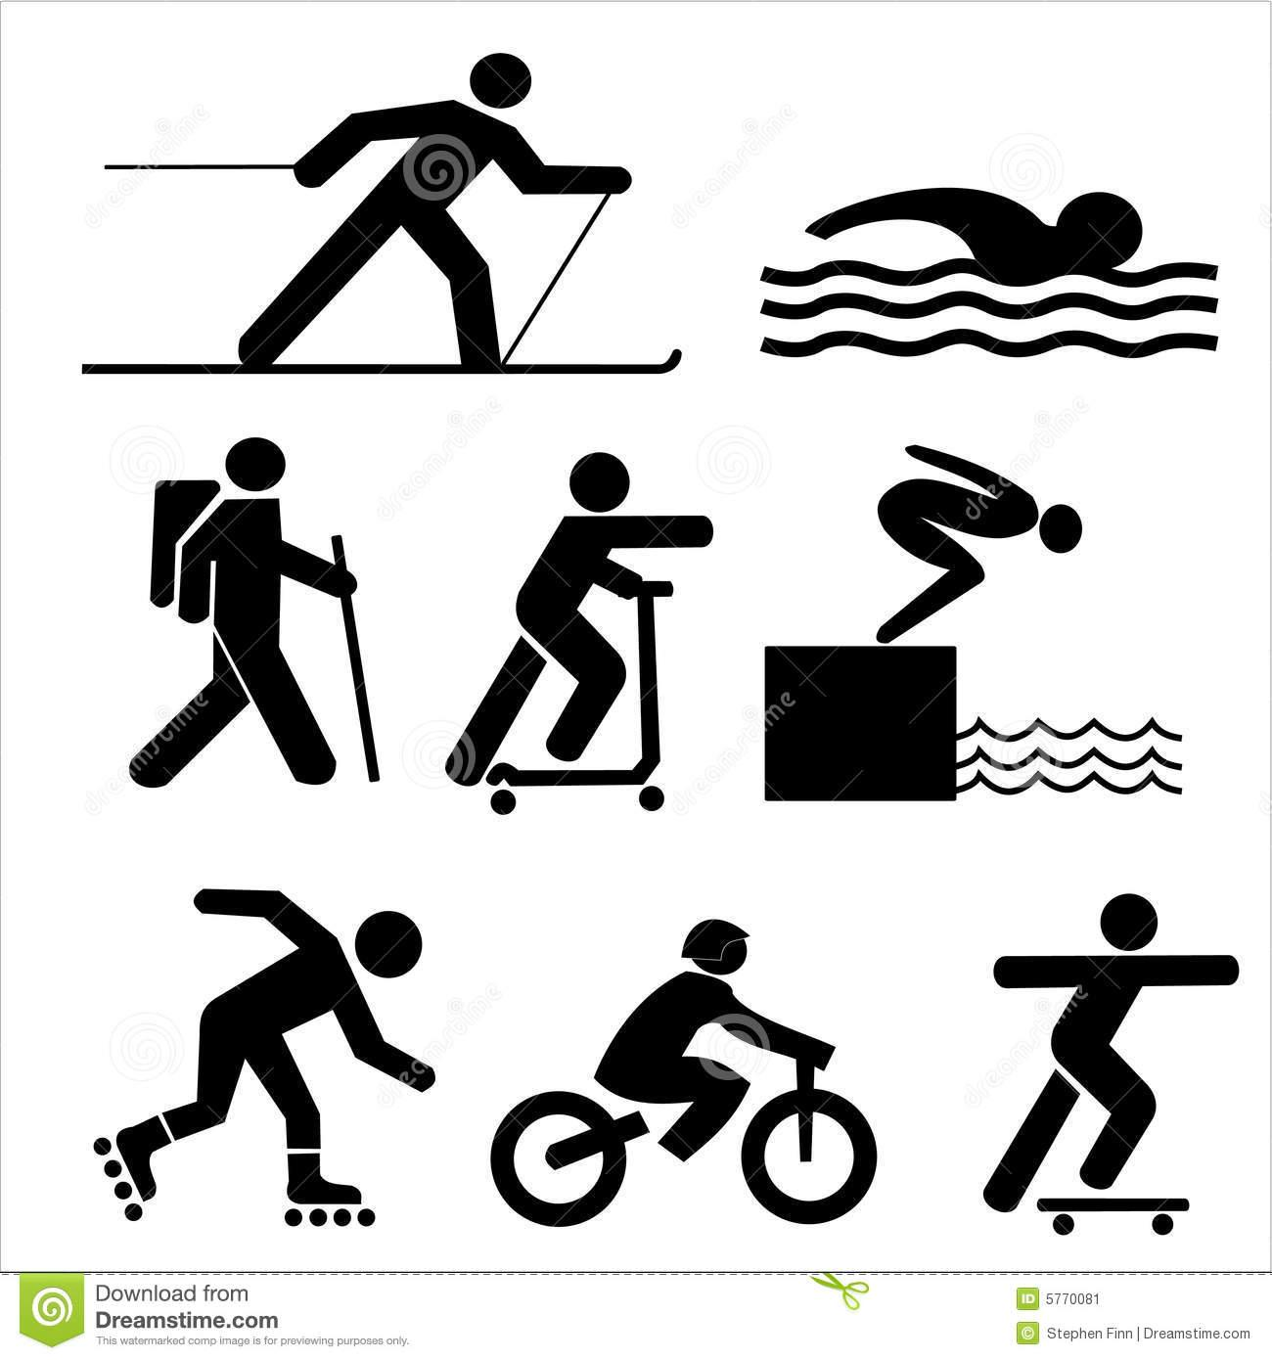
Primary Prevention
2- Exercising and active life style:
Walk and exercise for 30 minute or more, 5 days a week.
Get enough sleep at night.
Cessation of smoking.
Avoid social and psychological stresses.

Slide 19
3- Long term observation for what you eats and drinks.
Primary Prevention

Slide 20
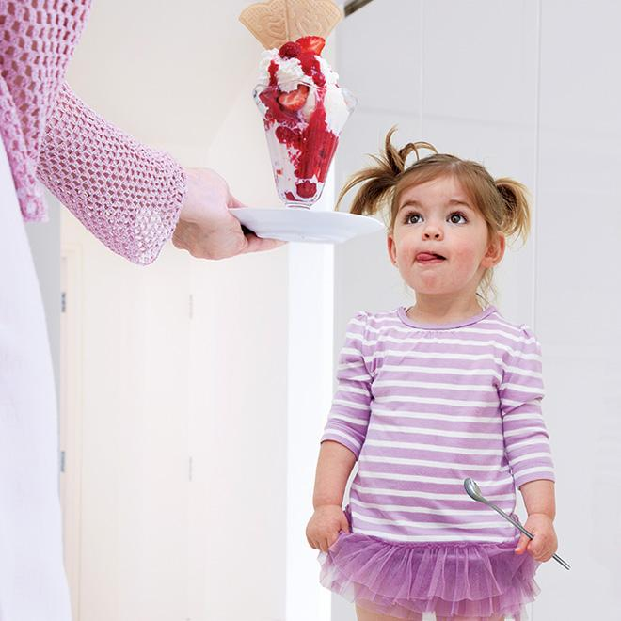
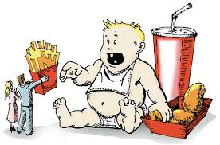
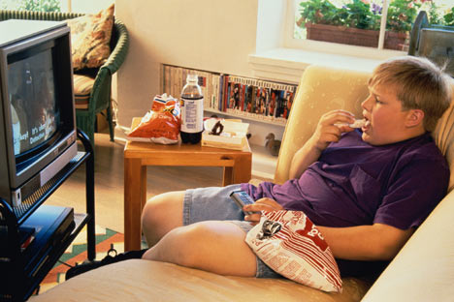
For children :
Primary Prevention
Change family eating habits and activity levels.
Reduce time spent in front of TV , computer and mobiles.
Avoid using food as a reward.
.

Slide 21
Obesity co-morbidities
DM : T2DM
Dyslipidemia : Reduction in serum (HDL) cholesterol of about 5%.
Heart diseases:
1) Coronary disease. 2) Heart failure.
3) MI. 4) Atrial fibrillation/flutter.
Skin changes:
1) Stretch marks (striae) 2) Acanthosis nigricans.
3) Hirsutism.

Slide 22
Obesity co-morbidities
Colon CA.
Gallstones.
Sleep apnea.
Gout and gouty arthritis.
Osteoarthritis “Knee”.
Psychological complications “suicide”.

Slide 23
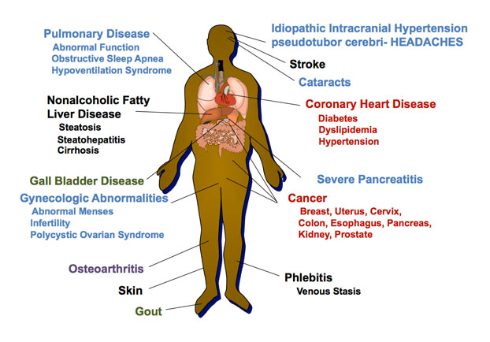
Obesity co-morbidities

Slide 24
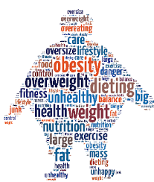
The management Secondary prevention
How to Treat ?

Slide 25
Exercise:
Weight loss is greater in diet plus exercise regimens than in diet-only regimens. Exercise regimens alone, without reduced-calorie diets, are not effective for weight loss.
Moderate physical exercise is introduced with 3 sessions per week, 30 minutes per session, then later increased, as tolerated.
Ex:
walking at 3 miles per hour (350 kcal/hour).
bicycling on level ground at 10 to 12 miles per hour (600 kcal/hour).

Slide 26
Dieting:
At 6-month follow-up, the low-carbohydrate/high-protein diet has been found to produce greater weight loss than the low-fat diet, and patients seemed to prefer the low-carbohydrate/high-protein diet.
Adherence to the diet (i.e., compliance) and the reliability of patient reporting of caloric intake have been problematic in studies on dietary intervention.
Reduce consumption of junk food
Eat 500 to 1,000 fewer calories each day.

Slide 27
Psychological/behavioral interventions
Psychological interventions should be part of any weight management program.
It should be adjusted to circumstances of the individuals or their families.

Slide 28
Drug treatment:
When to use?
Failure of diet and exercise
BMI > 30
BMI > 27 and associated with medical problems related to obesity
Orlistat have modest effectiveness (about 5% loss in body weight) when combined with diet and exercise alone, but mild gastrointestinal side effects are common.

Slide 29
Drugs:
Primary options:
orlistat: Patients usually complained from oily stools and fecal incontinence.
Secondary options:
Lorcaserin.
Liraglutid
Naltrexone/bupropion hydrochloride
Tertiary options (not preferable):
phentermine.

Slide 30
Types of Bariatric surgical intervention:

Slide 31
The role of health team, medical students and schools …

Slide 32
The Health Team is a part ..
The physical activity and eating behaviors that affect weight are influenced by many sectors of society, including families, community organizations, health care providers, faith-based institutions, businesses, government agencies, the media, and schools.
The involvement of all of these sectors will be needed to reverse the epidemic.

Slide 33
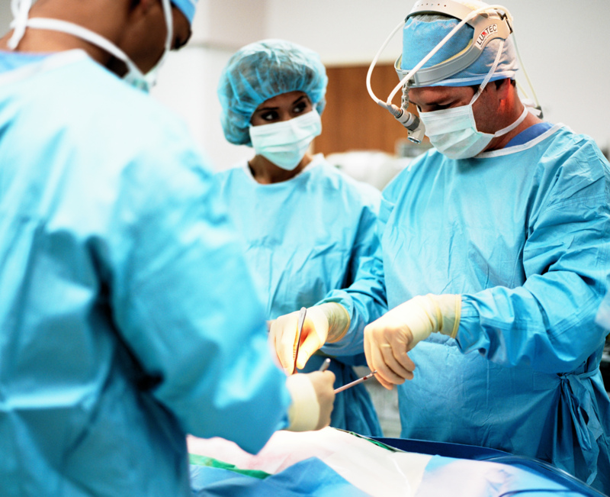
Bariatric surgical intervention:
Patients with BMI ≥40 kg/m^2 (i.e., morbidly obese category), or ≥35 kg/m^2 with obesity-related comorbidity (e.g., hypertension, diabetes, sleep apnea, GORD) may be candidates for most bariatric procedures.

Slide 34
The Health Team and medical students
Health professionals have an important role in promoting preventive measures and encouraging positive lifestyle Behaviors “ awareness of the population” ..
Also have a role in counseling patients about safe and effective weight loss and weight maintenance programs.

Slide 35
Schools ..
Schools cannot solve the obesity epidemic on their own as well .
School can also help address obesity by providing:
Screening
Health information
Referrals to students
The Role of Schools in Obesity Prevention :
More nutritious food
Physical activity
Health services.
Health education

Slide 36
Take home massage
The best measure of obesity is body mass index (BMI).
The prevalence in KSA is high among both genders.
Obesity is a multifactorial condition “ Genetic, environment and behavior”.
Obesity is associated with comorbidities “ DM,HTN..etc”.
The prevention and management start by diet and physical activity.
The involvement of all of society sectors will be needed to reverse the epidemic.

Slide 37
Review the Quiz
What is the cause of Obesity?
A) Unhealthy diet.
B) Genetics.
C) Low physical activity.
D) All of the above.
Which of the following records considered as morbid obesity?
A) BMI of 26 kg/m2
B) BMI of 30 kg/m2
C) BMI of 41 kg/m2
D) BMI 38 kg/m2

Slide 38
Review the Quiz
Which of the following is the best to start with in managing Obesity?
A) Diet
B) Drugs
C) Exercise
D) A+C
What is the prevalence of Obesity among Female in KSA?
A) 36%
B) 15%
C) 45%
D) 24%

Slide 39
References
Oxford handbook of general practice
Obesity Saudi Guidelines :
http://www.saudijobesity.com/article.asp?issn=2347-2618;year=2013;volume=1;issue=1;spage=18;epage=30;aulast=Al-Shehri
http://bestpractice.bmj.com/best-practice/monograph/211/treatment/details.html#expsec-5
https://www.ncbi.nlm.nih.gov/pmc/articles/PMC4193060/
WHO website

Slide 40
Be healthy and stay safe
THANK U
Qs?

