Slide 1
LOW BACK PAIN
Abdullah alJumaiah
Abdul-Aziz alsaud
Nawaf alotaibi

Slide 2
Objectives:
Common causes .
Diagnosis including history, red flags, and examination .
Brief comment on mechanical, inflammatory, root nerve.
Compression, and malignancy .
Role of primary health care in management.
When to refer to a specialist.
Prevention and education

Slide 3
Quiz:
Q1: The two most affected nerve roots in Radiculopathy?
L4 and L5.
L5 and S1.
S1 and S2.
L4 and S2.
Q2:what is the prevalence of back pain in Saudi Arabia ?
10%
35%
50%
70%

Slide 4
Introduction
Back pain accounts for at least 5-6.5% of all presenting problems in general practice.
In USA it is the commonest cause of limitation of activity in those under the age of 45.
Approximately 85–90% of the population will experience back pain at some stage of their lives.
70% of the world’s population will have at least one disabling episode of low back pain in their lives.
The main cause of back pain presenting to the doctor is dysfunction of the intervertebral joint.
In Saudi Arabia Seven studies were cross-sectional and found a prevalence and pattern ranging from 53.2% to 79.17%.

Slide 5
Common causes
Vertebral dysfunction with non - radicular pain
Radiculopathy
Spondylolisthesis
Lumbar spondylosis
Spondyloarthropathies
Acute low back pain

Slide 6
Vertebral dysfunction with non-radicular pain
Common cause of low back pain.
Caused by dysfunction of the pain-sensitive facet joint.
History of: lifting heavy objects or twisting the back.
Pain: unilateral lumbar, refers over sacrum and buttocks
Aggravated by: activity, lifting, gardening, housework
Relived by: warmth

Slide 7
Radiculopathy:
Radicular pain: Disc protrusion, tumor or a narrowed intervertebral foramina ➜ Nerve root compression.
Pain in the leg |P.s: could be with back pain or alone.
The two most affected nerve roots are: L5 and S1.
Sciatica: is a term used when herniated disc compress sciatic nerve and it is characterized by: sharp, shooting pain through
The buttock and back of the leg. Might be associated with:-
Numbness
muscular weakness
pins and needles or tingling
Difficulty in moving or controlling the leg.

Slide 8
Spondylolisthesis :
Spondylolisthesis is a condition in which one bone in your back (vertebra) slides forward over the bone below it.
5% of the population have spondylolisthesis but not all are symptomatic.
Caused by:
defective joint ”congenital”
Trauma
Stress fracture caused from overuse of the joint.
joint damaged by an infection or arthritis.
Onset of back pain is due to concurrent disc degeneration.
aggravated by: prolonged standing, walking and exercise.

Slide 9
Lumbar spondylosis:
Known as: degenerative osteoarthritis or osteoarthrosis.
Follow vertebral dysfunction (severe disc disruption and degeneration).
Main feature: Stiffness of the low back.
progressive deterioration ➜ subluxation of the facet joints➜ narrowing of the spinal foramen.

Slide 10
Spondyloarthropathies:
Group of disorders characterized by involvement of the sacroiliac joints & ascending spondylitis & extra-spinal manifestations.
Pain and stiffness worse in the morning and improves with exercise.
Main disorders in this group:- Ankylosing spondylitis, psoriatic arthritis and the inflammatory bowel diseases.
People in their teens and 20s, particularly males, are affected most often.

Slide 11
Ankylosing spondylitis
Ankylosing spondylitis is hereditary.
Many genes can cause it the major gene that causes this disease is HLA-B27.
Can be diagnosed by imaging, doctor may order x-ray to detect any changes of the sacroiliac joints.
Sacroiliitis is a key sign of spondyloarthritis.
Among the blood tests you may need is a test for the HLA-B27 gene. However, having this gene does not mean spondyloarthritis will always develop.

Slide 12
Ankylosing spondylitis
Treatment:
Most recommended are exercises that promote spinal extension and mobility.
The first lines of symptomatic treatment are the NSAIDs.
For joint swelling you may use corticosteroid medications into joints or tendon sheaths.
DMARDs such as sulfasalazine for patients who do not respond to the above lines of treatment.
TNF alpha blockers like infliximab are very effective but expensive with many side effects.
Surgical treatment is very helpful in some patients.

Slide 13
Malignant disease:
Important to identify malignant disease as early as possible because of the effect of a delayed diagnosis on treatment and prognosis.
More than one nerve root may be involved
The neurological signs will be progressive.
Age >50 years.
history of malignancy, six main primary malignancies that metastasize to the spine from (prostate, breast, lung, thyroid, kidney and melanoma).
Symptoms include:-
Gradually Worsening back pain.
Aggravated by lying down.
Limb paresthesia or weakness.
Fever, weight loss.

Slide 14
Quiz:
Q1: The two most affected nerve roots in Radiculopathy?
L4 and L5.
L5 and S1.
S1 and S2.
L4 and S2.
Q2:what is the prevalence of back pain in Saudi Arabia ?
10%
35%
50%
70%

Slide 15
Objectives:
Common causes .
Diagnosis including history, red flags, and examination .
Brief comment on mechanical, inflammatory, root nerve.
Compression, and malignancy .
Role of primary health care in management.
When to refer to a specialist.
Prevention and education

Slide 16
Qs
Patient came to the clinic complaining of low back pain, in examination the big toe extension is weak, which nerve root you think is involved?
L3
L4
L5
S1
Which of the following investigation should be done in case you suspect inflammatory disease:
Erect lumbar spine x-ray
MRI
Single photon emission computed tomography (SPECT)
CT myelogram

Slide 17
Clinical approach

Slide 18
History
Key questions
Can you describe the nature of your back pain?
Aching throbbing pain = Inflammation
Intense sharp or stabbing = Radicular pain (e.g. Sciatica)
Was your pain brought on by an injury?
Is it worse when you wake in the morning or later in the day?
Night, early morning = Inflammatory back pain
End of day, following activity = Mechanical pain

Slide 19
History
How do you sleep during the night?
What effect of the rest or activity on the pain?
provoked by activity and relieved by rest suggests mechanical dysfunction.
worse at rest and relieved by moderate activity suggests inflammation.
Is the pain worse when sitting or standing?
Pain aggravated by standing or walking is suggestive of spondylolisthesis.
Pain aggravated by sitting and improved with standing indicates a discogenic problem.

Slide 20
History
What effect of the coughing or sneezing or any straining on the pain?
Is the pain continues or intermittent?
Continuous pain, present day and night, is suggestive of neoplasia or infection.
Do you have a history of psoriasis, diarrhea, penile discharge, eye trouble or severe pain in your joints?
The inflammatory disorders must be kept in mind.
Most common inflammatory disease that affect the back is spondyloarthropathies.

Slide 21
History
10) Do you have any urinary symptoms?
Possibility of urinary tract infection must be considered.
Especially in pregnant women with low back pain.
11) What medication are you taking? Are you on anticoagulants?
Anticoagulant use increase risk of retroperitoneal hemorrhage.
12) Do you feel tense or depressed or irritable?
Depressive illness has to be considered in any patient with a chronic pain complaint.

Slide 22
Red flags
Age >50 years or <20 years
History of cancer
Temperature >37.8°C = infection
Constant pain—day and night especially severe night pain
Unexplained weight loss
Symptoms in other systems, e.g. cough, breast mass

Slide 23
Red flags
Significant trauma
Features of spondyloarthropathy, e.g. peripheral arthritis (e.g. age <40 years, night-time waking)
Use of anticoagulants or corticosteroids
No improvement over 1 month
Possible cauda equina syndrome

Slide 24
Cauda equina syndrome
Cauda equina syndrome characterized by:
saddle anesthesia
recent onset bladder dysfunction/overflow incontinence
bilateral progressive neurological deficit
The most common cause of CES is disc herniation.
Can be prevented by Early diagnosis.
Once it is diagnosed the treatment is surgical decompression.

Slide 25
Examination
You should perform a physical examination to reproduce the patient’s symptoms and localized the level of lesion.
look, feel, move and test function.

Slide 26
Components of physical examination
1- Inspection:
Start in the waiting room.
A patient who is noted to be standing is likely to have a significant disc lesion.
The spine must be adequately exposed and inspected in good light.
Note the general contour and look any asymmetry of the shoulders back or legs.
Look for any muscle wasting.
Lumbar lordosis.
Lateral deviation “scoliosis”.

Slide 27
Components of physical examination
2- Active movements:
There are three main movements of the lumbar spine:
Extension (20–30°)
Lateral flexion “Right and Left” (30°)
Flexion (75–90°: average 80°)

Slide 28
Components of physical examination
3- Palpation
Patient should be in prone position.
Palpation occurs:
centrally (spinous processes to coccyx) , looking for any tenderness.
unilateral—right and left sides (1.5 cm from midline)
Soft tissues: temperature, tenderness.

Slide 29
4- provocative tests
A)Femoral stretch test:
Knee flexion hip extension while the patient is lying in prone position.
Positive if pain felt in ipsilateral anterior thigh.
Positive test mean that the L3 and L4 nerve roots are involved.

Slide 30
B) Straight leg raising (SLR) test
Done while the patient lying in supine position.
The test is positive when the pain occurs with less than 60 degree hip flexion.

Slide 31
C) Slump test
It is a screening test for a disc lesion.
More sensitive than the SLR test.
Should be performed in patient with back pain extending into the legs.

Slide 32
Method of Slump test
The patient sits on the couch in a relaxed manner.
The patient then slumps forward (without excessive trunk flexion), and then places the chin on the chest.
The unaffected leg is straightened.
The affected leg only is then straightened
Both legs are straightened together.
The foot of the affected straightened leg is dorsiflexed.
Slump test video

Slide 33
5- Neurological testing of lower limbs
Do Neurological examination if patient has any signs or symptoms of nerve root compression.
If there is nerve roots compression patient will have pain, paraesthesia, anaesthesia and weakness, extend into the leg.

Slide 34
Main nerve roots
L3
Motor → extension of knee
Sensation → anterior thigh
Reflex → knee jerk (L3, L4)
L4
Motor → ankle dorsiflexion and foot inversion.
Sensation → inner border of foot to great toe
Reflex → knee jerk

Slide 35
Main nerve roots
L5
Motor: walking on heels (ankle dorsiflexion), extension of great toe
Sensation → middle three toes (dorsum)
Reflex → nil
S1
Motor: walking on toes (ankle planter flexion), foot eversio
Sensation → little toe, most of sole
Reflex → ankle jerk (S1, S2)

Slide 36
￼Mechanical & Inflammatory Back Pain
 | Inflammatory back pain | Mechanical back pain
Age Of Onset | < 40 Years | Any Age
Type Of Onset | gradual | Acute
Symptoms Duration | > 3 Months | < 4 Weeks
Morning Stiffness | > 30 Minuets | < 30 Minuets
Timing | Night, Early Morning | End Of Day, Following Activity
Effect Of Exercise | Improvement | Exacerbation
Sacroiliac Joint Tenderness | Frequent | Absent
Back Mobility | Loss In All Planes | Abnormal Flexion
Radiation | More Localized, Bilateral | Tends To Be Diffuse, Unilateral
Nature Of The Pain | Aching, Throbbing | Deep Dull Ache, Sharp If Root Compression

Slide 37
Investigation
Some investigations to order:
1) Erect lumbar spine x-ray
Recommended if recent significant trauma, osteoporosis, or age over 70 years.
2) MRI spine
Provides an excellent assessment of the discal pathology, nerve root compression, and the facet joints.
CT if MRI is contraindicated.
3) Single photon emission computed tomography (SPECT)
Marker of pathologies that cause an increased blood flow like inflammation.

Slide 38
X-Ray

Slide 39
X-Ray
Metastatic prostate cancer

Slide 40
MRI
Normal MRI

Slide 41
MRI

Slide 42
MRI
Degenerative disease

Slide 43
Qs
Patient came to the clinic complaining of low back pain, in examination the big toe extension is weak, which nerve root you think is involved?
L3
L4
L5
S1
Which of the following investigation should be done in case you suspect inflammatory disease:
Erect lumbar spine x-ray
MRI
Single photon emission computed tomography (SPECT)
CT myelogram

Slide 44
Objectives:
Common causes .
Diagnosis including history, red flags, and examination .
Brief comment on mechanical, inflammatory, root nerve.
Compression, and malignancy .
Role of primary health care in management.
When to refer to a specialist.
Prevention and education

Slide 45
Qs
Which one of the following is do you think is appropriate to referral ?
Fracutres
Caude equina
A+B
Undiagnosed back pain
All of the above
One the prevention methods
Weight loss
Exercises
Standing straight
All of the above

Slide 46
Role of PHC:
Educate patient about the natural history of back pain.
Ask about and address the patient’s concerns and goals.
Maximize functional status.
Relief the pain.
Improve associated symptoms, such as sleep or mood disturbances or fatigue.
Referral of complicated cases.
Prevention.

Slide 47
When to refer ?
Urgent/Emergency referrals :
Cauda equina
Sever radiculopathy.
Fractures.
Other referrals
Recalcitrant spinal canal stenosis
Neoplasia or infection
Undiagnosed back pain
Paget disease
Continuing pain of 3 months’ duration without a clearly definable cause
Notes:
Severe unremitting worsening of pain (at night and pain when laying down)
Weight loss, fever, and history of cancer or HIV
Both consider neoplasia/infection
Any neurological signs
The use of steroids or iv drugs
Cauda Equina Syndrome - EMERGENCY referral to ER.
Severe unremitting worsening of pain (at night and pain when laying down), consider infection/tumor – URGENT referral to ER for pain control – will need prompt investigation.
Significant trauma – consider fractures – check for instability and refer URGENTLY to spinal surgery.
Weight loss, fever, history of cancer/HIV – consider infection/tumor – refer URGENTLY for MRI Scan and to spinal surgery.
Use of IV drugs or steroids – consider infection /compression fracture – URGENT referral to spinal surgery.
Patient over 50 (if first ever episode of serious back pain) – refer SOON for prompt investigation/spinal surgery.
Widespread neurological signs – consider infection/tumor/neurological disease – refer SOON to neurology/spinal surgery/investigate further.

Slide 48
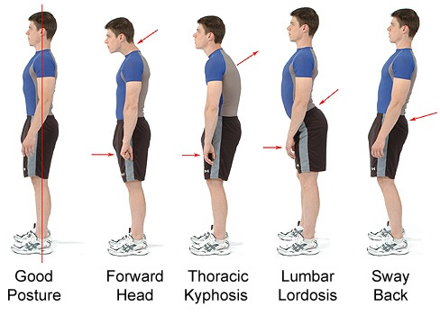
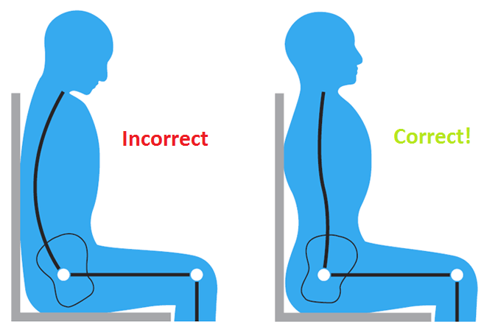
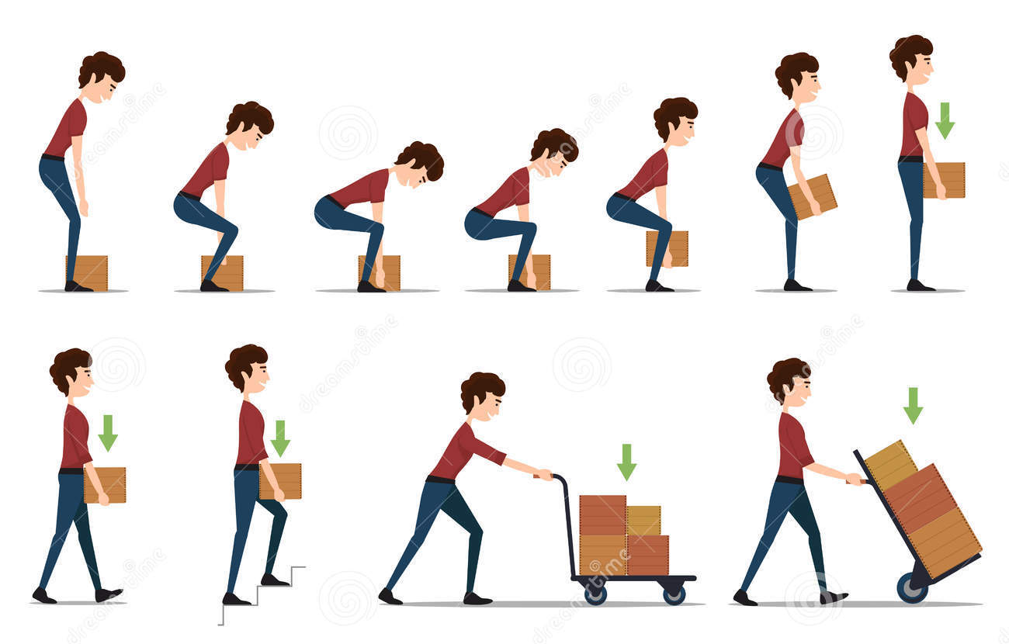
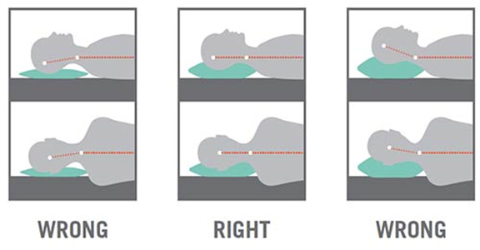
Sit
Standing
How to lift/bend
Prevention
Weight loss
Sleeping
Exercise program
Notes:
Stand upright, with your head facing forward and your back straight. Balance your weight evenly on both feet and keep your legs straight.
How to lift → One of the biggest causes of back injury, particularly at work, is lifting or handling objects incorrectly, push rather than pull, and distribute the weight
Sleeping → Your mattress should be firm enough to support your body while supporting the weight of your shoulders and buttocks, keeping your spine straight.

Slide 49
Qs
Which one of the following is do you think is appropriate to referral ?
Fracutres
Caude equina
A+B
Undiagnosed back pain
All of the above
One the prevention methods
Weight loss
Exercises
Standing straight
All of the above

Slide 50
THANK YOU

