Slide 1
SMOKING & DRUG ABUSE
By :
Abdulaziz Alkorbi
Abdulaziz Alabdulkarim
Abdulaziz Alhoshan

Slide 2
Q1)
The addictive ingredient in tobacco is :
A- Nicotine
B- Tar
C- Smoke
D- unknown

Slide 3
Q2)
Fatimah smokes a pack of cigarettes a day and has just given birth. Which of the following is FALSE regarding the health of her newborn, Her baby will:
A- Generally have normal birth weight
B- have an increased risk of sudden infant death syndrome
C- more likely develop chronic respiratory problems
D- be hospitalized more often and have poor overall health

Slide 4
Q3)
Which of the following is associated with smoking?
A-Chronic bronchitis
B-Tongue cancer
C-Lung cancer
D-All of the above

Slide 5
Q4)
Which of the following antismoking drugs are the most effective one:
A- Nicotine gum
B- Bupropion SR
C- Varenicline
D- Nicotine skin patch

Slide 6
Q5)
Which one of the following is a stimulant substance ?
A- cocaine
B-heroin
C-Xanax
D-valium

Slide 7
Q6)
Which one of the following is the oldest abused substance and most wildly used ?
A-cocaine
B-heroin
C-alcohol
D-methamphetamine

Slide 8
Objectives :
Epidemiology of smoking in Saudi Arabia
Risks of smoking (Morbidity and Mortality)
Effect of passive smoking on pregnancy, children, ….
How are you going to help the smoker to quit and how to overcome withdrawal symptoms
Role of PHC physician “smoking cessation clinic’
Update in pharmacological management, smoking cessation medication
Nicotine preparations, Varniciline, Bupropion, …….
Factors lead to substance abuse
Highlight on types of substance abuse
How to approach subjects with substance abuse

Slide 9
Definition of smoking :
Smoking is the action or habit of inhaling and exhaling the smoke of tobacco or a drug.

Slide 10
Epidemiology of smoking in Saudi Arabia :
A study was conducted on 10735 individuals aged 15 years or older (5253 men and 5482 women) which was performed between April and June 2013 to assess the status of tobacco consumption in the Kingdom of Saudi Arabia (KSA).
RESULTS :
Overall prevalence : 12.2 %
MALES : 21.5 %
FEMALES : 1.1 %
Mean age of smoking initiation was 19.1 years
8.9 % of smokers started smoking before the age of 15 years.

Slide 11
Epidemiology of smoking in Saudi Arabia :
A study was conducted in September 2005 to asses the prevalence of smoking habits among male medical students at the College of Medicine, King Saud University .
RESULTS :
13 % active smokers
5.3% ex smokers
38.2% passive smokers
The common reason given for the smoking behavior was the influence of friends (35.6%)

Slide 12
Objectives :
Epidemiology of smoking in Saudi Arabia
Risks of smoking (Morbidity and Mortality)
Effect of passive smoking on pregnancy, children, ….
How are you going to help the smoker to quit and how to overcome withdrawal symptoms
Role of PHC physician “smoking cessation clinic’
Update in pharmacological management, smoking cessation medication
Nicotine preparations, Varniciline, Bupropion, …….
Factors lead to substance abuse
Highlight on types of substance abuse
How to approach subjects with substance abuse

Slide 13
> 480,000 deaths each YEAR in the United States from Cigarette smoking
SMOKING
Alcohol use
>
Illegal drug use
HIV
Motor vehicle injuries
Firearm-related incidents

Slide 14
Parts of body affected by smoking

Slide 15
Smoking and Cardiovascular System
➔
Smoking causes ➔ stroke
 CHD¹
Smoking damages the blood vessels
the leading causes of death in the US.
Thicker > narrow > heart beat⬆> blood pressure⬆ >> clots
Notes:
Which make them thicker > narrow > hb ^ > bp ^ >> clots

Slide 16
Smoking and Respiratory System
Lung diseases caused by smoking include COPD, which includes emphysema and chronic bronchitis
For people with asthma , tobacco smoke can trigger the attack and make the attack worse.
Smokers are 12 to 13 times more likely
to die from COPD than nonsmokers
Notes:
Smoking damages airways + alveoli

Slide 17
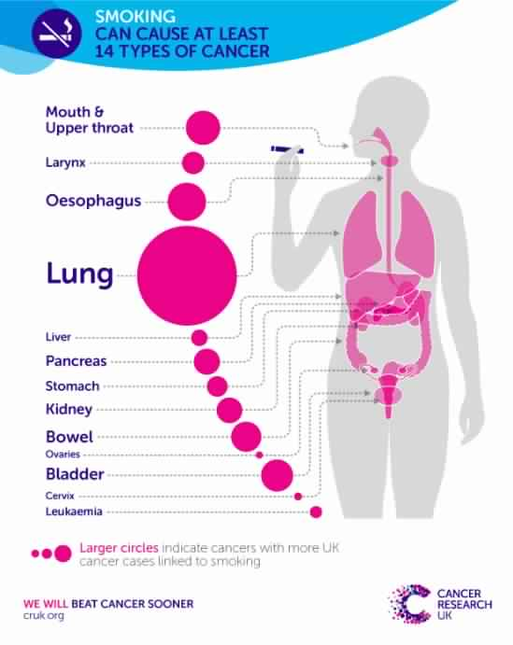
Smoking and Cancer
Smoking can cause cancer in different parts of the body :
Notes:
Oropharynx (includes parts of the throat, tongue, soft palate, and the tonsils)

Slide 18
Smoking and diabetes
Smoking is a cause of type 2 diabetes mellitus.
Smokers are 20%-30% more likely to develop diabetes than non smokers.

Slide 19
Objectives :
Epidemiology of smoking in Saudi Arabia
Risks of smoking (Morbidity and Mortality)
Effect of passive smoking on pregnancy, children, ….
How are you going to help the smoker to quit and how to overcome withdrawal symptoms
Role of PHC physician “smoking cessation clinic’
Update in pharmacological management, smoking cessation medication
Nicotine preparations, Varniciline, Bupropion, …….
Factors lead to substance abuse
Highlight on types of substance abuse
How to approach subjects with substance abuse

Slide 20
Types of smoking
1- Active smoking:
is the intentional inhalation of smoke using the methods of smoking such as: cigarettes and cigars.
2-Passive smoking (second-hand smoking):
is the inhalation of smoke by persons other than the intended 'active' smoker.

Slide 21
Effect of passive smoking
Nonsmokers exposed to secondhand smoke
25% to 30% increased risk of heart disease.
20% to 30% increased risk of lung cancer.

Slide 22
In pregnancy :
Miscarriage
Premature birth
Lower birth weight than expected
Sudden infant death syndrome
congenital anomalies
Learning problems and attention-deficit/hyperactivity disorder
Notes:
Sudden Infant Death Syndrome (SIDS) is the sudden, unexplained, unexpected death of an infant in the first year of life. SIDS is the leading cause of death in otherwise healthy infants. Secondhand smoke increases the risk for SIDS.

Slide 23
Objectives :
Epidemiology of smoking in Saudi Arabia
Risks of smoking (Morbidity and Mortality)
Effect of passive smoking on pregnancy, children, ….
How are you going to help the smoker to quit and how to overcome withdrawal symptoms
Role of PHC physician “smoking cessation clinic’
Update in pharmacological management, smoking cessation medication
Nicotine preparations, Varniciline, Bupropion, …….
Factors lead to substance abuse
Highlight on types of substance abuse
How to approach subjects with substance abuse

Slide 24
quitting smoking
There are many plans and strategies for helping people to quit smoking.
START
S = Set a quit date.
T = Tell family, friends, and co-workers that you plan to quit.
A = Anticipate and plan for the challenges you'll face while quitting.
R = Remove cigarettes and other tobacco products and triggers
from your home, car, and work.
T = Talk to your doctor about getting help to quit.

Slide 25
Withdrawal symptoms and how over come them.

Slide 26
Objectives :
Epidemiology of smoking in Saudi Arabia
Risks of smoking (Morbidity and Mortality)
Effect of passive smoking on pregnancy, children, ….
How are you going to help the smoker to quit and how to overcome withdrawal symptoms
Role of PHC physician “smoking cessation clinic’
Update in pharmacological management, smoking cessation medication
Nicotine preparations, Varniciline, Bupropion, …….
Factors lead to substance abuse
Highlight on types of substance abuse
How to approach subjects with substance abuse

Slide 27
Health professionals are essential in promoting tobacco-free lifestyles by Counseling the smokers
70% of all tobacco users admit they would like to quit
Less than 10% of are successful.

Slide 28
Five A’s Counseling Strategy:
Ask: Have you ever been a smoker?
Advise: quitting smoking is very important for you because can cause cardiovascular and respiratory disease
Assess: Are you willing to quit smoking now? What keeps you from quitting?
Assist: provide support to the patient to quit
Arrange: follow up contact in person or by telephone

Slide 30
Objectives :
Epidemiology of smoking in Saudi Arabia
Risks of smoking (Morbidity and Mortality)
Effect of passive smoking on pregnancy, children, ….
How are you going to help the smoker to quit and how to overcome withdrawal symptoms
Role of PHC physician “smoking cessation clinic’
Update in pharmacological management, smoking cessation medication
Nicotine preparations, Varniciline, Bupropion, …….
Factors lead to substance abuse
Highlight on types of substance abuse
How to approach subjects with substance abuse

Slide 31
Before choosing a pharmacologic tool physician should consider “Possible side effects and Contraindications”.
Three drugs are currently used as first line pharmacotherapy for smoking cessation, nicotine replacement therapy, bupropion and varenicline

Slide 32
Pharmacological
Nicotine replacement therapy: rates of quitting (17.6%)
nicotine patch
nicotine gum
nicotine nasal spray
nicotine inhaler
Bupropion : rates of quitting (19.1%)
Varenicline: rates of quitting (27.6%)

Slide 33
Nicotine skin patch:
For how long?
8-12 weeks or longer if necessary.
Possible side effects?
local skin reaction, disturbed sleep
Contraindications?
pregnant and breastfeeding

Slide 34
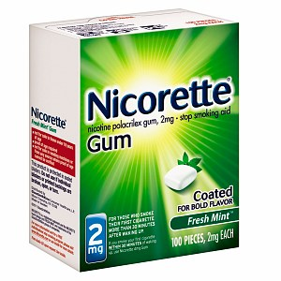
Nicotine gum:
For how long
several weeks to several months
Possible side effects
burning in throat, dental problems
Contraindications
pregnant and breast feeding

Slide 35
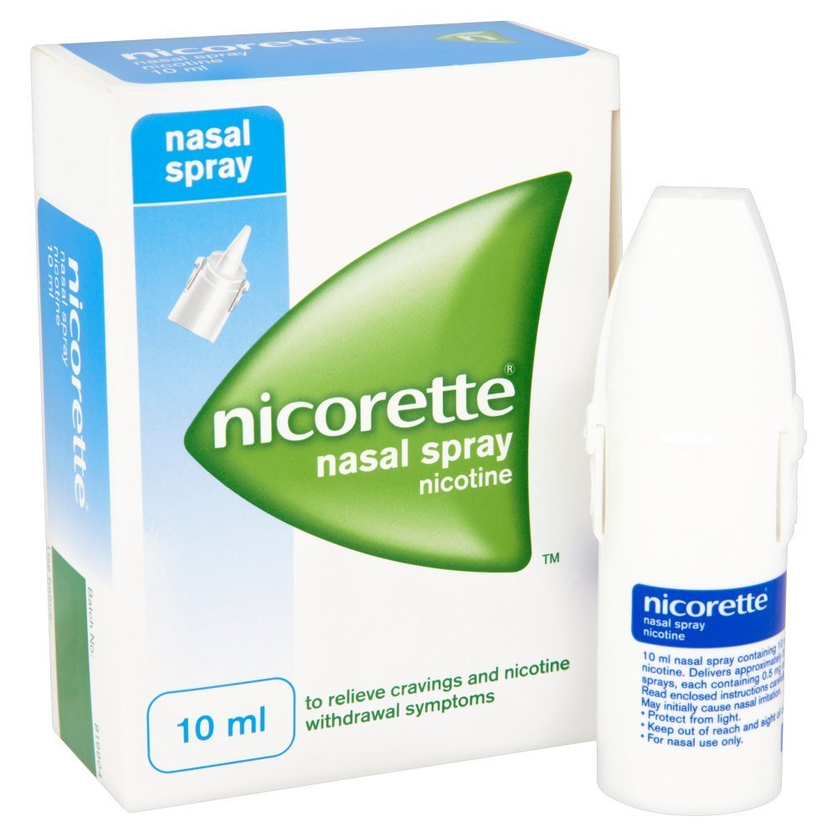
Nicotine nasal spray:
Nicotine here is absorbed faster, And also its available for prescription use only.
Possible side effects:
runny nose
sneezing
coughing

Slide 36
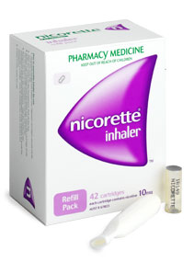
Nicotine inhalator :
The inhalator releases nicotine into your mouth when you inhale.
Possible side effects:
Coughing and rhinitis.
contraindicated :
in case of bronchospastic disease

Slide 37
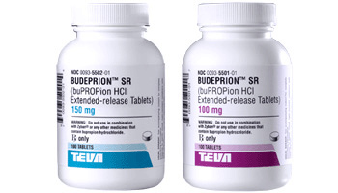
Bupropion
For how long:
7-12 weeks
Possible side effects
Dry mouth, weight gain
Contraindications:
pregnant or breastfeeding. seizures

Slide 38
Varenicline
Possible side effects?
Cardiovascular effects
Headache
Nausea
Abnormal dreams and Nightmares

Slide 39
Objectives :
Epidemiology of smoking in Saudi Arabia
Risks of smoking (Morbidity and Mortality)
Effect of passive smoking on pregnancy, children, ….
How are you going to help the smoker to quit and how to overcome withdrawal symptoms
Role of PHC physician “smoking cessation clinic’
Update in pharmacological management, smoking cessation medication
Nicotine preparations, Varniciline, Bupropion, …….
Factors lead to substance abuse
Highlight on types of substance abuse
How to approach subjects with substance abuse

Slide 40
Genetics contribute to the increased likelihood that an individual will abuse drugs, and to what extent the substance abuse may escalate.
Environmental risk factors include availability of drugs, poverty, social changes, peer influences, employment status, type of occupation and cultural attitudes.

Slide 41
Objectives :
Epidemiology of smoking in Saudi Arabia
Risks of smoking (Morbidity and Mortality)
Effect of passive smoking on pregnancy, children, ….
How are you going to help the smoker to quit and how to overcome withdrawal symptoms
Role of PHC physician “smoking cessation clinic’
Update in pharmacological management, smoking cessation medication
Nicotine preparations, Varniciline, Bupropion, …….
Factors lead to substance abuse
Highlight on types of substance abuse
How to approach subjects with substance abuse

Slide 42
Stimulant Abuse:
Stimulants include illegal drugs such as cocaine and methamphetamine.
Depressant Abuse:
Depressants include opiates such as heroin, morphine and opium, as well as sedative-hypnotic medications such as Xanax, Ativan and Valium.
Alcohol Abuse:
Alcohol affects every organ in the body, and it is the oldest and most widely used

Slide 43
Objectives :
Epidemiology of smoking in Saudi Arabia
Risks of smoking (Morbidity and Mortality)
Effect of passive smoking on pregnancy, children, ….
How are you going to help the smoker to quit and how to overcome withdrawal symptoms
Role of PHC physician “smoking cessation clinic’
Update in pharmacological management, smoking cessation medication
Nicotine preparations, Varniciline, Bupropion, …….
Factors lead to substance abuse
Highlight on types of substance abuse
How to approach subjects with substance abuse

Slide 44
• Counseling the smokers by a Physician to cut down the number of cigarettes gradually.
• Prescribe nicotine replacement treatments for the smokers.
• Follow up with the Quit smokers to avoid any relapses.

Slide 45
Q1)
The addictive ingredient in tobacco is :
A- Nicotin
B- Tar
C- Smoke
D- unknown

Slide 46
Q2)
Fatimah smokes a pack of cigarettes a day and has just given birth. Which of the following is FALSE regarding the health of her newborn, Her baby will:
A- Generally have normal birth weight
B- have an increased risk of sudden infant death syndrome
C- more likely develop chronic respiratory problems
D- be hospitalized more often and have poorer overall health

Slide 47
Q3)
Which of the following is associated with smoking?
A-Chronic bronchitis
B-Tongue cancer
C-Lung cancer
D-All of the above

Slide 48
Q4)
Which of the following antismoking drugs are the most effective one:
A- Nicotine gum
B- Bupropion SR
C- Varenicline
D- Nicotine skin patch

Slide 49
Q5)
Which one of the following is a stimulant substance ?
A- cocaine
B-heroin
C-Xanax
D-valium

Slide 50
Q6)
Which one of the following is the oldest abused substance and most wildly used ?
A-cocaine
B-heroin
C-alcohol
D-methamphetamine

Slide 51
Thank you !
Any questions ?

Slide 52
References :
https://www.ncbi.nlm.nih.gov/pmc/articles/PMC3927255/
http://www.aafp.org/afp/2012/0315/p591.html
http://search.proquest.com/docview/206257677?pq-origsite=summon
https://www.nice.org.uk/guidance/ph10/chapter/4-recommendations
http://www.quit.org.au/preparing-to-quit/choosing-best-way-to-quit/nicotine-replacement-products
http://www.mayoclinic.org/diseases-conditions/drug-addiction/basics/risk-factors/con-20020970
https://www.nice.org.uk/guidance/ph26
http://www.uptodate.com/contents/secondhand-smoke-exposure-effects-in-adults/abstract/7,8?utdPopup=true
https://www.cdc.gov/tobacco/data_statistics/fact_sheets/secondhand_smoke/health_effects/

Slide 53
References :
http://reference.medscape.com/medline/abstract/24967831
http://www.cdc.gov/mmwr/preview/mmwrhtml/mm64e1218a1.htm
http://www.samhsa.gov/data/2k13/DAWN2k11ED/DAWN2k11ED.htm
http://reference.medscape.com/medline/abstract/26624241
https://www.drugabuse.gov/drugs-abuse/cocaine
http://www.unodc.org/wdr2015/
https://www.researchgate.net/publication/262799110_Substance_use_disorders_in_Saudi_Arabia_Review_article
https://www.ncbi.nlm.nih.gov/books/NBK64942

