Slide 1
SCREENING & PREVENTION
LOLOWAH ALGHUSON, MAYAR ALSAGER, NOUF ALRUSHAID AND NADA ALKHASHLAN

Slide 2
OBJECTIVES:
To Define screening / prevention and its uses in family practice
To understand the Criteria for screening tests
To identify Screening types and targeted people for each type with examples.
To explain pros and cons of screening .
To identify appropriate approaches for prevention and screening of common problems in primary care .
To justify the rational for selection of a screening test with practical case /condition, examples like for CA. breast, Ca. colon, Ca. prostate

Slide 3
1- WHICH ONE OF THE FOLLOWING IS NOT ON WILSON-JUNGNER CRITERIA?
Natural history of illness is well understood
Detectable at early age
Acceptable to the population
Test has to be highly specific
Notes:
abnswer d

Slide 4
2- which one of the following have high risk of breast cancer ?
A. Early age when first child is born
B. Breastfeeding
C. Have a first-degree relative with a BRCA1 or BRCA2 gene mutation
D. Multiple sexual partners

Slide 5
3- A 62 year old asymptomatic patient came to you concerned that he might have colorectal cancer, especially that his best friend just died and he had colorectal cancer, what is the most appropriate initial test?
A. Do fecal occult blood test annually until he is 75
B. colonoscopy as soon as possible and do it again 5 years later
C. Transrectal ultrasound (TRUS)
Notes:
Answer Is “A”

Slide 6
4- 30 Years old male. On screening his BP was 135\85. Which one of the following statements is correct
A. Screen him again after 3 years
B. Lifestyle modification and screen him every year
C. Start treatment with ACE Inhibitor.
..D. Do Nothing.
Notes:
answer b

Slide 7
5- At which age we have to stop cervical cancer testing for women who had regular cervical cancer testing in the past 10 years with normal results ?
50 years old
> 65 years old
< 21 years old
45 years old

Slide 8
SCREENING

Slide 9
SCREENING:
To look for diseases in a group of asymptomatic people to identify these diseases in its early stages.

Slide 10
WHEN TO SCREEN?

Slide 11
WILSON-JUNGNER CRITERIA:
The condition being screened for is an important health problem
Natural history of the condition is well understood
There is a detectable early stage
Treatment at early stage is of more benefit than at late stage
There is a suitable test to detect early stage disease
The test is acceptable to the target population

Slide 12
WILSON-JUNGNER CRITERIA: (CONT)
Intervals for repeating the test have been determined
Adequate health service provision has been made for the extra clinical workload resulting from screening
Risks, both physical and psychological, should be
less than the benefits
Costs are worthwhile in relation to benefits gained

Slide 13
PREVENTION

Slide 14
PREVENTION:
Averting and eliminating diseases and minimizing the impact of diseases.
The action of stopping something from happening

Slide 15
TYPES OF SCREENING

Slide 16
Mass screening
Application of screening test to large unselected population.
Examples:
1)Visual defects in school children.
2)Mammography in women aged 40 years.
3)TB screening

Slide 17
2) High risk or selective screening.
It is applied selectively to high risk groups
Examples:
Screening fetus for Down’s syndrome in a mother who already has a baby with Down’s syndrome.

Slide 18
advantages of screening

Slide 19
Improved prognosis for some cases detected by screening.
Less radical treatment for some early cases.
Reassurance for those with negative test results.
Increased information on natural history of disease and benefits of treatment at early stage.
economic saving on future treatment.

Slide 20
disadvantages of screening

Slide 21
Longer morbidity in cases where prognosis is unaltered.
False reassurance for those with false-negative results.
Anxiety, Unnecessary intervention and sometimes morbidity for those with false-positive results.

Slide 22
Diabetes

Slide 23
In KSA:
•it’s A very common disease in KSA (23.7%*) of adults aged 30-70 years of age.
•A disease with debilitating complications (DR, ESRD, amputations, CAD.)
•Potentially preventable, and complications can be avoidable.
•Patients with Impaired Glucose Tolerance may benefit from intervention such as lifestyle modifications or pharmaceutical agents.
•Early screening may help people avoid the more serious complications of this disease, including chronic hyperglycemia that’s associated with long-term damage of the eyes, kidneys, nerves, heart, and blood vessels.

Slide 24
•the American Diabetes Association consensus statement titled “Type 2 Diabetes in Children and Adolescents” recommends that overweight youths with any two of the risk factors listed below be screened.
•Testing should be done every 2 years starting at age 10 years or at the onset of puberty if it occurs at a younger age. Testing may be considered in other high-risk patients who display any of the following characteristics:
–Have a family history of type 2 diabetes
–Belong to a certain race/ethnic group
–Have signs of insulin resistance or conditions associated with insulin resistance (acanthosis nigricans, hypertension, dyslipidemia, polycystic ovary syndrome).

Slide 25
Risk factors of Type 2:
1)Age >65
2) Race/ethnicity (including African-Americans, Native Americans, Asian-Americans)
3) Overweight (a body mass index equal to or greater than 25)
4) FH of DM
5) Past medical history of gestational diabetes or a baby >4kg at birth
6)Impaired glucose tolerance
7)Polycystic ovary syndrome

Slide 26
Screening for DM
The best screening test for diabetes, the fasting plasma glucose (FPG), is also a component of diagnostic testing.
•The U.S. Preventive Services Task Force recommends screening for abnormal blood glucose and type 2 diabetes in:
adults 40 to 70 years of age who are overweight or obese, and repeating testing every 3 years if results are normal.
•Screen all adults who are overweight ( BMI ≥ 25 kg/ m2) and have additional risk factors.
•Screening for type 1 diabetes Not recommended

Slide 27
Should I be screened for diabetes?
Age between 40 and 74 A screening test is advisable if patients have any of the symptoms of diabetes.
It is also advisable for people with a number of risk factors for type 2 diabetes

Slide 28
Prevention of DM
Type 1 DM can’t be prevented
Type 2 might be prevented if caught early (IGT) Impaired Glucose Tolerance (with lifestyle modifications(diet and exercise) and/or drugs (metformin) )

Slide 29
Hypertension

Slide 30
•It is common in KSA (26.1%) of adults aged 30-70 years of age.
•It is the most commonly diagnosed condition at outpatient office visits.
•Usually asymptomatic and found during routine BP screening or incidentally. Occasionally headache or visual disturbance
• May be symptoms of end-organ damage, TIAs, previous CVA/MI, angina
•High blood pressure is a major risk factor to heart failure, heart attack, stroke, and chronic kidney disease.
•An important feature of hypertension is that it remains asymptomatic until target tissue damage has already happened, hence the importance of screening programs.
o For males, the prevalence of hypertension was 28.6%,
o while for females; the prevalence was significantly lower at 23.9%

Slide 31
Screening Tests:
Office Blood Pressure Measurement
Ambulatory and Home Blood Pressure Monitoring

Slide 32
Screening for HTN (USPTF) united states prevenitive task force
•Annual screening for adults aged 40 years or older
•Annual screening for those who have high-normal blood pressure (130 to 139/85 to 89 mm Hg), those who are overweight or obese.
• Adults aged 18 to 39 years with normal blood pressure (<130/85 mm Hg) who do not have other risk factors should be rescreened every 3 to 5 years.
•The USPSTF recommends rescreening with properly measured office blood pressure and, if blood pressure is elevated, confirming the diagnosis of hypertension with ABPM

Slide 33
Ambulatory BP monitoring (ABPM) A BP-measuring device is worn
on the body for 24h. It takes BP every 20 min in the daytime and less frequently (usually hourly) at night. i BP readings on ABPM are more strongly correlated to end-organ damage than one-off measurements.
ABPM is used for: The diagnosis of hypertension
Home BP monitoring (HBPM) Useful
If ABPM facilities are not available within a reasonable time frame for
diagnosis of hypertension

Slide 34
Indications for ABPM/HBPM
•If BP on repeat testing is ≥140/90mmHg and not known to be hypertensive, offer ambulatory BP monitoring (ABPM) or home BP monitoring (HBPM) to confirm the diagnosis, for people on antihypertensive medication
• If hypertension is not confirmed on ABPM/HBPM, measure BP every 5y or more frequently if close to 140/90 mmHg

Slide 35
Colorectal
Cancer

Slide 36
the most common cancer among male and the 3rd among female in Saudi Arabia.
with early detection and intervention almost all cases of Colorectal cancer can be prevented.
Who is at higher risk?
Family history
Ulcerative colitis
Previous colorectal cancer

Slide 37
Who to screen ?
average-risk adults
( 50 - 75 )
?
high-risk adults
earlier with Colonoscopy
Notes:
Patients and clinicians may chose to weigh screening options of commonly recommended screening tests for colorectal cancer based on recommended frequency of screening, necessary preparation, and other criteria.

Slide 38
Common Screening tests For average-risk adults
Sigmoidoscopy
Every 5 years
Standard Colonoscopy
Every 10 years
FOBT
annually

Slide 39
other Screening tests
Stool DNA test with high sensitivity
(repeat test interval uncertain)
Virtual Colonoscopy
( CT colonography)
Every 5-10 years

Slide 40
How fecal occult blood tests work (FOBT) ?
Both polyps and colorectal cancers can bleed, and FOBT checks for tiny amounts of blood in stool that cannot be seen visually.
Types:
1- guaiac (gFOBT): uses a chemical to detect heme, a component of the blood protein hemoglobin. Because the guaiac FOBT can also detect heme in some foods (for example, red meat),Guaiac FOBT people have to avoid certain foods before having this test.
2- fecal immunochemical test (FIT, also known as iFOBT) uses antibodies to detect human hemoglobin protein specifically
Notes:
(Blood in stool may also indicate the presence of conditions that are not cancer, such as hemorrhoids.)

Slide 41
gFOBT
iFOBT (FIT)
Notes:
two types of FOBT are approved by the Food and Drug Administration (FDA) to screen for colorectal cancer: guaiac FOBT (gFOBT) and the fecal immunochemical (or immunohistochemical) test (FIT, also known as iFOBT). With both types of FOBT, stool samples are collected by the patient using a kit, and the samples are returned to the doctor.
Guaiac FOBT uses a chemical to detect heme, a component of the blood protein hemoglobin. Because the guaiac FOBT can also detect heme in some foods (for example, red meat), people have to avoid certain foods before having this test.
FIT uses antibodies to detect human hemoglobin protein specifically (4, 5). Dietary restrictions are typically not required for FIT.

Slide 42
Fecal Occult Blood Test
Advantages:
No cleansing of the colon is necessary.
Samples can be collected at home.
Cost is low compared with other colorectal cancer screening tests.
There is no risk of damage to the lining of the colon.
No sedation is needed

Slide 43
Screening Test | Interval | Preparation Needed | Advantages/Disadvantages
Fecal occult blood test (guaiac-based) | Annually or every 3 years in combination with a sigmoidoscopy offered every 5 years | some recommend avoiding vitamin C, aspirin, and nonsteroidal anti-inflammatory medication for 1 week prior to test | 2-3 samples of stool required Positive test requires follow up with colonoscopy
Fecal occult blood test (immunochemical-based) | Annually or every 3 years in combination with sigmoidoscopy offered every 5 years | None | Positive test requires follow up with colonoscopy
Stool DNA test | Every 3 years, but interval not well-established | None | Positive test requires follow up with colonoscopy

Slide 44
Screening Test | Interval | Preparation Needed | Advantages/Disadvantages
Flexible sigmoidoscopy | Every 5 years, alone or in conjunction with annual fecal occult blood tests | More limited preparation than colonoscopy needed | Allows removal of precancerous polyps at time of procedure Risk of perforation and bleeding Detection of polyps is limited to distal colon
Virtual colonoscopy | Every 5 years or every 5-10 years | Usually laxatives and low fiber diet or 2 L polyethylene glycol or other diarrhetic solution in the 24 hours prior to procedure | May not detect small to medium sized polyps Positive test requires subsequent colonoscopy for removal of precancerous polyps
Colonoscopy | Every 10 years | Consumption of 2-4 L polyethylene glycol or other diarrhetic solution in the 24 hours prior to procedure | Allows removal of precancerous polyps at time of procedure Preparation may dissuade some patients Risks include dehydration from bowel preparation, risks associated with sedation, infections, colonic perforations, and bleeding

Slide 45
Efficacy of screening:
Colonoscopy screening appears to reduce both colorectal cancer incidence and colorectal cancer-related mortality by identifying and removing pre-cancerous polyps.
Fecal occult blood test screening reduces colorectal cancer mortality by identifying cancers early in their course, before patient is symptomatic, but does not appear to reduce overall mortality in average-risk patients.
Flexible sigmoidoscopy screening reduces colorectal cancer incidence and colorectal cancer mortality for most patients aged 55-74 years.
Computed tomography (CT) colonography screening can identify 90% of asymptomatic adults with polyps > 10 mm.

Slide 46
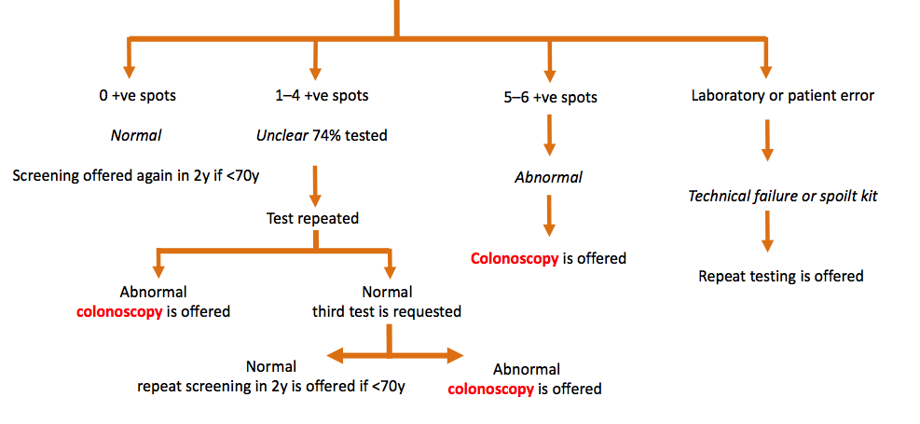
gFOCT & when to refer to colonoscopy

Slide 47
Prostate
Cancer

Slide 48
Prostate cancer is the sixth most common cancer worldwide.
It is the 5th most common cancer affecting saudi males.

Slide 49
No guideline suggests routine screening without patient choice.
guidelines vary regarding the balance of benefits and harms of screening for prostate cancer.
Shared decision making:
Engage patients in shared decision-making by presenting current evidence on potential benefits and harms of screening.

Slide 50
The potential benefits:
A small reduction in prostate cancer-specific mortality, but this effect is uncertain and inconsistent across trials.
The potential harms:
possible emotional distress with false positive results.
Risk for bleeding, infection.
urinary retention from a potentially unnecessary prostate biopsy.
delayed diagnosis due to false negative results.

Slide 51
Who Is eligible ?
Consider engaging men aged 50-69 years and those aged > 40 years with risk factors (black race or family history in first-degree relative) in shared decision-making for an informed choice regarding prostate cancer screening
Risk for prostate cancer increased with:
those aged 50-69 years
black men
men with a family history of prostate cancer, particularly in a first-degree relative

Slide 52
Screening tests
Digital rectal examination (DRE):
Operator-dependent, fails to detect early prostate cancers, and lacks specificity. Annual screening in the
USA and Germany has not d mortality.
as complementary test
Prostate-specific antigen (PSA):
is the primary screening method
Transrectal ultrasound (TRUS)
Too expensive
The most effective screening regime involves rectal examination and PSA testing followed by TRUS for suspicious lesions.
PSA testing reported to be more useful than DRE for early detection of prostate cancer(
Optimal screening interval is unknown but serial screening does increase detection.

Slide 53
Performing a PSA test after Digital rectal examination may cause a transient ↑ in PSA levels (X), so do the PSA test before doing a digital rectal examination. If that is not possible, delay the test for 1wk after the examination.
Exclude urinary infection before PSA testing.
Do NOT do a PSA test if the man has:
A proven UTI—treat the UTI and postpone the PSA test for 1mo
Exercised vigorously in the previous 48h
Had a prostate biopsy <6wk ago
PSA cut-offs that should prompt referral Based on Oxford Handbook of General Practice:
Age | PSA (ng/mL) indicates referal to urology
50–59 | ≥3.0
60–69 | ≥4.0
70 | >5.0

Slide 54
Reasons for increased PSA:
Prostate cancer
Benign prostatic hypertrophy Acute or chronic prostatitis
Physical exercise
Acute Urinary retention
Prostate instrumentation (includes prostate biopsy and urinary catheterization)
Old age

Slide 55
Breast
Cancer

Slide 56
Breast cancer is the top cancer in women worldwide and in the Kingdom.
According to local statistics, breast cancer tops the list of the most common cancers in women in the Kingdom of Saudi Arabia, by a rate of about 28% compared to the rest of the cancer types in women and 13% of cancers between sexes.
Breast cancer does occur in men too, but at a lower rate.
The rates of breast cancer incidence are increasing in all world countries.
It is observed that breast cancer mortality rates have decreased in developed countries due to early screening programs and modern therapy.
Breast cancer affects Saudi women at an early age compared to developed countries, imposing socio-economic burdens.
Recovery rate of early detected cases may exceed 90%.

Slide 57
Breast Awareness
•Breast awareness means knowing what your breasts look and feel like normally. And you should be aware of any
changes in your breasts.
•The breast awareness 5-point code
1.Know what is normal for you
2. Know what changes to look and feel for
3. Look and feel
4. Report any changes to your GP without delay
5. Attend for routine breast screening if you are aged 50 or over

Slide 58
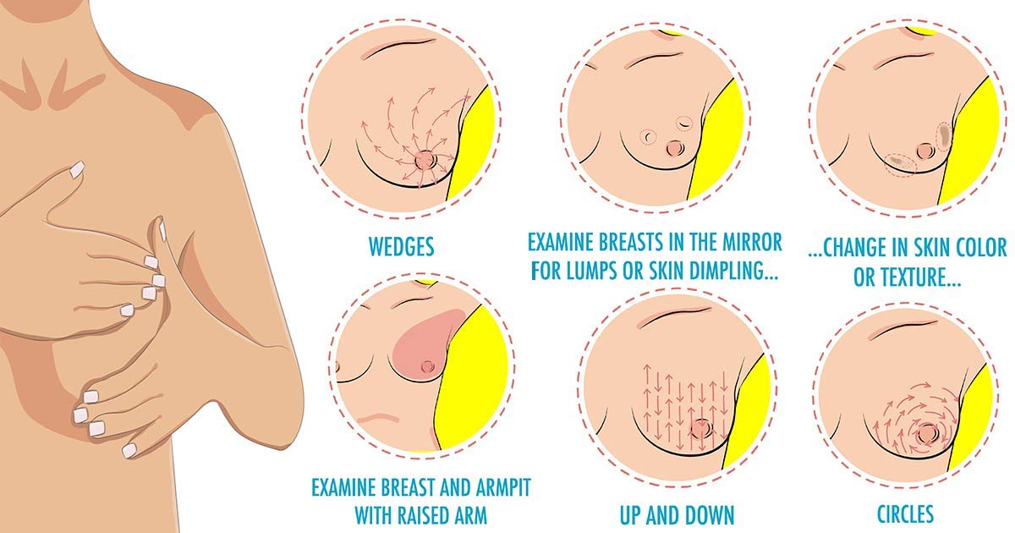
Monthly Self Breast Examination

Slide 59
Changes to be aware of :
•Size
•Nipples
•shape
•Rashes On or around the nipple
•Discharge From one or both nipples
•Skin changes
•Swelling
•Pain Continuous, in one part of the breast or armpit
•Lump or thickening Different to the rest of the breast tissue

Slide 60
Aim of screening
•The aim of the screening is to detect breast cancer at an early stage in order to increase survival chances
stage I tumours—>5y survival 84%
stage IV tumours—>5y survival 18%

Slide 61
Risk Factors
•Age : 81% of breast cancers occur in women >50y
•Early menarche or late menopause increase the risk
•Pregnancy : 32% decrease risk in women reporting three births compared to women reporting one, on late age when first child is born it will increase risk .
•Breastfeeding : decrease relative risk by 4.3% for each year of breastfeeding
•Combined hormonal contraception : Slight increase risk
•HRT Risk : increase by 6 cases/1,000 after 5y combined HRT use and
19 cases/1,000 after 10y use.

Slide 62
Risk Factors
•A personal and family history of breast cancer or ovarian cancer.
•One first degree relative with breast cancer increase the Risk X2 .
•Have a known BRCA1 or BRCA2 gene mutation → based on having genetic testing.
•Have a first-degree relative with a BRCA1 or BRCA2 gene mutation→ have not had genetic testing themselves
•Ionizing radiation Exposure increase risk

Slide 63
Screening test
Women >50y :
Two-view mammographic screening is currently available to women aged 50–70y every 3y.
Screening detects 85% of cancers in women aged >50y
70–80% screening-detected cancers have good prognosis.

Slide 64
High-risk women <50y :
•Women with family history of breast cancer may be at increase risk of breast cancer and may benefit from earlier screening and/or genetic screening
•All high-risk women aged 40–49y should be offered annual
two-view mammography
•Women known to have a genetic mutation should be offered annual
MRI surveillance from 20y if TP53 mutation, and from 30y if BRCA1/2
mutation

Slide 65
MRI surveillance should also be offered to women aged:
1) 30–39y with 10y risk >8%
2) 40 –49y with 10y risk >20%
3) 40–49y with a dense breast pattern on mammography

Slide 66
Summary
Cancer Type | Screening test | When | Who
Breast | Mammography | Yearly | high-risk women aged 40–49 years old
 |  | Every 3 years | Women 50 years old and above
 | Clinical breast examination | Yearly | Women 40 years old and above
 | Breast self examination | Monthly | Women 30 years old and above
 | Breast MRI | Women with Genetic risk

Slide 67
Cervical
cancer

Slide 68
•Cervical cancer is the easiest gynecologic cancer to prevent, with regular screening tests and follow-up.
•About 241 new cervical cancer cases are diagnosed annually in Saudi Arabia (estimations for 2012).
•Cervical cancer is the 8th most common female cancer in women aged 15 to 44 years in Saudi Arabia
•HPV types 16 and 18 are responsible for about 70% of all cervical cancer cases worldwide. HPV vaccines that prevent HPV 16 and 18 infections are now available
•Almost exclusively occurs in women who have been sexually active.
•Incidence is dropping probably due to the cervical cancer screening program and changes in sexual practices.

Slide 69
Risk Factors
• Low social class
• Smoking
• Early age of 1st intercourse
• Early age of 1st pregnancy
• Multiple sexual partners
• HPV infection (types 16, 18, 31, and 33)
•Method of contraception (decrease with
barrier methods, increase if >5y COC use)
• Immunosuppression, HIV

Slide 70
cervical cancer screening
The most frequent method for cervical cancer screening is :
•Cytology (pap smear ) , and there are alternative methods such as HPV DNA tests and visual inspection with acetic acid (VIA).
Pap test : is used to find cell changes or abnormal cells in the cervix. (These abnormal cells may be pre-cancer or cancer, but they may also be other things, too.)
Cells are lightly scraped or brushed off the cervix. They are sent to a lab and looked at under a microscope to see if the cells are normal or if changes can be seen. The Pap test is a very good test for finding cancer cells and cells that might become cancer.

Slide 71
•HPV testing : checks for the virus, not cell changes.
Infection with human papillomavirus (HPV) 16, 18, 31, and 33 is associated with cervical cancer.
99.7% of cervical cancers contain HPV DNA and women with HPV infection are 70x more likely to develop high-grade cervical abnormalities.
If the test negative → returned to normal recall
If the test positive → referred for colposcopy.
HPV testing is also used as a test of cure after treatment for CIn.

Slide 72
Cervical cancer testing should start at age 21→ Women under age 21 should not be tested.
Women between the ages of 21 and 29 → should have a Pap test done every 3 years. HPV testing should not be used in this age group unless it’s needed after an abnormal Pap test result.
Women between the ages of 30 and 65 → should have a Pap test plus an HPV test (called “co-testing”) done every 5 years. This is the preferred approach, but it’s OK to have a Pap test alone every 3 years.
Women over age 65→ who had regular cervical cancer testing in the past 10 years with normal results should not be tested for cervical cancer .

Slide 73
Women with a history of a serious cervical pre-cancer → should continue to be tested for at least 20 years after that diagnosis, even if testing goes past age 65.
•All women who have been vaccinated against HPV should still follow the screening recommendations for their age groups.

Slide 74
HPV VACCINE
What HPV vaccines are available ?
•Three vaccines are approved by the Food and Drug Administration FDA to prevent HPV infection: Gardasil, Gardasil 9, and Cervarix.
All three vaccines prevent infections with HPV types 16 and 18, two high-risk HPVs that cause about 70% of cervical cancers .
Gardasil also prevents infection with HPV types 6 and 11, which cause 90% of genital warts
Gardasil 9 prevents infection with the same four HPV types plus five additional high-risk HPV types (31, 33, 45, 52, and 58).

Slide 75
.
Who is the HPV vaccine for? And, when should it be given?
The Centers for Disease Control and Prevention (CDC) recommends routine HPV vaccine for girls and boys ages 11 or 12, although some organizations recommend starting the vaccine as early as age 9 or 10. It's ideal for girls and boys to receive the vaccine before they have sexual contact and are exposed to HPV because once someone is infected with the virus, the vaccine might not be as effective or might not work at all.

Slide 76
summary
Cervical | Pap Smear | 3 year | sexually active
 |  | yearly | Women Who are HIV positive

Slide 77
1- WHICH ONE OF THE FOLLOWING IS NOT ON WILSON-JUNGNER CRITERIA?
Natural history of illness is well understood
Detectable at early age
Acceptable to the population
Test has to be highly specific
Notes:
abnswer d

Slide 78
2- which one of the following have high risk of breast cancer ?
A. Early age when first child is born
B. Breastfeeding
C. Have a first-degree relative with a BRCA1 or BRCA2 gene mutation
D. Multiple sexual partners
Notes:
c

Slide 79
3- A 62 year old asymptomatic patient came to you concerned that he might have colorectal cancer especially that his best friend just died and he had colorectal cancer, what is the most appropriate initial test?
A. Do fecal occult blood test annually until he is 75
B. colonoscopy as soon as possible and do it again 5 years later
C. Transrectal ultrasound (TRUS)
Notes:
Answer Is “A”

Slide 80
4- 30 Years old male. On screening his BP was 135\85. Which one of the following statements is correct
A. Screen him again after 3 years
B. Lifestyle modification and screen him every year
C. Start treatment with ACE Inhibitor.
..D. Do Nothing.
Notes:
answer b

Slide 81
5- At which age we have to stop cervical cancer testing for women who had regular cervical cancer testing in the past 10 years with normal results ?
50 years old
> 65 years old
< 21 years old
45 years old
Notes:
b

