Slide 1
Smoking And Substance Abuse
Done by:
- Ghaida Al-Masaad - Malak Al-Khathlan - Reema Hazazi - Najla Bin Rabah

Slide 2
Objectives: 1- Epidemiology of smoking in Saudi Arabia 2- Risks of smoking (Morbidity and Mortality) 3- Effect of passive smoking on pregnancy, children, …. 4- Helping the smoker to quit with smoking cessation aids and overcoming nicotine withdrawal symptoms 5- Role of PHC physician “smoking cessation clinic’ 6- Update of the smoking cessation medication in pharmacological management 7- Nicotine preparations, Varenicline, Bupropion, ……. 8- Factors that lead to substance abuse 9- Highlighting types of substance abuse 10- Method to approach subjects with substance abuse

Slide 3
1- What is the expected annual death due to tobacco use in 2030: A. 500.000 B. 400.000 C. 6.000.000 D. 8.000.000
MCQs
Notes:
The answer is: D

Slide 4
2- Effect of second-hand smoking on children: A. Asthma B. Otitis media C. All of the above D. None of the above
MCQs
Notes:
The answer is: C

Slide 5
3- When it is contraindicated to use Bupropion? A. Heart disease B. Seizure C. Kidney stones D. Peptic ulcer
MCQs
Notes:
The answer is: B

Slide 6
4- Which one of the following is the most common substance abuse: A. Cocaine B. Alcohol C. Cannabis D. Steroids
MCQs
Notes:
The answer is: C

Slide 7
5- Which one of the following cases is at risk of substance abuse: A. People who are mentally well. B. Young people whose there families use certain medications. C. People who are just graduated. D. Children who goes to school and blend with others in society.
MCQs
Notes:
The answer is: B

Slide 8
SMOKING IS THE ONLY LEGAL CONSUMER PRODUCT THAT KILLS YOU WHEN YOU USE IT
FACT:

Slide 9
What makes the smoking dangers?
Tobacco

Slide 10
Epidemiology
Tobacco is the single greatest risk factor for cancer mortality worldwide causing estimated 22% death per year.
21% of the global population aged 15 and above smoked tobacco.
Each day, more than 3,200 people younger than 18 years of age smoke their first cigarette.
Notes:
Smoking prevalence is commonly defined as the percentage of daily smokers in a population

Slide 11
Epidemiology of smoking in Saudi Arabia
A study was conducted between April and June 2013 to assess the status of tobacco consumption in the Kingdom of Saudi Arabia (KSA).
Overall prevalence of current smoking was 12.2 % and males were more likely to smoke than females (21.5 % vs. 1.1 %).
Mean age of smoking initiation was 19.1 years (±6.5 years) with 8.9 % of smokers starting before the age of 15 years.

Slide 13
Epidemiology of smoking in Saudi Arabia
A study reveals that the most common trigger for Saudi female to start smoking is “their experience of seeing someone they know is smoking”
Notes:
Comparison and prevalence of smoking among Saudi females from different Departments of the College of Applied Medical Sciences in Dammam.
tried smoking was 13.3%. Of those, 0.9% were active smokers.
Respiratory Care Department has the highest prevalence of smoking (25%; n = 11 out of 63)

Slide 14
Survey results

Slide 15
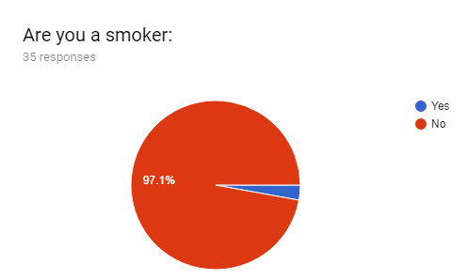
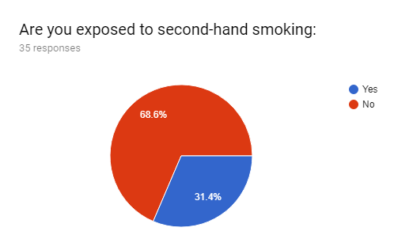
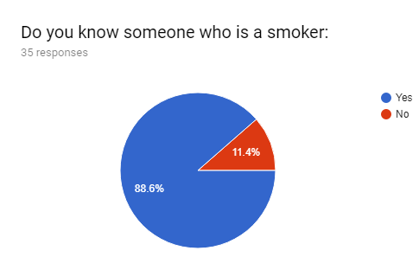
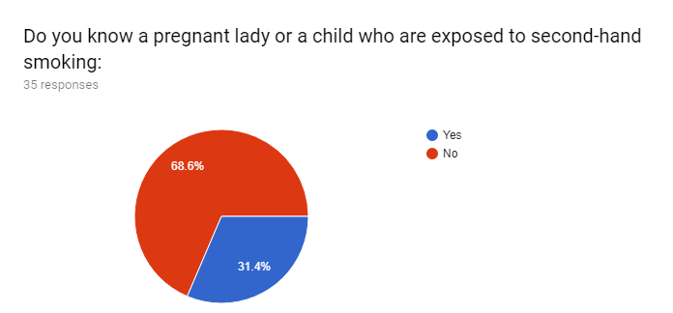
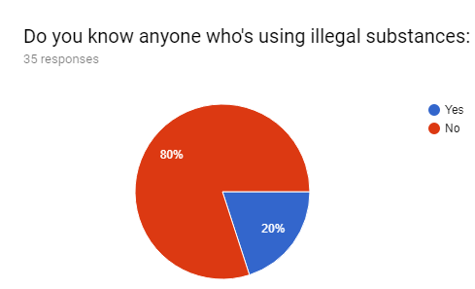
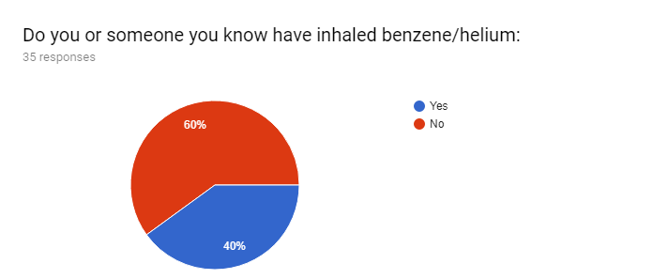

Slide 16
Role Play with Video

Slide 17
Why teens and kids start smoking?

Slide 20
Why teens and kids start smoking?
Peer influence
Adult smoking
Coping with stress
Advertising
Media

Slide 21
Risks of smoking (Morbidity and Mortality)

Slide 22
Short term health consequences:
Respiratory and non respiratory:
Addiction to nicotine
Notes:
WHO

Slide 23
Long-term health consequences
The fact that most young people who smoke regularly continue to smoke throughout adulthood.
Cigarette smokers have a lower level of lung function than those persons who have never smoked
Smoking reduces the rate of lung growth.

Slide 24
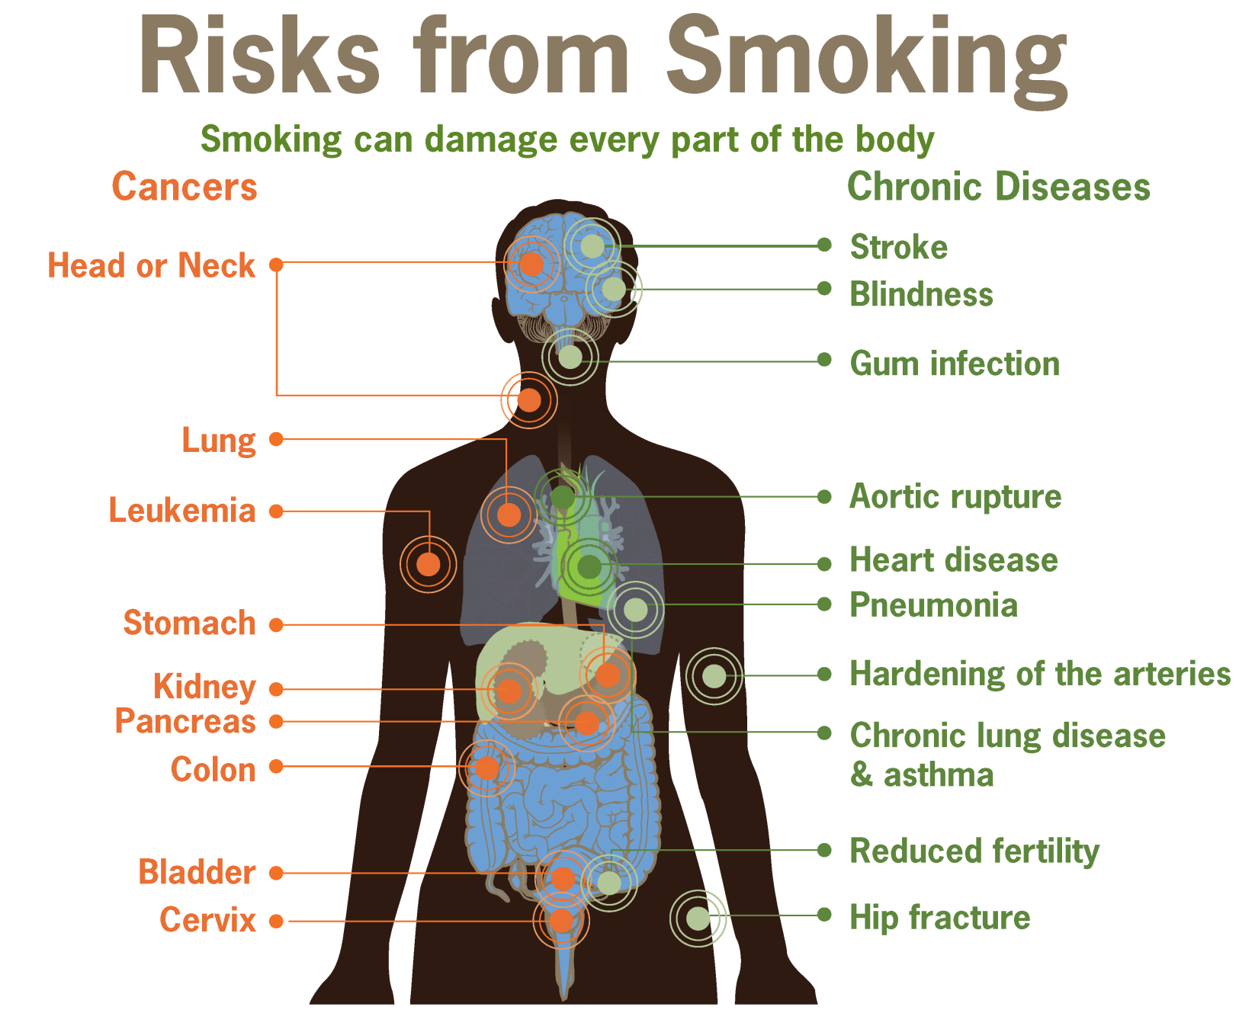

Slide 25
Cancer
Chronic lung diseases
Cardiovascular
Strokes

Slide 26
In adults, cigarette smoking causes heart disease and stroke. Studies have shown that early signs of these diseases can be found in adolescents who smoke.
The resting heart rates of young adult smokers are two to three beats per minute faster than nonsmokers.(1)

Slide 27
Smoking hurts young people's physical fitness in terms of both performance and endurance—even among young people trained in competitive running. On average, someone who smokes a pack or more of cigarettes each day lives 7 years less than someone who never smoked.
Teenage smokers suffer from shortness of breath almost three times as often as teens who don't smoke, and produce phlegm more than twice as often as teens who don't smoke.(3)
Teenage smokers are more likely to have seen a doctor or other health professionals for an emotional or psychological complaint.(3)

Slide 28
Teens who smoke are three times more likely than nonsmokers to use alcohol, eight times more likely to use marijuana, and 22 times more likely to use cocaine. Smoking is associated with a host of other risky behaviors, such as fighting and engaging in unprotected sex.

Slide 29
CANCER
Nearly 9 out of 10 lung cancers are caused by smoking cigarettes.
Treatments are getting better.
In the United States, more than 7,300 nonsmokers die each year from lung cancer caused by secondhand smoke.
Smokers have a greater risk for lung cancer today than they did in 1964, even though they smoke fewer cigarettes? WHY?!
Notes:
Smoking can cause cancer and then block your body from fighting it DNA damage + low immunete.
One reason may be changes in how cigarettes are made and what chemicals they contain.⁵
Smoking can cause cancer almost anywhere in your body, including the:⁵
Blood (acute myeloid leukemia)
Bladder
Cervix
Colon and rectum
Esophagus
Kidney and renal pelvis
Larynx
Liver
Lungs
Mouth and throat
Pancreas
Stomach
Trachea, lung. and bronchus

Slide 30
About 13,150 new cases of laryngeal cancer (10,490 in men and 2,660 in women)
About 3,710 people (2,970 men and 740 women) will die from laryngeal cancer
Notes:
The rate of new cases of laryngeal cancer is falling by about 2% to 3% a year, most likely because fewer people are smoking.

Slide 31
Effect of passive smoking on pregnancy

Slide 32
• A study found a significant association between SHS exposure during pregnancy and decreased birth weight.
• Second-hand smoke are a miscarriage, low birth weight, early birth, learning or behavioral deficiencies in your child, and Sudden Infant Death Syndrome.
• Smoking during pregnancy in many countries is recognized as the most important preventable risk factor for an unsuccessful pregnancy outcome 2003 study.

Slide 33
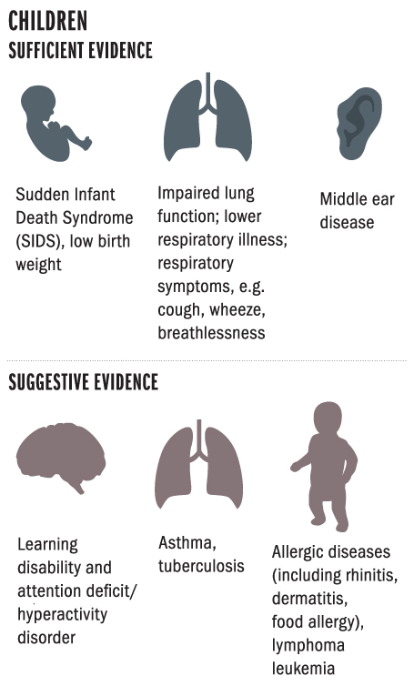
Effect of passive smoking on children:
Notes:
Sufficient evidence is the term used by the US Surgeon General to indicate that current evidence strongly supports the inference of a causal relationship between smoking and specific health outcomes.
Suggestive evidence = similar term used to indicate that current evidence, although indicative, is not yet sufficient to infer a causal relationship.

Slide 37
Helping the smoker to quit:
Have a Plan
Stay on Track
Notes:
Desire

Slide 38
Have a Plan:
1. Cold turkey.
2. Behavioral therapy.
3. Nicotine replacement therapy.
4. Medication.
5. Combo treatments.
Notes:
1- About 90% of people who try to quit smoking do it without outside support -- no aids, therapy, or medicine. Although most people try to quit this way, it's not the most effective or successful method. Only between 4% and 7% are able to quit by doing it alone.
2- This involves working with a counsellor to find ways not to smoke. Together, you'll find your triggers (such as emotions or situations that make you want to smoke) and make a plan to get through the cravings.

Slide 39
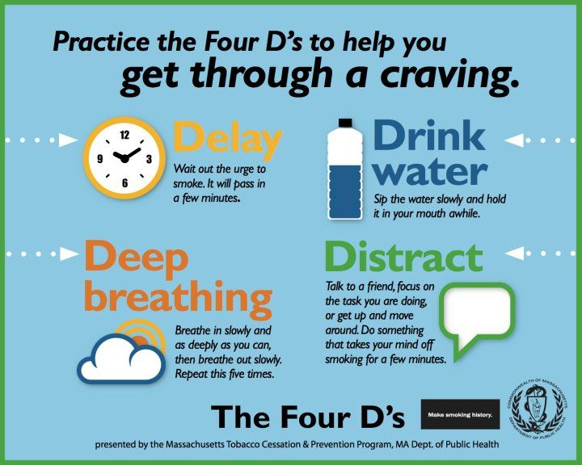
Stay on Track:
1. Know your triggers and avoid them early on.
2. Know that the first few days are the toughest.
3. Try a new hobby with friends who don't smoke.
4. Reward yourself.
5. Don't give in to your cravings.
Notes:
1- Write down your triggers and how you can manage each situation. And avoid situations that normally make you want to smoke, especially during the first 3 months. This is when you're most likely to start smoking again.
2- You'll probably feel irritable, depressed, slow, and tired, especially if you're quitting cold turkey. Have a quit-smoking support group available. It can be a good friend or a quit line you can call. Once you get past those first days, you'll begin to feel more normal (though you’ll still have cigarette cravings).

Slide 40
Role of PHC physician “smoking cessation clinic”:
GPs should take the opportunity to advise all patients who smoke to quit when they attend a consultation.
Five A’s
Five R’s
Ask
Relevance
Advice
Risks
Assess
Rewards
Assist
Roadblocks
Arrange
Repeat
Notes:
5% quit with only asking

Slide 41
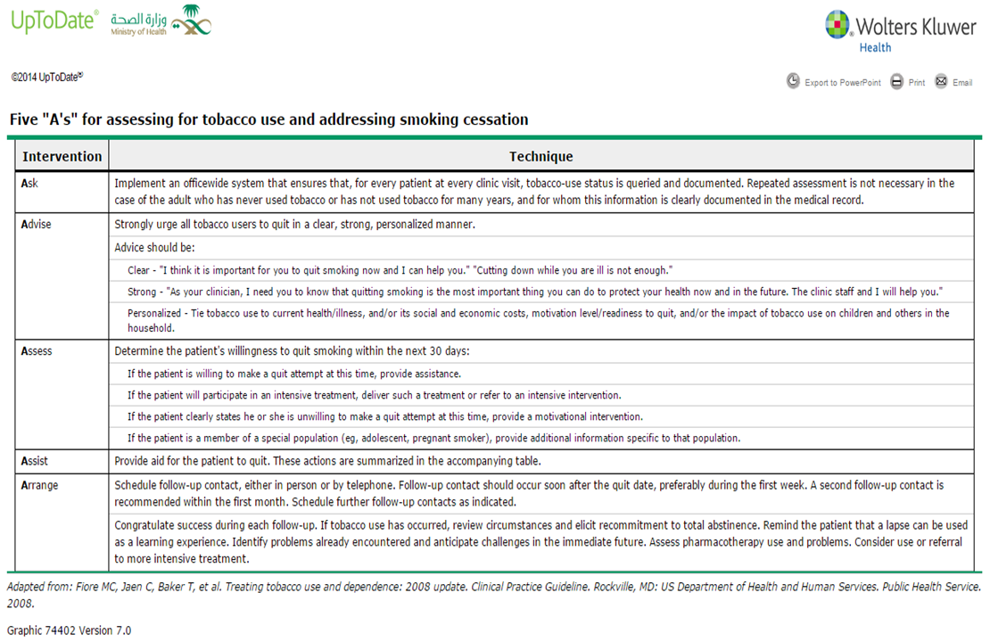

Slide 43
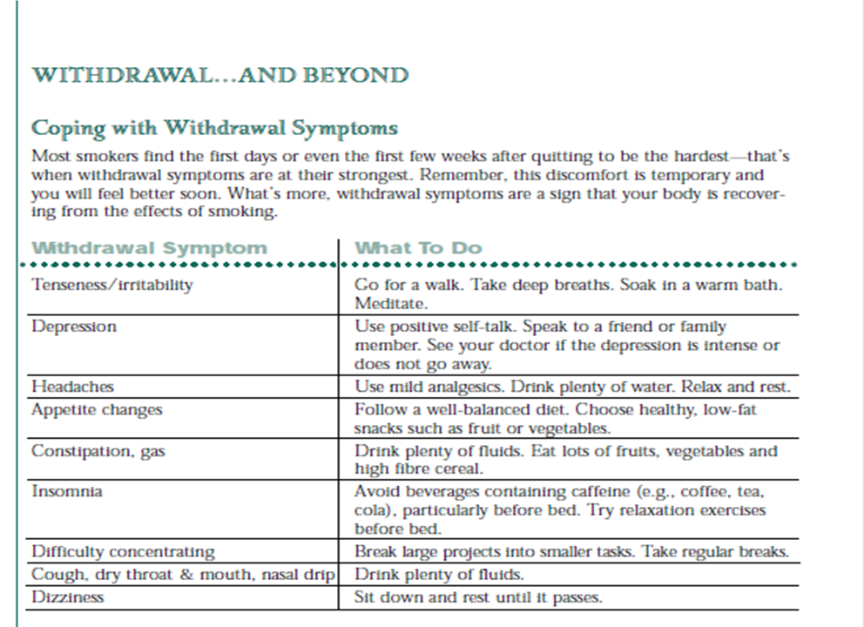
Overcoming nicotine withdrawal symptoms:
Notes:
Characterized by symptoms that include headache, anxiety, nausea and a craving for more tobacco.
Nicotine creates a chemical dependency, so that the body develops a need for a certain level of nicotine at all times.

Slide 44
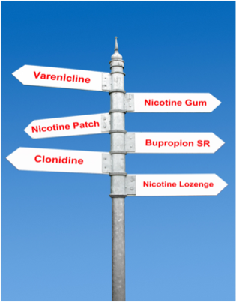
Different pharmacological tools:
Before choosing a pharmacologic tool, physician should consider “Advantages of each, Disadvantages, Contraindications”

Slide 45
Pharmacological management:
• Nicotine replacement therapy(NRT).
• Non- NRT:
Bupropion- Varniciline
Notes:
Pharmacotherapy can be divided into two groups: nicotine replacement therapy (NRT) and non-NRT. NRT increases abstinence rates by 2 to 3 times that of placebo.35 All pharmacotherapy treatments approximately double the cessation rates.
NRT, varenicline or bupropion should normally be prescribed as part of an abstinent- contingent treatment, in which the smoker makes a commitment to stop smoking on or before a particular date (target stop date). The prescription of NRT, varenicline or bupropion should be suf cient to last only until 2 weeks after the target stop date. Normally, this will be after 2 weeks of NRT therapy, and 3–4 weeks for varenicline or bupropion, to allow for the different methods of administration and mode of action. Subsequent prescriptions should be given only to people who have demonstrated, on re-assessment, that their quit attempt is continuing.

Slide 46
Pharmacological management:
NRT, varenicline or bupropion should normally be prescribed as part of an abstinent- contingent treatment, in which the smoker makes a commitment to stop smoking on or before a particular date (target stop date).
The prescription of NRT, varenicline or bupropion should be sufcient to last only until 2 weeks after the target stop date.
Subsequent prescriptions should be given only to people who have demonstrated, on reassessment, that their quit attempt is continuing.

Slide 47
Nicotine replacement therapy:
• NRT works by replacing nicotine from cigarettes and relieving or preventing nicotine withdrawal symptoms.
• It is available as: patches , short acting oral forms (lozenges, chewing gum) ,nasal sprays, nicotine inhalator.
• Contraindicated in post MI patients ,patients with serious arrhythmias and pregnant and lactating women.
Notes:
Absorption from NRT-like gum and patches is gradual and time is allowed for development of tolerance to nicotine withdrawal in the brain. The stimulant and euphoric effects of rapidly absorbed nicotine from cigarette smoking does not occur. However, the high levels of nicotine maintained in the brain by NRTs prevent the nicotine withdrawal symptoms and thus the efficacy of NRT

Slide 48
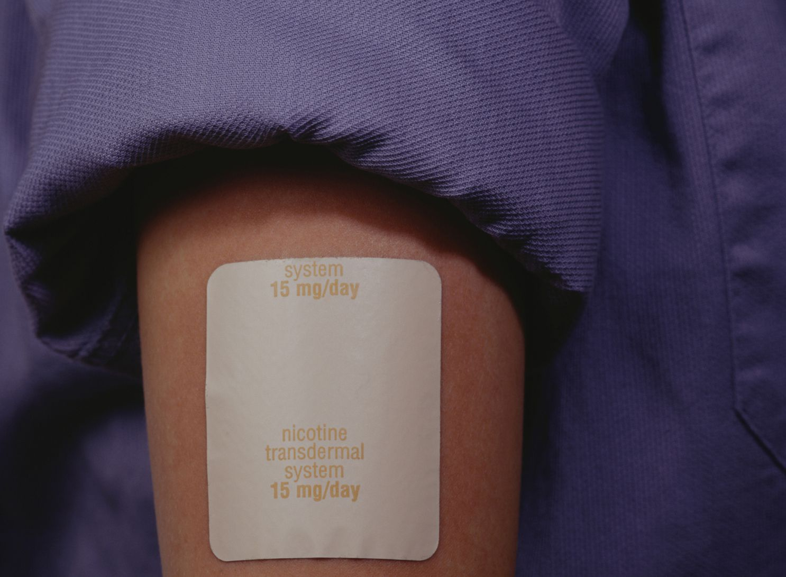
Nicotine replacement therapy:
Nicotine patch:
• Nicotine patches are the preferred method of NRT because
of the ease of use and high concentrations of nicotine delivered.
• Nicotine levels rise gradually and then plateau for most of the day.
Advantages:
Ease of use, minimal side effects and demonstrated efficacy.
Adverse effects:
Can lead to localized skin sensitivity and irritation
Notes:
as the patch diffuses nicotine through the skin and into the bloodstream at a constant rate.

Slide 49
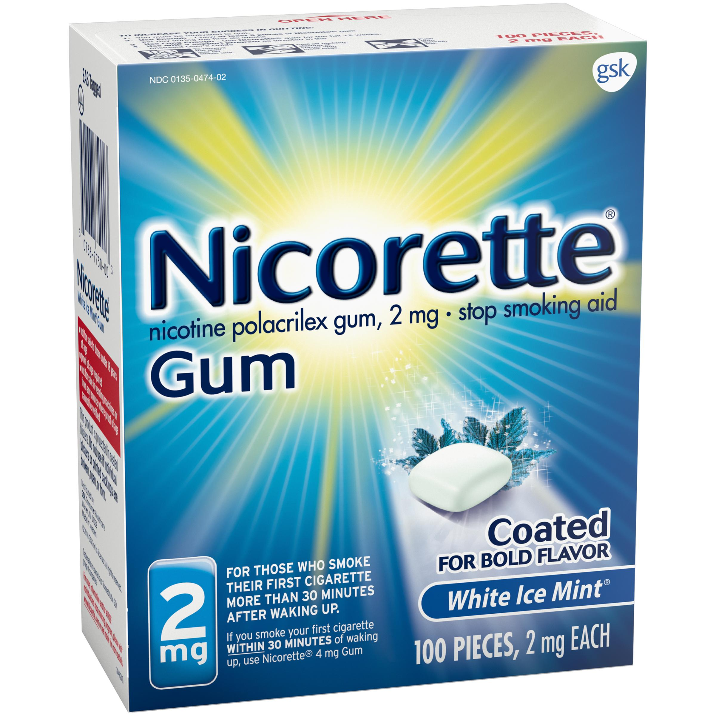
Nicotine replacement therapy:
Nicotine gum:
• It cause a gradual rising and falling of nicotine levels throughout the day.
• Used in place of smoking when the patient craves nicotine.
• Appropriate patient education is required for optimal use of the nicotine gum “chewing and parking”.
Adverse effects:
Sore mouth, throat or jaw, hiccups, dyspepsia, nausea,
flatulence and gastrointestinal discomfort.
Notes:
over the counter
Appropriate patient education is required for optimal use of the nicotine gum. Chew the gum until a “peppery” taste or tingling sensation occurs, then “park” the gum between cheek and gum, to facilitate nicotine absorption through the oral mucosa. Repeat the process of intermittently “chewing and parking” for about 30 minutes.

Slide 50
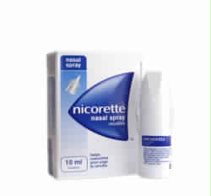
Nicotine replacement therapy:
Nicotine nasal spray:
• It is used in place of smoking when the patient craves nicotine.
• Plasma nicotine levels peak within 10 minutes and are about two-thirds those of cigarette (fast absorption).
• Its available for prescription use only.
Adverse effects:
Headache, burning, rhinitis, watering eyes,
nasal or throat irritation, sneezing and coughing.

Slide 51
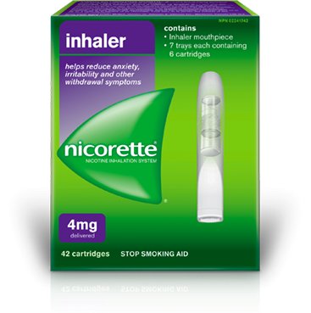
Nicotine replacement therapy:
Nicotine inhaler:
• The best choice for smokers that need a change for the hand to mouth behavior, and the tactile/sensory stimulation that cigarettes provide.
• The device does not deliver nicotine to the lungs.
• It is also effective as a combination therapy with other NRT agents and bupropion. • Its available for prescription use only.
• It is contraindicated with bronchospastic disease.?
Notes:
Each puff on the inhaler delivers 13 ng. To receive levels similar to most cigarettes, over 20 minutes, 80 puffs are needed to get 2 mg of nicotine. Absorption occurs from the oral and pharyngeal mucosa and gastrointestinal tract secondary to swallowing.

Slide 52
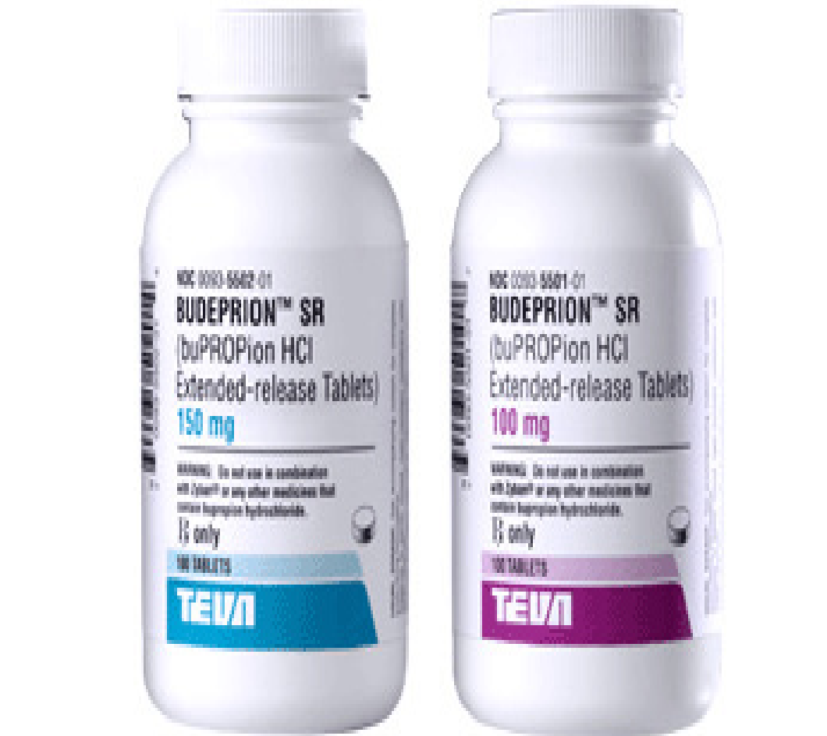
Bupropion (antidepressant ):
• Bupropion is well known as an antidepressant, but clinician noted that it had a specific effect on nicotine craving.
• It inhibits both noradrenergic and dopaminergic uptake.
• Decrease weight gain associated with smoking cessation
• Bupropion is most effective in combination therapy.
Adverse effects:
Insomnia, nausea and dry mouth
Contraindication:
Patients with a history of seizures or conditions that predispose to seizure,
pregnancy ,breast feeding and young people under 18.
Notes:
The usual dose for smoking cessation is 150mg once a day for three days increasing to 150 mg twice a day, continued for 7 to 12 weeks. The quit attempt is generally initiated a week after starting pharmacotherapy.
,(anorexia, brain tumour, or alcohol or benzodiazepine withdrawal)

Slide 53
Varenicline:
• A selective nicotinic receptor partial agonist.
• It designed to bind to same receptor sites as nicotine it alleviates withdrawal symptoms related to quitting smoking but the drug also blocks the rewarding effects of nicotine.
•The person sets a date to stop smoking, and starts taking varenicline tablets 1 or 2 weeks before this date.
Adverse effects:
Psychological effect.
Nausea, constipation, headache, insomnia, and vivid dreams
Contraindication:
Pregnancy and breast feeding, young people under 18 .
Notes:
Activation of mesolimbic dopaminergic system by nicotine causes release of dopaminewhich promotes reinforcement and reward process leads to craving. • Varenicline antagonize this and decrease dopamine release
Varenicline works by reducing a person’s craving for a cigarette and by reducing the effects they feel if they do have a cigarette. The person sets a date to stop smoking, and starts taking varenicline tablets 1 or 2 weeks before this date. Treatment normally lasts for 12 weeks.

Slide 54
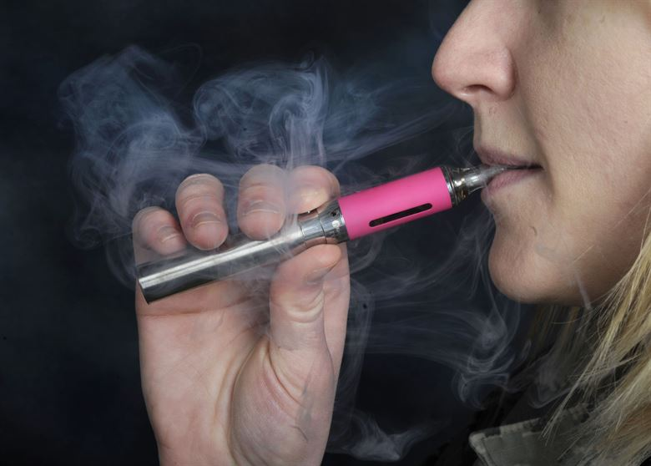
Other methods :
•Electronic cigarettes
•Complementary medicine( Hypnotherapy-Acupuncture)
There is no evidence to support these methods as an effective aid to smoking cessation.

Slide 55
Pregnancy
There is, insufficient, high-quality evidence to determine whether the use of pharmacotherapy (i.e. NRT, bupropion or varenicline) is effective and safe during pregnancy.
Some guidelines recommend the use of NRT in pregnancy under medical supervision, but only when behavioural therapy has failed and in heavily dependent smokers who remain motivated to quit.

Slide 56
Adolescents
No smoking-cessation medications are FDA-approved in children or adolescents (under 18 years).
The UK NICE guidelines, however, support the use of NRT if required, along with behavioural interventions in teenagers over 12 years of age.
If a decision is made to use NRT in a teenager, it should be used in conjunction with behavioural therapy and should be individualised.

Slide 57
Substance abuse
- According to the Home Office report:
More than one third of adults aged 16 to 59 have taken an illegal drug or used a substance unlawfully at some point in their lives. Cannabis was the most common, followed by powder cocaine and ecstasy.
- The government's (What About Youth? survey):
Found that 5% of 15 year old had used cannabis in the past month and 9% had used it in the past year.
- The Health and Social Care Information Centre's survey:
Found that around 3% of 11 to 15 year old reported inhaling glue, gas or other solvents.
Notes:
Cannabis 7%, powder cocaine 2% and ecstasy 2% in the past year.

Slide 58
What is substance abuse?
Depending on or regular excessive consumption of substances leading to physical, mental or social problems.

Slide 59
Who is at risk of substance abuse?
Who have mental health problems
Who are being sexually abused
People not in employment, education or training or homeless
Children and young people whose families use drugs
Children and young people who are not in secure environments
People who are known to use drugs occasionally or recreationally

Slide 60
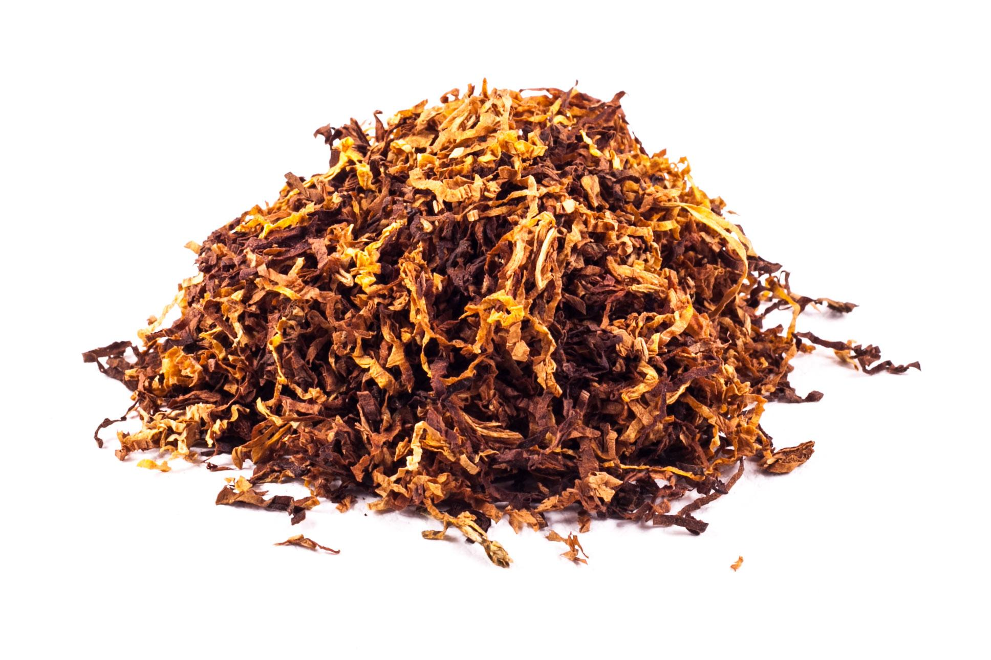
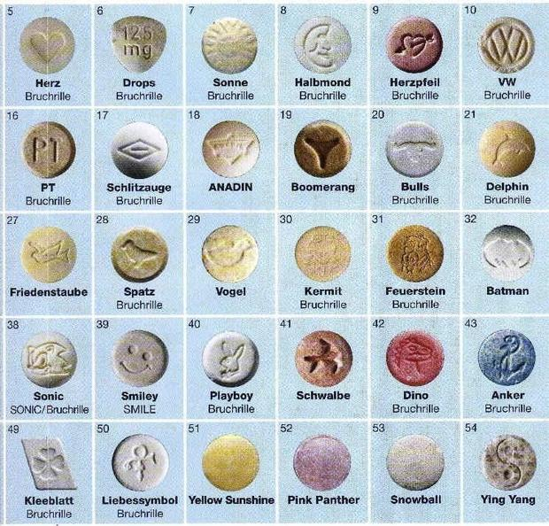
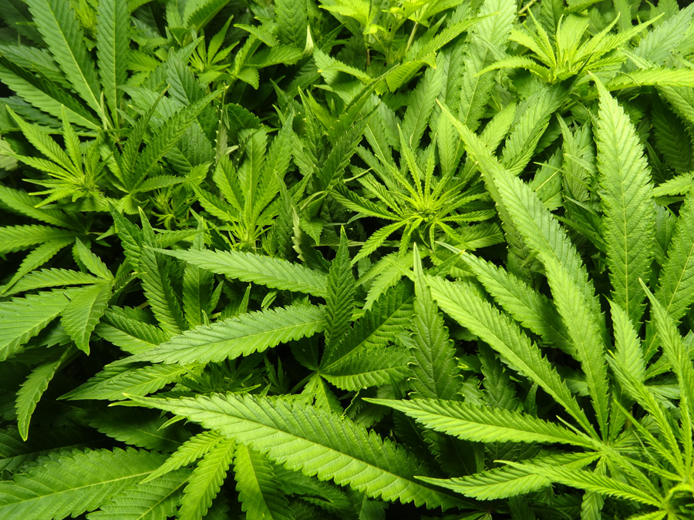
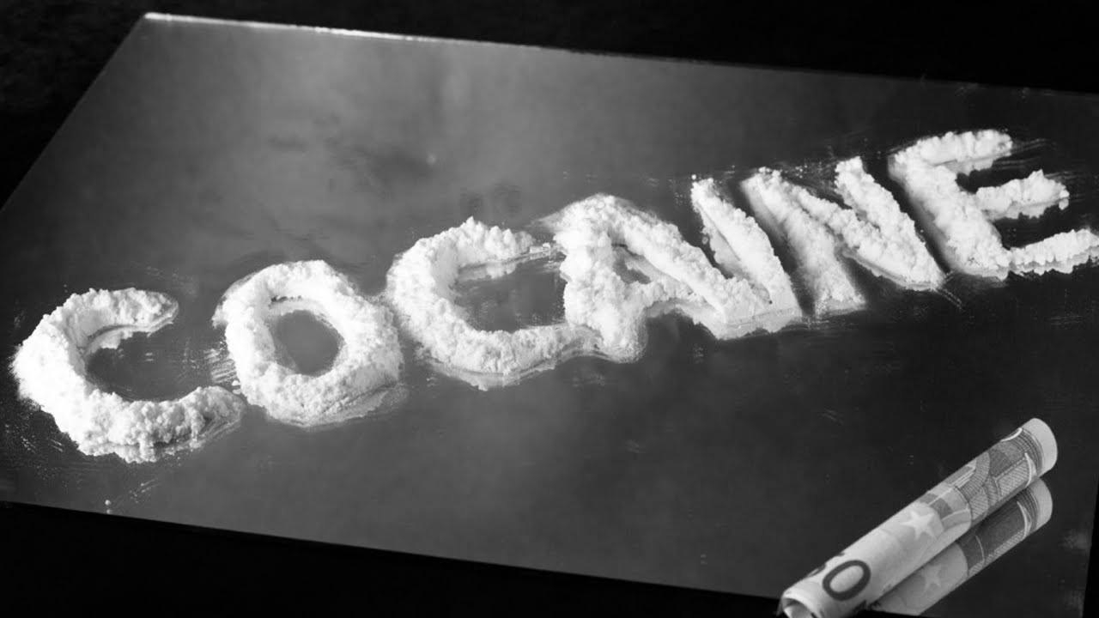
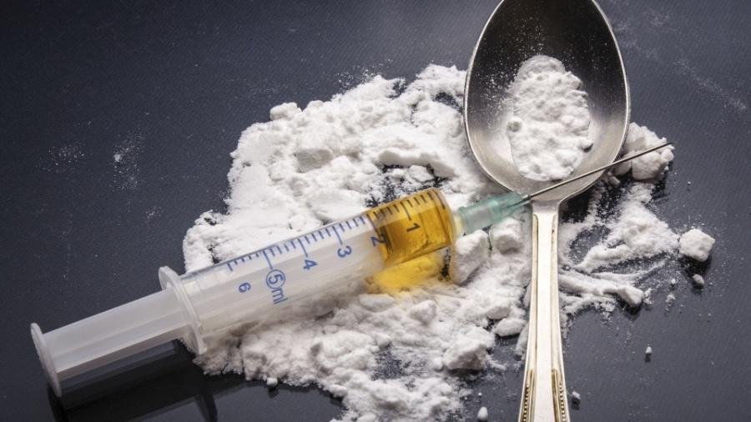
Notes:
Psychoactive drugs are substances that can change the consciousness, mood, and thoughts of those who take them. They include tobacco and alcohol; as well as cannabis, amphetamines, ecstasy, cocaine, and heroin

Slide 61
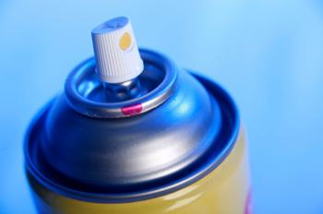
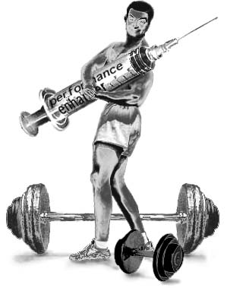
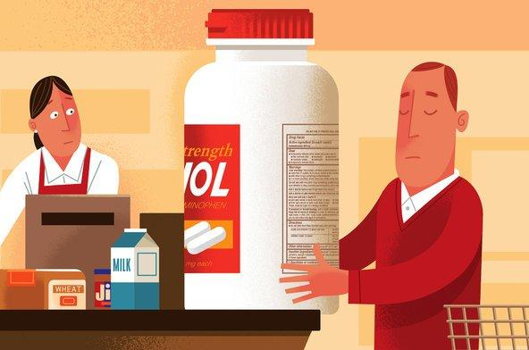
Notes:
Solvents & Volatile substances
Image and performance enhancing drugs & and over the counter medicines

Slide 62
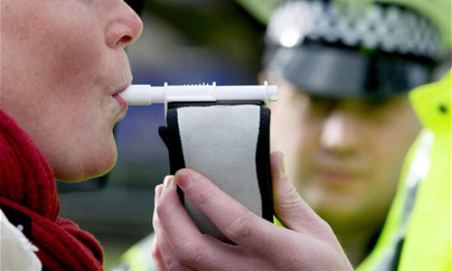
Assessment:
People presenting for substance abuse should be assessed
Notes:
People presenting for substance abuse should be assessed to establish the presence and severity of their case: Use urinalysis to aid identification of the use of opioids and other substances; consideration may also be given to other such as oral fluid and/or breath testing

Slide 63
How to approach patients with substance abuse?
• Symptoms that suggest drug abuse:
1. Acute chest pain in a young person.
2. Acute psychosis.
3. Mood and sleep disorders.
• Take a history of drug and alcohol misuse:
1. What type and method of administration?
2. In what quantity?
3. How frequently?
• Review current and previous physical and mental health problems; these problems should be treated alongside the drug abuse.

Slide 64
How to approach patients with substance abuse?
• Consider the risks of self-harm as a response to withdrawal symptoms.
• Consider the current social and personal circumstances, including employment and financial status, living arrangements and social support.
• Consider the impact of drug abuse on family members.
• Develop strategies to reduce the risk of relapse, taking into account the person's support network.
Take into account:
Stigma and discrimination.
Ensure that discussions take place in settings in which confidentiality, privacy and dignity can be maintained.
Avoid clinical language without adequate explanation.
Aim to preserve continuity of care and minimize changes.
Notes:
-Self harm:
1.Physical health risks (withdrawal seizures, delirium tremens, blood-borne viruses, accidental overdose)
2.The impact that substance use may have on other risks (such as self-harm, suicide, self-neglect, violence, abuse of or by others, accidental injury and offending behaviour).
-If a person presenting also for abuses alcohol, healthcare professionals should consider the following:
If the person is not alcohol dependent, attempts should be made to address their alcohol misuse, because they may increase this as a response to withdrawal symptoms.
If the person is alcohol dependent, alcohol detoxification should be offered.

Slide 65
What should on healthcare professional to do?
Establish and sustain a respectful and supportive relationship with the patient.
Ensure that maintaining the patient’s engagement with services remains a major focus of the care plan.
People who abuse drugs should be given the same care, respect and privacy as any other person.
Notes:
-Good communication between doctor and patient is essential
-Take time to engage the person from the start, and build a respectful, trusting, non-judgemental relationship.
-To enable patients to make informed decisions about their treatment and care, doctor should explain options and harm reduction interventions.
-Review regularly the care plan of the patient receiving maintenance treatment.

Slide 66
Healthcare professional should explain and give detailed information
Physical and psychological aspects of substance withdrawal, including the duration and intensity of symptoms, and how these may be managed.
The use of non-pharmacological approaches to manage or cope with withdrawal symptoms.
The importance of continued support, as well as psychosocial and appropriate pharmacological interventions to maintain abstinence.
Healthcare professional should give advices on aspects of lifestyle
Balanced diet.
Adequate hydration.
Good sleep.
Regular physical exercise.
Notes:
-Before undertaking any investigations for substance abuse, and before each treatment decision is taken: provide the patient with full information about the management, to ensure informed consent.

Slide 67
Management:
Detoxification refers to the process by which the effects of drugs are eliminated from dependent users in a safe and effective manner, such that withdrawal symptoms are minimized.
Abstinence may be one of the long-term goals of treatment, it is not always achieved.
Pharmacological approaches along with psychosocial interventions are the primary treatment option.

Slide 68
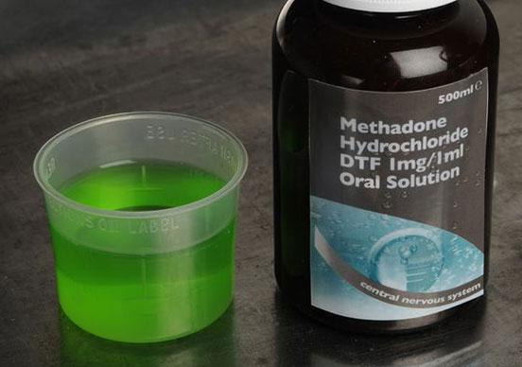
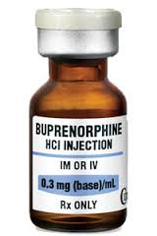
Pharmacological interventions
The choice of medication:
Notes:
-Methadone or buprenorphine should be offered as the first-line treatment in opioid detoxification.

Slide 69
Pharmacological interventions
Dosage and duration:
When determining the starting dose and duration, the healthcare professionals should take into account the:
Severity of dependence
Stability of the patient
The duration of opioid detoxification should normally be up to 4 to 12 weeks.
Continued treatment, support and monitoring designed to maintain health status. This should normally be for a period of at least 6 months.
Notes:
-Stability of the patient (including polydrug and alcohol use, and comorbid mental health problems)
-Continued treatment:
The frequency of screening should be set at three tests per week for the first 3 weeks, two tests per week for the next 3 weeks, and one per week thereafter until stability is achieved.
Urinalysis should be the preferred method of testing but oral fluid tests may be considered as an alternative.

Slide 70
Psychosocial interventions
Supporting families:
Offer family members an assessment of their personal, social and mental health needs.
Provide verbal and written information and advice on the impact of drug abuse on patients and families.
Provide information about self-help and support groups for families.
Self-help:
Provide the patients with information about self-help groups.
Notes:
-Doctor should discuss with people who abuse drugs whether to involve their families in their assessment and treatment plans. However, doctor should ensure that the patient right to confidentiality is respected.
-If the patient agrees, families should have the opportunity to be involved in decisions about treatment and care. Families should also be given the information and support they need.
-Doctor should consider offering individual family meetings and should incloud:
Information and education about drug misuse
Help to identify sources of stress related to drug abuse

Slide 71
At The End..
• Reducing the crime associated with drug abuse.
• Reducing the number of people who take or inject drugs.
• Preventing the transmission of blood-borne viruses.
• Reducing the number of attendances at accident and emergency departments for injection-site infections.
Notes:
Our aim is:…

Slide 72
References:
National Institute for Health and Care Excellence Guidelines
https://www.cdc.gov/tobacco/data_statistics/fact_sheets/fast_facts/index.htm
https://www.ncbi.nlm.nih.gov/pmc/articles/PMC4491232/
https://www.ncbi.nlm.nih.gov/pubmed/16680263
https://www.ncbi.nlm.nih.gov/pubmed/29114195
https://www.webmd.com/smoking-cessation/quit-smoking#1
.CDC, Preventing Tobacco Use Among Young People—A Report of the Surgeon General, 1994
http://www.who.int/tobacco/research/youth/health_effects/en/
http://www.medbroadcast.com/channel/smoking/youth-and-smoking/why-teens-and-kids-start-smoking
https://www.cdc.gov/tobacco/campaign/tips/diseases/cancer.html
https://www.cancer.org/cancer/laryngeal-and-hypopharyngeal-cancer/about/key-statistics.html
Notes:
Our aim is:…

Slide 73
MCQs

Slide 74
Thank you

