Slide 1
Women’s Health
Sarah Nasser AlJasser
Najd Ali AlOmran
Lama abdulmohsen Alwallan
Atheel Saleh Aldbassi

Slide 2
Role Play
Moneera is a 52 years old housewife is brought by her youngest daughter to the primary care clinic

Slide 4
Menopause
Menopause is a normal physiologic process, defined as the permanent cessation of menses for 12 months or more due to cessation of ovarian hormone production.
The age at natural menopause is between 45 years and 50 years. Early menopause is defined as menopause occurring before the age of 45 years, while premature menopause occurs before the age of 40 years.

Slide 5
WHO classification
Premenopausal women: who have experienced regular menstrual bleeding within the last 12 months.
Perimenopausal women: defined as those women who have experienced irregular menses within the last 12 months or the absence of menstrual bleeding for more than 3 months but less than 12 months.
Postmenopausal women: are those who have not experienced menstrual bleeding for 12 months or more.

Slide 6
Menopause
Physical
Sexual
Vasomotor
Psychological

Slide 7
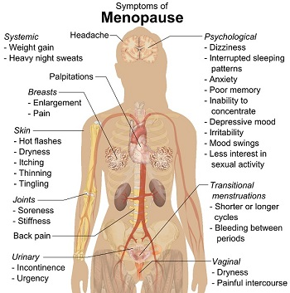

Slide 8
Reporting of menopausal symptoms by women all over the
world

Slide 9
In Latin America, the most reported symptoms included hot flushes (68.9%), followed by sleeping disturbances (68.4%)

Slide 10
In Australia, menopause was associated mostly with hot flashes, followed by night sweats

Slide 11
In Egypt, the most common symptoms were fatigue, followed by headache.
Women from most countries in East and Southeast Asia reported joint and muscle pain as the most frequent complaint

Slide 12
Age of onset of natural menopause also varies worldwide
In the US, the median age at menopause is 51 years.
Younger ages are observed in Africa, for example, in Morocco, a median age of 48.4 years.
In Alexandria, a mean age ± standard deviation (SD) of 46.7±5.44 years
In South Asia, the mean age of onset of natural menopause in Pakistan is 49.3 years

Slide 13
Age of onset of natural menopause also varies worldwide
In Saudi Arabia, only one study has been performed and showed the mean age at natural menopause to be 48.98 years with a median age of 50 years.
The symptoms reported to be most prevalent were joint and muscle pain (80.7%), physical and mental exhaustion (64.7%), and hot flushes and sweating (47.1%).

Slide 14
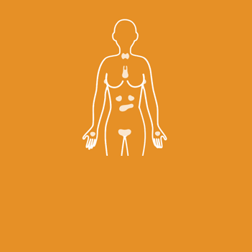
How to manage menopause?

Slide 15
How to manage
menopause:
Eating healthy:
Eating a well-balanced diet and maintaining a healthy weight is key to lowering the risk of heart disease, diabetes, and other chronic health conditions.
The National Institutes of Health (NIH)advises adults between the ages of 19 and 70 to get 600 international units (IUs) of vitamin D per day.
The NIH also encourages adult women up to the age of 50 to get 1,000 mg of calcium per day and women between the ages of 51 and 70 to get 1,200 mg of calcium daily.

Slide 16
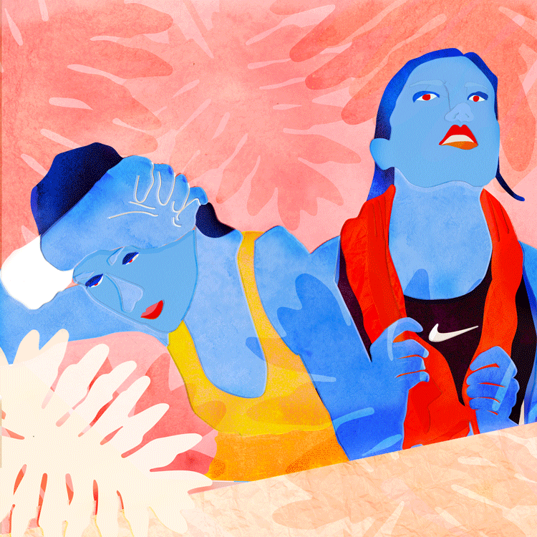
How to manage menopause:
Getting regular physical activity is important at any age, but it may offer extra perks during menopause. It can help in relieving hot flashes, regulating mood, and managing weight.
The CDC encourages adults to get 7 to 8 hours of sleep each night.
Exercising during the day, avoiding caffeine in the evening, and following a regular sleep schedule may help in falling and staying asleep more easily.
Practicing relaxation strategies, such as deep breathing, progressive
muscle relaxation, or meditation, may also help.
Notes:
Mention how obesity affect the symptoms:
Studies show a higher frequency of Vasomotor symptoms in women who gain weight during the postmenopausal period.
Hot flashes are associated with a higher body mass index (BMI).

Slide 17
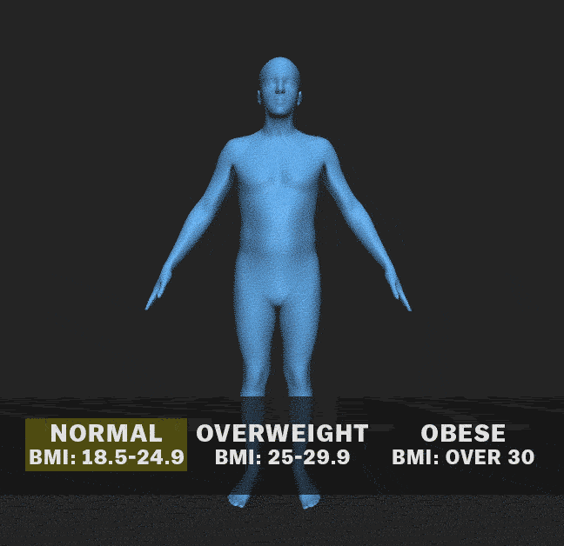
Menopause & Obesity

Slide 18
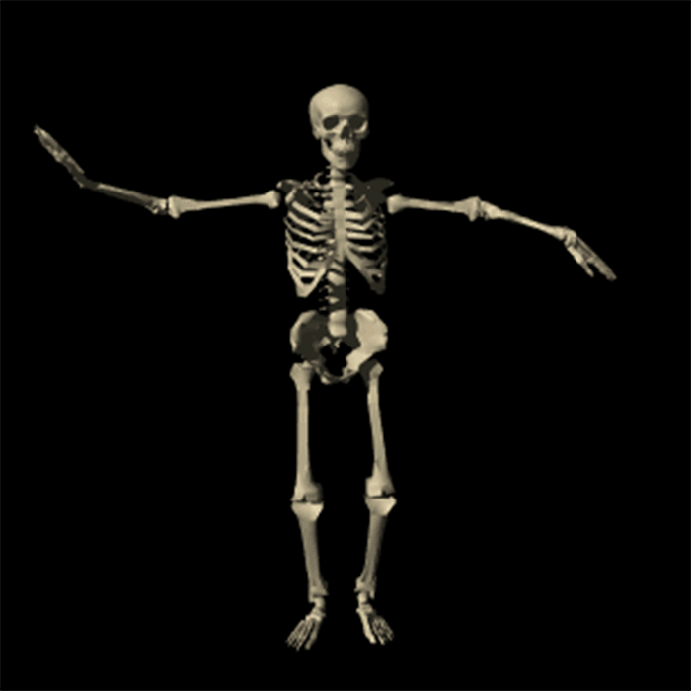
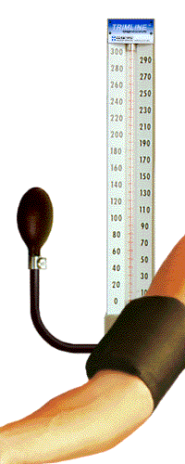
How to manage menopause:
Maintaining bone strength:
Eat foods that are rich in calcium and vitamin D.
Practice strength training exercises, such as weight lifting or yoga.
Learn to exercise in safe ways to help prevent bone fractures and other injuries.
Take steps to prevent falls, for example, by installing hand rails on stairways.
Monitor blood pressure:
Measure blood pressure regularly.
If already diagnosed with hypertension, follow prescribed
treatments.

Slide 19
Non-Hormonal treatments for menopausal symptoms
Paroxetine: The only nonhormonal therapy that is specifically approved for hot flashes (in the United States). This agent has been used for many years for depression but can be taken at a lower dose for hot flashes.
Gabapentin: A drug that is primarily used to treat seizures. It also relieves hot flashes in some women, preferably given as a single bedtime dose or during the daytime as well.
Herbal treatments: A number of herbal treatments have been promoted as a "natural" remedy for hot flashes. In fact, many postmenopausal women use black cohosh for hot flashes, but clinical trials have shown that it is not more effective than placebo. Herbal treatments are not recommended for hot flashes or other menopausal symptoms.

Slide 20
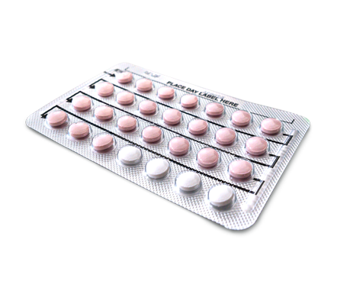
Hormonal Treatment
Combined Estrogen and Progestin
Many health outcomes potentially associated with the use of hormone therapy in postmenopausal women have been examined.
Estrogen Alone
The use of estrogen without progestin has generally been restricted to women who have had a hysterectomy, because unopposed estrogen use increases the risk of endometrial cancer in women with an intact uterus.

Slide 21
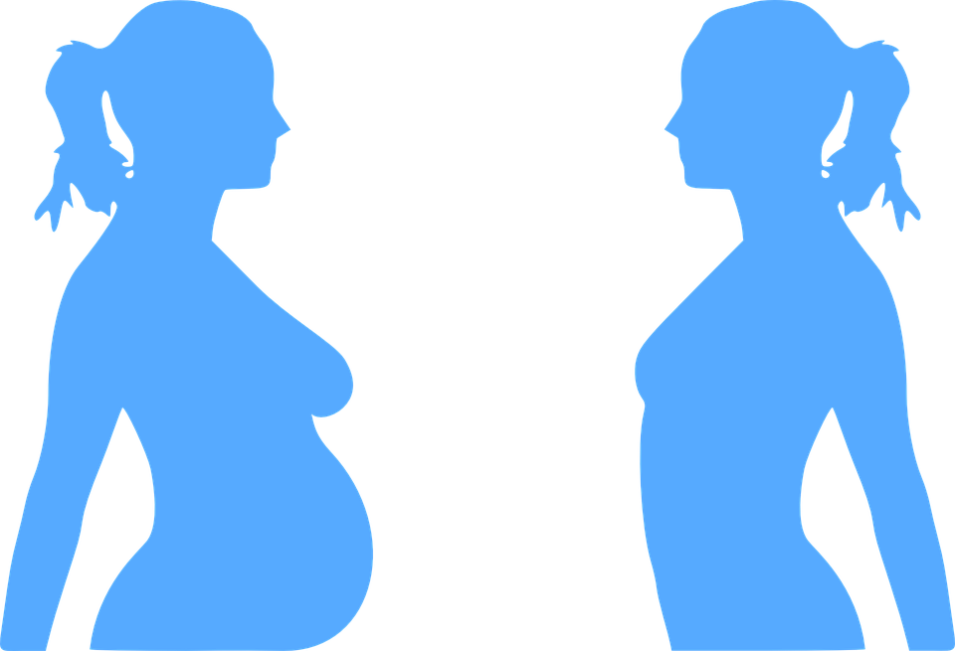
Case
You have been Nora’s doctor for the past 3 years. She is a 35-year-old saudi woman with a BMI of 32 kg/m² who sees you primarily for her idiopathic chronic hypertension, which is well controlled on an ACE inhibitor. She has smoked shisha for the past 10 years. She is in today for her annual exam and mentions that she is getting married after 6 months and would like to start a family. She has never been pregnant before.
On physical exam, her BP=138/84, Ht=157.4 cm , Wt=79.5 kg Otherwise, her exam is unremarkable

Slide 22
Preconception care
What is the goal of counseling a woman about pregnancy prior to conception?
The goal is to optimize, whenever possible, a woman’s health and knowledge before planning and conceiving a pregnancy in order to eliminate, or at least reduce, the risk associated with pregnancy for the woman and her future baby

Slide 23
What are the major topics that should be discussed or addressed with any woman prior to conception?
Identify undiagnosed, untreated or poorly controlled medical conditions
Nutritional issues
Social issues
Mental health issues
Risks of medication and radiation exposure in early pregnancy
Occupational and environmental exposures
Review immunization history and recommend appropriate immunizations
Family history and genetic history including racial/ethnic background and specific genetic risks
Tobacco, alcohol, and substance abuse and other high-risk behaviors (such as sexual activity
and risk for STIs)
Screening for intimate partner violence issues

Slide 24
For the patient in this case, what specific topics need to be addressed?
• Lifestyle changes by increasing physical activity and eating healthy foods.
• Weight loss in obese non-pregnant women has proven health benefits: for nora, she may see improvement in her blood pressure and decrease the need for antihypertensive therapy .
•Obesity in pregnancy is associated with increased risks including higher rates of gestational diabetes, preeclampsia, cesarean delivery, anesthesia complications, post-operative complications).
•She needs to maintain the ideal recommended weight gain during pregnancy( 12- 15 kg)
Notes:
• Weight loss and exercise:
Mary’s BMI is 32.9 and she is obese [BMI ≥ 30]; weight loss in obese non-pregnant women has proven health benefits: for Mary, she may see improvement in her blood pressure and decrease the need for antihypertensive therapy; obesity in pregnancy is associated with increased risks including higher rates of gestational diabetes, preeclampsia, cesarean delivery, anesthesia complications, post-operative complications)
• The effect of chronic medical disease (idiopathic hypertension) on pregnancy (increased risk of preeclampsia, fetal growth restriction, abruption and recommendations for heightened maternal and fetal surveillance in pregnancy)
• Need to modify antihypertensive therapy. ACE inhibitors are contraindicated in pregnancy due to risks for fetal renal dysgenesis and dysfunction
• Effect of smoking on pregnancy (increased risk of fetal growth restriction)
and discuss any family history of birth defects or genetic disorders: referral for genetic counseling may be warranted if issues are identified
• Discussion of increased risk of Down’s Syndrome and other trisomies based on current age of 39 and probable older age when she conceives. Screening options may include cell free fetal DNA, nuchal translucency and first trimester screening, quadruple screen and integrated/sequential techniques
• Begin prenatal multivitamins or at least folic acid supplementation (0.4 mg per day) for the prevention of fetal neural tube defects and 4 mg/day if they have had a prior child/pregnancy with a neural tube defect
• Accurate recording of LMP and cycle length in order to assist in dating her pregnancy and allow her to present early for prenatal care when she does conceive.
• Review immunization history; employment, medical or behavioral risk factors for infections against which effective vaccines are available; and test for evidence of immunity against rubella: recommend immunizations based on your review

Slide 25
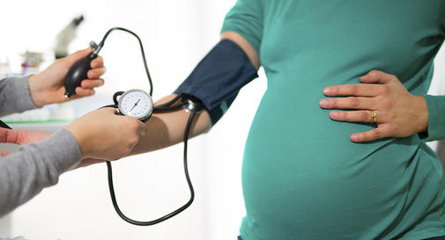
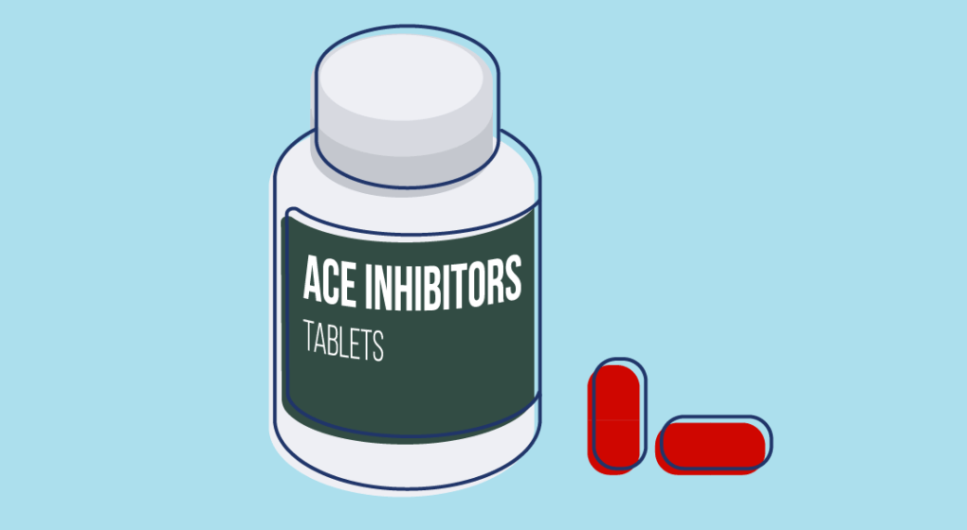
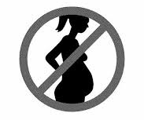
• The effect of chronic medical disease (idiopathic hypertension) on pregnancy (increased risk of preeclampsia, fetal growth restriction, abruption and recommendations for heightened maternal and fetal surveillance in pregnancy)
• Need to modify antihypertensive therapy. ACE inhibitors are contraindicated in pregnancy due to risks for fetal renal dysgenesis and dysfunction.Patients should switch to another medication (eg, labetalol or alpha-methyldopa)
Notes:
Fetal growth restriction
Pulmonary hypoplasia

Slide 26
• Effect of smoking on pregnancy (increased risk of fetal growth restriction)
and discuss any family history of birth defects or genetic disorders: referral for genetic counseling may be warranted if issues are identified
• Discussion of increased risk of Down’s Syndrome and other trisomies based on current age of 35 and probable older age when she conceives. Screening options may include cell free fetal DNA, nuchal translucency and first trimester screening, quadruple screen and integrated/sequential techniques
Notes:
If patient didnt stop smoking reefer her to a smoking clinic

Slide 27
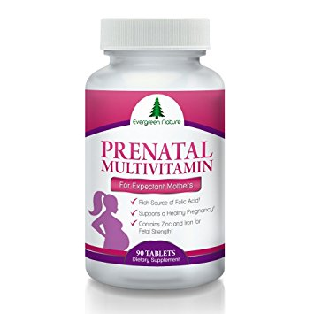
• Begin prenatal multivitamins or at least folic acid supplementation (0.4 mg per day) for the prevention of fetal neural tube defects and 4 mg/day if they have had a prior child/pregnancy with a neural tube defect
• Accurate recording of LMP and cycle length in order to assist in dating her pregnancy and allow her to present early for prenatal care when she does conceive.
• Review immunization history; employment, medical or behavioral risk factors for infections against which effective vaccines are available; and test for evidence of immunity against rubella: recommended immunizations based on your review

Slide 28
Case
A 23 year old woman who’s an undergraduate student in her last year, recently got married but want child spacing for about 1 year till she graduates. Her husband is reluctant to use any male contraception method. She is herself afraid of having any contraceptive method that will affect her fertility.
What is the preferred method of contraception in this case?
How will you counsel her regarding that specific contraceptive method?

Slide 29
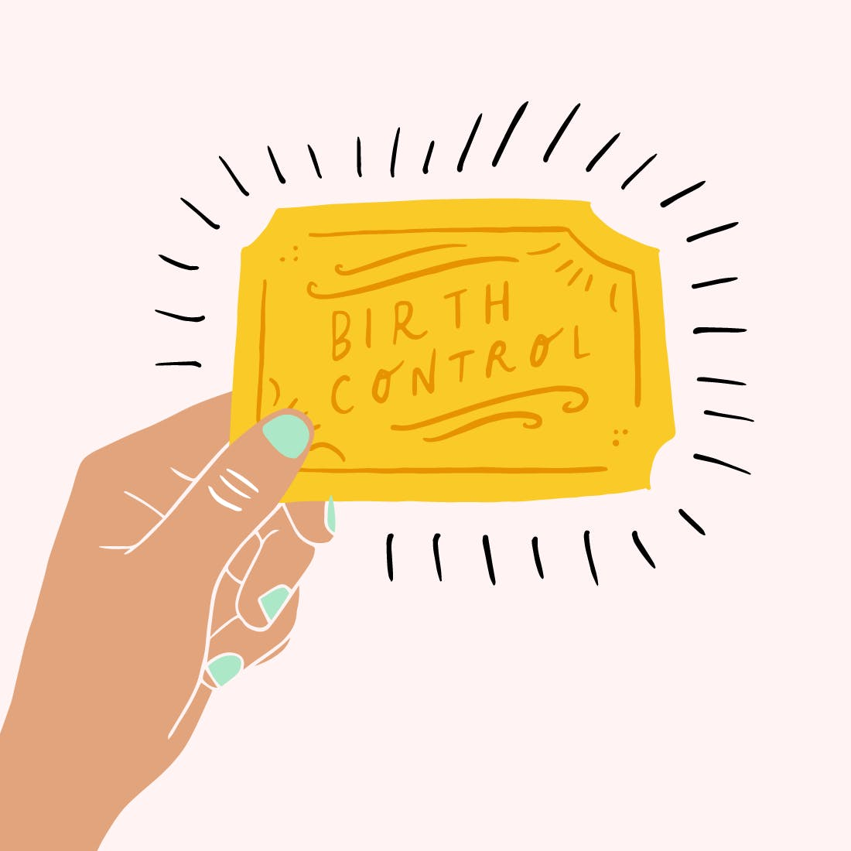
a) Oral contraceptives are preferred as they don’t affect long term fertility.
b) One pill daily is taken per 21 days followed by a pill free interval of 7 days. Each pack is started on the fifth day of the period. If a pill is missed take 2 pills as soon as possible. Advise her of danger signs and adverse effects of pills (cardiovascular effects like MI and DVT, cervical cancer risk, breast tenderness, headache, bleeding disturbances and weight gain).

Slide 30
Combined oral contraceptive pills
-Estrogen-progesterone contraceptives:
92% effective.
Oral pills daily at the same time.
How to take your pill:
Combined Oral Contraceptive Pill This pill has 21 hormone pills and 7 inactive pills (28 pills).
There are different ways of taking the pill:
•take all 28 pills and have a bleed each month.
•take just the hormone pills and have no bleeds at all.
•take just the hormone pills some months and have a bleed every few months.
Notes:
http://www.familyplanning.org.nz/advice/contraception/combined-oral-contraceptive-pill
http://www.familyplanning.org.nz/media/172505/instruction-pad-coc-pill-sept-2014.pdf

Slide 31
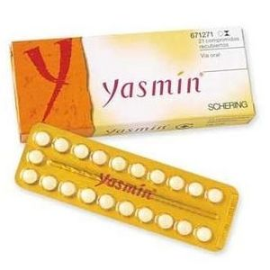
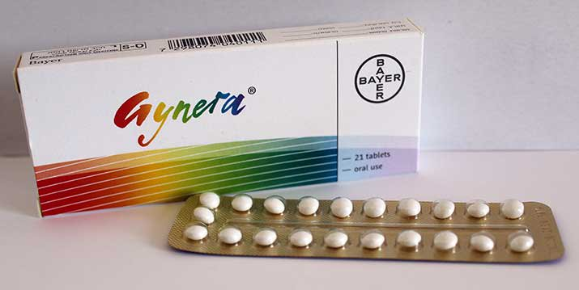
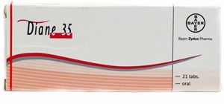
Types
21 tablets each contain 0.03 mg ethinylestradiol, 0-075 mg gestodene
Each tablet contains 3 mg drospirenone and 0.030 mg ethinylestradiol.
35 Tablet
Cyproterone (2mg), Ethinyl Estradiol (0.035mg)
Marvelon 21 or 28:desogestrel 0.15 mg and ethinyl estradiol 0.03 mg.

Slide 32
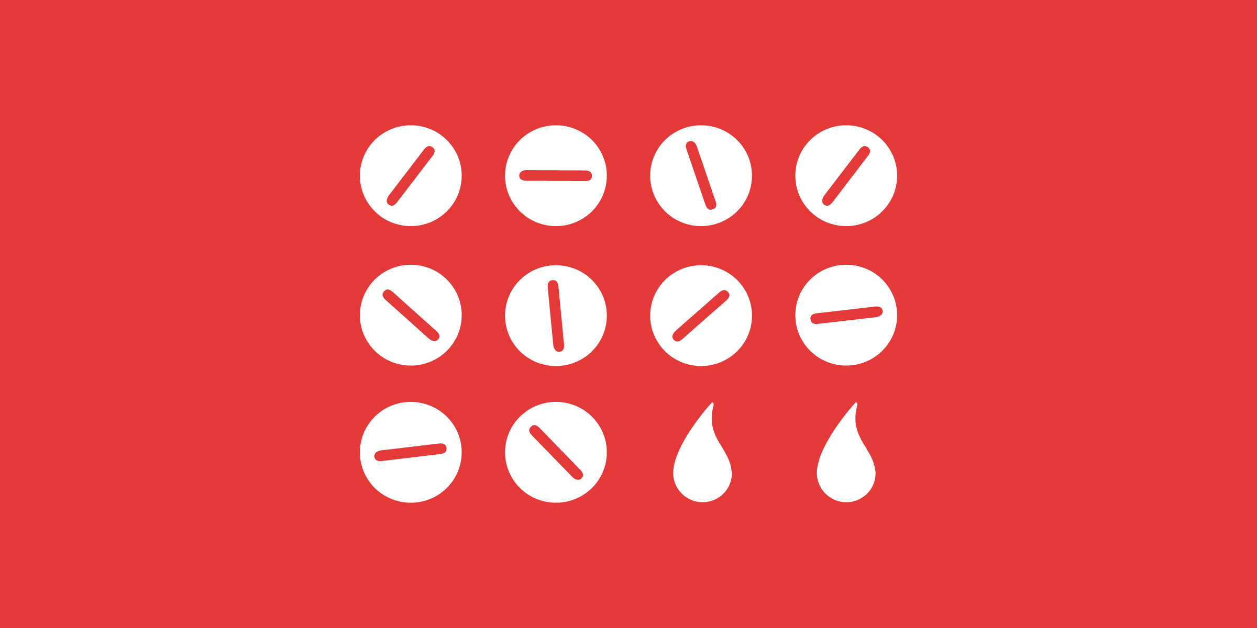
Management of side effects
1-Acne: Types of Birth Control to Treat Acne in Women:
-ortho Tri-cyclen: estrogen combined with a progestin called norgestimate.
-Estrostep: estrogen combined with a progestin called norethindrone.
-YAZ: estrogen combined with a progentin called drospirenone. (proved by FDA to may have increased risk for blood clots compared to other progestins.
2-spotting (abnormal bleeding):
-modest increases in estrogen may often lead to improved bleeding patterns.
-Extending the duration of OC active ingredient treatment from 21 to 24 days may also be helpful.
Notes:
Acne
only three types of birth control pills have been approved by the FDA for treating acne. All three are "combination" oral contraceptives that contain both estrogen and progesterone. In fact, birth control pills that contain only progesterone can actually make acne worse.
Each type of birth control pill used for acne contains a low dose of the same form of estrogen. But each one uses a different form of progesterone
Spotting:
The only reasonably effective pharmacologic approach for the management of most women experiencing unscheduled bleeding with use of an OC is to consider increasing the estrogen dose if a 20-mcg preparation was being used.
Unscheduled bleeding in association with OC use is a common problem, particularly during the first several months of use. The major consequence of bleeding problems has been method discontinuation. Although few randomized clinical trials comparing combination OCs have been conducted and differences in data analysis and definitions of bleeding have made attempts to compare regimens across studies difficult, best evidence to date shows that low-dose (20-mcg ethinyl estradiol) OCs compared less favorably with higher estrogen dose products
https://www.medscape.org/viewarticle/558761

Slide 33
Will antibiotics stop my contraception working?
Most antibiotics don’t affect contraception.
Only types that interact with hormonal contraception and make it less effective are rifampicin-like antibiotics.
There will be a need of using an additional contraception method, such as barriers, change to different method of contraception.
Notes:
https://www.nhs.uk/conditions/contraception/antibiotics-contraception/

Slide 34
Missed pills The 7 day rule
• You will not be safe until you have taken 7 hormone pills in a row.
• Use another method of contraception such as condoms or do not have sexual intercourse while taking the 7 hormone pills.
•If during this time a condom breaks or slips off, you will need an emergency contraceptive pill(ECP).
•If there are less than 7 hormone pills left in the pack, finish the hormone pills and start your new pack immediately (miss the 7 inactive pills or the 7 day break).
If you miss one or more pills, you may get spotting or bleeding.
If you vomit or have severe diarrhoea for a week or more, you should follow the 7 day rule.

Slide 35
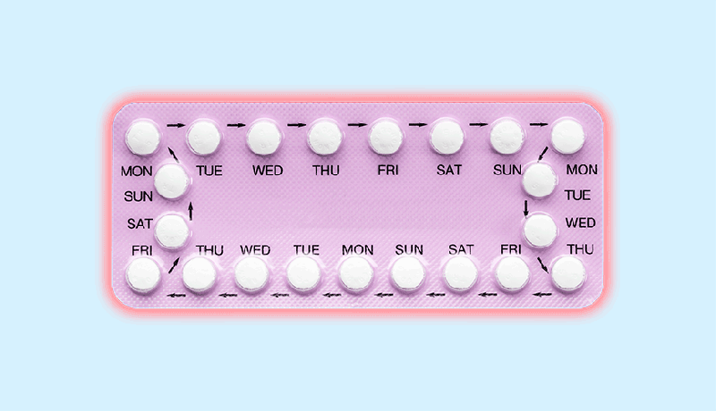
The pill may be affected by:
•medication for epilepsy
•rifampicin for TB
•medication for HIV infection
•laxatives
•St John’s Wort

Slide 36
Contraindication using estrogen/progesterone contraceptive:
-Migraine with Aura
-Blood clots
-Breast cancer
-Liver disease.
Contraindication for Women age > 35 with:
- Smoke
- HTN
- Migraine

Slide 37
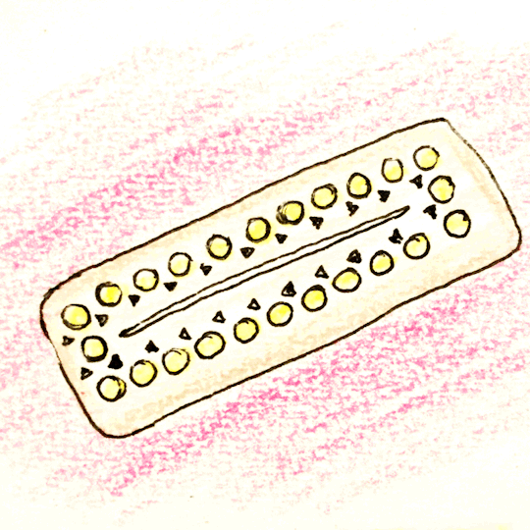
Emergency contraception:
-Emergency contraception (EC) can prevent up to over 95% of pregnancies when taken within 5 days after intercourse.
-Unprotected intercourse → inhibit ovulation and fertilization.
-Plan B or "the morning after pill": two pills 0.75 mg levenorgestrel
-Other options:
Pills containing ulipristal acetate (brand name, ella) are available by prescription only. Ulipristal is effective up to 120 hours (5 days) after unprotected sex and works about twice as well as levonorgestrel pills.
Certain types of "regular" birth control pills containing estrogen and levonorgestrel were used for EC in the past but are less effective and have more side effects than other EC pill
Copper IUD can be used in emergency has 0% failure rate.
Notes:
http://www.who.int/mediacentre/factsheets/fs244/en/
http://ec.princeton.edu/pills/Levonorgestrel.html
http://www.doctorksa.com/Pages/article/21591/emergency-contraception-what-it-is

Slide 38
Question

Slide 39
Thank you!

Slide 40
References:
https://www.ncbi.nlm.nih.gov/pmc/articles/PMC4493969/#b14-ijwh-7-645
https://www.uptodate.com/contents/nonhormonal-treatments-for-menopausal-symptoms-beyond-the-basics
https://www.sciencedaily.com/releases/2017/05/170531084443.htm

