Slide 1

Dr.Saad Mohammad Al-Saad
MBBS, SBFM, ABFM, Geriatrics, WHO cc fellowship
Assistant Professor / Consultant Family physician
Department of Family and Community Medicine
College of medicine, King Saud University
Outpatient Management of Bronchial Asthma
COMM - 421
(TBL) Team Based Learning
GINA 2017

Slide 2
Introduction:
Asthma
Asthma is a heterogeneous disease, usually characterized by chronic airway inflammation. It is defined by the history of respiratory symptoms such as wheeze, shortness of breath, chest tightness and cough that vary over time and in intensity, together with variable expiratory airflow limitation. [GINA 2017]
GINA 2017, Box 5-1 (1/3)

Slide 3
Epidemiology:
Asthma affects an estimated 300 million individuals worldwide.
It is a serious global health problem affecting all age groups, with increasing prevalence in many developing countries, rising treatment costs, and a rising burden for patients and the community through loss of productivity, disruption to the family and it still contributes to many deaths worldwide.

Slide 4
KSA
the prevalence of physician-diagnosed asthma among Saudi school boys in industrial and nonindustrial areas were 13.9% and 8%, respectively.
the prevalence of asthma and associated symptoms in 16–18 years old adolescents attending high schools in the city of Riyadh. Of 3073 students (1504 boys and 1569 girls), the prevalence of lifetime wheeze, wheeze during the past 12 months, and physician-diagnosed asthma were 25.3%, 18.5%, and 19.6%, respectively.
The prevalence of exercise-induced wheezing and night coughing in the previous 12 months were 20.2% and 25.7%, respectively.
a recent study by Nahhas et al conducted among 5188 primary school children in Madinah showed that the prevalence of asthma was 23.6%, where 41.7% had symptoms suggestive of at least one allergic disorder.

Slide 9
MAKING THE DIAGNOSIS OF ASTHMA:
Asthma has two key defining features:
a history of variable respiratory symptoms such as:
wheeze, shortness of breath, chest tightness and cough that vary over time and in intensity,
evidence of variable expiratory airflow limitation:
At least once during the diagnostic process when FEV1 is low,
the FEV1/FVC ratio is reduced.
The FEV1/FVC ratio is normally more than 0.75–0.80 in adults, and more than 0.90 in children.

Slide 10
Factors that may trigger or worsen asthma symptoms:
viral infections
domestic
occupational allergens
(e.g. house dust mite, pollens, cockroach), tobacco smoke,
exercise
stress.
drugs e.g beta blocker, aspirin and NSAIDs.

Slide 11
History:
Document that variation in lung function is greater than in healthy people.
For example: FEV1 increases by more than 12% and 200mL after inhaling a bronchodilator. This is called ‘bronchodilator reversibility’.
Average daily diurnal PEF variability is >10% .
FEV1 increases by more than 12% and 200mL from baseline after 4 weeks of anti-inflammatory treatment (outside respiratory infections).
Bronchodilator reversibility may be absent during severe exacerbations or viral infections.

Slide 12
Physical examination
Physical examination in people with asthma
  Often normal
  The most frequent finding is wheezing on auscultation, especially on forced expiration
  Other allergic manifestations: e.g. atopic dermatitis / eczema
Wheezing is also found in other conditions, for example:
  Respiratory infections
  COPD
  Upper airway dysfunction
  Endobronchial obstruction
  Inhaled foreign body
Wheezing may be absent during severe asthma exacerbations (‘silent chest’)
GINA 2017

Slide 13
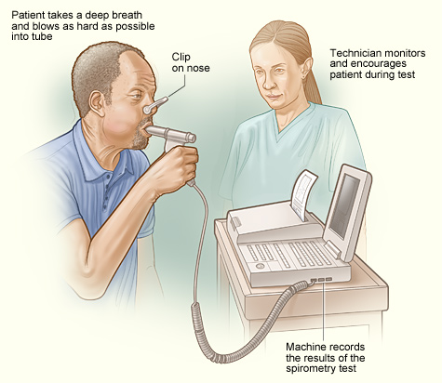
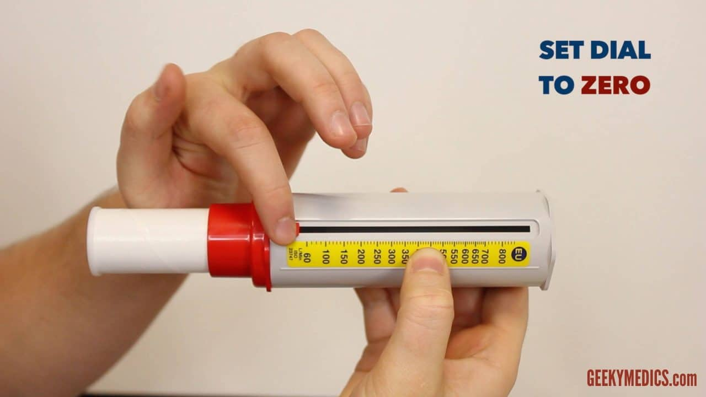
Investigations
Spirometry
PEFR (peak expiratory flow rate)

Slide 15
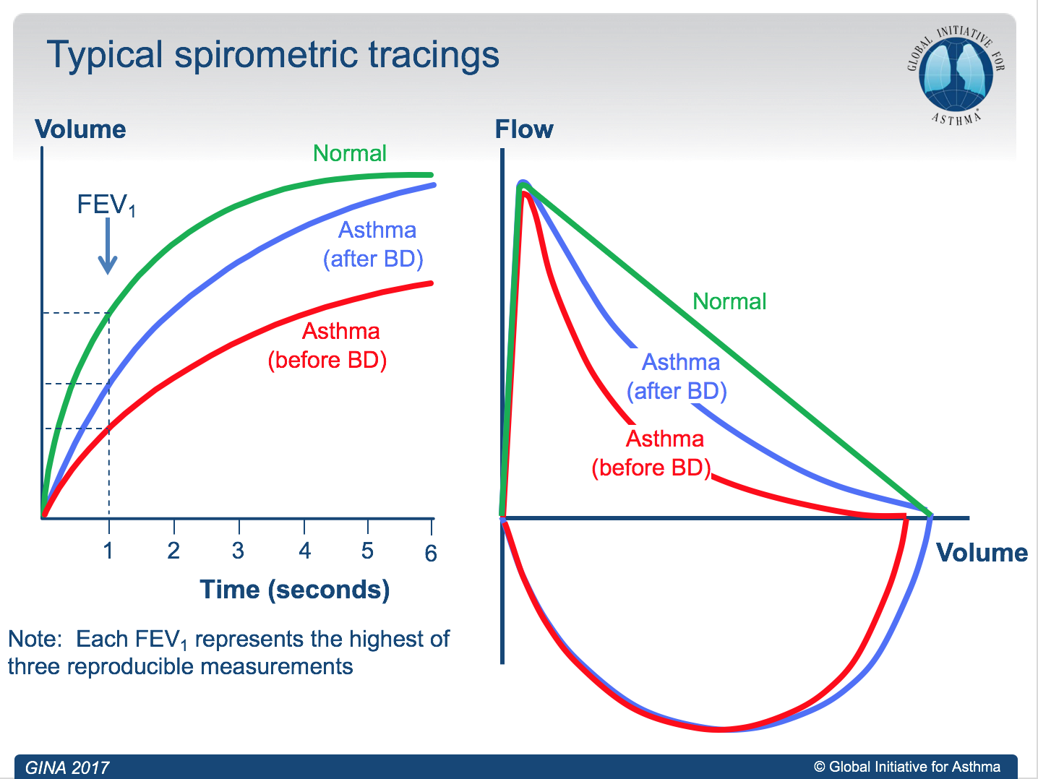

Slide 16
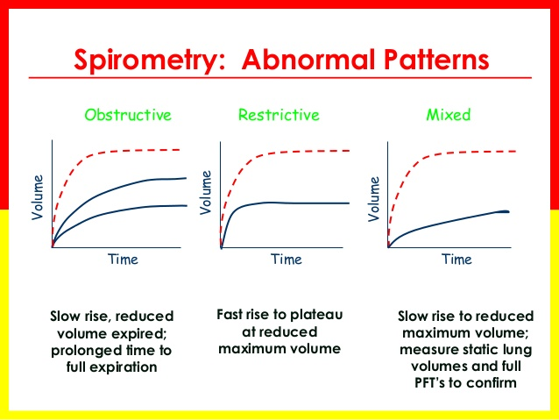

Slide 17
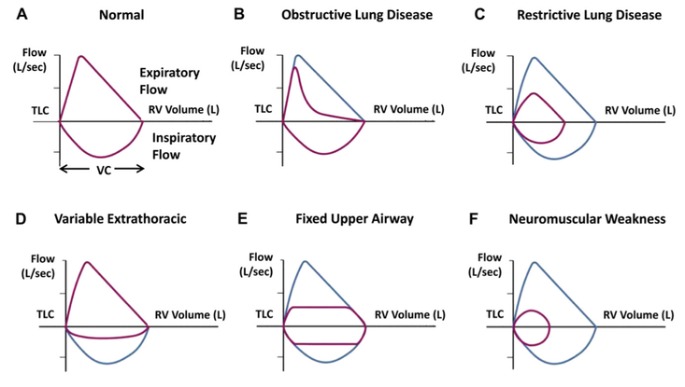

Slide 18
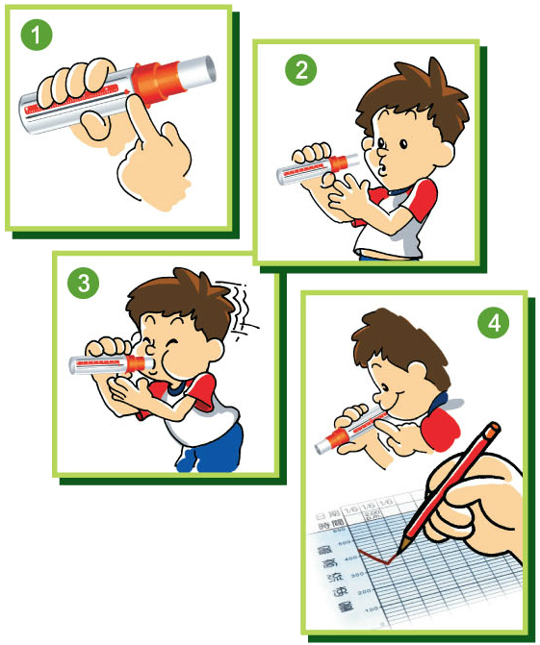
PEFR (peak expiratory flow rate)
• Use:
1. Monitoring changes in airflow limitation in asthma
2. response to treatment.
• Advantages:
1. Portable
2. Can be used at the bedside
• Disadvantages:
1. Effort-dependent
2. Poor measure of chronic airflow limitation

Slide 20
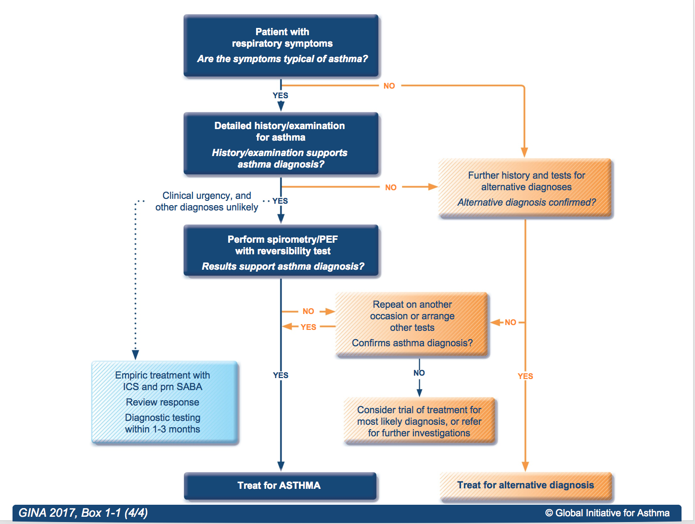
Diagnostic flow-chart for asthma in clinics

Slide 21
DIAGNOSING ASTHMA IN SPECIAL POPULATIONS:
The elderly:
Asthma may be under-diagnosed in the elderly, due to poor perception, an assumption that dyspnea is normal in old age, lack of fitness, or reduced activity. Asthma may also be over-diagnosed in the elderly through confusion with shortness of breath due to left ventricular failure or ischemic heart disease.

Slide 22
DIAGNOSING ASTHMA IN SPECIAL POPULATIONS:
Smokers and ex-smokers:
Asthma and COPD may co-exist or overlap (asthma-COPD overlap), particularly in smokers and the elderly.

Slide 23
DIAGNOSING ASTHMA IN SPECIAL POPULATIONS:
Confirming an asthma diagnosis in patients taking controller treatment:
For many patients (25–35%) with a diagnosis of asthma in primary care, the
diagnosis cannot be confirmed. If the basis of the diagnosis has not already
been documented, confirmation with objective testing should be sought.

Slide 24
DIAGNOSING ASTHMA IN SPECIAL POPULATIONS:
For example, if lung function is normal, repeat reversibility testing after withholding medications for more than 12 hours. If the patient has frequent symptoms, consider a trial of step-up in controller treatment and repeat lung function testing after 3 months.

Slide 25
ASSESSING A PATIENT WITH ASTHMA:
Schedule a routine review at least once a year.
1. Asthma control – assess both symptom control and risk factors:
• Assess symptom control over the last 4 weeks
• Identify any other risk factors for poor outcomes
• Measure lung function before starting treatment, 3–6 months later, and
then periodically, e.g. at least yearly in most patients.

Slide 26
HOW TO ASSESS ASTHMA CONTROL:
A. Symptom control
In the past 4 weeks, has the patient had: | Well-controlled | Partly controlled | Uncontrolled
Daytime asthma symptoms more than twice a week? Yes No | None of these | 1-2 of these | 3-4 of these
Any night waking due to asthma? Yes No
Reliever needed for symptoms* more than twice a week? Yes No
Any activity limitation due to asthma? Yes No
Level of asthma symptom control
*Excludes reliever taken before exercise, because many people take this routinely
GINA 2017, Box 2-2A

Slide 27
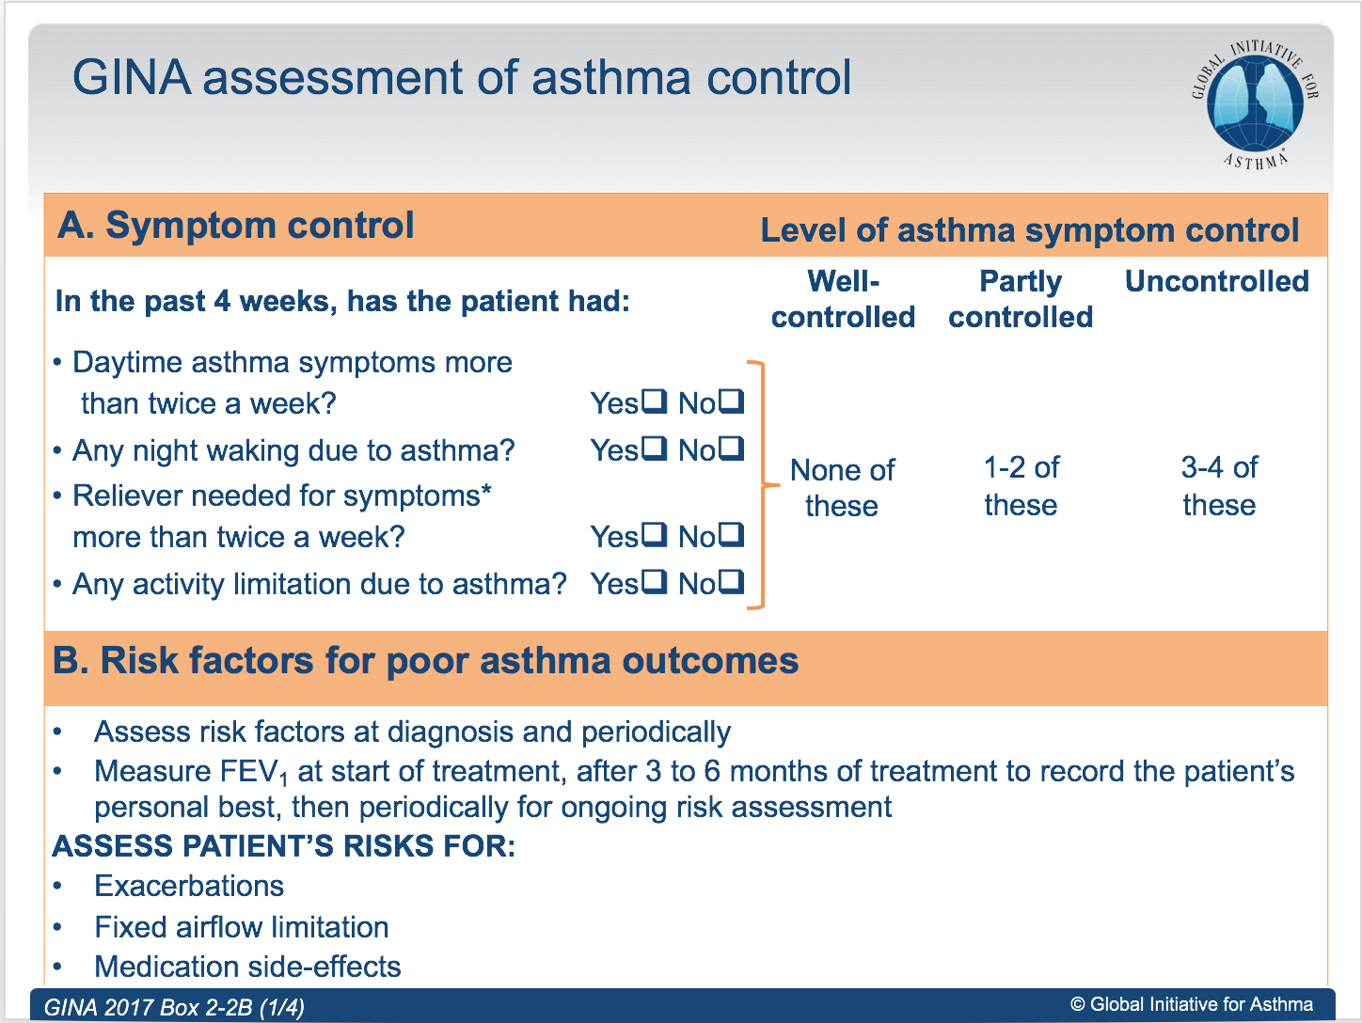

Slide 28
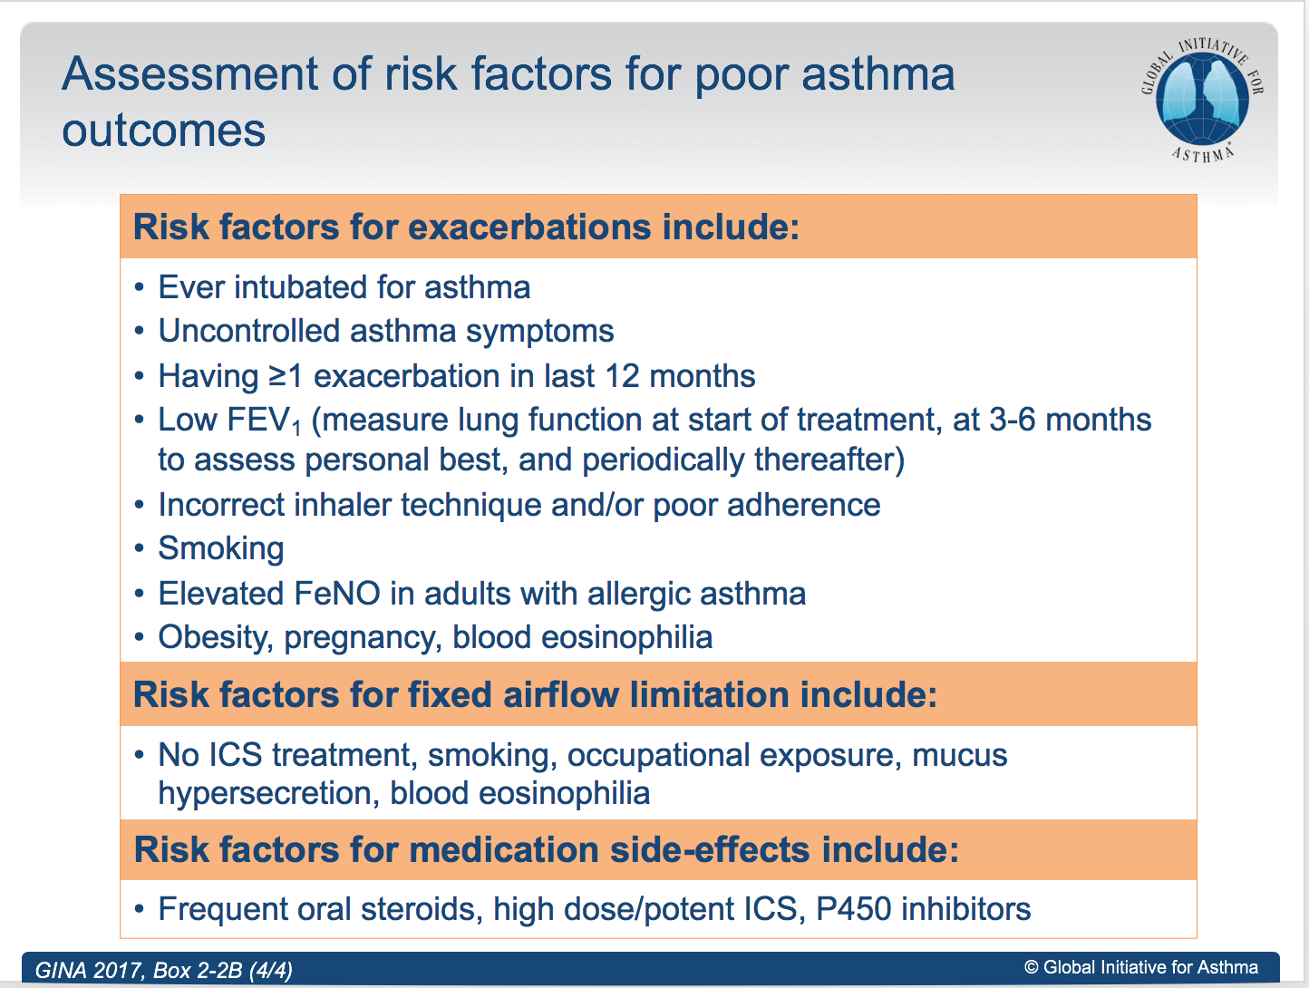

Slide 29
ASSESSING A PATIENT WITH ASTHMA:
2. Treatment issues:
• Record the patient’s treatment, and ask about side-effects
• Watch the patient using their inhaler, to check their technique
• Have an open empathic discussion about adherence
• Check that the patient has a written asthma action plan
• Ask the patient about their attitudes and goals for their asthma

Slide 30
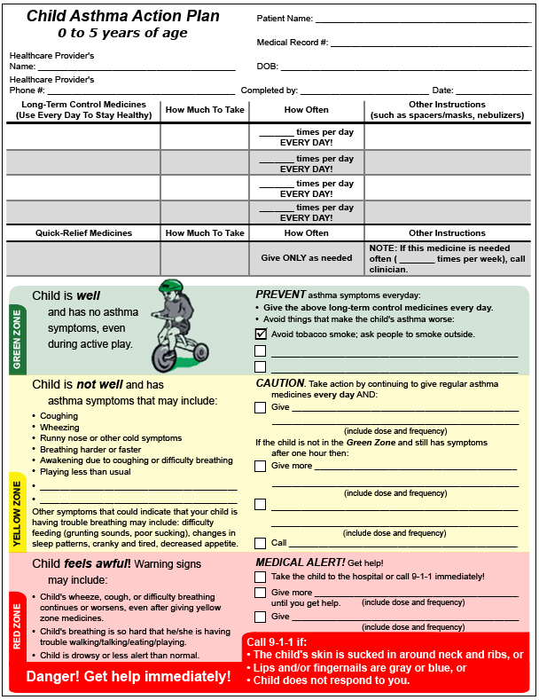
Asthma Action Plan (example)

Slide 31
ASSESSING A PATIENT WITH ASTHMA:
3. Are there any comorbidities?
• These include rhinitis, rhinosinusitis, gastroesophageal reflux (GERD),
obesity, obstructive sleep apnea, depression and anxiety.
• Comorbidities should be identified as they may contribute to respiratory
symptoms and poor quality of life.

Slide 32
What is the role of lung function in monitoring asthma?
Lung function is most useful as an indicator of future risk. It should be recorded at diagnosis, 3–6 months after starting treatment, and periodically thereafter.
Most patients should have lung function measured at least every 1-2 years.

Slide 33
MANAGEMENT OF ASTHMA:
Treating to control symptoms and minimize risk:
Treatment of asthma for symptom control and risk reduction includes:
Medications: Every patient with asthma should have a reliever medication, and most adults and adolescents with asthma should have a controller medication
Treating modifiable risk factors
Non-pharmacological therapies and strategies

Slide 34
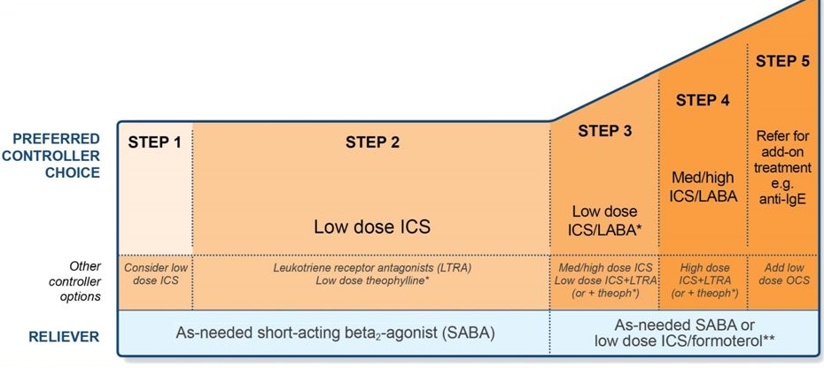
Stepwise approach to asthma treatment:

Slide 35
STEPWISE APPROACH FOR ADJUSTING TREATMENT :
STEP 1: As-needed SABA with no controller
STEP 2: Regular low dose ICS plus as-needed SABA
STEP 3: Low dose ICS/LABA either as maintenance treatment plus as needed SABA, or as ICS/formoterol maintenance and reliever therapy
STEP 4: Low dose ICS/formoterol maintenance and reliever therapy, or medium dose ICS/LABA as maintenance plus as-needed SABA
STEP 5: Refer for expert investigation and add-on treatment

Slide 36
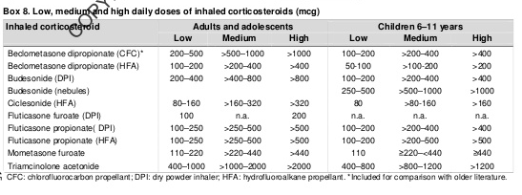
Low, medium and high daily doses of inhaled corticosteroids (mcg)

Slide 37
INITIAL CONTROLLER TREATMENT:
For the best outcomes, regular daily controller treatment should be initiated as
soon as possible after the diagnosis of asthma is made.
Regular low dose ICS is recommended for all patients with a diagnosis of asthma and any of the following:
Asthma symptoms more than twice a month
Waking due to asthma more than once a month
Any asthma symptoms plus any risk factor(s) for exacerbations (e.g. needing OCS for asthma within the last 12 months; low FEV1; ever in intensive care unit for asthma)

Slide 38
Cont.
Before starting initial controller treatment:
• Record evidence for the diagnosis of asthma, if possible
• Document symptom control and risk factors
• Assess lung function, when possible
• Train the patient to use the inhaler correctly, and check their technique
• Schedule a follow-up visit

Slide 39
Cont.
After starting initial controller treatment:
• Review response after 2–3 months, or according to clinical urgency
• Consider step down when asthma has been well-controlled for 3 months

Slide 40
Cont.
A stepwise approach to treatment, customized to the individual patient, takes into account the effectiveness of available medications, their safety, and their cost to the patient

Slide 41
Assessing asthma severity
How?
  Asthma severity is assessed retrospectively from the level of treatment required to control symptoms and exacerbations
When?
  Assess asthma severity after patient has been on controller treatment for several months
  Severity is not static – it may change over months or years, or as different treatments become available
Categories of asthma severity
  Mild asthma: well-controlled with Steps 1 or 2 (as-needed SABA or low dose ICS)
  Moderate asthma: well-controlled with Step 3 (low-dose ICS/LABA)
  Severe asthma: requires Step 4/5 (moderate or high dose ICS/LABA ± add-on), or remains uncontrolled despite this treatment
GINA 2017

Slide 42
How often should patients with asthma be reviewed?
Patients should preferably be seen 1–3 months after starting treatment and
every 3–12 months after that, except in pregnancy when they should be
reviewed every 4–6 weeks. After an exacerbation, a review visit within 1 week
should be scheduled.

Slide 43
Stepping up asthma treatment:
Sustained step-up (for at least 2–3 months): if symptoms and/or exacerbations persist despite 2–3 months of controller treatment.
Short-term step-up (for 1–2 weeks) by clinician or by patient with written asthma action plan, e.g. during viral infection or allergen exposure

Slide 44
Stepping down treatment when asthma is well-controlled:
Consider stepping down treatment once good asthma control has been achieved and maintained for 3 months.
Choose an appropriate time for step-down (no respiratory infection, patient not travelling, not pregnant).
Step down through available formulations to reduce the ICS dose by 25–50% at 2–3 month intervals.

Slide 45
NON-PHARMACOLOGICAL STRATEGIES AND INTERVENTIONS:
Smoking cessation advice.
Physical activity: encourage people with asthma to engage in regular physical activity because of its general health benefits.
Occupational asthma: ask all patients with adult-onset asthma about their work history.
NSAIDs including aspirin: always ask about asthma before prescribing.

Slide 46
The written asthma action plan should include:
• The patient’s usual asthma medications
• When and how to increase medications, and start OCS
• How to access medical care if symptoms fail to respond

Slide 47

Emergency treatment should be considered for:
Peak Flow less than 40% predicted normal
Failure to respond to β₂-agonist
Severe wheezing or coughing
Extreme anxiety due to breathlessness
Gasping for air, sweaty, or cyanotic
Rapid deterioration over a few hours
Severe retractions and nasal flaring
Hunched forward

Slide 48


