Slide 1
Approach to Difficult Patient
Prof. Norah A. AlRowais

Slide 2
Objectives
To know the causes of difficult consultations in general.
To be aware about different types of difficult patients.
How to deal appropriately with such patients.

Slide 3
Case #1
A patient comes to the office frequently, talks a lot, and stays well past the time allotted for the appointment.

Slide 4
Case #2
A patient cannot accept that there is no apparent demonstrable physical cause for his physical symptoms. He will show up frequently in one or multiple physicians’ offices, have batteries of tests repeated, receive symptomatic treatment, and still not improve.

Slide 5
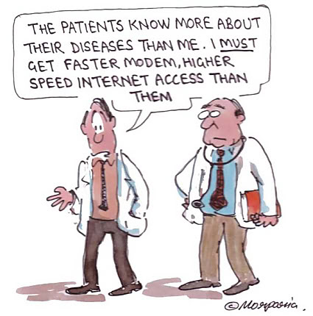

Slide 6
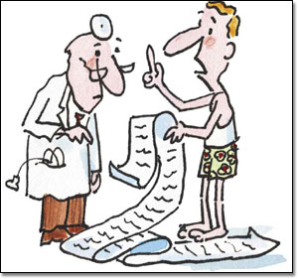
These patients present with print-outs of either complex and/or marginal information about their problem from a Web site and begin demanding unnecessary medical tests or treatments

Slide 7
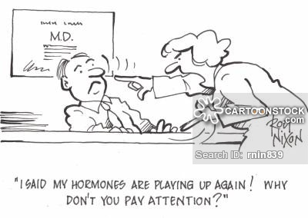
Difficult Patients
Difficult Patient is someone who blocks the therapeutic relationship and deviates from expected patient behavior.
Prevalence estimated at 15-30%.

Slide 8
What makes an interaction difficult?

Slide 9
What makes an interaction difficult?
Fear of the unknown, of not knowing how the other person will react, of hurting someone’s feelings or of feeling hurt
Conflict: few people enjoy conflict and most go out of their way to avoid it
Surprise: catching someone off guard can make an otherwise smooth interaction difficult
Change: interactions involving having to make a change often make people feel uncomfortable

Slide 10
Why do we avoid difficult interactions?

Slide 11
Why do we avoid difficult interactions?
We’re afraid we’ll make the situation worse
We don’t want to feel bad, and we don’t want others to feel bad
We may hear things about ourselves that we don’t want to hear
We, and the other person, may get emotional We don’t know how the interaction will end, and we fear the consequences

Slide 12
“Difficult”: different for different individuals.
Someone labeled “difficult” by a person may not be seen as quite so difficult by another.
Differences in expertise and experience account for differences in perception.

Slide 13
Patient’s Needs
Personal needs: To be recognized and treated with respect; need to feel important
Practical needs: Need for specialized knowledge and medical expertise

Slide 14
Factors that influence doctor- patient communication
Patient-related factors
Doctor-related factors
Situational factors
Health-care system factors

Slide 15
Patient’s related factors
Behavioral issues
Angry/argumentative/rude
Demanding/entitled
Drug-seeking behavior
Hypervigilance to body sensations
Manipulative
Nonadherence to treatment for chronic medical conditions
Reluctance to take responsibility for his or her health Self-saboteur

Slide 16
Patient’s related factors Cont’
Conditions
Addiction to alcohol or drugs
Chronic pain syndromes
Conflict between patient’s and physician’s goals for the visit
Financial constraints causing difficulty with therapy adherence
Functional somatic disorders
Multiple (more than four) medical issues per visit
Physical, emotional, or mental abuse

Slide 17
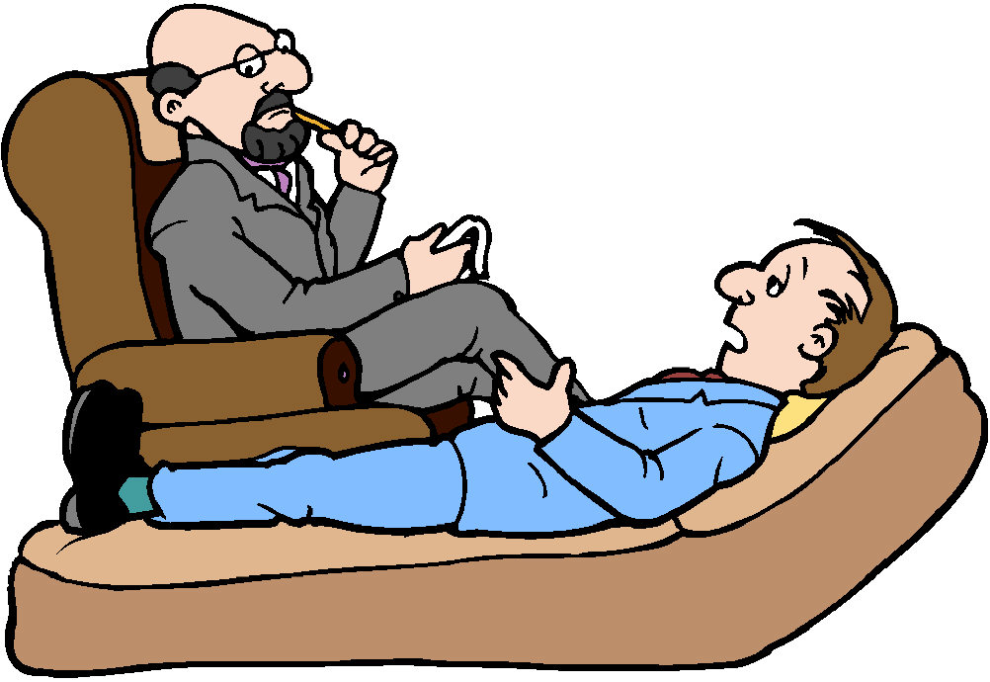
Patient’s related factors Cont’
Psychiatric diagnosis
Borderline personality disorder
Dependent personality disorder
Underlying mood disorder

Slide 18
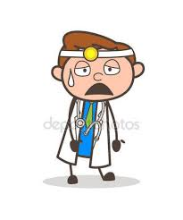
Doctor related factors
Attitudes
Emotional burnout
Insecurity
Intolerance of diagnostic uncertainty
Negative bias toward specific health conditions
Perceived time pressure

Slide 19
Doctor related factors Cont’
Conditions
Anxiety/depression
Exhaustion/ overworked
Personal health issues
Situational stressors
Sleep deprivation

Slide 20
Doctor related factors Cont’
Knowledge
Inadequate training in psychosocial medicine
Limited knowledge of the patient’s health condition

Slide 21
Doctor related factors Cont’
Skills
Difficulty expressing empathy
Easily frustrated Poor communication skills

Slide 22
Situational factors
Language and literacy issues
Companions during consultation
Breaking bad news
Environmental issues (setting): room temperature, lightening, noise….
Crowded clinic
Poor organization

Slide 23
Health-care system factors
Cost of care
Access to health-care system
Availability of services

Slide 24
Another look to difficult patients

Slide 25
The dependent clinger, who is excessively dependent on the doctor. While expressing thanks and gratitude for actions taken by the doctor the patient is also desperate for reassurance at every turn and manifests this by returning continually with an array of symptoms.
The entitled demander, who also has an inexhaustible need but, instead of using flattery, uses intimidation, devaluation and guilt induction. This patient will often view the doctor as a barrier to receiving services and complains when every request is not met

Slide 26
The manipulative help-rejector, who again has a 'quenchless need for emotional supplies' and returns repeatedly to the surgery to report that the treatment did not work. If any symptom is relieved another appears in its place.
The self-destructive denier, who, although possibly suffering from a serious disease, makes no significant alterations in lifestyle. To the doctor it often feels that the patient's aim is paradoxically to defeat any attempts to preserve his or her life.

Slide 28
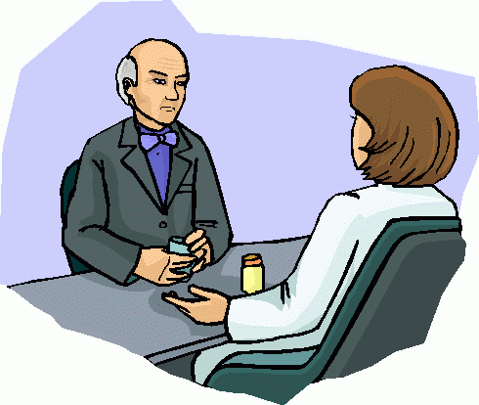
Approach to the difficult patients

Slide 29
When confronted with difficult patients… take HEART
Hear them out.
Empathize.
Acknowledge
Respond appropriately.
Take responsibility for action/Thank your patient.

Slide 30
Dealing with Demanding Patient
The first step in addressing unnecessary demands is to ascertain the patient's needs.
Allow the patient to fully tell the story, with minimal interruptions.
Ask the patient for details: “I understand you are here because you want an MRI of your knee; I'd like to understand how you reached that decision.”
Consider agreeing with the patient.

Slide 31
Dealing with Demanding Patient Cont’
Negotiate agenda and goals :
Set limits.
Reinforcement and help.
Compromise and be flexible.
Avoid argumentation.
Explain your rationale.
Pay attention to the way you say no.
Under pressure, breathe deeply and start over.
For some patients “firm boundaries are the rule”

Slide 32
Dealing with Demanding Patient Cont’
Summarize the points aloud for the patient.
An attempt to reflect the emotion behind the request is important. e.g “It sounds incredibly frustrating to be laid up with knee pain for so long, but…”

Slide 33
Dealing with Angry Patients
Empathy
Non-judgmental attitude
Respect
Support
Flexibility

Slide 34
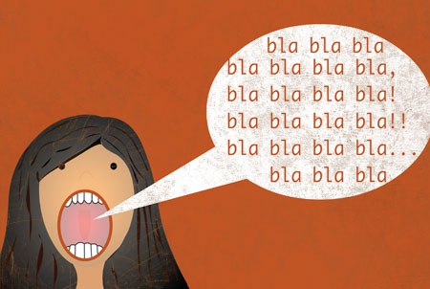
Dealing with Talkative patients
many patients have a script of what they want to say to the doctor.
Letting them speak uninterrupted initially allows you to gather key details form the history and lets the patient disclose their agenda.
It is important that the doctor takes control and directs the consultation.

Slide 35
Dealing with Talkative patients Cont’
They need to be politely but firmly steered back to the key points.
Acknowledge any deviation and then focus the patient back to the question asked.
Regularly summaries problems and concerns to allow you to impose focus to the consultation.
If you need to interrupt then use non verbal as well as verbal signs such as raising your hand to indicate that you want to speak.

Slide 36
Talkative Patients Communication Skills
Verbal Communication:
Summarization
Prioritization
Interruption
Close ended question
Non - verbal Communication:
Hand movement.
Sympathy & empathy.

Slide 37
The CALMER Approach to Difficult Clinical Encounters
Element | Approach
Catalyst for change | Identify the patient’s status in the stages of change model Recommend how the patient can advance to the next stage
Alter thoughts to change feelings | Identify the negative feelings elicited by the patient Clarify how these feelings influence the encounter Strategize how to reduce your own negativity and distress
Listen and then make a diagnosis | Remove or minimize barriers to communication Improve working relationships Enhance probability of accurate diagnoses
Make an agreement | Negotiate, agree on, and confirm a plan for health improvement
Education and follow-up | Set achievable goals and realistic time frames, and ensure follow-up
Reach out and discuss feelings | Ensure a strategy for your own self-care
Managing difficult encounters, AAFP, March 15,2013

Slide 38
How to cope with difficult patients
Recognize your own feelings, difficult patients evoke a feeling of anxiety, pressure, boredom, or frustration.
Use resources (groups).
Involve colleagues in your management plan. “you are not alone.”

Slide 39
Take home message
Recognition of your difficult patient is important, but dealing with him/her is much more important.

Slide 40
Questions?

