Slide 1
Home Health Care
Dr.Abdulaziz Alodhayani

Slide 2
She Wants To Go Home
Ms. Salha suﬀers from a stroke & hemiplegia on the left side received hospitalization. She has a complicated medical history (DM, CAD,2 coronary stents placed, HTN, Dyslipidemia , Schizophrenia, Major depressive disorder, Neuropathic pain, COPD) She takes over nine medications.
Despite the stability of the situation still needing long term nursing help , medication management & physiotherapy.!!

Slide 3
WHAT IS HOME CARE (HC)?
DOES IT DIFFER FROM HOME HEALTHCARE (HHC)?

Slide 4
HOME CARE refers to any type of care (medical or non-‐medical) that is provided for the client in their home (companionship/ homemaking services and personal care services)
“Home Health care“ refers to the provision of skilled nursing care and other care such as speech, physical or respiratory therapy

Slide 5
KSUMC-HHC Program

Slide 7
KSUMC-HHC
HHC Unit location – 2nd floor, OPD building.
Reports to Medical Admin. office

Slide 8
HHC Services
HHC serves all KSU staff and their dependents in Riyadh City.
Received referrals from Inpatient, OPD and from the community.
Integrated with eSiHi system

Slide 9
HHC Unit
Head of the Unit/administration
Office development/case manager
Home Health Care team members:
Physicians
Nursing staff
Physiotherapists
Other supporting services: SW, Dietician

Slide 12
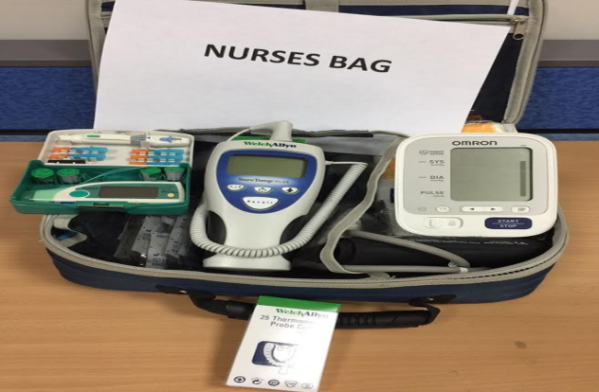
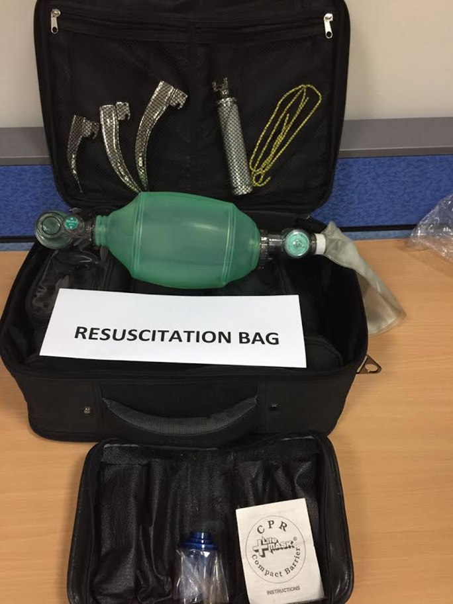
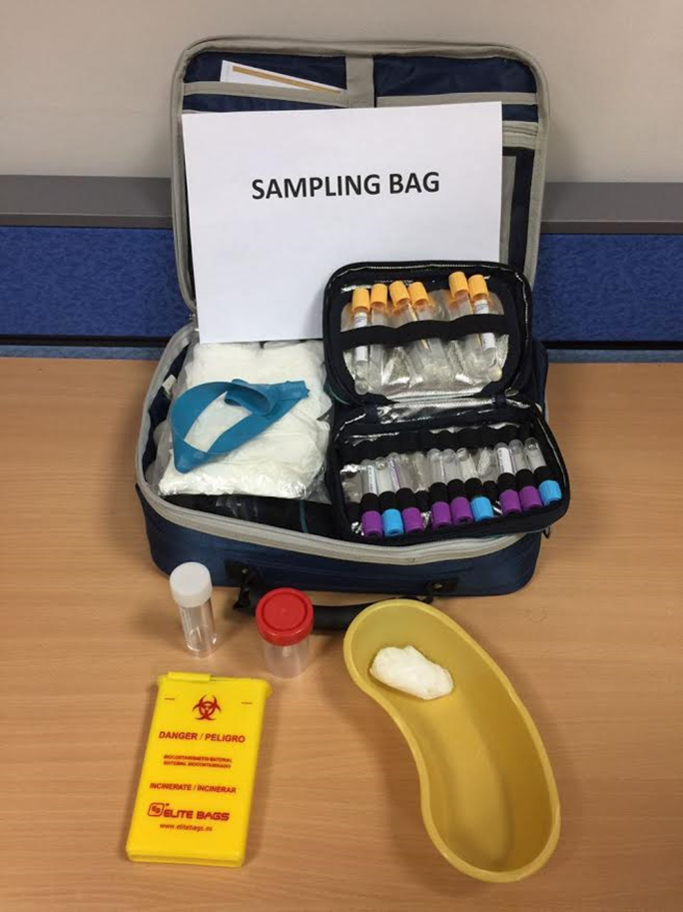
Two HHC Teams going daily to the field.

Slide 13
Services provided by HHC
- Medical: Chronic Disease Management: DM,HTN,DLD, BPSD, Ostop.,PD, Fragility
Pain management
Wound Care: Debridement, dressing, wound treatment.
Procedures: NGT, Foleys cath, pot-op care
Polypharmcy management

Slide 14
HHC services
ED admission.
Laboratory investigations: Sampling and transfer
Medication delivery
Equipments & Personal supply: Chairs, beds, mattress, CPAP, O2 nebs, personal care materials

Slide 15
Eligible patients for HHC

Slide 16
WHY HHC IS NEEDED?
Cost Effectiveness :
Growing Demand for Higher Quality Life.
More widespread availability of high-technology services has resulted in increased hospital cost.
Earlier discharge of hospitalized patients, reducing the length of hospital stays & Need to free occupied beds
Need More Home Health care
Sharon etal.Home Care JAMA 2003;290:1203-‐

Slide 17
Home Health Care : Does it Lead To Improve Medical Care ?!!
An Economic Evaluation of Home Care Results From RCT showed that Using home care to reduce hospital stays improved the health outcomes without significantly increasing social costs.
European study showed that HHC lead to 38% decrease in cost.
Dougherty, Geoffrey E. MD, MSc, FRCP(C) *; Soderstrom, Lee PhD +; Schiffrin, Alicia MD. Medical Care. 36(4): 586-598, April 1998. Hernandez C, Casas A, Escarrabill J, et al.
Dr. Al-Dahi study in 2007 showed 65% in secondary care & 56%in long stay rehabilitation care cost by using HHC.
Home hospitalisation of exacerbated chronic obstructive pulmonary disease patients. Eur Respir J 2003;21(1):58-67.

Slide 19
How to access the HHC service
Esihi Referral
Submitting KSU staff evidence
Medial report
Consent signature
Nursing acuity level submission
NOK contacts/Home location

Slide 20
THANK YOU

