Slide 1
Adolescents Health
Alhanouf Almuhanna
Rasha Bassas
Rawa Alohali
Noura Albeeshi

Slide 2
Objectives:
Define adolescent age: World health organization definition.
Understand adolescent’s physiological and behavioral characteristics.
Recognize the importance of adolescent health.
Determine adolescent health problems: physical, psychological and social problems.
Recognize common adolescent health problems in Saudi Arabia: Retrieved from available evidence-based studies.
Understand the comprehensive approach to common adolescent health problems in primary health care.
Understand the role of family, school and community in adolescent health care.

Slide 3
Definition
Adolescence, transitional phase of growth and development between childhood and adulthood. The World Health Organization (WHO) defines an adolescent as any person between ages 10 and 19.

Slide 4
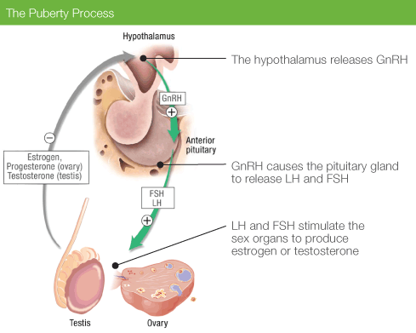
Adolescent physiological characteristics
Hormonal:
● Hypothalamus releases GNRH to anterior pituitary to stimulate it.
● Anterior pituitary then releases LH & FSH to testis and ovaries
● Sex steroid synthesis
● Sexual maturation

Slide 5
Physical changes during adolescence
FOR GIRLS:
Early physical changes from about 10 or 11 years, but they might start as young as 8 years or as old as 13 years.
Physical changes around puberty include:
Breast development
Axillary hair growth
Changes in body shape and height
Growth of pubic and body hair
Menarche.

Slide 6
Physical changes during adolescence
FOR BOYS:
Physical changes usually start around 11 or 12 years, but they might start as young as 9 years or as old as 14 years.
Physical changes include:
Growth of the penis and testes (testicles)
Changes in body shape and height
Erections with ejaculation
Growth of body and facial hair
Change in voice.

Slide 7
Skeletal changes
Bone growth is increased during adolescence due to an increase in sex hormones.
>95% of the adult skeleton is formed by the end of adolescence.
Weight gain in boys mainly due to increase muscle growth and girls mainly due to fat that develops in breast and hip.

Slide 9
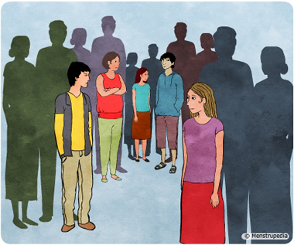
Behavioral changes during adolescence
Social changes:
Searching for identity, starting to develop their sense of self and trying to build up character.
Concern about other people’s opinions.
Seeking more independence and autonomy over their decisions, emotions and actions and to disengage from parental control.
Seeking more responsibility at home & school.
Looking for new experiences and engaging in more risk.
Self-esteem and peer-pressure: influenced more by friends, especially when it comes to behavioral and sense of self-esteem they can use tobacco just because there close friends are smokers

Slide 10
Emotional changes :
More self conscious specially about physical appearance.
Intense emotions at different times > unpredictable moods.
More emotional.
Dietary changes:
● Obesity due to bad eating habits e.g. eating junk food and physical inactivity.
● Anorexia nervosa and bulimia due to physical appearance perception.

Slide 11
Importance Of Adolescent Health

Slide 12
The power of youth is the common wealth for the entire world. The faces of young people are the faces of our past, our present and our future. No segment in the society can match with the power, idealism, enthusiasm and courage of the young people. –Kailash Satyarthi

Slide 13
Globally: AROUND 1 IN 6 PERSONS IN THE WORLD IS AN ADOLESCENT!THAT IS 1.2 BILLION PEOPLE AGED 10 TO 19.
Locally: 25% of the population.

Slide 14
Facts
Young people account for 15% of the disease and injury burden worldwide
Roughly 70% of premature deaths among adults can be linked to behavior initiated during adolescence, such as tobacco use, poor eating habits, and risky sex.
In 2012: Road traffic injuries were the leading cause of death, with some 330 adolescents dying every day.
In 2015: An estimated 1.3 million adolescents died, mostly from preventable or treatable causes.

Slide 15
ADOLESCENT HEALTH PROBLEMS

Slide 16
THE IMPORTANCE OF ADOLESCENT HEALTH AND DEVELOPMENT TO ACHIEVING THE MILLENNIUM DEVELOPMENT GOALS.
Notes:
These are the mellennium development goals of 2015

Slide 17
Better adolescent health will directly contribute to achieving five of the eight internationally agreed-upon goals:
Reversing the spread of HIV/AIDS;
Reducing maternal deaths;
Reducing infant and child deaths;
Developing and implementing strategies for decent and productive work for youth;
And reducing poverty.

Slide 18
EARLY PREGNANCY AND CHILDBIRTH
Complications linked to pregnancy and childbirth are the second cause of death for 15-19- year-old girls globally.

Slide 19
Some 11% of all births worldwide are to girls aged 15 to 19 years, and the vast majority are in low- and middle-income countries.

Slide 20
Girls who do become pregnant need access to quality antenatal care.
What are some of the ways that can reduce girls getting pregnant and giving birth at too young an age?
Better access to contraceptive information and services can.
Laws that specify a minimum age of marriage at 18.

Slide 21
HIV
More than 2 million adolescents are living with HIV. Although the overall number of HIV-related deaths is down 30% since the peak in 2006 estimates suggest that HIV deaths among adolescents are rising.
Depression is the top cause of illness and disability among adolescents and suicide is the third cause of death. Risk factors: Violence, poverty, humiliation and feeling devalued.
Mental Health

Slide 22
Violence is a leading cause of death.
An estimated 180 adolescents die every day as a result of interpersonal violence.
Globally, some 30% of girls aged 15 to 19 experience violence by a partner.
How violence can be prevented?
Violence
Harmful drinking among adolescents is a major concern in many countries. It reduces self-control and increases risky behaviors, such as unsafe sex or risky driving.
It is a primary cause of injuries, violence and premature deaths. It also can lead to health problems in later life and affect life expectancy.
Strategies for reducing harmful drinking
Alcohol and drugs

Slide 23
Injuries
Unintentional injuries are the leading cause of death and disability among adolescents. In 2015, over 115 000 adolescents died as a result of road traffic accidents. Young drivers need advice on driving safely, while laws that prohibit driving under the influence of alcohol and drugs need to be strictly enforced. Blood alcohol levels need to be set lower for teenage drivers. Graduated licences for novice drivers with zero-tolerance for drink-driving are recommended.
Drowning is also a major cause of death among adolescents – 57 000 adolescents, two-thirds of them boys, are estimated to have drowned in 2015, and teaching children and adolescents to swim is an essential intervention to prevent these deaths.

Slide 24
Malnutrition and obesity
Many boys and girls in developing countries enter adolescence undernourished, making them more vulnerable to disease and early death. At the other end of the spectrum, the number of adolescents who are overweight or obese is increasing in low, middle and high-income countries.

Slide 25
Exercise and nutrition
Iron deficiency anaemia is the leading cause of years lost to death and disability in 2015. Iron and folic acid supplements are a solution that also helps to promote health before adolescents become parents. Regular deworming in areas where intestinal helminths such as hookworm are common is recommended to prevent micronutrient (including iron) deficiencies.
Developing healthy eating and exercise habits in adolescence are foundations for good health in adulthood. Reducing the marketing of foods high in saturated fats, trans-fatty acids, free sugars, or salt and providing access to healthy foods and opportunities to engage in physical activity are important for all but especially children and adolescents. Yet available survey data indicate that fewer than 1 in every 4 adolescents meets the recommended guidelines for physical activity: 60 minutes of moderate to vigorous physical activity daily.

Slide 26
Tobacco use
The vast majority of people using tobacco today began doing so when they were adolescents. Prohibiting the sale of tobacco products to minors and increasing the price of tobacco products through higher taxes, banning tobacco advertising and ensuring smoke-free environments are crucial. Globally, at least 1 in 10 adolescents aged 13 to 15 years uses tobacco, although there are areas where this figure is much higher. Cigarette smoking seems to be decreasing among younger adolescents in some high-income countries.

Slide 27
Most causes of mortality and morbidity in adolescents, such as road side accidents cigarette/shisha smoking and drug abuse can be prevented by simple measures including health education and counseling. If adolescents are properly cared for and groomed, physically and emotionally at homes and schools, they will enjoy good physical & mental health. School environment and behavior of teachers play a critical role in character building and personality development of adolescents. Importance of school health clinics for health education & counseling has important role.
Antismoking program should be established, including prohibition of the sale and use of cigarettes in public places, along with application of firm traffic laws forbidding adolescents aged less than 18 years from driving.

Slide 28
common adolescent health problems in Saudi Arabia: Retrieved from available evidence-based studies 25% of Saudi population are Adolescents

Slide 29
Saudi society is different from western societies in many respects. It is conservative society with strong Islamic values. The pattern of adolescent’s problems is expected to be different from that in the west. For example illegitimate teenage pregnancies are common in western world, but do not exist in KSA.

Slide 30
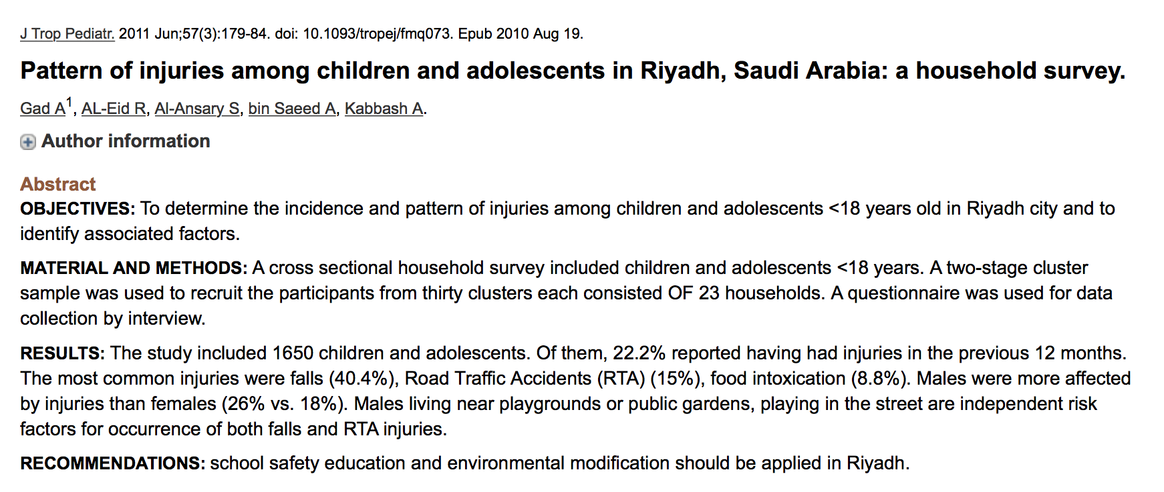
Injuries:

Slide 31
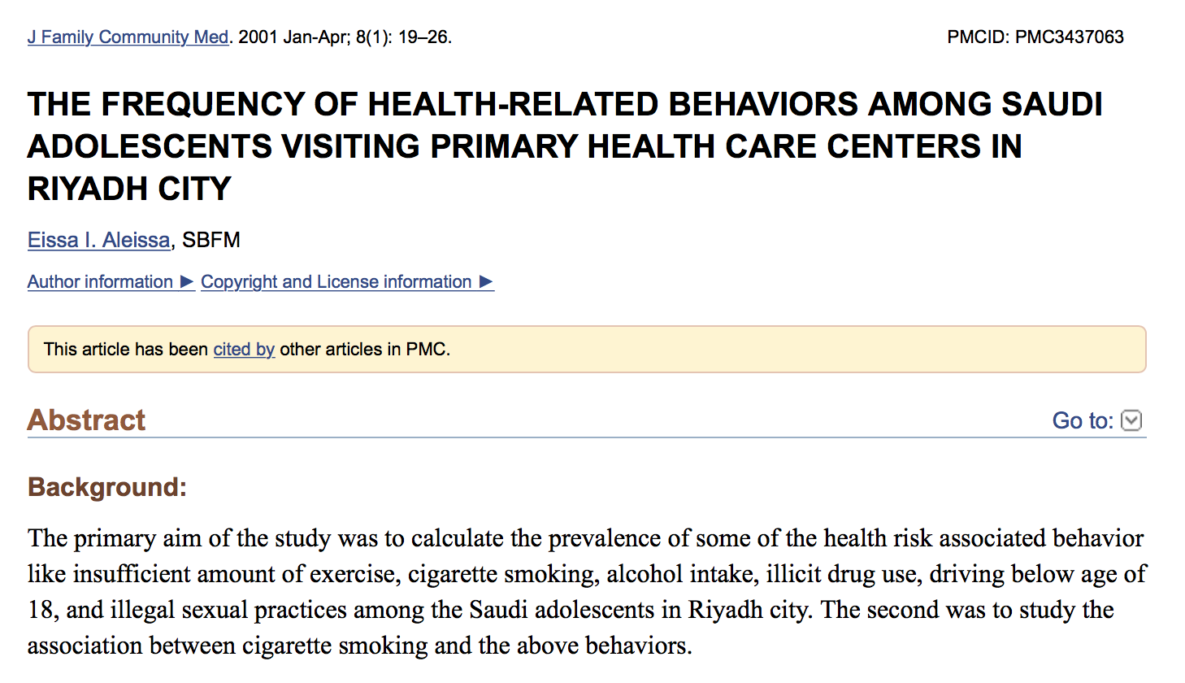
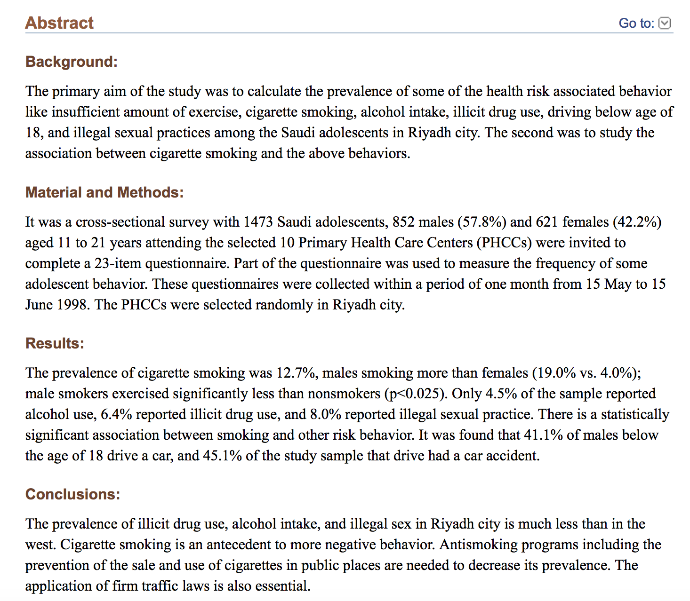
Substance abuse

Slide 32
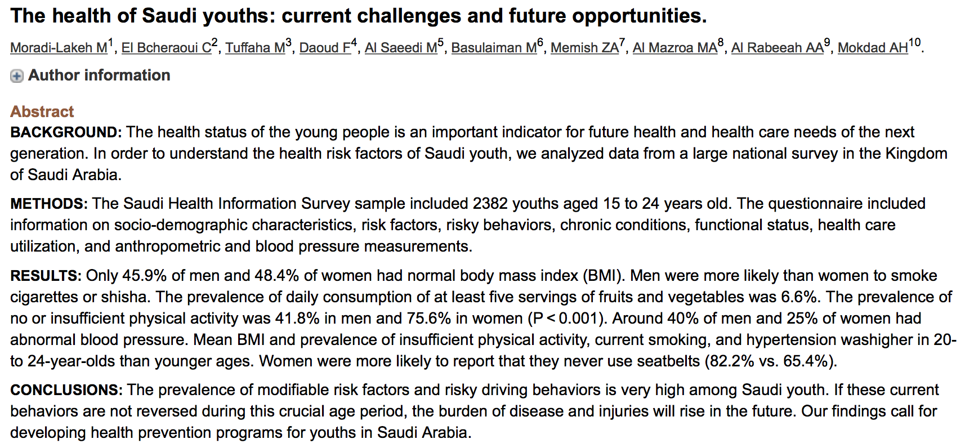

Slide 33
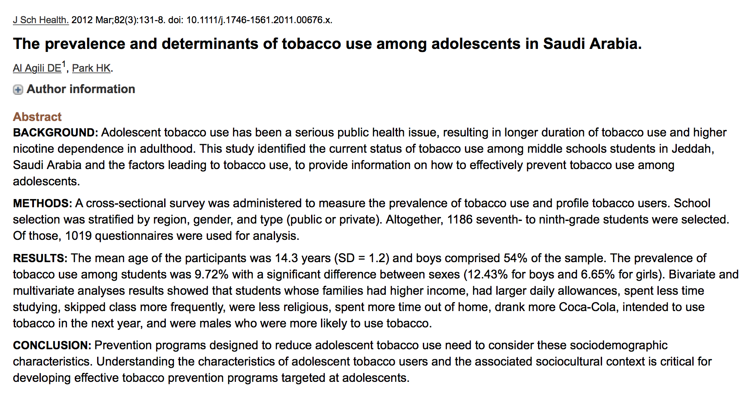

Slide 34
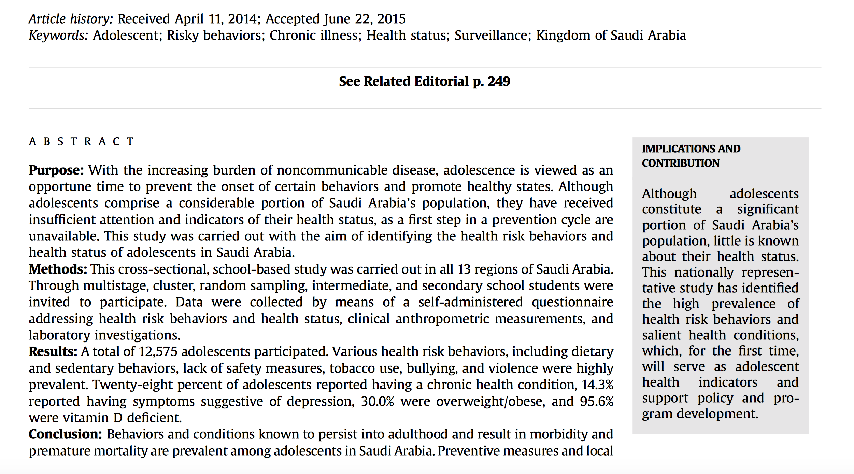
Malnutrition + obesity

Slide 35
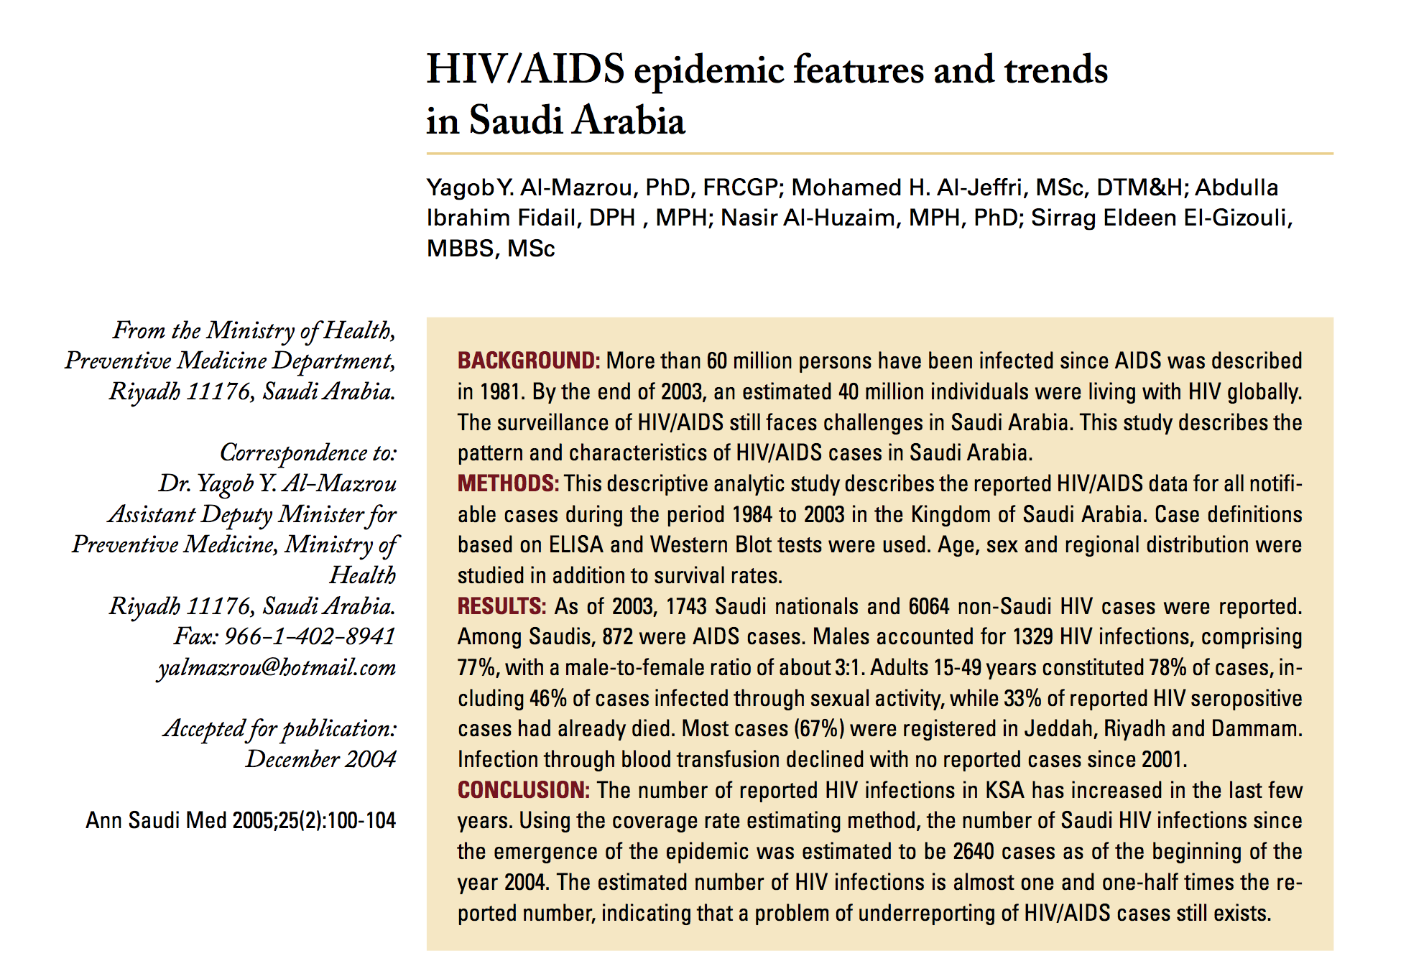
HIV

Slide 36
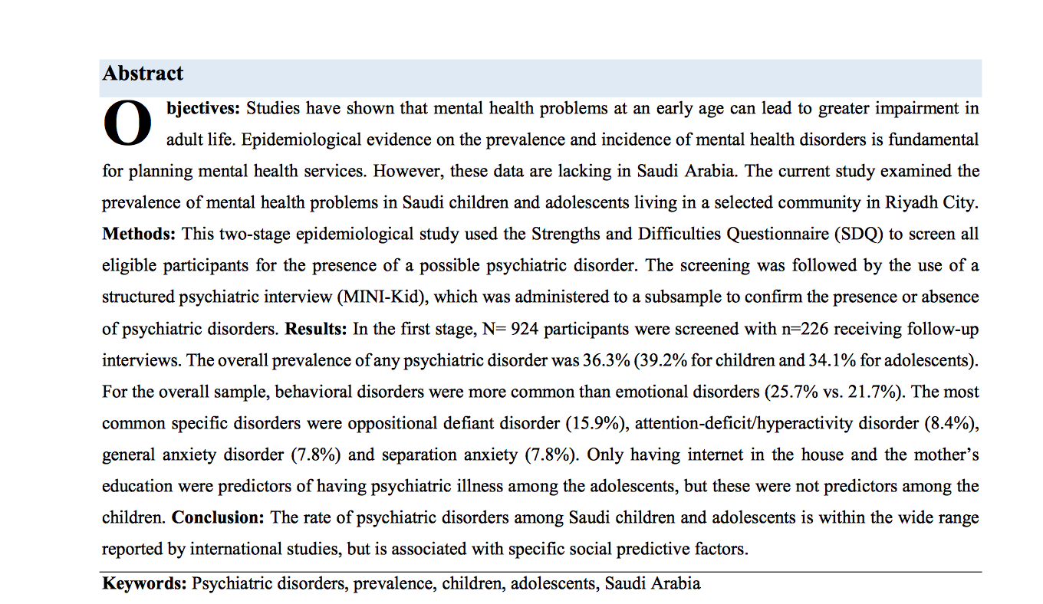
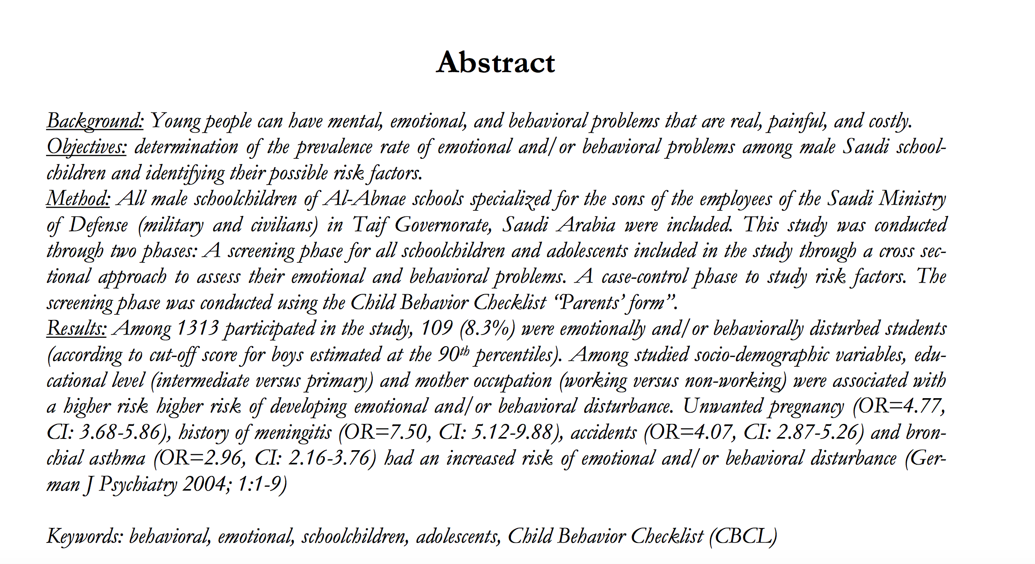
Mental health

Slide 37
How family physicians approach adolescent health problems?
1-Begin by discussing the teens past medical history with the teen & their parents. Ask the parents about their concerns and then obtain their consent to talk to the teen in private.
2-Establish ground rules for confidentiality
3-Obtain information
4-Maintain an “open-door” policy and encourage adolescents and their parents to seek help as soon as possible

Slide 38
Road Traffic Accident
Provide access to safe and reliable public transport
Establish road safety regulations such as speed limits
Implement strict laws and punishment to prevent adolescents younger than 18 from driving

Slide 39
Health status: obesity
1- Dietary management: Adequate education about healthy food choices to reduce fast food consumption and encourage healthy snacks and good food choices.
2- Enhancing physical activity: Children and adolescents should engage in 60 minutes of moderate to vigorous exercise per day to achieve optimal cardiovascular health.
3- Restrict sedentary behavior: screen time should be limited to less than 2 hours a day.
4-Medical intervention when necessary

Slide 40
Health status: Mental health
Building life skills in adolescents and providing them with psychosocial support in schools and other community settings can help promote good mental health
Programs to help strengthen the ties between adolescents and their families are also important.
If problems arise, they should be detected and managed by competent and caring health workers and referred to psychiatry

Slide 41
Substance abuse and smoking
- Prohibit sales of tobacco to minors - Increase prices
- Ban smoking advertising
- Ensure smoke free environment
- Establish National programs for the awareness against substance
- Early detection of substance consumers
- Seek experts in adolescent suffering from addiction

Slide 42
What’s our role in it?

Slide 43
The role of the family
Active good parenting is very important in promoting the lifelong health and safety of their children. This includes:
-Becoming positive role models
-Providing guidance and setting boundaries
Non-governmental organizations as well as the departments/ministries should continue to promote and support parental interventions which is important for a positive adolescent health and development

Slide 44
The role of the school
A positive association has been established between the number of years of schooling and improved health outcomes.
Schools can be a source of health education & physical activity through physical education class (football, basketball, etc.)
School cafeterias can also aid the promotion of healthy eating.
In some situations the classroom that can be a safespace to express their opinion and views.

Slide 45
The role of the community
1-Promoting physical activities for both boys and girls through community efforts such as community sponsored sports programs. Such programs will help adolescents stay healthy as well as allow to socialize with others.
2-Allowing adolescents to become active contributors to their environment and community. For example giving them chores to do at home or facilitating volunteering opportunities for them. This will allow them to develop positive abilities & skills that have a positive effect on them.

Slide 46
THANK YOU

