Slide 1
Common psychiatric Disorers
Ibtihal al-mshawi
Hadeel Alsulami
Rawan ghandour

Slide 2
"Incorporating mental health care into practice highlights the "family" aspect of family medicine."

Slide 3
Objectives :
1-To understand the prevalence of anxiety, depression, and somatic
symptom disorder in Saudi Arabia
2-To understand the etiology of anxiety, depression and somatic
symptom disorder
3-To understand the clinical features and management of anxiety in
a family medicine setting
4-To understand the clinical features and management of depression
in a family medicine setting
5-To understand the clinical features and management of psycho-
somatic illness in a family medicine setting
6-To have knowledge of counseling and psychotherapy in the
management of common psychiatric problems in family medicine
7-To understand appropriate time to consult a psychiatrist

Slide 4
Pre-seminar Quiz
https://www.menti.com/2a1191b8
499808
Notes:
https://www.menti.com/2a1191b8
https://www.mentimeter.com/public/d6ec8b8e92912f7c52b21d06aa6313bc

Slide 5
Anxiety
https://www.youtube.com/watch?v=oh2hqleoQRs

Slide 6
What does Anxiety mean ?
Subjective feeling of worry, fear, and apprehension accompanied by autonomic symptoms (such as palpitation, sweating), caused by anticipation of threat/danger
Der Schrei der Natur
1893
Edward munch

Slide 7
Anxiety is only considered abnormal when it occurs in the absence of a stressful trigger, impairs physical, occupational, or social functioning, and/ or is excessively severe or prolonged.

Slide 8
Prevalence of Anxiety
–The most common mental illness in the U.S., affecting 40 million adults in the United States age 18 and older, or 18.1% of the population every year.
–That’s more than the entire population of Saudi Arabia in 2016.
Prevalence of anxiety in Saudi Arabia
I a study done on 822 male patients that attended Primary Health Care Centers, Eastern Saudi Arabia: The overall prevalence of anxiety was 22.3% with 17.0% of the attendees having mild degree of anxiety.
Notes:
https://www.nice.org.uk/guidance/cg113/chapter/Key-priorities-for-implementation
https://www.ncbi.nlm.nih.gov/pmc/articles/PMC5088358/pdf/ijpbs-10-02-3868.pdf

Slide 9
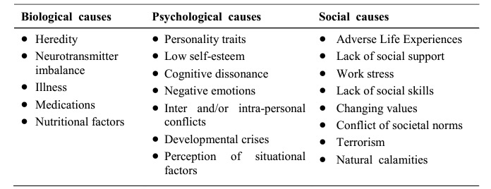
Etiology
Etiology of Anxiety

Slide 10
Symptoms
Physical symptoms: | Psychological symptoms:
• Dry mouth. • Tremor. • Dizziness. • Tinnitus. • Headache. • Epigastric discomfort. • Difficulty swallowing. • Frequent/loose motions/flatulence. • Chest discomfort. • Difficulty breathing. • Palpitations. • Frequency/urgency of micturition. • Sexual dysfunction. • Menstrual problems. | • Fearful anticipation. • Irritability. • Sensitivity to noise. • Restlessness. • Poor concentration. • Worrying thoughts. • Insomnia and/or nightmares. • Depression. • Obsessions. • Depersonalization. • Fear of losing control/dying.
Clinical Features of anxiety:

Slide 11
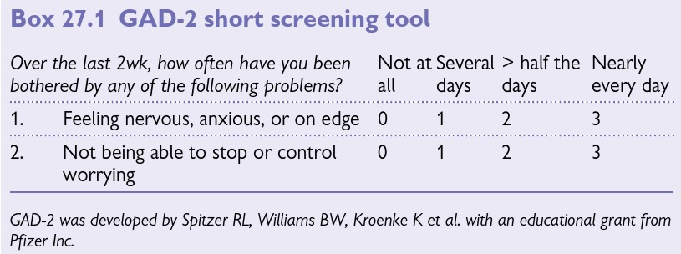
Generalized anxiety disorder (GAD)
Adolescence.
Excessive, difficult-to-control worry about a number of events/activities occurring on most days for ≥6mo.
Lifetime prevalence is 5%.
Notes:
Assessment Check TFTs. Use GAD-2 score (see Box 27.1) for screening: • If score �3, consider anxiety disorder • If score <3 but you suspect anxiety is a factor, ask ‘Do you find yourself avoiding places or activities and does this cause you problems?’—if the answer is yes, consider anxiety disorder.

Slide 12
Generalized anxiety disorder (GAD) Management
From the National Institute for Health and Excellence (NICE)
Individual high-intensity psychological intervention.
(ex: cognitive behavioural therapy (CBT).
Identification
Education and monitoring.
1
>= one of the following:
Individual non-facilitated self-help.
Individual guided self-help.
Psychoeducational groups.
2
Per Px Preference
3
Drug treatment (SSRI).
A risk of self-harm or suicide or
Significant comorbidity (substance misuse, personality disorder or complex physical health problems) or
Self-neglect or
An inadequate response to step 3 interventions.
4
Referral

Slide 13
Panic Disorder
Panic Attack | Panic Disorder
Period of intense fear with characteristic symptoms. Can be spontaneous or situational. | Chronic disorder; recurrent panic attacks associated with persistent fear of having (or the consequences of) another attack
Depression accompanies panic disorder in 56% of cases.

Slide 14
Panic Disorder
Symptoms:
Shortness of breath/smothering
sensations
Chest discomfort or pain
Choking
Sweating
Palpitations and tachycardia
Dizziness or
faintness
Nausea or abdominal pain
Flushes or chills
Trembling or shaking
Fear of dying
Examination: Obvious distress; sweating; tachycardia; hyperventilation.
High BP is common and usually settles. Otherwise examination is normal.

Slide 15
Panic Disorder
Management/ Non-pharmacological:
Recognition and diagnosis. Educate about the condition, commence active monitoring. Avoid alcohol, illicit drugs, and caffeine.
Step 1
Treatment in primary care—offer (in order of effectiveness):
psychological therapy (CBT), drug treatment or self-help (bibliotherapy or CCBT). Choice depends on severity of symptoms, co-morbidities and patient preference.
Step 2
Consideration of alternative treatment—if one step 2 treatment is ineffective, change to or add another.
Step 3
Offer referral for specialist treatment if ≥2 primary care treatments have failed.
Step 4
Notes:
DO YOU KNOW WHY?

Slide 16
Panic Disorder
Management:
Offer SSRI (e.g. paroxetine, citalopram). Warn about possible transient increase in anxiety on starting treatment.
If SSRI is not suitable or ineffective, offer a TCA (e.g. imipramine, clomipramine) or non-drug treatment.
Continue for ≥6mo, reviewing every 8–12wk.
Minimize discontinuation symptoms by tapering dose over time.

Slide 17
Phobias
Similar to GAD and characterized by two features:
• Avoidance: Of the circumstances that provoke anxiety.
• Anticipatory Anxiety: If there is a prospect of meeting that situation.
1- Simple Phobia:
≥1 object/situation e.g. flying, enclosed spaces, spiders.
Common in early life;
most adult phobias are a continuation of childhood phobias.
Treatment: is only needed if symptoms are frequent, intrusive,
or prevent necessary activities. Exposure therapy is effective.

Slide 18
Phobias cont.
2- Social Phobia:
Intense/persistent fear of being negatively
evaluated by others.
Fear and avoidance of social situations
(e.g. using a phone, speaking in front of a group).
Significantly disabling; not just shyness.
Generalized or Specific.
Management
• Drug therapy SSRIs—continue ≥12mo or long-term if symptoms remain unresolved, there is a co-morbid condition (e.g. depression, GAD, panic attacks), a history of relapse, or early onset.
• Psychological therapies CBT +/- exposure.
Notes:
Intense/persistent fear of being scrutinized or negatively
evaluated by others leads to fear and avoidance of social situations (e.g.
using a telephone, speaking in front of a group). Significantly disabling; not
just shyness. May be generalized (person fears most social situations) or
specific (related to certain activities only).

Slide 19
Phobias cont.
3- Agoraphobia:
Onset 20–40y with an initial panic attack.
Subsequently, panic attacks, fear of fainting and/or loss of control are experienced in crowds, away from home, or in situations from which escape is difficult. Avoidance results in patients remaining within their homes.
Management:
Difficult in general practice.
• Behaviour therapy, e.g. exposure, coping with panic attacks. Home
visits may be required but should be resisted as part of therapy.
• Drug treatment: SSRIs (citalopram and paroxetine are licensed); MAOIs;
TCAs (imipramine and clomipramine are commonly used).
Relapse Rate Is High.
Notes:
Onset 20–40y with an initial panic attack.
Subsequently, panic attacks, fear of fainting and/or loss of control are experienced in crowds, away from home, or in situations from which escape is difficult. Avoidance results in patients remaining within their homes where they know symptoms will not occur. Other symptoms include depression, depersonalization, and obsessional thoughts.

Slide 20
Other anxiety-type disorders
Obsessive Compulsive Disorder (OCD)
• Obsessional thinking: Recurrent persistent thoughts, impulses, and images causing anxiety or distress
• Compulsive behavior: Repetitive behaviors, rituals, or mental acts.
• Other features Indecisiveness and inability to take action, anxiety and depression.
• Do you wash or clean a lot?
• Do you check things a lot?
• Is there any thought that keeps bothering you that you would like to get rid of but can’t?
• Do your daily activities take a long time to finish?
• Are you concerned about orderliness or symmetry?
• Do these problems trouble you?

Slide 21
Obsessive Compulsive Disorder (OCD)
Management:
Children or young | Adults
• Mild functional impairment: Guided self-help. Include support and help for family and carers. • Moderate/severe functional impairment: CBT including ERP. Refer if symptoms do not improve. Drug therapy should only be initiated in secondary care. | • Mild functional impairment: short CBT (<10h), including exposure-response prevention (ERP) or group therapy. • Moderate functional impairment: more intensive CBT (>10h) or drug therapy (SSRI, e.g. fluoxetine). • Severe functional impairment: psychological therapy + drug treatment. If inadequate response at 12wk, offer a different SSRI or clomipramine. Refer if symptoms persist.

Slide 22
Depression
Período Azul
1903
Pablo Picasso

Slide 23
Role play

Slide 24
Depressive disorders are characterized by persistent low mood, loss of interest and enjoyment,, and reduced energy, causing varying levels of social and occupational dysfunction.

Slide 25
Prevalence of Depression in Saudi
 Cross-sectional study was conducted in three large primary care centers in Riyadh .They used Arabic version of PHQ-2 and PHQ-9. Patients included in the survey analysis were 477. The study found the point-prevalence of screened depression (showing signs of depression) to be 49.9% among the adult visitors to primary healthcare.

Slide 26
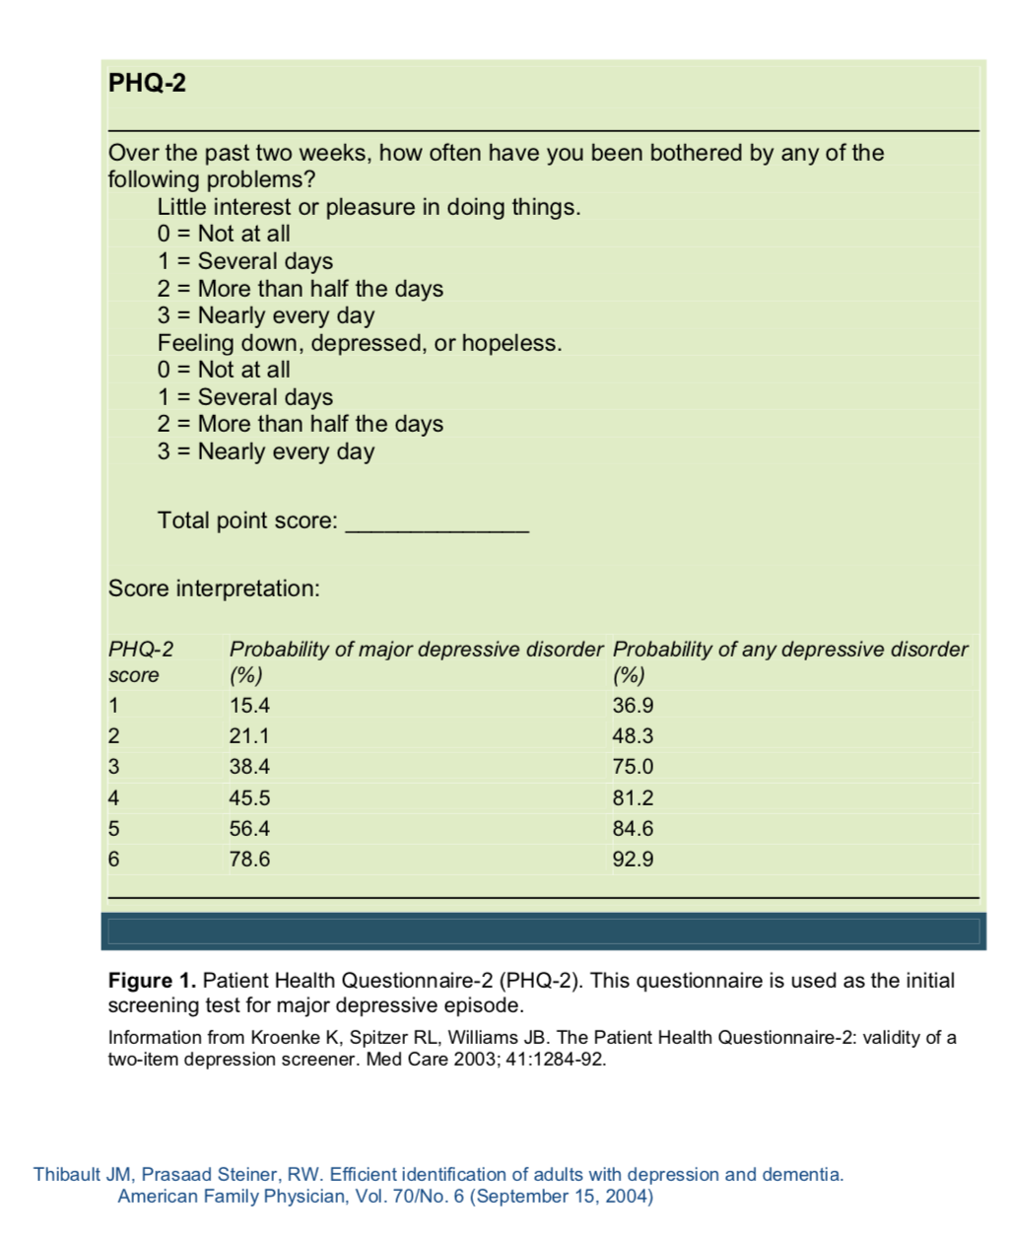
Patient health questionnaire 2

Slide 27
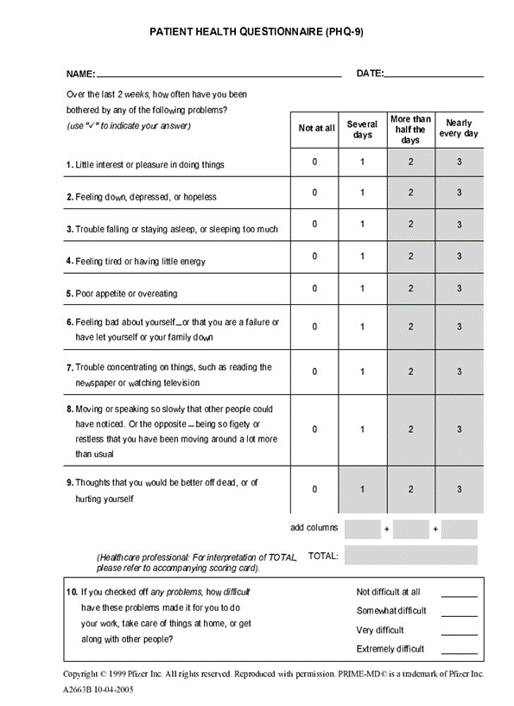
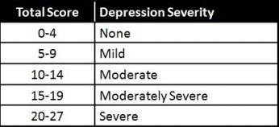
Patient health questionnaire 9

Slide 28
Genetical
01
Causes of Depression
Vestibulum nec congue tempus
Vestibulum nec congue tempus
Vestibulum nec congue tempus
Biological
Psychological
03
02
Vestibulum nec congue tempus

Slide 29
Causes of Depression
1)Mental, Physical or Sexual Abuse.
2)Major events: Death or loss of loved one.
3)Social Isolation due to Other mental illnesses.
4)Co-exists with a Major illness or may be triggered by it.
5)Certain Medications (isotretinoin , interferon-alpha, and corticosteroids).
6)The Abuse Substance, nearly 30% of them have major or clinical depression.

Slide 30
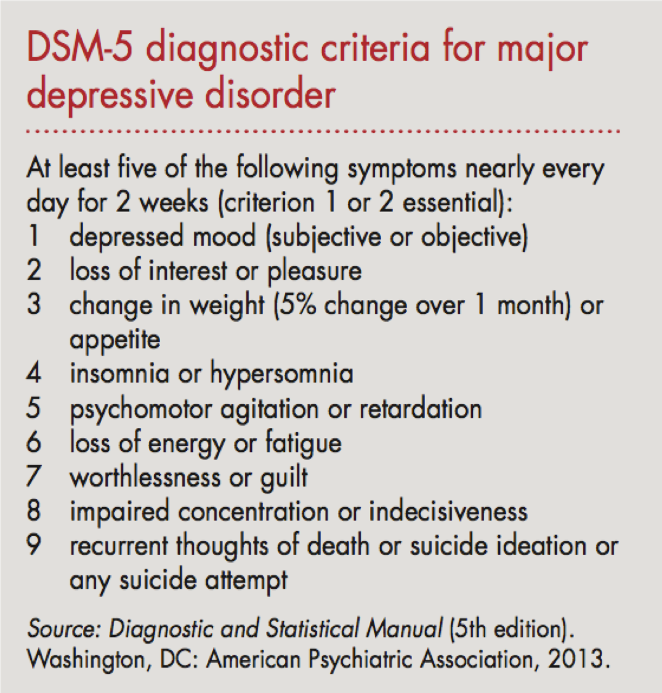

Slide 31
Clinical features of Depression ..
● Two key features:
• Depressed mood and/or • decrease interest or pleasure, which must be disabling to the patient
●Other symptoms Incloud :
. Change in appetite/weight • Insomnia or hypersomnia
• Fatigue or loss of energy • Poor concentration
• Poor appetite or overeating • Feelings of hopelessness
• Low energy or fatigue • Low self-esteem
• Psychomotor agitation/retardation • Sense of worthlessness or guilt
• Recurrent thoughts of death/suicide • Poor concentration or difficulty making decisions

Slide 32
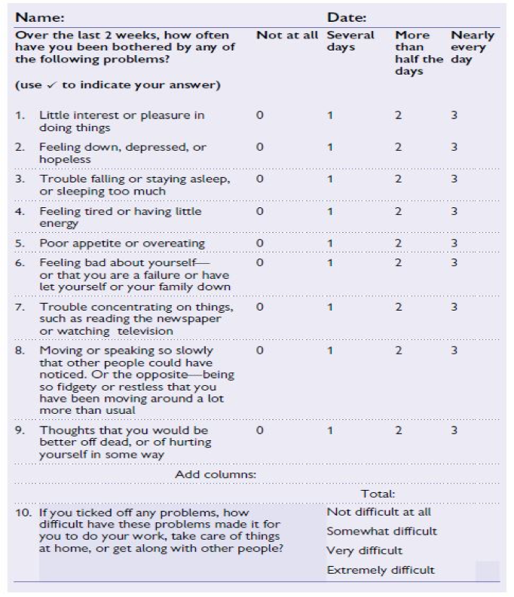
Management of depression ..
●First Assess severity for ALL Patients :
Can be done using a depression symptom count
or patient self-complete measure, such as the PHQ-9.
●Sub threshold depression (PHQ-9 of <5)
●Mild depression (PHQ-9 of 5–9)
●Moderate depression (PHQ-9 of 10–14)
●Moderately severe depression (PHQ-9 of 15–19)
●Severe depression (PHQ-9 ≥20)

Slide 33
Always ask patients directly about suicidal ideas and intent
Risk factors for suicide:
• Male > Female • Age 40–60y
• Living alone • Divorced > widowed > single >married
• Unemployment • Chronic physical illness
• Past psychiatric history • Recent admission to psychiatric hospital
• History of suicide attempt/self-harm • Alcohol/drug misuse
• Family history of suicide

Slide 34
●Mild depression:
psychological therapy
●Moderate depression:
psychological therapy and/or antidepressants
●Severe depression:
Antidepressants, and consider addition of psychological therapy to maintain remission. Consider psychiatric review, Electroconvulsive therapy (ECT).

Slide 35
Psychotherapy “Talk Therapy”
Interpersonal therapy
Psychodynamic therapy
Cognitive behavioral therapy
Behavioral activation

Slide 36
Antidepressants
Consider for:
●Patients with moderate/severe depression ± psychological therapy
●Dysthymia (subthreshold depressive symptoms lasting >2y)
●Mild depression if other treatment strategies have failed
What should I tell the patient?
Giving patients information ↑ compliance. When starting antidepressant drugs explain:
●The reasons for prescribing
●Timescale of action—unlikely to have any effect for 2wk; effects build up to maximum effect at 4–6wk
●Likely side effects including possible exacerbation of anxiety in the first 2wk of treatment

Slide 37
Selective serotonin re-uptake inhibitors (SSRIs) (e.g. fluoxetine, citalopram ,sertraline).
Usually first choice as less likely to be discontinued due to side effects and safer in overdose.
Side effects:
↑ in anxiety/agitation when starting medication
GI side effects, including dyspepsia
Sexual dysfunction
Consider co-prescribing a PPI for stomach protection if >60y or other risk factors for GI bleeding.
Only fluoxetine has been shown to be of benefit for the treatment of depression in children
Elderly people—particularly those taking SSRIs—are prone to hyponatraemia when taking antidepressants.
Serotonin and noradrenaline re-uptake inhibitors (SNRIs) (e.g. venlafaxine,duloxetine)
Avoid if uncontrolled hypertension.
Venlafaxine is also contraindicated if high risk of arrhythmia

Slide 38
Monoamine oxidase inhibitors (MAOIs) (e.g. phenelzine).
Should only be initiated in a specialist setting. Do not start until:
>1–2wk after a tricyclic has been stopped
>1wk after an SSRI has been stopped
Patients taking MAOIs must be very careful with diet, eating only fresh foods and avoiding :
Alcohol
foods containing tyramine, such as mature cheese, pickled herring, broad bean pods, and meat, yeast, or soya bean extracts.
Failure to do so can result in rapid ↑ in BP (often heralded by a headache).
Do not start other antidepressants until 2wk after treatment with MAOIs has been stopped.

Slide 39
Tricyclic and related anti-depressants (TCAs) (e.g. lofepramine, trazodone).
Titrate dose up from low dose until the patient feels the drug is helping or until side effects intrude.
Common side effects include :
drowsiness, dry mouth
blurred vision,
Constipation
urinary retention
sweating.
Use with caution for patients with:
CVD because of risk of arrhythmia
patients with prostatic hypertrophy (↑ risk of retention)
patients with raised intraocular pressures (↑ risk of acute glaucoma).
Mirtazapine (Presynaptic α2-adrenoreceptor antagonist)
↑ central noradrenergic and serotonergic neurotransmission.
Causes sedation during initial treatment and may also cause ↑ weight .
Reboxetine (Selective inhibitor of noradrenaline re-uptake)
●Not recommended for elderly patients.

Slide 40
Electroconvulsive therapy (ECT)
Electroconvulsive therapy (ECT)
is a procedure, done under general anesthesia, in which small electric currents are passed through the brain, intentionally triggering a brief seizure.
Highly effective treatment for depression.
Onset of action may be more rapid than that of drug treatments, with benefit often seen within 1 week of commencing treatment.
Indications for the use of ECT include the following:
Need for a rapid antidepressant response
Failure of drug therapies
History of good response to ECT
Patient preference
High risk of suicide
High risk of medical morbidity and mortality

Slide 41
Follow-up
Review patients every 1–2wk until stable assessing response, compliance, side effects, and suicidal risk
Continue for 4–6wk before judging a treatment as failed—and a further 2–4wk if partial response
Continue treatment for at least 6mo in total—12mo in the elderly and those with generalized anxiety disorder.
Advise patients with a history of recurrent depression to continue for >2y

Slide 42
Discontinuation reactions
●Occur once a drug has been used ≥ 8wk.
●Usually become apparent <5d after stopping the drug.
●Warn about possible reactions:
○Withdrawal of SSRIs and SNRIs—GI disturbances, headache, nausea, paraesthesiae, dizziness, anxiety, tinnitus, sleep disturbances, flu-like symptoms, sweating
○Withdrawal of other antidepressants (especially MAOIs)—nausea, vomiting, anorexia, headache, flu-like symptoms, insomnia, paraesthesiae, anxiety/panic, and restlessness

Slide 43
Psyco-somatic Disorders

Slide 44
Prevalence of somatization in Saudi
A study done in Aseer, Saudi Arabia in 2008 out of a sample size of 224 about half of the sample had one or more psychological disorders. The prevalence of Somatic Symptom Disorders was 16%.
A study done on Patients attending the Primary Health care Clinics in 2002, Saudi Arabia. Out of a sample size of 431 the prevalence of somatic symptom disorder was 19.1%.

Slide 45
Psyco-somatic Disorders
A nonspecific physical symptoms that cannot be fully explained by a known medical condition after appropriate investigation.
The person is experiencing symptoms and believes they are sick (that is, not faking the illness)
People with somatic symptom disorder typically go to a primary care provider rather than psychiatrist or other mental health professional. They often refuse to believe their symptoms are the result of mental or emotional causes rather than physical causes.
I in addition, the symptoms may be caused or exacerbated by anxiety, depression.
it is common for somatization, depression, and anxiety to all occur together.

Slide 46
Causes of somatic symptom disorder
The exact cause of somatic symptom disorder is unknown, but any of these factors may play a role:
Genetic and biological factors, such as an increased sensitivity to pain
Experiencing stressful life events, trauma or violence
Having experienced past trauma, such as childhood sexual abuse
Having anxiety or depression
People who have a negative outlook
Notes:
https://www.mayoclinic.org/diseases-conditions/somatic-symptom-disorder/symptoms-causes/syc-20377776

Slide 47
Clinical features
The essential feature of somatization is a chronic history of unexplained physical symptoms, those symptoms may include:
Generalized symptoms;
Abdominal pain that is vague , Arthralgia, Backache, Chest pain that is nonspecific, Chronic tiredness and fatique, Headache
Gastrointestinal symptoms;
Chronic bloating, Constipation, Diarrhea, Food intolerance to multiple foods, Nausea and vomiting
Genitourinary symptoms:
Erectile dysfunction,Decreased libido, Dysuria, Menses that is painful, irregular, and heavy
Neurological:
Headaches,Dizziness, Amnesia ,Vision changes ,Paralysis or muscle weakness

Slide 48
Diagnosis
According to the Diagnostic and Statistical Manual for Mental Disorders, Fifth Edition (DSM-5) category of Somatic Symptom Disorders and Other Related Disorders represents a group of disorders characterized by thoughts, feelings, or behaviors related to somatic symptoms.
Criteria for Somatic Symptom Disorder.
A. One or more somatic symptoms that are distressing or result in significant disruption of daily life.
B. Excessive thoughts, feelings, behaviors related to the somatic symptoms or associated health concerns as manifested by at least one of the following:
1.Disproportionate and persistent thoughts about the seriousness of one's symptoms.
2.Persistently high level of anxiety about health or symptoms.
3.Excessive time and energy devoted to these symptoms or health concerns.
C. Although any one somatic symptom may not be continuously present, the state of being symptomatic is persistent (typically more than 6 months).

Slide 49
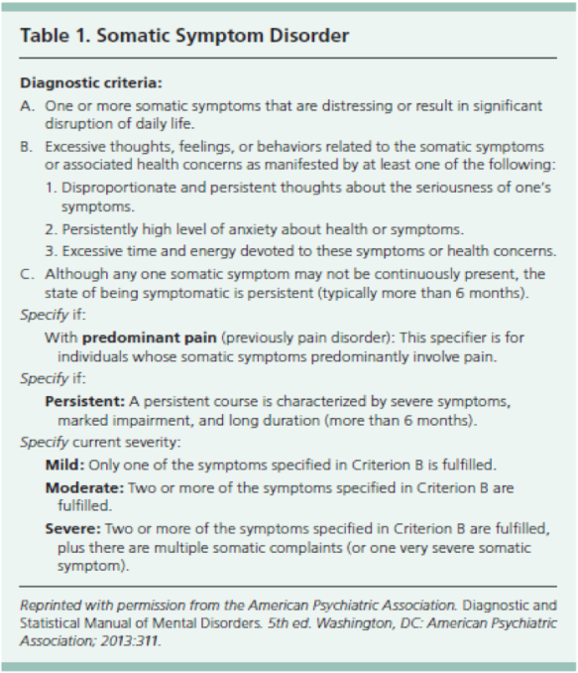

Slide 50
Management of psycosomatic
The components of SSD currently treated include the following:
Somatic symptoms
Health related anxiety
Preoccupation and rumination about health concerns
Unhelpful illness behaviors
Treatments used as interventions for these components include:
Psychiatric consultation intervention (PCI)
Cognitive based therapy (CBT)
Behavioral techniques (relaxation training and mindfulness)
Other psychotherapies
Psychotropic medications

Slide 51
Goals for the Physical Therapist or Clinician:
Be empathetic
Instead of focusing on each physical symptom get the big picture by asking questions such as "How do these problems affect you?" or "How can I help you today?". It will be difficult to help the patient focus on the most important issues related to their health.
Refer the patient for psychotherapy
Establish realistic timeframes for goals of treatment
Ensure patient compliance
Communicate with other healthcare providers to ensure you are not providing conflicting treatment
Encourage the patient to become active and independent in managing their health to reduce dependency on their spouse, significant other or caregivers

Slide 52
What is counseling
Counseling :
Usually reflective listening to encourage patients to think about and try to resolve their own difficulties. There is little evidence of beneficial effects or cost-effectiveness, but if there is a specific, identifiable cause for the patient’s symptoms,
is distinct from psychotherapy is a form of activity in which the physician engages in an educational dialogue with the patient, the goal is to be aware of patient's problems
Usually is less than 20 mins

Slide 53
How to achieve effective counselling in general ?
CLIENT
Client-centered
Listening
Interaction
Exploration
Nonjudgment
Trust
GATHER
Greet:
Ask
Tell
Help
Explain
Return

Slide 54
In a psychiatric history what should ask for ?
Presenting complaint
chronological account
past history of similar symptoms.
Ask directly about thoughts of suicide and self-harm
FAMILY HISTORY :
psychiatric illness
recent loss or serious illness of a family member
Bereavement
Depression
suicide or attempted suicide
Psychosis,
alcoholism, drug use

Slide 55
Personal history:
abuse (as a child, domestic violence)
substance misuse
serious illness (including past psychiatric history and major physical illness)
recent significant events (e.g. childbirth, house move)
Attitudes and beliefs :
how does the patient see him/herself?
What does he/she think is wrong?
How does he/she think other people view the situation?
What does the patient want you to do about it
Occupation :
home situation:
housing, relationships,
social support,
debt etc

Slide 56
What is psychotherapy ?
psychotherapy; any form of treatment for mental illness, behavioural maldatation, or other problems
a physician deliberately establishes a professional relationship with a patient for the purpose of removing, modifying, or retarding existing symptoms
minimum period for psychotherapy is 20 mins

Slide 57
Counseling vs psychotherapy
 | Counseling | psychotherapy
Goal | To find out patients problems | treatment for mental illness By modifying or removing existing behavior
Time | Less than 20 mins | More than 20 mins

Slide 58
What are the psychotherapy ?
Problem-solving therapy (PST):
involves drawing up a list of problems and generating and agreeing solutions, broken down into steps, for patients to work on as homework between session
Cognitive behaviour therapy (CBT)
Behavioural therapies Aim to change behaviour. Usually the therapist uses a system of graded exposure (systematic desensitization), combined with teaching a method of anxiety reduction
• Cognitive therapy Focuses on people’s thoughts and the reasoning behind their assumptions on the basis that incorrect assumptions (that are often unconscious) l abnormal reactions which then reinforce these assumptions further (a vicious cycle)

Slide 59
Other types
computerized CBT:
Particularly useful for patients with mild symptoms or who do not wish to be referred to specialist psychological therapy services.
Interpersonal therapy (IPT):
Individual or group therapy concentrating on the difficulties that arise in maintaining relationships with others.

Slide 60
Management for each disorder in PHC (SUMMARY)?
ANXIETY | Step 1: identification and assessment, education, and active monitoring Step 2: offer low-intensity psychological intervention Step 3: offer-high intensity psychological intervention and/or drug treatment Step 4: offer referral for specialist treatment
Depression | Step 1 : Provide education about depression and information about support available Simple problem-solving strategies , Active monitoring Step 2 : Low-intensity psychosocial intervention, Group-based peer support, Drug treatment step 3: High-intensity psychological interventions, Drug treatment, Combined treatments Collaborative care Step 4:Referral to psychiatry
Panic disorder | Step 1 Recognition and diagnosis step2 psychological therapy (CBT), drug treatment or self-help Step 3 Consideration of alternative treatment Step 4 Offer referral for specialist
Phobia and other anxiety disorders | CBT and medication depending on severity of symptoms and effects on life

Slide 61
When to refer or consult?

Slide 62
"The key is knowing when to refer if the problem goes beyond the family physician's expertise or ability to address, just like with severe cardiac problems,"

Slide 63
When to refer to psychiatry ?
Inadequate response to multiple treatments
High suicidal or homicidal risk
Severe self-neglect
Psychotic features after ruling out other causes
Significant comorbidity (Substance abuse, complex picture )

