Slide 2
Role Play

Slide 3
SEXUALLY TRANSMITTED INFECTION
( وَلاَ تَقْرَبُوا الزِّنَى إِنَّهُ كَانَ فَاحِشَةً وَسَاءَ سَبِيلاً ” (الإسراء:٣٢”
Done By:
Yara alzamil
Shahad AlQahtani
Lamyaa Althawadi
Nada Bin Semaih

Slide 4
Objective
1.List of common sexually transmitted infections.
2. Method to take a sexual history and risk factors.
3. Discussion about the differential diagnosis of:
Vaginal and urethral discharge
Ulcerative and non-ulcerative genitalia
Pelvic pain and dysuria
4. List of the possible sexually transmitted infections among heterosexual and homosexual person
5. Investigation, diagnosis and management of sexually transmitted infections.
6. Methods of prevention
7. Complications of sexually transmitted disease.
8. Dermatological pictures of different sexually transmitted infection

Slide 5
What do we mean by STIs ?

Slide 6
SEXUALLY TRANSMITTED INFECTIONS (STIS) ARE INFECTIONS THAT ARE SPREAD PRIMARILY THROUGH PERSON-TO-PERSON SEXUAL CONTACT. THERE ARE MORE THAN 30 DIFFERENT SEXUALLY TRANSMISSIBLE BACTERIA, VIRUSES AND PARASITES.” WORLD HEALTH ORGANIZATION.
ACCORDING TO THE AMERICAN SOCIAL HEALTH ORGANIZATION, ONE OUT OF FOUR TEENS IN THE UNITED STATES BECOMES INFECTED WITH AN STD EACH YEAR. BY THE AGE OF 25, HALF OF ALL SEXUALLY ACTIVE YOUNG ADULTS WILL GET AN STD.

Slide 7
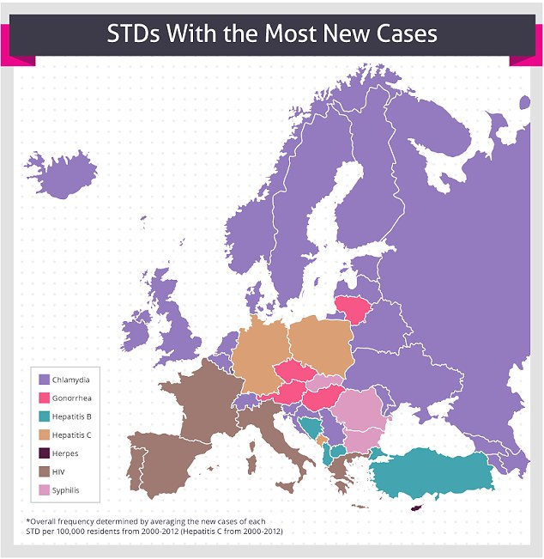

Slide 8
Epidemiology
Some STDs have a greater worldwide presence than others. Nearly two thirds of all STDs worldwide affect people under the age of 25 years. Of these, another third is less than 20 years of age. The rates are higher among teenage girls than in boys, with girls twice as likely to be infected.

Slide 9
Case..
18 Years old Lady present with itchy painful multiple red lesions in her genitalia
Notes:
Key points
DDX

Slide 10
How to approach patient with STI?
PRIVACY
Patients presenting with possible STIs are frequently anxious, embarrassed and concerned about confidentiality.
The clinical setting must ensure privacy and reinforce confidentiality.
The most common symptoms are:
Vaginal discharge
Urethral discharge
Dysuria
Dyspareunia
Genital ulceration
(2) HISTORY TAKING

Slide 11
B) any associated symptoms :
Like fever, pain, itch, malodour, genital swelling, skin rash, joint pains
C) Risk factors :
(Age (under 25 years),multiple sex partner ,Sexual activity with infected partner, Condom not used ,History of prior STD,Pregnancy history and plans)
Also, In women, menstrual, contraception and obstetric history should be obtained

Slide 12
General examination:
Must include Eyes , Mouth , Throat, Skin, Lymph nodes, CNS examination
B) Local examination:
Inspection (inguinal, genital and perianal areas)
Skin rash
Skin swelling
Ulcers
Erythema
Discharge
Hygiene
(3) PHYSICAL EXAMINATION
Palpation
Temperature
Tenderness
Discharge
Lymphadenopathy

Slide 13
(4) INVESTIGATION
Swab
Serology
PCR
Culture
Blood test
(5) MANAGEMENT

Slide 14
Sexual Transmitted Infections
Bacterial
Viral
parasite

Slide 15
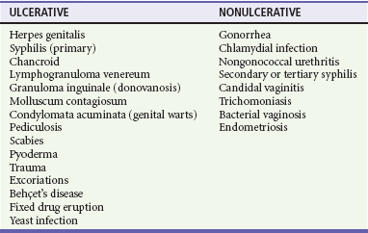
Ulcerative and non-ulcerative genitalia DDX

Slide 16
Common STDs
Bacterial Vaginosis
HIV
Chlamydia
Gonorrhea
Syphilis

Slide 17
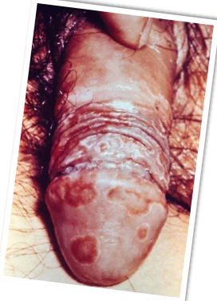
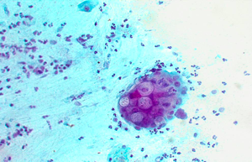
Chlamydia Trachomatis

Slide 18
Chlamydia Trachomatis
It is a common sexually transmitted disease (STD) caused by the bacterium, Chlamydia trachomatis
Most common bacterial STD
Incubation period is 1-3 weeks
Many cases are asymptomatic (75% of infections in women and 50% in men are without symptoms).

Slide 19
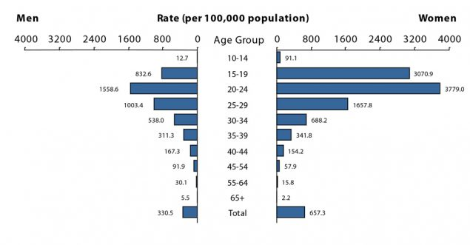
The rates of reported cases of chlamydia are highest among adolescents and
young adults aged 15–24 years
CHLAMYDIA — RATES OF REPORTED CASES BY AGE GROUP AND SEX, UNITED STATES, 2016

Slide 20
Diagnosis:
Clinical picture:
Male (discharge, dysuria, scrotal pain, fever)
Female (discharge, postcoital bleed, pelvic pain)
Nucleic Acid Amplification Tests (NAATs) as initial test
Cell culture
Treatment:
Uncomplicated → doxycycline: 100mg per day for seven days (contraindicated in pregnancy)
1st line in pregnancy : azithromycin 1 g orally as a single dose

Slide 21
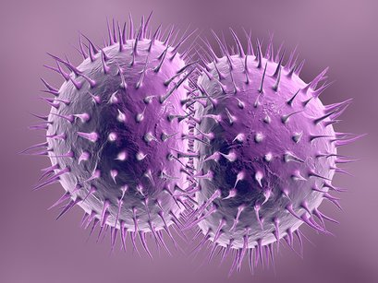
NEISSERIA GONORRHOEAE
In the United States, an estimated 820,000 new N. gonorrhoeae infections occur each year . Gonorrhea is the second most commonly reported communicable disease.

Slide 22
Signs And Symptoms
discharge from the vagina (watery, creamy, or slightly green)
pain or burning sensation while urinating
the need to urinate more frequently
heavier periods or spotting
sore throat
pain upon engaging in sexual intercourse
sharp pain in the lower abdomen
fever
greater frequency or urgency of urination
a pus-like discharge (or drip) from the penis (white, yellow, beige, or greenish)
swelling or redness at the opening of the penis
swelling or pain in the testicles

Slide 23
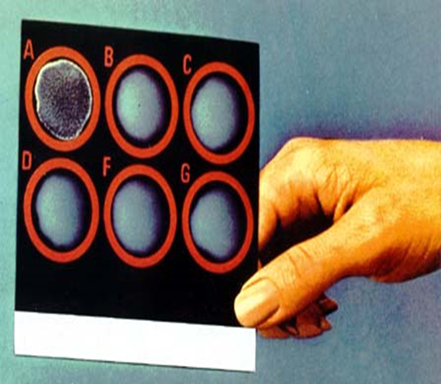
Diagnosis
Transport media required unless transfer to the lab. is immediate.
Direct smear for Gram stain of urethra and cervical specimens to see Gram negative diplococci within a neutrophil (intracellular) , more sensitive in men .
Culture on Thayer-Martin or other selective medium.
Isolates identified by sugar fermentation of glucose only ( does not ferment maltose or sucrose) or Coagglutination test.
nucleic acid amplification tests (NAATs)

Slide 24
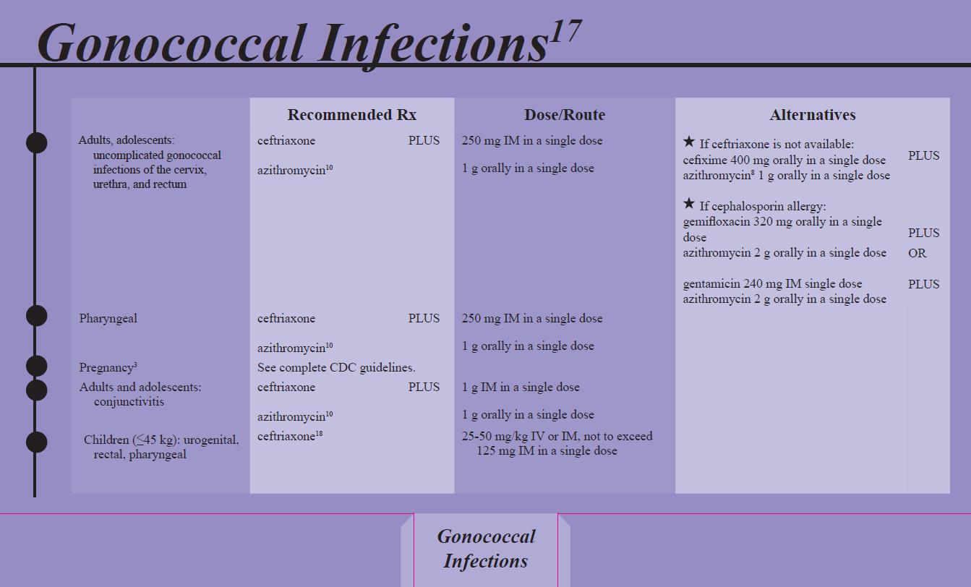
Managment

Slide 25
Vaginal and urethral discharge DDX

Slide 26
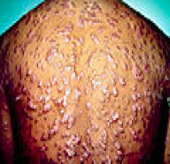
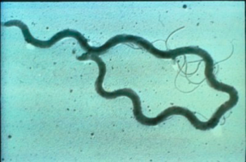
Syphilis

Slide 27
Modes of transmission
Sexual
blood Transfusion
vertical

Slide 28
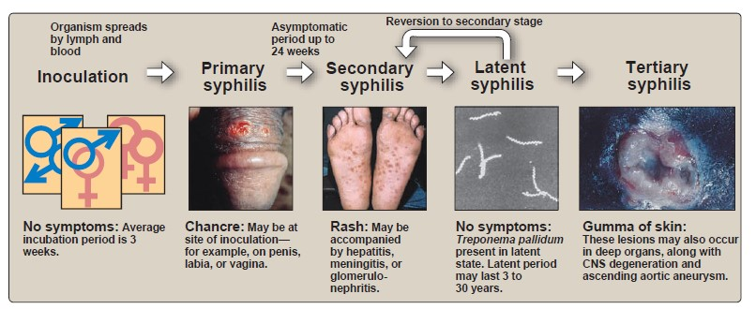
Stages of Syphilis

Slide 29
Process of laboratory diagnosis of syphilis

Slide 30
Primary Syphilis Treatment
Recommended Regimen for Adults
Benzathine penicillin G 2.4 million units IM in a single dose
Recommended Regimen for Infants and Children
Benzathine penicillin G 50,000 units/kg IM, up to the adult dose of 2.4 million units in a single dose

Slide 31
Latent Syphilis
having serologic proof of infection without signs and symptoms of the disease.
latent syphilis is not transmitted sexually, the objective of treating persons in this stage of disease is to prevent complications and transmission

Slide 32
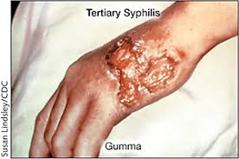
Tertiary syphilis
Tertiary syphilis refers to gummas and cardiovascular syphilis but not to neurosyphilis.
Recommended Regimen
Tertiary Syphilis with Normal CSF Examination
Benzathine penicillin G 7.2 million units total, administered as 3 doses of 2.4 million units IM each at 1-week intervals

Slide 33
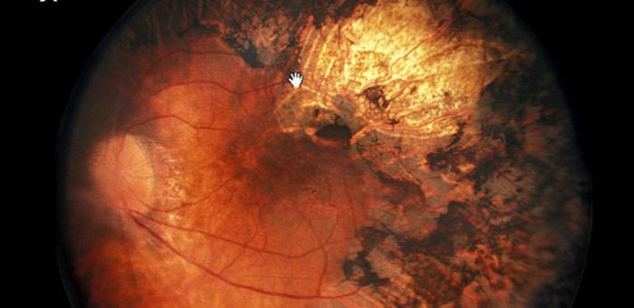
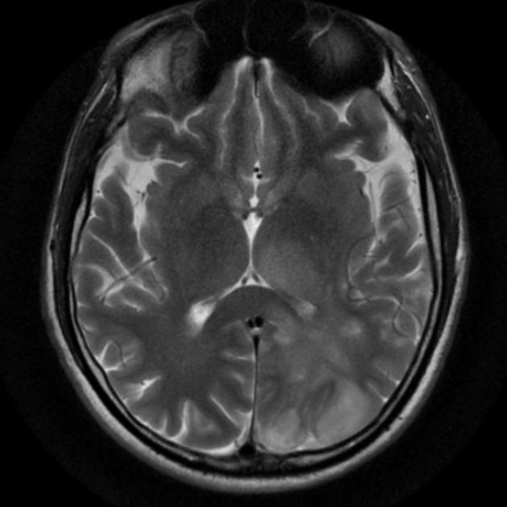
Neurosyphilis And Ocular syphilis

Slide 34
Neurosyphilis And Ocular syphilis
Neurosyphilis :
Neurosyphilis is caused by Treponema pallidum. This is the bacteria that causes syphilis. Neurosyphilis usually occurs about 10 to 20 years after a person is first infected with syphilis. Not everyone who has syphilis develops this complication.
Neurosyphilis can occur at any time after initial infection.
Ocular syphilis:
All stages of syphilis can involve the eye.
Eye involvement tends to occur most frequently in secondary syphilis and late syphilis
there are almost no eye findings that are absolutely specific for syphilis

Slide 35
Neurosyphilis And Ocular syphilis Treatment
Recommended Regimen
Neurosyphilis and Ocular Syphilis
Aqueous crystalline penicillin G 18–24 million units per day, administered as 3–4 million units IV every 4 hours or continuous infusion, for 10–14 days

Slide 36
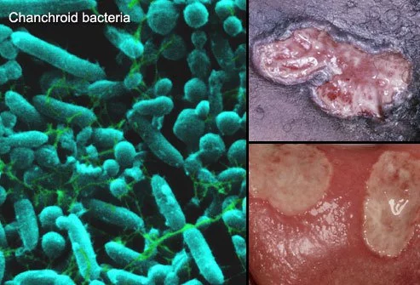
Chancroid

Slide 37
Chancroid
Chancroid is a bacterial infection that causes open sores on or around the genitals of men and women , The bacterium Haemophilus ducreyi causes this infection. It attacks tissue in the genital area and produces an open sore that’s sometimes referred to as a chancroid or ulcer. Chancroid may also spread from skin-to-skin contact with an infected person.
Modes of transmission:
Sexual contact

Slide 38
Signs & Symptoms :
Men :
Men may notice a small, red bump on their genitals that may change to an open sore within a day or two.
Women :
Women may develop four or more red bumps on the labia, between the labia and anus, or on the thighs. The labia are the folds of skin that cover the female genitals. After the bumps become ulcerated, or open, women may experience a burning or painful sensation during urination or bowel movements.

Slide 39
Diagnosing chancroid
Diagnosing the condition may involve taking samples of the fluid that drains from the sore. These samples are sent to a laboratory for analysis.
Treating chancroid :
Chancroid may be successfully treated with medication or surgery.
Medication : Your doctor will prescribe antibiotics to kill the bacteria that are causing your ulcers.
Surgery :
Your doctor may drain a large and painful abscess in your lymph nodes with a needle or through surgery. This reduces swelling and pain as the sore heals but might cause some light scarring at the site.

Slide 40
HIV
Etiology:
Retrovirus, either HIV-1 or HIV-2
HIV-2 is almost entirely confined to West Africa
Modes of Transmission:
Sexual intercourse (Vaginal or Anal)
Mother-to-child (transplacental, perinatal, breastfeeding).
Contaminated blood, blood products and organ transplantation
Contaminated needles

Slide 41
Transmission of HIV from mother to child
In the absence of any interventions transmission rates range from 15-45%. This rate can be reduced to levels below 5% with effective interventions.

Slide 42
Risk factors and stages of HIV infection
Risk factors:
STIs (due to open sores)
Unprotected sex
Multiple sexual partners
Uncircumcised males
Stages of HIV infection
Acute HIV infection
Chronic HIV infection
AIDS

Slide 43
Acute HIV infection
Acute HIV infection generally develops within 2 to 4 weeks after a person is infected with HIV.
During acute stage, many people have flu-like symptoms.
In the acute stage, HIV multiplies rapidly and spreads throughout the body. The virus attacks and destroys the infection-fighting CD4 cells of the immune system.
HIV can be transmitted during any stage of infection, but the risk is greatest during acute HIV infection

Slide 44
Chronic HIV infection
HIV continues to multiply in the body but at very low rate.
People with chronic HIV infection may not have any HIV-related symptoms, but they can still spread HIV to others.
Without treatment, chronic HIV infection usually advances to AIDS in 10 to 12 years.

Slide 45
AIDS
AIDS is diagnosed when a person with HIV has a CD4 count of less than 200 cells/mm3 and/or one or more opportunistic infections.
Without treatment, people with AIDS typically survive about 3 years.
Mortality in HIV patients is mostly due to infections, cancers, or wasting.

Slide 46
Diagnosis & complications
ELISA
Screening
High sensitivity
PCR
Measure the viral load
Western Blot
Confirmatory test
complications:
Tuberculosis, Cytomegalovirus, Toxoplasmosis.
Kaposi’s sarcoma.

Slide 47
Treatment of HIV
Antiviral Therapy
Triple therapy HAART:
2 nucleoside reverse transcriptase inhibitors
Zidovudine, Nevirapine
Protease inhibitor
Saquinavir, Indiniavir

Slide 48
Treatments to prevent mother-to-baby transmission
UK guidelines recommend that patient should start taking AZT (zidovudine) in the final three months (third trimester) of pregnancy.
an intravenous injection of AZT during delivery and have a caesarean .

Slide 49
Herpes Simplex Virus
Etiology
Genital Herpes caused by Herpes Simplex Virus type 2 (HSV-2)
Oral Herpes caused by HSV-1
HSV-1 can cause genital lesions
Mode of transmission
Contact with person who is shedding (either sexual contact of regular physical contact)
Vertical transmission (very rare)
Through the birth canal

Slide 50
Signs & symptoms
It is a lifelong infection with exacerbations and remissions
Primary Herpes Infection:
Painful shallow ulcers (Around the mouth (oral herpes type 1) or on genitalia( genital herpes Type 2))
In Immunocompromised patients, symptoms are more severe with increased instances of shedding
Herpes encephalitis
Herpes viral meningitis
Herpes esophagitis

Slide 51
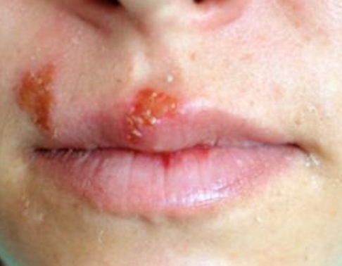
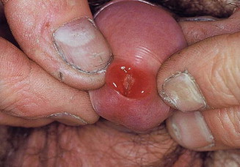
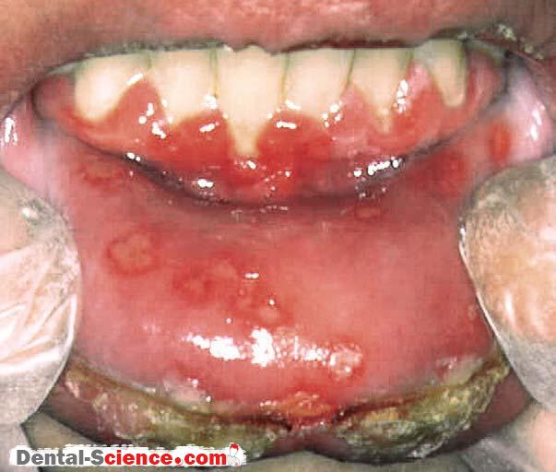
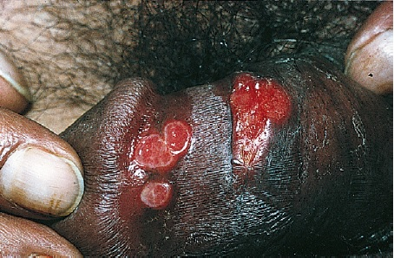
Skin manifestations
Oral herpes
Urethritis
Vulvovaginitis
Gingivosomatitis Herpitica

Slide 52
Diagnosis & complications
Diagnosis:
Clinical presentation and history
PCR
Tzanck smear w/ Giemsa stain shows multinucleated giant epithelial cells.
Dacron Swab from base of genital lesion can be tested by:
viral culture
herpes simplex virus (HSV) antigen detection
polymerase chain reaction (PCR) of HSV DNA
Serologic testing for antibody for current or past infection if necessary
Complications:
Rectal infection may lead to proctitis
Genital pain, Urethritis, Cervicitis.
Aseptic meningitis
Involvement of sacral autonomic plexus leading to urine retention
Increased risk of acquiring and transmitting HIV.

Slide 53
Presence of HSV in the birth canal during delivery
Causes:
neonatal herpes:(a serious and sometimes fatal condition) Neonatal herpes can cause an overwhelming infection resulting in central nervous system damage, mental retardation, or death.
Medication: Acyclovir for symptomatic women, Suggested C/S if active genital lesions
.

Slide 54
Treatment
1st line: oral Acyclovir, valacyclovir, or famcyclovir + symptomatic treatment for pain
2nd line: topical antiviral + symptomatic treatment.

Slide 55
Human Papillomavirus
Etiology:
Over 90% are caused by HPV types 6 and 11.
HPV types 16 and 18 are known to cause cancer
In females, warts occur around mostly in the vagina, anus, and cervix. In males, genital warts are less common but might present on the tip of the penis
Mode of transmission:
Sexual contact
Direct skin contact

Slide 56
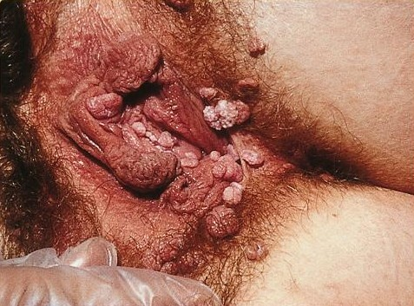
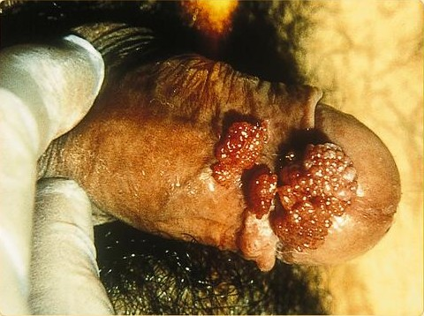
Signs & Symptoms
Signs and symptoms:
Genital warts present as soft, moist, pink/flesh-colored bumps.
Usually painless.
Cauliflower-like appearance of condylomata acuminata HPV
Complications
HPV is the main risk factor for cervical cancer,(And rarely Vulvar/Vaginal,Rectal cancer) as such we have to perform a Pap smear screening test for early detection of cervical cancer in females.

Slide 57
Treatment
Podofilox topical solution
Podophylin resin
Cryotherapy
Electro-cauterization
Surgical removal
Laser ablation

Slide 58
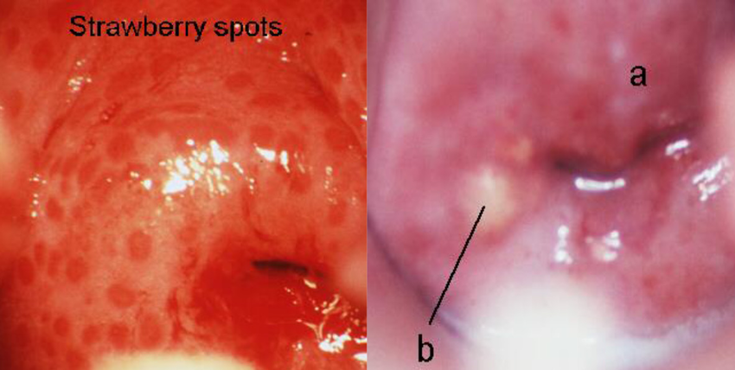
Trichomoniasis
Parasitic Infection Caused By Trichomonas vaginalis
Most common curable STD.
Modes of transmission :
Sexual contact
Mother to child
Signs and Symptoms :
“Usually asymptomatic”
Symptoms experienced include pain, burning or itching in the penis, urethra (urethritis), or vagina (vaginitis). Discomfort for both sexes may increase during intercourse and urination. For women there may also be a yellow-green, itchy, frothy, foul-smelling ("fishy" smell) vaginal discharge.
STRAWBERRY CERVIX

Slide 59
Trichomoniasis
Diagnosis :
- The first is known as saline microscopy. This is the most commonly used method and requires an endocervical, vaginal, or penile swab specimen for examination under a microscope.
- The second diagnostic method is culture, which has historically been the "gold standard" in infectious disease diagnosis.
- The third method includes the nucleic acid amplification tests (NAATs) which are more sensitive.

Slide 60
Treatment:
Treatment for both pregnant and non-pregnant women is usually with metronidazole, by mouth once. Caution should be used in pregnancy, especially in the first trimester. Sexual partners, even if they have no symptoms, should also be treated.

Slide 61
Top 9 Risk Factors for Sexually Transmitted Diseases :
1Un-protected Sex .
2 Multiple Partners .
3Being Under 25 Years Old .
4Alcohol Use.
5illicit Drug Use.
6Trading Sex for Money or Drugs.
7Serial Monogamy.
8Having an STD.
9Using Birth Control Pills As Your Sole Form of Contraception .
Notes:
https://www.verywell.com/top-risk-factors-for-acquiring-an-std-3133104

Slide 62
Methods of prevention :
# Use latex condoms every time you have sex.
#Avoid sharing towels or underclothing.
#Wash before and after intercourse.
#Get a vaccination for hepatitis B. This is a series of three shots.
#Get tested for HIV.
#If you have a problem with drug or alcohol abuse, get help. People who are drunk or on drugs often fail to have safe sex.
#Consider that not having sex is the only sure way to prevent STDs .
Notes:
https://www.webmd.com/sex-relationships/understanding-stds-prevention

Slide 63
Role of primary care physician in prevention
The prevention and control of STIs are based on the following five major strategies:
Education and counseling of persons at risk on ways to avoid STIs through changes in sexual behaviors and use of recommended prevention services;
Identification of asymptomatic infected persons and of symptomatic persons unlikely to seek diagnostic and treatment services;
Effective diagnosis, treatment, and counseling for all infected persons;
Evaluation, treatment, and counseling for all sex partners of persons who are infected with an STI; and
Pre-exposure vaccination of persons at risk for vaccine-preventable STIs.

Slide 64
Primary prevention of STIs begins with changing the sexual behaviors that place persons at risk for infection.

Slide 65
Complications of STDs
Bacterial STDs :
Untreated chlamydia and gonorrhea infections have a high risk of complications. Between 10 and 30 percent of women infected with these STIs will develop pelvic inflammatory disease (PID) .Approximately 10 to 20 percent of the time PID can produce scarring that causes infertility, along with chronic pelvic pain and ectopic (tubal) pregnancies .
Human Papillomavirus (HPV) :
Some HPV strains may produce genital warts or cause HPV-related cancers.
Herpes Simplex Virus (HSV):
a new herpes simplex infection can have multiple complications, including miscarriage, early labor and premature babies and severe complications in the fetus if the infection spreads to the brain and nervous system. Herpes, meningitis, and encephalitis are usually fatal if not promptly treated.

Slide 66
Hepatitis B and C :
Both hepatitis B and C viral infections may have minimal symptoms for years to decades, but long-term complications include liver scarring (cirrhosis), liver failure, liver cancer and, eventually, death.
Parasitic STD Complications :
Trichomoniasis infections during pregnancy can cause pre-term delivery and low birth weights. Trichomoniasis infections greatly increase your risk of getting other STIs, especially HIV.

Slide 67
MCQs ..
1: which one of the following confirmatory test for HIV?
A-PCR
B-Rapid HIV Test
C-ELISA
D- Western Blot
2: Which ONE of the following is the most infectious phase of syphilis disease?
A-Latent phase
B-Late primary phase.
C-Early Primary phase
D-Tertiary phase
3- Patient with dysuria reported having extramarital sexual relationship. The gram stain revealed intracellular gram-negative diplococci. Which ONE of the following is the causative agent?
A-Gonorrhea
B-Chlamydia
C-E.coli
D- Cyanobacterium
4-Which one of the following most common STIs worldwide?
a- HIV
b-Chlamydia
c-Gonorrhea
d-Syphilis

Slide 68
References
1- NICE guidelines British Association of Sexual Health and HIV
2-Mycotic Infections in Immunocompromised Hosts: Clinical and Microbiological Aspects
3- https://www.cdc.gov/std/tg2015/toc.htm
4-http://bacteriologynotes.com/pathogenesis-and-clinical-manifestations-of-treponema-pallidum/
5-https://www.cdc.gov/std/stats16/chlamydia.htm
6-http://www.who.int/reproductivehealth/topics/sexual_health/sh_definitions/en/
7-Kumar and Clark's Clinical Medicine E-Book
8-https://microbeonline.com/laboratory-diagnosis-of-syphilis/
9-https://medlineplus.gov/ency/article/000703.htm

