Slide 1
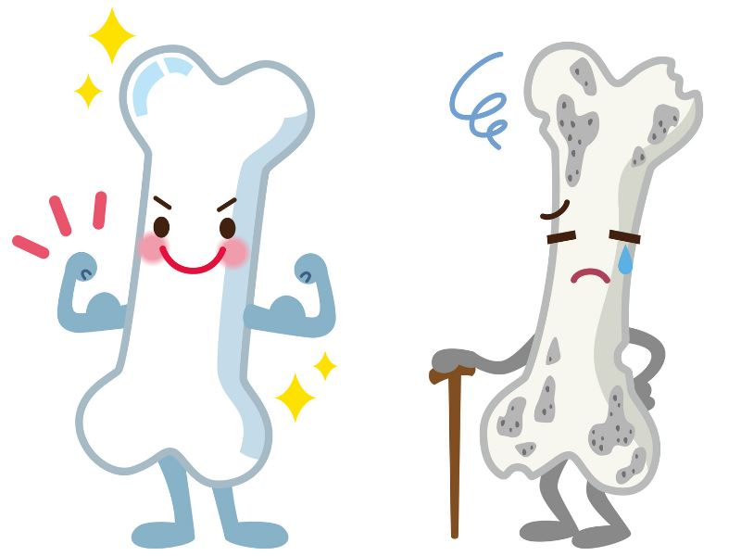
Osteoporosis
Prof AlJohara M AlQuaiz
Ahad alanazi
Hanan khushaim
Jumana Fatani
Wajda Alhothali

Slide 2
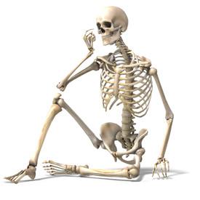
MCQs
Go to www.menti.com and use the code 771112
Notes:
1. At what age do you have the most bone density?
A. Your 20s
B. Your 30s
C. Your 40s
D. Your 50s
2. Which test is used to screen for osteoporosis?
A. Blood test
B. Special type of X-ray
C. Urine test
D. All of the above
3. How is osteoporosis treated?
A. Medicines
B. Surgery
C. X-ray treatments
D. It can't be treated
4. Which of these makes it more likely that you’ll get osteoporosis?
A. Drinking too much alcohol
B. Family history
C. Smoking
D. All of the above
5. Which of theses medications increase the risk of osteoporosis?
Heparin
Lithium
Loop diuretics
All of the above

Slide 3
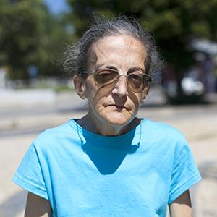
https://www.youtube.com/watch?v=wkPnoJktqIk

Slide 4
Maria Filomena, 2014
“ I am very scared of falling and becoming confined to a wheelchair . ”
“ I feel quite limited, I am very careful and try to avoid falls. I can’t fall! ”
“ We live our lives from within our homes, and when we need to go out, it is with a lot of suffering. ”

Slide 5
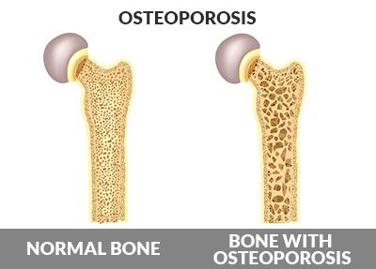
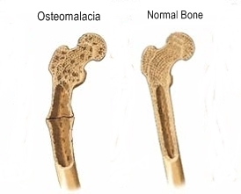
• Osteoporosis is characterized by low bone mass, micro-architectural disruption, and increased skeletal fragility resulting in decreased bone strength & increase risk of fracture despite the normal mineralization.
• Osteomalacia: Inadequate mineralization occurs AFTER the closure of the growth plates in adults.

Slide 6
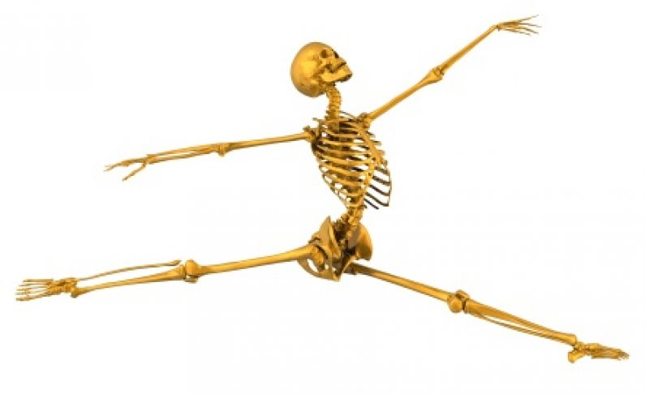
BONE STRENGTH
BONE STRENGTH= BONE QUALITY + BONE MASS
BONE QUALITY:
It is described operationally as an amalgamation of all the factors that determine how well the skeleton can resist fracturing, such as microarchitecture, accumulated microscopic damage, the quality of collagen, the size of mineral crystals, and the rate of bone turnover.
BONE MASS:
The amount of bone tissue in the skeleton, can keep growing until around age 30.
At that point, bones have reached their maximum strength and density (peak bone mass)
Depend on DEXA.
Cancellous bone (trabecular or spongy bone) More affected by osteoporosis

Slide 7
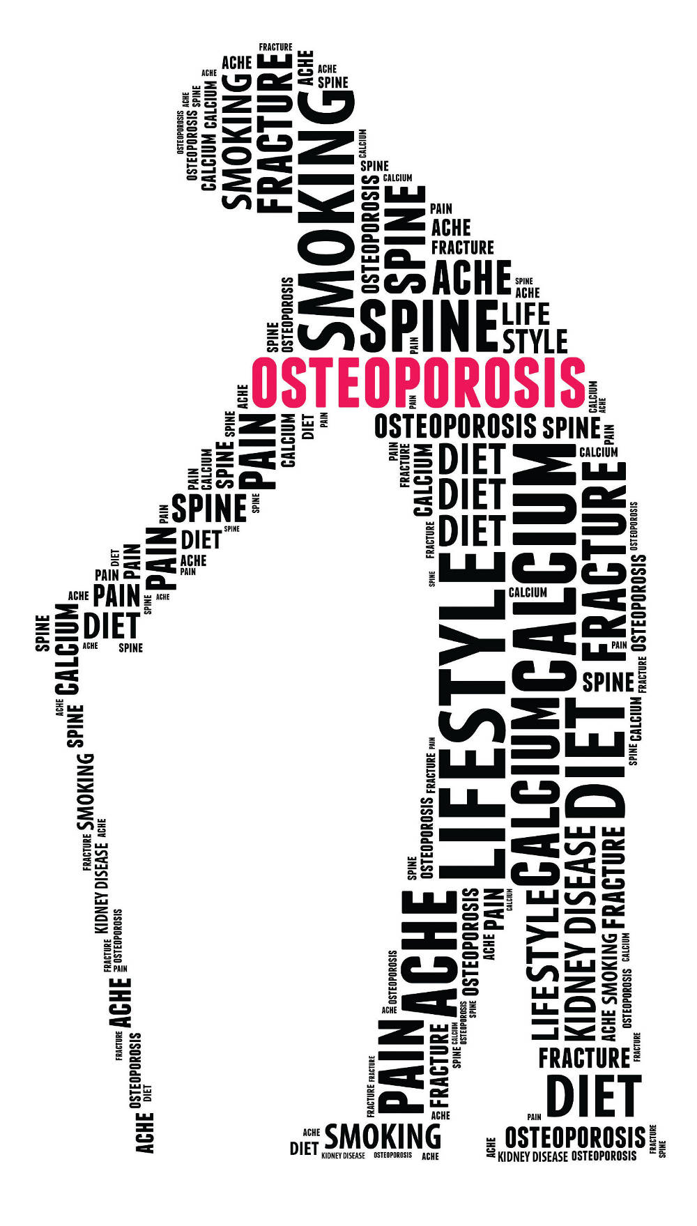
Signs & Symptoms:
Osteoporosis | Osteomalacia
Osteoporosis has no clinical manifestations until there is a fracture. Back pain, caused by a fractured or collapsed vertebra Loss of height over time A stooped posture A bone fracture that occurs much more easily than expected | Generalized bone pain (backache). Muscle weakness. Reduced bone density. Vertebral changes: Bi-concave vertebra, vertebral collapse, kyphosis. Stress fractures (in children with stress the bone will bend but in adult with much stress it won’t bend it will fracture): Loosers zones in scapula, ribs, pelvis, and proximal femur.

Slide 8
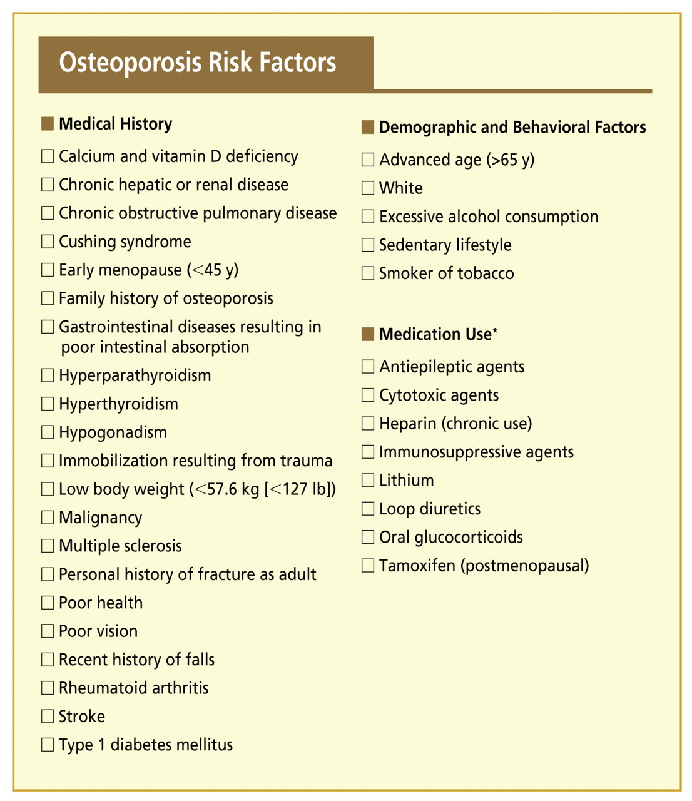
Factors Affecting osteoporosis:

Slide 9
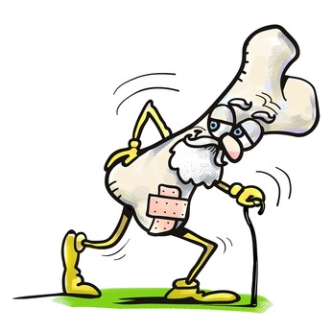
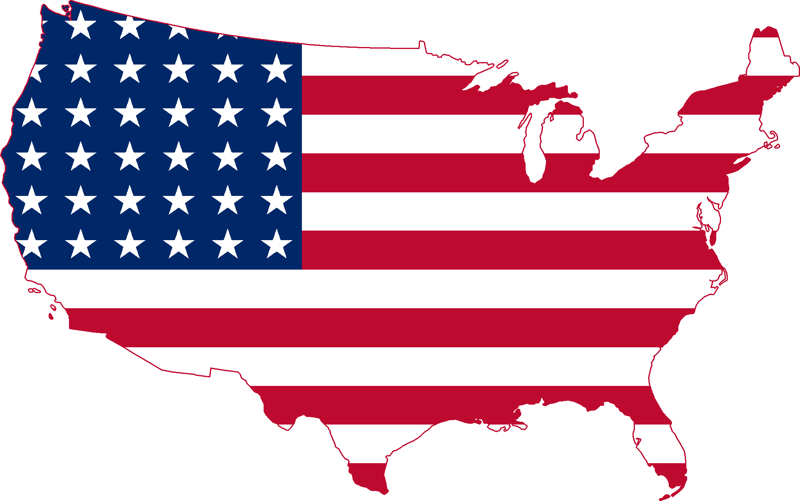
Numbers
over 200 million people worldwide suffer from Osteoporosis
Prevalence of Osteopenia was 46.3% and Osteoporosis 30.7%.
536,000 new fragility fractures each year
30% of all postmenopausal women have osteoporosis and At least 40% of these women and 15-30% of men will sustain one or more fragility fractures in their lifetime

Slide 10
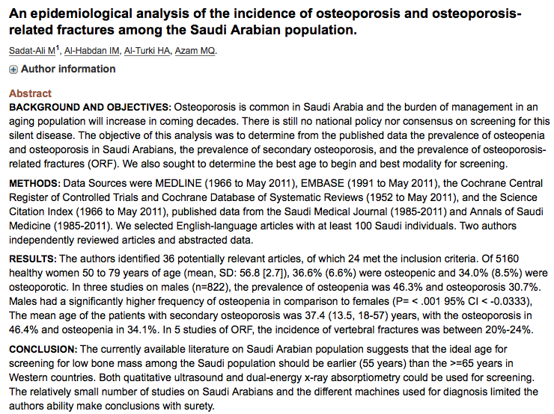

Slide 11
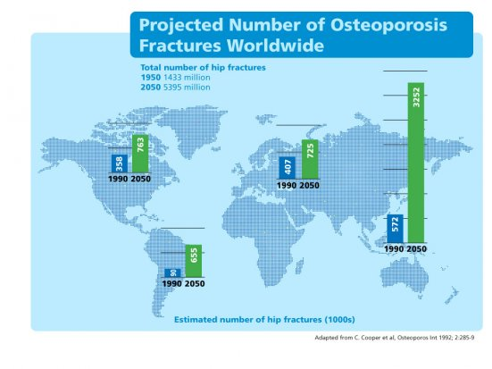
Projections
By 2050, the worldwide incidence of hip fracture is projected to increase by 240% in women and 310% in men

Slide 12
CASE 1
A 58 years old female, came to primary care clinic complaining of back pain. She asked for DEXA.
What questions would you like to ask?
Would you do DEXA for her?
What are the secondary causes of osteoporosis?

Slide 13
HPI:SOCRATES
Previous fragility fracture?
Menstrual history?
Past medical history:
Medications history:
Family history of fractures:

Slide 14
Findings:
History:
Diffuse bone & joint pain, ms weakness, difficulty walking
Onset: Insidious
Site: lower spine, pelvis, lower extremities
Pain: dull aching
Aggravated by activity & weight bearing
Examination:
Tender to palpation
Proximal muscle weakness, wasting, hypotonia, discomfort with movement
Gait: waddling
Notes:
-Evaluate risk factors (FRAX): if moderate (10-20)--> DEXA
-FHx.
2ry causes: DM, hyperpara, hyperthyroid,

Slide 15
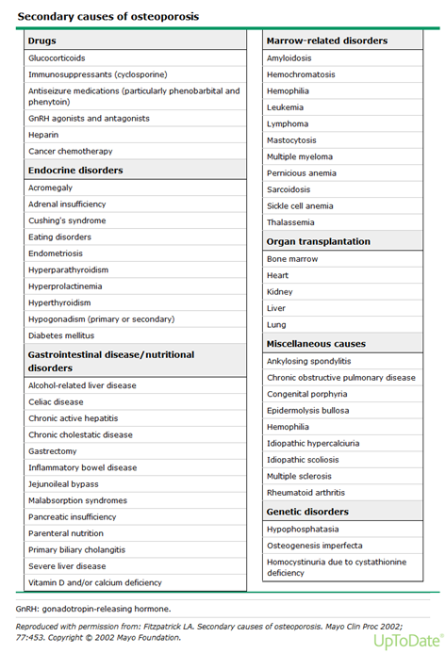

Slide 16
Patients with osteoporosis should have normal serum calcium, phosphorus, and alkaline phosphatase levels. Laboratory abnormalities should prompt a search for an alternative diagnosis.
Notes:
BTMs are not routinely indicated in patients when initiating osteoporosis therapy. However, for individual patients (eg, patients with conditions that might interfere with drug absorption or efficacy) we sometimes measure fasting urinary NTX, serum CTX, or serum PINP before and three to six months after starting bisphosphonates or other antiresorptive therapy. A 50 or 30 percent reduction in urinary NTX excretion or serum CTX, respectively, provides evidence of compliance and drug efficacy.

Slide 17
Diagnosing Osteoporosis
Major features (at least 4 of 5) | Minor features (none required)
The fracture is associated with minimal or no trauma, as in a fall from a standing height or less | Generalized increase in cortical thickness of the femoral diaphyses
The fracture line originates at the lateral cortex and is substantially transverse in its orientation, although it may become oblique as it progresses medially across the femur | Unilateral or bilateral prodromal symptoms such as dull or aching pain in the groin or thigh
Localized periosteal or endosteal thickening of the lateral cortex is present at the fracture site (“beaking” or “ aring”) | Bilateral incomplete or complete femoral diaphysis fractures
Complete fractures extend through both cortices and may be associated with a medial spike; incomplete fractures involve only the lateral cortex | Delayed fracture healing
The fracture is noncomminuted or minimally comminuted

Slide 18
Diagnosing Osteoporosis with DEXA
Dual-energy x-ray absorptiometry (DEXA)
T-score: (used for postmenopausal women and men >50 years)
≥-1.0: normal
<--1.0 to <--2.5: osteopenia
≤-2.5: osteoporosis
≤-2.5 plus fragility fracture: severe osteoporosis
Z-score: (used for premenopausal women, men <50 years, and children)
<-2.0: below expected range, and a cause should be sought
Notes:
a T-score between -1.0 and -2.5 is classified as low bone mass (osteopenia), and a T-score of -1.0 or higher is normal
Many studies have demonstrated that low BMD is associated with an increased risk of fracture [12,15-21]. Individuals with T-scores of ≤-2.5 have the highest risk of fracture. However, because there are more individuals with osteopenia than osteoporosis, the absolute number of fractures in subjects with T-scores in the osteopenia range is greater than in those with T-scores in the osteoporosis range [7-9,22]. Since most fractures occur in patients with T-scores better than -2.5, treatment strategies relying solely on BMD testing will miss many patients at risk for fracture who might benefit from interventions to reduce fracture risk.
FRAX®
predicts the 10-year probability of hip fracture and major
osteoporotic fracture (hip, clinical spine, humerus, or fore-
arm).
https://www.sheffield.ac.uk/FRAX/tool.aspx?country=63

Slide 19
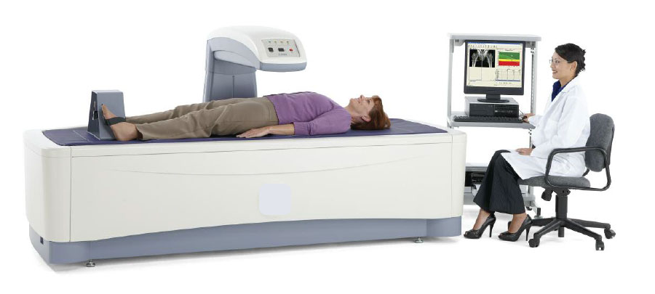
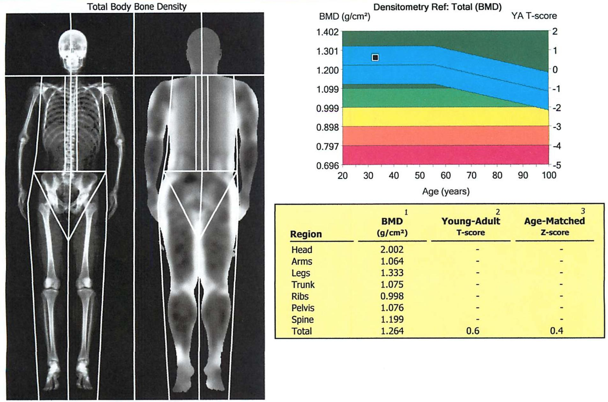
DEXA SCAN

Slide 20
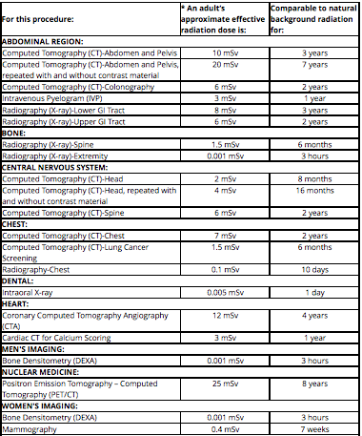
Radiation exposure in DEXA

Slide 21
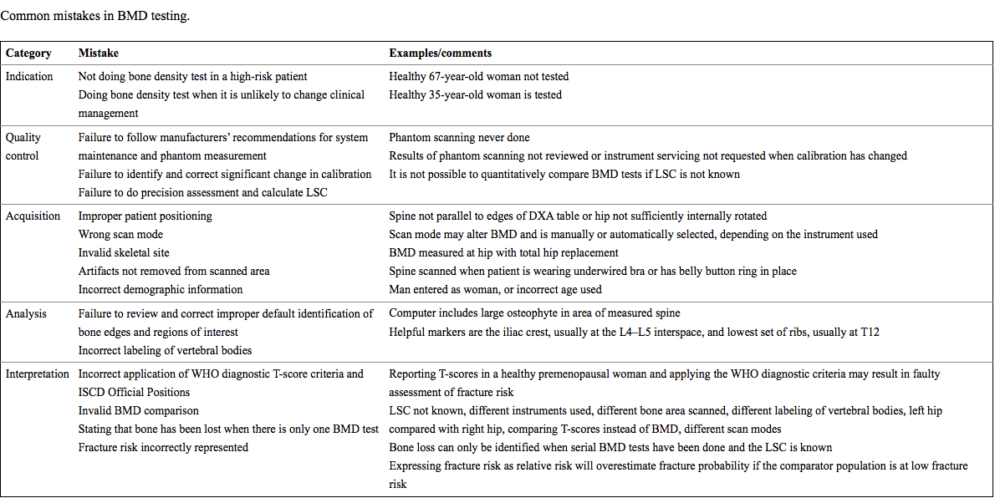
Variability in DEXA results

Slide 22
Case 2
Salha a 78 years old woman came for her regular follow up appointment for hypertension and dyslipidemia at the primary care clinic, and she mentioned that she suddenly developed severe back pain while performing her daily routine activity 2 days ago (while she was lifting her hand bag from the floor).
What investigations will you order?
Indication for X-ray?
Do we need DEXA?
Notes:
Action: pharmacologic therapy like: Injectable agents such as teriparatide, denosumab, or zoledronic acid can be considered as initial therapy for those who have the highest fracture risk (e.g., older women who have had multiple vertebral fractures or hip fractures, or who have very low T-scores),
Do we need DEXA? For baseline it is indicated in All postmenopausal women With a history of fracture(s) without major trauma With osteopenia identified radiographically

Slide 23
Indications for spinal radiograph
Clinical indications for spine radiographs, in the absence of trauma or malignancy, include :
Acute back pain
Focal tenderness
Loss of height(more than 4cam)
Suspected cases of osteoporosis, either primary or due to secondary causes
Spinal x ray would also be appropriate in patients over 50 years of age who have other radiographic features suggesting osteoporosis (thinned cortices, reduced density [radiographic osteopenia], reduced number of trabeculae) in any skeletal site (8-10).
C
Notes:
however , The sensitivity and reliability of standard radiography to assess BMD are poor, and this technique should not be used to diagnose osteoporosis in the absence of vertebral fractures.

Slide 24
Risk factors leading to osteoporotic fractures
Clinical risk factors considered in the FRAX assessment of fracture probability
Age
Sex
Low body mass index (≤19 kg/m2)
Previous fragility fracture, including morphometric vertebral fracture
Parental history of hip fracture
Current glucocorticoid treatment (any dose, by mouth for 3 months or more)
Current smoking
Alcohol intake 3 or more units daily
Secondary causes of osteoporosis including: Rheumatoid arthritis, Type I diabetes, Osteogenesis imperfecta in adults, Long-standing untreated hyperthyroidism , Hypogonadism/premature menopause (<45 years), Chronic malnutrition, Chronic malabsorption and Chronic liver disease
Notes:
Vertebral morphometry is a quantitative method to identify osteoporotic vertebral fractures based on the measurement of vertebral heights.

Slide 25
Factors That Increase Risk of Falling and Fracture
01
Neurologic disorders
Parkinson disease
Seizure disorder
Peripheral neuropathy
02
Medications
Sedatives and hypnotics
Antihypertensive agents
Narcotic analgesics
03
Environmental factors
Poor lighting
Stairs
Slippery floors
Throw rugs
04
others
s
Impaired vision
Impaired hearing
Proximal myopathy

Slide 26
Osteoporotic fractures
Definition of fragility fracture: After ruling out pathologies(like multiple myeloma), any fracture in an adult woman (aside from a fracture of the digits, skull, or face) that occurs from a standing height or less, without major trauma such as a motor vehicle accident, can be considered a low-trauma or fragility fracture.
One in two women and one in five men over the age of 50 are at risk of a fracture due to osteoporosis
Fractures due to osteoporosis occur as a result of reduced bone strength, where a bone is subjected to a force greater than that which it can resist. In other words, a bone can break as the result of a simple fall such as slipping on ice
The lower the bone density, the greater the risk of fracture, but fracture does not depend entirely on having a low bone density. Genetic predisposition, older age, and how likely we are to fall are the main risks for having an osteoporotic fracture.

Slide 27
Common fractures with osteoporosis (fragility fractures)
Hip fracture | Wrist fracture | Spinal (vertebral fractures)
Age: over 75 Hip fractures are the most serious consequence of osteoporosis, increased mortality of 12 to 20% during the following 2 years | Age : in women aged between 40 and 65, and in men over 60, | The most common early consequence of estrogen deficiency. Vertebral fracture is the most common osteoporotic fracture and indicates a high risk for future fractures
usually caused by a fall within the home, | Wrist fractures usually occur due to a fall outdoors, a fall onto the outstretched hand to save oneself and, therefore, are less common in the elderly | often occur while performing routine everyday activities, such as lifting a light load, rather than having a fall,
Treatment: -require a surgical operation to stabilize the fracture. -(hip screws and plate or joint replacement) | Treatment: -may need surgical intervention sometimes, Usually treated by applying plaster cast on outpatient basis | Spinal fractures can cause loss of height and kyphosis , and Due to the change in shape of the spinal bones, the back muscles have to work harder and this can lead to chronic pain. Treatment: focused on pain control and rehabilitation
Notes:
Fractures occur earliest at sites where trabecular bone contributes most to bone strength;

Slide 28
Fracture risk should be assessed in:
1. Fracture probability should be assessed in postmenopausal women, and men age 50 years or more, who have risk factors for fracture, using FRAX. In individuals at intermediate risk, bone mineral density (BMD) measurement should be performed using dual-energy X-ray absorptiometry and fracture probability re-estimated using FRAX.
2. Vertebral fracture assessment should be considered in postmenopausal women and men age >50 years if there is a history of ≥4cm height loss, kyphosis, recent or current long-term oral glucocorticoid therapy, or a BMD T-score ≤ -2.5.

Slide 29
FRAX
Estimates the 10-year probability of hip fracture and major osteoporotic fracture (hip, clinical spine, proximal humerus, or forearm) for untreated patients between ages 40 and 90 years using easily obtainable clinical risk factors for fracture.
The current National Osteoporosis Foundation Guide recommends treating patients with FRAX 10-year risk scores of > or = 3% for hip fracture or > or = 20% for major osteoporotic fracture, to reduce their fracture risk.

Slide 30
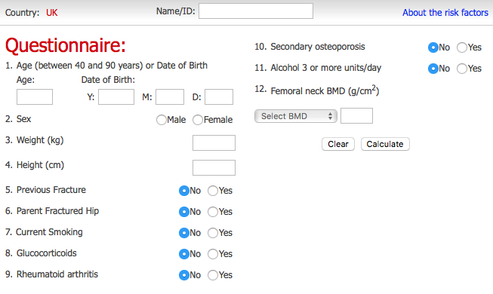
https://www.sheffield.ac.uk/FRAX/tool.aspx

Slide 31
Case 3
A 68-year-old women, otherwise healthy with no medical problems seeking your advice regarding bone health. She smokes water pipe regularly and she isn’t taking any treatment. Physical examination was negative, her body mass index (BMI) is 42 kg/m2.
How would you manage her?

Slide 32
Management
Medication
Lifestyle
Vitamin D
Supplementations
Follow up

Slide 33
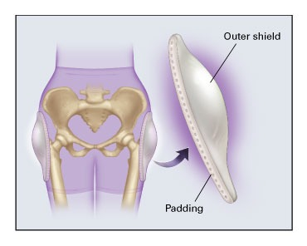
Management
Lifestyle
Smoking
Alcohol to ≤2 units/day
Diet
Coffee
Fall Prevention
Exercise
Notes:
Smoking accelerates bone loss
Alcohol increase risk of fracture, falling, poor nutrition.
Weight bearing Exercise improves the bone mass ,maintain bone density, increased muscle strength and decrease the risk of fall.
It is recommended to exercise for at least 30 minutes, three times per week.
Adequate dietary intake of Ca and VitD
Daily intake of 330 mg of caffeine, equivalent to 4 cups (600 ml) of coffee, or more may be associated with a modestly increased risk of osteoporotic fractures, especially in women with a low intake of calcium.

Slide 34
Management
Medication
Bisphosphonates (e.g. Alendronate) | Analogues of inorganic pyrophosphate that inhibit bone resorption.
SERMs (e.g. Raloxifene ) | Selective oestrogen receptor modulator and inhibits bone resorption.
Teriparatide | Recombinant human parathyroid hormone [PTH]
Denusomab | Monoclonal antibody that decreases osteoclast activation
Notes:
Teriparatide: when administered intermittently, has anabolic skeletal effects which are most marked in cancellous bone.

Slide 35
Alendronate (Fosamax)
10 mg daily or 70 mg once a week by mouth for the treatment of osteoporosis
5 mg daily prevention of osteoporosis
Alendronate should be taken after an overnight fast and at least 30 minutes before the first food or drink (other than water) of the day or any other oral medicinal products or supplementation (including calcium).
Side effects:
Mild upper gastrointestinal events, esophageal ulcerations, perforations, bleeding events, muscular and joint pains
Contraindications:
Abnormalities of the esophagus; inability to stand or sit upright for at least 30 minutes.

Slide 36
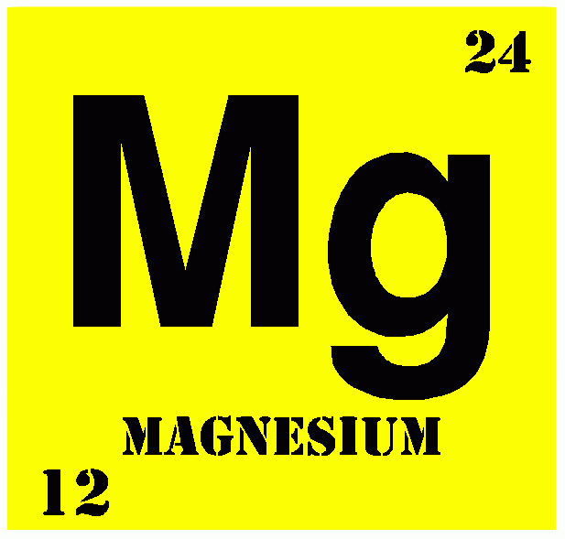
Management
Considered low if < 20 ng/mL
Vitamin D
Importance:
enhance the response to bisphosphonate therapy and prevent fractures.
The dose needed to correct deficiency varies among individuals, Recent results suggest doses greater than 1,000 IU or even 4,000 IU of vitamin D per day may be needed
A meta-analysis of studies in postmenopausal women found a significant reduction in hip and non-vertebral fractures with vitamin D supplementation at doses ≥700 to 800 IU/day
some studies have also shown improvement in muscle strength, balance, and fall risk as well as survival
Notes:
Magnesium is necessary to activate all the enzymes that metabolize vitamin D.
a deficiency of magnesium is usually associated with low production of active vitamin D metabolites or by-products
Vitamin K is responsible for routing the calcium to where it is needed in the body, so that it doesn’t go where it shouldn’t, like your organs and arteries

Slide 37
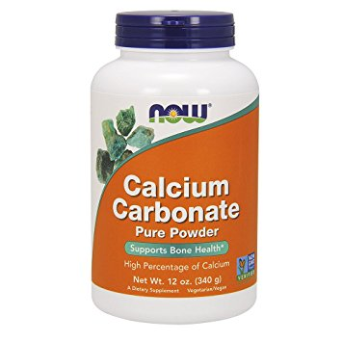
Management
Supplementations
The WHI study showed a small but significant increase in hip BMD (1%) in the group that received 1,000 mg of calcium and 400 IU of vitamin D per day.
Calcium supplementation has been shown to slightly increase BMD, and a recent meta-analysis showed a 15% reduced risk of total fractures
Calcium, For adults aged 50 years and older, the recommended calcium intake is 1,200 mg/day, increase BMD, 15% reduced risk of total fractures
Magnesium is indicated for individuals who are at risk for hypomagnesemia.
Vitamins A and K
taken it with food or following meals
Common side effects include upset stomach and metallic taste
Notes:
Supplementation as an adjunct to other treatments for osteoporosis

Slide 38
Management
Follow up
AACE/ACE recommend follow-up DXA every 1 to 2 years or at a less-frequent interval, depending on clinical circumstances.
Follow-up of patients should ideally be conducted in the same facility with the same machine

Slide 39
Summery
Osteoporosis has no clinical manifestations until there is a fracture
Osteoporosis is characterized by low bone mass, microarchitectural disruption, and increased skeletal fragility. A clinical diagnosis of osteoporosis may be made in the presence of a:
Fragility fracture
T-score ≤-2.5 standard deviations (SD) at any site based upon bone mineral density (BMD) measurement
Bone mineral density screening should be offered to patients with risk factors for osteoporosis and to all women older than 65 years.

Slide 40
Question
A 60-year-old woman presents with the results of her DEXA scan.She has a T score of –1.5 SD at the hip and –2.5 at the spine. Which of the following is the most accurate interpretation of these results?
She has osteoporosis at the spine and osteopenia at the hip.
She has osteoporosis in both areas.
This is a normal examination.
She has osteoporosis of the hip and osteopenia at the spine.
You need to know the Z score.
Notes:
Correct answer is A

Slide 42
Videos
https://www.youtube.com/watch?v=dMI8mGk1QuY
https://www.youtube.com/watch?v=wdqATU1Sz_E
https://www.youtube.com/watch?v=c5tc01WFYks
https://www.youtube.com/watch?v=BNDTPeZNRVA

Slide 43
REFERENCES
Uptodate
NOGG guideline 2017
International OSteoporosis Website
Hallström H, Wolk A, Glynn A, Michaëlsson K. Coffee,tea and caffeine consumption in relation to osteoporotic fracture risk in a cohort of Swedish women. Osteoporos Int. 2006;17:1055-1064.
AACE/ACE Guidelines
https://www.urmc.rochester.edu/encyclopedia/content.aspx?contenttypeid=40&contentid=OsteoporosisBonesQuiz
https://www.mdedge.com/ccjm/article/95089/endocrinology/bone-density-vs-bone-quality-whats-clinician-do
http://jaoa.org/article.aspx?articleid=2093588

Slide 44
Thank you.

