Slide 1
Neurocognitive Disorders
Dr. Mohammed Alblowi
SB-Psych
Consultation Liaison Psychiatry – Queen’s University
Neuropsychiatry – University of Western Ontario

Slide 4
Cognitive functions
Attention
Concentration
Memory
Speed of Processing
Orientation
Perseveration
Impulsiveness
Language Processing
“Executive functions”

Slide 5
Neurocognitive Disorders
Cognitive deficits are present in many mental disorders but only disorders whose core features are cognitive are included in the NCD category.
The cognitive decline was not present from birth or very early in life therefore represent a decline from a previously attained level of functioning.

Slide 6
Topics:
Delirium
Major NCDs (dementias and amnestic syndrome).
Mild NCDs.
Seizure
TBI.

Slide 7
81 year old man with diagnosis of Benign Prostate Hypertrophy and Hypertension, came in with 3 days history prior to admission of:
low-grade fever and nocturia.
Poor sleep. (Daughter gave him diphenhydramine for sleep).
On day of admission, became confused, had high grade fever. No loss of consciousness, vomiting
Past medical history: Hypertension
Personal/ Social History: Smoke tobacco
In hospital, diagnosed to have UTI and acute urinary retention.
6 hours after admission, became combative, agitated, confused. Pulled out IV and insisted on going home

Slide 9
Many terms are used to describe this disorder:
Acute confusional state
acute organic syndrome
Acute brain failure.
Acute brain syndrome.
Acute cerebral insufficiency.
Exogenous psychosis.
Metabolic encephalopathy.
ICU psychosis
Toxic encephalopathy.

Slide 10
The Diagnostic and Statistical Manual of Mental Disorders, Fifth Edition (DSM-5)diagnostic criteria for delirium is as follows
Disturbance in attention (ie, reduced ability to direct, focus, sustain, and shift attention) and awareness.
Change in cognition (eg, memory deficit, disorientation, language disturbance, perceptual disturbance) that is not better accounted for by a preexisting, established, or evolving dementia.
The disturbance develops over a short period (usually hours to days) and tends to fluctuate during the course of the day.
There is evidence from the history, physical examination, or laboratory findings that the disturbance is caused by a direct physiologic consequence of a general medical condition, an intoxicating substance, medication use, or more than one cause.

Slide 11
Clinical features
Acute onset of mental status change with fluctuating course.
Attentional deficits.
Confusion or disorganized thinking.
Perceptual disturbances.
Disturbed sleep/wake cycle. ( sundowning phenomena)
Altered psychomotor activity.
Disorientation and memory impairment.
Behavioral and emotional abnormalities.
Other cognitive deficits

Slide 12
Epidemiology
Prevalence of delirium
Delirium complicates at least 25% of all hospitalizations in the elderly
Fong et al 2009

Slide 13
Importance
Previous studies 32%-66% of cases are unrecognized by Medical Staff
↑ morbidity and mortality
↑ length of stay
↑ rates of admission to long term care facilities
20% of patients discharged post hip # still had evidence of delirium (Journal of American Geriatric Society 2001 May;49(5):678-9).

Slide 14
Types:
Hyperactive (30%) | The most clear and least controversial.
Hypoactive (24%) | The most difficult type to identify. A large percentage of these patients are inappropriately diagnosed and treated as depressed. Classically, these patients present with symptoms that are commonly associated with depression (lethargy, apathy, decreased level of alertness, psychomotor retardation, and decreased speech production).
Mixed (46%) | Waxing and waning ‌ pattern. Commonly seen in surgical patients (agitated at times, with alternating episodes of hypoactivity).

Slide 16
Predisposing risk factors
>60 years of age
Male sex
Visual impairment
Underlying brain pathology such as stroke, tumor, vasculitis, trauma, dementia
Major medical illness
Recent major surgery
Depression
Functional dependence
Dehydration
Substance abuse/dependence
Hip fx
Metabolic abnormalities
Polypharmacy

Slide 17
Management
Treatment of the underlying medical cause

Slide 18
Non-Pharmacological
Symptomatic measures involving attention to fluid and electrolyte balance, nutritional status, and early treatment of infections.
environmental interventions.
Reduce unfamiliarity by providing a calendar, a clock, family pictures, and personal objects.
Maintain a moderate sensory balance in the patient by avoiding sensory overstimulation or deprivation.
Minimize staff changes, limit ambient noise and the number of visits from strangers, and provide a radio or a television set, a nightlight, and where necessary, eyeglasses and hearing aids.
Proper communication and support are critical with these patients

Slide 19
Pharmacological
All the patient’s medications should be reviewed, and any unnecessary drugs should be discontinued.
These patients should receive the lowest possible dose and should not get drugs such as phenobarbital or long- acting benzodiazepines.
Often used is haloperidol starting at 0.25 mg daily. Haloperidol may be repeated every 30 minutes, PO or IM.
The atypical antipsychotics—risperidone, olanzapine, quetiapine, and aripiprazole—may be used at low doses.

Slide 21
Major NCDs

Slide 22
Why changing names
Dementia typically refers to degenerative d/o in elderly
DSM expands category to d/o of younger –
e.g. HIV, traumatic brain injury.
More global.
Individuals with substantial decline in a single domain can receive diagnosis

Slide 23
Characteristic :
Significant Cognitive Decline
Interfere with independence
Not due to delirium
Not due to other mental disorder

Slide 24
Cognitive domains:
Complex attention
Executive function
Learning & memory
Language
Perceptual-motor
Social cognition

Slide 25
Dementia:
A chronic global impairment of cognitive functions without disturbed consciousness.
The essential feature is a loss of intellectual abilities of sufficient severity to interfere with social or occupational functioning or both.

Slide 26
In early stages
Gradual loss of social and intellectual skills (first noticed in work setting where high performance is required).
Decrease in the range of interest and enthusiasm.
Mood changes (depressed, irritable, or easily provoked).
Multiple somatic complaints with vague psychiatric symptoms.

Slide 27
In late stages, cognitive disturbances emerge:
Memory impairment (short-term memory first then, in advanced stages long-term memory is affected).
Thinking and speech: inappropriate repetition of the same thoughts (perseveration) with vague and imprecise speech.
Significant change in mood and behavior: shrinkage of social interaction with catastrophic reaction (agitation under stressful circumstances secondary to the subjective awareness of intellectual deficits )
Judgment impairment.
Psychotic features: hallucinations and delusions.
Disorientation: particularly to time, and when severe to place and person.

Slide 28
Epidemiology:
No gender difference
Increasing age is the most important risk factor. It is primarily a disorder of the elderly ( if < 65 years, it is called presenile dementia).
3.1/ 1000 person years at age 60-64
175.0/ 1000 person years at age 95+

Slide 29
The most common causes of dementia :
Alzheimer’s disease: continuous deterioration of intellectual functioning due to degenerative process affecting the whole cortex, especially cholinergic neurons.
Vascular (multi-infarct) dementia: stepwise deterioration of intellectual functioning due to multiple infarcts of varying sizes or arteriosclerosis in the main intracranial vessels. It usually occurs in patients with hypertension or diabetes.
Medical conditions: e.g. metabolic causes: vitamin deficiency (e.g. B12), hypothyroidism.

Slide 30
Differential diagnosis:
Normal aging: age-related cognitive decline (the course is not progressively deteriorating), no loss of social or occupational functioning.
Depression in the elderly (Pseudo-dementia): cognitive disturbance is relatively of rapid onset and preceded by depressive features. The differentiation is sometimes difficult as demented patients may also become depressed as they begin to comprehend their progressive cognitive impairment. EEG and CT scan are normal in pseudo-dementia.
Delirium: the onset is rapid and consciousness is impaired. Some demented patients may develop delirium. Diagnosis of dementia cannot be made before delirium clears.

Slide 32
Treatment:
First, Identify and correct any treatable or controllable condition e.g.: hypothyroidism, vitamin B12 deficiency, hypertension, diabetes.
Supportive measures:
provide good physical care (meals, hygiene, …).
encourage the family’s involvement.
support the care givers (they are prone to depression).
keep in familiar settings if possible to avoid accidents, wandering away,…etc.

Slide 33
Symptomatic treatment:
If agitated, aggressive, or insomniac: give a small dose of antidopaminergic drug (e.g. olanzapine 5mg, risperidone 2mg, or quetiapine 25mg). If depressed: give a small dose of antidepressant (e.g. escitalopram 5 mg or sertraline 25mg). Be aware of possible mental side effects of such medications e.g. confusion, over-sedation, risk of falling down.
Memory-enhancing medications (mainly for Alzheimer’s dementia); Cholinesterase Inhibitors :
Donepezil (Aricept): 5 mg at night & can be increased gradually to 10 mg. It is well tolerated (S/E: diarrhea , weight loss ,bradycardia ,and syncope).
Rivastigmine ( Exelon ):1.5 mg twice/day & can be increased gradually to maximum 6mg twice/day (S/E: anorexia , fatigue , somnolence, and dizziness )
Galantamine ( Reminyl):4mg twice/day & can be increased gradually to 12mg twice/day (S/E: similar to rivastigmine )
Memantine (Epixa, Akatinol): an N-methyl-D-aspartate (NMDA) receptor antagonist , protects neurons from neurodegenerative process induced by glutamate excitotoxicity.

Slide 34
Amnestic syndrome :

Slide 35
Characteristic:
It is a major NCD due to another medical condition.
impaired short-term memory due to a specific brain insult, in the absence of generalized intellectual impairment.
The immediate memory (frontal lobe function) is usually intact: i.e. digit span test is normal.
It is often known as Wernicke – Korsakoff’s syndrome.

Slide 36
Wernicke’s encephaopathy
an acute syndrome
Characterized by impairment of 1- memory
2- ataxia
3- ophthalmoplegia

Slide 37
Korsakoff’s psychosis
Chronic memory defect.
Peripheral neuropathy
Irritability

Slide 39
Treatment & prognosis:
• Identify and reverse the cause if possible.
• Thiamine supply (if due to thiamine deficiency).
• Supportive medical measures (no specific treatment).
Prognosis: Good vs Bad

Slide 40
Mild Neurocognitive Disorder
A. Evidence of modest cognitive decline from a previous level of performance in one or more cognitive domains (complex attention, executive function, learning and memory, language, perceptual motor, or social cognition) based on:
1. Concern of the individual, a knowledgeable informant, or the clinician that there has
been a mild decline in cognitive function; and
2. A modest impairment in cognitive performance, preferably documented by standardized neuropsychological testing or, in its absence, another quantified clinical assessment.
B. The cognitive deficits do not interfere with capacity for independence in everyday activities (i.e., complex instrumental activities of daily living such as paying bills or managing medications are preserved, but greater effort, compensatory strategies, or accommodation may be required).
C. The cognitive deficits do not occur exclusively in the context of a delirium.
D. The cognitive deficits are not better explained by another mental disorder (e.g., major depressive disorder, schizophrenia).
Specify etiology whether due to: Alzheimer’s disease, Lewy body disease, vascular disease, traumatic brain injury, substance/medication use, Parkinson’s disease, Huntington’s disease, another medical condition, multiple etiologies, unspecified.

Slide 41
Epilepsy:

Slide 42
Complex partial seizure:
Episodic brief recurrent attacks stereotypic in nature associated with paroxysmal discharges of epileptic foci
Usually located in limbic structure, particularly the temporal lobes (70 % arise from temporal lobe; therefore, it is commonly called temporal lobe epilepsy).
Complex partial seizures, the most common focal seizures found in adults (30 % of all adult epileptics), may appear at any age; onset is usually in adolescence. Seizure may be triggered by bright lights, colors, noises, trauma, or intense emotions.

Slide 43
Features: (depend on the site of the focus)
Pre-ictal: irritability, lethargy and dizziness.
Aura: epigastric discomfort associated with distortion of sensations; visual, auditory, gustatory, olfactory or tactile.
Ictus:
behavior disturbances: repetitive movements, e.g. chewing, grimacing, automatism.
confusion and disturbed consciousness.
fear, panic, derealization, memory disturbance.
thinking disturbances.
hallucinations .

Slide 44
Possible Causes:
Perinatal injuries.
Prolonged febrile convulsions (lead to mesiotemporal sclerosis).
Trauma to the base of the skull.
Hamartomas of temporal lobe, fibrosis or gliosis.
Hippocambal sclerosis.
Vascular malformation

Slide 45
Diagnosis:
This type of seizure disorder may mimic and be confused with any psychiatric disorder:
1- Psychosis: schizophrenia, mood disorder, brief psychosis, etc.
2- Neurosis: panic disorder, generalized anxiety disorder, depersonalization disorder, …etc.
Diagnosis is mainly clinical; EEG findings are not necessary for diagnosis. (EEG with sphenoidal or nasopharyngeal leads, shows temporal area spikes).

Slide 46
Management:
Proper assessment of all aspects of the patient’s life.
Anticonvulsants e.g. carbamazepine (Tegretol) 200 - 400 mg twice or three times per day.
Neurology consultation is helpful.

Slide 47
Traumatic Brain Injury

Slide 48
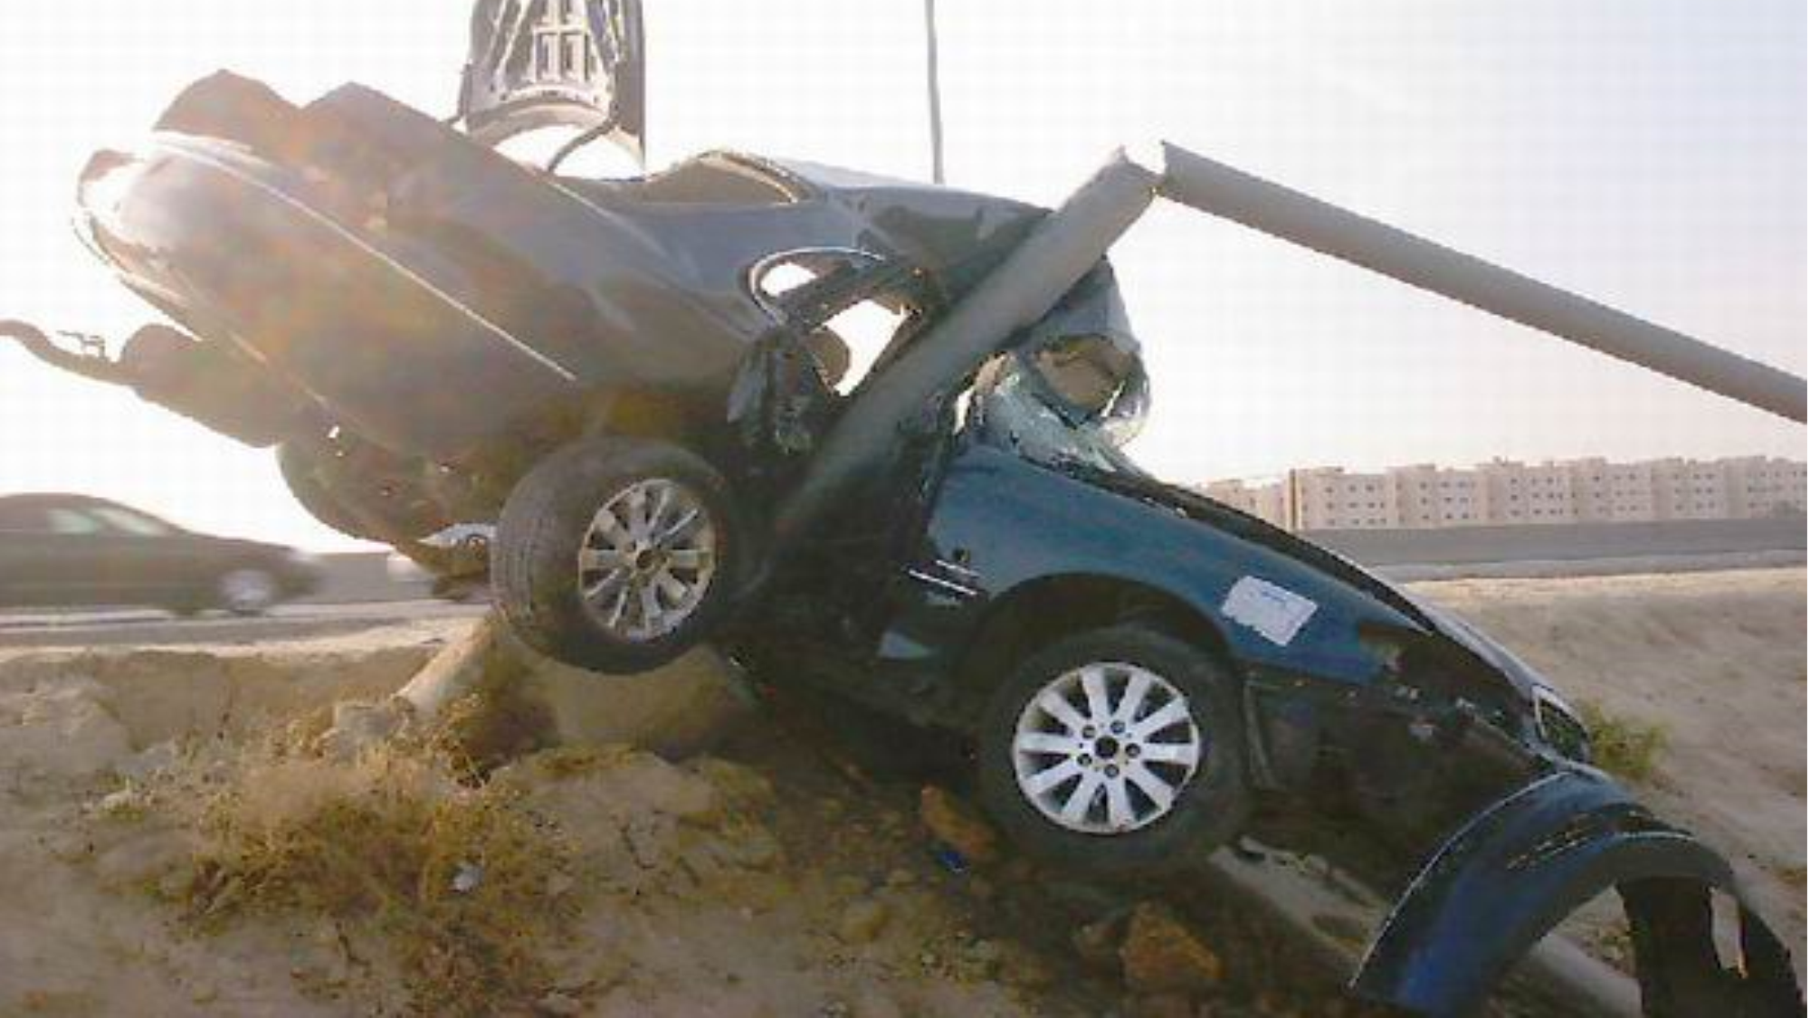

Slide 49
Definition:
an insult to the brain from an external mechanical force, possibly leading to permanent or temporary impairment of cognitive, physical, and psychosocial functions, with an associated diminished or altered state of consciousness
Area of function affected:
1- Cognitive
2- Sensory/perceptual
3- Seizures
4- Other physical changes
5- Social-emotional

Slide 50
Acute consequences:
Impaired consciousness in varying duration (hours, days, weeks or months) long duration suggests poor prognosis.
Delirium (after severe head trauma).
Memory defects : on recovery of consciousness, defects of memory are usually present.
anterograde (post-traumatic) amnesia:
amnesia for events in the time between the trauma and the resumption of normal continuous memory. It is a good prognostic factor: probably full recovery when anterograde amnesia was less than 12 hours.
retrograde amnesia:
amnesia for events in the time between the trauma and the last clearly recalled memory before the injury. It is not a good predictor of outcome.

Slide 51
Chronic Consequences:
Lasting cognitive impairment: there is more likelihood of cognitive impairment when the injury has caused a prolonged post traumatic amnesia (of more than 24 hours).Cognitive impairment was particularly associated with parietal and temporal damage, especially on the left side. Recovery of function may be very slow and may continue over the years.
Emotional disturbances:
Depressive, anxiety and phobic features are common, and associated with somatic complaints such as headache, fatigue and, dizziness.
Personality changes:
There may be irritability, reduced control of aggressive impulses, sexual disinhibition and some coarsening of behaviour and premorbid personality traits, particularly after frontal lobe injury.

Slide 52
Con’t
Psychotic features:
Depression with psychotic features (associated with non-dominant frontal damage). Paranoid Psychosis (associated with temporal lobe damage).
Social consequences:
Many patients and their relatives experience severe distress of head injury, and have to make substantial changes in their way of life.
Medico-legal aspects:
Compensation issue is more likely to contribute to disability if the patient feels someone else is at fault, financial compensation is possible, low social status and in industrial injury.

Slide 53
Factors affecting the outcome of head trauma:
Loss of consciousness and post-traumatic amnesia.
Amount and location of brain damage.
Premorbid personality and past psychiatric history.
Development of seizures.
Medico-legal factors e.g. compensation.

Slide 54
Management:
Pharmacotherapy.
physical therapy.
occupational therapy.
Recreation therapy.
speech therapy.
Cognitive rehabilitation especially during the first 6 months after injury.

