Slide 1
Approach to Obese Patient
Supervised by: Dr Saad Alsaad
Moath Baeshan, Mohammad Alzahim and Khalid Alduraibi

Slide 2
Objectives
To define obesity and classify the degree of obesity based on BMI, waist circumference and waist-hip-ratio.
The prevalence of obesity in Saudi Arabia.
Methods to prevent obesity in the community.
Common causes of obesity in the community.
Common health problems associated with obesity.
The evidence based approach to reducing weight (exercise, dieting, drug treatment, and bariatric surgical intervention)
The roles of health team, medical students, and school health professionals in addressing the problems of obesity in the community

Slide 3
Question
How to calculate BMI?
Notes:
A

Slide 4
MCQ 1
Which of the following patients should receive pharmacotherapy?
BMI 28 with DM
BMI 24 with DM
BMI 26 with no other diseases
BMI 28 with no other diseases
Notes:
A

Slide 5
MCQ 2
Which of the following is NOT considered a primary prevention method in obese patients?
Healthy diet
Physical activity
Bariatric surgery
Breastfeeding
Notes:
C

Slide 6
MCQ 3
Which of the following is considered a ‘very low calorie diet’ ?
800-1200 kcal/day
1000-1500 kcal/day
<800 kcal/day
<600 kcal/day
Notes:
C

Slide 7
MCQ 4
Which of the following is the role of a medical student in addressing obesity?
Promoting Healthy Nutrition at School
Create non-judgmental atmosphere
Consider barriers people might have
Be a role model
Notes:
C

Slide 8
MCQ 5
How many calories should be consumed per day in the 1st month after bariatric surgery?
2000-2500 kcal/day
1500-2000 kcal/day
1000-1500 kcal/day
400-800 kcal/day
Notes:
C

Slide 9
?
What is Obesity?
Is obesity the same as being overweight?

Slide 10
Obesity Definition
Obesity is defined as abnormal or excessive fat accumulation that may impair health.
It’s also defined by a BMI of greater than or equal to 30.

Slide 11
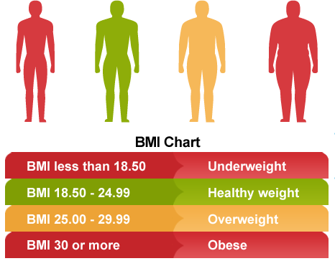
Obesity Classification
Weight (Kg)
Height² (m²)
Based on BMI
=

Slide 12
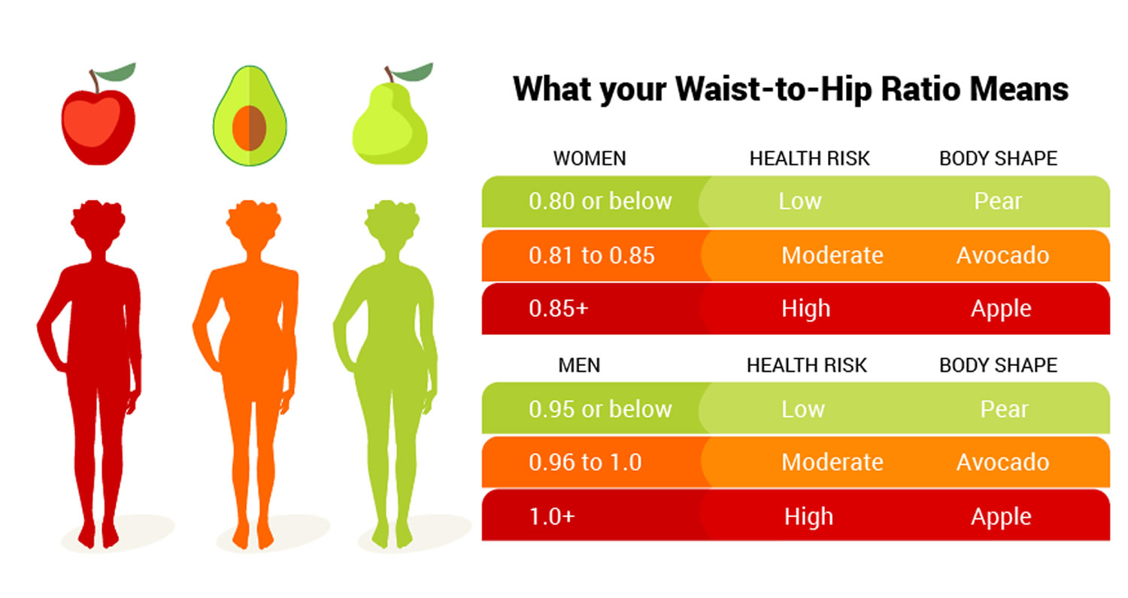
Obesity Classification
Based on Waist Hip Ratio

Slide 13
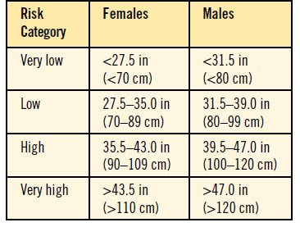
Obesity Classification
Waist Circumference

Slide 14
Obesity Prevalence
2014 nationally (10,735) Male 24.1% and Female 33.5% > 28.7%.Memish et al. (2014)
2014 Riyadh, Jeddah, and Al-Khobar (2,908)
Obesity: Male = 24.1%; Females = 14%
Prevalence of overweight equals 20.8% and 19.5%
Prevalence of abdominal obesity equals to 30.3% and 38.7% in females and males respectively).
Al-Hazzaa et al. (2014)
The overall obesity will increase to 41% in men and 78% in women by 2022.Al-Quwaidhi et al. (2014)
And if things continue as they are
KSA

Slide 15
How To Prevent
Obesity in the community ?
Primary Prevention:
Education:
Maintaining a balanced diet and a healthy behavior Special consideration for children:
Avoid using food as a reward.
Encouragement of healthy food consumption.
Exercising and active life style:
Walk and exercise for 30 minute or more, 5 days a week.
Reduce time spent in front of TV, computer, and mobiles.
Breastfeeding:
A recent systematic review however found only a 10 percent reduction of overweight children with long term breastfeeding

Slide 16
How To Prevent
Obesity in the community ?
Secondary Prevention:
Exercise
Diet
Drug Management
Bariatric surgery

Slide 17
How To Prevent
Obesity in the community ?
Tertiary Prevention:
Decreasing the progression to more severe obesity
Reducing the likelihood of associated musculoskeletal, metabolic, or vascular disorders (e.g., osteoarthritis, diabetes, or cardiovascular disease).

Slide 18
Obesity Causes

Slide 19
Behavioural causes
Cultural
Other (less common)
Saudi cuisine
Junk food
Ceremonies
Unhealthy diet (high caloric intake)
Low physical activity
Sedentary lifestyle
Smoking cessation
Hypothyroidism
Cushing’s syndrome
PCOS
Insulinoma
Drugs
Steroids
Sulphonylureas
Insulin
Contraceptives
Obesity Causes
Genetic
Childbirth
Notes:
Nicotine speeds up metabolism
Reduce appetite
Habit you may crave high-calorie foods to replace cigarettes.
Childbirth: low thyroid function, Stress, Dec sleeping hour

Slide 20
Obesity associated Health problems

Slide 21
Obesity associated Health problems
Polycystic ovarian syndrome (PCOS)
Breathlessness and sleep apnoea
Mortality (BMI >30 kg/m²)
Coronary heart disease
Hypertension
Cancers (breast in post-menopause, endometrium, colon, oesophagus)
Type 2 DM
Dyslipidaemia
Gallbladder disease
Osteoarthritis (knee)
Gout / hyperuricaemia

Slide 22
Evidence-based approach
to decrease weight
Diet
Physical activity
Medications
Bariatric surgery
Behavioural therapy

Slide 23
Diet
Low calorie diet (800-1800 kcal/day)
Very low calorie diet (<800 kcal/day)
Requires supervision
Not for more than 12 weeks
Used when weight loss has plateaued
Notes:
(SIGN guidelines)
Book
Normal: F 2000 M 2500

Slide 24
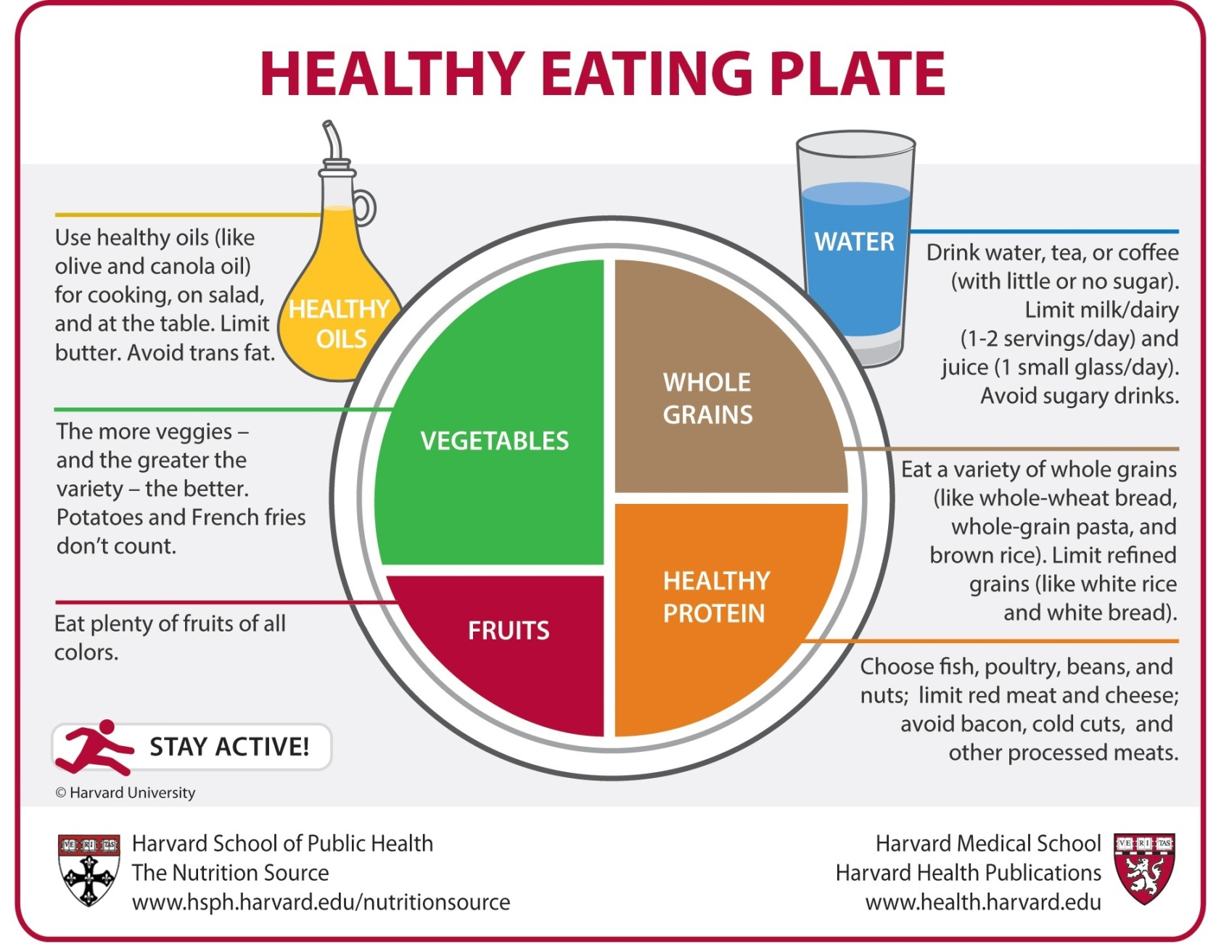
Healthy Eating Plate

Slide 25
Food Composition
Healthy eating plate requires some amendments for obese patients.
Carbohydrates: < 30g/day
Fat: < 30% of total daily caloric intake
Notes:
Low carb diet is better than low fat diet
(SIGN guidelines)

Slide 26
Exercise
For a normal adult: 30 min/day for at least 5 days/week (150 min/week)
For an obese adult: 40-50 min/day for at least 5 days/week (200-250 min/week)
Exercise alone is not effective in losing weight.
Notes:
Scottish Intercollegiate Guidelines Network. Management of obesity: a national clinical guideline. Scottish Intercollegiate Guidelines Network; 2010
(SIGN guidelines)

Slide 27
Benefits of Exercise
Reduction in the risk of:
DM
CHD
Osteoporosis
Some cancers
Management of:
Hypertension
Hypercholesterolaemia
DM
Arthritis
Notes:
Colon (40%), breast and prostate
Arthritis (maintain range of motion)

Slide 28
Diet or Exercise
Diet only: short term effects unless maintained.
Exercise only: help in preventing weight gain but not in significant weight loss.
Therefore, both of them are required as lifestyle modifications for obesity.
Notes:
Alfadda AA, Al-Dhwayan MM, Alharbi AA, Al Khudhair BK, Al Nozha OM, Al-Qahtani NM, Alzahrani SH, Bardisi WM, Sallam RM, Riva JJ, Brożek JL. The Saudi clinical practice guideline for the management of overweight and obesity in adults. Saudi medical journal. 2016 Oct;37(10):1151.

Slide 29
Lifestyle Modification
Aim: weight loss of 0.5-1 kg/week till the target BMI is reached.
Adjuncts to diet and exercise: behavioural therapy

Slide 30
Pharmacotherapy
When to use:
BMI ≥30 kg/m2
BMI ≥27 kg/m2 + obesity-related comorbidity

Slide 31
Medications
Orlistat:
Acts by inhibiting Lipase in the GI tract, thus preventing fat absorption.
Inhibits absorption of fat-soluble vitamins (A,D,E,K), thus, they should be supplied.
Should be used as an adjunct to diet and exercise
Other:
Naltrexone/bupropion (US and EU approved)
Liraglutide (US and EU approved)
Notes:
High-dose liraglutide, a glucagon-like peptide-1 receptor agonist
Frantzides C, Luu M. Obesity in Adults [Internet]. London: BMJ Publishing Group Ltd. 2015 [cited 2015 Jun 9]. Available from: Best Practice

Slide 32
Bariatric Surgery
When to consider?
BMI ≥ 40 kg/m2
or BMI ≥35 kg/m2 with obesity-related comorbidity (e.g., hypertension, diabetes, sleep apnoea, GORD)
When non-surgical methods have failed.

Slide 33
Bariatric Surgery
How does it reduce weight? Reduces food intake by altering hunger and satiety.
Techniques: (Laparoscopic vs open)
Sleeve gastrectomy (USA, KSA)
Gastric bypass
Adjustable gastric banding (UK)
Revisions
Biliopancreatic diversion/duodenal switch
Notes:
through changes to the stomach, small intestine, or a hybrid of both.
They can be broadly categorized into restrictive operations, malabsorptive operations, and combination operations
Al Kadi, A., Siddiqui, Z. R., Malik, A. M., & Al Naami, M. (2017). Comparison of the efficacy of standard bariatric surgical procedures on Saudi population using the bariatric analysis and reporting outcome system. Saudi medical journal, 38(3), 251-256.

Slide 34
Bariatric Surgery

Slide 36
Bariatric Surgery
After discharge:
Diet
Immediate
Full liquid diet for 2-3 weeks.
Gradually changed to soft, solid food (salads, fruits, vegetables and soft proteins)
400-800 kcal/day for the 1st month.
Notes:
Soft proteins: Mashed potatoes, Hummus, tomato soup, Youghurt
Discharge: 4-6 days

Slide 37
Bariatric Surgery
After discharge:
Diet
In the 1st 12 months:
Healthy diet
No meals skipping
Regular dietician visits.

Slide 38
Bariatric Surgery
After discharge:
1. Diet
For epigastric pain and vomiting:
Eat slowly
Stop eating once they reach satiety
No food and beverages at the same time
Notes:
Chew your food adequately
Wait about 30 minutes after a meal to drink anything and avoid drinking 30 minutes before a meal.
Dumping syndrome. If too much food enters your small intestine quickly, you are likely to experience nausea, vomiting, dizziness, sweating and diarrhea. Eating too much or too fast, eating foods high in fat or sugar, and not chewing your food adequately can all cause nausea or vomiting after meals

Slide 39
Bariatric Surgery
Dumping syndrome:
If too much food enters your small intestine quickly, you are likely to experience nausea, vomiting, dizziness, sweating and diarrhea. Eating too much or too fast, eating foods high in fat or sugar, and not chewing your food adequately can all cause nausea or vomiting after meals
Notes:
https://www.mayoclinic.org/tests-procedures/gastric-bypass-surgery/in-depth/gastric-bypass-diet/art-20048472

Slide 40
Bariatric Surgery

Slide 41
Bariatric Surgery
After discharge:
2. Blood pressure and weight should be measured
Weekly in the 1st 4-6 months (Rapid weight loss phase)
Then at 8, 10 and 12 months.
Then annually.

Slide 42
Bariatric Surgery
Vitamin B12, Folate(B9) and thiamine (B1)
Aminotransferases, alkaline phosphatase, bilirubin, GGT (LFT)
Total protein and Albumin
25-hydroxyvitamin D, parathyroid hormone
Zinc and Copper
After discharge:
3. Labs (3,6,9 months then annually)
CBC
Electrolytes
Glucose and Glucose Tolerance test
Complete lipid profile
Complete iron studies
Notes:
Elrazek, A. E., Elbanna, A. E., & Bilasy, S. E. (2014). Medical management of patients after bariatric surgery: Principles and guidelines. World journal of gastrointestinal surgery, 6(11), 220-8.

Slide 43
Maintenance
Once weight loss is achieved, the patient should be followed up to maintain his/her body weight.

Slide 44
How To Address
Obesity Health problems ?

Slide 45
How To Address
Obesity Health problems ?
Health Team
Work with other health care team members to develop a comprehensive scheme for them
Create non-judgmental atmosphere
Consider barriers people might have

Slide 46
How To Address
Obesity Health problems ?
School Health Professionals
Promoting Healthy Nutrition at School
Increase daily physical activity of the students
Implement a screening program to detect and provide appropriate care

Slide 47
How To Address
Obesity Health problems ?
Medical Students
Aware their relatives and friends
Be a role model

Slide 48
MCQs

Slide 49
MCQ 1
Which of the following patients should receive pharmacotherapy?
BMI 28 with DM
BMI 24 with DM
BMI 26 with no other diseases
BMI 28 with no other diseases
Notes:
A

Slide 50
MCQ 2
Which of the following is NOT considered a primary prevention method in obese patients?
Healthy diet
Physical activity
Bariatric surgery
Breastfeeding
Notes:
C

Slide 51
MCQ 3
Which of the following is considered a ‘very low calorie diet’?
800-1200 kcal/day
1000-1500 kcal/day
<800 kcal/day
<600 kcal/day
Notes:
C

Slide 52
MCQ 4
Which of the following is the role of a medical student in addressing obesity?
Promoting Healthy Nutrition at School
Create non-judgmental atmosphere
Consider barriers people might have
Be a role model
Notes:
C

Slide 53
MCQ 5
How many calories should be consumed per day in the 1st month after bariatric surgery?
2000-2500 kcal/day
1500-2000 kcal/day
1000-1500 kcal/day
400-800 kcal/day
Notes:
C

Slide 54
References
http://www.who.int/mediacentre/factsheets/fs311/en/ http://obesity.imedpub.com/a-review-of-prevalence-of-obesity-in-saudi-arabia.php?aid=17699
NHLBI Obesity Education Initiative Expert Panel on the Identification, Evaluation, and Treatment of Obesity in Adults (US). Clinical Guidelines on the Identification, Evaluation, and Treatment of Overweight and Obesity in Adults: The Evidence Report.
https://www.nhlbi.nih.gov/files/docs/guidelines/ob_gdlns.pdf
Scottish Intercollegiate Guidelines Network. Management of obesity: a national clinical guideline. Scottish Intercollegiate Guidelines Network; 2010.
Al Kadi, A., Siddiqui, Z. R., Malik, A. M., & Al Naami, M. (2017). Comparison of the efficacy of standard bariatric surgical procedures on Saudi population using the bariatric analysis and reporting outcome system. Saudi medical journal, 38(3), 251-256.

Slide 55
References
Gilden Tsai A, Wadden TA. The evolution of very-low-calorie diets: an update and meta-analysis. Obesity 2006;14(8):1283-93
Alfadda AA, Al-Dhwayan MM, Alharbi AA, Al Khudhair BK, Al Nozha OM, Al-Qahtani NM, Alzahrani SH, Bardisi WM, Sallam RM, Riva JJ, Brożek JL. The Saudi clinical practice guideline for the management of overweight and obesity in adults. Saudi medical journal. 2016 Oct;37(10):1151.
Frantzides C, Luu M. Obesity in Adults [Internet]. London: BMJ Publishing Group Ltd. 2015 [cited 2015 Jun 9]. Available from: Best Practice
Simon Chantal, Chapter eight, Oxford Handbook of General Practice.
Management and Prevention of Pediatric Obesity in Canada
Elrazek, A. E., Elbanna, A. E., & Bilasy, S. E. (2014). Medical management of patients after bariatric surgery: Principles and guidelines. World journal of gastrointestinal surgery, 6(11), 220-8.

Slide 56
Role Play
Obesity
Counseling

Slide 58
Thank You
For Your Listening
Any Questions ?

