Slide 2
Objectives
❖ To define screening/prevention and its uses in family practice
❖ To understand the criteria for screening tests
❖ To identify screening types and examples of targeted people for each type
❖ To identify appropriate approaches for prevention and screening of the common problems in primary care
❖ To explain pros and cons of screening
❖ To justify the rationale for selection of a screening test with practical case /condition.

Slide 3
MCQs:
1- which of the following is an example of tertiary prevention?
A 52 years old woman receiving speech rehabilitation after suffering from a stroke.
A 33 years old healthy woman getting a pap smear.
A child receiving his mmr vaccine.
A 40 years-old man receiving anti-smoking counseling.

Slide 4
2- all of the following are considered primary prevention methods for breast cancer EXCEPT:
Early pregnancy
Breastfeeding
Oral contraceptives
Exercise

Slide 5
3 – which of the following methods is a primary prevention method for prostate cancer?
Eating fruits and vegetables daily
PSA test annually
Flu vaccine
Digital rectal exam biannually

Slide 6
4 – which is most important in a screening test?
Very low cost and availability
Fast results
Highly sensitive
Highly specific

Slide 7
5 – A 50 years old obese male underwent a fasting blood glucose test to screen for diabetes, with the test showing normal results. What is the next best step in his management plan?
Repeat the test at a later time
Order additional tests to confirm negative result
Reassure the patient and send him home without a follow up

Slide 8
Prevention
The action of stopping something (such as illness or harmful event) from happening or arising.

Slide 9
Preventative medicine? A "modern approach"
Preventive medicine is an interdisciplinary branch of medicine that focuses on the whole patients and the many factors influencing their health and teaching people about the early signs of disease that they should watch for, and what type of treatment to seek.
The aim is to reduce or discontinue specific or predictable problems, protect the current state of well-being, or promote desired outcomes or behaviors.

Slide 10
Types of prevention
Primary prevention
Secondary prevention
Tertiary prevention

Slide 11
Primary prevention
Primary prevention is concerned with preventing the onset of disease; it aims to reduce the incidence of disease. It involves interventions that are applied before there is any evidence of disease or injury.
Examples include protection against the effects of a disease agent. It can also include changes to behaviors. The strategy is to remove causative risk factors (risk reduction), which protects health and so overlaps with health promotion.
Examples: vaccination, healthy lifestyle, hygiene, quit smoking.

Slide 12
Secondary prevention
Secondary prevention is concerned with detecting a disease in its earliest stages, before symptoms appear, and intervening to slow or stop its progression: "catch it early." The assumption is that earlier intervention will be more effective, and that the disease can be slowed or reversed.
It includes the use of screening tests or other suitable procedures to detect serious disease as early as possible so that its progress can be arrested and, if possible, the disease eradicated.
Examples: PSA test, PAP smear, annual endoscopy, annual BP measurement.

Slide 13
Tertiary prevention
Tertiary prevention refers to interventions designed to arrest the progress of an established disease and to control its negative consequences: to reduce disability and handicap, to minimize suffering caused by existing departures from good health, and to promote the patient's adjustment to irreversible conditions. "Minimize the consequences." This extends the concept of prevention into the field of clinical medicine and rehabilitation.
Examples: chemotherapy, rehabilitation.

Slide 14
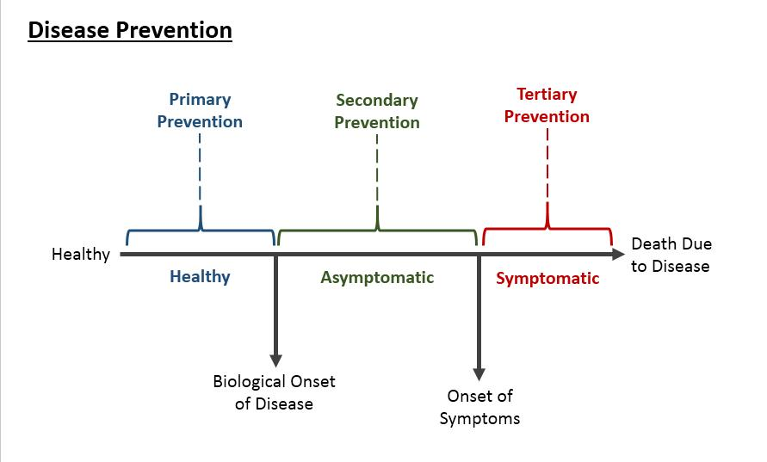

Slide 16
What is screening ?
Screening is the process of identifying healthy people who may be at increased risk of disease or condition.
Screening refers to the use of simple tests across an apparently healthy population in order to identify individuals who have risk factors or early stages of disease, but do not yet have symptoms (WHO).
The underlying concept of screening is that early detection of risk factors or early disease is beneficial for the clinical or public

Slide 17
Why do we screen people ?
The underlying concept of screening is that early detection of risk factors or early disease is beneficial for the clinical or public
To prevent or delay the development of advanced disease

Slide 18
getting screened is the first step in early intervention to prevent potential health events later in their lives

Slide 19
Criteria for implementing a screening test
The wilson criteria for implementing a screening test requires that for a screening test to be justified:
The condition should be an important health problem
The natural history of the condition should be understood
There should be a recognizable latent or early symptomatic stage
There should be a test that is easy to perform and interpret, acceptable, accurate, reliable, sensitive and specific

Slide 20
There should be an accepted treatment recognized for the disease
Treatment should be more effective if started early
There should be a policy on who should be treated
Diagnosis and treatment should be cost-effective
Criteria for implementing a screening test

Slide 21
Types of Screening
Screening has a few main types, namely:
1.Mass screening: is screening of a whole population or sub-group.
Ex: visual defects in school children.
2.High risk /selection screening :
Applied selectively to a high risk groups.
Ex: screening of cervix cancer in lower social groups.
3.Multi-purpose OR multi-phasic :
Applying two or more screening tests in combination to a large number of people at one time (usually expensive).
4.Opportunistic screening

Slide 22
Screening Targets
In short, when screening for a specific disease, the targeted population must not show any signs or symptoms related to that specific disease upon administering the test.

Slide 23
Common screening tests
Cholesterol measurements
Fecal occult blood test
Pap smear
PSA level
Mammography
Colonoscopy
Blood sugar
PPD test (TB)
AFP + ultrasound (congenital anomalies)
Fundoscopy
…….

Slide 24
Benefits of screening
If a screening test is justified according to the aforementioned criteria, then the benefits of screening include:
Early detection of serious medical conditions
More effective treatment
Reduced risk of disease-related complications
Reduced mortality

Slide 25
The downside of Screening
Other than the anxiety of awaiting the results, the main disadvantages of screening revolve around inaccurate results.
Screening test may in fact have 4 different results, rather than 2 (i.E. Positive, negative)
False positives: leads to anxiety and further testing, and possibly even unnecessary treatment as a result of that
False negatives: more dangerous than false positive, since the problem does exist but is not detected, which delays the diagnosis and allows the disease/condition to progress

Slide 26
Which test for which condition?
An ideal screening test for any condition should be fast in producing results, acceptably specific, cheap to administer, and most importantly very sensitive.

Slide 27
Examples of screening for conditions seen in primary care.

Slide 28
Hypertension
Rationale for screening: common condition seen in primary health care practice that if left undiagnosed may cause devastating vascular complications (stroke, MI, aortic dissection) which can be detected by a cheap BP monitor test and can be usually controlled if picked up early in it's course.

Slide 29
Saudi Hypertension Management Society Guidelines for screening
Measure blood pressure in each visit for all adults aged 18 years and older.
Measurement of blood pressure should be performed using a properly validated blood pressure monitor that is maintained and regularly calibrated per the manufacturer’s instructions.
Follow the proper technique of blood pressure measurement
Children aged 3 years and older should have their bp measured during every healthcare visit, especially with the growing prevalence of obesity in children.
Screening is recommended annually for adults aged 40 years or older and for those who are at increased risk of high blood pressure including those who have high-normal blood pressure (130–139/85–89 mm hg) and those who are overweight or obese. Adults aged 18–39 years with normal blood pressure (<130/85 mm hg) who do not have other risk factors should be re-screened every 3–5 years.

Slide 30
Type II DM
Why to screen?
Wide spread disease with an increasing rates and debilitating consequences if left untreated, which include eye damage, kidney problems, and vascular manifestations.

Slide 31
Who to screen?
According to the american association of clinical endocrinologists
screen asymptomatic individuals if risk factors present:
Acanthosis nigricans
Age ≥ 45 years and obese or overweight (repeat every 3 yrs if normal)
Antipsychotic therapy for schizophrenia and/or severe bipolar disease
Cardiovascular disease or family history of type 2 diabetes
Chronic steroid exposure
HDL cholesterol level < 35 mg per dl (0.91 mmol per L) and/or a triglyceride level > 250 mg per dl
History of gestational diabetes mellitus or delivery of a baby weighing > 9 lb (4.1 kg)
Hypertension (blood pressure > 140/90 mm hg or taking medication for hypertension)
Impaired glucose tolerance, impaired fasting glucose, and/or metabolic syndrome
Member of an at-risk racial or ethnic group: asian, black, hispanic, native american
Polycystic ovarian syndrome

Slide 32
What are the preferred screening tests for diabetes?
Fasting plasma glucose (FPG) is the best screening test for diabetes, it is also a component of the diagnostic testing, it is cheap and very sensitive. Along with FPG test, the 75-g oral glucose tolerance test (OGTT) is also suitable test for diabetes screening
Healthy diet and regular exercise are considerable preventive measures against type II DM

Slide 33
Hyperlipidemia
Why to screen? The relation between high blood levels of cholesterol, LDL and low HDL and coronary heart disease is well established.

Slide 34
Who to screen?
Screening men:
The U.S. Preventive services task force (USPSTF) strongly recommends screening men 35 years and older for lipid disorders. The USPSTF also recommends screening men 20 to 35 years of age for lipid disorders if they are at increased risk of coronary heart disease (CHD).
Screening women:
The USPSTF strongly recommends screening women 45 years and older for lipid disorders if they are at increased risk of CHD. The USPSTF also recommends screening women 20 to 45 years of age for lipid disorders if they are at increased risk of CHD.

Slide 35
Newborn and maternal screening

Slide 36
Newborn screening
Since screening for phenylketonuria was commenced in victoria in 1966, it has expanded to include congenital hypothyroidism, cystic fibrosis, and over 20 rare conditions. All of this is to ensure early detection and treatment of these various conditions.

Slide 37
Maternal screening
Infections: rubella, syphilis, hepatitis B, hepatitis C, HIV, group B streptococcus (GBS) culture
Glucose tolerance test for gestational diabetes
Anemia
Folic acid
Rhesus (rhd) factor

Slide 38
Periodic health examinations based on age

Slide 39
< 6 Y\O
1. Counseling for parents examples: breast feeding, dental health, passive smoking.
2. Screening examples: developmental milestones, vision, hernias.
3. Chemoprophylaxis: floride, iron, vitamin K.

Slide 41
7-18 Y\O
1. Counseling examples: depression, smoking, sun and vitamin D exposure
2. Screening: BMI, dental hygeine, std's for sexually
Active teens
3. Chemoprophylaxis: folic acid, vaccinations: influenza, MMR.

Slide 42
18-59 Y\O
1. Counseling: violence, drug and alcohol abuse, behavioural obesity counseling.
2. Screening: BP, blood lipids, fasting blood glucose,
PAP smear, mammogram
3. Chemoprophylaxis: aspirin, folic acid, immunizations.

Slide 43
Osteoporosis
1ry prevention: well-nourishment, high diary intake, sun exposure, doing weight bearing exercises and, avoid smoking
Supplements: bisphosphonates in both genders, and raloxifene or hormonal therapy for post-menopausal women
Screening: DEXA scan (dual-energy x-ray absorptiometry)
When? 65 years old

Slide 44
Breast Cancer
1ry prevention: by breast feeding, pregnancy, exercising
And avoiding: smoking, being obese, OCP, hormonal replacements...
Screening:
How? Mamography:
When? 40 years-old

Slide 45
MCQs:
1- which of the following is an example of tertiary prevention?
A 52 years old woman receiving speech rehabilitation after suffering from a stroke.
A 33 years old healthy woman getting a pap smear.
A child receiving his mmr vaccine.
A 40 years-old man receiving anti-smoking counseling.

Slide 46
2- all of the following are considered primary prevention methods for breast cancer EXCEPT:
Early pregnancy
Breastfeeding
Oral contraceptives
Exercise

Slide 47
3 – which of the following methods is a primary prevention method for prostate cancer?
Eating fruits and vegetables daily
PSA test annually
Flu vaccine
Digital rectal exam biannually

Slide 48
4 – which is most important in a screening test?
Very low cost and availability
Fast results
Highly sensitive
Highly specific

Slide 49
:
5 – A 50 year old obese male underwent a fasting blood glucose test to screen for diabetes, with the test showing normal results. What is the next best step in his management plan?
Repeat the test at a later time
Order additional tests to confirm negative result
Reassure the patient and send him home without a followup

Slide 50
References
https://www.gov.uk/guidance/nhs-population-screening-explained).
https://www.healthknowledge.org.uk/public-health-textbook/disease-causation-diagnostic/2c-diagnosis-screening/principles-methods-applications
https://en.oxforddictionaries.com/definition/prevention
https://www.cdc.gov/pictureofamerica/pdfs/picture_of_america_prevention.pdf
https://www.sgu.edu/blog/medical/what-is-preventive-medicine/
https://www.med.uottawa.ca/sim/data/Prevention_e.htm
Kingdom of Saudi Arabia Saudi Health Council Saudi Cancer Registry Cancer Incidence Report Saudi Arabia 2014
American cancer society, colo-rectal cancer prevention
Recommendations for Prostate Cancer Early Detection
https://www.pregnancybirthbaby.org.au/blood-tests-during-pregnancy
https://www.rch.org.au/rchcpg/hospital_clinical_guideline_index/Newborn_Screening_Test/
https://www.uspreventiveservicestaskforce.org/Page/Document/RecommendationStatementFinal/high-blood-pressure-in-adults-screening
https://www.aafp.org/afp/2009/1201/p1273.html
https://www.aafp.org/afp/2016/0115/p103.html#afp20160115p103-t1
https://www.nhs.uk/conditions/nhs-screening/
https://www.ncbi.nlm.nih.gov/pubmedhealth/PMH0072602/
SOME PREVIOUS STUDENTS’ WORKS

