Slide 1
Adolescent health Abdulrahman alnasser- omar altujjar- hassan albeladi

Slide 2
Objective
Define adolescent age: World health organization definition.
Understand adolescent’s physiological and behavioral characteristics.
Recognize the importance of adolescent health.
Determine adolescent health problems: physical, psychological and social problems.
Recognize common adolescent health problems in Saudi Arabia: Retrieved from available evidence-based studies.
Understand the comprehensive approach to common adolescent health problems in primary health care.
Understand the role of family, school and community in adolescent health care.

Slide 3
Some Qs
Q1. Adolescence age is between:
a) 8-15
b) 10-15
c) 10-19
d) 7-20

Slide 4
Q2. What is the adolescence population in Saudi Arabia?
Some Qs
a) 10%
b) 25%
c) 30%
d) 50%

Slide 5
Some Qs
Q3. The first sign of physical changes in girls is ?
A- Menarche.
B- Pubic hair.
C- Axillary hair.
D- Breast enlargement.

Slide 6
Q4. What is the leading cause of death in adolescents?
Some Qs
a) HIV
b) Injuries
c) Cancer
d) Suicide

Slide 7
Q5. What is the most common mental health problem in adolescence?
Some Qs
a) Anxiety
b) Schizophrenia
c) Depression
d) Bipolar

Slide 8
WHO Definition of adolescents
Is period of growth and development between childhood and adulthood
Any person between age 10-19

Slide 9
Adolescent population in KSA
Around 25%
Notes:
Saudi arabia population account for 34 m
Around 25% consider adolcent( 8m)
The papulation of adolcent in Saudi Arabia 25 of population

Slide 10
Why adolescence period is important?
Adolescent health behaviors have a direct effect on along term health outcomes and quality of life
Adolescence health is a key ensure the boys and girls grow into healthy and productive men and women
promoting and protecting adolescent health will lead to great public health, economic , social and demographic benefits
Notes:
They are at high risk of alcohol intake ,drug abuse, smoking
Which can cause many disease cancers, infertility, hypertension, heart disease and premature death so they should be taught about their ill effects .

Slide 11
adolescent’s physiological and behavioral characteristics.
Hormonal changes
Physical changes
Behavioral changes
Emotional changes
Changes in teenage relationships

Slide 12
Hormonal changes
Notes:
The GNRH release from hypothalamus which
act on anterior pituitary gland to release LH and FSH
Then the LH and FSH stimulate the
maturation of testis and ovary
they also play a major role in Sex steroid synthesis

Slide 13
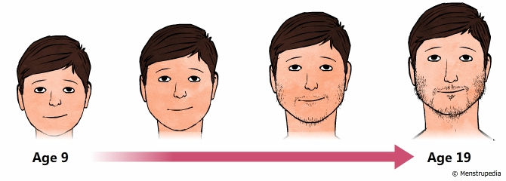
Physical changes (male)
growth of the penis and testes (testicles)
changes in body shape and height
growth of body and facial hair
changes to voice

Slide 14
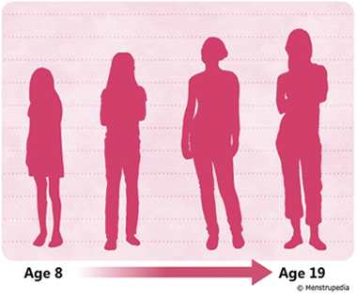
Physical changes (female)
Breast development
first change
Growth of pubic and body hair
Axillary hair growth
Menarche

Slide 15
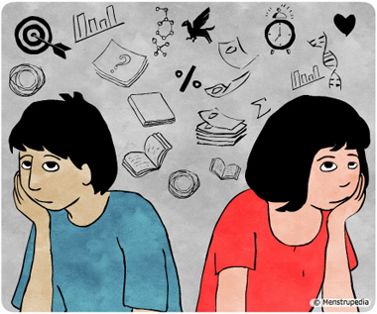
Social changes
Searching for identity.
Seeking more independence.
Seeking more responsibility.
Looking for new experiences and engaging in
more risk.
thinking more about right and wrong
Influenced more by friends
Communicating in different ways
Notes:
Searching for identity: young people are busy working out who they are and where they fit in the world, and this can be influenced by gender, peer group, cultural background, and family expectations
Seeking more independence: this is likely to influence the decisions your child makes and the relationship with his family and friends
Seeking more responsibility at home & school
our words and actions still shape your child’s sense of right and wrong. But as your child moves towards adulthood, he’ll have a stronger sense of his own personal values and morals.
● Looking for new experiences and engaging in more risk taking behavior; they get into more fights and they might carry weapons.
● Thinking more about ‘right’ & ‘wrong’ your child will start developing a stronger individual set of values and morals.
● Influenced more by friends, especially when it comes to behavioral and sense of self-esteem they can use tobacco just because there close friends are smokers.
● Communicating in different ways: the internet, mobile phones, and social media can significantly influence them and learn about the world

Slide 16
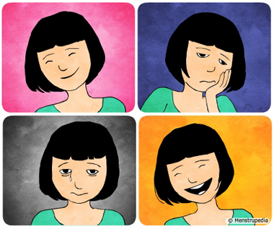
Emotional change
Moods might seem unpredictable These emotional ups and downs
( mood swing )
More conscious about physical appearance
( insecurity fear and doubt )
Fluctuating self esteem

Slide 17
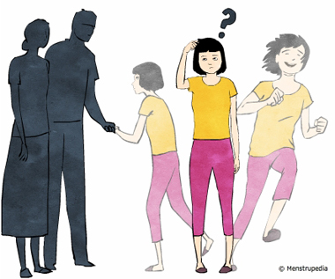
Changes in relationships
spend less time with family
more arguments with you
sees things differently from you
Notes:
wants to spend less time with family and more time with her friends and peers. If you find this hard, it might help to know that friends are more likely to influence your child’s short-term choices, like appearance and interests. Your influence is important on your child’s long-term decisions, like career choices, values and morals.
There might be more arguments with you. Some conflict is normal, because teenagers are seeking more independence. It actually shows that your child is maturing. Conflict tends to peak in early adolescence. Even if you feel like you’re arguing with your child all the time, it isn’t likely to affect your relationship with him in the longer term.
And it might seem like your child sees things differently from you now. This isn’t because she wants to upset you – it’s because she’s beginning to think more abstractly, and is questioning different points of view. At the same time, some teenagers find it difficult to understand how their words and actions affect other people. This will probably change with time.

Slide 18
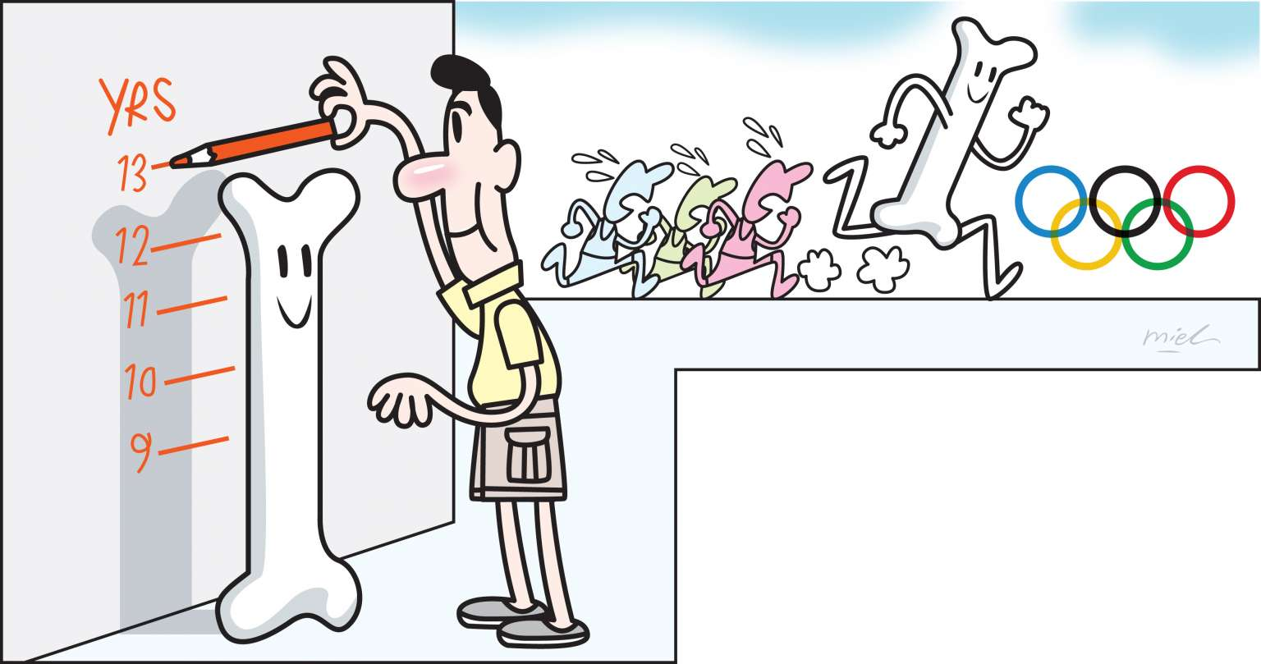
Skeletal changes
Increased in sex hormone lead to increased bone growth in adolescence.
At the end of adolescence more than 95 percent of skeleton is formed
1-Height grow peak in boys are at the age of 13 and they grow average of 26 cm and height growth peak in girls are at the age of 11 and they grow average of 23 cm.
2-Weight gain in boys mostly because of muscle growth and for girls are because of fat that develop in breast and hips

Slide 19
Dietary changes:
Weight problems ‘obesity’ from eating a lot of junk food and physical inactivity
Anorexia nervosa and bulimia from not eating because of appearance

Slide 20
Adolescent health problems
5 February 2018 WHO, Adolescents: health risks and solutions; http://www.who.int/news-room/fact-sheets/detail/adolescents-health-risks-and-solutions

Slide 21
Physical
Early pregnancy and childbirth
Malnutrition and obesity
Psychological
Alcohol and drugs
Violence
Infectious
HIV
Other Infectious diseases
Injuries
Mental health
(Depression & suicide)
Others
Tobacco use
Exercise and nutrition

Slide 22
Early pregnancy and childbirth
The leading cause of death for 15– 19-year-old girls globally is complications from pregnancy and childbirth.
11% of all births worldwide are still to girls aged 15 to 19 years old. The majority of these births occur in low- and middle-income countries.
A girl with little or no education has fewer skills and that will affect their life.
What are the ways that can lead to safe pregnancy, reduce girls getting pregnant and giving birth at too young age?
Better access to contraceptive information and services
Laws that specify a minimum age of marriage at 18
Access to quality antenatal care, childbirth and postnatal care among adolescents
Islamic preventive measures (Principles & rules, faith, punishment, and fate)

Slide 23
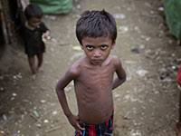
Malnutrition and Obesity
Many boys and girls in developing countries enter adolescence undernourished, making them more vulnerable to disease and early death.
The number of adolescents who are overweight or obese is increasing in low, middle and high-income countries.
Exercise and nutrition
Regular exercise & healthy eating habits in adolescence are foundations for good health in adulthood.
Reducing the marketing of foods high in saturated fats, trans-fatty acids, free sugars, or salt and providing access to healthy foods and opportunities to engage in physical activity are important for all but especially children and adolescents.
Recommended guidelines for physical activity: 60 minutes of moderate-vigorous activity daily.
Iron deficiency anaemia is the leading cause of years lost to death and disability in 2015.
Iron and folic acid supplements are a solution, which helps to promote health before adulthood.
Regular deworming in areas where intestinal helminths (hookworm) are common is recommended to prevent micronutrient (including iron) deficiencies.

Slide 24
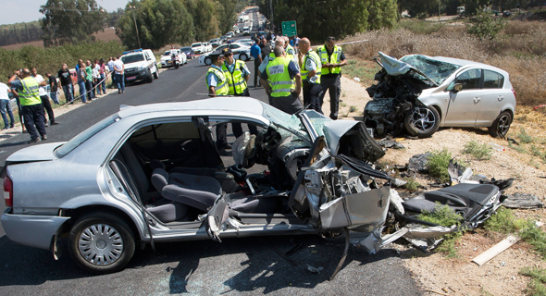
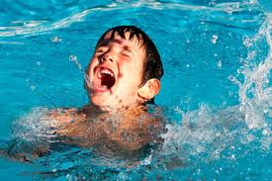
Injuries
Unintentional injuries are the leading cause of death and disability among adolescents.
In 2015, over 115 000 adolescents died as a result of RTA.
How we can Prevent it?
Advice young drivers to driving safely.
Graduated licenses.
Strictly enforced the laws that prohibit driving under the influence of alcohol and drugs.
Blood alcohol levels need to be set lower for teenage drivers.
Drowning is also a major cause of death among adolescents.
57 000 adolescents, two-thirds of them boys, are estimated to have drowned in 2015.
To prevent this:
Teaching children and adolescents to swim.

Slide 25
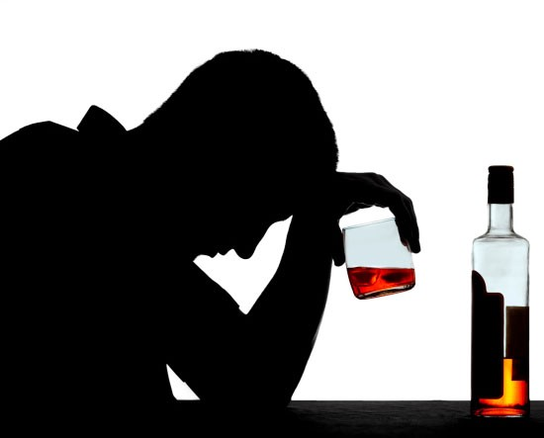
Alcohol And Drugs
Alcohol:
Harmful drinking among adolescents is a major concern in many countries.
It reduces self-control and increases risky behaviours, such as unsafe sex or dangerous driving.
It is a primary cause of injuries: due to road traffic accidents, violence and premature deaths.
It can also lead to health problems in later life and affect life expectancy.
How we can Prevent it?
Setting a minimum age for buying and consuming alcohol.
Regulating how alcoholic drinks are targeted at the younger market.
Islamic preventive measures (Principles & rules, faith, punishment, and fate)
Drugs:
Drug use among 15–19 years old is also an important global concern.
To control this:
Reducing drug demand, drug supply, or both, and successful programmes usually include structural, community, and individual-level interventions.

Slide 26
Violence
Violence is a leading cause of death in older adolescent males.
Around 43% of all adolescent male of the low- and middle-income countries in the WHO Americas Region is due to violence.
Globally, 1 in 10 girls under the age of 20 years report experiencing sexual violence.
How we can Prevent it?
Promoting nurturing relationships between parents and children early in life
Providing training in life skills
Reducing access to alcohol and firearms
Ongoing support
Mental health (Depression and suicide)
Depression is the third leading cause of illness and disability among adolescents.
Suicide is the third leading cause of death in older adolescents (15–19 years).
Risk factors that increase developing of the mental health problems are:
Violence, poverty, humiliation and feeling devalued
To control this:
Building life skills in children and adolescents
psychosocial support in schools
Programmes to help strengthen the ties between adolescents and their families

Slide 27
infectious diseases
HIV
More than 2 million adolescents are living with HIV.
The overall number of HIV-related deaths is down 30% since the peak in 2006 estimates suggest that HIV deaths among adolescents are rising.
How we can Prevent it?
Avoid prohibited relationships or safe relationship
Clean needles for those who inject drugs
Better access to HIV testing and counselling
Others
Diarrhoea and lower respiratory tract infections are estimated to be among the top 5 causes of death for 10–19 years old.
These two diseases, together with meningitis, are the top three causes of adolescent death in African low and middle-income countries.
Childhood and adolescent deaths and disability from measles have fallen markedly due to vaccination ( e.g. by 90% in the African Region between 2000 and 2012)

Slide 28
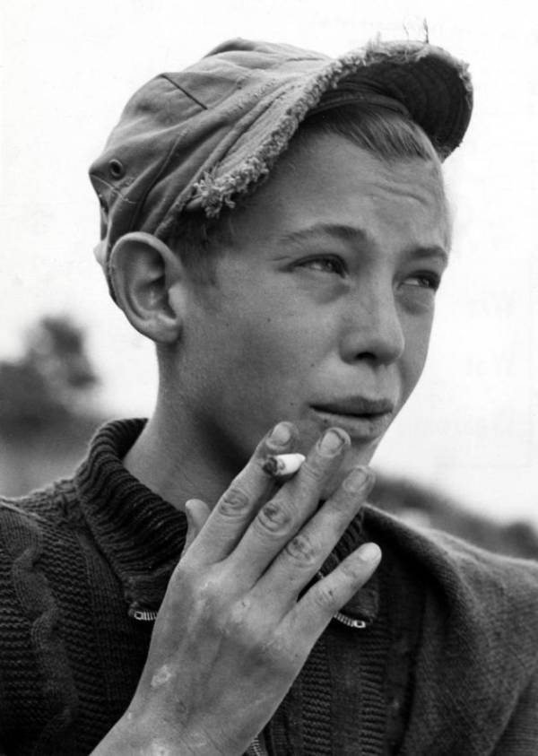
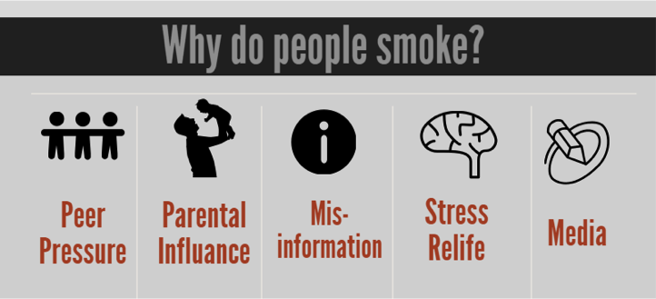
Tobacco use
The vast majority of people using tobacco today began doing so when they were adolescents.
Globally, at least 1 in 10 adolescents aged 13 to 15 years uses tobacco
How we can Prevent it?
Prohibiting the sale of tobacco products to minors
increasing the price of tobacco products
ensuring smoke-free environments

Slide 29
Adolescent health problems in Saudi Arabia
Medical and Behavioral Problems among Saudi Adolescents; https://www.ncbi.nlm.nih.gov/pmc/articles/PMC3883599/

Slide 30
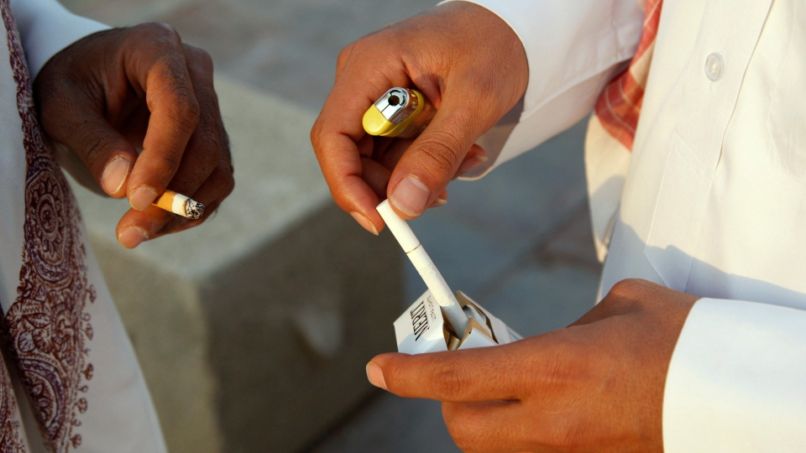
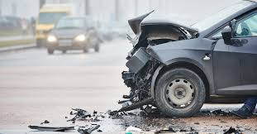
CIGARETTE SMOKING
The prevalence of cigarette smoking is 12.7% among the Riyadh city study sample.
The habit is more common in males (19.0%) than females (4.0%)
CAR ACCIDENT
The same study indicate that adolescents males who drive car, 45% of them had a car accident.

Slide 31
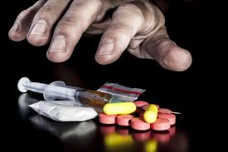
MENTAL HEALTH PROBLEMS:
A study carried out in Tiaf Governorate,
That most important problems were:
1.Anxiety (13.5%)
2.Somatic disorders (12.2%)
3.Obsession (10.8%)
4.Aggression (8.1%)
5.Delinquency and depression (4.1%).
DRUG USE
The prevalence of drug use in this survey was 6.4%
More common in males 10.6% than females 0.8% in study subjects.
Volatile substance was commonly abused among adolescents.

Slide 32
How to approach common adolescent health problems as family physician?

Slide 33
Smoking:
Awareness of community in campaigns about the harm of smoking in health.
Explain the harm effects of smoking to the patients on their health and environment in clinic.
Maintain an “open-door” policy and encourage adolescents and their parents to seek help as soon as possible
Try to help patients in withdrawing smoking.
Explain to smoker to avoid smoking beside his family.

Slide 34
Mental health:
Programs to help strengthen the ties between adolescents and their families are important.
If problems arise, they should be detected and managed by competent and caring health workers.
Always ask about mental problems to patient attending primary health care because it affects their health and social life especially adolescents.
Awareness of community in campaigns about the importance of common mental problems in social life and health.
Establish confidentiality
Maintain an “open-door” policy and encourage adolescents and their parents to seek help as soon as possible

Slide 35
Obesity and physical inactivity:
Developing healthy eating and exercise habits in adolescence are foundations to prevent obesity and it is complications.
Awareness of community in campaigns about the harm of fast food on health.
Awareness of community in campaigns about the benefits of being physical active on health.
Explain to obese patients attending the clinic the importance of reducing their weight on their health and their social life.
Advise the patients to change their lifestyle by eating healthy food and doing exercises.

Slide 36
The role of family, school, and community in adolescent health care

Slide 37
Family role:
Positive parent-child relationships are associated with higher levels of adolescent self-esteem, happiness, and life satisfaction, and lower levels of emotional and physical distress.
Close parent-child relationships also have been linked to safer sex behaviors among adolescents and lower use of alcohol, tobacco.
parents play a large and vital role, they help shape adolescents’ educational plans, their moral and social values.
Parents can provide needed support and affection and help adolescents understand how their choices can affect their health and well-being
Building life skills in children and adolescents can prevent mental problems and promote good mental health.

Slide 38
School role:
School health programs can reduce the prevalence of health risk behaviors among adolescents and have a positive effect.
School health clinics for health, vaccinations and counseling has an important role.
Providing healthy food in schools.
Establish a good school social environment to protect against risky behaviors.
Explaining and Educating children and adolescent in schools about the dangers of using tobacco.
Provides adolescents with psychosocial support in schools and other community settings

Slide 39
Community role:
Establishing of firm traffic laws preventing adolescent aged less than 18 from driving.
Establishing anti-smoking program involving prohibition of sale and using cigarettes in public places and raise the price.
Raising awareness of health issues for adolescents among general public by using campaigns and social apps.
Supervision over media content because adolescents who are exposed to media portrayals of violence, sexual content, smoking, and drinking are at risk for adopting these behaviors.
Establishing a good centers for adolescents care and dealing with their problems
Laws and regulation on roads such as speed limits and cameras to capture Traffic Violations.
Reducing the marketing of foods high in saturated fats, free sugars and salt.

Slide 40
Take home massage
Adolescent Is period of growth and development between childhood and adulthood (Any person between age 10-19).
Adolescent period is important because it has a direct effect on a long term health outcomes and quality of life.
Adolescent physiological and behavioral characteristics include hormonal changes, physical changes, behavioral and emotional changes.
Adolescent health problems can be physical, psychological, infectious and others.
Adolescent health problems in Saudi Arabia include cigarette smoking, car accident, mental health problems and drug use.
Adolescent health is responsibility of family, school and community.
behavioral characteristics

Slide 42
Case :
A 17 years old male came to primary health care clinic with chronic cough. He says that he has these symptoms after he smoked cigarettes.
As family physician how would you approach this patient ?
History taking:
-Duration of smoking -Cigarettes count -Duration of cough -Productive or dry
-SOB and hemoptysis -Triggers and relievers - Past medical/surgical -Allergy -Medication
-Social
Physical examination:
-Vital signs -Inspection -Auscultation
Investigation:
-CBC -X-Ray
Management plan:
-Smoking cessation - using nicotine gum and patches -Avoid second hand smoke
-Religious (Prohibited in Islam)

Slide 43
References
https://raisingchildren.net.au/teens/development/understanding-your-teenager/teen-development
http://teachersinstitute.yale.edu/curriculum/units/1991/5/91.05.07.x.html#b
http://www.vivo.colostate.edu/hbooks/pathphys/endocrine/hypopit/lhfsh.html
http://www.who.int/maternal_child_adolescent/topics/adolescence/why-invest/en/
https://www.stats.gov.sa/sites/default/files/en-demographic-research-2016_2.pdf
https://www.hhs.gov/ash/oah/adolescent-development/healthy-relationships/parents-child/index.html
https://www.cdc.gov/healthyyouth/about/why_schools.htm
http://www.who.int/mediacentre/factsheets/fs345/en/#
Oxford handbook of General practice

Slide 44
Some Qs
Q1. Adolescence age is between:
a) 8-15
b) 10-15
c) 10-19
d) 7-20

Slide 45
Q2. What is the adolescence population in Saudi Arabia?
Some Qs
a) 10%
b) 25%
c) 30%
d) 50%

Slide 46
Some Qs
Q3. The first sign of physical changes in girls is ?
A- Menarche.
B- Pubic hair.
C- Axillary hair.
D- Breast enlargement.

Slide 47
Q4. What is the leading cause of death in adolescents?
Some Qs
a) HIV
b) Injuries
c) Cancer
d) Suicide

Slide 48
Q5. What is the most common mental health problem in adolescence?
Some Qs
a) Anxiety
b) Schizophrenia
c) Depression
d) Bipolar

Slide 50
THANK YOU

