Slide 1
Changes in bowel habits
Supervisor: Dr Mohammed Batais
Students:
Abdullah abdulaziz aldhibaib
Abdulrahman albaraka
Adel alshehry

Slide 2
Objectives:
- Define constipation and diarrhea .
- Discuss the definition, etiology and classification of IBS.
- Explain how to diagnose IBS .
- List the alarm symptoms and differential diagnosis .
- Provide a comprehensive management plan and follow up for patients with IBS.
- Recognize when to refer to specialist .
- Demonstrate history taking and physical examination for patients presented with history suggestive of IBS. i.e Role play.
- Practical: Examination of the Abdomen, how to perform the examination?

Slide 3
Question 1
Passage of three or more loose or liquid stools per day is a definition of what ?
A- Constipation.
B- Diharrea.
C- Hematochezia.
D- Tenesmus.

Slide 4
Question 2
Which one of these symptom consider as red flag ?
A- Abdominal pain or discomfort.
B- Bloating.
C- Change in bowel habit.
D- Rectal bleeding.

Slide 5
Question 3
Which one of the following is clinically diagnostic of IBS ?
A- Rebound tenderness.
B- Improvement with defecation.
C- Blood mixed with stool.
D- Pale stool.

Slide 6
Question 4
Is high intake of fibers is helpful in managing IBS patients ?
Is acupuncture or reflexology helpful in managing IBS ?

Slide 7
Question 5
According to NICE diagnostic approach which of the following meets the criteria?
A-altered stool passage.
B- abdominal bloating.
C- symptoms made worse by eating.
D- all of the above.
E-A+b

Slide 8
Definitions:
Constipation:
Less than three bowel movements in a week, and stools are hard, dry, and small, making them painful and difficult to pass also a sensation of an incomplete evacuation.
Diarrhoea:
Passage of three or more loose stools per day (or more frequent passage than is normal for the individual).
Notes:
Frequent passing of formed stools is not diarrhoea

Slide 9
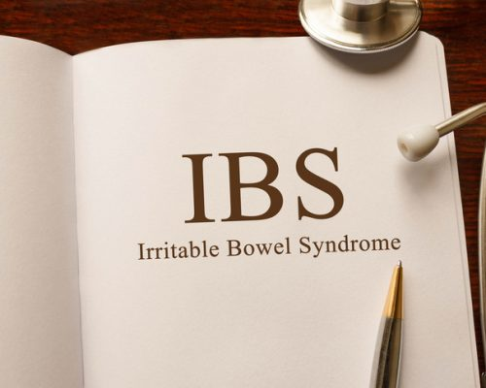

Slide 10
Definition of IBS:
It is a chronic or recurrent abdominal pain, altered bowel habits, and bloating, with the absence of organic or biochemical abnormalities.
An IBS patient can present with predominance in either diarrhoea or constipation.
IBS most often starts to affect people between the ages of 20-30 years and is more common in women with prevalence in general population of 10 to 20 %.
The number of newly diagnosed cases of irritable bowel syndrome (IBS) is increasing worldwide.
It is one of the top 10 reasons for visits to primary care physicians.
Notes:
Recent trends indicate that there is also a significant prevalence of IBS in older people.
IBS diagnosis should be a consideration when an older person presents with unexplained abdominal symptoms.

Slide 11
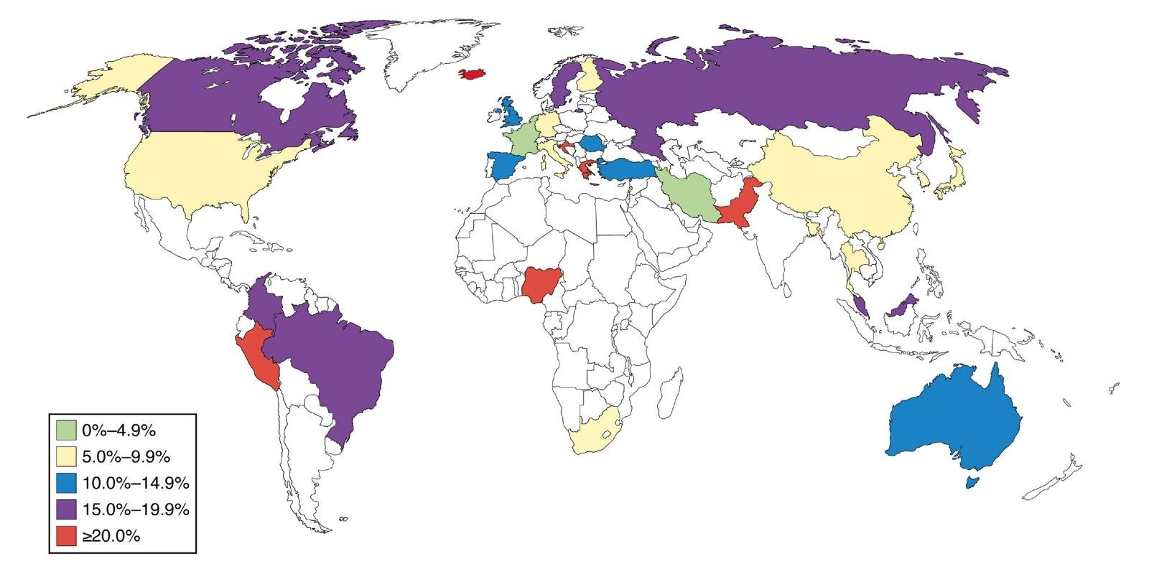
Prevalence of IBS globally
Some studies suggests that the prevalence in Saudi Arabia is between 10 to 20% with some studies reaching to 31.8% in medical student. And 40% in teachers.

Slide 12
Etiology of IBS
The causes of irritable bowel syndrome remain poorly defined but there are multiple factor which play a role in this disorder for ex:
Stress and anxiety.
Visceral hypersensitivity.
Gastrointestinal infections.
Neurohormonal stress response.
Food sensitivity.
Psychological disorders.
Intestinal inflammation.
Notes:
Infection with Giardia lamblia has been shown to lead to an increased prevalence of IBS
excessive release of 5-HT in D-IBS, and relative deficiency C-IBS.
two-third of patients with IBS have psychological disorders
Intestinal inflammation {Theory that IBS represent a low grade inflammation not detected by test with raised number of mast cells (This theory supported by the improvement of the condition with mast cell stabilizers}
Alteration in fecal microflora {Both quantitative and qualitative alteration in intestinal bacterial contents have been reported}

Slide 13
Classification of IBS:
IBS-C
IBS-M
IBS-D
IBS-U

Slide 14
Classification of IBS
IBS with constipation (IBS-C): hard or lumpy stools for more than 25% of bowel movements and loose (mushy) or watery stools for less than 25% of bowel movements.
IBS with diarrhoea (IBS-D): loose or watery stools for more than 25% of bowel movements and hard or lumpy stool for more than 25% of bowel movements.
Mixed IBS (IBS-M): hard or lumpy stools for ≤25% of bowel movements and loose (mushy) or watery stools for ≤25% of bowel movements.
Unspecified IBS: insufficient abnormality of stool consistency to meet criteria for above subtypes.

Slide 15
Diagnostic approach
National Institute for Health and Care Excellence [NICE]:
A diagnosis of IBS should be considered only if the person has abdominal pain or discomfort that is either relieved by defaecation or associated with altered bowel frequency or stool form. This should be accompanied by at least two of the following four symptoms:
1- altered stool passage (straining, urgency, incomplete evacuation).
2- abdominal bloating (more common in women than men), distension, tension or hardness.
3- symptoms made worse by eating.
4-passage of mucus.

Slide 16
Diagnostic approach A-History:
1. Initial assessment for IBS
if the person reports having had any of the following symptoms for at least 6 months:
1. Abdominal pain or discomfort
2. Bloating
3. Change in bowel habit.

Slide 17
Diagnostic approach
2-Assesment of risk factor:
Age < 50
Female gender
Previous enteric infection
3. Exclude alarm symptoms (red flags):
All people presenting with possible IBS symptoms should be assessed and clinically examined for red flag indicators and should be referred to secondary care for further investigation if any are present.

Slide 18
DDx
Inflammatory bowel disease. (crohn’s disease & Ulcerative colitis)
Celiac disease
Lactose intolerance
Colorectal Cancer
GI infection (Recent Antibiotic use)
Ischemic colitis

Slide 19
Abdominal examination

Slide 20
Abdominal Examination
1- Inspection
2- Palpation
3- Percussion
4- Auscultation

Slide 21
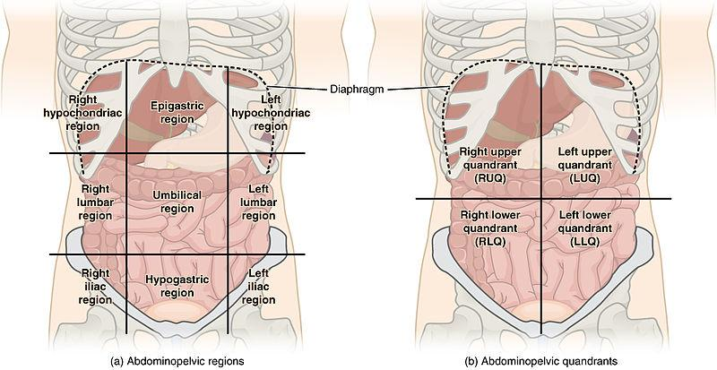
Abdominal Examination

Slide 22
PR Examination
Usually PR is done but there is indication when you have to do it:
Assessment of the prostate (particularly symptoms of outflow obstruction).
When there has been rectal bleeding (prior to proctoscopy, sigmoidoscopy and colonoscopy).
Constipation.
Change of bowel habit.
Problems with urinary or faecal continence.

Slide 23
PR Examination
1-Inspection
Skin disease. For example, natal cleft dermatitis .
Skin tags.
Pilonidal sinus.
Genital warts.
Anal fissures.
Anal fistula.
External haemorrhoids.
Rectal prolapse.
Skin discolouration with Crohn's disease.
External thrombosed piles.
2-Internal
Assessment of the prostate and the rectum

Slide 24
Diagnostic tests: B-Investigations:
No specific tests
In people who meet the IBS diagnostic criteria, the following tests should be undertaken to exclude other diagnoses:
CBC.
ESR.
CRP.
Endomysial antibodies [EMA] and anti-tissue transglutaminase [TTG].

Slide 25
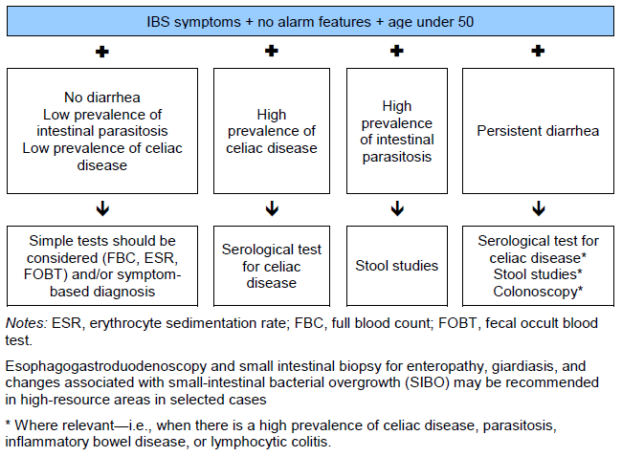
IBS diagnostic algorithm according to World Gastroenterology Organisation Global Guidelines

Slide 26
Alarming Sx
Weight loss
Rectal bleeding
Anemia
Nocturnal symptoms
+ve FHx Colorectal CA.
Notes:
As long you’re thinking of another disease, you have to excluded first as IBS is a diagnosis of exclusion

Slide 27
Rx:
Lifestyle advice:
Relaxation techniques such as meditation.
Physical activities and exercise.
Dietary advice:
High fluid intake (8 cups per day)
soluble fiber supplementation like oats.
Avoid high intake of insoluble fibers, and limit fruits (3 per day).
People with diarrhoea should avoid artificial sweeteners.
Notes:
Tell the patient yo watch what they eat to identify precipitating factors
To eat more Fibers but it might cause flatulance.
Fluids: especially water or other non-caffeinated drinks, for example herbal teas.

Slide 28
Symptoms persist?
Don’t forget that you have address any psychiatric problems.

Slide 29
Dietary management
include single food avoidance and exclusion diets (for example, a low FODMAP [fermentable oligosaccharides, disaccharides, monosaccharaides and polyols] diet).
Done by dietitian.

Slide 30
Pharmacological therapy:
Constipation-predominant IBS | Diarrhea-predominant IBS
Laxative should be considered in C-IBS. Lactulose to be avoided. Consider linaclotide for people with IBS only if: Optimal or maximum tolerated doses of previous laxatives from different classes have not helped and they have had constipation for at least 12 months. Follow up people taking linaclotide after 3 months. | Loperamide (antimotility) should be the first choice. Consider TCA as second-line treatment if loperamide did not work. Switch to SSRI if not effective.
Notes:
Phrmacological treatment is initiated along the dietary therapy
TCA : doxepin and desipramine

Slide 31
Cont.
Antispasmodic agents taken when required along side life style and dietary management .
Mebeverine for relieving of pain
Follow up is required for possible side effect
People with IBS should be advised how to adjust their doses of laxative or antimotility agent according to the clinical response. The dose should be titrated according to stool consistency, with the aim of achieving a soft, well-formed stool.

Slide 32
When to refer
Do not respond to pharmacological treatments after 12 months.
Who develop a continuing symptom profile (described as refractory IBS).
Notes:
Cognitive behavioural therapy [CBT]

Slide 33
Follow up
Notes:
Follow-up should be agreed between the healthcare professional and the person with IBS, based on the response of the person's symptoms to interventions. This should form part of the annual patient review. The emergence of any 'red flag' symptoms during management and follow-up should prompt further investigation and/or referral to secondary care. [2008]
No long-term monitoring is necessary. Patients with IBS should follow the standard recommendations for screening for colorectal cancer as well as for gynaecological and genitourinary malignancies.

Slide 34
Case:
Khalid is a 31 years old presenting to the clinic due to abdominal pain for the last 9 months. How to approach this patient?

Slide 35
Question 1
Passage of three or more loose or liquid stools per day is a definition of what ?
A-constipation
b- diharrea
C- hematochezia
D-tenesmus

Slide 36
Question 2
Which one of these symptom consider as red flag ?
A- Abdominal pain or discomfort
B-Bloating
C-Change in bowel habit.
D-rectal bleeding

Slide 37
Question 3
Which one of the following is one of the diagnostic criteria of IBS ?
A- rebound tenderness
B-improvement with defecation
C-blood mixed with stool
D-pale stool

Slide 38
Question 4
High intake of fibers is helpful in managing IBS patients ?
Is acupuncture or reflexology helpful in managing IBS ?

Slide 39
Question 5
According to nice diagnostic approach which of the following is meet the criteria?
A-altered stool passage.
B- abdominal bloating.
C- symptoms made worse by eating.
D- all of the above.
4-A+b

Slide 40
References
1- https://www.webmd.com/digestive-disorders/qa/how-is-constipation-defined
2- http://www.who.int/news-room/fact-sheets/detail/diarrhoeal-disease
3- https://emedicine.medscape.com/article/930844-overview
4-https://www.nice.org.uk/
5-https://patient.info/doctor/abdominal-examination
6- http://article.sapub.org/10.5923.j.ajmms.20180801.02.html

Slide 41
Thank you
Any questions?

