Slide 1
Common Psychiatric Problems
Zaid Alwethenani
Mohammed Alsahil
Supervised by Dr. Yousef Alturki

Slide 2
MCQs

Slide 3
Q1
The fear of being alone in public places, particularly places from which a rapid exit would be difficult or help might not be available is a definition of which of the following?
A- Social Phobia
B- Specific Phobia
C- Agoraphobia
D- Panic attack

Slide 4
Q2
Treatment of choice for panic disorder?
A- Cognitive behavioral therapy
B- Selective Serotonin Reuptake Inhibitor
C- Benzodiazepine
D- Non of the above

Slide 5
Q3
According to depression diagnostic criteria which of the following symptoms must be present?
A- Loss of interest
B- Fatigue, loss of energy
C- Feeling worthlessness
D- All of the above

Slide 6
Q4
A 45 years old female came to you 3 times within 2 weeks C/O severe abdominal pain. Her vital signs was normal, on examination her abdomen is soft and there is no remarkable signs. Her brother died 2 months ago due to colon cancer. What is the most likely diagnosis:
A- SSD
B- IBD
C-peptic ulcer
D- colon cancer

Slide 7
Q5
Focuses on people’s thoughts and the reasoning behind their assumptions.
A- Problem-solving therapy
B- Behavioral therapy
C- Cognitive therapy
D- Guided self-help

Slide 8
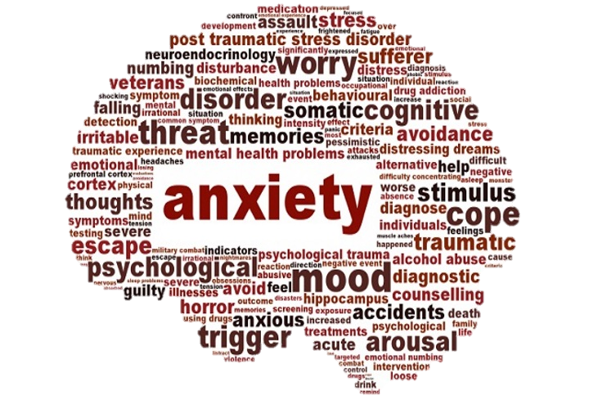

Slide 9
Anxiety (video)

Slide 10
Definition
Subjective feeling of worry, fear and apprehension accompanied by autonomic symptoms ( such as palpitation and sweating ) caused by anticipation of threat or danger.

Slide 11
Case Scenario
Fahad is a 21 years old student at KSU has an exam after 2 days and his brother noticed that he appears restless, irritable and his hands are shaking.

Slide 12
When do we consider Anxiety abnormal?
When it occurs in the absence of a stressful trigger.
Impairs physical, occupational or social functioning.
Excessively severe or prolonged.

Slide 13
Prevalence of Anxiety
In U.S.
Anxiety affect 40 million adults, 18.1% of the population every year and is considered the most common mental illness in the U.S.
In Saudi Arabia
822 males who attended PHC centers were the sample of a study that took place in Eastern Saudi Arabia. The study shows an overall prevalence of 22.3% with 17% of the attendees having a mild degree of anxiety.

Slide 14
Etiology In General
Biological causes such as
Heredity
Medications
Psychological causes such as
Personality traits
Low self-esteem
Social causes such as
Work stress
Lack of social support

Slide 15
Common Symptoms
Feeling nervous and restless
Increased heart rate
Breathing rapidly
Dry mouth
Palpitation
Sweating
Having trouble sleeping

Slide 16
Anxiety Disorders
Generalized anxiety disorder
Phobias
Panic attacks
Obsessive compulsive disorder
Post traumatic stress disorder

Slide 17
Generalized Anxiety Disorder
characterized by excessive, exaggerated anxiety and worry about everyday life events with no obvious reasons for worry.
the worry is often unrealistic or out of proportion for the situation.
so dominates the person's thinking that it interferes with daily functioning, including work, school, social activities, and relationships.

Slide 18
Epidemiology
GAD affects 6.8 million adults 3.1% of U.S. population .
Women > Men (2:1) .
Risk is highest between childhood and middle age .

Slide 19
Diagnostic Criteria
Characterized by > 6 months of excessive anxiety and worry that is difficult to control and associated with at least 3 of the following 6 symptoms occurring more days than not for at least 6 months:
Restlessness
Being easily fatigue
Difficulty concentrating
Irritability
Muscle tension
Sleep disturbance

Slide 20
Diagnosis Criteria
Anxiety causing significant distress or impairment in social, occupational or other important area of functioning
The disturbance is not better explained by another mental disorder
The disturbance is not attributable to the physiological effects of a substance or another medical condition

Slide 21
Management
Rule out medical causes
Cognitive-behavioral therapy (CBT)
Medication:
Antidepressant: SSRIs (e.g. paroxetine) or SNRIs (e.g. Venlafaxine)
Buspirone: effective in reducing cognitive symptoms of GAD
Benzodiazepines: for a limited period (to avoid dependence)

Slide 22
Phobias
A phobia is defined as an irrational fear that produces a conscious avoidance of the feared subject, activity, or situation.
There are three types of phobia recognized by the American Psychiatric Association including:
Specific Phobia
Social Phobia
Agoraphobia

Slide 23
Phobias
Specific Phobia
Also called simple phobia characterized by irrational and out of proportion fear to specific object or situation (e.g. animals, insects, blood, needles, flying, heights).
Social Phobia
Profound fear of public humiliation and being singled out or judged by others in a social situation.
Agoraphobia
The fear of being alone in public places, particularly places from which a rapid exit would be difficult or help might not be available.

Slide 24
Panic Disorder
Panic Attack
Period of intense fear with characteristic symptoms, can be spontaneous or situational.
Panic disorder
Chronic disorder characterized by recurrent panic attacks associated with persistent fear of having another one.

Slide 25
Clinical Features
Shortness of breath
Chest pain or discomfort
Palpitation
Sweating
Feeling of choking
Shaking
Nausea or abdominal distress
Feeling of dying

Slide 26
Diagnostic Criteria
Panic attacks must be associated with more than 1 month of:
Persistent worry about having another attack or consequence of the attack (e.g. death)
Significant behavioral change related to the attacks
Panic attacks NOT resulting from substance use or medical condition or another psychiatric illness.

Slide 27
Management
Cognitive behavioral therapy:
Treatment of choice for panic attacks
Medications:
SSRI (e.g. paroxetine)
NOTE: Warn the patient about possible transient increase in anxiety on starting treatment

Slide 29
Depression
Depression is a common medical illness that negatively affects how you feel, the way you think and how you act.
Depression causes feelings of sadness and/or a loss of interest in activities once enjoyed.
It can lead to a variety of emotional and physical problems and can decrease a person’s ability to function at work and at home.

Slide 30
Difference between depression and sadness

Slide 31
Prevalence of depression
In a study done on 822 male patients that attended PHC centers:
Showed an overall prevalence of depression was 32.8% with mild depression accounting for 22.9%

Slide 32
Causes of depression
There are a number of factors that may increase the chance of depression, including:
Physical, sexual and emotional abuse
Certain medications: such as isotretinoin and corticosteroids.
Genetics: family history of depression increase the risk.
Substance abuse.
Sometimes triggered by another medical condition.

Slide 33
Clinical features (DSM-5)
Depressed mood and/or loss of interest or pleasure (A MUST).
Appetite or weight change (5% change over 1 month).
Insomnia or hypersomnia.
Psychomotor agitation or retardation.
Fatigue or loss of energy.
Feeling worthlessness or excessive guilt.
Diminished concentration.
Recurrent thoughts of death or any suicide attempt.

Slide 34
Major depressive disorder
Diagnostic Criteria (DSM-5)
Five or more of the previous symptoms nearly everyday for the last two weeks.
Not due to substance abuse or medication or underlying medical condition.
Causing distress or impairment of functioning.

Slide 35
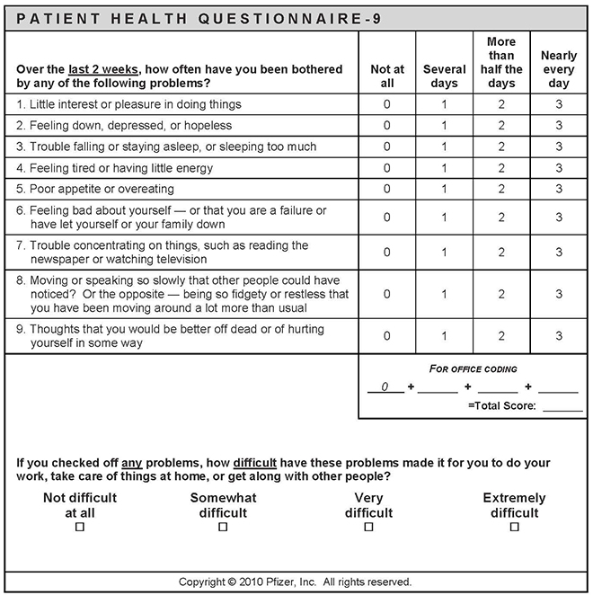
Management of depression
Management of a patient with depression start by assessing the severity of the depression using depression symptoms count or patient self-complete measures , such as PHQ-9

Slide 36
Management of depression
Mild depression (PHQ-9 of 5-9)
Usually managed by psychological therapy alone.
Moderate depression (PHQ-9 of 10-14)
Psychological therapy and/or antidepressant.
Severe depression (PHQ-9 of >20)
Antidepressant, and consider addition of psychological therapy to maintain remission.

Slide 37
Antidepressants
Selective Serotonin Reuptake Inhibitors (SSRIs):​e.g. fluoxetine, paroxetine.
Selective serotonin – Norepinephrine Reuptake Inhibitors (SNRIs): e.g. venlafaxine, duloxetine.
Have proven to be very useful in the treatment of severe depression. They shorten the duration in most cases.
Desirable therapeutic antidepressant effect requires a period of time, usually 3-5 weeks.

Slide 38
Psyco-somatic​

Slide 39
Case Scenario​
Nasser is a 30 years old healthy male. after his mother passed away his life would never be the same. he developed symptoms like dizziness, migraines and stomach pain.​

Slide 40
somatic symptom disorder​
Somatization: Physical symptoms in response to emotional distress. Characterized by an excessive preoccupation with bodily sensations combined with a fear of physical illness. Common feature of depression, anxiety, schizophrenia, and substance use.​
Medically unexplained symptoms (MUS): are physical symptoms for which no organic cause can be demonstrated​

Slide 41
Classification MUS​
Classification MUS can be divided into 3 types of complaint: ​
Pain of a specific location, e.g. back pain, headache, fibromyalgia ​
Functional disturbance in a particular organ, e.g. IBS, palpitations ​
Fatigue/exhaustion e.g. chronic fatigue syndrome ​
Many patients have >1 MUS. There are also common overlaps of symptoms, e.g. patients with IBS often meet diagnostic criteria for chronic pelvic pain and vice versa.​

Slide 42
Causes of somatic symptom disorder​
The exact cause of somatic symptom disorder is unknown, but any of these factors may play a role:​
Genetic and biological factors, such as an increased sensitivity to pain​
Experiencing stressful life events, trauma or violence​
Having experienced past trauma, such as childhood sexual abuse​
Having anxiety or depression​
People who have a negative outlook ​

Slide 43
Prevalence in Saudi Arabia​
A study was performed in primary care patients at the King Khalid University Hospital at 2002, out of 431 primary care patients shows clinically significant prevalence rates of somatization (19.3 %) .​
A study was performed in Asir region 2008, of the 227 patients who were approached, the prevalence of somatization detected by general health questionnaire was 16%​
A cross sectional study was conducted in 2014 among 400 adult attendants of three primary health care centers in Abha City. High prevalence of somatization was reported among patients in the age group 51-60 years. The prevalence of somatoform disorders was 60.8%. ​

Slide 44
Patient with somatic disorder Presents with:​
>2y history of multiple symptoms with no physical explanation. ​
Refusal to be reassured that there is no explanation for the symptoms. ​
Impaired social/family functioning due to these symptoms and/or associated behavior. ​
People with somatic symptom disorder typically go to a primary care provider rather than psychiatrist or other mental health professional. They often refuse to believe their symptoms are the result of mental or emotional causes rather than physical causes. ​

Slide 45
Clinical features​
Those symptoms may include:​
Generalized symptoms; Abdominal pain that is vague , Arthralgia, Backache, Chest pain that is nonspecific, Chronic tiredness and fatique, Headache​
Gastrointestinal symptoms; Chronic bloating, Constipation, Diarrhea, Food intolerance to multiple foods, Nausea and vomiting​
Genitourinary symptoms; Erectile dysfunction,Decreased libido, Dysuria, Menses that is painful, irregular, and heavy​
Neurological;Headaches,Dizziness, Amnesia ,Vision changes ,Paralysis or muscle weakness​

Slide 46
Diagnosis:​
According to the (DSM-5) category of Somatic Symptom Disorders and Other Related Disorders represents a group of disorders characterized by thoughts, feelings, or behaviors related to somatic symptoms.​
Criteria for Somatic Symptom Disorder.​
A. One or more somatic symptoms that are distressing or result in significant disruption of daily life.​
B. Excessive thoughts, feelings, behaviours related to the somatic symptoms or associated health concerns as manifested by at least one of the following:​
Disproportionate and persistent thoughts about the seriousness of one's symptoms. ​
Persistently high level of anxiety about health or symptoms. ​
Excessive time and energy devoted to these symptoms or health concerns. ​
C. Although any one somatic symptom may not be continuously present, the state of being symptomatic is persistent (typically more than 6 months).​

Slide 48
Management
The components of SSD currently treated include the following:​
1- Somatic symptoms​
2- Health related anxiety​
3-Preoccupation and rumination about health concerns​
4-Unhelpful illness behaviours​

Slide 49
Treatments used as interventions for these components include:​
1- Psychiatric consultation intervention (PCI)
2-Cognitive based therapy (CBT)
3- Behavioral techniques (relaxation training and mindfulness)
4- Other psychotherapies
5- Psychotropic medications​

Slide 50
Counselling​

Slide 51
Counselling​
Usually reflective listening to encourage patients to think about and try to resolve their own difficulties.​

Slide 52
Psychological therapies​

Slide 53
Types of psychological therapies​
1-Problem-solving therapy (PST) ​ | 6-Behavioural activation​
2-Cognitive behaviour therapy (CBT)​ A-Behavioural therapies B- Cognitive therapy​ | 7-Interpersonal therapy (IPT)​
3-Individual non-facilitated self-help​ | 8-Psychoeducational groups​
4-Guided self-help​ | 9-Applied relaxation​
5-Mindfulness-based cognitive therapy​

Slide 54
1-Problem-solving therapy (PST)
drawing up a list of problems and generating and agreeing solutions, broken down into steps.
2.A-Behavioural therapies
Aim to change behavior, uses a system of graded exposure
2.B-Cognitive therapy
Focusses on people’s thoughts and the reasoning behind their assumptions on the basis that incorrect assumptions

Slide 55
3-Individual non-facilitated self-help
involves a self-help resource (usually a book, workbook or online) usually with minimal therapist contact, for example an occasional short telephone call of no more than 5 minutes
4-Guided self-help
Uses books/printed materials under the supervision of a trained facilitator who introduces, monitors, then reviews the outcome of each treatment
5-Mindfulness-based cognitive therapy​
Skills training programme designed to enable patients to prevent the recurrence of depression​

Slide 56
6-Behavioural activation​
Therapist and patient work together, with the aim of identifying effects that the patient’s behaviour might have on symptoms, mood, and problems.​
7-Interpersonal therapy (IPT): ​
Individual or group therapy concentrating on the difficulties that arise in maintaining relationships with others. Focusses on current, not past, relationships and works on the premise that if interpersonal conflicts are resolved​
8-psychoeducational Group therapy​
can be used to explore depression or chronic physical health conditions, e.g. diabetes. Run by trained practitioners, they also involve the element of peer support​
Group or individual therapy that teaches patients to relax quickly in different situations​
9-Applied relaxation​

Slide 57
When to refer to Psychiatrist ?​
Medically unexplained symptoms​
Psychotically depressed (with delusions or hallucinations)​
Substance abuse/addiction​
Signs of dementia​
Suicidality​
harmful drinking or alcohol dependence​
Self-neglect​
in risk to self or others​
Poor response to treatment​

Slide 58
Q1
The fear of being alone in public places, particularly places from which a rapid exit would be difficult or help might not be available is a definition of which of the following?
Social Phobia
Specific Phobia
Agoraphobia
Panic attack

Slide 59
Q2
Treatment of choice for panic disorder?
Cognitive behavioral therapy
Selective Serotonin Reuptake Inhibitor
Benzodiazepine
Non of the above

Slide 60
Q3
According to depression diagnostic criteria which of the following symptoms must be present?
Loss of interest
Fatigue, loss of energy
Feeling worthlessness
All of the above

Slide 61
Q4
A 45 years old female came to you 3 times within 2 weeks C/O severe abdominal pain. Her vital signs was normal, on examination her abdomen is soft and there is no remarkable signs. Her brother died 2 months ago due to colon cancer. What is the most likely diagnosis:
A- SSD
B- IBD
C-peptic ulcer
D- colon cancer

Slide 62
Q5
Focuses on people’s thoughts and the reasoning behind their assumptions.
A- Problem-solving therapy
B- Behavioral therapy
C- Cognitive therapy
D- Guided self-help

Slide 63
Case discussion

Slide 64
Case discussion
A 30 years old male came to your clinic complaining of inability to sleep and feels tired all the time

Slide 65
Take Home Messages
Anxiety, depression and somatic symptoms disorder are common psychiatric problems in Saudi Arabia.
Depression is more common in young adults
Panic attacks are sudden self-limited attacks of intense anxiety
SSD is a syndrome of physical symptoms that cause substantial distress or psychosocial impairment.

Slide 66
References
https://emedicine.medscape.com/article/286227-clinical
https://adaa.org/understanding-anxiety/generalized-anxiety-disorder-gad
https://www.webmd.com/anxiety-panic/guide/generalized-anxiety-disorder#1
https://emedicine.medscape.com/article/287913-overview
https://www.researchgate.net/publication/266194032_Depression_and_Anxiety_among_Males_Attending_Primary_Health_Care_Centers_Eastren_Saudi_Arabia_Prevalence_and_Predictors

Slide 67
References
Oxford Handbook of General Practice, 4th edition.​
https://www.ncbi.nlm.nih.gov/pmc/articles/PMC5563525/​
https://www.ncbi.nlm.nih.gov/pubmed/29209674​
https://bmcpsychiatry.biomedcentral.com/articles/10.1186/1471-244X-14-190​
American psychiatric association. Diagnostic and statistical manual of mental disorders. 5th ed. Washington, DC: American psychiatric publishing: 2013 ​
https://www.physio-pedia.com/Somatic_Symptom_Disorder​

