Slide 1
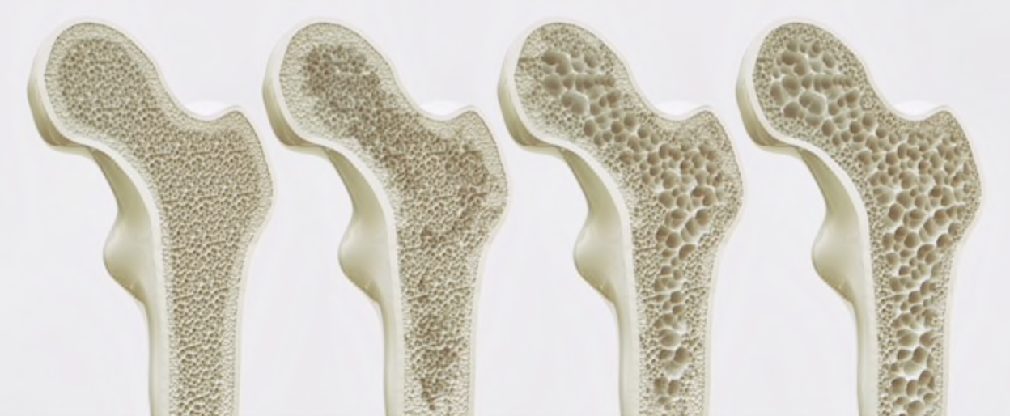
Osteoporosis
Abdulrahman AlZamil 435105884
Fahad Alabdullatif 435102745

Slide 2
Objectives
Definition of Osteoporosis and Osteomalacia / Rickets
Highlight on Vitamin D deficiency:
Prevalence in world / Saudi Arabia
Factors lead to Osteoporosis and Vitamin D deficiency
How patients could be presented
Common fractures with osteoporosis
Vitamin D and Comorbidities
Diagnosis, through
X- Ray
Role of DXA and how interpret (Normal, Osteopenia [Grades] and Osteoporosis)
Biochemistry
Management: (Osteopenia and Osteoporosis)
Prevention and advice
Role of Vitamin D and Calcium
Role of medications for osteoporosis

Slide 3
Quiz
Q1: 10 months Old female, presented to the clinic with bowed legs, dental problems and her growth profile is disturbed, what is the most likely diagnoses?
A. Osteomalacia
B. Rickets
C. Osteoporosis
D. Hypothyroidism

Slide 4
Quiz
Q2: Which of the following is the optimal daily intake of calcium for postmenopausal women?
A- 1200 mg
B- 1000 mg
C- 1500 mg
D- 900 mg

Slide 5
Quiz
Q3. Which of the following is the best way for adequate vitamin D levels:
A- Using sunscreens
B- Exposure to sunlight
C- Using supplements
D- Smoking cessation

Slide 6
Quiz
Q3. Which of the following is the best way for adequate vitamin D levels:
A- Using sunscreens
B- Exposure to sunlight
C- Using supplements
D- Smoking cessation

Slide 7
Quiz
Q4. Which one of the following isn't a risk factor for osteoporosis?
A - smoking
B - post-menopause
C - history of fragility fracture
D- D.M

Slide 8
Quiz
Q5. Which of the following DEXA values is diagnostic for osteopenia?
A- (-1.5 SD)
B- (-2.5 SD)
C- (-3)
D- (-0.9)

Slide 9
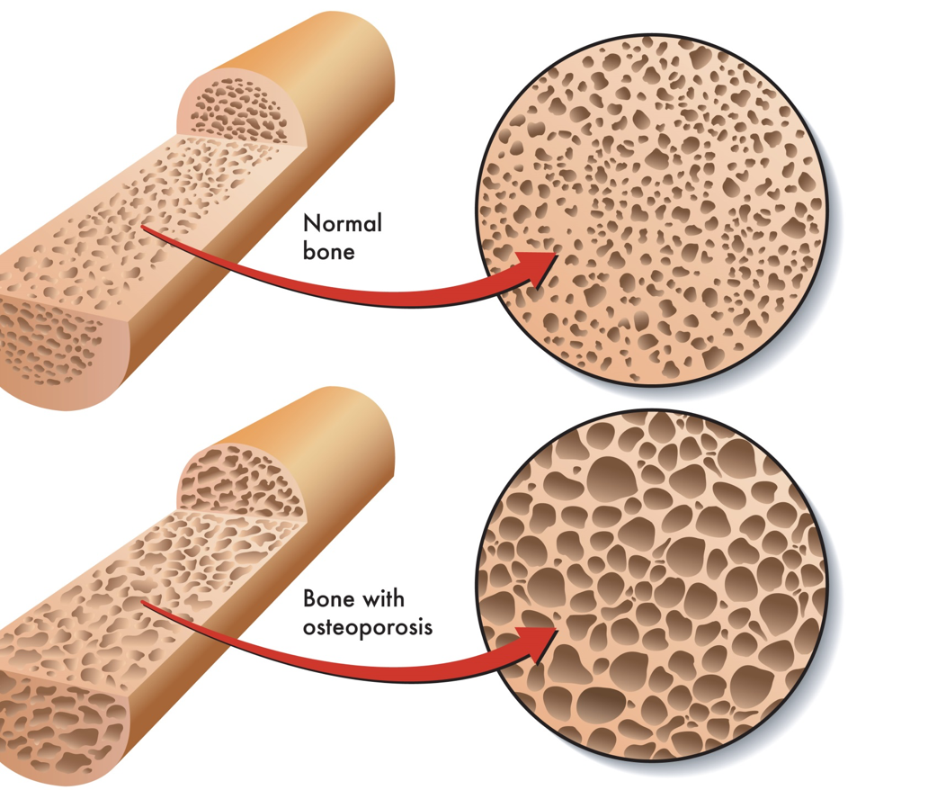
Osteoporosis
Characterized by low bone mass (Osteopenia)
Depletion of both calcium and bone protein
Micro architectural disruption
Normal mineralization
Painless, unless it causes a fracture
Risk factors:
Race (Caucasian)
Age
Hereditary
Body build (thin people)
Early menopause
Smoking/ alcohol intake/ drug abuse
Calcium intake (low Ca)
Secondary osteoporosis

Slide 10
Osteomalacia and Rickets:
Osteomalacia:
Deficient mineralization of bone and occurs after the closure of the growth plates (in adulthood).
All skeleton is incompletely calcified in adults.
Rickets:
Deficient mineralization of bone and cartilage and occurs before the closure of the growth plates (in childhood) resulting in bow legs.
Affects Areas of endochondral growth in children
Risk factors and causes:
Calcium deficiency
Hypophosphatemia
Defect in Vitamin D metabolism (nutritional, underexposure to sunlight, intestinal malabsorption, liver & kidney diseases)

Slide 11
Vitamin D
A group of fat-soluble sterol compounds that includes ergocalciferol (vitamin D2) and cholecalciferol (vitamin D3).
We can get it from:
Plant and animal sources
Exposing skin on exposure to ultraviolet light.
When activated in the liver and then the kidney, vitamin D promotes calcium absorption and bone mass.
A 25(OH) level of approximately 30 ng/ml (75 nmol/L) is considered by many to be optimal.

Slide 12
VITAMIN D: FROM WHERE DO WE GET VITAMIN D ?

Slide 13
Prevalence of Vitamin D deficiency:
The prevalence of low vitamin D levels may be increasing globally In a review of vitamin D levels in different regions of the world:
Vitamin D levels below 30ng/mL (75 nmol/L) were prevalent in every region studied
Low vitamin D levels (<10 ng/mL [25 nmol/L]) were more common in South Asia and the Middle East than in other regions .
In Saudi Arabia, osteoporosis is already a serious issue a report in the eastern region of Saudi Arabia indicates :
The incidence of postmenopausal osteoporosis (PMO) of 30 percent to 40 percent
Over 60 percent of postmenopausal women already having some degree of osteopenia.
lSaudi Med J. 2004 Oct;25(10):1423-7.

Slide 14
Prevalence of Vitamin D deficiency:

Slide 15
Prevalence of Vitamin D deficiency:

Slide 16
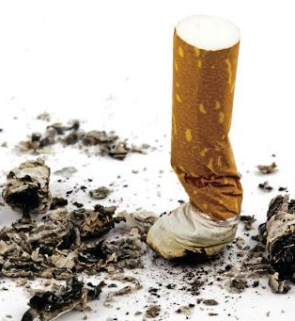
RISK FACTORS for osteoporosis and Vit D deficiency:
SMOKING:
Cigarette smoking was first identified as a risk factor for osteoporosis more than 20 years ago.
How does smoking affect bone health?
Cigarette smoke generates huge amounts of free radical and disturb balance of hormones (like estrogen) that bones need to stay strong.
Increased levels of the hormone cortisol, which leads to bone breakdown.
Smoking also damages blood vessels, so there is poor blood supply.

Slide 17
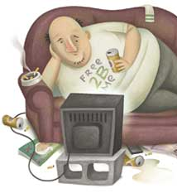
RISK FACTORS: PHYSICAL INACTIVITY
People who spend a lot of time sitting have a higher risk of osteoporosis than do those who are more active.
Physical activity prevent osteoporosis is based on evidence that it can regulate bone maintenance and stimulate bone formation and this reducing the overall risk of falls and fractures.
Most experts recommend exercising for at least 30 minutes three times per week.

Slide 18
RISK FACTORS : MEDICAL DISEASES
Premature menopause
Malabsorption
Chronic liver disease
IBD

Slide 19
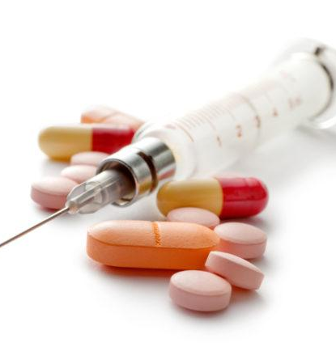
RISK FACTORS : MEDICATIONS
Steroids
Thyroxine(high ammount)
Phenytoin and Barbiturates
Aromatase Inhibitors and methotrexate
Thiazolidinediones
Chronic Lithium use

Slide 20
HOW PATIENTS COULD BE PRESENTED ?
There are no symptoms in the early stages of bone loss. But once bones have been weakened by osteoporosis, you may have signs and symptoms that include:
Back pain, caused by a fractured or collapsed vertebra
Loss of height over time
A stooped posture
A bone fracture that occurs much more easily than expected

Slide 21
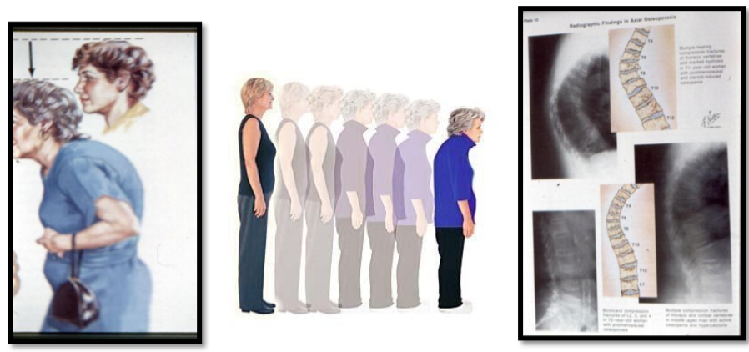

Slide 22
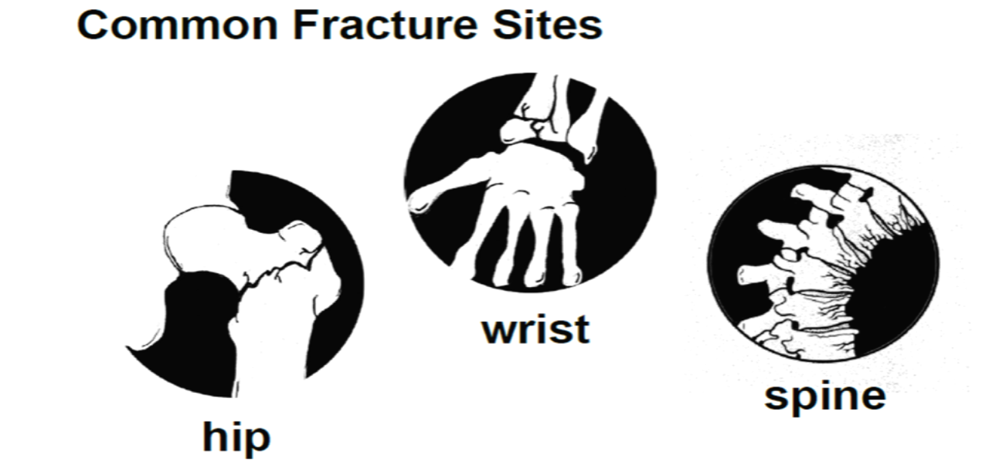
COMMON FRACTURES WITH OSTEOPOROSIS:
Spine Fractures: The most common type of spinal fracture (also known as a vertebral fracture) in people with osteoporosis is called a wedge or compression fracture.
Hip and Pelvis:
Femoral neck fractures: occurring in the narrow section of bone between the main shaft of the femur and the ball
Intertrochanteric hip fractures: where the shaft of the femur breaks just below the femoral neck.

Slide 23
COMMON FRACTURES WITH OSTEOPOROSIS:
Wrist and forearm: Falls are the most common cause of fractures of the wrist and forearm.
The two most common types of wrist fracture are:
Colles’ fracture: this is a fracture to the lower end of the radius, and very common in people with osteoporosis.
Scaphoid fracture : the scaphoid is a wedge-shaped bone located on the thumb side of the wrist, just where it meets the radius.
These fractures are less commonly related to osteoporosis.

Slide 24
COMORBIDITIES AND VITAMIN D:
CVS
Hypertension
Obesity
Diabetes

Slide 25
HOW DO WE DIAGNOSE OSTEOPOROSIS ?

Slide 26
X-Ray
Traditional X-rays can’t measure bone density , as more
than 30-50% bone loss is required to appreciate
decreased bone density on radiograph.

Slide 27
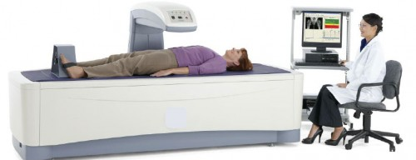
DEXA SCAN
A BONE DENSITY TEST IS THE ONLY TEST THAT CAN DIAGNOSE OSTEOPOROSIS BEFORE A BROKEN BONE OCCURS. THIS TEST HELPS TO ESTIMATE THE DENSITY OF YOUR BONES GOLD STANDARD TEST.

Slide 28
DEXA SCAN RESULTS
DEXA scores are reported as "T-scores" and "Z-scores."
The T-score is a comparison of a person's bone density with that of a healthy 30-year-old of the same sex.
The Z-score is a comparison of a person's bone density with that of an average person of the same age and sex.

Slide 29
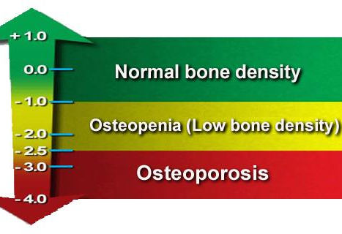
DEXA SCAN RESULTS
≥ -1.0 : normal
< -1.0 to < -2.5 : osteopenia
≤ -2.5 : osteoporosis

Slide 30
Fracture Risk Assessment Tool (FRAX)
FRAX score : https://www.sheffield.ac.uk/FRAX/tool.aspx?country=9
Your FRAX score is your risk of having an osteoporosis-related fracture in the next 10 years .
The formula for measuring your risk uses factors such as:
age
weight
gender
smoking history
alcohol use
fracture history

Slide 31
Labs:
Laboratory evaluation – postmenopausal women with low BMD ( T-score below -2.5 ) and/or fragility fracture have the following basic tests:
Biochemistry profile (especially calcium, phosphorous, albumin, total protein, creatinine, liver enzymes including alkaline phosphatase, electrolytes).
25-hydroxyvitamin D (25[OH]D).
Complete blood count (CBC).
Thyroid stimulating hormone ( TSH )
Vitamin D deficiency, characterized by hypocalcemia and/or hypophosphatemia

Slide 32
When to treat?
The National Osteoporosis Foundation recommends treatment for:
Postmenopausal women with T-scores less than -2.0, regardless of risk factors.
Postmenopausal women with T-scores less than -1.5, with osteoporosis risk factors present.
In addition, anyone with a fragility fracture (a fracture from a minor injury) should be treated for osteoporosis. regardless of the DEXA scan results.

Slide 33
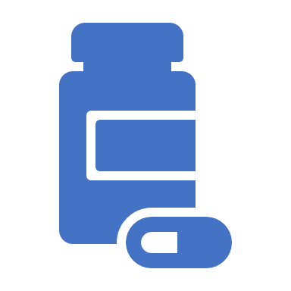
Management
Non-pharmacological
Pharmacological

Slide 34
Management goals
Prevent fractures.
Improve Quality of Life.
Increase Bone Density and Mineralization.
Prevent Further Falls.

Slide 35
NON-PHARMACOLOGICAL THERAPY
Diet: Adequate Vitamin D and Calcium intake
Exercise: weight-bearing exercises
Smoking cessation: because smoking accelerates bone loss
Eliminate or reduce alcohol
Avoid drugs that affect the bone (glucocorticoids)

Slide 36
Pharmacological therapy
Bisphosphonate
Denosumab
Selective estrogen receptor modulator “Tamoxifen and Raloxifine”
Parathyroid hormone (Teriparatide)
Calcitonin Recommended to be given with Vitamin D and calcium

Slide 37
Pharmacological therapy
Bisphosphonate : (The first drug we start with)
Drugs which inhibit osteoclast activities: e.g. Bisphosphonates like sodium alendronate.
drug of choice for management of adrenal glucocorticoid-induced osteoporosis.
Can cause osteonecrosis of the jaw.

Slide 38
Pharmacological therapy
Teriparatide (Forteo)
Teriparatide is approved for the treatment of postmenopausal women with severe bone loss, men with osteoporosis who have high risk of fracture, and individuals whose condition has not improved with bisphosphonate therapy.
20 mcg subcutaneous per day for up to 2 years
Side effects: Arthralgia, pain, nausea, transient orthostatic hypotension, hypercalcemia, hyperuricemia

Slide 39
Pharmacological therapy
Denosumab (Prolia)
Denosumab is a human monoclonal antibody that inhibits the formation and activity of osteoclasts .
It appears to be a reasonable alternative for persons whose condition does not improve with bisphosphonates.
Side effects:
Small risk of osteonecrosis of the jaw (especially older women with poor dental hygiene or cancer).
Muscular and joint pain
Contraindications:
Hypocalcemia

Slide 40
Pharmacological therapy
Ralofexine
Raloxifene, a selective estrogen receptor modulator.
Used if bisphosphonates are not tolerated or contraindicated
Reduce the risk of breast cancer
Side effects:
Hot flashes , leg cramps , increased risk of blood clots

Slide 41
Pharmacological therapy
Hormone replacement therapy
At some time in the past there was a recommendation of HRT (Hormone replacement Therapy) for post-menopausal women And men; but now this is discontinued because of the side effect ( such as tumor ) .

Slide 42
The National Osteoporosis Foundation (NOF) recommends that pharmacologic therapy should be reserved for:
Postmenopausal women
Men aged 50 years or older who present with the following:
- A hip or vertebral fracture.
- T-score of –2.5 or less.
- Low bone mass (T-score between –1.0 and –2.5 with a 10-year probability of a hip fracture of 3% or greater.

Slide 43
Surgical therapy
Vertebroplasty :
Is the injection of bone cement into the collapsed vertebra
Possible complication is leakage of cement into spinal canal (nerve injury) or venous blood (cement PE).
Kyphoplasty :
Is the injection of bone cement into the collapsed vertebra AFTER inflating a balloon in it to correct collapse and make a void (empty space) into which cement is injected.
https://www.youtube.com/watch?v=_lUhQLFHriw

Slide 44
Prevention
Prevention of osteoporosis should start from childhood
Healthy diet
Adequate sunshine
Regular exercise
Avoidance of smoking or alcohol
Caution in steroid use

Slide 45
Any Questions ? 33000010006080200524

Slide 46
Thank You For Listening

Slide 47
Quiz

