Slide 1
Women health Supervisor: Dr. Sayed Irfan student led seminar: zeyad Rasheed Hassan AlShammasi A1

Slide 2
Objectives:
Screening for tobacco use, alcohol misuse, Intimate partner violence, dyslipidemia, diabetes, blood pressure, and depression
Use of aspirin for primary prevention for CVD. Risks and unique presentations of CVD in women
Preconception and contraception counseling of premenopausal women
Counseling of high-risk sexually active women to reduce the risk of sexually transmitted infections. Screening for chlamydia, gonorrhea and syphilis
Screening of cervical cancer, breast cancer and colorectal cancer and osteoporosis
Recommended immunizations for women
Counseling for menopause

Slide 3
QUESTIONS
Whish of the following is best to screen for alcohol abuse
A) ALT
B) GGT
C) AST
What is the risk to develop CVD in women above the age of 50 ?
A) 20%
B)30%
C)40%
Q\ What is the most common cause of cervical cancer?
A) HPV
B) smocking
C) EBV

Slide 4
What do we mean by screening?
Screening refers to the use of simple tests across an apparently healthy population in order to identify individuals who have risk factors or early stages of disease, but do not yet have symptoms (WHO)
When a screen tool is described as efficient ?
2 major criteria
(specificity and sensitivity )
Sensitivity mean that if the disease is there it will catch it
Specificity mean that if the disease is not there it wont report it

Slide 5
But why screening ?
Advantages of screening :
Early detection of a disease can dramatically change a prognosis for patients
It has a an economic role in which the coast of treatment can reduced
It’s a research tool in which you can apply multiple studies to the society and its health
It can orient and educate public about the disease they are prone to and teach them a
bout it
Is there any negative aspect of screening?
Yes
False positive result can lead to un needed intervention and un necessary worry to patient
A false negative result : lead ti missing the disease and falsely insure the patient about is health

Slide 6
What are different types of screening
Mammography. A mammogram is a special type of X-ray of the breasts. ...
Echocardiography. ...
Pap smear
Psa level
Complete Blood Count (CBC) ...
Colonoscopy. ...
Prothrombin Time (PT) ...
Bone Density Study. ...
Computer Axial Tomography (CT or CAT Scan)
etc.

Slide 7
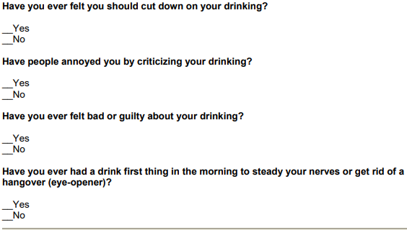
Screening for tobacco alcohol misuse :
CAGE TOOL modified
“CAGE” is an acronym formed from the italicized words in the questionnaire (cut-annoyed-guilty-eye).
Need 2 for men and one for women

Slide 8
Other useful screening tests
Alcohol odor
Lab LFT,GGT
Slurred speech

Slide 9
DM
Whom we screen ?
All adults beginning at 45 years of age.
Adults with BMI ≥ 25 plus one of the following risk factors:
Physical inactivity .
1st degree relative with DMT2.
Hypertension.
HDL < 35 mg/dL or TAG > 150 mg/dL.
Polycystic ovarian syndrome
Screening method: Random blood sugar
Oral glucose tolerance test
HBA1C
Retinal exam

Slide 10
HTN (130/90)mmhg
Office measurement of blood pressure is most commonly done with a manual or automated sphygmomanometer
ANNUAL screening for adults aged 40 years or older AND for those who are at increased risk for high blood pressure
Adults aged 18 to 39 years with normal blood pressure (<130/85 mm Hg) who do not have other risk factors should be rescreened every 3 to 5 years

Slide 11
Dyslipidemia
Dyslipidemia: serum HDL <1.2mmol/L (male) or <1.0 (female); fasting serum triglycerides >1.8mmol/L
Recommended 5-yearly health checks for those aged 40–74y including a lipid profile is recommended
Routine follow up: Take non-fasting samples, testing
total blood cholesterol and total cholesterol: HDL ratio

Slide 12
Intimate partner violence,
The 6 tools that showed the most sensitivity and specificity were:¹¹
HITS (Hurt, Insult, Threaten, Scream)
OVAT (Ingoing Violence Assessment Tool)
STaT (Slapped, Things and Threaten) HARK (Humiliation, Afraid, Rape, Kick)

Slide 13
Depression
Screening questions:
During the last month, have you often been bothered by feeling down, depressed, or hopeless?
During the last month, have you often been bothered by having little interest or pleasure in doing things?
If +ve response to either question, further investigations are required

Slide 14
Risks of CVD in women
leading cause of death for women in the United States.
The average lifetime risk of developing CVD in women at 50 years of age is ≈40%
Unique presentations of CVD in women

Slide 15
Use of aspirin for primary prevention for CVD. Risks and unique presentations of CVD in women
Aspirin
Aspirin (ASA) has proven to be effective for both men and women in the secondary prevention of CVD and in the treatment of acute MI. However, for primary prevention of CVD in women, data have been more limited. In the large-scale Women’s Health Study (WHS), almost 40,000 healthy women over the age of 45 were randomly assigned to low dose ASA (100 mg every other day) or to placebo for ten years, and major CVD events were evaluated.
Overall, the trial showed a statistically non-significant 9% reduction in the primary composite outcome of major CVD events with low-dose aspirin
https://www.ncbi.nlm.nih.gov/pmc/articles/PMC4834856/.

Slide 16
unique presentations of CVD in women
After sudden cardiac death, the most common presentation of obstructive CAD for women is atypical symptoms such as back pain, indigestion, nausea/vomiting and weakness Frequently women reported pain in the jaw and neck and describe their symptoms as more anguished and frightening (emotional component) compared with men

Slide 17
Preconception counseling of premenopausal women

Slide 18
Contraception counseling
A sexually active woman has an 85% chance of becoming pregnant in <1y without contraception, and 1 in 3 pregnancies are unplanned.
The goals of contraceptive counseling:
Educate women about contraception
Discuss current and future contraceptive needs
Select a contraceptive modality,

Slide 19
Q/ Menopause is diagnosed by ?
>12 months amenorrhea with no other cause

Slide 20
Counseling for menopause
Psychological symptoms in menopause (depression/anxiety) are controversial, Some studies report that thy are more common, others find no association
Depression is multifactorial—consider social, physical, and cultural
factors.
Before choosing HRT as solution some regular aerobic exercise (swimming/ running) might help in decrease them and insomnia as well.

Slide 21
Flushes and sweats
80% of women have flushes during the menopause which is associated with mild palpitations , 20 % seek help
Lifestyle changes with Low-intensity exercise (e.g. yoga) and; avoiding trigger foods/drinks (e.g. spicy foods, caffeine, alcohol).
Drug : (Gabapentin) decrease flushes by 45%

Slide 22
Sexual dysfunction and urinary problems
Vaginal dryness and atrophy are common and managed by topical (atropine), loss of libido responds to administration of androgen with HRT, until libido is re-established.
Urine incontinence, nocturnal, and urgency are the most common urinary problem asked for help
No response for HRT ,topical estrogen may show some benefits

Slide 23
Before treating menopause woman
We should exclude
Physical illness, e.g. thyroid disease, anemia, DM, chronic renal disease
Side effects of medication, e.g. Ca2+ antagonists cause flushing
Social problems or psychiatric illness

Slide 24
Contraception counseling
A sexually active woman has an 85% chance of becoming pregnant in <1y without contraception, and 1 in 3 pregnancies are unplanned.
The goals of contraceptive counseling:
Educate women about contraception
Discuss current and future contraceptive needs
Select a contraceptive modality,

Slide 25
The effect of STIs on women can be more serious than men. Untreated STIs can cause infertility, pelvic inflammatory diseases, pre-term delivery, and fetal/neonatal pathologies, ectopic pregnancy, increased risk of HIV transmission or worst cervical cancer.
STIs among women

Slide 26
Sexually transmitted infection
Criteria of screening :
All sexually active women 24 years and younger should be screened annually for chlamydia.
All adolescents should be screened and adults through 65 years of age for HIV
High risk group:
Sexually active adults, with multiple partners
who have an STI or have had one within the past year
Causative organisms: chlamydia, gonorrhea, syphilis, HIV

Slide 27
HOW CAN STIs AFFECT THE MOTHER AND HER FETUS ?
She may pass the infection to her baby before, during, or after the baby’s birth.
She could go into labor too early. This makes it more likely that her baby will be born weighing less than 5 pounds, which is less than a healthy newborn baby should weigh
The infection may cause serious health problems in her baby.
HOW CAN WE PREVENT THAT??
(“C-section”) to protect her baby from infection.

Slide 28
Screening of chlamydia
Chlamydia is preventable cause of infertility, ectopic pregnancy and inflammatory pelvic disease.
Screening programs aimed :
younger people>25 to reduce the prevalence
SCREENING METHOD :
-Urine test
-Self-taken vagina swab

Slide 29
Screening of gonorrhea
Swab.
Urine Vagina test.
Screening of syphilis
If suspected send blood sample for serologic test (nonterponemal test VDRL,TPHA) or treponema antibody absorption test.

Slide 30
Osteoporosis
Screening for osteoporosis involves fracture risk assessment and measurement of bone mineral density We recommend assessing risk factors for fracture in all adults, especially postmenopausal women
Q/Risk factors??

Slide 31
Risk factors
Advanced age
Previous fracture
Long-term glucocorticoid therapy
Low body weight (less than 58 kg [127 lb])
Family history of hip fracture
Cigarette smoking
Excess alcohol intake

Slide 32
Test of screening
Dual-energy x-ray absorptiometry
DXA is the most widely used method for measuring BMD
Criteria of screening:
in all women 65 years of age and older
in postmenopausal women less than 65 years if one or more risk factors are present .
We suggest not performing routine BMD(bone mineral density) measurements in premenopausal women.
Postmenopausal women with fracture

Slide 33
Site of screening:
DXA of hip and spine.
Repeat of screening:
- In women 65 years of age and older with normal or slightly low bone mass with no risk factor (follow-up DXA in 10 to 15 years).
- In women 65 years of age and older with low bone mass at any site, and with no risk ( follow-up DXA in three to five years )

Slide 34
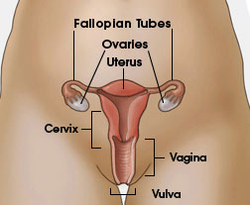
Cervical Cancer
Cervical cancer used to be the leading cause of cancer death.
Cervical cancer is the third most common cancer in the world.
Cervical cancer is highly preventable because screening tests and a vaccine to prevent human papillomavirus (HPV) infections are available.
Notes:
In women in developing countries, cervical cancer was the second most common type of cancer

Slide 35
Risk Factors for Cervical Cancer
Almost all cervical cancers are caused by human papillomavirus (HPV).
Other things can increase your risk of cervical cancer—
- Smoking.
- Having given birth to three or more children.
- Having several sexual partners.

Slide 36
Cervical Cancer: Diagnosis and Treatment
Early detection: Pap test.
Tests to confirm a diagnosis of cervical cancer include:
- A colposcopy and cervical biopsy.
- An endocervical biopsy (or curettage).
Treatment
Surgery
Chemotherapy
Radiation

Slide 37
Breast cancer
Breast cancer is the most common cancer among women in the United States.
Breast cancer is the second leading cause of cancer deaths among women in the United States.
Getting mammograms regularly can lower the risk of dying from breast cancer.

Slide 38
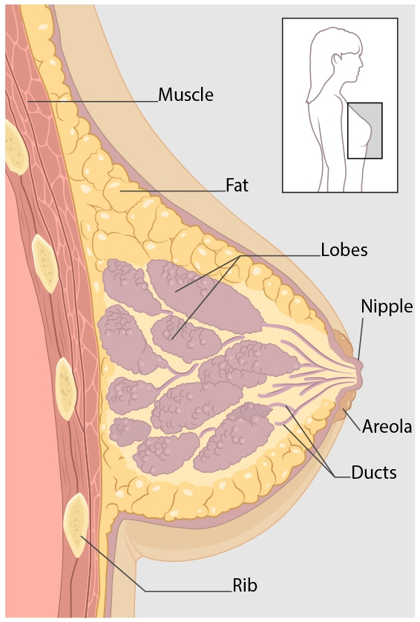
Kinds of Breast Cancer
The most common kinds of breast cancer are :-
- Invasive ductal carcinoma.
- Invasive lobular carcinoma.
There are several other less common kinds of breast cancer, such as Paget’s disease, medullary, mucinous, and inflammatory breast cancer.

Slide 39
Symptoms of Breast Cancer
New lump in the breast or underarm (armpit).
Thickening or swelling of part of the breast.
Irritation or dimpling of breast skin.
Redness or flaky skin in the nipple area or the breast.
Pulling in of the nipple or pain in the nipple area.
Nipple discharge other than breast milk, including blood.
Any change in the size or the shape of the breast.
Pain in any area of the breast.
Notes:
‪nipples was slightly retracting‬
lump

Slide 40
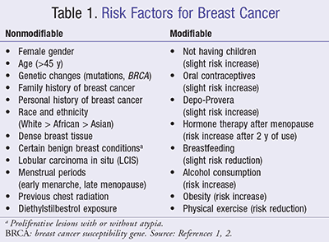
Risk Factors for Breast Cancer
Notes:
depo provera : birth control shot

Slide 41
Diagnosis of Breast Cancer
Breast ultrasound.
Diagnostic mammogram.
Magnetic resonance imaging (MRI)
Biopsy.
Treatment of Breast Cancer
Surgery.
Chemotherapy.
Hormonal therapy.
Radiation therapy.
Notes:
core biopsy

Slide 42
Screening of COLORECTAL CANCER
Colonoscopy:
In strong family history at 35-40 y and repeat colonoscopy aged 55.
every 2 years until 70 y in patient with previous colon cancer.
blood occult test:
every 2 years to the patients aged 60-74 years.
in some cases refer to genetic counseling “as in familial adenomatous polyp”
Prophylactic colonoctomy “cases as ulcerative colitis”

Slide 43
immunization
maternal immunization protects both the mother and fetus from the morbidity of certain infections
Ideally, women should be vaccinated against preventable diseases in their environment prior to conception according to the recommended adult immunization schedule

Slide 44
general guidelines for immunization of pregnant women:
● immunizations routinely recommended for all pregnant women: tetanus, diphtheria, pertussis, and influenza.
● Following delivery, postpartum women should receive all recommended vaccines that could not be or were not administered during pregnancy (eg, measles, mumps, and rubella; varicella; tetanus toxoid, diphtheria, and acellular pertussis ) .
=in order to protect their health and the fetus from the morbidity of certain infections.
● Providers should be aware of and follow contraindications and precautions for immunization of pregnant women (eg, avoid administration of live attenuated virus vaccines).

Slide 45
Two types of vaccines
Routine Vaccines :
Hepatitis A, Hepatitis B ,Human Papillomavirus (HPV), Influenza (inactivated) , Influenza (LAIV), Measles, Mumps, Rubella (MMR), Meningococcal, Meningococcal (MenB),Pneumococcal Conjugate (PCV13), Pneumococcal Polysaccharide (PPSV23) ,Polio (IPV) , Tetanus, Diphtheria, and Pertussis (Tdap); & Tetanus and Diphtheria (Td) ,Varicella , Zoster
Travel and Other:
Anthrax , BCG , Japanese Encephalitis , Rabies , Typhoid , Vaccinia (Smallpox) , Yellow Fever

Slide 46
Recommended women vaccines
Influenza
Hepatitis A , Hepatitis B (at high risk)
Human papillomavirus (HPV)
Measles , mumps and rubella (MMR)
Meningococcal , pneumococcal at high risk )
Varicella (chickenpox)

Slide 47
Pregnancy vaccines
Pertussis : it can be life threatening for the new born.
Influenza virus : increase the chances of pre-mature labor
and delivery.
Tetanus , diphtheria and additionally Hepatitis B: pregnant women should undergo hepatitis B test.

Slide 48
Postpartum vaccines
Recommended vaccines that could not be administrated during pregnancy, eg: mumps, rubella, tetanus toxoid, measles, varicella and acellular pertussis.
Could be giving live attenuated at this stage !

Slide 49
Travel Recommended vaccines
These vaccines are recommended for pregnant women planning to travel to endemic areas where there is a high risk of exposure:
Anthrax
Japanese Encephalitis(??)
Typhoid
Yellow fever (Breastfeeding is a precaution for yellow fever vaccine)

Slide 50
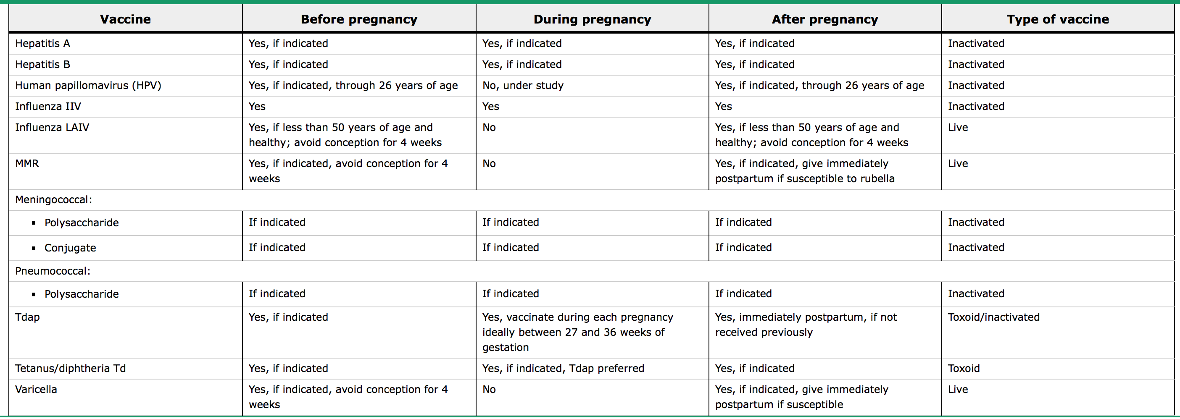
Immunizations that may be administered before, during, and after pregnancy

Slide 51
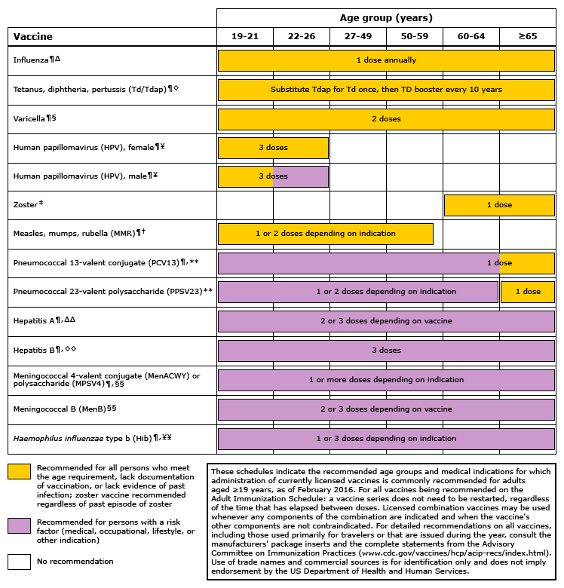

Slide 52
QUESTIONS
Whish of the following is best to screen for alcohol abuse
A) ALT
B) GGT
C) AST
What is the risk to develop CVD in women above the age of 50 ?
A) 20%
B)30%
C)40%
Q\ What is the most common cause of cervical cancer?
A) HPV
B) smocking
C) EBV

Slide 53
https://www.cdc.gov/std/herpes/the-facts/default.htm https://www.cdc.gov/std/chlamydia/the-facts/default.htm https://www.cdc.gov/std/syphilis/the-facts/default.htm https://www.uptodate.com/contents/overview-of-the-treatment-of-newly-diagnosed-non-metastatic-breast-cancer?search=breast%20cancer&source=search_result&selectedTitle=1~150&usage_type=default&display_rank=1 https://www.uptodate.com/contents/screening-for-osteoporosis?source=search_result&search=screening%20osteoporosis%20in%20women&selectedTitle=1~150#H20 https://www.uptodate.com/contents/immunizations-during-pregnancy?source=search_result&search=Recommended%20immunizations%20for%20women.&selectedTitle=1~150
REFRENCESE

