Slide 1
Smoking and Substance Abuse
Supervisor: Prof. Jamal Jarallah
Khalid Ahmed Alnaeem: 435100452
Abdullah Alfraih: 435101761
Mohammed Alfadhel:435106277

Slide 2
Objectives
Epidemiology of smoking in Saudi Arabia
Risks of smoking (Morbidity and Mortality)
Effect of passive smoking on pregnancy, children, ....
Helping the smoker to quit with smoking cessation aids and overcoming nicotine withdrawal symptoms
Role of PHC physician “smoking cessation clinic’
Update of the smoking cessation medication in pharmacological management
Nicotine preparations, Varenicline, Bupropion, .......
Factors that lead to substance abuse
Highlighting types of substance abuse
Method to approach subjects with substance abuse

Slide 3
Mcq’s
According to the ministry of health, what is the percentage of smoking in Saudi individuals ?
10%
12%
15%
18%
Smoking is responsible for approximately what percentage of lung cancers
50%
65%
75%
90%

Slide 4
Mcq’s
Which medication gets rid of symptoms faster than any other medication in term of NRTs ?
skin patches
chewing gum
lozenges
intranasal spray
Nicotine Gum (Nicorette®) is Contraindicated in:
Active temporomandibular joint disease
Eplipsy
Pregnancy
Osteoprosis

Slide 5
Mcq’s
A chronic relapsing and remitting illness, and patients require a longitudinal, chronic care approach “ describes which of the following?
Hazardous use
Substance abuse
Substance dependence
At-risk use
Which of the following is the best treatment for stimulant drug dependence?
Buprenorphine
Beta Blockers
Benzodiazepines
Behavioral Therapy

Slide 7
World Wide
Over 1.1 billion individuals have smoked Tobacco.
Far more males than females
Currently, responsible for approximately 6 million deaths yearly.
Fortunately, declining in many countries.

Slide 8
In Saudi Arabia ??

Slide 9
In Saudi Arabia
12.2% of Saudi individuals are tobacco smokers
Males far greater than females (15-20:1)
Majority are aged between 35-54 years
More than half started before the age of 18 years

Slide 10
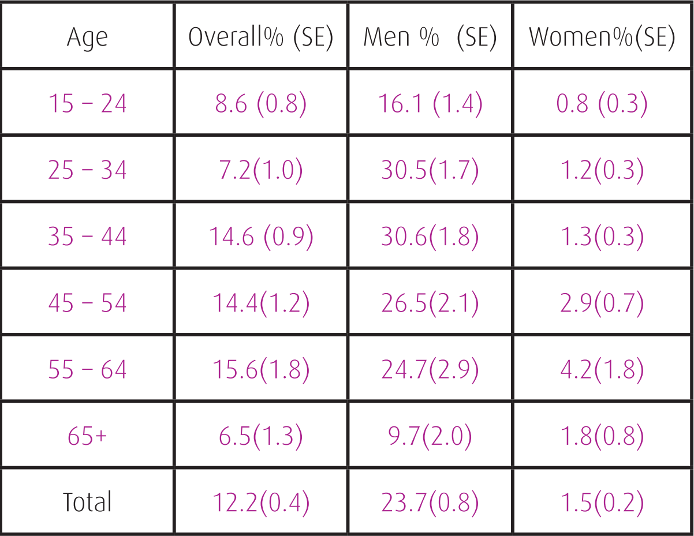
Prevalence

Slide 11
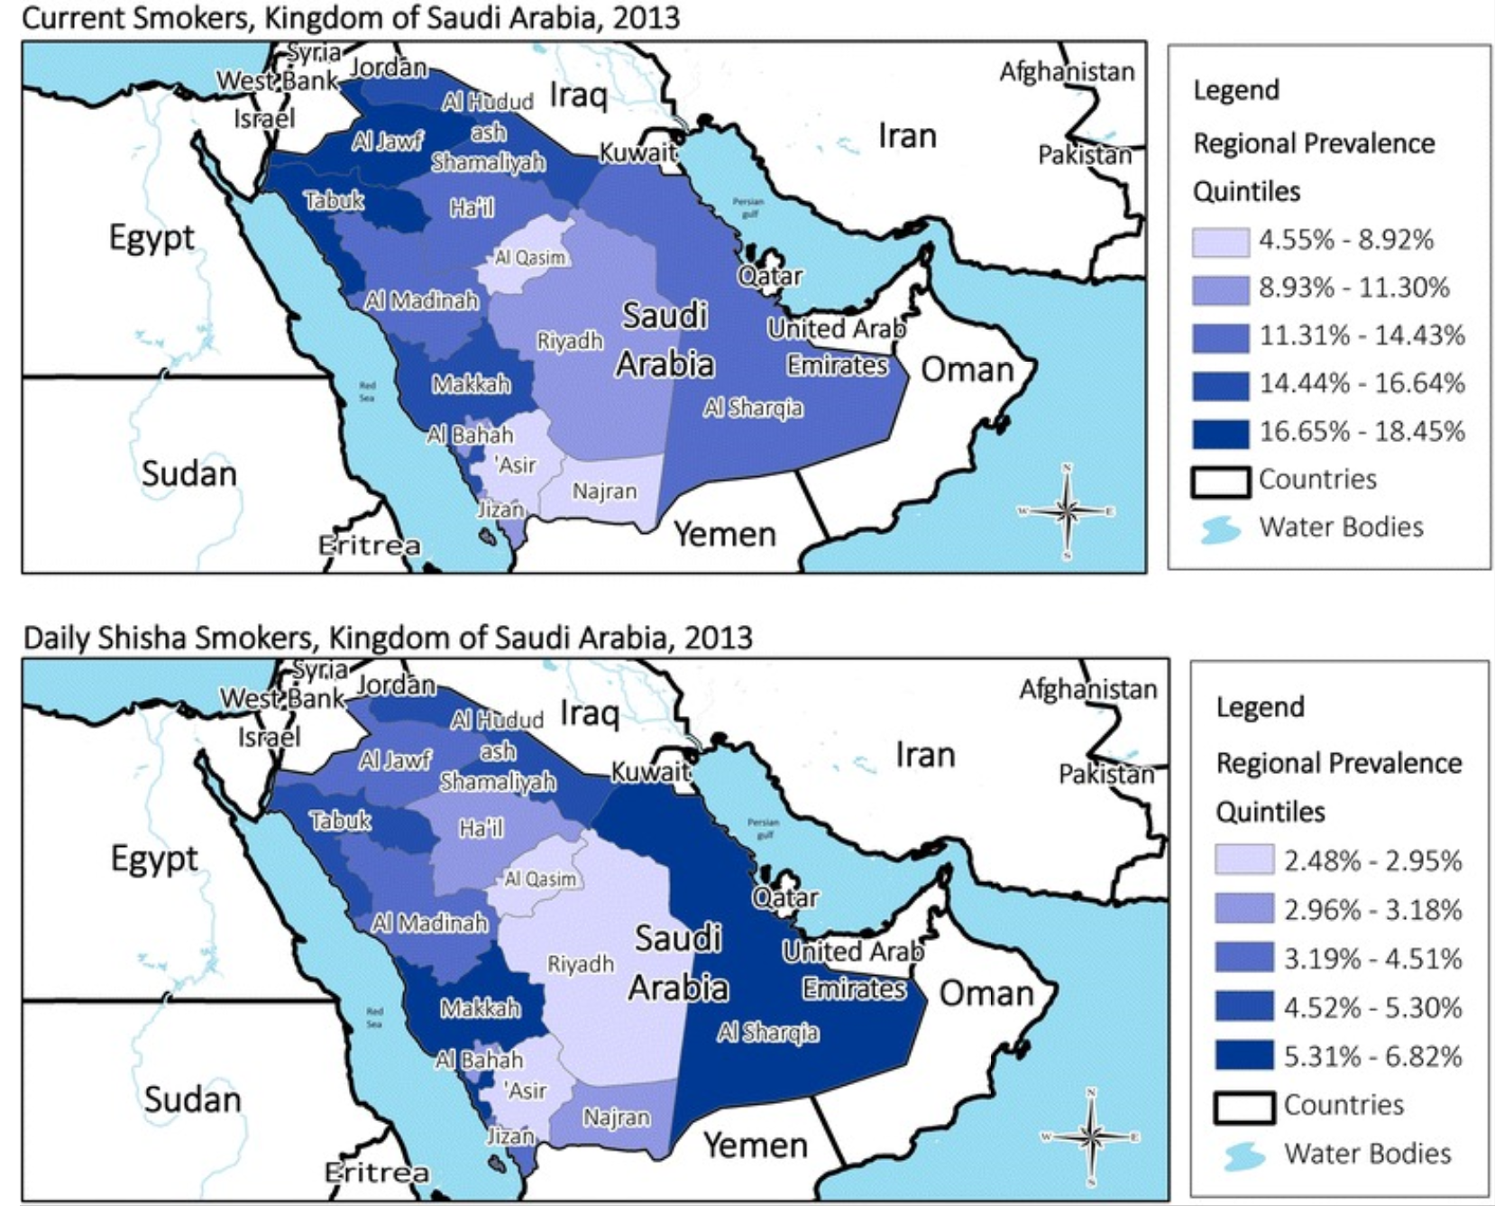

Slide 12
Risks of Smoking

Slide 13
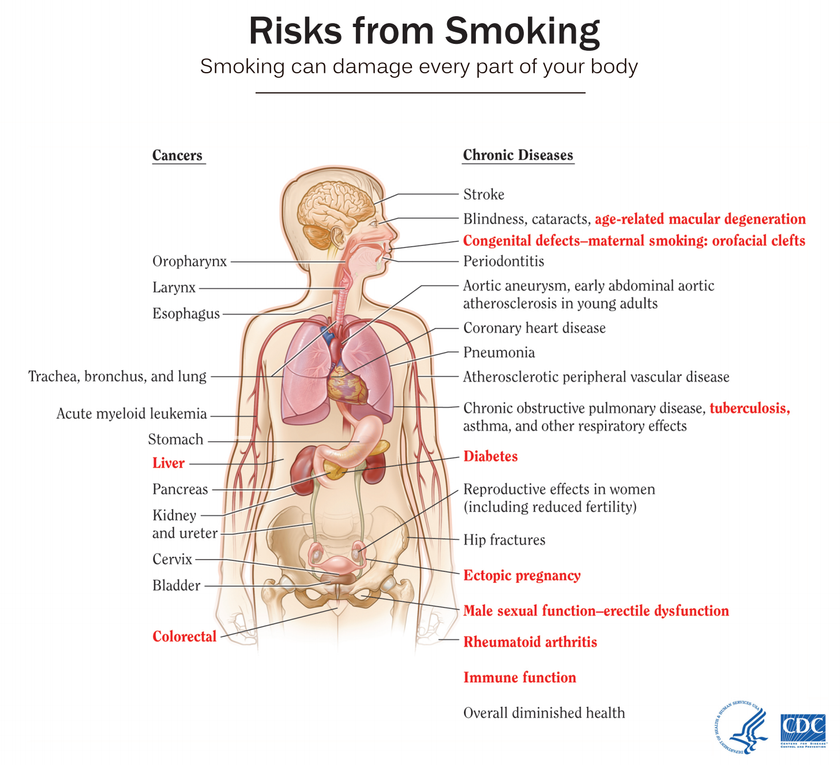
Risks of smoking
Smoking is responsible for around 6 million deaths yearly
It affects a variety of organs systems in the body
The lung is the most affected
Overall, mortality is 3 times that on non smokers.

Slide 14
Smoking and Respiratory Diseases
Smoking is the most common cause of COPD.
Cigarette smoking causes most cases of lung cancer.
men 25 times - women 25.7 times more likely to develop lung cancer
Smoking causes about 90% of all lung cancer deaths.
Smoking worsens conditions like asthma and URTI.

Slide 16
Smoking and cardiovascular diseases
Smoking causes stroke and coronary heart disease
Even less than five cigarettes a day can have early signs of cardiovascular disease.
Smoking results in narrowing of the vessels and increases the risk of clots and plaques.
it increases the likelihood of Hemorrhagic and ischemic strokes
Notes:
Raises triglycerides and lowers HDL
Makes the blood sticky ➔more risk of clots
Damages the lining of blood vessels
Increases the risk of plaque build up

Slide 17
Smoking and Cancer
Blood (acute myeloid leukemia)
Bladder
Cervix
Colon and rectum
Esophagus
Kidney and renal pelvis
Larynx
Liver
Lungs
Mouth and throat
Pancreas
Stomach
Trachea, lung. and bronchus

Slide 18
Other health effects
Pregnancy issues
Reproductive issues: infertility, miscarriages and birth defects
Smoking can affect bone health.
Smoking affects the health of teeth
Smoking can increase your risk for cataracts and age-related macular degeneration (AMD).
Smoking is a cause of type 2 diabetes mellitus and can make it harder to control.
adverse effects on the body, including inflammation, decreased immune function and healing.
Smoking is a cause of rheumatoid arthritis.

Slide 19
Passive Smoking

Slide 20
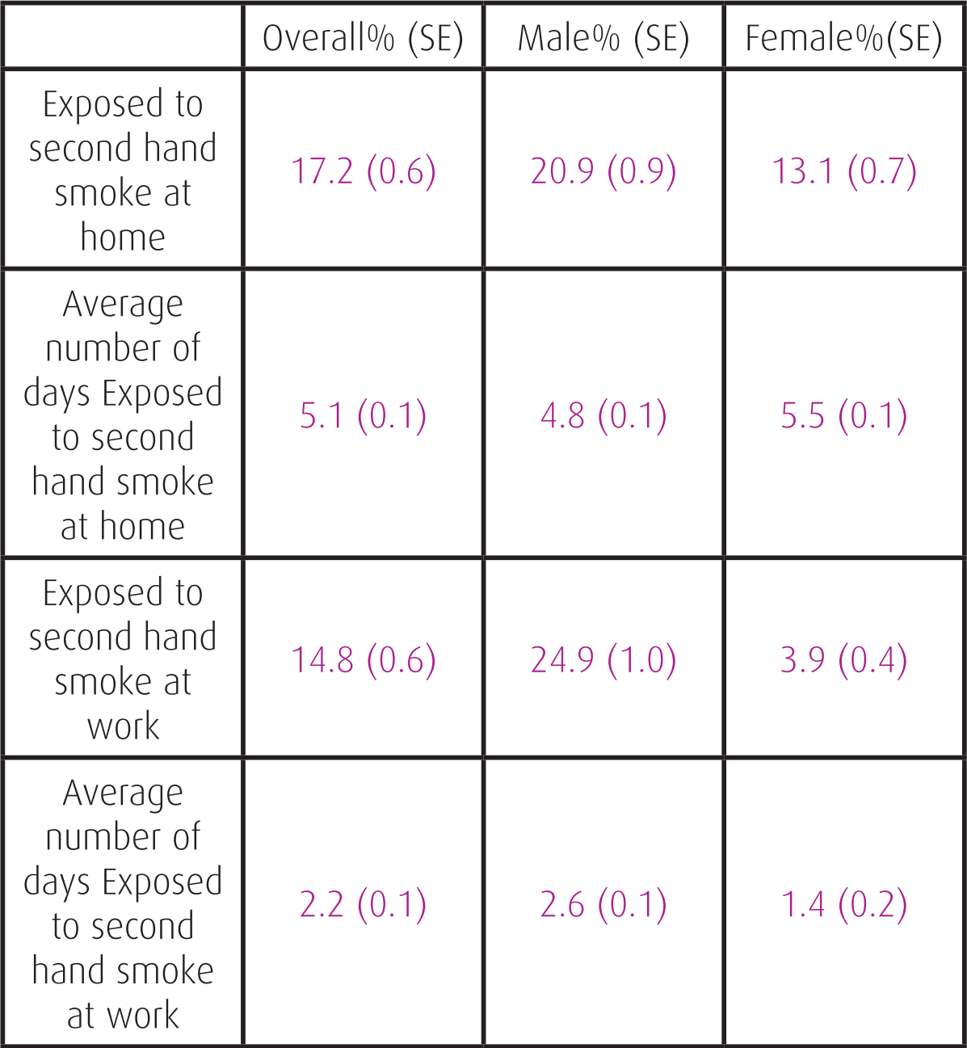
Passive Smoking
Inhaling Smoke that comes from burning tobacco products
Exhaled smoke plus the “sidestream”
It affects 17.2 % of Saudi people

Slide 21
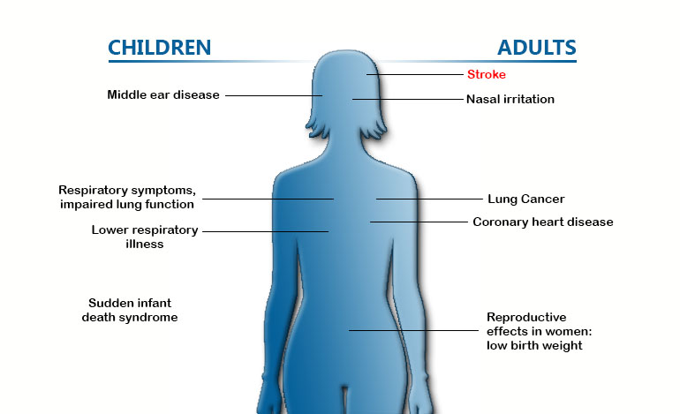
Passive Smoking
Passive smoking causes about 600 thousand deaths each year.
Results in several adverse health affects on respiratory and cardiac systems.
Individuals get exposed to unfiltered smoke. (4000 irritants)

Slide 22
Passive Smoking in Pregnancy
Low birth weight baby.
Risk of sudden infant death syndrome
Prematurity
Miscarriage
Notes:
Makes more difficult to get pregnant

Slide 23
Passive smoking in children
The immune and respiratory systems are not completely developed yet
Children exposed to smoke are at risk of respiratory diseases such as asthma and infections
Meningitis and ear infections are also increased with passive smoking.
Particularly vulnerable in cars

Slide 25
Quitting smoking

Slide 26
5 R’s model
Relevance: Why is stopping relevant to the smoker
Risks: what are the risks of smoking
Rewards: what are the rewards when quitting
Roadblocks: barriers against quitting
Repetition

Slide 27
Challenges
Behavioral and social connections: smoking is tied to everyday activity.
Emotional connections: Smokers link smoking with certain emotions
Physical addiction : Nicotine withdrawal symptoms.

Slide 28
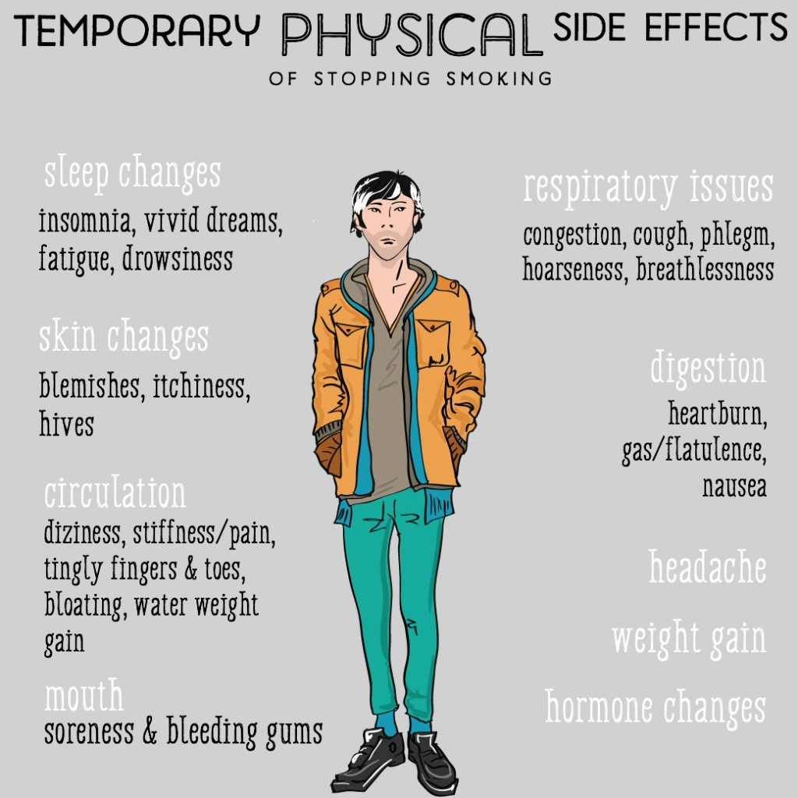

Slide 29
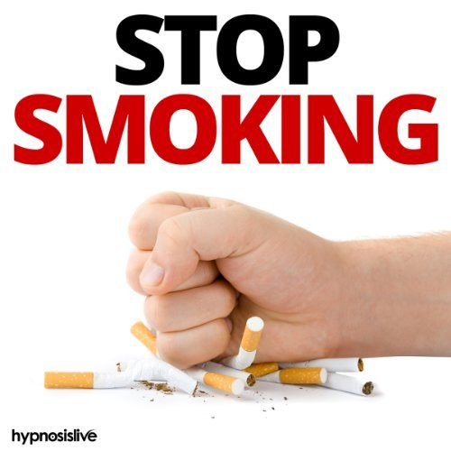
Role of PHC physician in smoking cessation
Primary care providers are in the unique position in helping tobacco users.
If all primary care providers routinely ask about tobacco use and advise tobacco users to stop, they have the potential to reach more than 80% of all tobacco users per year
Trigger 40% of cases to make a quit attempt; and help 2-3% of those receiving brief advice quit successfully.

Slide 30
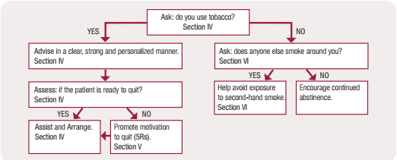
The 5A’s model

Slide 31
The 5A’s model
The 5As (Ask, Advise, Assess, Assist, Arrange) summarize all the activities that a primary care provider can do to help a tobacco user within 3-5 minutes in a primary care setting. This model can guide you through the right process to talk to patients who are ready to quit about tobacco use and deliver advice.
1- Ask
Systematically identify all tobacco users at every visit.
– “Do you smoke cigarettes?”
– “Do you use any tobacco products?”
Countries should consider expanding the vital signs to include tobacco use.

Slide 32
2- Advise
Clear :
“Cutting down while you are ill is not enough.”
“Occasional or light smoking is still dangerous.”
Strong :
It is the most important thing you can do to protect your health.
Personalized :
− “What do you not like about being a smoker?

Slide 33
3- Assess
Assess readiness to make a quit attempt.
Ask two questions:
1. “Would you like to be a nontobacco user?”
2. “Do you think you have a chance of quitting successfully?”
If the patient is ready you can move on to Assist and Arrange steps.
4- Assist
Use the STAR method to facilitate and help your patient to develop a quit plan:
− Set a quit date ideally within two weeks.
− Tell family, friends, and coworkers about quitting, and ask for support.
− Anticipate challenges to the upcoming quit attempt.
− Remove tobacco products from the patient’s environment.

Slide 34
5-Arrange
Arrange a follow-up contact with your patient either in person or by telephone.
When:
- The first follow up in the first week.
- A second follow up within one month after the quit date.
For patients who have used tobacco again:
− Remind them to view relapse as a learning experience.
− Link to more intensive treatment if available.

Slide 35
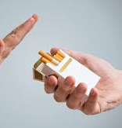
General Advises
Spend as much free time as you can in public places where smoking is not allowed.
If you miss the feeling of having something in your mouth, try (toothpicks, cinnamon sticks, السواك)
Call a friend, family member, or a telephone stop-smoking help-line “937” when you need help or support.
Work out to relieve stress.
Attend group behavior therapy.

Slide 36
Update in Pharmacological management
1- NRT’s.
2- Non NRT’s.
bupropion
varenicline

Slide 37
NRT
Nicotine replacement therapy (NRT) is the most commonly used family of quit smoking medications. These medications can double your chances of quitting for good.
NRT reduces withdrawal feelings by giving you a small controlled amount of nicotine, but none of the other dangerous chemicals found in cigarettes. This small amount of nicotine helps satisfy your craving for nicotine and reduces the urge to smoke.
Doctors and other medical experts think NRT is the one of the most helpful tools smokers can use to quit. Some smokers have mild to moderate side effects. However, research shows that NRT is safe and effective.

Slide 38
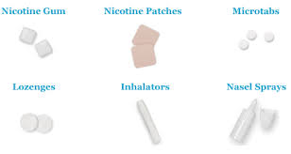
NRT comes in a variety of forms that are used in different ways.
Quitting is different for everyone. Try various tools until you find the ones that help you succeed.
Types of NRT:
Skin patches
Chewing gum
lozenges
Inhaler
Intranasal spray

Slide 39
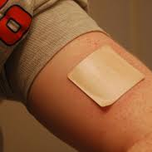
1- Nicotine Patch (Nicoderm CQ®):
Placed on the skin to supply a small controlled amount of nicotine to the body.
Helps reduce nicotine withdrawal symptoms and urges to smoke.
No need to talk to a health care provider before using.
Side effects:
Nausea / vomiting.
Headache
Increased blood pressure
Acne
Anorexia
others.

Slide 40
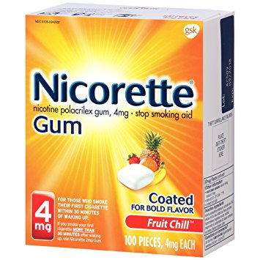
2-Nicotine Gum (Nicorette®):
Chewed to release nicotine that gets absorbed through tissue inside the mouth.
Helps reduce nicotine withdrawal symptoms, available over the counter.
No need to talk to a health care provider before using.
Side effects:
Nausea / vomiting
Mouth / tooth or jaw problems.
Dizziness
Diarrhea
Weakness
Rash
Contraindicated in active temporomandibular joint disease.

Slide 41
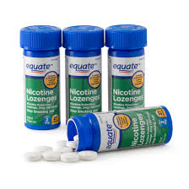
3- Nicotine Lozenge (Nicorette®):
Looks like hard candy; placed in the mouth where it slowly dissolves, releasing nicotine.
Helps reduce nicotine withdrawal symptoms, available over the counter.
No need to talk to a health care provider before using.
Side effects:
increased blood pressure
Nausea / vomiting.
Tachycardia
Dizziness
Insomnia

Slide 42
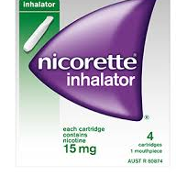
4- Nicotine Inhaler (Nicotrol® Inhaler):
Delivers a specific amount of nicotine to the user with each puff.
Helps reduce nicotine withdrawal symptoms, available only from your doctor.
Nicotine Inhaler works much more quickly than the nicotine gum.
Side effects:
Mouth/throat irritation
Nausea / vomiting
Cough
Headache
Rhinitis
Dyspepsia
Disadvantages:
It is more expensive than nicotine gum.

Slide 43
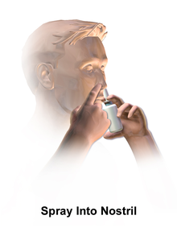
5- Nicotine Nasal Spray (Nicotrol®):
Pump bottle inserted into the nose and sprayed to deliver a specific amount of nicotine to the user with each spray.
Helps reduce nicotine withdrawal symptoms, available only from your doctor.
This medication gets rid of symptoms faster than any other medication.
Side effects:
Local irritation .
CNS and psychological manifestations.
Fatigue
Weight gain
sweating.

Slide 44
Quitting starts with self approaching and cooperation with the physician’s advices including pharmacological tools then follow-ups as advised by the physician.
Summary of NRT types:
NRT Types | How to Get Them | How to Use Them
Patch | Over the Counter | Place on the skin Gives a small and steady amount of nicotine
Gum | Over the Counter | Chew to release nicotine Chew until you get a tingling feeling, then place between cheek and gums
Lozenge | Over the Counter | Place in the mouth like hard candy Releases nicotine as it slowly dissolves in the mouth
Inhaler | Prescription | Cartridge attached to a mouthpiece Inhaling through the mouthpiece gives a specific amount of nicotine
Nasal Spray | Prescription | Pump bottle containing nicotine Put into nose and spray

Slide 45
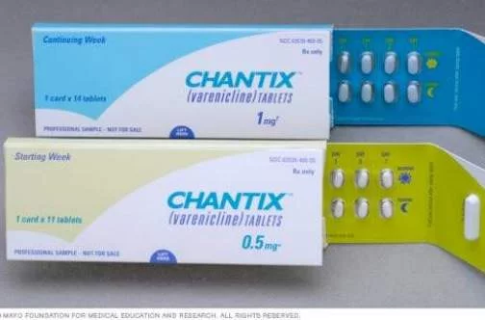
Non NRT’s
Varenicline (Chantix®):
Pills that eases nicotine withdrawal symptoms and blocks effects of nicotine from cigarettes if the user starts smoking again. It blocks pleasant effect of nicotine on the brain. FDA approved in 2006.
Contains no nicotine, available only from your doctor.
Varenicline was superior to single form of NRT, and to Bupropion, but combination of NRT is more effective than Varenicline.
Side effects:
Nausea
Headache
Sleeping troubles
nightmares.
Contraindications:
pregnancy/ breast feeding.
Age under 18.

Slide 46
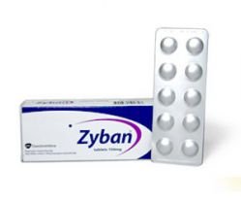
Non NRT’s
Bupropion SR (Wellbutrin® or Zyban®):
It’s a medication used as an antidepressant and a smoking cessation aid.
Contains no nicotine, available only from your doctor.
It is a norepinephrine-dopamine reuptake inhibitor (NDRI) and a nicotinic receptor antagonist.
Side effects:
Seizures
Insomnia
dry mouth
Contraindications:
Epilepsy
Active brain tumors.
Pregnancy/breast feeding
Age under 18
Notes:
Other Side effect
trouble in sleeping
Agitation
headaches

Slide 47
Substance Abuse

Slide 48
Definition of Substance Abuse:
Substance abuse refers to the harmful or hazardous use of psychoactive substances, including alcohol and illicit drugs.
- WHO

Slide 49
Factors That Lead To Substance Abuse

Slide 50
Familial risk factors:
Childhood maltreatment (including abuse and neglect).
Parental or familial substance abuse.
Marital status of parents.
Level of parental education.
Parent-child relationship.
Familial socioeconomic status.
Child perception that parents approve of substance abuse.

Slide 51
Social risk factors:
Deviant peer relationships.
Peer pressure and popularity.
Bullying.
Gang affiliation.

Slide 52
Individual risk factors:
Attention Deficit Hyperactivity Disorder (ADHD).
Depression.

Slide 53
Risk factors for drug addiction:
Risk Factors | Protective Factors
Aggressive behavior in childhood. | Good self-control.
Lack of parental supervision. | Parental monitoring and support.
Poor social skills. | Positive relationships.
Drug experimentation. | Good grades.
Availability of drugs at school. | School anti-drug policies.
Community poverty. | Neighborhood resources.

Slide 55
Approach To Subjects With Substance Abuse

Slide 57
Screening Tools for Substance Use Disorders
Single-question screen
“How many times in the past year have you used an illegal drug or used a prescription medication for nonmedical reasons?”

Slide 58
Hazardous use:
Patients with hazardous substance use may benefit from brief counseling by a physician. Counseling using a motivational interviewing approach in the clinical setting has been shown to decrease the quantity and frequency of drug and alcohol use.
During counseling, the physician elicits the patient's own reasons for change, rather than telling the patient why he or she should change. Confronting or pushing the patient to change is usually not successful and can decrease motivation for change.

Slide 59
Substance abuse:
Substance abuse is characterized by the development of consequences from substance use, and these consequences can serve as motivators for change.
For patients with substance abuse, experts generally recommend advising abstinence.
For patients who are not committed to abstinence, it is useful to provide a variety of options for change, and harm reduction is an appropriate goal.
Harm reduction strategies reduce the negative health consequences of substance use. Common examples include providing clean needles to persons who continue to inject drugs, and not driving while intoxicated.

Slide 60
Substance dependence:
Substance dependence is a chronic relapsing and remitting illness, and patients require a longitudinal, chronic care approach that can include pharmacotherapy, referral to specialty treatment, mutual help meetings, and ongoing counseling and care coordination.
Brief counseling can help an ambivalent patient with substance dependence to enter a treatment program, engage with mutual help meetings, or agree to a trial of pharmacotherapy.
Physicians should engage family members in the treatment plan when appropriate and with the patient's consent. Treatment programs that involve families have improved rates of retention and abstinence.

Slide 61
PRINCIPLE/TECHNIQUE | RATIONALE
Resist the righting reflex | Physicians want patients to change or correct unhealthy behaviors. Telling them to do so is a natural reflex, but it can generate resistance in patients. Instead, help them generate their own argument for healthy changes.
Understand the patient's motivations | Patients are more likely to change for reasons that they value highly. By eliciting these reasons, physicians can be more effective.
Motivational Interviewing Principles for Physicians

Slide 62
PRINCIPLE/TECHNIQUE | RATIONALE
Listen to the patient | Physicians need to listen to patients to elicit the best path to behavior change.
Empower the patient | Physicians can help patients take an active role in their health care and support self-efficacy.
Motivational Interviewing Principles for Physicians
​

Slide 63
PRINCIPLE/TECHNIQUE | RATIONALE
Elicit-provide-elicit | A nonconfrontational approach to advice or information giving that allows the patient to express his or her feelings about change and assists the physician in assessing readiness for change.
Decision analysis (“pros and cons”) | Physicians can help patients make changes by articulating the advantages and disadvantages of the changes.
Motivational Interviewing Principles for Physicians

Slide 64
PRINCIPLE/TECHNIQUE | RATIONALE
Reflections | Physicians can identify statements that the patient makes in support of change and reflect them back to the patient, highlighting the patient's reasons for change.
Affirmations | Most patients with substance abuse and dependence feel guilt and shame about their drug use and may lack confidence that they can make changes. Physicians can promote self-efficacy with honest and meaningful affirmations.
Motivational Interviewing Principles for Physicians

Slide 65
Pharmacotherapy:
OPIOID AGONISTS: BUPRENORPHINE AND METHADONE
Buprenorphine is a partial agonist of mu opioid receptors. Formulations include sublingual buprenorphine and sublingual buprenorphine/naloxone tablets or strips (Suboxone).
The naloxone component is poorly absorbed via the sublingual route and is present only to prevent misuse of the medication by crushing and injecting the combined product. Because of this safety feature, buprenorphine/naloxone is the preferred formulation.

Slide 66
Some patients are not candidates for office-based treatment of opioid dependence and should be referred to a narcotic treatment program where they can receive methadone pharmacotherapy and counseling services.
Methadone maintenance therapy reduces opioid abuse and associated harms.

Slide 67
BENZODIAZEPINE DEPENDENCE
Physicians may attempt a slow taper (usually over months) of benzodiazepines in selected patients.
Most patients should generally be referred to a specialist, if possible. Risks of tapering benzodiazepines include increased anxiety and depression symptoms, seizures, and altered mental status.

Slide 68
STIMULANT DEPENDENCE
Despite continued research efforts and several potential candidate medications, no pharmacologic treatment for stimulant (e.g., cocaine, methamphetamine) dependence can be recommended for use in the primary care setting. Behavioral therapies have demonstrated effectiveness in the treatment of stimulant dependence.

Slide 69
Referral
Referral for specialty addiction treatment is recommended for patients with substance dependence disorders. However, primary care physicians with appropriate experience, training, and support can provide some or all these services.

Slide 70
Role Play

Slide 71
A young patient came to your clinic with chest pain and you suspected drug abuse. You screened him and he was positive.
How will you approach him?

Slide 72
Mcq’s
According to the ministry of health, what is the percentage of smoking in Saudi individuals ?
10%
12%
15%
18%
Smoking is responsible for approximately what percentage of lung cancers
50%
65%
75%
90%

Slide 73
Mcq’s
Which medication gets rid of symptoms faster than any other medication in term of NRTs ?
skin patches
chewing gum
lozenges
intranasal spray
Nicotine Gum (Nicorette®) is Contraindicated in:
Active temporomandibular joint disease
Eplipsy
Pregnancy
Osteoprosis

Slide 74
Mcq’s
A chronic relapsing and remitting illness, and patients require a longitudinal, chronic care approach “ describes which of the following?
Hazardous use
Substance abuse
Substance dependence
At-risk use
Which of the following is the best treatment for stimulant drug dependence?
Buprenorphine
Beta Blockers
Benzodiazepines
Behavioral Therapy

Slide 75
Thank you

Slide 76
References
World health organization
Moradi-Lakeh M, El Bcheraoui C, Tuffaha M, et al. Tobacco consumption in the Kingdom of Saudi Arabia, 2013: findings from a national survey. BMC Public Health. 2015;15:611. Published 2015 Jul 5. doi:10.1186/s12889-015-1902-3 (Pubmed)
https://www.moh.gov.sa/Ministry/Statistics/Documents/smoking.pdf (Minstery of Health)
CDC
NHS
https://www.cdc.gov/tobacco/campaign/tips/quit-smoking/guide/explore-medications.html
http://apps.who.int/iris/bitstream/handle/10665/112835/9789241506953_eng.pdf;jsessionid=433CEB0C24EE5F5FED904DDAD528C731?sequence=1
Am Fam Physician. 2013 Jul 15;88(2):113-21
https://www.drugabuse.gov/publications/drugs-brains-behavior-science-addiction/drug-misuse-addiction
Whitesell M, Bachand A, Peel J, Brown M. Familial, social, and individual factors contributing to risk for adolescent substance use. J Addict. 2013;2013:579310.
Cochrane liprary

