Slide 1
Approach to the patient with back pain.
By: Rawaf Alrawaf , Mohammed Abunayan, Abdullah aljafar
Supervisor: Dr. Amr Jamal

Slide 2
Objectives
Common causes
Diagnosis including history, Red Flags, and Examination
Brief comment on Mechanical, Inflammatory, Root nerve compression, and Malignancy
Role of primary health care in management
When to refer to a specialist
Prevention and Education

Slide 3
1- Which of the following is a red flag or danger signal relative to the diagnosis of LBP?
a. Cough b. Diarrhea
c. Chest pain d. Constipation

Slide 4
2- Which of the following is not indicative of inflammatory back pain?
a. Insidious onset b. Onset before 40 years of age
c. Pain for more than 3 months d. Morning stiffness e. Aggravation of pain with activity

Slide 5
3- Which of the following is characteristic of a history of mechanical Lower Back Pain?
a. Relatively acute onset b. History of overuse or a precipitating injury
c. Pain worse during the day d. All

Slide 6
4- What is the most cost-effective and crucial aspect of the treatment of chronic LBP?
a. Patient education b. Physiotherapy
c. Bed rest d. Morning stiffness

Slide 7
In Saudi Arabia the prevalence of nonspecific low back pain is estimated between 53.2% to 79.17%.
In Saudi Arabia the prevalence of low back pain in health sciences students is 56.6%.
Notes:
AlShayhan FA, Saadeddin M. Prevalence of low back pain among health sciences students. Eur J Orthop Surg Traumatol. 2018 Feb;28(2):165-170. doi: 10.1007/s00590-017-2034-5. Epub 2017 Aug 30.

Slide 8
How do you approach a patient with back pain to reach a diagnosis?
HISTORY
PHYSICAL EXAMINATION
IMAGING?
Personal data
HPI
Neurological symptoms
Red flags
PMHx
PSHx
MHx
SocialHx
FamilyHx
Systemic review
Look
Feel
Move
Special test
Neurological Ex

Slide 9
HISTORY
Personal Data:
Name
Age
Occupation
Residance

Slide 10
History of Presenting Illness
Chief complaint
When?
Site
Onset
Course
Character
Radiaton
Exacerbating factors
Alleviating factors
Timing
Severity
Associated symptoms
constitutional symptoms

Slide 11
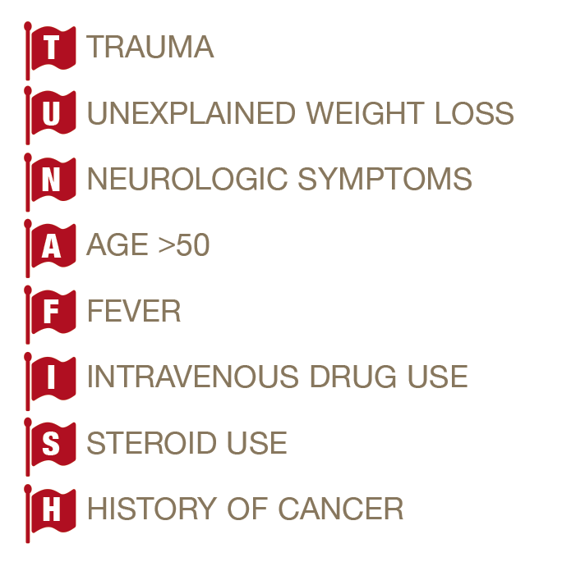
Neurological Symptoms
Weakness
Hypo/Hyper – reflexia
Loss of sensation
Bow incontinence
Urinary retention
Red Flags
TUNA FISH

Slide 12
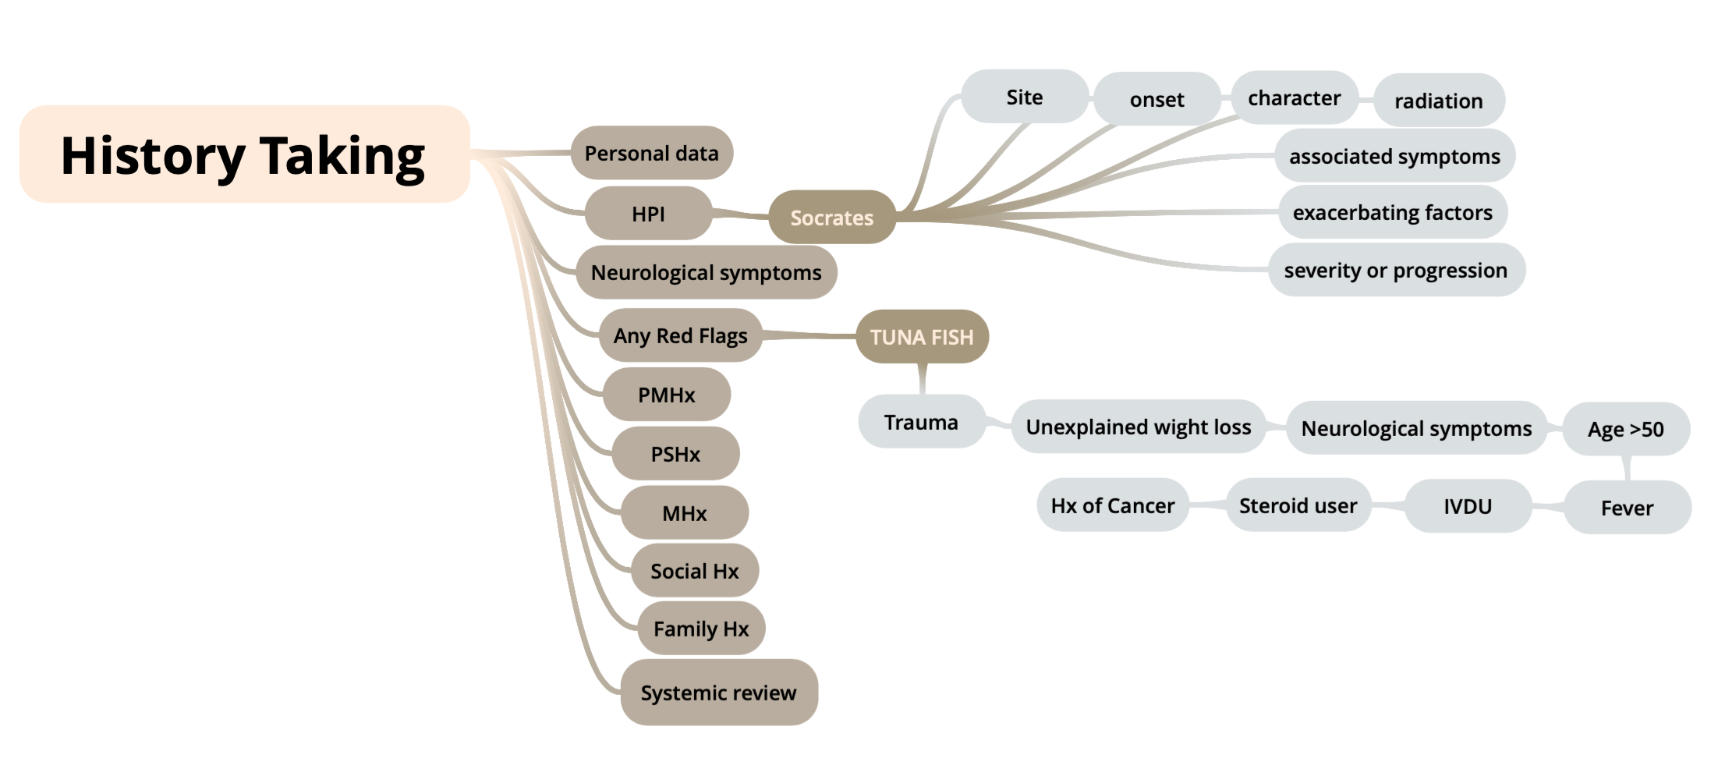

Slide 13
The chief complaint is always, Doctor I have pain!

Slide 15
PHYSICAL EX
Look
Position
Exposure
Look for deformity such as scoliosis, a lateral curvature of the spine that may be simple (‘C’ shaped) or compound (‘S’ shaped) , inspecting from both the back and the side.
Note especially loss of the normal thoracic kyphosis and lumbar lordosis, which is typical of ankylosing spondylitis and it’s one of common back pain causes.
soft-tissue abnormalities like a hairy patch or lipoma that might overlie a congenital abnormality, e.g. spina bifida.
Ulcers, scars of previous surgeries.
shoulders and pelvis level.
Muscle wasting.
Notes:
To start the examination, have the patient standing and clothed only in underpants
Look for deformity, inspecting from both the back and the side.
Note especially loss of the normal thoracic kyphosis and lumbar lordosis, which is typical of ankylosing spondylitis.
Also note any evidence of scoliosis, a lateral curvature of the spine that may be simple (‘C’ shaped) or compound (‘S’ shaped)
soft-tissue abnormalities like a hairy patch or lipoma that might overlie a congenital abnormality, e.g. spina bifida.
Muscle wasting
shoulders & pelvis level.

Slide 16
Feel
Start while patient on standing position looking for gaps, steps or tenderness along vertebral column.
Then on supine position to check peripheral nerves for sensation.
Palpation occurs:
centrally
unilateral
Soft tissues
After warning the patient, lightly percuss the spine with your closed fist and note any tenderness.
Notes:
centrally (spinous processes to coccyx) , looking for any tenderness.
unilateral—right and left sides (1.5 cm from midline)
Soft tissues: temperature, tenderness.
After warning the patient, lightly percuss the spine with your closed fist and note any tenderness.

Slide 17
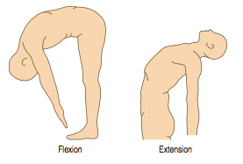
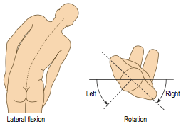
Move
There are three main movements of the lumbar spine:
Flexion (>90 degrees)
Extension (15-25 degrees)
Lateral bending (up to 30 degrees)
Rotation
Notes:
Flexion: ask the patient to try to touch his toes with his legs straight. (Patients with advanced ankylosing spondylitis have a flat ankylosed spine and all the bending occurs at the hips )
Extension: ask the patient to straighten up and lean back as far as possible (normal 10–20° from neutral erect posture).
Lateral bending is assessed by getting the patient to slide the right hand down the right leg as far as possible without bending forwards, and then the same for the left side. (This movement tends to be restricted early in ankylosing spondylitis).
The rotational motion of the spine and the mobility of the thorax become early restricted in ankylosing spondylitis

Slide 18
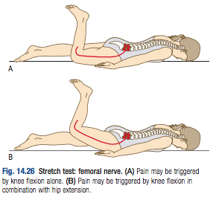
Special tests
Femoral stretch test:
Knee flexion hip extension while the patient is lying in prone position.
Positive if pain felt in ipsilateral anterior thigh.
Positive test mean that the L3 and L4 nerve roots are involved.

Slide 19
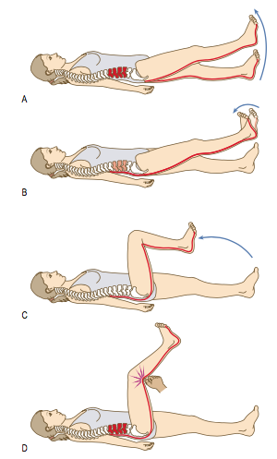
Special tests
Straight leg raising (SLR) test
Done while the patient lying in supine position.
Tension increased by dorsiflexion of foot (Bragard’s test). Root tension relieved by flexion at the knee.
Pressure over centre of popliteal fossa causes pain locally and radiation into the back.
Positive test mean that the L4, L5 and S1 nerve roots are involved (Sciatica).

Slide 20
Neurological testing of lower limbs
Do Neurological examination if patient has any signs or symptoms of nerve root compression.
Examining for sensation and power.
If there is nerve roots compression patient will have pain, pareasthesia, anesthesia and weakness, extend into the leg.

Slide 21
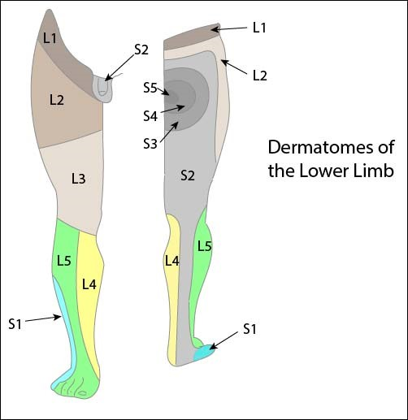
Main nerve roots
A- L1:
Motor → Hip flexion(psoas major)
Sensation→ around the groin and hip area
Reflex → cremasteric relfex (L1,L2)
B- L2:
Motor → Hip flexion
Sensation→ anterior thigh
Reflex → knee jerk (L2,L3, L4)

Slide 22
Main nerve roots
C- L3
Motor → extension of knee
Sensation → anterior thigh
Reflex → knee jerk (L3, L4)
D- L4
Motor → ankle dorsiflexion and foot inversion.
Sensation → inner border of foot to great toe
Reflex → knee jerk

Slide 23
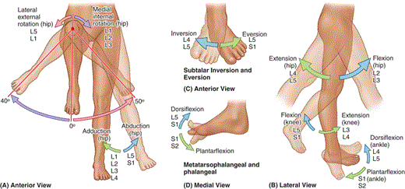
Main nerve roots
E- L5
Motor: walking on heels (ankle dorsiflexion), extension of great toe
Sensation → middle three toes (dorsum)
Reflex → nil
F- S1
Motor: walking on toes (ankle planter flexion), foot eversion
Sensation → little toe, most of sole
Reflex → ankle jerk (S1, S2)

Slide 24
IMAGING?
Imaging
High-risk patients
Most patients with low back pain with or without sciatica do not routinely require imaging when presenting in a non-specialist setting.
Reassure.. that their symptoms will respond to conservative treatment.
If symptoms persist longer than 6 to 8 weeks, plain x-rays should be obtained at that time
Notes:
Assessment of back pain [Internet]. BMJ Best Practice; 2018 [cited 4 September 2018]. Available from: https://bestpractice.bmj.com/topics/en-gb/189/pdf/189.pd

Slide 25
MRI or CT, only if: neurological compromise, infection, or tumors is considered
After discussion with a spinal surgeon.
MRI is the preferred study. If contraindicated a CT myelogram is usually warranted.
In trauma situations, the standard AP pelvis and cervical spine radiographs should be obtained.
Notes:
a patient has metal in their spine or is unable to undergo an MRI,

Slide 26
Imaging
Do not routinely offer imaging in a non-specialist setting.
Explain to the patient that if she/he is being referred for specialist opinion, she/he may not need imaging.
Consider imaging for people with low back pain with or without sciatica only if the result is likely to change management.
Notes:
Low back pain and sciatica in over 16s: assessment and management. NICE guideline; 2016.

Slide 27
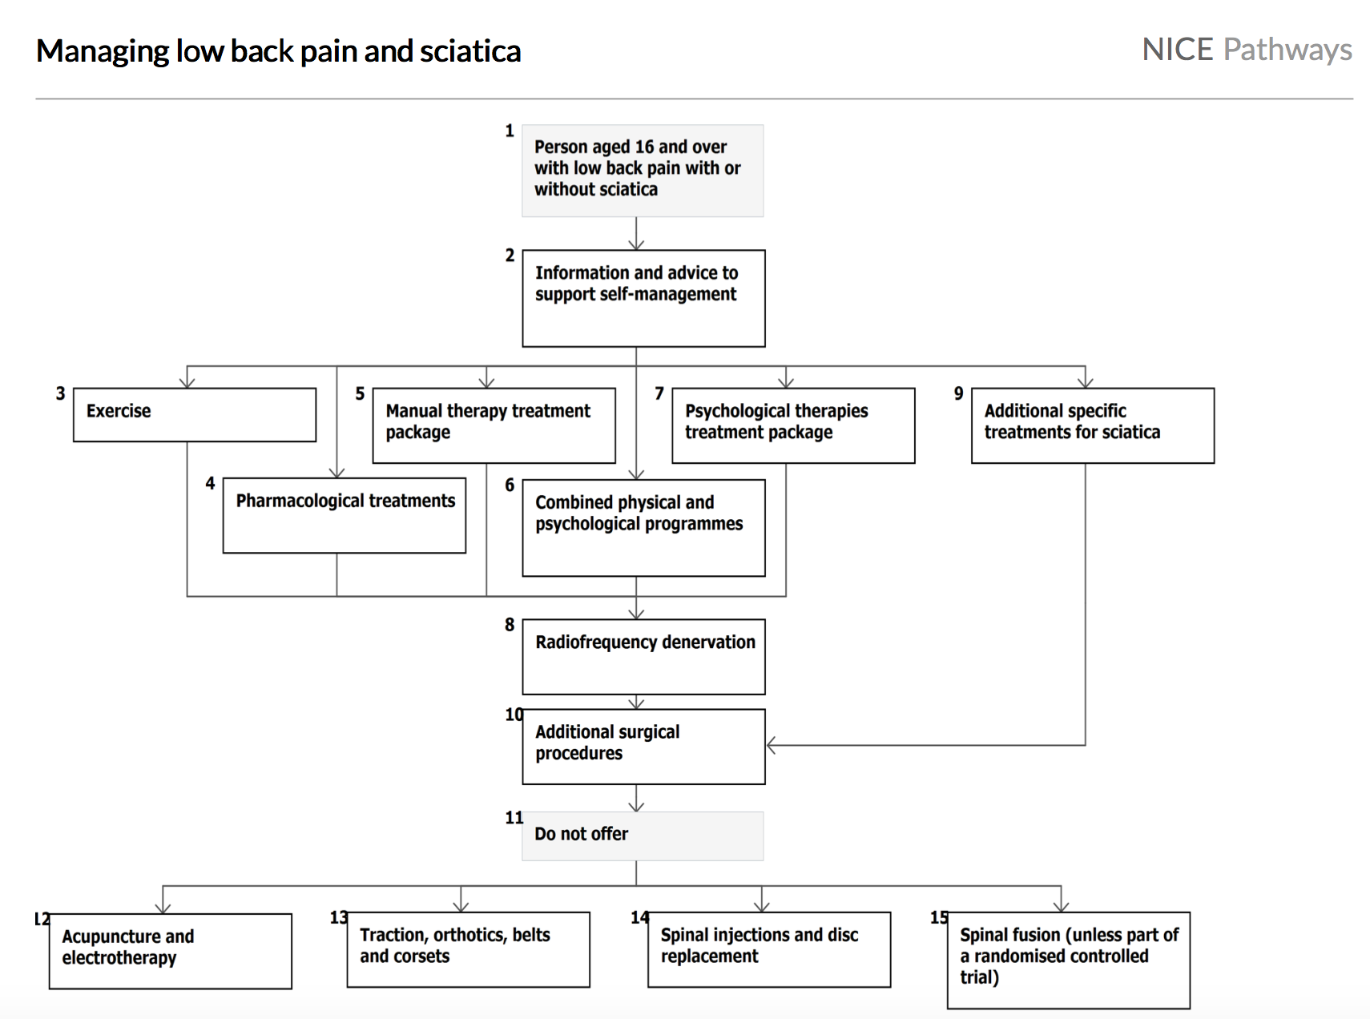
Notes:
Low back pain and sciatica in over 16s: assessment and management. NICE guideline; 2016.

Slide 28
MANAGEMENT IN FAMILY MEDICINE
CRAPRIOPS
C: CHECK & CHUNK
R: Reassurance
A: Advice
P: Prescription
R: Referral
I: Investigation
O: Observation
P: Prevention
S: Safety netting

Slide 29
Mechanical
Tends to get better or worse depending on your position – for example, it may feel better when sitting or lying down.
Typically feels worse when moving
Can develop suddenly or gradually
Might sometimes be the result of poor posture or lifting something awkwardly, but often occurs for no apparent reason
May be due to a minor injury
Notes:
Evaluation of low back pain in adults [Internet]. Uptodate.com. 2018 [cited 4 September 2018]. Available from: https://www.uptodate.com/contents/evaluation-of-low-back-pain-in-adults?search=evalu%20ation-of-low-back-pain-in adults&source=search_result&selectedTitle=1~150&usage_type=default&display_rank=1

Slide 30
Inflammation
Age at onset of back pain <45 years
Back pain lasting > 3 months
Night pain
Early morning pain and stiffness lasting more than one hour
Insidious onset
Tenderness/inflammation over the joint
Increased by Rest and Relived by activity
Notes:
Evaluation of low back pain in adults [Internet]. Uptodate.com. 2018 [cited 4 September 2018]. Available from: https://www.uptodate.com/contents/evaluation-of-low-back-pain-in-adults?search=evalu%20ation-of-low-back-pain-in adults&source=search_result&selectedTitle=1~150&usage_type=default&display_rank=1

Slide 31
Inflammatory
Mechanical
<40 y/o
Chronic
>3 months duration
>60 min morning stiffness
Night pain is common
Improve with exercise
Any Age
Acute
<4 weeks duration
<30 min morning stiffness
Night pain is absent
Worsens with exercise

Slide 32
Root Nerve Compression
Characterized by radicular pain arising from nerve root impingement due to herniated discs.
Radicular pain: Pain that radiates into the lower extremity directly along the course of a spinal nerve root.
Notes:
Evaluation of low back pain in adults [Internet]. Uptodate.com. 2018 [cited 4 September 2018]. Available from: https://www.uptodate.com/contents/evaluation-of-low-back-pain-in-adults?search=evalu%20ation-of-low-back-pain-in adults&source=search_result&selectedTitle=1~150&usage_type=default&display_rank=1

Slide 33
Malignancy
Metastatic tumors are found mostly in patients older than 50 years .
Metastatic disease is more common than primary tumors of the spine, and thoracic spine metastatic lesions are more common than lumbar
Patient usually has constitutional symptoms such as fever ,Wight loss, loss of appetite and N\V
Notes:
Evaluation of low back pain in adults [Internet]. Uptodate.com. 2018 [cited 4 September 2018]. Available from: https://www.uptodate.com/contents/evaluation-of-low-back-pain-in-adults?search=evalu%20ation-of-low-back-pain-in adults&source=search_result&selectedTitle=1~150&usage_type=default&display_rank=1

Slide 34
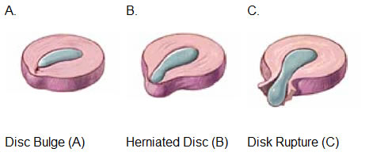
Herniated Disc
Causes of lumbar disc herniation:
1- Trauma or injury to the disc
2- Disc degeneration (inflammatory process)
3- Congenital predisposition
There are three types of disc herniation
Protrusion / bulge
Disc herniation
Sequestration (disc rupture)
Notes:
Assessment of back pain [Internet]. BMJ Best Practice; 2018 [cited 4 September 2018]. Available from: https://bestpractice.bmj.com/topics/en-gb/189/pdf/189.pdf

Slide 35
Herniated DISC
Risk Factors :
Age – Middle age is the most common age group 35 – 45, due to degenerative disks.
Weight – Cause more stress on the disks
Smoking – Decreases oxygen levels in your blood, which deprives them of vital nutrients
Physically demanding jobs that require repetitive movements or sitting or standing too long.
Notes:
Assessment of back pain [Internet]. BMJ Best Practice; 2018 [cited 4 September 2018]. Available from: https://bestpractice.bmj.com/topics/en-gb/189/pdf/189.pdf

Slide 36
Herniated DISC
Signs and Symptoms :
Sciatica is a symptom frequently associated with a lumbar herniated disk.
Tingling ("pins-and-needles" sensation) or numbness in one leg that can begin in the buttock or behind the knee and extend to the thigh, ankle, or foot.
Weakness in certain muscles in one or both legs.
Pain in the front of the thigh.
cauda equina syndrome
Notes:
Assessment of back pain [Internet]. BMJ Best Practice; 2018 [cited 4 September 2018]. Available from: https://bestpractice.bmj.com/topics/en-gb/189/pdf/189.pdf

Slide 37
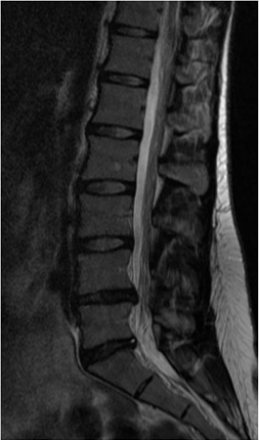
Herniated DISC
Investigations:
MRI: herniated disc
Management:
Saddle (perineal) anaesthesia, sphincter dysfunction, bladder retention, and leg weakness = Cauda Equina Syndrome (CES)
Urgent referral to the hospital.
Emergency decompression of the spinal canal within 48 hours after the onset of symptoms
Notes:
Assessment of back pain [Internet]. BMJ Best Practice; 2018 [cited 4 September 2018]. Available from: https://bestpractice.bmj.com/topics/en-gb/189/pdf/189.pdf

Slide 38
Herniated DISC
Management:
< 3 Months | > 3 Months
1st Line: Paracetamol | 1st Line: Continue pain management
Adjunctive: Topical analgesics/Opioid/Muscle Relaxant | Refer to pain clinic. If with Axial back pain: +Physiotherapy.
Notes:
Assessment of back pain [Internet]. BMJ Best Practice; 2018 [cited 4 September 2018]. Available from: https://bestpractice.bmj.com/topics/en-gb/189/pdf/189.pdf

Slide 39
Role of PHC:
Educate patient about the natural history of back pain.
Ask about and address the patient’s concerns and goals. (patient centered care)
Maximize functional status.
Relief the pain.
Improve associated symptoms, such as sleep or mood disturbances or fatigue.
Referral of complicated cases.
Prevention heavy lifting, socio-demographic factors such as smoking and obesity
Primary care services have an approach to risk stratification for young people and adults presenting with a new episode of low back pain with or without sciatica.
Young people and adults with low back pain with or without sciatica are given advice and information to self-manage their condition. ₍₆₎

Slide 40
When to refer ?
Urgent/Emergency referrals :
Cauda equina
Sever radiculopathy.
Fractures.
Other referrals
Recalcitrant spinal canal stenosis
Neoplasia or infection
Undiagnosed back pain
Paget disease
Continuing pain of 3 months’ duration without a clearly definable cause₍₁₆₎
Notes:
Severe unremitting worsening of pain (at night and pain when laying down)
Weight loss, fever, and history of cancer or HIV
Both consider neoplasia/infection
Any neurological signs
The use of steroids or iv drugs
Cauda Equina Syndrome - EMERGENCY referral to ER.
Severe unremitting worsening of pain (at night and pain when laying down), consider infection/tumor – URGENT referral to ER for pain control – will need prompt investigation.
Significant trauma – consider fractures – check for instability and refer URGENTLY to spinal surgery.
Weight loss, fever, history of cancer/HIV – consider infection/tumor – refer URGENTLY for MRI Scan and to spinal surgery.
Use of IV drugs or steroids – consider infection /compression fracture – URGENT referral to spinal surgery.
Patient over 50 (if first ever episode of serious back pain) – refer SOON for prompt investigation/spinal surgery.
Widespread neurological signs – consider infection/tumor/neurological disease – refer SOON to neurology/spinal surgery/investigate further.

Slide 41
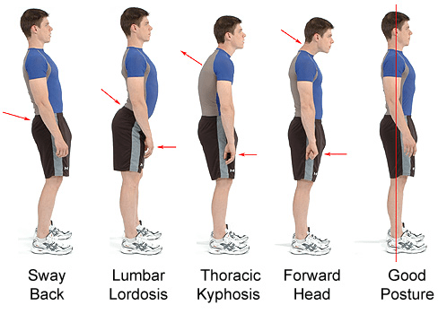
Prevention and education
Losing weight: too much upper body weight can strain the lower back.
Posture: How you sit, stand and lie down can have an important effect on your back. The following tips should help you maintain a good posture.
Standing: Stand upright, with your head facing forward and your back straight. Balance your weight evenly on both feet and keep your legs straight

Slide 42
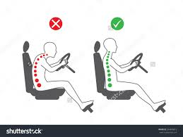
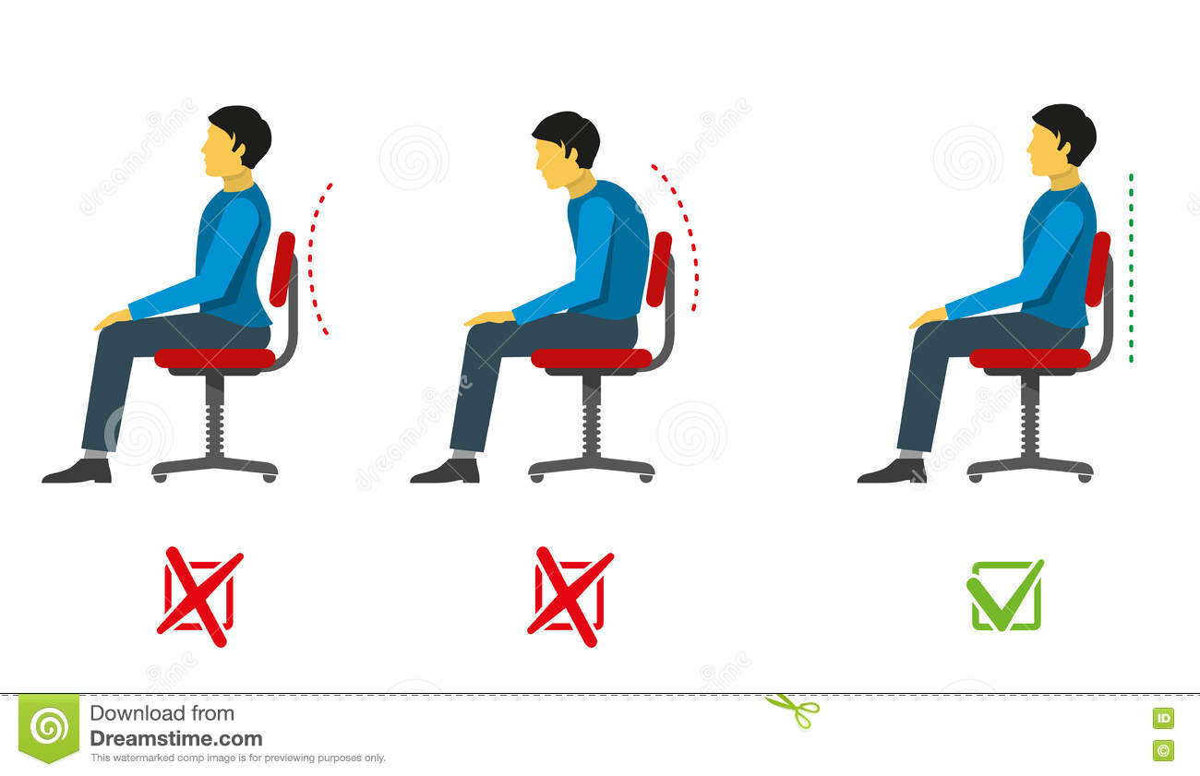
Prevention and education
Sitting and driving:
Sit up with your back straight and your shoulders back. Your knees and hips should be level and your feet should be flat on the floor.

Slide 43
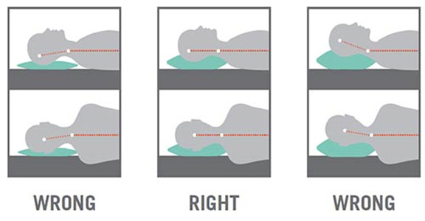
Prevention and education
Sleeping:
Your mattress should be firm enough to support your body while supporting the weight of your shoulders and buttocks, keeping your spine straight.

Slide 44
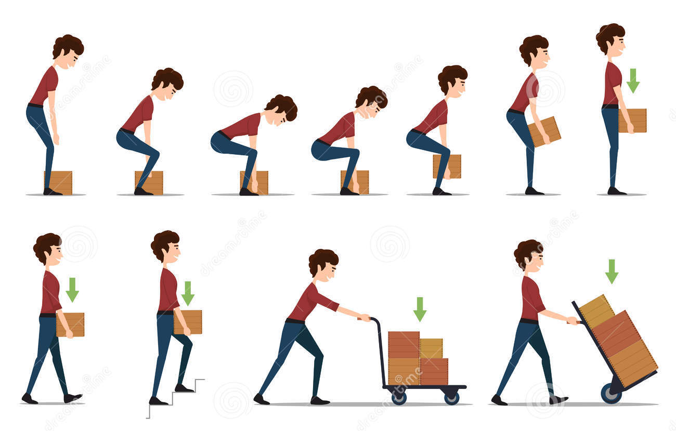
Prevention and education
Lifting and carrying:
One of the biggest causes of back injury is lifting or handling objects incorrectly.
Think before you lift:
can you manage the lift?
Push rather than pull – if you have to move a heavy object across the floor, it is better to push it rather than pull it.

Slide 45
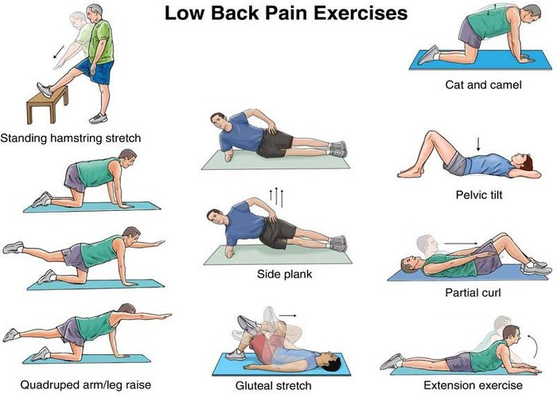
Prevention and education
Exercise:
Exercise is both an excellent way of preventing back pain and of reducing it, but should seek medical advice before starting an
exercise programs if you've had
back pain for six weeks or more.

Slide 46
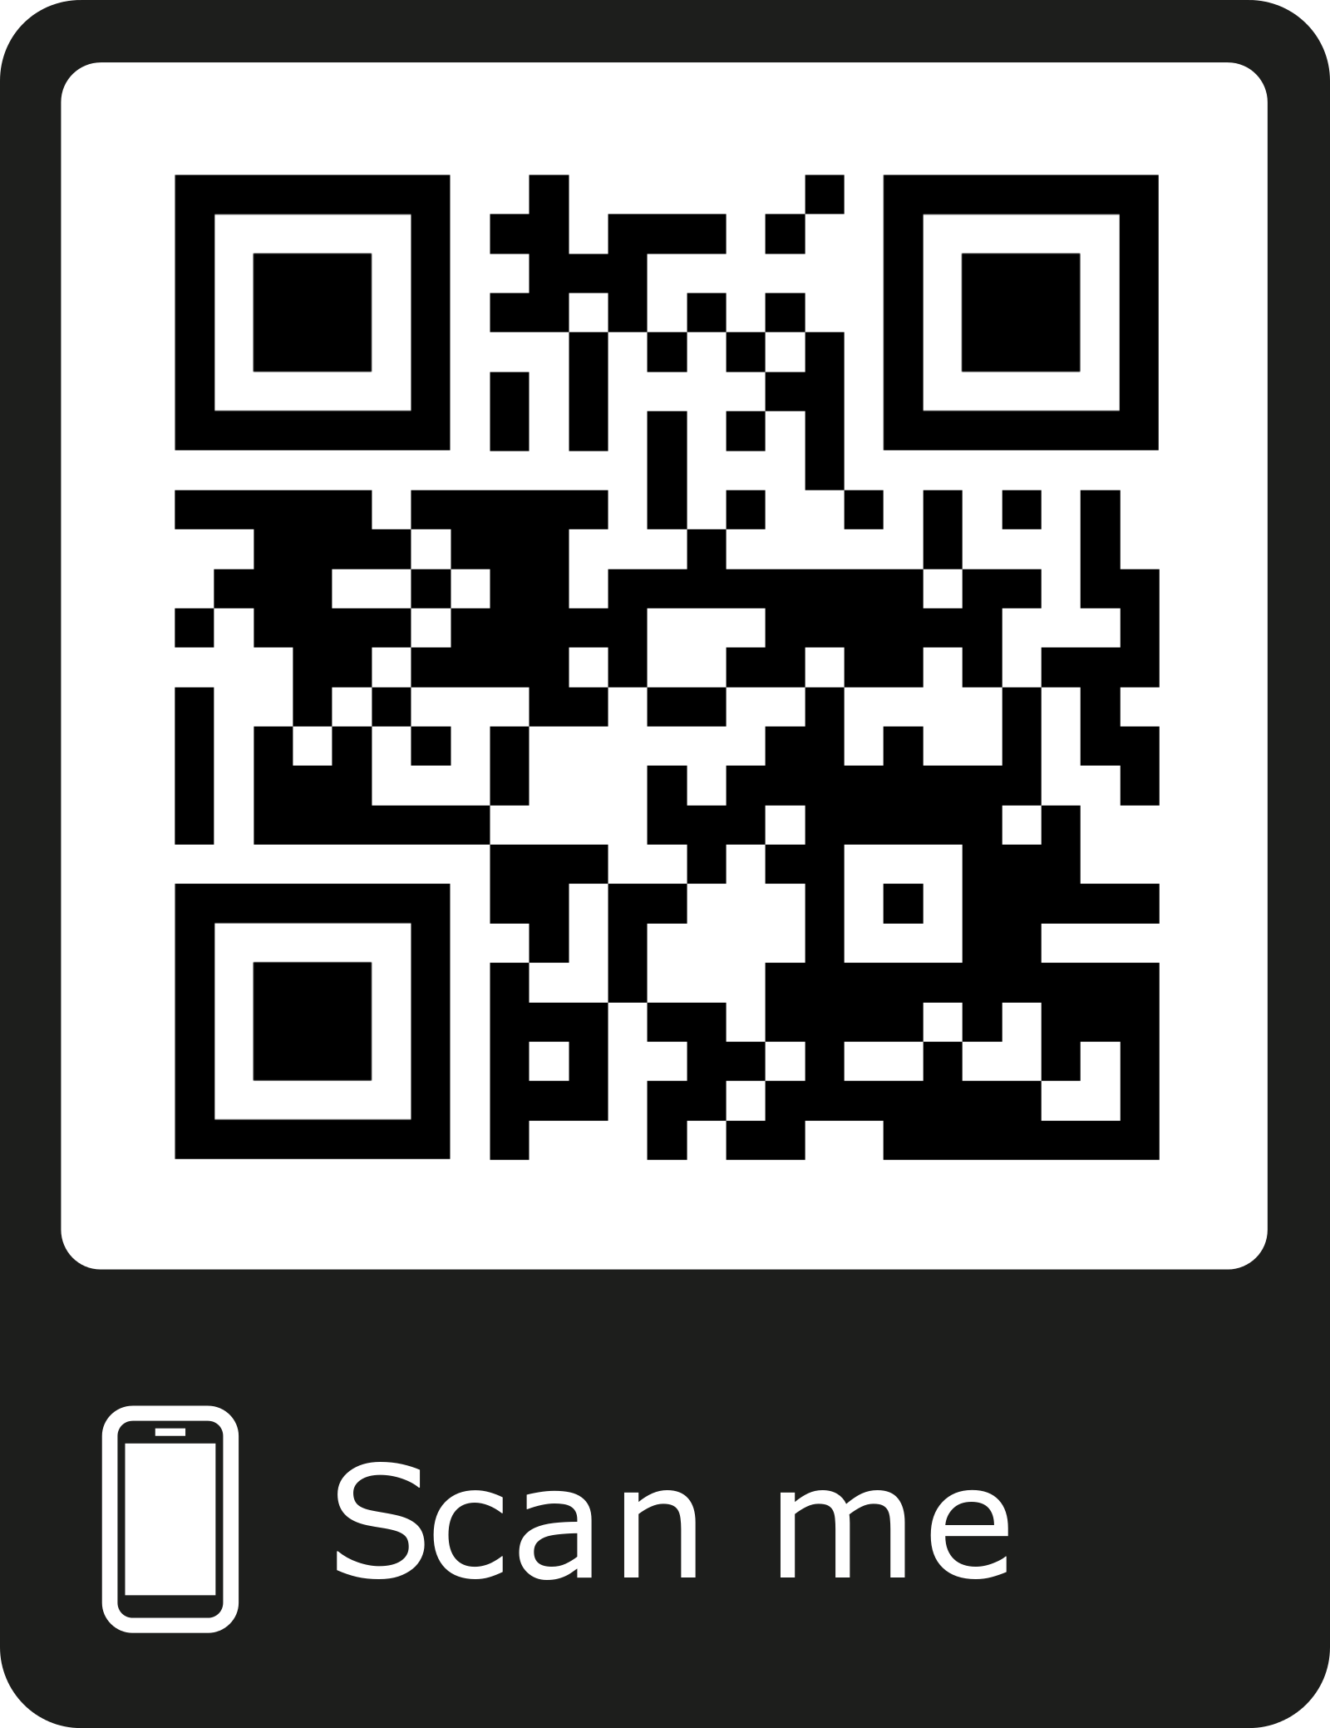

Slide 47
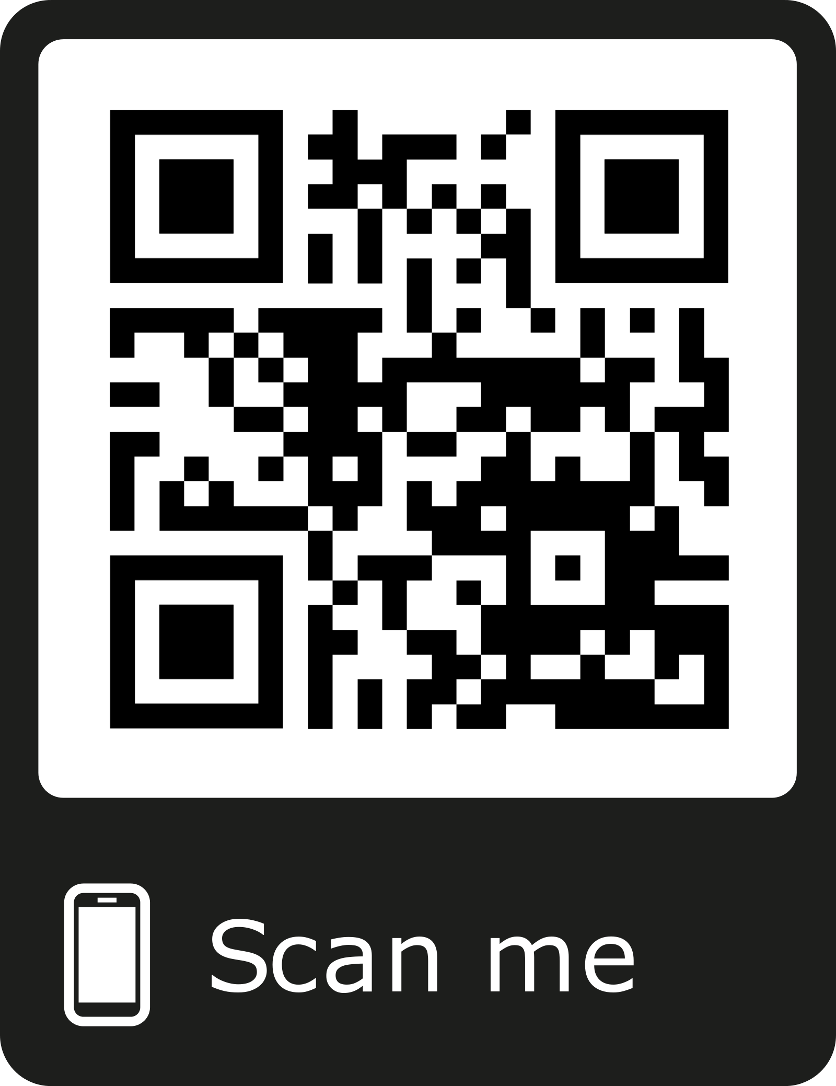

Slide 48
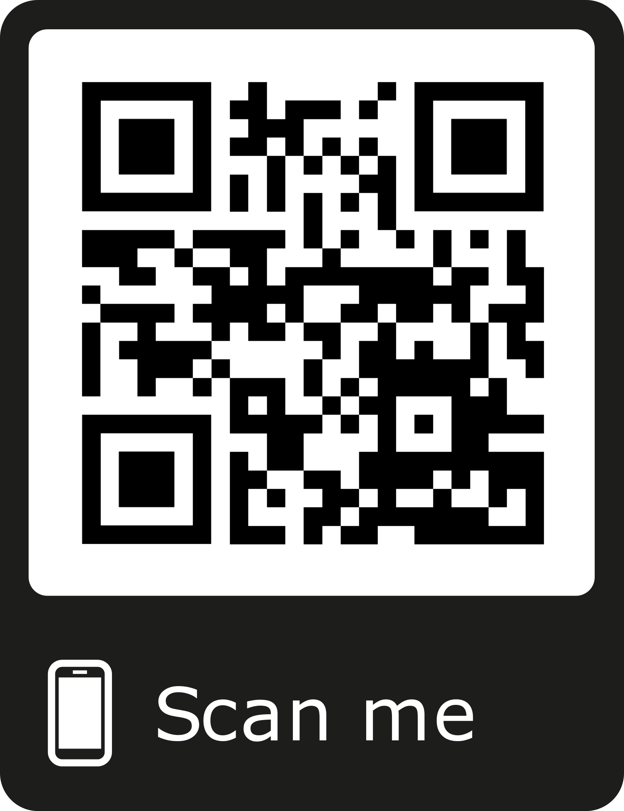

Slide 49
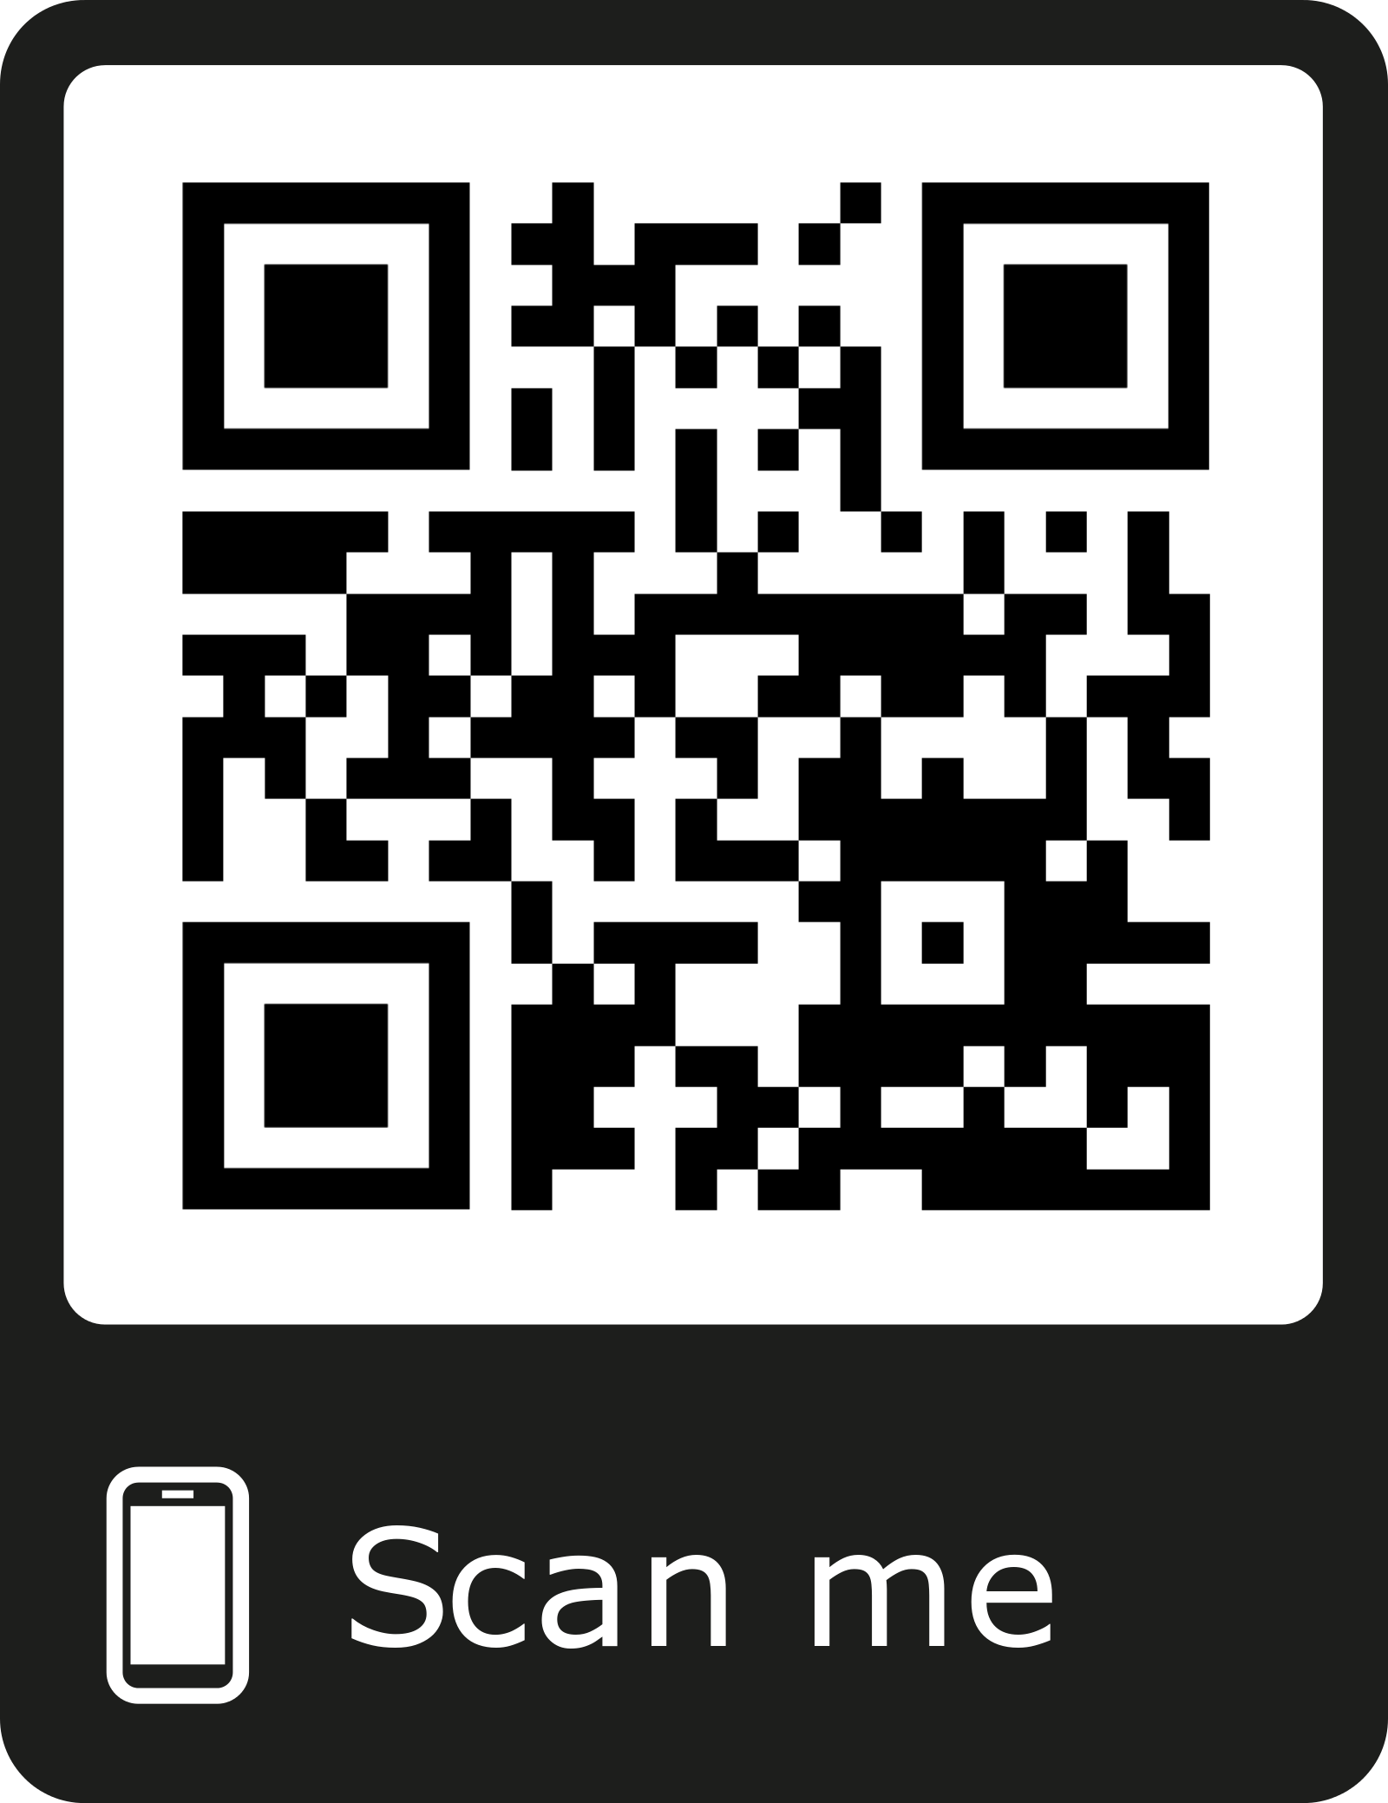

Slide 50
Take Home Message
Back pain mostly diagnosed clinically.
Exclude the RED FLAGS
Imaging is not a must
Medications is not everything
When you suspects Cauda Equine Refer

