Slide 1
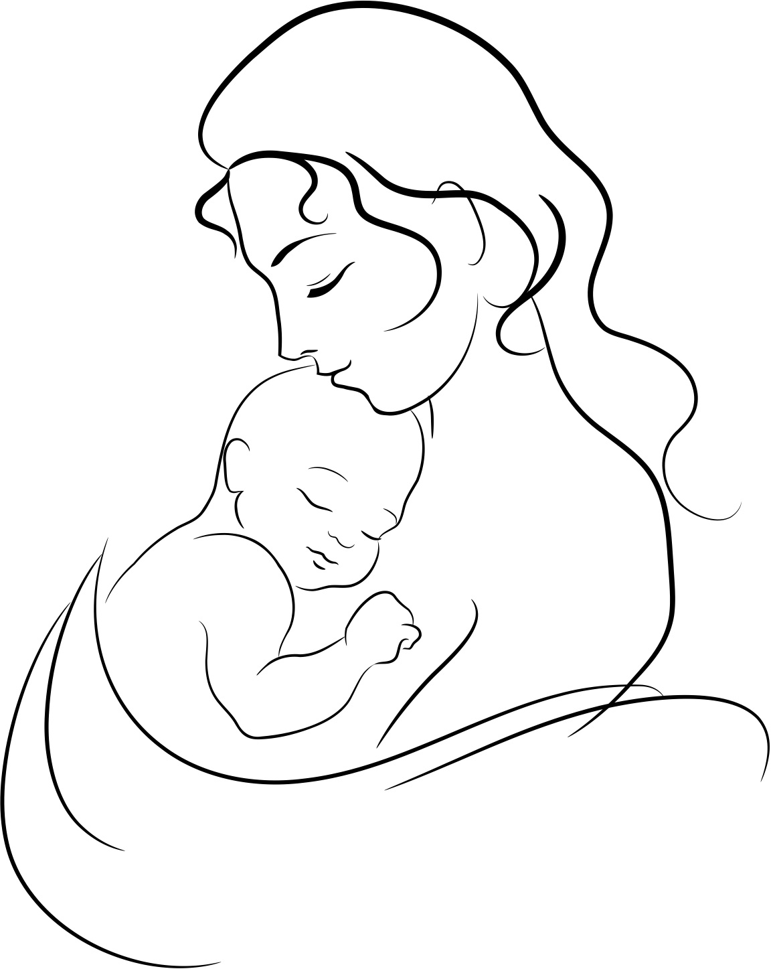
Maternal and child health
Presenters:
Ibrahim Alshayea
Abdullah Alshnaifi
Faisal Alqahtani

Slide 2
Objectives
Health behaviors and health systems indicators that affect the health, wellness, and quality of life of women, children, and families.
Factors affecting pregnancy and childbirth, including preconception health status, Age, access to appropriate preconception and interconnection health care, and poverty.
Health risks that include hypertension and heart disease, diabetes, depression, genetic conditions, sexually transmitted diseases (STDs), inadequate nutrition, unhealthy weight, tobacco use and alcohol abuse
Social and physical determinants of maternal health
Social and physical determinants of infant and child health
How to improve the health and well-being of women, infants, children, and families

Slide 3
Questions
What is the single largest infectious cause of death in children worldwide?
Which of the following is a normal weight for a newborn baby?
1.6 kg
2.6 kg
4 kg
5 kg
Notes:
- Answer for q1 is pneumonia. It accounts for around 16% of all deaths of children under five years.
- How to protect from pneumonia? protect children from pneumonia including promoting exclusive breastfeeding and adequate complementary feeding;
prevent pneumonia with vaccinations, reducing household air pollution

Slide 4
Questions
What is the single largest infectious cause of death in children worldwide?
Pneumonia
Which of the following is a normal weight for a newborn baby?
1.6 kg
2.6 kg
4 kg
5 kg
Notes:
- Answer for q1 is pneumonia. It accounts for around 16% of all deaths of children under five years.
- How to protect from pneumonia? protect children from pneumonia including promoting exclusive breastfeeding and adequate complementary feeding;
prevent pneumonia with vaccinations, reducing household air pollution

Slide 5
Facts
Nearly 830 women die every day due to complications during pregnancy and childbirth
Women die in pregnancy and childbirth for 5 main reasons
Maternal health mirrors the gap between the rich and the poor
More than 135 million women give birth per year
Notes:
Fact 2: These are severe bleeding, infections, unsafe abortion, hypertensive disorders (pre-eclampsia and eclampsia), and medical complications like cardiac disease, diabetes, or HIV/AIDS complicating or complicated by pregnancy.
Fact 3: Less than 1% of maternal deaths occur in high-income countries. The maternal mortality ratio in developing countries is 239 per 100 000 births versus 12 per 100 000 in developed countries.
Fact 4: About 20 million of them are estimated to experience pregnancy-related illness after childbirth. The list of morbidities is long and diverse, and includes fever, anaemia, fistula, incontinence, infertility and depression.

Slide 6
Definitions
Maternal health: refers to the health of women during pregnancy, childbirth and the postpartum period.
Health indicators: a measurable characteristic that describes the health of a population (e.g., life expectancy, mortality, disease incidence or prevalence, or other health states)
Notes:
Give an example of health indicator

Slide 7
Deaths between 28 week of gestation to less than 7 days of life expressed as per 1000 of total births.
Deaths in the first 28 days of life expressed as per 1000 of total live births
Number of maternal deaths in a given period per population of women who are reproductive age
Deaths between 28 days of life to < 1 year expressed as per 1000 of total live births
Number of maternal deaths per live births
Maternal mortality ratio
Maternal mortality rate
Perinatal mortality rate
Neonatal mortality rate
Postnatal mortality rate

Slide 8
Deaths between 28 week of gestation to less than 7 days of life expressed as per 1000 of total births.
Deaths in the first 28 days of life expressed as per 1000 of total live births
Number of maternal deaths in a given period per population of women who are reproductive age
Deaths between 28 days of life to < 1 year expressed as per 1000 of total live births
Number of maternal deaths per live births
Maternal mortality ratio
Maternal mortality rate
Perinatal mortality rate
Neonatal mortality rate
Postnatal mortality rate

Slide 9
Deaths between 28 week of gestation to less than 7 days of life expressed as per 1000 of total births.
Deaths in the first 28 days of life expressed as per 1000 of total live births
Number of maternal deaths in a given period per population of women who are reproductive age
Deaths between 28 days of life to < 1 year expressed as per 1000 of total live births
Number of maternal deaths per live births
Maternal mortality ratio
Maternal mortality rate
Perinatal mortality rate
Neonatal mortality rate
Postnatal mortality rate

Slide 10
Deaths between 28 week of gestation to less than 7 days of life expressed as per 1000 of total births.
Deaths in the first 28 days of life expressed as per 1000 of total live births
Number of maternal deaths in a given period per population of women who are reproductive age
Deaths between 28 days of life to < 1 year expressed as per 1000 of total live births
Number of maternal deaths per live births
Maternal mortality ratio
Maternal mortality rate
Perinatal mortality rate
Neonatal mortality rate
Postnatal mortality rate

Slide 11
Deaths between 28 week of gestation to less than 7 days of life expressed as per 1000 of total births.
Deaths in the first 28 days of life expressed as per 1000 of total live births
Number of maternal deaths in a given period per population of women who are reproductive age
Deaths between 28 days of life to < 1 year expressed as per 1000 of total live births
Number of maternal deaths per live births
Maternal mortality ratio
Maternal mortality rate
Perinatal mortality rate
Neonatal mortality rate
Postnatal mortality rate

Slide 12
Deaths between 28 week of gestation to less than 7 days of life expressed as per 1000 of total births.
Deaths in the first 28 days of life expressed as per 1000 of total live births
Number of maternal deaths in a given period per population of women who are reproductive age
Deaths between 28 days of life to < 1 year expressed as per 1000 of total live births
Number of maternal deaths per live births
Maternal mortality ratio
Maternal mortality rate
Perinatal mortality rate
Neonatal mortality rate
Postnatal mortality rate

Slide 13
What is maternal death?

Slide 17
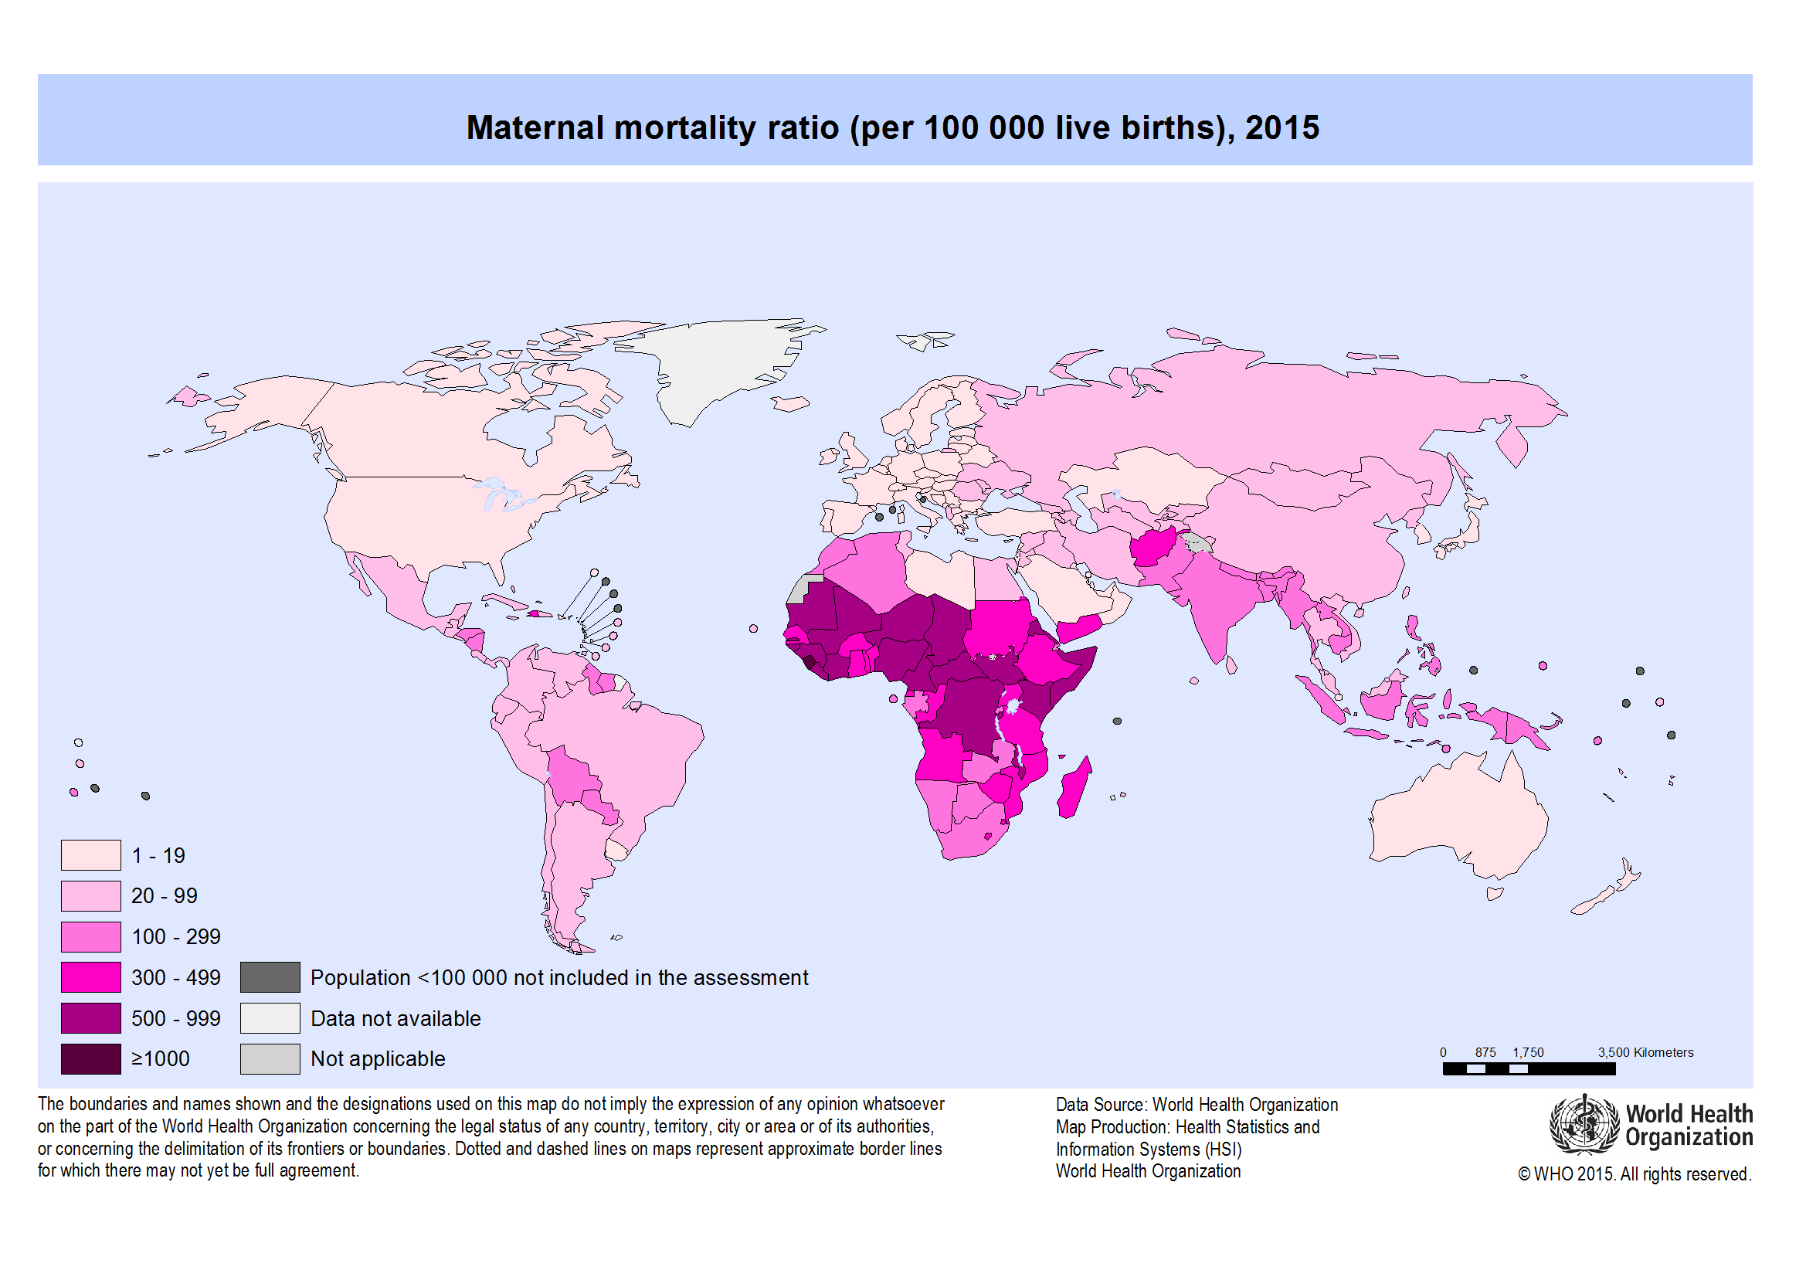

Slide 18
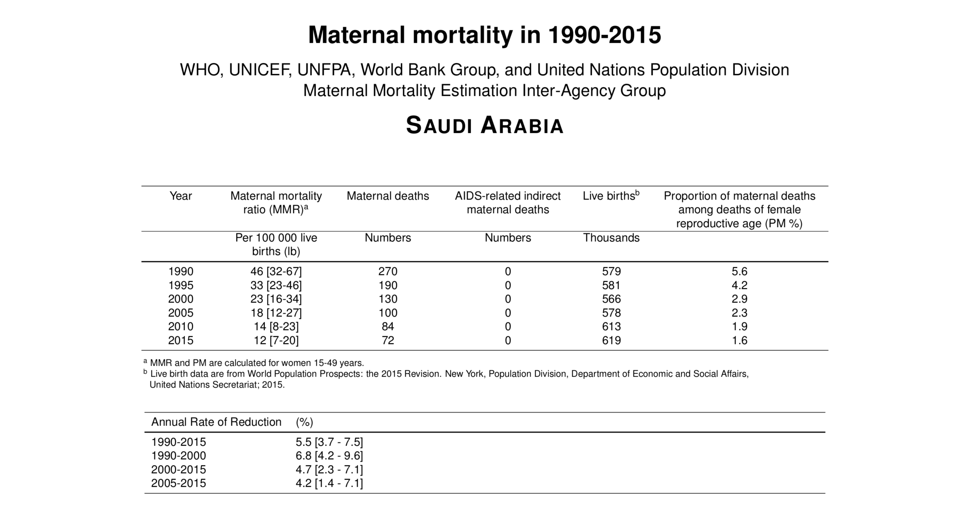

Slide 19
Health system indicator for children
perinatal mortality rate
Deaths between 28th week of gestation to less than 7 days of lif expressed as per 1000 of total births (live and still)
Neonatal mortality rate
Postnatal mortality rate
Deaths between 28 days of life to less than 1 year expressed as per 1000 of total live births.
Under-5 mortality
Deaths below 5 years expressed as per 1000 of the number of children below the age of 5 years.
Deaths in the first 28 days of life expressed as per 1000 of total live births.

Slide 20
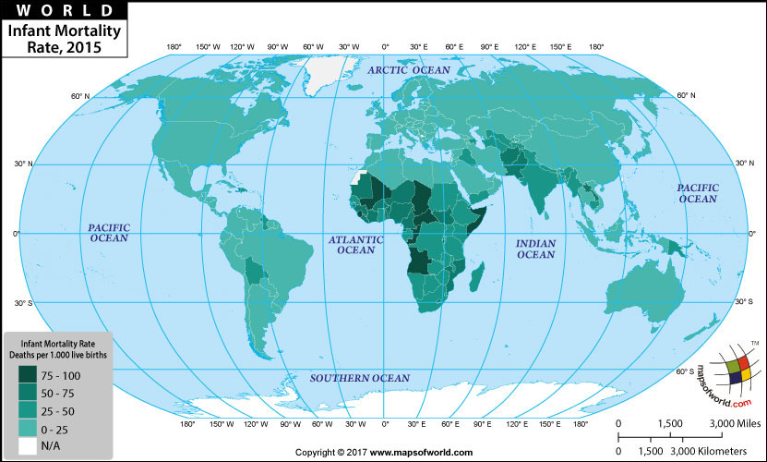

Slide 21
Factors affecting pregnancy and childbirth
Existing health conditions:
high BP, PCOS, DM, kidney disease, HIV/AIDS
1
Lifestyle factors:
alcohol use, smoking, drug use
2
Age:
young age, 1st pregnancy after 35 years of age
3
conditions of pregnancy:
multiple gestations, gestational diabetes, pre-eclampsia/eclampsia
4
Poverty
5
Notes:
High BP: Uncontrolled high blood pressure, however, can damage the mother’s kidneys and increase the risk for low birth weight or preeclampsia.¹ It is very important for women to have their blood pressure checked at every prenatal visit so that healthcare providers can detect any changes and make decisions about treatment.
PCOS: Women with PCOS have higher rates of pregnancy loss before 20 weeks of pregnancy, diabetes during pregnancy (gestational diabetes), preeclampsia, and cesarean section.
DM: Babies of mothers with diabetes tend to be large and are likely to have low blood sugar soon after birth.
Kidney disease: But kidney disease can cause difficulties getting and staying pregnant as well as problems during pregnancy, including preterm delivery, low birth weight, and preeclampsia. Nearly one-fifth of women who develop preeclampsia early in pregnancy are found to have undiagnosed kidney disease.
Young age: Pregnant teens are more likely to develop pregnancy-related high blood pressure and anemia (lack of healthy red blood cells) and to go through preterm (early) labor and delivery than women who are older.
After 35: arch shows that older women are at higher risk for certain problems than younger women, including:
*Pregnancy-related high blood pressure (called gestational hypertension) and diabetes (called gestational diabetes)
*Pregnancy loss
*Ectopic pregnancy (when the embryo attaches itself outside the uterus), a condition that can be life-threatening
*Cesarean (surgical) delivery
*Delivery complications, such as excessive bleeding
*Prolonged labor (lasting more than 20 hours)
*Labor that does not advance
*Genetic disorders, such as Down syndrome, in the baby
Multiple gestations: Pregnancy with twins, triplets, or more fetuses, called multiple gestation, increases the risk of infants being born prematurely (before 37 weeks of pregnancy).
Gestational diabetes occurs when a woman who didn’t have diabetes before develops diabetes when she is pregnant. Gestational diabetes can cause problems for both mother and fetus, including preterm labor and delivery, and high blood pressure. It also increases the risk that a woman and her baby will develop type 2 diabetes later in life.
Preeclampsia is a sudden increase in a pregnant woman’s blood pressure after the 20th week of pregnancy. It can affect the mother’s kidneys, liver, and brain. The condition can be fatal for both the mother and the fetus or cause long-term health problems. Eclampsia is a more severe form of preeclampsia that includes seizures and possibly coma.
Poverty: Almost all maternal deaths (99%) occur in developing countries.

Slide 22
Stages of maternal care
Preconception
Antenatal
postpartum
Notes:
Preconception health refers to the health of women and men during their reproductive years, which are the years they can have a child. It focuses on taking steps now to protect the health of a baby they might have sometime in the future.
Antenatal: is the care a mother receives from healthcare professionals during pregnancy, like:
Folic acid and vitamin D supplements
Nutrition, diet and food hygiene
Lifestyle factors : smoking, recreational drug use and drinking alcohol
Antenatal screening tests
Any complications or infections in a previous pregnancy
Treatment for a chronic disease.

Slide 23
Hypertension
MOST COMMON !!
If high blood pressure continues after 20 weeks of pregnancy, Preeclampsia can develop:
serious damage to your organs, including your brain and kidneys.
Preeclampsia with seizures becomes eclampsia (fatal).

Slide 24
Hypertension
Effect on the baby’s growth rate (low birth weight).
Placental abruption.
Preterm delivery.
Caesarean delivery.

Slide 25
Heart disease
Does it affect the baby?
Excess weight gain during pregnancy.
Preeclampsia/gestational hypertension.
Preterm birth.
Growth-restricted baby.
Clinically significant bleeding during pregnancy (abruption).
The development of gestational diabetes/gestational impaired glucose intolerance.

Slide 26
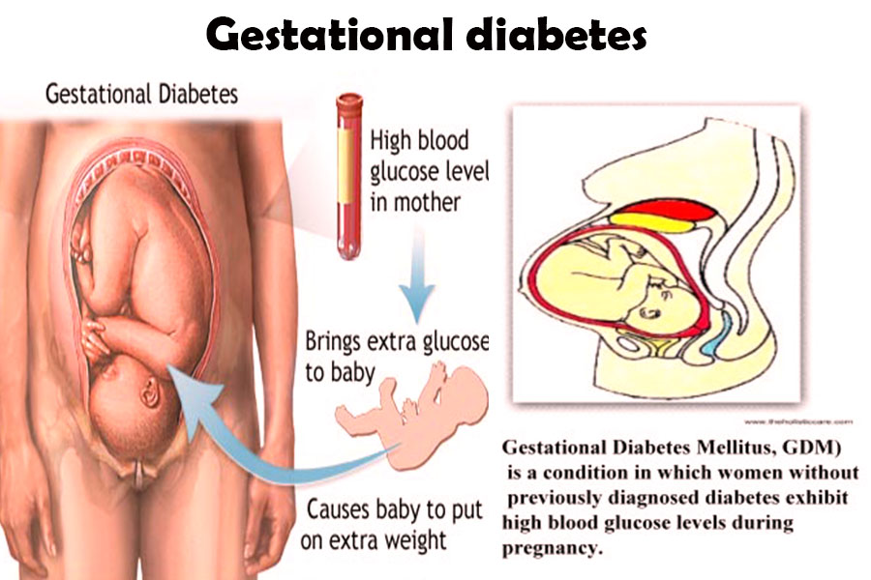
Diabetes
What are the risk factors of Gestational diabetes ?
Birth Defects.
Stillbirth.
Preterm Birth.
Being born too large and developing obesity or type 2 diabetes in the future.
High blood sugar throughout pregnancy increases women’s risk of having a cesarean delivery.

Slide 27
Unhealthy weight
Is It Important to Gain the Recommended Amount of Weight During Pregnancy?
Gaining less → Small baby.
Gaining more→ large baby.
Unhealthy weight

Slide 28
Inadequate nutrition
Health risks for the mother:
1
Iron-deficiency → Maternal morbidity and mortality, Preterm birth and Neurological dysfunction.
Vitamin A deficiency → Night-blindness
Neonatal health risk:
2
Folate deficiency → deficits in the development of the neural tube.
Calcium deficiency → restricts fetal skeletal development.
Iron-deficiency → intrauterine growth retardation and low birth weight.

Slide 29
Tobacco use
How Does Smoking During Pregnancy be harmful?
Makes it harder for a woman to get pregnant.
Premature birth(being born too early).
certain birth defects
Infant death.
Risk of miscarriage.
Sudden Infant Death Syndrome (SIDS).

Slide 30
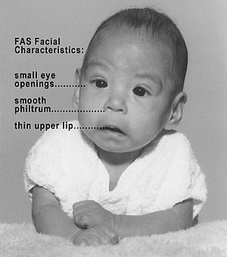
Alcohol
How Might alcohol
Affect the Pregnancy?
Amount, type and timing?
Fetal alcohol spectrum disorders (FASDs).
lifelong physical, behavioral, and
intellectual disabilities.

Slide 31
sexually transmitted diseases (STDs)
Can pregnant women get an STD?

Slide 32
sexually transmitted diseases (STDs)
STD can be more serious, even life-threatening.
Risk of transmitting HIV To the newborn.

Slide 33
Depression
What can cause depression during pregnancy?
Can depression during pregnancy cause harm to the baby?
Poor nutrition.
Drinking, smoking and suicidal behavior.
Babies born to mothers who are depressed may be less active, show less attention and be more agitated than babies born to moms who are not depressed

Slide 34
Genetic conditions
What are they ?
Cystic fibrosis
Marfan syndrome
PCKD
Neurofibromatosis.

Slide 35
Social and Physical Determinants of Maternal and Child Health
Q: what is the difference between physical & social determinants?

Slide 36
Social determinants of maternal health
1-Social Determinants of Maternal Health include:
Race and ethnicity .
Age .
socioeconomic factors, such as: income level & educational attainment.
Access to medical care
Pre-pregnancy health
General health status

Slide 37
Physical determinants of maternal health
Some environmental factors can shape a woman’s overall health status before, during, and after pregnancy by:
1- Affecting her health directly.
2- Affecting her ability to engage in healthy behaviors.

Slide 38
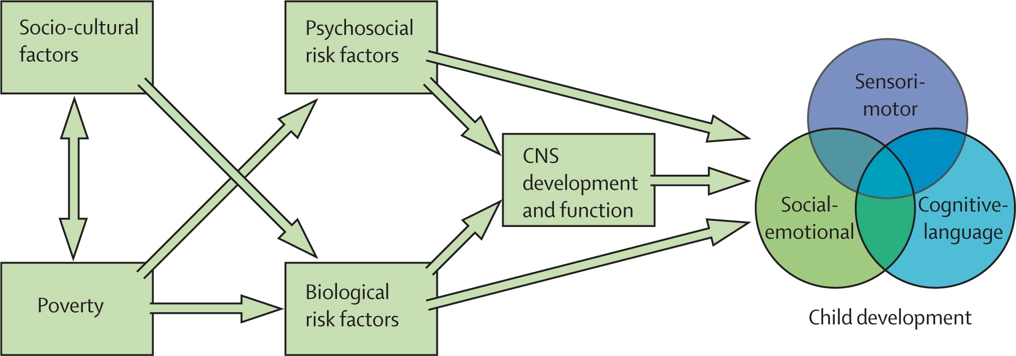

Slide 39
Social and physical determinants of infants and child health

Slide 40
Determinants of Infant and Child Health:
Biological
Social

Slide 41
1- Biological determinants of health:
Birth weight
Age of The Mother
Repeated pregnancies (why?)
Birth Spacing: < 1 year = 2-4 times risk of mortality.
Multiple Births
Notes:
1) low birth weight (< 2.5 kg) & high birth weight (> 4 kg)
Low weight → increase the risk of dm2
Low or high weight → increase the risk of obesity in later life
2) -
3) Increase the risk of mischarge
4)-
5) more risk due to low birth weight

Slide 42
2- Social determinants of health:
Income
Education
nutrition
Violence
Health care quality
Environmental conditions
Culture
Notes:
The social environment exerts a strong influence on child health especially through :
Income: how?
Nutrition : breast and formula use,
Violence: (wife beating, infanticide, wars, child abuse, domestic violence)
Cultural Factors :
Religion ,Customs, Early marriages, Sex of child, Quality of mothering, Traditions affecting (cleanliness, eating, clothing, child care)

Slide 43
More than 1 in 4 child deaths could be prevented by cleaning up the environment.
Notes:
According to (WHO) every year enviromental risks such as indoor and out door air pollution , second hand smoke and unsafe water take the lives of 1.7 million child
Under the age of 5 years- 26% of child death

Slide 44
Differences in the quality of life within and between countries affect how long people live
Notes:
Social determinants not only affect the child heath , it also have an impact on the life expectancy of the child
A child born in Japan has a chance of living 43 years longer than a child born in Sierra Leone.

Slide 45
Question: how can we improve the health of the mother after delivery?

Slide 46
Major causes of maternal mortality:

Slide 48
Maternal health:
assessment of vaginal bleeding, uterine contraction, temperature and heart rate should be done routinely during the first 24 hours
Iron and folic acid supplementation should be provided for at least 3 months after delivery.
Breastfeeding assessment.

Slide 49
postpartum depression
After 10–14 days, all women should be asked about postpartum depression .
approximately 10 to 15% of women suffer from postpartum mood disorders (PPMDs.

Slide 50
Question
How can we improve the health of the infants after delivery?

Slide 51
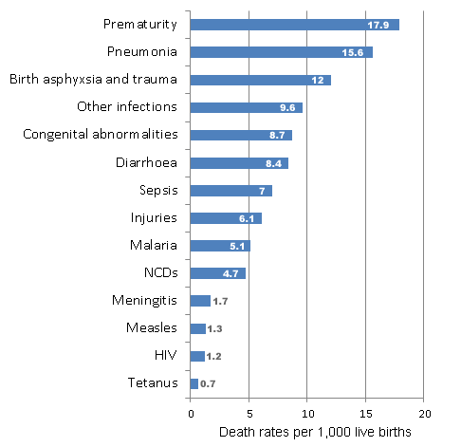
Causes of children mortality under the age of 5

Slide 52
infants health:
Promote early and exclusive breastfeeding.
A full clinical examination should be done 1 hour after birth. This includes giving vitamin K prophylaxis and hepatitis B vaccination (within 24 hours).
vaccination ( before & during pregnancy, and for the infant).

Slide 53
Test your knowledge!
Q1: Mention 3 factors affecting pregnancy.
Q2: all of the followings are parts of the social determinants of child health except?
Income
Education
Birth weight
Nutrition

Slide 54
Test your knowledge!
Q3: which one of the following is a risk for night blindness to the mother?
Folate deficiency
Calcium deficiency
Vitamin A deficiency
Iron deficiency
Q4: which of the following leads to deficit in the development of the neural tube?
Iron deficiency
Folate deficiency
Calcium deficiency
Vitamin A deficiency

Slide 55
Test your knowledge!
Q1: Mention 3 factors affecting pregnancy.
Existing health conditions, lifestyle factors and poverty
Q2: all of the followings are parts of the social determinants of child health except?
Income
Education
Birth weight
Nutrition

Slide 56
Test your knowledge!
Q3: which one of the following is a risk for night blindness to the mother?
Folate deficiency
Calcium deficiency
Vitamin A deficiency
Iron deficiency
Q4: which of the following leads to deficit in the development of the neural tube?
Iron deficiency
Folate deficiency
Calcium deficiency
Vitamin A deficiency

Slide 57
Questions?

Slide 58
Thank you!

