Slide 1
Approach to the patient
with Back pain
Presented By:
Hesham AlGhofili & Gassan Almoqbel
Supervised by: Dr. Amr Jamal

Slide 2
Objectives
Diagnosis including history, Red Flags, and Examination
Brief comment on Mechanical, Inflammatory, Root nerve compression, and Malignancy
Common causes
Role of primary health care in management
When to refer to a specialist
Prevention and Education

Slide 3
In USA it is the commonest cause of limitation of activity in those under the age of 45. (1)
The lifetime prevalence of non-specific (common) low back pain is estimated at 60–70% (1)
Notes:
Hengel KM, Visser B, Sluiter JK. The prevalence and incidence of musculoskeletal symptoms among hospital physicians: A systematic review. International Archives of Occupational and Environmental Health. 2011;84(2):115-9.

Slide 4
79.2%
53.2%
In Saudi Arabia Seven studies were cross-sectional and found a prevalence and pattern ranging from 53.2% to 79.17%. (2)
Notes:
Awaji M. Epidemiology of Low Back Pain in Saudi Arabia. J Adv Med Pharm Sci [Internet]. 2016;6(4):1–9. Available from: http://sciencedomain.org/abstract/13544

Slide 5
Role play

Slide 6
MCQs!

Slide 7
1- Which of the following is not indicative of inflammatory back pain? (3)
a. Insidious onset b. Onset before 40 years of age
c. Pain for more than 3 months d. Morning stiffness e. Aggravation of pain with activity
https://PollEv.com/surveys/kPSMW0SBL/web

Slide 8
2- Which of the following is (are) characteristic of a history of mechanical Lower Back Pain? (3)
a. Relatively acute onset b. History of overuse or a precipitating injury
c. Pain worse during the day d. All

Slide 9
3- Which of the following is (are) a "red flag(s)" or danger signal(s) relative to the diagnosis of LBP? (3)
a. Cough b. Impotence
c. Chest pain d. Constipation

Slide 10
4- What is the most cost-effective and crucial aspect of the treatment of chronic LBP? (3)
a. Patient education b. Physiotherapy
c. Bed rest d. Morning stiffness

Slide 11
5- Which of the following is the most common cause of LBP? (3)
a. Metastatic bone disease b. Inflammatory back pain
c. Lumbosacral sprain or strain d. None of the above

Slide 12
What is the diagnostic approach to a patient with back pain?
A thorough history and physical examination helps elucidate the diagnosis in most patients.

Slide 13
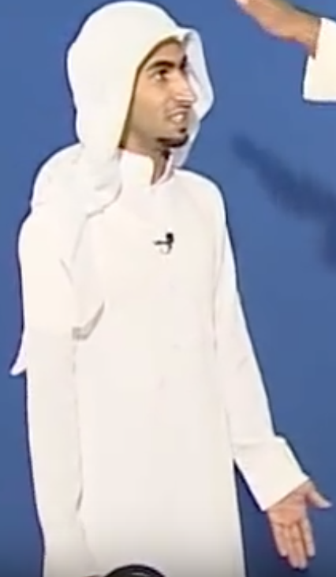
Hx taking ₍₄₎
Doctor I have PAIN!

Slide 14
DDx
Mechanical
Systemic
Referred
Lumbar strain or sprain
Malignancy
Acute Aneurysm
Herniated disc and spinal stenosis
Multiple myeloma
Pelvic disease
Metastatic carcinoma
Prostatitis/Endometriosis
Degenerative processes of disc and facet joint
Infection
Renal disease
Compression fracture
Osteomyelitis
Stones / Pyelonephritis
Spondylolysis
TB
GI disease
Brucellosis
Pancreatitis
Inflammation
Ankylosing spondylitis
Cholecystitis

Slide 15
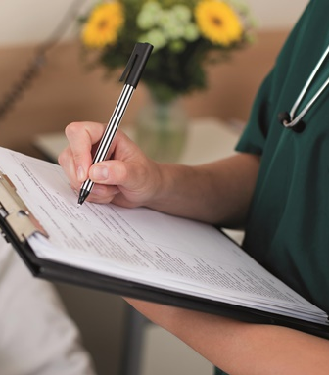
Hx taking
1
Personal Data
2
SOCRATES
3
Neurological?
4
Red Flags!
5
PMH
6
Past Surgical Hx
7
Medications
8
Family, Social & Systemic Review

Slide 16
Hx taking
1
Personal Data
Age?
Residence?
Occupation?
2
SOCRATES
Site?
Associated?
Onset?
Timing?
Character?
Exacerbating?
Radiation?
Severity?

Slide 17
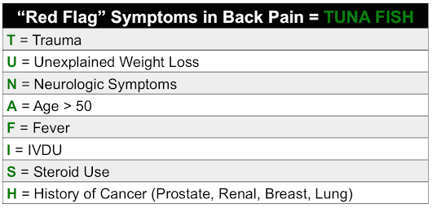
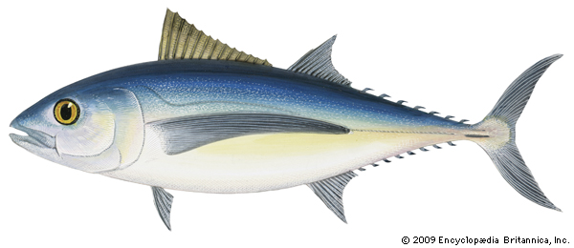
Hx taking
3
Neurological?
4
Red Flags!
Warrant additional diagnostic imaging

Slide 18
Hx taking
5
PMH
Trauma?
Cancer?
Psychatic?
6
Past Surgical Hx
7
Medications
Steroid?
8
Family, Social & Systemic Review
Inherited disease?
Smoking?
Alcohol?
Social?

Slide 19
Hx taking
One More thing
Idea
Concern
Expectation
How does it affect him/her Emotionally/Functionally

Slide 20
Physical Examination
Will be explained by Gassan in latter slides
Laboratory tests
Not necessary in the evaluation of back pain unless the concerned about the possibility of malignancy or infection ₍₅₎
FBC, ESR, C-reactive protein (CRP), and blood cultures
Urinalysis and Culture.. Why?
Notes:
Assessment of back pain [Internet]. BMJ Best Practice; 2018 [cited 4 September 2018]. Available from: https://bestpractice.bmj.com/topics/en-gb/189/pdf/189.pd

Slide 21
Imaging
High-risk patients
Most patients with low back pain with or without sciatica do not routinely require imaging when presenting in a non-specialist setting. ₍₅₎
Reassure.. that their symptoms will respond to conservative treatment. ₍₅₎
If symptoms persist longer than 6 to 8 weeks, plain x-rays should be obtained at that time ₍₅₎
Notes:
Assessment of back pain [Internet]. BMJ Best Practice; 2018 [cited 4 September 2018]. Available from: https://bestpractice.bmj.com/topics/en-gb/189/pdf/189.pd

Slide 22
Imaging
MRI or CT, only if: neurological compromise, infection, or tumors is considered ₍₅₎
After discussion with a spinal surgeon.
MRI is the preferred study. If contraindicated a CT myelogram is usually warranted.₍₅₎
In trauma situations, the standard AP pelvis and cervical spine radiographs should be obtained. ₍₅₎
Notes:
a patient has metal in their spine or is unable to undergo an MRI,

Slide 23
Imaging ₍₆₎
Do not routinely offer imaging in a non-specialist setting.
Explain to the patient that if she/he is being referred for specialist opinion, she/he may not need imaging.
Consider imaging for people with low back pain with or without sciatica only if the result is likely to change management.
Notes:
Low back pain and sciatica in over 16s: assessment and management. NICE guideline; 2016.

Slide 24
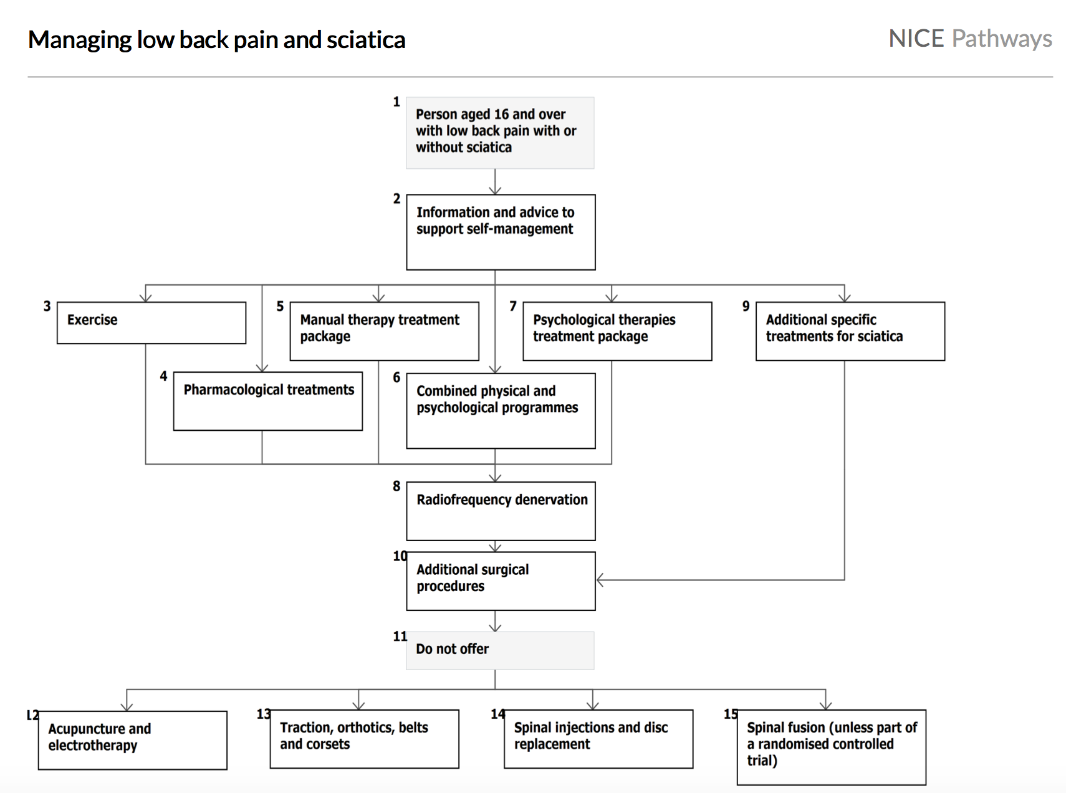
Notes:
Low back pain and sciatica in over 16s: assessment and management. NICE guideline; 2016.

Slide 25
Case
A 38-year-old man with no significant history of back pain developed acute LBP when lifting boxes 2 weeks ago.
The pain is aching in nature, located in the left lumbar area, and associated with spasms. He describes previous similar episodes several years ago, which resolved without seeing a doctor.
He denies any leg pain or weakness. He also denies fevers, chills, weight loss, and recent infections
On examination, there is decreased lumbar flexion and extension secondary to pain, but a neurologic exam is unremarkable.
Mechanical
Inflammation
Malignancy
Root Nerve Compression
Notes:
What is the type of this pain?
Evaluation of low back pain in adults [Internet]. Uptodate.com. 2018 [cited 4 September 2018]. Available from: https://www.uptodate.com/contents/evaluation-of-low-back-pain-in-adults?search=evalu%20ation-of-low-back-pain-in adults&source=search_result&selectedTitle=1~150&usage_type=default&display_rank=1

Slide 26
Case
A 20-year-old man presents to his primary care physician with low back pain and stiffness that has persisted for more than 3 months.
There is no history of obvious injury but he is a very avid sportsman. His back symptoms are worse when he awakes in the morning, and the stiffness lasts more than 1 hour. His back symptoms improve with exercise. He has a desk job and finds that sitting for long periods of time exacerbates his symptoms.
His back symptoms also wake him in the second half of the night. He normally takes an anti-inflammatory drug during the day, and finds his stiffness is worse when he misses a dose. He has had 2 bouts of iritis in the past.
Mechanical
Inflammation
Malignancy
Root Nerve Compression
Notes:
What is the type of this pain?
Swanson’s Family Medicine Review (7th Ed.)

Slide 27
Case
9-year-old male patient who had a history of low back pain for about a year and was reporting severe, constant, and aching lower back pain of 8-9 on a scale of 10.
as well as radicular right leg pain, decreased sensation on the right, difficulty straightening his right leg making it difficult to walk.
An MRI showed a rather large L5-S1 herniated disc on the right side with severe degenerative disc disease.
Mechanical
Inflammation
Malignancy
Root Nerve Compression
Notes:
What is the type of this pain?
What is the investigation of choice and why we ordered it? While the previous cases we didn’t.
Dog and Rooster I. Disc Herniation Case Studies| Spine Institute of San Diego : Center for Spinal [Internet]. Sdspineinstitute.com. 2018 [cited 6 September 2018]. Available from: http://www.sdspineinstitute.com/case-studies/disc-herniations/lumbar.html

Slide 28
Case
A man aged 78 years presented to his general practitioner with new-onset low back pain. The patient had metastatic prostate cancer, which was diagnosed 2 years ago.
He reported a 6-week history of constant, burning pain in the lower lumbar region, which was worse at night and was 7/10 in severity on the Numeric Pain Rating Scale.
He had no relief with regular paracetamol or ibuprofen. He had not had lower limb weakness, numbness, lower urinary tract symptoms or weight loss.
Mechanical
Inflammation
Malignancy
Root Nerve Compression
Notes:
What is the type of this pain?
Practitioners T. RACGP - Back pain in a cancer patient: a case study [Internet]. Racgp.org.au. 2018 [cited 6 September 2018]. Available from: https://www.racgp.org.au/afp/2014/august/back-pain-in-a-cancer-patient/

Slide 29
Mechanical
Tends to get better or worse depending on your position – for example, it may feel better when sitting or lying down.
Typically feels worse when moving
Can develop suddenly or gradually
Might sometimes be the result of poor posture or lifting something awkwardly, but often occurs for no apparent reason
May be due to a minor injury
Notes:
Evaluation of low back pain in adults [Internet]. Uptodate.com. 2018 [cited 4 September 2018]. Available from: https://www.uptodate.com/contents/evaluation-of-low-back-pain-in-adults?search=evalu%20ation-of-low-back-pain-in adults&source=search_result&selectedTitle=1~150&usage_type=default&display_rank=1

Slide 30
Inflammation
Age at onset of back pain <45 years
Back pain lasting > 3 months
Night pain
Early morning pain and stiffness lasting more than one hour
Insidious onset
Tenderness/inflammation over the joint
Increased by Rest and Relived by activity
Notes:
Evaluation of low back pain in adults [Internet]. Uptodate.com. 2018 [cited 4 September 2018]. Available from: https://www.uptodate.com/contents/evaluation-of-low-back-pain-in-adults?search=evalu%20ation-of-low-back-pain-in adults&source=search_result&selectedTitle=1~150&usage_type=default&display_rank=1

Slide 32
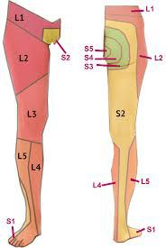
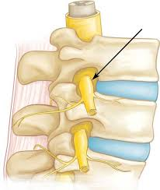
Root Nerve Compression
Characterized by radicular pain arising from nerve root impingement due to herniated discs.
Radicular pain: Pain that radiates into the lower extremity directly along the course of a spinal nerve root.
Notes:
Evaluation of low back pain in adults [Internet]. Uptodate.com. 2018 [cited 4 September 2018]. Available from: https://www.uptodate.com/contents/evaluation-of-low-back-pain-in-adults?search=evalu%20ation-of-low-back-pain-in adults&source=search_result&selectedTitle=1~150&usage_type=default&display_rank=1

Slide 33
Malignancy
Metastatic tumors are found mostly in patients older than 50 years .
Metastatic disease is more common than primary tumors of the spine, and thoracic spine metastatic lesions are more common than lumbar
Patient usually has constitutional symptoms such as fever ,Wight loss, loss of appetite and N\V
Notes:
Evaluation of low back pain in adults [Internet]. Uptodate.com. 2018 [cited 4 September 2018]. Available from: https://www.uptodate.com/contents/evaluation-of-low-back-pain-in-adults?search=evalu%20ation-of-low-back-pain-in adults&source=search_result&selectedTitle=1~150&usage_type=default&display_rank=1

Slide 34
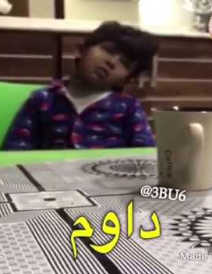
Others
Pediatrics:
In Primary care settings most of the cases are due to overloaded school backpacks.. ₍₁₀₎
Also think about psychological causes to avoid going to school.
Women:
Ask about pregnancy.
Psychiatric patients: 75% of Depressed patients present with pain .. One of the most common sites is Lower back pain ₍₁₁₎
Notes:
Evaluation of the child with back pain [Internet]. Uptodate.com. 2018 [cited 4 September 2018]. Available from: https://www.uptodate.com/contents/evaluation-of-the-child-with-back-pain
13. Kleiber B, Jain S, Trivedi MH. Depression and Pain: Implications for Symptomatic Presentation and Pharmacological Treatments. Psychiatry (Edgmont). 2005;2(5):12-18.

Slide 35
Case
A 28-year-old man with chronic low back pain (LBP) comes to your office for renewal of his medication. He was injured at work 5 years ago while attempting to lift a box of heavy tools. Since that time, he has been off work, living on compensation insurance payments, and he has not been able to find a job that does not aggravate his back.
On physical examination, the patient demonstrates some vague tenderness in the paravertebral area around L3 to L5. He has some limitations on both flexion and extension.
What is the most likely diagnosis?
What is the next step?
Notes:
Musculoskeletal lower back pain [Internet]. BMJ Best Practice. 2018 [cited 4 September 2018]. Available from: https://bestpractice.bmj.com/topics/en-gb/778

Slide 36
Lumbar muscular strain/sprain
Stiffness, and/or soreness of the lumbosacral region (underneath the twelfth rib and above the gluteal folds) persisting for <12 weeks. ₍₁₂₎
What is the difference between strain and sprain?
Strains occur when a muscle is stretched too far and tears, damaging the muscle itself.
Sprains happen when over-stretching and tearing affects ligaments, which connect the bones together.
Notes:
Musculoskeletal lower back pain [Internet]. BMJ Best Practice. 2018 [cited 4 September 2018]. Available from: https://bestpractice.bmj.com/topics/en-gb/778

Slide 37
Lumbar muscular strain/sprain
The most common source of back pain but do not sound serious and do not typically cause long-lasting pain.
Arises from any combination of pathology involving discs, vertebrae, facet joints, ligaments, and/or muscles.
Notes:
Musculoskeletal lower back pain [Internet]. BMJ Best Practice. 2018 [cited 4 September 2018]. Available from: https://bestpractice.bmj.com/topics/en-gb/778

Slide 38
Lumbar muscular strain/sprain
Clinical presentation: Sharp intense pain for 1 to 2 days; muscle spasm; most patients recover within 3 months
Risk factors?
Lifting a heavy object, or twisting the spine while lifting
Sudden movements that place too much stress on the low back, such as a fall
Poor posture over time
Sports injuries, especially in sports that involve twisting or large forces of impact
Notes:
Musculoskeletal lower back pain [Internet]. BMJ Best Practice. 2018 [cited 4 September 2018]. Available from: https://bestpractice.bmj.com/topics/en-gb/778

Slide 39
Lumbar muscular strain/sprain
Benign physical examination.
<4 Weeks
>6 Weeks
Investigations? ₍₁₂₎
Clinical diagnosis
Lumbar Spine X-Ray
Lumbar Spine MRI
Lumbar Spine CT
Labs
Management:
What is the aim of the treatment?
Reducing pain and restoring functional status.
Notes:
Musculoskeletal lower back pain [Internet]. BMJ Best Practice. 2018 [cited 4 September 2018]. Available from: https://bestpractice.bmj.com/topics/en-gb/778

Slide 40
Lumbar muscular strain/sprain
Management:₍₁₂₎
Acute (< 4 Weeks) | Subacute (4-12 Weeks) | Chronic (> 12 Week)
1st Line: Patient Education + Normal Activity. | 1st Line: Patient Education + Normal Activity. | 1st Line: CBT
+: Self care temp. treatment Heat Ice | Adjunctive: Active physiotherapy and exercise therapy. | Adjunctive: Rehabilitation/TCA/Opioid/Surgery.
Adjunctive: Analgesics/Muscle relaxant.
Evidence B
Evidence B
Evidence C
Notes:
Patient education serves as the framework for managing LBP. Patients with acute nonspecific LBP should be informed of the high likelihood of a good prognosis but warned of the high risk of frequent recurrences. Patients should be advised to limit bed rest and stay active, as these are associated with reduced pain and better functional outcomes. Evidence B

Slide 41
Lumbar muscular strain/sprain
Management:
For the Muscle relaxant:
NSAIDs if the first line. (Cochrane)
Paracetamol (Evidence C)
Notes:
Musculoskeletal lower back pain [Internet]. BMJ Best Practice. 2018 [cited 4 September 2018]. Available from: https://bestpractice.bmj.com/topics/en-gb/778

Slide 42
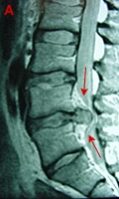
Case
38 year old laborer who had the immediate onset of left leg burning pain and weakness after lifting a heavy load. He had onset of some bladder incontinence
What is the most likely diagnosis?
What is the next step?

Slide 43
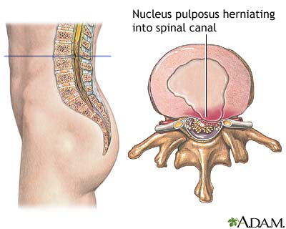
Herniated nucleus pulposus (HNP)
A complex, multi-factorial, clinical condition characterized by low back pain with or without the concurrence of radicular lower limb symptoms in the presence of radiologically-confirmed degenerative disc disease.
The pain is exacerbated by activity, but may be present in certain positions, such as sitting.
Notes:
Assessment of back pain [Internet]. BMJ Best Practice; 2018 [cited 4 September 2018]. Available from: https://bestpractice.bmj.com/topics/en-gb/189/pdf/189.pdf

Slide 44
Herniated nucleus pulposus (HNP)
Radiating lower extremity pain in a dermatomal distribution;
History of bowel or bladder dysfunction, bilateral sciatica, and saddle anesthesia may be symptoms of severe compression of the cauda equine
Positive straight-leg raise or contralateral straight leg (reproduced below 60° of hip flexion); positive femoral stretch test may suggest upper lumbar disc herniation.
Notes:
Assessment of back pain [Internet]. BMJ Best Practice; 2018 [cited 4 September 2018]. Available from: https://bestpractice.bmj.com/topics/en-gb/189/pdf/189.pdf

Slide 45
Herniated nucleus pulposus (HNP)
Causes:
Complex mechanical and inflammatory process.
Genetic influences have been found to be more important than the mechanical effects.
Associated with increasing age, smoking, the presence of facet joint tropism and arthritis, abnormal pelvic morphology, and changes in sagittal alignment.
Notes:
Assessment of back pain [Internet]. BMJ Best Practice; 2018 [cited 4 September 2018]. Available from: https://bestpractice.bmj.com/topics/en-gb/189/pdf/189.pdf

Slide 46
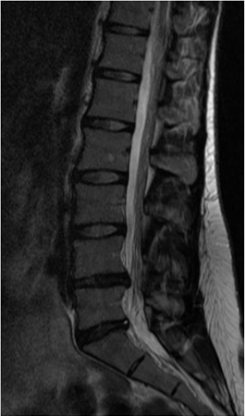
Herniated nucleus pulposus (HNP)
Investigations:
MRI: herniated disc
Management:
Saddle (perineal) anaesthesia, sphincter dysfunction, bladder retention, and leg weakness = Cauda Equina Syndrome (CES)
Urgent referral to the hospital.
Emergency decompression of the spinal canal within 48 hours after the onset of symptoms
Notes:
Assessment of back pain [Internet]. BMJ Best Practice; 2018 [cited 4 September 2018]. Available from: https://bestpractice.bmj.com/topics/en-gb/189/pdf/189.pdf

Slide 47
Herniated nucleus pulposus (HNP)
Management:
< 3 Months | > 3 Months
1st Line: Paracetamol | 1st Line: Continue pain management
Adjunctive: Topical analgesics/Opioid/Muscle Relaxant | Refer to pain clinic. If with Axial back pain: +Physiotherapy.
Notes:
Assessment of back pain [Internet]. BMJ Best Practice; 2018 [cited 4 September 2018]. Available from: https://bestpractice.bmj.com/topics/en-gb/189/pdf/189.pdf

Slide 48
Case
A 63-year-old woman presents with low back pain and cramping in both posterior thighs and numb- ness radiating into the feet with ambulation. It wors- ens with standing and walking and improves with sit- ting and bending forward. She has no bowel or bladder complaints.
On examination, she has full strength, normal sensation, reflexes are symmetric, and she has 2+ peripheral pulses. Straight leg raise is negative. What is this patient’s most likely diagnosis?
What is the most likely diagnosis?
What is the next step?

Slide 49
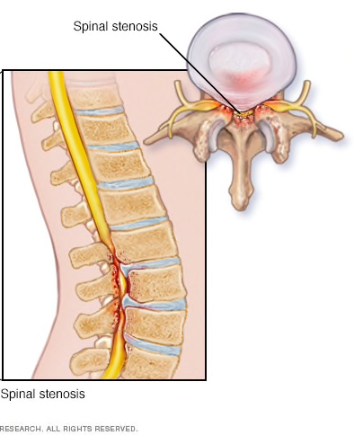
Spinal stenosis
Lumbar spondylosis refers to degenerative conditions of the lumbar spine that narrow the spinal canal, lateral recesses, and neural foramina. Facet joint and ligamentous hypertrophy, intervertebral disc protrusion, and spondylolisthesis may all contribute to the stenosis, and symptoms result from neural compression of the cauda equina, exiting nerve roots, or both.
Notes:
Assessment of back pain [Internet]. BMJ Best Practice; 2018 [cited 4 September 2018]. Available from: https://bestpractice.bmj.com/topics/en-gb/189/pdf/189.pdf

Slide 50
Spinal stenosis
Intermittent pain radiating to the thigh or legs.
Worse with prolonged standing, activity, or lumbar extension.
Pain is typically relieved by sitting, lying down, and/or lumbar flexion; patient may describe intermittent burning, numbness, heaviness, or weakness in their legs, unilateral or bilateral radicular pain, motor deficits, bowel and bladder dysfunction, and back and buttock pain with standing and ambulation
Notes:
Assessment of back pain [Internet]. BMJ Best Practice; 2018 [cited 4 September 2018]. Available from: https://bestpractice.bmj.com/topics/en-gb/189/pdf/189.pdf

Slide 51
Spinal stenosis
Patients walk with a forward flexed gait; patients with vascular claudication have diminished pulses and typical skin changes, such as mottled discoloration, thinning and shiny skin
Notes:
Assessment of back pain [Internet]. BMJ Best Practice; 2018 [cited 4 September 2018]. Available from: https://bestpractice.bmj.com/topics/en-gb/189/pdf/189.pdf

Slide 52
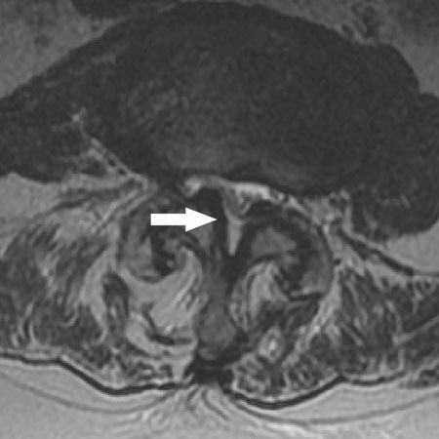
Spinal stenosis
Investigations:
MRI:
Notes:
Assessment of back pain [Internet]. BMJ Best Practice; 2018 [cited 4 September 2018]. Available from: https://bestpractice.bmj.com/topics/en-gb/189/pdf/189.pdf

Slide 53
Spinal stenosis
Management:
significant acute neurological deficit | No significant acute neurological deficit: pain affecting quality of life and/or functional activities | Chronic symptoms
1st Line: surgical decompression | 1st Line: analgesics (NSAIDs) | 1st analgesics
 | Adjunct: non-pharmaceutical measures/Oral corticosteroids | Adjunct: Non-pharmaceutical measures / Chronic pain agents / Surgery
 | 2nd Line: epidural corticosteroid injection
Notes:
Assessment of back pain [Internet]. BMJ Best Practice; 2018 [cited 4 September 2018]. Available from: https://bestpractice.bmj.com/topics/en-gb/189/pdf/189.pdf

Slide 54
Spinal stenosis
Management:
Non Pharmaceutical measures:
Temporary reduction in physical activity is recommended; patients should be careful to avoid bending, lifting, or twisting movements until the pain subsides.
Bed rest is not recommended.
Prolonged bed rest (>4 days) is contra-indicated, especially in older patients as it may lead to rapid de-conditioning and increased risk of DVT.
Notes:
Assessment of back pain [Internet]. BMJ Best Practice; 2018 [cited 4 September 2018]. Available from: https://bestpractice.bmj.com/topics/en-gb/189/pdf/189.pdf

Slide 55
Almost done ☹

Slide 56
Case
A 70-year-old man, 6 months after renal transplantation and on corticosteroid treatment, presents with severe back pain. X-ray evaluation of the thoracic and lumbar spine discloses evidence of multiple vertebral compression fractures.
What is the most likely diagnosis?
What is the next step?
Notes:
Osteoporosis - Symptoms, diagnosis and treatment | BMJ Best Practice [Internet]. Bestpractice.bmj.com. 2018 [cited 6 September 2018]. Available from: https://bestpractice.bmj.com/topics/en-us/85/case-history

Slide 57
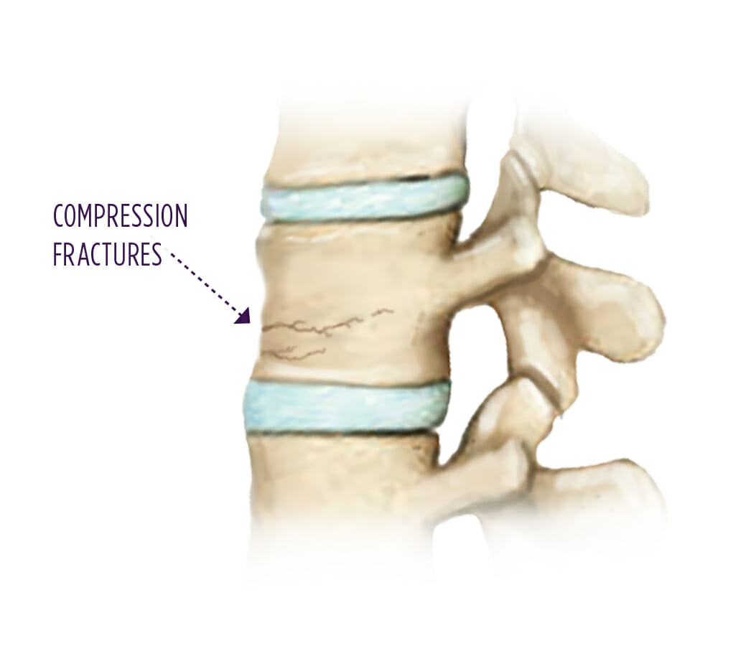
Compression fracture
Most osteoporotic spinal compression fractures represent an isolated failure of the anterior spinal column due to a combination of flexion and axial compression loading.
The stability of the spine is not compromised with this type of fracture. These fractures are traditionally considered benign injuries that heal without complications.
Notes:
Assessment of back pain [Internet]. BMJ Best Practice; 2018 [cited 4 September 2018]. Available from: https://bestpractice.bmj.com/topics/en-gb/189/pdf/189.pdf

Slide 58
Compression fracture
Typically history of trauma, although acute event not always recalled; pain at rest and at night, previous history of fractures (e.g., distal radius, hip or other vertebral compression fractures)
Tenderness to palpation over the midline; increased kyphosis, normal neurological examination unless there is retropulsion of bone into the neural elements, such as in burst fractures
Notes:
Assessment of back pain [Internet]. BMJ Best Practice; 2018 [cited 4 September 2018]. Available from: https://bestpractice.bmj.com/topics/en-gb/189/pdf/189.pdf

Slide 59
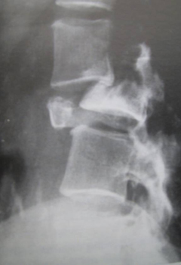
Compression fracture
plain x-rays:
MRI?
Useful in distinguishing between osteoporotic compression fractures and those caused by underlying tumour or infection.
Notes:
Assessment of back pain [Internet]. BMJ Best Practice; 2018 [cited 4 September 2018]. Available from: https://bestpractice.bmj.com/topics/en-gb/189/pdf/189.pdf

Slide 60
Compression fracture
Management:
1st: Limited bed rest.
Adjunctive: Analgesia (Paracetamol/NSAIDs)
Notes:
Assessment of back pain [Internet]. BMJ Best Practice; 2018 [cited 4 September 2018]. Available from: https://bestpractice.bmj.com/topics/en-gb/189/pdf/189.pdf

Slide 61
Examination
look, feel, move and test function.
You should perform a physical examination to reproduce the patient’s symptoms and localized the level of lesion. ₍₇₎₍₁₄₎₍₁₅₎

Slide 62
Components of physical examination
1- Inspection:
Position
Exposure
Look for deformity, inspecting from both the back and the side.
Note especially loss of the normal thoracic kyphosis and lumbar lordosis, which is typical of ankylosing spondylitis.
Also note any evidence of scoliosis, a lateral curvature of the spine that may be simple (‘C’ shaped) or compound (‘S’ shaped)
soft-tissue abnormalities like a hairy patch or lipoma that might overlie a congenital abnormality, e.g. spina bifida.
Muscle wasting
shoulders & pelvis level. ₍₇₎₍₁₄₎₍₁₅₎
Notes:
To start the examination, have the patient standing and clothed only in underpants
Look for deformity, inspecting from both the back and the side.
Note especially loss of the normal thoracic kyphosis and lumbar lordosis, which is typical of ankylosing spondylitis.
Also note any evidence of scoliosis, a lateral curvature of the spine that may be simple (‘C’ shaped) or compound (‘S’ shaped)
soft-tissue abnormalities like a hairy patch or lipoma that might overlie a congenital abnormality, e.g. spina bifida.
Muscle wasting
shoulders & pelvis level.

Slide 63
Components of physical examination
2- Palpation
Patient should be in prone position.
Palpation occurs:
centrally
unilateral
Soft tissues
After warning the patient, lightly percuss the spine with your closed fist and note any tenderness. ₍₇₎₍₁₄₎₍₁₅₎
Notes:
centrally (spinous processes to coccyx) , looking for any tenderness.
unilateral—right and left sides (1.5 cm from midline)
Soft tissues: temperature, tenderness.
After warning the patient, lightly percuss the spine with your closed fist and note any tenderness.

Slide 64
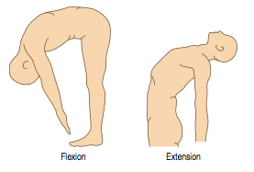
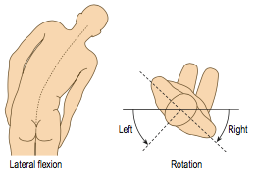
Components of physical examination
3- Active movements:
There are three main movements of the lumbar spine:
Flexion
Extension
Lateral bending
Rotation ₍₇₎₍₁₄₎₍₁₅₎₍₁₆₎
Notes:
Flexion: ask the patient to try to touch his toes with his legs straight. (Patients with advanced ankylosing spondylitis have a flat ankylosed spine and all the bending occurs at the hips )
Extension: ask the patient to straighten up and lean back as far as possible (normal 10–20° from neutral erect posture).
Lateral bending is assessed by getting the patient to slide the right hand down the right leg as far as possible without bending forwards, and then the same for the left side. (This movement tends to be restricted early in ankylosing spondylitis).
The rotational motion of the spine and the mobility of the thorax become early restricted in ankylosing spondylitis

Slide 65
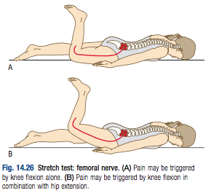
Components of physical examination
4- provocative tests
Femoral stretch test:
Knee flexion hip extension while the patient is lying in prone position.
Positive if pain felt in ipsilateral anterior thigh.
Positive test mean that the L3 and L4 nerve roots are involved. ₍₇₎₍₁₄₎₍₁₅₎

Slide 66
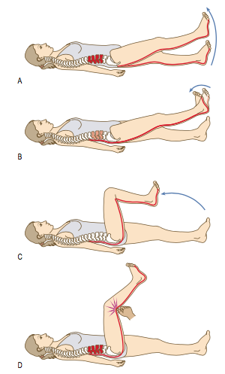
Components of physical examination
Straight leg raising (SLR) test
Done while the patient lying in supine position.
Tension increased by dorsiflexion of foot (Bragard’s test). Root tension relieved by flexion at the knee.
Pressure over centre of popliteal fossa causes pain locally and radiation into the back.
Positive test mean that the L4, L5 and S1 nerve roots are involved. ₍₇₎₍₁₄₎₍₁₅₎

Slide 67
Components of physical examination
5- Neurological testing of lower limbs
Do Neurological examination if patient has any signs or symptoms of nerve root compression.
If there is nerve roots compression patient will have pain, pareasthesia, anesthesia and weakness, extend into the leg. ₍₇₎₍₁₄₎₍₁₅₎

Slide 68
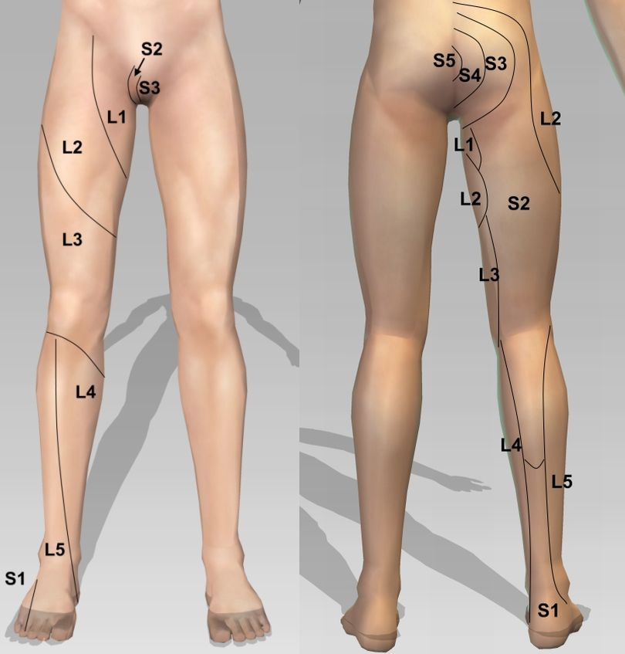
Main nerve roots
A- L1:
Motor → Hip flexion(psoas major)
Sensation→ around the groin and hip area
Reflex → cremasteric relfex (L1,L2)
B- L2:
Motor → Hip flexion
Sensation→ anterior thigh
Reflex → knee jerk (L2,L3, L4)₍₇₎₍₁₄₎₍₁₅₎

Slide 69
Main nerve roots
C- L3
Motor → extension of knee
Sensation → anterior thigh
Reflex → knee jerk (L3, L4)
D- L4
Motor → ankle dorsiflexion and foot inversion.
Sensation → inner border of foot to great toe
Reflex → knee jerk₍₇₎₍₁₄₎₍₁₅₎

Slide 70
Main nerve roots
E- L5
Motor: walking on heels (ankle dorsiflexion), extension of great toe
Sensation → middle three toes (dorsum)
Reflex → nil
F- S1
Motor: walking on toes (ankle planter flexion), foot eversion
Sensation → little toe, most of sole
Reflex → ankle jerk (S1, S2)₍₇₎₍₁₄₎₍₁₅₎

Slide 71
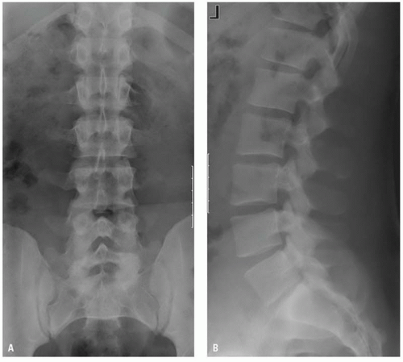
X-Ray
Normal lumbar spine radiographs. A: AP projection. B: Lateral projection.

Slide 72
X-Ray
Metastatic prostate cancer

Slide 73
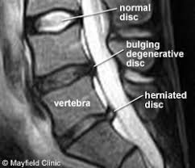
MRI
Normal MRI

Slide 74
MRI
Degenerative disease

Slide 75
Role of PHC:
Educate patient about the natural history of back pain.
Ask about and address the patient’s concerns and goals. (patient centered care)
Maximize functional status.
Relief the pain.
Improve associated symptoms, such as sleep or mood disturbances or fatigue.
Referral of complicated cases.
Prevention heavy lifting, socio-demographic factors such as smoking and obesity
Primary care services have an approach to risk stratification for young people and adults presenting with a new episode of low back pain with or without sciatica.
Young people and adults with low back pain with or without sciatica are given advice and information to self-manage their condition. ₍₆₎

Slide 76
When to refer ?
Urgent/Emergency referrals :
Cauda equina
Sever radiculopathy.
Fractures.
Other referrals
Recalcitrant spinal canal stenosis
Neoplasia or infection
Undiagnosed back pain
Paget disease
Continuing pain of 3 months’ duration without a clearly definable cause₍₁₆₎
Notes:
Severe unremitting worsening of pain (at night and pain when laying down)
Weight loss, fever, and history of cancer or HIV
Both consider neoplasia/infection
Any neurological signs
The use of steroids or iv drugs
Cauda Equina Syndrome - EMERGENCY referral to ER.
Severe unremitting worsening of pain (at night and pain when laying down), consider infection/tumor – URGENT referral to ER for pain control – will need prompt investigation.
Significant trauma – consider fractures – check for instability and refer URGENTLY to spinal surgery.
Weight loss, fever, history of cancer/HIV – consider infection/tumor – refer URGENTLY for MRI Scan and to spinal surgery.
Use of IV drugs or steroids – consider infection /compression fracture – URGENT referral to spinal surgery.
Patient over 50 (if first ever episode of serious back pain) – refer SOON for prompt investigation/spinal surgery.
Widespread neurological signs – consider infection/tumor/neurological disease – refer SOON to neurology/spinal surgery/investigate further.

Slide 77
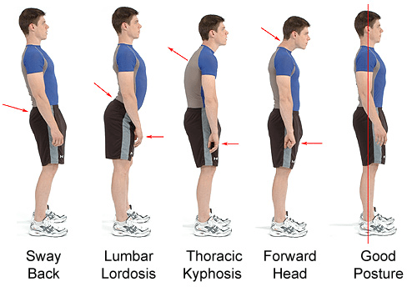
Prevention and education
Losing weight: too much upper body weight can strain the lower back.
Posture: How you sit, stand and lie down can have an important effect on your back. The following tips should help you maintain a good posture.
Standing: Stand upright, with your head facing forward and your back straight. Balance your weight evenly on both feet and keep your legs straight

Slide 78
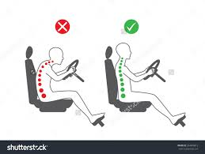
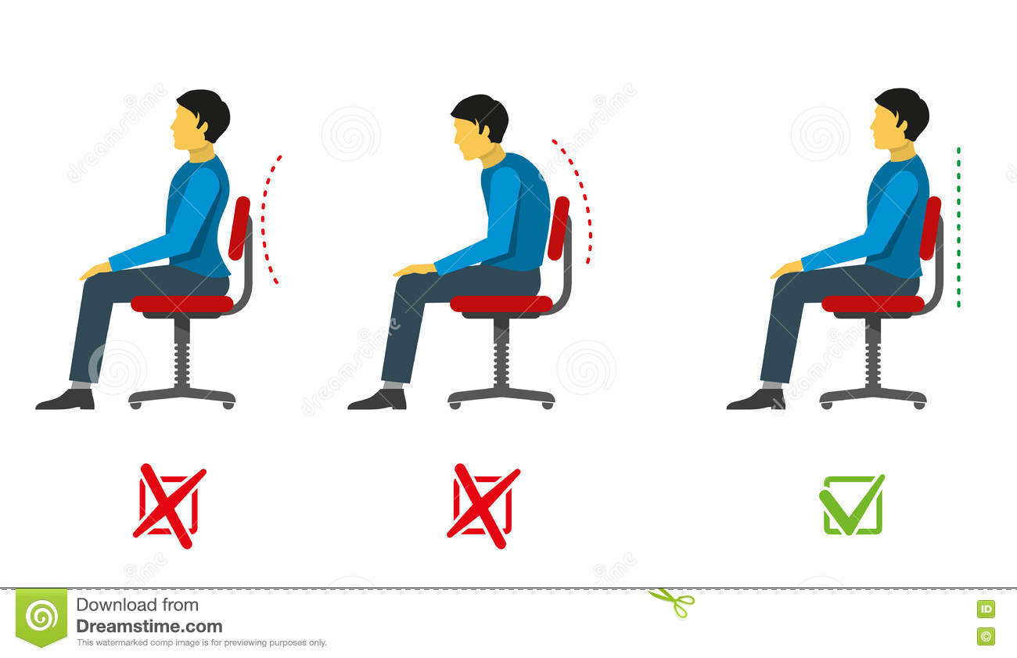
Prevention and education
Sitting and driving:
Sit up with your back straight and your shoulders back. Your knees and hips should be level and your feet should be flat on the floor.

Slide 79
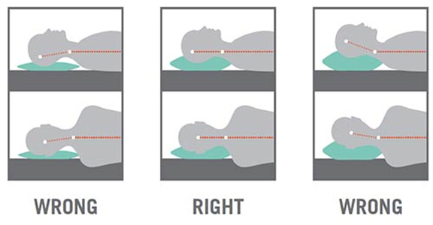
Prevention and education
Sleeping:
Your mattress should be firm enough to support your body while supporting the weight of your shoulders and buttocks, keeping your spine straight.

Slide 80
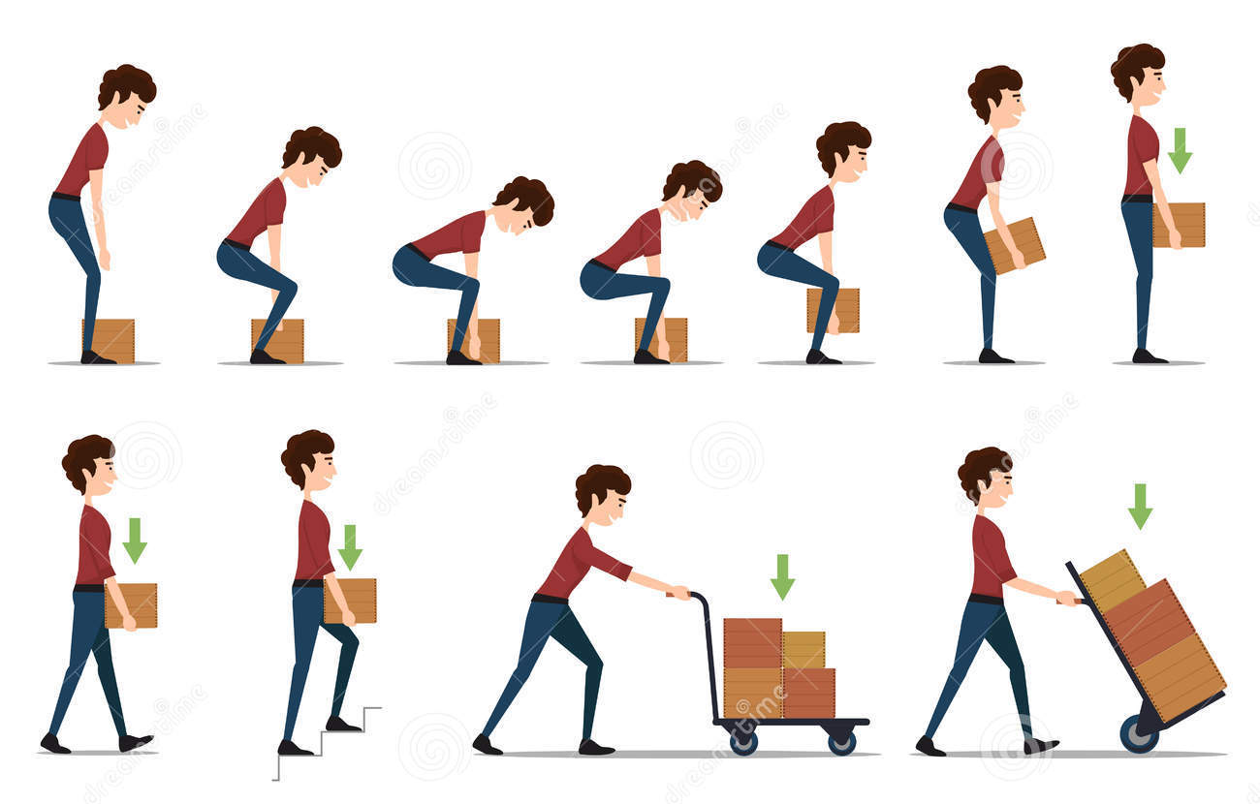
Prevention and education
Lifting and carrying:
One of the biggest causes of back injury is lifting or handling objects incorrectly.
Think before you lift:
can you manage the lift?
Push rather than pull – if you have to move a heavy object across the floor, it is better to push it rather than pull it.

Slide 81
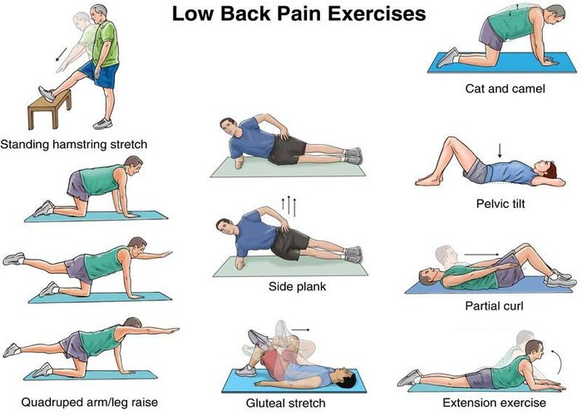
Prevention and education
Exercise:
Exercise is both an excellent way of preventing back pain and of reducing it, but should seek medical advice before starting an exercise programs if you've had back pain for six weeks or more.

Slide 82
Role play

Slide 83
1- Which of the following is not indicative of inflammatory back pain?
a. Insidious onset b. Onset before 40 years of age
c. Pain for more than 3 months d. Morning stiffness e. Aggravation of pain with activity
https://PollEv.com/surveys/kPSMW0SBL/web

Slide 84
2- Which of the following is (are) characteristic of a history of mechanical Lower Back Pain?
a. Relatively acute onset b. History of overuse or a precipitating injury
c. Pain worse during the day d. All

Slide 85
3- Which of the following is (are) a "red flag(s)" or danger signal(s) relative to the diagnosis of LBP?
a. Cough b. Impotence
c. Chest pain d. Constipation

Slide 86
4- What is the most cost-effective and crucial aspect of the treatment of chronic LBP?
a. Patient education b. Physiotherapy
c. Bed rest d. Morning stiffness

Slide 87
5- Which of the following is the most common cause of LBP?
a. Metastatic bone disease b. Inflammatory back pain
c. Lumbosacral sprain or strain d. None of the above

Slide 88
References
1. Hengel KM, Visser B, Sluiter JK. The prevalence and incidence of musculoskeletal symptoms among hospital physicians: A systematic review. International Archives of Occupational and Environmental Health. 2011;84(2):115-9.
2. Awaji M. Epidemiology of Low Back Pain in Saudi Arabia. J Adv Med Pharm Sci [Internet]. 2016;6(4):1–9. Available from: http://sciencedomain.org/abstract/13544
3. Swanson’s Family Medicine Review (7th Ed.)
4. Henderson M, Tierney L, Smetana G. The patient history. New York: McGraw-Hill Medical; 2012.
5. Assessment of back pain [Internet]. BMJ Best Practice; 2018 [cited 4 September 2018]. Available from: https://bestpractice.bmj.com/topics/en-gb/189/pdf/189.pdf

Slide 89
References
6. Low back pain and sciatica in over 16s: assessment and management. NICE guideline; 2016.
7. Evaluation of low back pain in adults [Internet]. Uptodate.com. 2018 [cited 4 September 2018]. Available from: https://www.uptodate.com/contents/evaluation-of-low-back-pain-in-adults?search=evalu%20ation-of-low-back-pain-in adults&source=search_result&selectedTitle=1~150&usage_type=default&display_rank=1
8. Dog and Rooster I. Disc Herniation Case Studies| Spine Institute of San Diego : Center for Spinal [Internet]. Sdspineinstitute.com. 2018 [cited 6 September 2018]. Available from: http://www.sdspineinstitute.com/case-studies/disc-herniations/lumbar.html
9. Practitioners T. RACGP - Back pain in a cancer patient: a case study [Internet]. Racgp.org.au. 2018 [cited 6 September 2018]. Available from: https://www.racgp.org.au/afp/2014/august/back-pain-in-a-cancer-patient/

Slide 90
References
10. Evaluation of the child with back pain [Internet]. Uptodate.com. 2018 [cited 4 September 2018]. Available from: https://www.uptodate.com/contents/evaluation-of-the-child-with-back-pain
11. Kleiber B, Jain S, Trivedi MH. Depression and Pain: Implications for Symptomatic Presentation and Pharmacological Treatments. Psychiatry (Edgmont). 2005;2(5):12-18.
12. Musculoskeletal lower back pain [Internet]. BMJ Best Practice. 2018 [cited 4 September 2018]. Available from: https://bestpractice.bmj.com/topics/en-gb/778
13. Osteoporosis - Symptoms, diagnosis and treatment | BMJ Best Practice [Internet]. Bestpractice.bmj.com. 2018 [cited 6 September 2018]. Available from: https://bestpractice.bmj.com/topics/en-us/85/case-history

Slide 91
References
14. Talley Clinical Examination - 7th Ed
15. Macleod's Clinical Examination (13th Ed.)
16. Low back pain [Internet]. EBM Guidelines Available from: http://www.ebm-guidelines.com/ebmg/ltk.free?p_artikkeli=ebm00435

Slide 92
Take Home Message
Back pain mostly diagnosed clinically.
Exclude the RED FLAGS
Don’t forget ICE
Imaging is not a must يا ابني
Medications is not everything even يا ابني
When you suspects Cauda Equine Refer!!
Not every patient deserve a complete rest.. Some are contraindicated.

