Slide 2
Objective
objectives:
Health behaviors and health systems indicators that affect the health, wellness, and quality of life of women, children, and families.
Factors affecting pregnancy and childbirth, including preconception health status, Age, access to appropriate preconception and interconnection health care, and poverty.
Health risks that include hypertension and heart disease, diabetes, depression, genetic conditions, sexually transmitted diseases (STDs), inadequate nutrition, unhealthy weight, tobacco use and alcohol abuse.
Social and physical determinants of maternal health.
Social and physical determinants of infant and child health.
How to improve the health and well-being of women, infants, children, and families.

Slide 3
Pre-test:
Pre-Seminar MCQs Go to https://www.menti.com/5812651f

Slide 4
Question
Is obtained by dividing the number of maternal deaths in a population during some time interval by the number of women who are of reproductive age occurring in the same period referred to :
Neonatal mortality rate
Proportion maternal death
Maternal mortality ratio
Maternal mortality rate

Slide 5
Question
Which of the following deficiencies in mother can cause deficits in the development of the child’s neural tube?
Folate deficiency
Calcium deficiency
Iron-deficiency
Vitamin A deficiency

Slide 6
Question
What is the leading known cause of mental retardation?
Down Syndrome
Fetal Alcohol Syndrome Fetal Alcohol Effects
Cerebral Palsy
Spina Bifida

Slide 7
Question
What is the newborn normal weight ?
2.5 kg
1.5 kg
6 kg
10 kg

Slide 8
Question
Higher blood pressures on two occasions at least 4 hours apart. Significant proteinuria, Clinical symptoms resulting from the involvement of the kidneys, brain, liver
Gastional HTN
Severe pre-eclampsia
HELLP syndrome
Eclampsia

Slide 9
Definition:
Maternal health:
Maternal health refers to the health of women during pregnancy, childbirth and the postpartum period,

Slide 10
Definition:
It encompasses the health care dimensions of family planning, preconception, prenatal, and postnatal care in order to ensure a positive and fulfilling experience in most cases and reduce maternal morbidity and mortality in other cases.

Slide 11
Facts:
Fact 1
Nearly 830 women die every day due to complications during pregnancy and childbirth.
Fact 2
Women die in pregnancy and childbirth for 5 main reasons
These are severe bleeding, infections, unsafe abortion, hypertensive disorders (pre-eclampsia and eclampsia), and medical complications like cardiac disease, diabetes, or HIV/AIDS complicating or complicated by pregnancy.

Slide 12
Facts:
Fact 3
More than 135 million women give birth per year
About 20 million of them are estimated to experience pregnancy-related illness after childbirth. The list of morbidities is long and diverse, and includes fever, anaemia, fistula, incontinence, infertility and depression. Women who suffer from fistula are often stigmatized and ostracized by their husbands, families and communities.
Fact 4
About 16 million girls aged between 15 and 19 give birth each year
They account for more than 10% of all births. In the developing world, about 90% of the births to adolescents occur in marriage. In low- and middle-income countries, complications from pregnancy and childbirth are the leading cause of death among girls 15-19.

Slide 13
Facts:
Fact 5
Maternal health mirrors the gap between the rich and the poor
Fact 6
Most maternal deaths can be prevented

Slide 14
Facts:
Fact 7
Many women don’t see a skilled health professional enough during pregnancy
Although a large proportion of women see skilled health personnel at least once during their pregnancy, only about half receive the recommended minimum of at least 4 visits during the pregnancy. Women who do not receive the necessary check-ups miss the opportunity to detect problems and receive appropriate care and treatment. This also includes immunization and prevention of mother-to-child transmission of HIV/AIDS.
Fact 8
About 22 million abortions continue to be performed unsafely each year
Over 5 million of these result in complications some of which may end in death. Almost every one of these deaths and complications could have been prevented through sexuality education, contraceptive use, and the provision of safe, legal induced abortion, and care for complications of unsafe abortions.

Slide 15
Facts:
Fact 9
Reducing the maternal mortality ratio has been slow
Fact 10
The lack of skilled care is the main obstacle to better health for mothers

Slide 16
Notes:
In tthis figure we can see that is the number of women death generally increased in poor countries >>
Also< there are decreased of Maternal coditions , tb , in rich countries as will as in TB And hiv percentage>>

Slide 17
Health Systems Indicators
ddddd
DEFINITION:
variables that reflect the state of health of persons in a community.
Notes:
efore going through health indicators you should know about its definition : Definition: Health indicators are variables that reflect the state of health of persons in a community. hey inform about the quality of health care, and access of health care, and they are considered as quantitative measures.

Slide 18
Health Systems Indicators (Maternal)
dddff
Health indicators could be used to:
•Assess the health care needs.
•Compare health status of different areas or groups of people over
•time, one country with other countries or worldwide.
•Monitoring and evaluation of health services, activities and
•programs-access, quality, effectiveness and equality.
Notes:
hey inform about the quality of health care, and access of health care, and they are considered as quantitative measures.

Slide 19
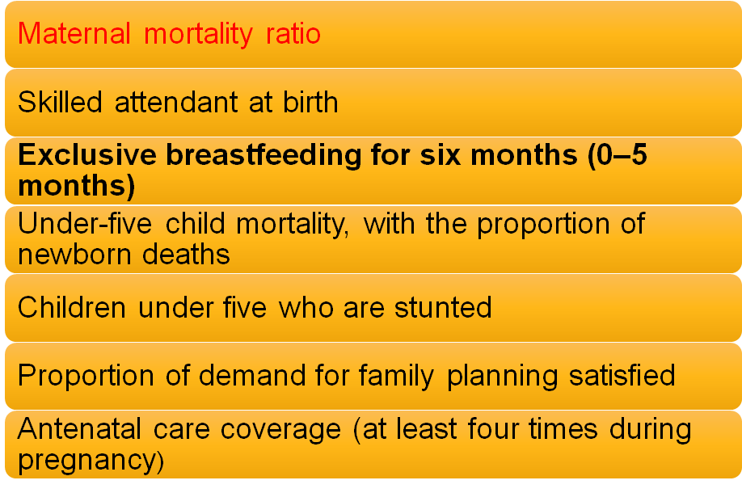
Maternal health indicators:

Slide 20
Health Systems Indicators (Maternal)

Slide 21
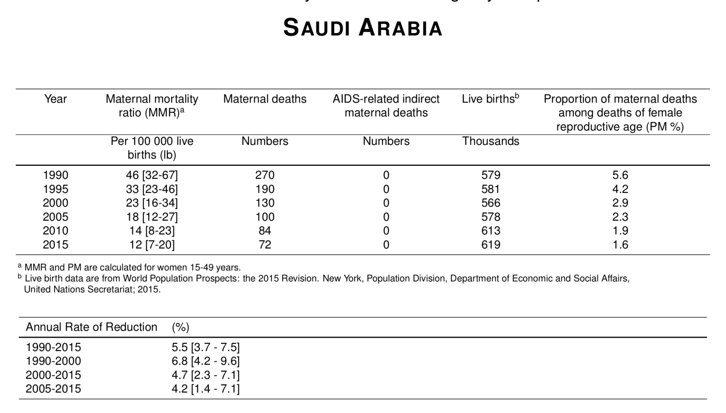
Health Systems Indicators (Maternal)
Notes:
The percentage of MMr from 1990 to 2015 decreased by 75%
The percentage of Live births from 1990 to 2015 increased by 7 %
The percentage of maternal deaths from 1990 to 2015 decreased by 73%

Slide 22
Health Systems Indicators (Infant)

Slide 23
Perinatal Mortality rate: Deaths between 28th week of gestation to less than 7 days of life expressed as per 1000 of total births (live and still) Reflects maternal health status, quality of maternal care and obstetric services
Neonatal Mortality rate: Deaths in the first 28 days of life expressed as per 1000 of total live births. Reflects primarily quality of obstetric care and neonatal care as well as maternal nutrition and health status

Slide 24
Post neonatal Mortality rate: Deaths between 28 days of life to less than 1 year expressed as per 1000 of total live births. Reflects infants' health care, nutrition and sanitation of the environment
Under-5 Mortality: Deaths below 5 years expressed as per 1000 of the number of children below the age of 5 years.

Slide 25
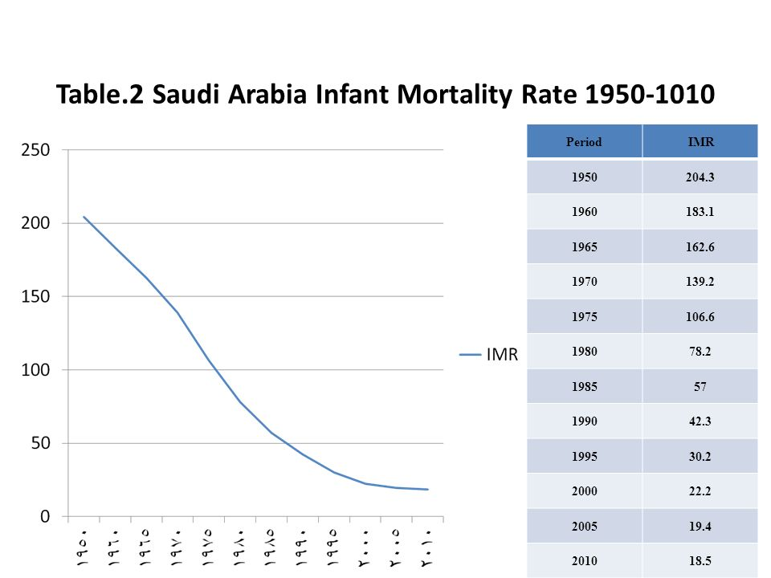
Health Systems Indicators (Infant)

Slide 26
Factors can affect pregnancy and childbirth :

Slide 27
Case Discussion:
•Sarah is a 30-year old women . she smokes 10 cigarettes a day. She came to the Primary Care Clinic at KKUH for consultation about getting pregnant for the first time. On examination : Her BP was 160/90mmhg and Her BMI was 32.

Slide 28
Case Discussion:
What is the role of family physician here and how would you manage this patient?
What is your Advice?

Slide 29
1. Preconception:
Preconception health care :
Is the medical care of a woman or man receives from the doctor or other health professionals that aimed to increase the chance of having a healthy baby.

Slide 30
1. Preconception:
What is involved in preconception counseling?
Questionnaire, Blood work, Urinalysis ..etc
A)Maternal behaviors like : Tobacco use , alcohol use , failure to consume adequate folic acid.
B)Other conditions like : unintended pregnancy , experiencing physical abuse , experiencing high levels of stress.
C)Certain maternal health conditions like : Diabetes , hypertension , obesity

Slide 31
2. Age:
• The chances of surviving the first year of life were better for infants born to mothers aged 20-34 years than for those born to mothers of other ages.
•Your risk of pregnancy complications, such as high blood pressure and gestational diabetes, increases after 35 and continues to rise in your 40s. The odds of genetic problems also jump as you get older: At 40, your chance of conceiving a child with Down syndrome is one in 100; at 45 it's one in 30.

Slide 32
3. Antenatal Care:
Is the care you receive from healthcare professionals during your pregnancy.
1- folic acid and vitamin D supplements
2- nutrition, diet and food hygiene
3- lifestyle factors : smoking, recreational drug use and drinking alcohol
4- Antenatal screening tests

Slide 33
4. Interconception Health Care:
Interconceptional health care:
interconception health involves helping a woman understand the importance of being healthy between pregnancies and the need to wait at least 18 months before becoming pregnant again to help optimize birth outcome.

Slide 34
5. Poverty:
•The findings in analysis of NMIHS indicate that, for infants born to women living in poverty in the United States in 1988, overall excess mortality risk was approximately 60% compared with infants born to women living above the poverty level.
•hose living in poverty were more likely to smoke, to have poorer dietary habits, lower levels of education, and engage in higher risk and health-demoting practices.

Slide 35
6- Access to Preconception and
Interconception Healthcare:
Talking to a health-care provider before becoming pregnant at least 6 months.
•Why?
•Because a woman might have a subsequent pregnancy, services in the postpartum period
2. accessing services such as the Special Supplemental Nutrition Program for Women, Infants, and Children

Slide 36
MATERNAL HEALTH
Prenatal care
•It Is the care of woman who want to be pregnant.
•Duration : 6-12 months – 8 week of pregnancy
•Your job here as a Family physician is ??

Slide 37
Perinatal care
•Taking care of the pregnant woman's and prepare her for safe delivery
•Duration; from the Dx of pregnancy until delivery
•Your job here as a Family physician is ??

Slide 38
Postnatal care
•Is to insure that there is no complication after delivery

Slide 39
Case Discussion:

Slide 40
Role play
Risk factors ..

Slide 41
Hypertension
Risk Factor in maternal and child health
HTN
Heart Disease
GDM
Tobacco & alcohol use
STDs
Nutrition
Unhealthy weight
Genetic factor
Postpartum depression

Slide 42
Hypertension
•Most common and complicating 2-3% of pregnancies.
•risk for problems especially for Preeclampsia.
•Decreased blood flow to the placenta

Slide 43
Hypertension
Preeclampsia: •hypertension and proteinuria. •third trimester •5-8 %.
•Eclampsia
Notes:
AKA pregnancy-induced hypertension (PIH)

Slide 44
Hypertension
Other complications : •placental abruption. •Future cardiovascular disease.
•low birth weight
•Preterm delivery.
•Caesarean delivery.

Slide 45
Heart disease
•Complicates 1% to 4% of pregnancies
•Congenital heart disease (CHD) is the most common pre existing condition.
•Hypertension the most common acquired condition. •Incidence is increasing likely due to increasing maternal age and CVD risk factors.

Slide 46
Diabetes
•Onset of high blood sugar levels during pregnancy.
•7% .
•blood sugar usually returns to normal soon after delivery but it risk factor for type 2 diabetes.
•Risk factors for Gestational Diabetes Mellitus (GDM)? Age 25. BMI ≥ 30. Family or personal history.

Slide 47
Diabetes
•Complication:
Mother: Future DM, preeclampsia, Cesarean birth. Baby: high birth weight, low blood sugar, Preterm birth with respiratory distress syndrome in future may obesity or type 2 diabetes.

Slide 48
Unhealthy weight
•Recent CDC studies showed overweight or obese before pregnancy associated with a higher pregnancy complication.
•complication: Preeclampsia. GDM. Stillbirth. cesarean delivery.

Slide 49
Unhealthy weight
Gaining less Small baby. Gaining more large baby.

Slide 50
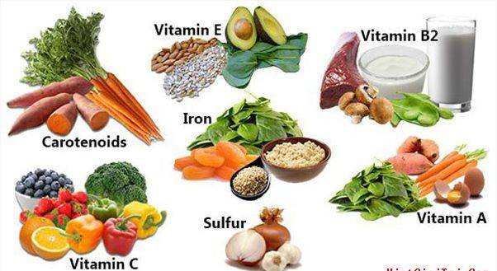
Inadequate nutrition
•Inadequate or deficient in nutrition for mother such as :
Iron → morbidity and mortality, Preterm birth and Neurological dysfunction. Vit A→ Night-blindness.
•Inadequate or deficient in nutrition for neonate such as :
Folate → deficits in the development of the neural tube.
Calcium → restricts fetal skeletal development.
Iron → intrauterine growth retardation and low birth weight.
Notes:
Increased risk of micronutrient deficiency during pregnancy – women who have micronutrient deficiencies when they become pregnant are unlikely to improve their micronutrient status during pregnancy.

Slide 51
Tobacco use
• Smoking effects :
harder for a woman to get pregnant. Premature birth certain birth defects(Cleft lip or cleft palate) Risk of miscarriage(placenta can separate). Sudden Infant Death Syndrome (SIDS).
•Second hand smoke effects: Low birth weight, asthmatic attack and SIDS.

Slide 52
Alcohol
•There is No known safe amount of alcohol use during pregnancy and Alcohol in the mother's blood passes to the baby through the umbilical cord.
•Fetal alcohol spectrum disorders (FASDs):lifelong physical, behavioral, and intellectual disabilities.
Complication of drinking alcohol:
Miscarriage, stillbirth.

Slide 53
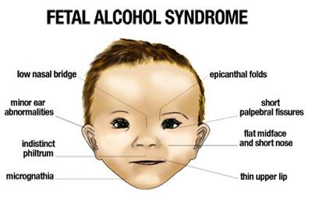
Alcohol

Slide 54
sexually transmitted diseases (STDs)
•sometimes serious, even life-threatening during pregnancy.
•Risk of transmitting HIV To the newborn.

Slide 55
sexually transmitted diseases (STDs)
•Perinatal HIV/AIDS
It recommends that all women who are pregnant or planning to get pregnant should get tested for HIV as early as possible. If a woman is treated for HIV early in her pregnancy, the risk of transmitting HIV to her baby can be 1% or less HOW?
HIV medication
Cesarean delivery No breastfeeding or pre-chewing her baby’s food

Slide 56
sexually transmitted diseases (STDs)
Other STDs:
•Chlamydia and Gonorrhea
•Syphilis
•Herpes simplex virus
•Hepatitis B & C

Slide 57
Depression
•Depression is Extreme sadness during pregnancy or after birth (postpartum).
•Can lead to:
Poor nutrition. Drinking, smoking and suicidal behavior.
•Babies born to mothers who are depressed may be less active, show less attention and be more agitated than babies born to moms who are not depressed.

Slide 58
Genetic conditions
•more than 50 percent of miscarriages in the early stages of pregnancy are due to abnormalities of the chromosomes. •Examples:
Cystic fibrosis Marfan syndrome PCKD Neurofibromatosis.

Slide 59
Summary
Preconception and early pregnancy counselling | Smoking, alcohol, illisting drug, diet, supplementation (folate, vit D, Iron), chronic diseases, screening, Review medications, problem in previous pregnancy, vaccinations.
Antenatal care | Pregnancy test, visits(16, 28, 34, 36, 38), if nulliparous (+ 25, 31),

Slide 62
Social and Physical Determinants of Maternal and Child Health

Slide 63
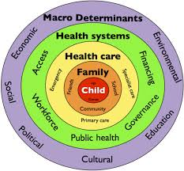
Social and Physical Determinants of maternal Child Health
A range of biological, social, environmental, and physical factors have been linked to maternal, infant, and child health outcomes.
Notes:
1- Race and ethnicity represent social rather than biological constructs that can provide useful information about how environmental, cultural, behavioral, and medical factors can affect patient health.
2-Age: Advanced age is a risk factor for female infertility, pregnancy loss, fetal anomalies, stillbirth, and obstetric complications.

Slide 64
1-Biological Determinants:
•Birth Weight: low birth weight (< 2.5 kg) & high birth weight (> 4 kg) .
•Age of The Mother : <19 years) or >over 30 years .
•Repeated pregnancies : risk of miscarriage.
•Birth Spacing: < 1 year = 2-4 times risk of mortality.
•Multiple Births: more risk due to low birth weight.
•Family Size: 3 or more children, more frequent/prolonged illness.

Slide 65
2- Social Determinants:
INCOME
EDUCATION
NUTRITION
VIOLENCE
HEALTH CARE QUALITY (DEVELOPING COUNTRIES)
ENVIRONMENTAL CONDITIONS
CULTURE
Notes:
The social environment exerts a strong influence on child health especially through :
Income: how?
Nutrition : breast and formula use,
Violence: (wife beating, infanticide, wars, child abuse, domestic violence)
Cultural Factors :
Religion ,Customs, Early marriages, Sex of child, Quality of mothering, Traditions affecting (cleanliness, eating, clothing, child care)

Slide 66
How to improve the health and well-being of women, infants, children, and families
•approximately 830 women die every day from causes related to pregnancy and childbirth.
•5.9 million children under age five died in 2015, 16000 every day.
•With quality health care, many of these deaths could be prevented.
Notes:
Provide postnatal care in first 24 hours for every birth:
Delay facility discharge for at least 24 hours.
Visit women with home births within the first 24 hours.
Provide every mother and baby four postnatal visits on : First day (24 hours), Day 3 (48–72 hours) , Between days 7–14 and the Sixth week.
approximately 830 women die every day from causes related to pregnancy and childbirth.
5.9 million children under age five died in 2015, 16000 every day.
With quality health care, many of these deaths could be prevented.

Slide 67
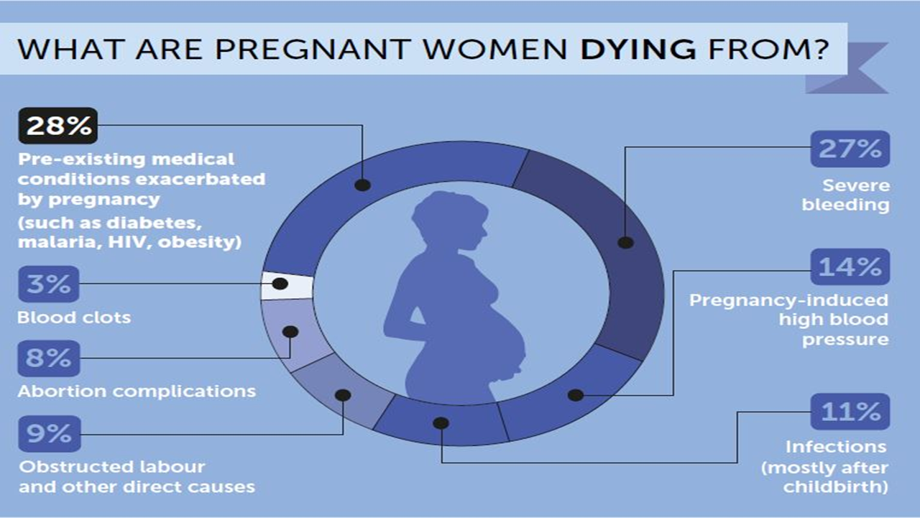

Slide 68
Postnatal care
1-assessment
2-visits
#vaccination
#prophylaxis

Slide 69
How to improve Maternal health?
•First 24 hours : assessment of vaginal bleeding, uterine contraction, temperature and heart rate should be done routinely during the first 24 hours.
•Breastfeeding should be assessed.
•women should be asked about their emotional wellbeing.
•After 10–14 days, all women should be asked about postpartum depression.
Notes:
1,2,3 → first 24h
5- emotional wellbeing, what family and social support she have
6- iron and fa should be provided for at least 3 months after delivery.

Slide 70
How to improve Maternal health?
•All women should be asked about sexual intercourse and possible dyspareunia as part of an assessment of overall well-being 2–6 weeks after birth.
•Iron and folic acid supplementation should be provided for at least 3 months after delivery.

Slide 71
How to improve infancy health?
Infant mortality:
Causes:
- Birth defects
- Preterm birth and low birth weight
- Maternal complications of pregnancy
- Sudden Infant Death Syndrome (SIDS)
- Injuries (e.g., suffocation).
Notes:
A newborn infant, or neonate, is a child under 28 days of age. During these first 28 days of life, the child is at highest risk of dying. It is thus crucial that appropriate feeding and care are provided during this period, both to improve the child’s chances of survival and to lay the foundations for a healthy life
The US infant death rate has declined 13% since 2005
1- for every 1,000 babies that are born, almost 6 die during their first year, 45% of child deaths under the age of 5 years take place during the neonatal period.
Preterm birth: (birth before 37 weeks gestation)
Preterm and low-birth-weight babies should be identified as soon as possible and should be provided special care.

Slide 72
How to improve infancy health?
•promote early and exclusive breastfeeding (EBF).
• Evidence shows EBF reduces the risks of mortality and morbidity and improves post-neonatal outcomes.
•Preterm and low-birth-weight babies should be identified as soon as possible and should be provided special care.
•A full clinical examination should be done 1 hour after birth. This includes giving vitamin K prophylaxis and hepatitis B vaccination (within 24 hours).

Slide 73
How to improve maternal and child health?
Vaccination:
Before pregnancy: measles, rubella
During pregnancy: vaccine to protect against whooping cough .
To the infant: hepatitis B, TB, Chickenpox.

Slide 75
What do we mean by child development milestones?

Slide 76
milestones
A growth chart is used by pediatricians and other health care providers to follow a child's growth over time.
•Growth charts have been constructed by observing the growth of large numbers of normal children over time.

Slide 77
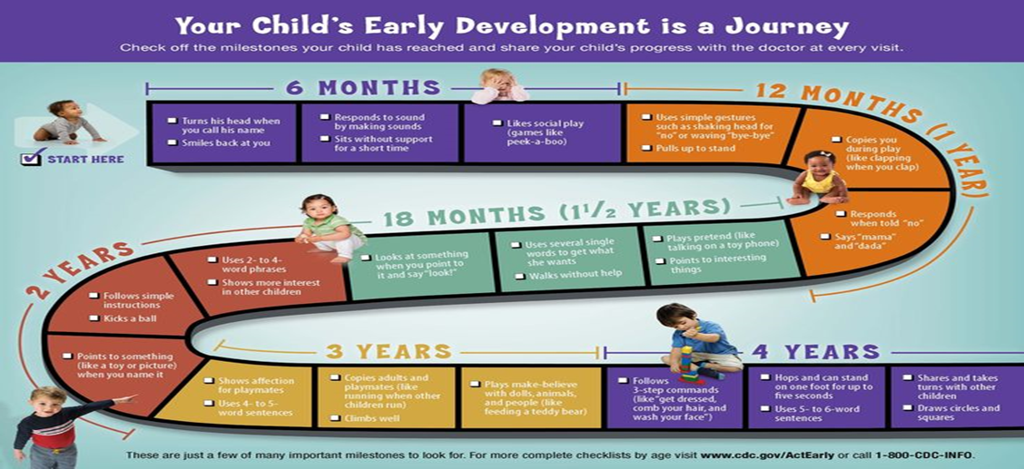
Child growth :

Slide 78
Child Care:
•Child care is the caring for and supervision of a child or children, usually from age six weeks to age thirteen. Child care is the action or skill of looking after children by a day-care center, babysitter, or other providers.

Slide 79
Question
is obtained by dividing the number of maternal deaths in a population during some time interval by the number women who are of reproductive age occurring in the same period referred to :
Neonatal mortality rate
Proportion maternal death
Maternal mortality ratio
Maternal mortality rate

Slide 80
Question
Which of the following deficiencies in mother can cause deficits in the development of the child’s neural tube?
Folate deficiency
Calcium deficiency
Iron-deficiency
Vitamin A deficiency

Slide 81
Question
What is the leading known cause of mental retardation?
Down Syndrome
Fetal Alcohol Syndrome Fetal Alcohol Effects
Cerebral Palsy
Spina Bifida

Slide 82
Question
What is the newborn normal weight ?
2.5 kg
1.5 kg
6 kg
10 kg

Slide 83
Question
What is the newborn normal weight ?
2.5 kg
1.5 kg
6 kg
10 kg

Slide 84
Question
What is the newborn normal weight ?
2.5 kg
1.5 kg
6 kg
10 kg

Slide 85
Question
Higher blood pressures on two occasions at least 4 hours apart. Significant proteinuria, Clinical symptoms resulting from the involvement of the kidneys, brain, liver
Gastional HTN
Severe pre-eclampsia
HELLP syndrome
Eclampsia

Slide 86
Role play
Vaccination

Slide 87
Thank you

