Slide 1
Common Psychiatric Problems in Primary Care
Supervised by: Dr. Yousef Alturki
Done by: Omar Alessa & Qusay Ajlan

Slide 2
Objectives
To understand the prevalence of anxiety, depression , and somatic symptom disorder in Saudi Arabia
To understand the etiology of anxiety, depression and somatic symptom disorder
To understand the clinical features and management of anxiety in family medicine setting
To understand the clinical features and management of depression in family medicine setting
To understand the clinical features and management of psycho-somatic illness in family medicine setting
To have knowledge of counseling and psychotherapy in the management of common psychiatric problems in family medicine
To understand appropriate time to consult a psychiatrist

Slide 3
MCQ

Slide 4
Q.1
A 32-year-old man presented with intense worries when he becomes in the middle of a row in the mosque as escape seems difficult. The most likely diagnosis is:
Panic disorder.
Specific phobia.
Agoraphobia.
Social phobia.

Slide 5
Q.2
A 20-year-old college student presented with repeated bouts of palpitation, sweating, and excessive worries when he uses public transport. The most likely diagnosis is:
Generalized anxiety disorder.
Posttraumatic disorder.
Agoraphobia with panic attacks.
Social phobia.

Slide 6
Q.3
Which one of the following symptom must be present to diagnose Depression?
Weight loss
Sleep disturbance
Anhedonia
Loss of appetite

Slide 7
Q.4
Which of the following is true regarding somatic symptom disorder ?
Always associated with mood disorders
Commonest in children
Chronic + not intentionally produced symptoms
Male often affected more than females

Slide 8
Q.5
In Which of the following situations you're supposed to refer a patient to see a psychiatrist
Patient asking
Suicidality
suspicion of a psychiatric problem behind the physical symptoms.
a past history of psychiatric problem
All of the above

Slide 9
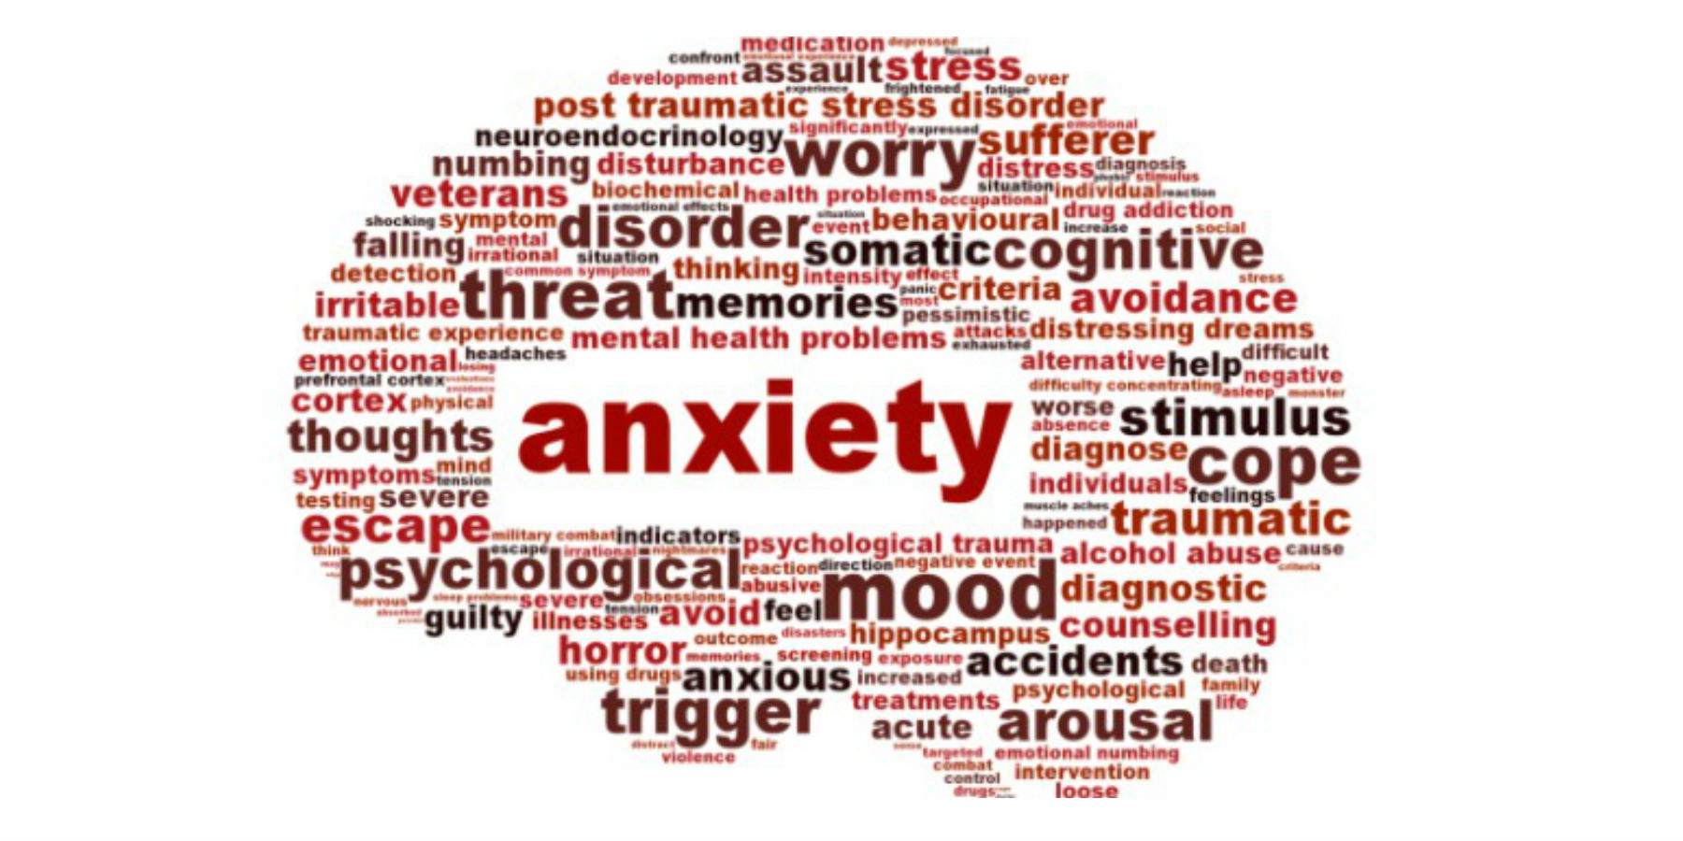
anxiety

Slide 10
What is anxiety

Slide 11
Anxiety is a subjective feeling of worry, fear and apprehension accompanied by autonomic symptoms.
Anxiety is a problem when it becomes overwhelming or unmanageable also comes up unexpectedly.
Notes:
People may avoid going about their daily lives in order to avoid anxiety. They may experience a lot of uncomfortable physical sensations and physical health problems. Many people say that they know their anxiety isn’t based in reality, but they feel ‘trapped’ by their thought and feelings. Anxiety disorders can be treated. It’s important to seek help if you’re concerned about anxiety in your life.

Slide 12
Features of anxiety
Psychological
Physical
Excessive worries.
Restlessness.
Hypervigilance.
Difficulty concentration.
Sensitivity to noise.
Insomnia.
Chest.
Cardiovascular.
Neurological.
Gastrointestinal.
Genitourinary.
Musculoskeletal.
Skin.

Slide 13
Prevalence of anxiety
A published paper showed that he prevalence of anxiety disorders that was obtained from 87 studies across 44 countries. Estimates of current prevalence ranged between 0.9% and 28.3%.
In Saudi Arabia however, it showed that the anxiety among Saudi male secondary schools’ students in Madinah was 61.6% students showed symptoms of anxiety. About 3.4% students showed severe symptoms of anxiety whereas 58.2% of them showed mild to moderate symptoms of anxiety.

Slide 14
Notes:
Prevalence of depression and anxiety disorders among outpatients attending gastroenterology clinic in four hospitals in Riyadh, Saudi Arabia (2013)

Slide 15
Etiology
The first consideration is the possibility that anxiety is due to a known or unrecognized medical condition.
Substance-induced anxiety disorder (over-the-counter medications, herbal medications, substances of abuse) is a diagnosis that often is missed.
Genetic factors significantly influence risk for many anxiety disorders.
Environmental factors such as early childhood trauma can also contribute to risk for later anxiety disorders.
Some individuals appear resilient to stress, while others are vulnerable to stress, which precipitates an anxiety disorder.

Slide 16
Classification of anxiety
Panic disorder.
Phobias. (Agoraphobia, social phobia and specific phobia).
Generalized anxiety disorder.
Obsessive compulsive disorder.

Slide 17
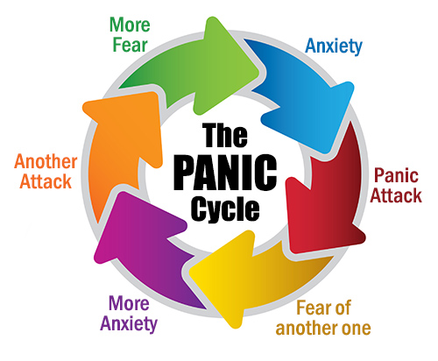
Panic disorder
It is a recurrent sudden attacks of severe fear.
Diagnostic criteria:
At least one of the attacks has been followed by ≥ 1
month of ≥ one of the following:
Persistent concern about having additional attacks.
Worry about the implications / consequences of the attacks (e.g. going mad or death).
A significant change in behaviour related to the attacks.
Not due to medical disease, substance.

Slide 18
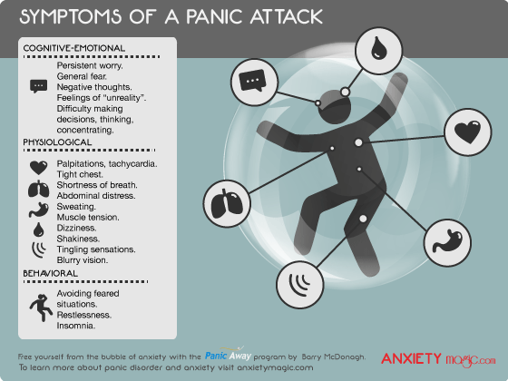
People may experience

Slide 20
Agoraphobia
Fear and avoidance of open and crowded places.
Those who suffer from agoraphobia either avoid the situation, endure it with severe stress or face it only with the presence of someone they trust.
Associated conditions:
Panic disorder
Social phobia
Depressive symptoms
Housebound-housewife syndrome

Slide 21
Social phobia
Social phobia is manifested by excessive, persistent fear of social and performance situations that is so severe that it disrupts daily life and relationships.
The most common social phobia is fear of public speaking.

Slide 22
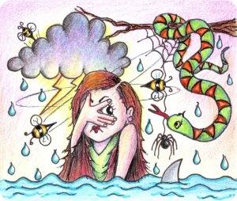
Specific phobia
Fear of a specific object or a situation with avoidance.
Treatment?

Slide 24
Generalized anxiety disorder
People showing excessive anxiety or worry, most days for at least 6 months, about a number of things such as personal health, work, social interactions, and everyday routine life circumstances.
The fear and anxiety can cause significant problems in areas of their life, such as social interactions, school, and work.

Slide 25
Diagnostic criteria
Excessive anxiety and worry (apprehensive expectation), occurring more days than not for at least 6 months, about a number of events or activities (such as work or school performance).
The individual finds it difficult to control the worry.
The anxiety and worry are associated with three (or more) of the following six symptoms (with at least some symptoms having been present for more days than not for the past 6 months):

Slide 26
Diagnostic criteria
1. Restlessness, feeling keyed up or on edge.
2. Being easily fatigued.
3. Difficulty concentrating or mind going blank.
4. Irritability.
5. Muscle tension.
6. Sleep disturbance (difficulty falling or staying asleep, or restless, unsatisfying sleep).

Slide 27
Diagnostic criteria
The anxiety, worry, or physical symptoms cause clinically significant distress or impairment in social, occupational, or other important areas of functioning.
The disturbance is not attributable to the physiological effects of a substance (e.g., a drug of abuse, a medication) or another medical condition (e.g., hyperthyroidism).
The disturbance is not better explained by another mental disorder (e.g., anxiety or worry about having panic attacks in panic disorder, negative evaluation in social anxiety disorder [social phobia].

Slide 28
management
Pharmacotherapy and Cognitive Behavioral Therapy are first line treatment (you can either give meds, or do CBT)
They are equally effective
Pharmacotherapy: SSRI (paroxetine), SNRI (venlafaxine)
CBT: good options for patients who don’t want meds or can’t tolerate them
If the patient is not getting better with medication, consult psychiatry.

Slide 29
depression

Slide 30
depression

Slide 31
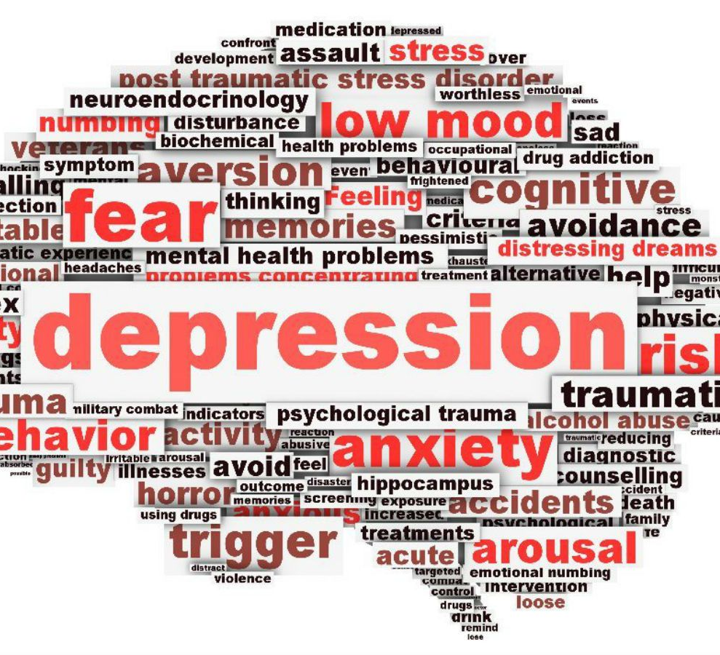
What is depression
is a common and serious medical illness that negatively affects how you feel, the way you think and how you act.
Depression causes feelings of sadness and/or a loss of interest in activities once enjoyed

Slide 32
Symptoms of depression
Depression symptoms can vary from mild to severe and can include:
Feeling sad or having a depressed mood
Loss of interest or pleasure in activities once enjoyed
Changes in appetite — weight loss or gain unrelated to dieting
Trouble sleeping or sleeping too much
Loss of energy or increased fatigue
Increase in purposeless physical activity (e.g., hand-wringing or pacing) or slowed movements and speech (actions observable by others)
Feeling worthless or guilty
Difficulty thinking, concentrating or making decisions
Thoughts of death or suicide

Slide 33
Prevalence and etiology
Females are more prone to have depression compared to males 2:1.
Depression is more common in younger adults.
Depression is estimated to affect 350 million people worldwide (WHO 2012).
Cross-sectional study was conducted in three large primary care centers in Riyadh
Patients included in the survey analysis were 477.
The study found the point-prevalence of screened depression (showing signs of depression) to be 49.9% among the adult visitors to primary healthcare.

Slide 34
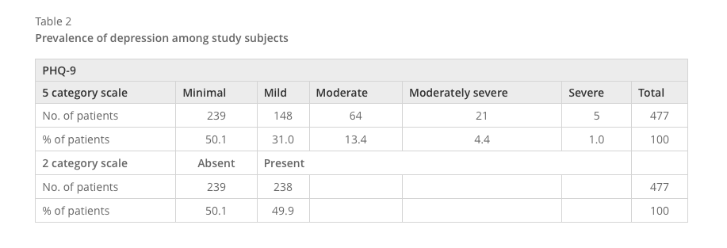

Slide 35
Prevalence and etiology
Abuse. Past physical, sexual, or emotional abuse can increase the vulnerability to clinical depression later in life.
Certain medications. Some drugs, such as isotretinoin (used to treat acne), the antiviral drug interferon-alpha, and corticosteroids, can increase your risk of depression.
Conflict. Depression in someone who has the biological vulnerability to develop depression may result from personal conflicts or disputes with family members or friends.
Death or a loss. Sadness or grief from the death or loss of a loved one, though natural, may increase the risk of depression.
Genetics. A family history of depression may increase the risk. It's thought that depression is a complex trait, meaning that there are probably many different genes that each exert small effects, rather than a single gene that contributes to disease risk. The genetics of depression, like most psychiatric disorders, are not as simple or straightforward as in purely genetic diseases such as Huntington's chorea or cystic fibrosis.
Major events. Even good events such as starting a new job, graduating, or getting married can lead to depression. So can moving, losing a job or income, getting divorced, or retiring. However, the syndrome of clinical depression is never just a "normal" response to stressful life events.
Other personal problems. Problems such as social isolation due to other mental illnesses or being cast out of a family or social group can contribute to the risk of developing clinical depression.
Serious illnesses. Sometimes depression co-exists with a major illness or may be triggered by another medical condition.
Substance abuse. Nearly 30% of people with substance abuse problems also have major or clinical depression.

Slide 36
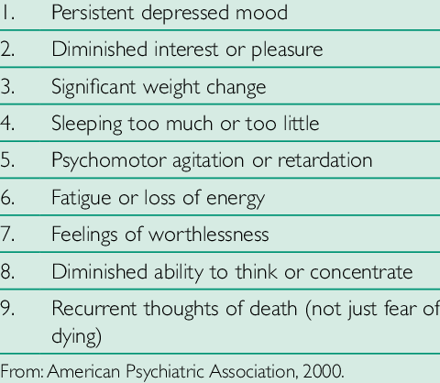
Five or more= major depressive disorder
+at least one of the symptoms is either no.1 or no.2:
+has to be 2 weeks or more
1. Low mood.
2. Loss of interest in pleasurable activities (anhedonia).
3. Appetite or body weight change (increased or decreased).
4.Insomnia or hypersomnia.
5. Psychomotor agitation or retardation.
6. Fatigue or loss of energy.
7. Feelings of worthlessness or excessive guilt.
8. Diminished concentration.
9. Recurrent thoughts of death or suicide.

Slide 37
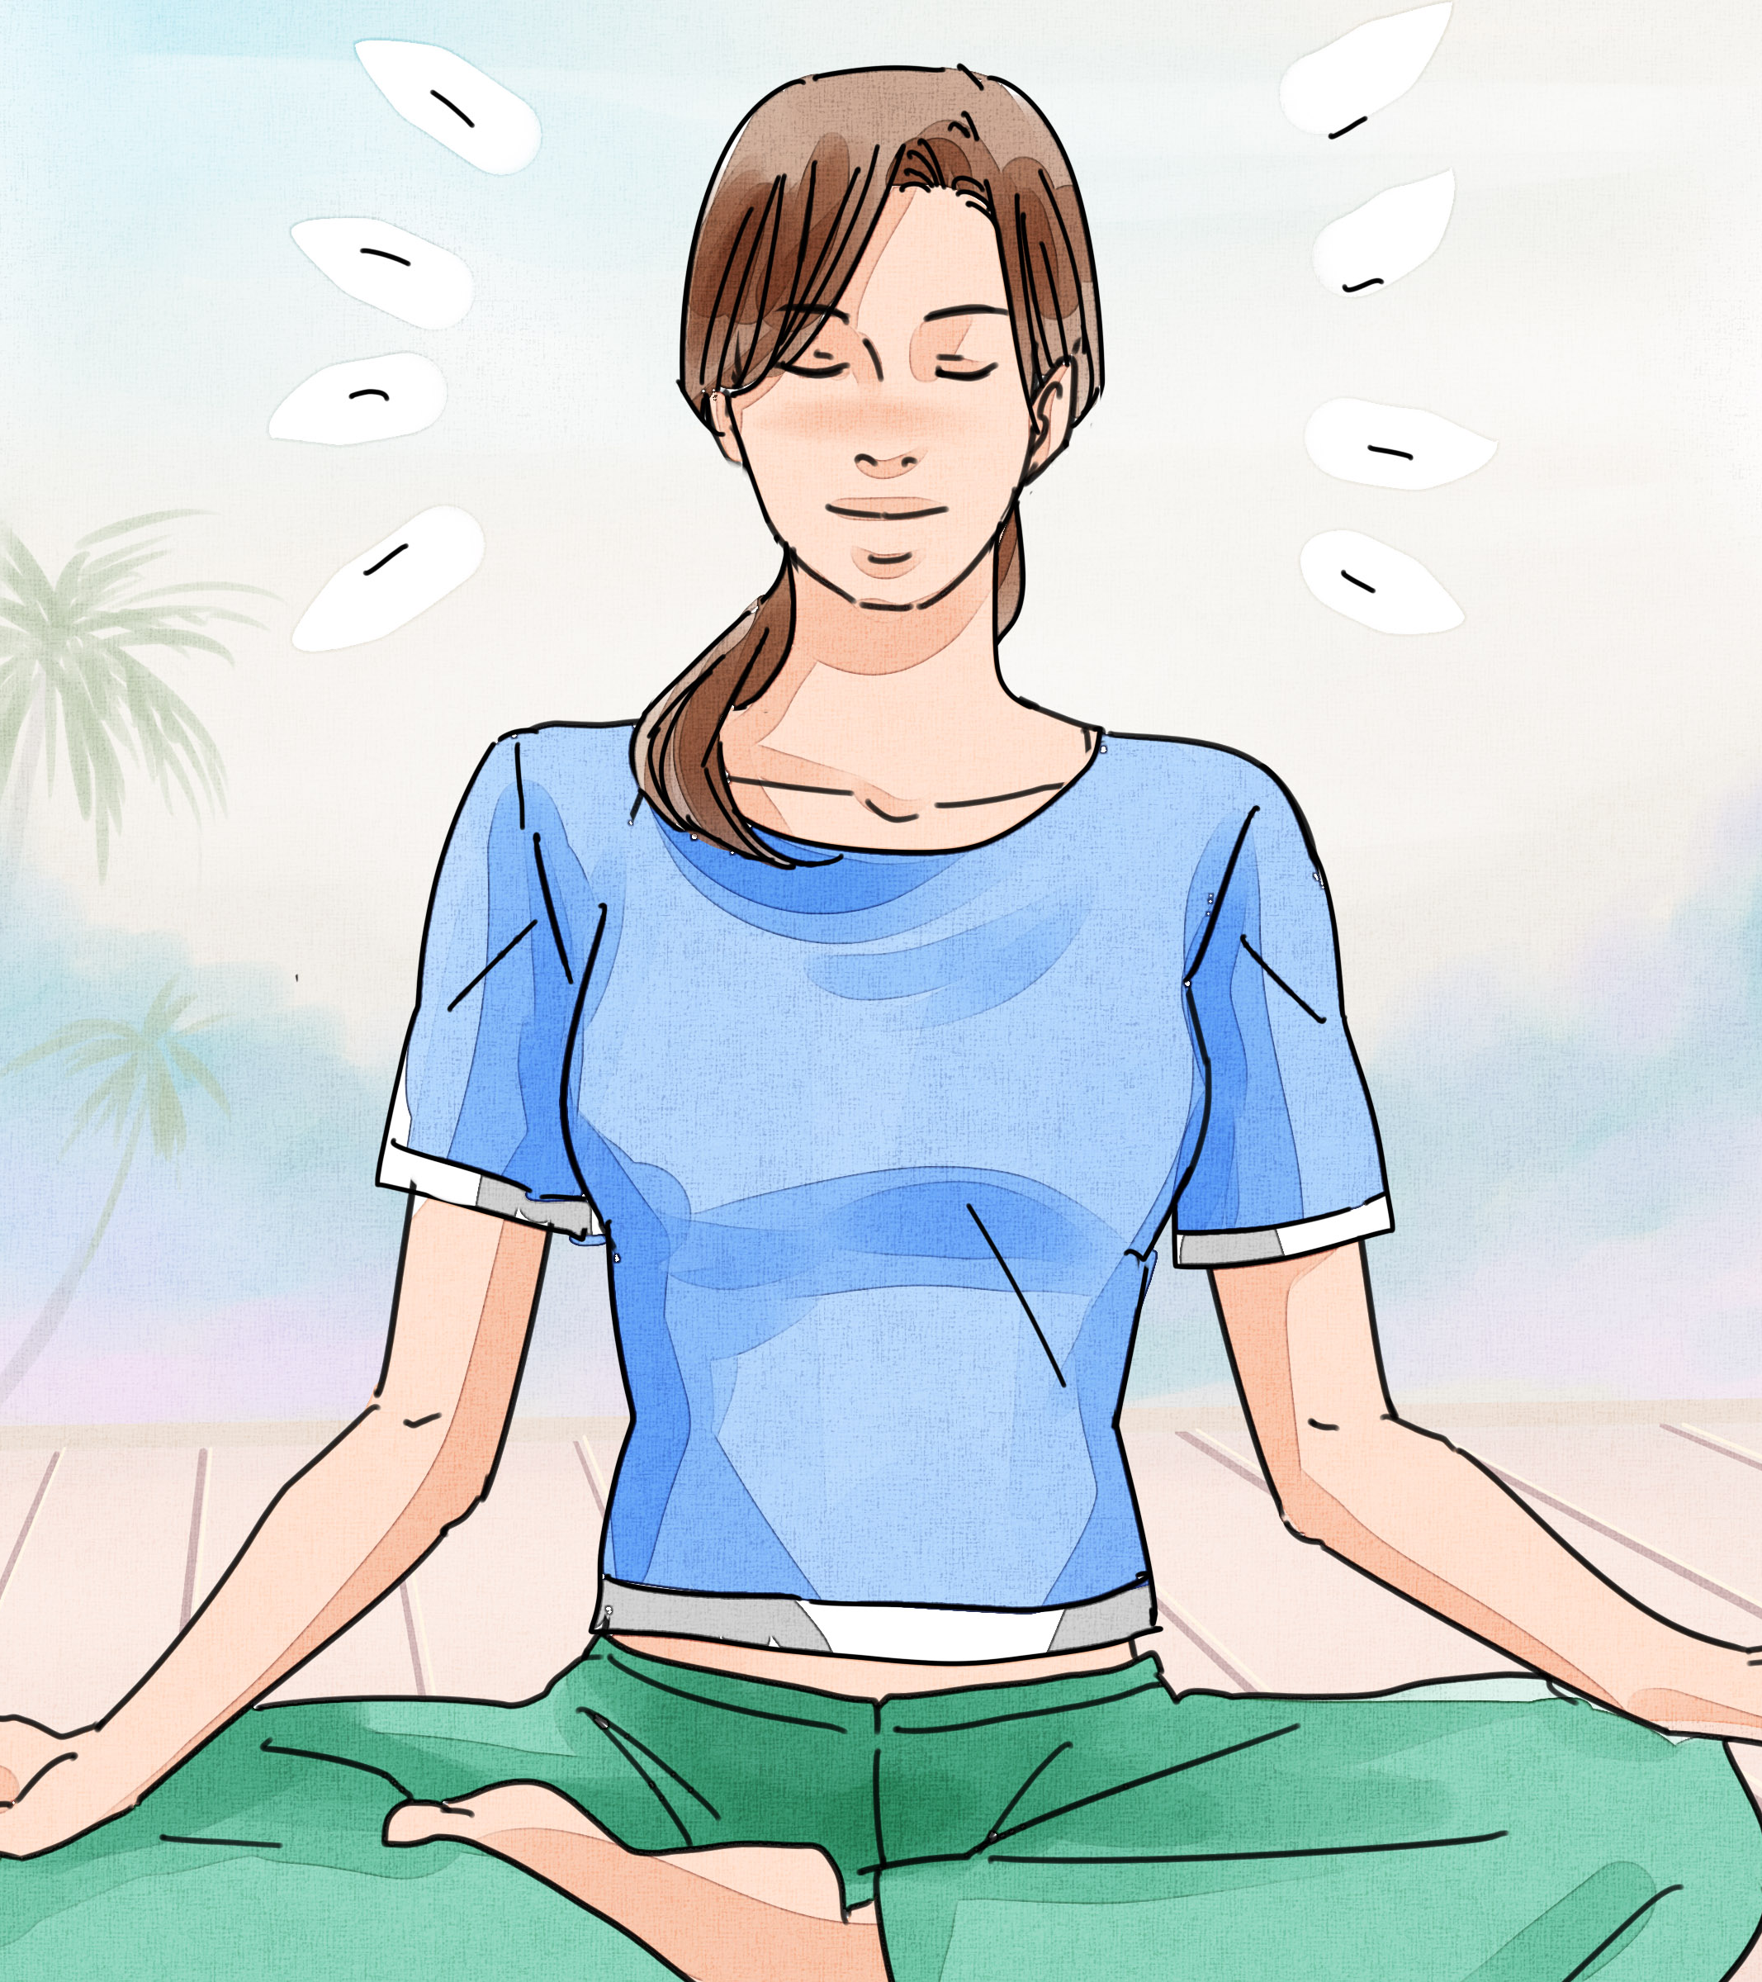
management
psychotherapy, medication, and electroconvulsive therapy. Psychotherapy is the treatment of choice (over medication) for people under 18.
exclude other causes
Severe (ex: suicidal): hospitalization & refer to psychiatrist
Not severe, not pregnant: antidepressants (SSRI: fluvoxamine)
Pregnant: antidepressants are avoided. Electroconvulsive therapy (ECT) may be used.
Notes:
Sometimes, the symptoms of depression can be more dangerous to the fetus than the side effects of the drugs. Therefore, they might be given, although this decision should be made by a specialist.

Slide 38
Somatic symptom disorder

Slide 39
Somatic symptom disorder

Slide 40
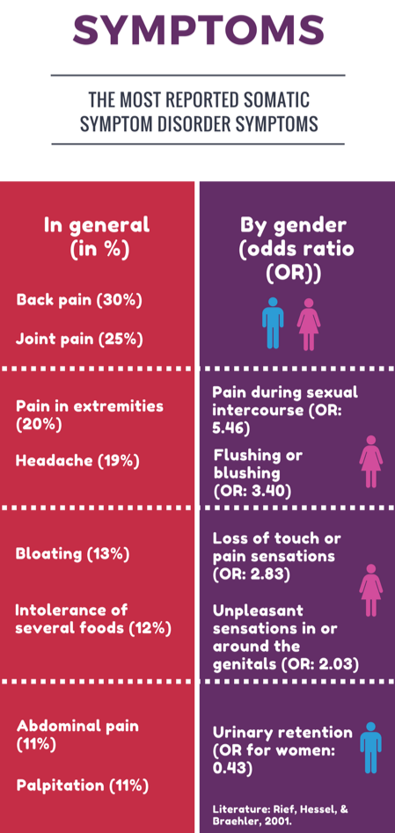
Somatic symptom disorder
a group of disorders, all of which fit the definition of physical symptoms similar to those observed in physical disease or injury for which there is no identifiable physical cause.
The symptoms are not intentionally produced.
The disorder is chronic
Notes:
Somatic symptom disorder involves a person having a significant focus on physical symptoms, such as pain, weakness or shortness of breath, that results in major distress and/or problems functioning. The individual has excessive thoughts, feelings and behaviors relating to the physical symptoms. The physical symptoms may or may not be associated with a diagnosed medical condition, but the person is experiencing symptoms and believes they are sick (that is, not faking the illness).
A person is not diagnosed with somatic symptom disorder solely because a medical cause can’t be identified for a physical symptom. The emphasis is on the extent to which the thoughts, feelings and behaviors related to the illness are excessive or out of proportion.

Slide 41
Prevalence and etiology
Women > men 5 – 10 : 1
The lifetime prevalence in the general population is about 2-5%.
These disorders can begin in childhood, adolescence, or adulthood.
More common in patients who bottle up their emotions and are less assertive
Alleviation of guilt through suffering.
To obtain attention or sympathy.
Faulty perception and assessment of somato-sensory inputs due to characteristic attention impairment.
Notes:
The prevalence of somatic symptom disorder in the general population is an estimated 5% to 7%,³
making this one of the most common categories of patient concerns in the primary care setting.⁷
An estimated 20% to 25% of patients who present with acute somatic symptoms go on to develop a chronic somatic illness.⁸
^{4,9}Females tend to present with somatic symptom disorder more often than males, with an estimated female-to-male ratio of 10:1.

Slide 42
Related disorders
Illness anxiety disorder involves a person preoccupied with having an illness or getting an illness – constantly worrying about their health. They may frequently check themselves for signs of illness, focus on health behaviors and take extreme precautions to avoid health risks. This condition was previously referred to as “hypochondriasis.” Unlike somatic symptom disorder, a person with illness anxiety disorder generally doesn’t experience symptoms.
Conversion disorder is a condition in which symptoms affect a person’s perception, sensation or movement with no evidence of a physical cause. A person may have numbness, blindness or trouble walking. The symptoms tend to come on suddenly and may last for a while or may go away quickly. People with conversion disorder also frequently experience depression or anxiety disorders.
Factitious disorder involves a person producing or faking physical or mental illness when he/she is not really sick, or intentionally making a minor illness worse. A person with factitious disorder may also create an illness or injury in another person. For example a person might fake the symptoms of a child in his/her care. The person may or may not seem to benefit from the situation they create.

Slide 45
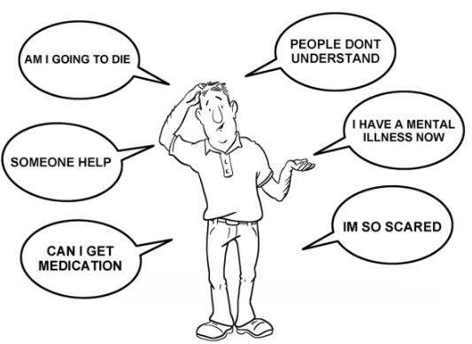
when to diagnose
Diagnostic criteria:
One or more somatic symptoms that are distressing or causing disruption in daily life
Excessive thoughts, feelings or behaviors related to the somatic symptoms or health concerns as shown by at least one of the following:
Disproportionate and ongoing thoughts about the seriousness of symptoms
Ongoing high level of anxiety about health or symptoms
Excessive time and energy spent on the symptoms or health concerns
3-At least one symptom is constantly present (typically more than six months), although there may be different symptoms and symptoms may come and go

Slide 46
management
having regular visits with a trusted
provide support and reassurance,
avoid unnecessary tests and treatments.
Psychotherapy
Antidepressant or anti-anxiety medication
CBT can help in some of the following ways
Notes:
Antidepressant or anti-anxiety medication if the person is also experiencing depression or anxiety.
Psychotherapy can help the individual change the thinking and behavior, and learn ways to cope with pain or other symptoms, deal with stress and improve functioning.

Slide 47
counseling
counseling helps patients to solve stressful problems by decision making with an expert physician. It opens the door for the best referral if needed helping the patient to choose decision among alternative courses of actions

Slide 48
When to refer a patient to a psychiatrist?
The major reasons for referral to psychiatry:
1.The patient has a psychiatric disorder, on psychotropic medications, or has a past history of such. 2.The staff are under strain over the patient because of his behavior is disturbing, demanding, manipulative, or suicidal. 3. Diagnostic uncertainty with suspicion of a psychiatric problem behind the physical symptoms. 4. The patient has asked to see a psychiatrist. However, patients are usually reluctant to see psychiatrist, and families may reinforce this attitude.

Slide 49
When to refer a patient to a psychiatrist?
Suicidality
Psychotic symptoms
Diagnostic questions
Developmental problems (children/adolescents)
Management review
Psychopharmacology assessment/advice
Substance abuse
Signs of dementia
Sleep problems
Sexual dysfunction
Abnormal bereavement
Family disfunction

Slide 50
conclusion
anxiety, depression , and somatic symptom disorder are common psychiatric diseases in Saudi Arabia
Depression is more common in younger adults
Panic attacks are Sudden self-limited attacks of intense anxiety
SSD is a syndrome of physical symptoms that cause substantial distress or psychosocial impairment

Slide 51
Q.1
A 32-year-old man presented with intense worries when he becomes in the middle of a row in the mosque as escape seems difficult. The most likely diagnosis is:
Panic disorder.
Specific phobia.
Agoraphobia.
Social phobia.

Slide 52
Q.2
A 20-year-old college student presented with repeated bouts of palpitation, sweating, and excessive worries when he uses public transport. The most likely diagnosis is:
Generalized anxiety disorder.
Posttraumatic disorder.
Agoraphobia with panic attacks.
Social phobia.

Slide 53
Q.3
Which one of the following symptom must be present to diagnose Depression?
Weight loss
Sleep disturbance
Anhedonia
Loss of appetite

Slide 54
Q.4
Which of the following is true regarding somatic symptom disorder ?
Always associated with mood disorders
Commonest in children
Chronic + not intentionally produced symptoms
Male often affected more than females

Slide 55
Q.5
In Which of the following situations you're supposed to refer a patient to see a psychiatrist
Patient asking
Suicidality
suspicion of a psychiatric problem behind the physical symptoms.
a past history of psychiatric problem
All of the above

Slide 56
references
https://www.cambridge.org/core/journals/psychological-medicine/article/global-prevalence-of-anxiety-disorders-a-systematic-review-and-metaregression/484845CE01E709EE4FB6554AA78E612F
https://www.researchgate.net/figure/Prevalence-of-depression-and-anxiety-disorders-among-outpatients-attending_fig1_264056493
https://bmcpsychiatry.biomedcentral.com/articles/10.1186/1471-244X-14-190
Diagnostic and Statistical Manual of Mental Disorders, Fifth Edition (DSM-5). American Psychiatric Association. (2013).
"Somatic symptom disorder Treatments and drugs - Mayo Clinic". Mayo Clinic. Archived from the original on 2017-04-19. Retrieved 2017-04-19.
Prof Al-Sughayir Manuel to basic psychiatry

Slide 57
Questions

Slide 58
THANK YOU

