Slide 1
Smoking and substance abuse
Done by :
Khalid alzahrani 435106801
Badr albadr 435100963
Abdulaziz almalki 435100646
Supervisor : prof. Jamal Jarallah

Slide 2
Objectives
Epidemiology of smoking in Saudi Arabia
Risks of smoking (Morbidity and Mortality)
Effect of passive smoking on pregnancy, children, ....
Helping the smoker to quit with smoking cessation aids and overcoming nicotine withdrawal symptoms
Role of PHC physician “smoking cessation clinic’
Update of the smoking cessation medication in pharmacological management
Nicotine preparations, Varenicline, Bupropion, .......
Factors that lead to substance abuse
Highlighting types of substance abuse
Method to approach subjects with substance abuse

Slide 3
questions
Who smoke more ?
Male
Female
What is the percentage of secondhand smoke effected people?
85%
40%
4%
17%

Slide 4
questions
The percentage of lung cancers caused by smoking is
95%
20%
50%
12%
Which one of the following is a side effect of bupropion ( Non NRT`s )?
Cough
Weakness
Dizziness
Seizures

Slide 5
questions
a chronic, relapsing disorder characterized by compulsive drug seeking and use despite adverse consequences. Is the definition of:
Drug abuse
Tolerance
Addiction
Dependence
the physiological state of neuroadaptation produced by repeated administration of a drug, necessitating continued administration to prevent appearance of withdrawal state. Is the definition of:
Drug abuse
Tolerance
Addiction
Dependence

Slide 6
questions
Which one of the following is a CNS stimulant ?
Lorazepam
Heroin
Methadone
Cocaine
Which one of the following is a screening questionnaire used in case of suspicion of adolescent drug/alcohol abuse ?
CAGE
Four Cs
CRAFFT
Fagerstörm

Slide 8
Epidemiology
-Overall, 12.1% of Saudis reported that they currently smoke tobacco. This prevalence was 23.7% among males and 1.5% among females.
-Daily tobacco smoking is 11.4% – 21.5% among males and 1.1% among females.
-11.4% (21.5% among males and 1.1% among females) of smokers consume cigarettes daily with an average of 15.0 cigarettes per day. 11.2% of Saudis consume shisha daily (20.9% for males and 1.4% for females).

Slide 10
Epidemiology
Overall, 29.7% started smoking before the age of 15, and 60.9% started smoking before the age of 18.
On average, Saudis start smoking at age 18 .
17.2% of Saudis are exposed to secondhand smoke at home.
14.8% of Saudis are exposed to secondhand smoke at work.

Slide 11
Risks of smoking
Smoking has long been associated with preventable morbidity and premature death in human population.
Several studies have specifically implicated smoking with lung cancer, coronary heart disease, chronic obstructive pulmonary disease, stroke and Polycythemia. Moreover, the extension of the damaging effects of smoking on health of non-smokers is increasingly being recognized and reported.

Slide 12
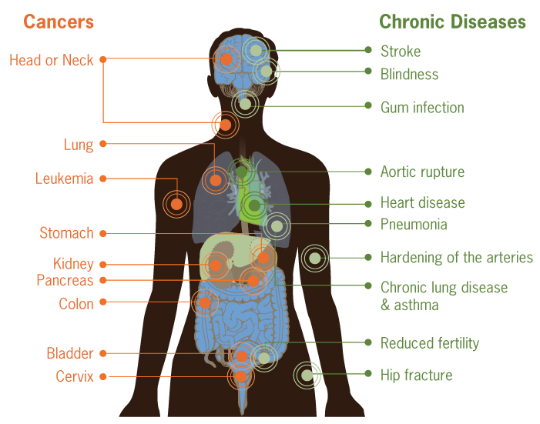
Risks of smoking
Lungs & airway:
Smoking causes about 90% of lung cancers. mouth , lips , throat ,voice box (larynx)
chronic obstructive pulmonary disease (COPD): bronchitis & emphysema
pneumonia
can also worsen or prolong the symptoms of respiratory conditions such as asthma, or respiratory tract infections such as the common cold.
Heart, Brain, Blood vessels
coronary heart disease, heart attack
stroke, cerebrovascular disease
peripheral vascular disease (damaged blood vessels)
Reproductive system
Male: can cause impotence because it limits the blood supply to the penis .
Male & Female : can reduce the fertility
It also causes cancer in Other organs
Pancreatic cancer
Bladder cancer
Skin cancer
Breast cancer
Prostate cancer

Slide 13
Risks of smoking

Slide 14
Risks of smoking
Smoking can also increase the risk /trigger some autoimmune disease
Rheumatoid arthritis

Slide 15
Effects of passive smoking
Why is passive smoking so dangerous?
Smoke that burns off the end of a cigarette called side stream smoke – may be even more toxic than the smoke inhaled by a smoker
Some research shows that the effect of exposure for a few minutes to a few hours can be just as dangerous as chronic smoking on the heart

Slide 16
Effects of passive smoking during pregnancy
If you are exposed to second-hand smoke during pregnancy, both you and your baby are put at risk.
Some of the health conditions associated with being exposed to second-hand smoke are a miscarriage, low birth weight, early birth, learning or behavioral deficiencies in your child, and Sudden Infant Death Syndrome

Slide 17
Active smoking during pregnancy
Smoking during pregnancy causes premature birth, low birth weight, certain birth defects, and ectopic pregnancy.
Smoking during pregnancy also causes complications with the placenta, These complications include placenta previa and placental abruption.

Slide 18
Effects of passive smoking on children
Passive smoking on children is more worrisome in those who have asthma. Exposure to the smoke increases asthma attacks, emergency visits, and hospital admissions. Children exposed are less likely to outgrow their asthma.
Children living with a smoker develop more respiratory infections that usually present more severe and last longer than in children not exposed to smoke.
The extent of effects of passive smoking on children is worse during the first 5 years of life where children spend most of their time with parents. Child’s symptom severity related directly to how much smoke they are exposed to.
Passive smoking worsens conditions such as pneumonia, bronchitis, bronchiolitis, laryngitis, influenza, ear infections, URTI, and sinus infections

Slide 19
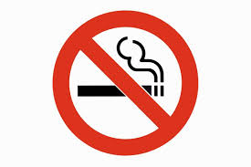
Smoking cessation

Slide 20
Smoking cessation
Nicotine addiction can be difficult to overcome
There are many support programs and cessation tools available to smokers who want to quit, including nicotine replacement products such as patches and gum, prescription medication, and free coaching.

Slide 21
PHC physician role:
PHC physician has an essential role in helping patients to quit smoking by:
educating the patient about smoking risks and benefits of cessation.
Prescribing smoking cessation pharmacological tools.
Explaining about each pharmacological tool’s advantages, disadvantages, and contraindications.

Slide 23
Pharmacological management:
1- NRT’s.
2- Non NRT’s.
bupropion
varenicline

Slide 24
NRT’s
NRT can reduce the cravings and withdrawal symptoms you experience that may hinder your attempt to give up smoking. NRTs are designed to wean your body off cigarettes and supply you with a controlled dose of nicotine while sparing you from exposure to other chemicals found in tobacco.
The U.S Food and Drug Administration (FDA) approved five types of NRT:
chewing gum
skin patches
lozenges
intranasal spray (prescription only)
inhaler (prescription only)
Contraindications for NRT’S :
Hypersensitivity
Smokers in postmyocardial infarction period
Life-threatening arrhythmias
Severe or worsening angina pectoris
Nonsmokers.
Pregnancy
Hypertension

Slide 25
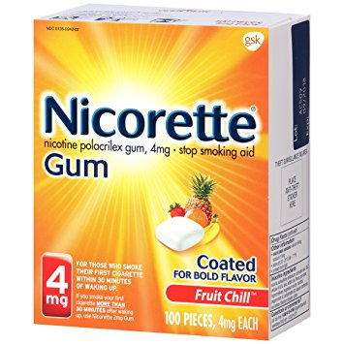
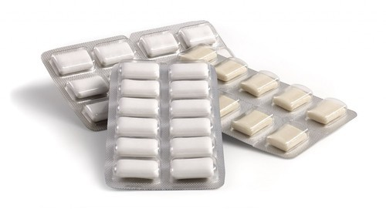
Nicotine chewing gum
Advantages: used to help people to stop smoking, it works by providing nicotine to your body to decrease the withdrawal symptoms experienced when smoking is stopped and as a substitute oral activity to reduce the urge to smoke.
Side effects:
Nausea / vomiting
Dizziness
Mouth / tooth or jaw problems.
Diarrhea
Weakness
Rash
Breathing difficulty
Mouth blisters
palpitation
Contraindicated in active temporomandibular joint disease.

Slide 26
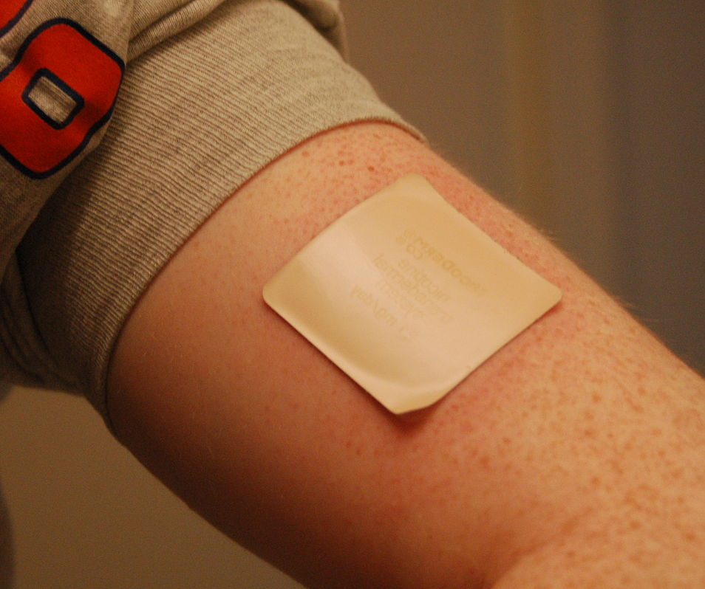
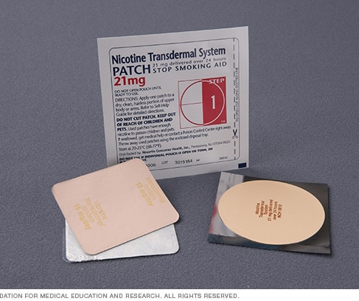
Nicotine transdermal patches
Advantages: used to help people stop smoking cigarettes. They provide a source of nicotine that reduces the withdrawal symptoms experienced when smoking is stopped.
Side effects:
Nausea / vomiting.
Headache
Increased blood pressure
Acne
Anorexia
others.

Slide 27
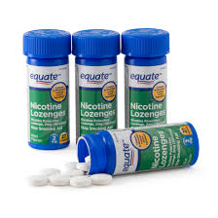
Nicotine lozenges
Side effects:
increased blood pressure
Nausea / vomiting.
Tachycardia
Dizziness
Insomnia

Slide 28
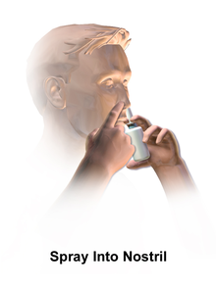
Nicotine nasal spray
Advantages:
Nicotine nasal spray is user-controlled dose and easy to use.
This medication gets rid of symptoms faster than any other medication.
Disadvantages:
Nicotine nasal sprays can be costly, and there is no generic form currently on the market.
This medication requires a prescription
Side effects:
Local irritation.
CNS and psychological manifestations.
Fatigue
Weight gain
sweating.

Slide 29
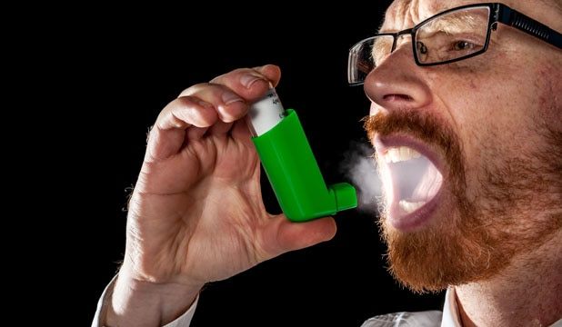
Nicotine inhalers
Advantages:
-It is easy to use.
-You can easily control the doses.
-Nicotine Inhaler works much more quickly than the nicotine gum.
-You can use it as per your requirement.
-If you use this according to the directions prescribed, then you can easily quit smoking.
Disadvantages:
It is more expensive than nicotine gum.
Side effects:
Mouth/throat irritation
Nausea / vomiting
Cough
Headache
Rhinitis
Dyspepsia

Slide 30
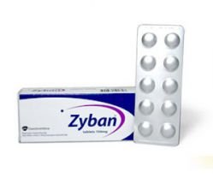
Non NRT’s: bupropion (zyban)
It’s a medication used as an antidepressant and a smoking cessation aid.
It is a norepinephrine-dopamine reuptake inhibitor (NDRI) and a nicotinic receptor antagonist.
Side effects:
seizures
dry mouth
trouble in sleeping
Agitation
headaches
Contraindications:
Epilepsy
Alcohol / benzodiazipines users.
Active brain tumors.
Pregnancy/breast feeding
Age under 18

Slide 31
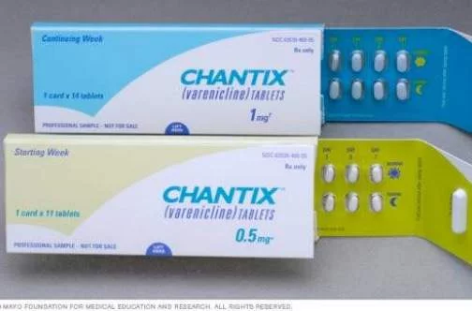
Non NRT’s: Varinecline. (Chantix/Champix)
It’s under smoking cessation aid class, used along with counseling and education to help people quit smoking. It works by blocking pleasant effect of nicotine (from smoking) on the brain.
Side effects:
Nausea
Headache
Sleeping troubles
nightmares.
Contraindications:
pregnancy/ breast feeding.
Age under 18.

Slide 32
Substance abuse

Slide 33
Definition
WHO definition
Substance abuse refers to the harmful or hazardous use of psychoactive substances, including alcohol and illicit drugs.

Slide 34
Terminology
Abuse: self-administration of any substance in a culturally disapproved manner that causes adverse consequences.
Dependence: the physiological state of neuroadaptation produced by repeated administration of a drug, necessitating continued administration to prevent appearance of withdrawal state.
Addiction: Addiction is defined as a chronic, relapsing disorder characterized by compulsive drug seeking and use despite adverse consequences.

Slide 35
Why people do drugs ?
People take drugs because they want to change something about their lives.
Here are some of the reasons people have given for taking drugs:
To feel good.
To feel better.
To do better.
Young people
To relieve boredom
To seem grown up
To rebel
To experiment ( curiosity )

Slide 36
What are the substances ?
According to the effect on CNS :
CNS suppressants:
Alcohol,
sedatives (Benzodiazepines),
inhalants,
opioids(morphine, heroin, tramadol)
CNS stimulants :
Amphetamine, cocaine

Slide 37
Factors that lead to substance abuse
Genes/biology
Genes
Mental disorders
Gender ?
Ethnicity ?
Home and Family.
The home environment, Especially during childhood, is a very important factor.
Parents or older family members use drugs or alcohol.
Others
Route of administration
Peer and School
Friends and other peers can have an increasingly strong influence during the teen years.
Poor performance
Poor social skills

Slide 38
Neonatal abstinence syndrome
The neonatal abstinence syndrome refers to a postnatal opioid withdrawal syndrome that can occur in 55 to 94% of newborns whose mothers were addicted to or treated with opioids while pregnant.

Slide 39
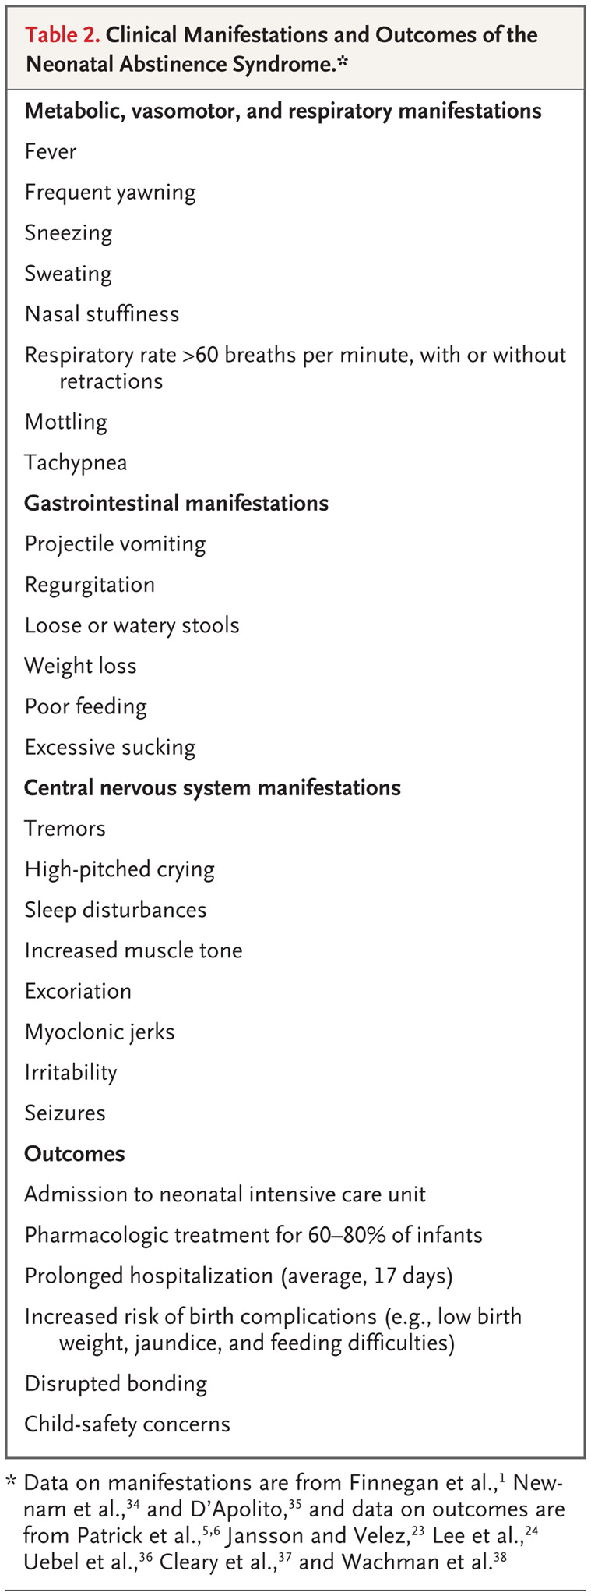

Slide 40
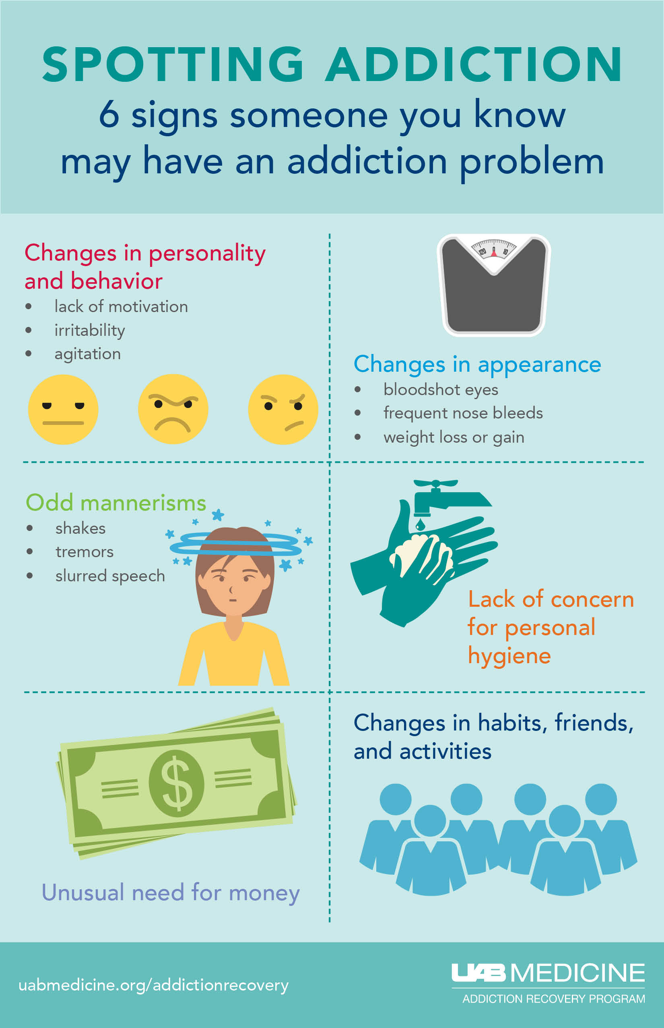
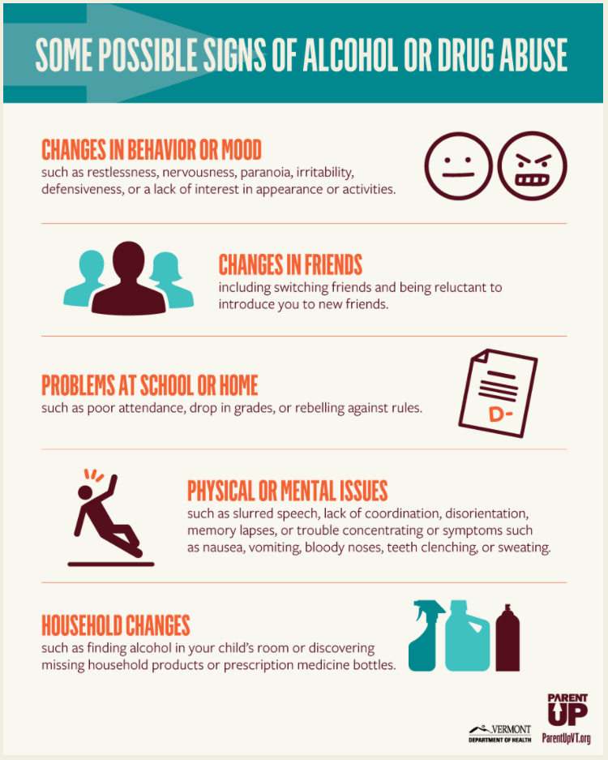
Signs of substance abuse/addiction

Slide 41
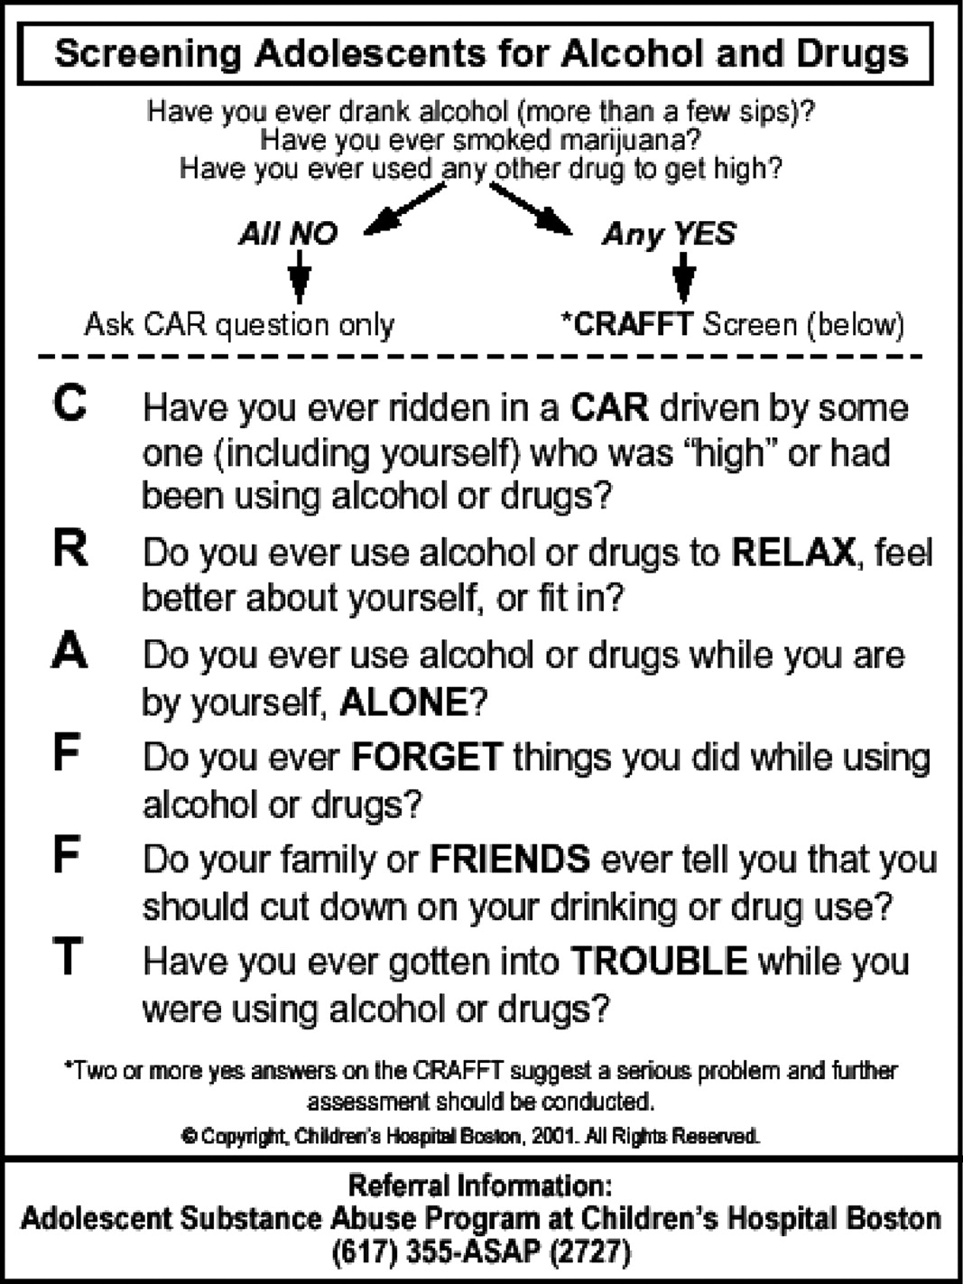

Slide 42
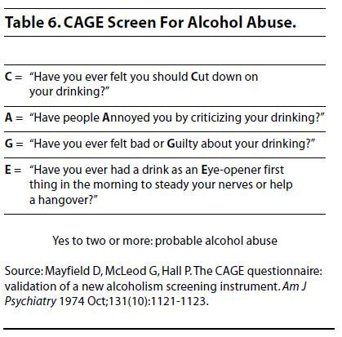

Slide 43
Methods to approach subjects with substance abuse
This guideline covers targeted interventions to prevent misuse of drugs, including illegal drugs, ‘legal highs’ and prescription-only medicines. It aims to prevent or delay harmful use of drugs in children, young people and adults who are most likely to start using drugs or who are already experimenting or using drugs occasionally.

Slide 44
Recommendations
1- Delivering drug misuse prevention activities as part of existing services
e.g. specialist services for people in groups at risk
People at risk of using drugs:
People who attend Nightclubs or festivals
Wider health services, such as sexual and reproductive health services or primary care
Supported accommodation or hostels for people without permanent accommodation
Gyms (to target people who are taking, or considering taking, image- and performance-enhancing drugs).
People with mental illnesses

Slide 45
Recommendations
2-Assessment at points of opportunities for vulnerability of drug use.
For example: appointment with general practitioner.
Use a consistent, locally agreed approach to assessment that is respectful, non-judgemental and proportionate to the person's presenting vulnerabilities.
Discuss the person's circumstances, taking account of their age and developmental stage. The initial discussion could include: - their physical and mental health and their personal, social, educational or employment circumstances (which may trigger a more in-depth assessment) - any drug use (including the type used and how often).

Slide 46
Recommendations
3-Children and young people assessed as vulnerable to drug misuse should:
Be considered for skills training for both them and their families. Training should build the following:
Listening | Conflict resolution | Refusal | Identifying and managing stress
Making decisions | Coping with criticism | Dealing with feelings of exclusion | Making healthy behaviour choices

Slide 47
Recommendations
4) Adults assessed as vulnerable to drug misuse should be offered the following at the same time as assessment: - Clear information on drugs and their effects - Advice and feedback on any existing drug use - Information on local services and where to find further advice and support
5) People at risk of using drugs should be considered to be provided with drug information.

Slide 48
Treatment
Treating withdrawal
Staying on treatment
Prevent relapsing
Goal

Slide 49
questions
Who smoke more ?
Male
Female
What is the percentage of secondhand smoke effected people?
85%
40%
4%
17%
Correct answer
Correct answer

Slide 50
questions
The percentage of lung cancers caused by smoking is
95%
20%
50%
12%
Which one of the following is a side effect of bupropion ( Non NRT`s )?
Cough
Weakness
Dizziness
Seizures
Correct answer
Correct answer

Slide 51
questions
a chronic, relapsing disorder characterized by compulsive drug seeking and use despite adverse consequences. Is the definition of:
Drug abuse
Tolerance
Addiction
Dependence
the physiological state of neuroadaptation produced by repeated administration of a drug, necessitating continued administration to prevent appearance of withdrawal state. Is the definition of:
Drug abuse
Tolerance
Addiction
Dependence

Slide 52
questions
Which one of the following is a CNS stimulant ?
Lorazepam
Heroin
Methadone
Cocaine
Which one of the following is a screening questionnaire used in case of suspicion of adolescent drug/alcohol abuse ?
CAGE
Four Cs
CRAFFT
Fagerstörm
Correct answer
Correct answer

Slide 53
references
http://www.healthdata.org/sites/default/files/files/Projects/KSA/Smoking-KSA-Findings-from-the-Saudi-Health-Interview-Survey.pdf
http://americanpregnancy.org
https://www.childrenshospital.vanderbilt.org
https://www.ncbi.nlm.nih.gov/pmc/articles/PMC3437166/#ref8
https://www.ncbi.nlm.nih.gov/pmc/articles/PMC3437166/#ref6
Davidson medicine 22th edition
Robbins basic pathology 9th edition
https://www.curejoy.com/content/effects-of-passive-smoking-during-pregnancy/
http://aaffp.org American family physician
https://www.nice.org.uk
https://www.drugabuse.gov/publications/drugs-brains-behavior-science-addiction/drug-misuse-addiction
https://www.drugabuse.gov/publications/drugs-brains-behavior-science-addiction/treatment-recovery
https://www.nejm.org/doi/full/10.1056/NEJMra1600879
https://www.drugrehab101.com
"Bupropion Hydrochloride Monograph for Professionals". Drugs.com. American Society of Health-System Pharmacists. 5 February 2018. Retrieved 15 July 2018.
FDA Buproprion Label Last revised 16 December 2014 as described on the FDA Label Website. See that site for updates. Page accessed 8 April 2016
Dwoskin, Linda P. (29 January 2014). Emerging Targets & Therapeutics in the Treatment of Psychostimulant Abuse. Elsevier Science. pp. 177–216.

