Slide 1
Changes in bowel habits
Thamer Fahad Al-Ahmadi
Mohammed aziz Al-shehri
Ali al-zhrani

Slide 2
Objectives:
- Define constipation and diarrhea
- Discuss the definition, etiology and classification of irritable bowel syndrome (IBS)
- Explain how to diagnose IBS
- List the alarm symptoms and differential diagnosis
- Provide a comprehensive management plan and follow up for patients with IBS
- Recognize when to refer to specialist
- Demonstrate history taking and physical examination for patients presented with history suggestive of IBS. i.e Role play.
- Practical: Examination of the Abdomen, how to perform the examination?

Slide 3
Question 1
Passage of three or more loose or liquid stools per day is a definition of what ?
A-constipation
b- diharrea
C- hematochezia
D-tenesmus

Slide 4
Question 2
Which one of these symptom consider as red flag ?
A- Abdominal pain or discomfort
B-Bloating
C-Change in bowel habit.
D-rectal bleeding

Slide 5
Question 3
Which one of the following is clinically diagnostic of IBS ?
A- rebound tenderness
B-improvement with defecation
C-blood mixed with stool
D-pale stool

Slide 6
Question 5
According to rome iii criteria for what length of time must patients complain of symptom before they diagnosed with IBS ?
A- 6 months
B- 9 months
C- one year
D- tow years

Slide 7
Question 5
High intake of fibers is helpful in managing IBS patients ?

Slide 8
Define constipation and diarrhea
Constipation
less than three bowel movements in a week, and stools are hard, dry, and small, making them painful and difficult to pass also a sensation of an incomplete Evacuation.
Diarrhea
Passage of three or more loose or liquid stools per day (or more frequent passage than is normal for the individual).
Notes:
Frequent passing of formed stools is not diarrhoea

Slide 9
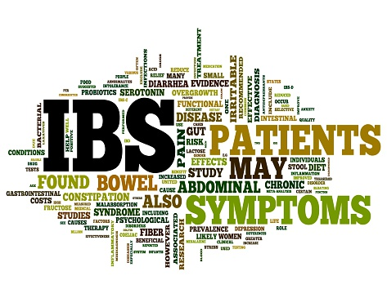

Slide 10
Definition of IBS
It is a chronic or recurrent abdominal pain, altered bowel habits, and bloating, with the absence of organic or biochemical abnormalities.
Known as functional gastrointestinal disorders (FGIDs).
People with IBS present most commonly with diarrhea predominant or constipation predominant.
IBS most often affects people between the ages of 20-30 years and is twice as common in women as in men.
The number of newly diagnosed cases of irritable bowel syndrome (IBS) is increasing worldwide. Prevalence in the general population is estimated to be between 10- 20% and the incidence of irritable bowel syndrome at 1-2% per year.
One of the top 10 reasons for visits to primary care physicians. (3)
Notes:
Functional gastrointestinal disorders (FGIDs) are common disorders that are characterized by persistent and recurring GI symptoms. These occur as a result of abnormal functioning of the GI tract. They are not caused by structural (tumors or masses) or biochemical abnormalities.
Recent trends indicate that there is also a significant prevalence of IBS in older people.
IBS diagnosis should be a consideration when an older person presents with unexplained abdominal symptoms.

Slide 11
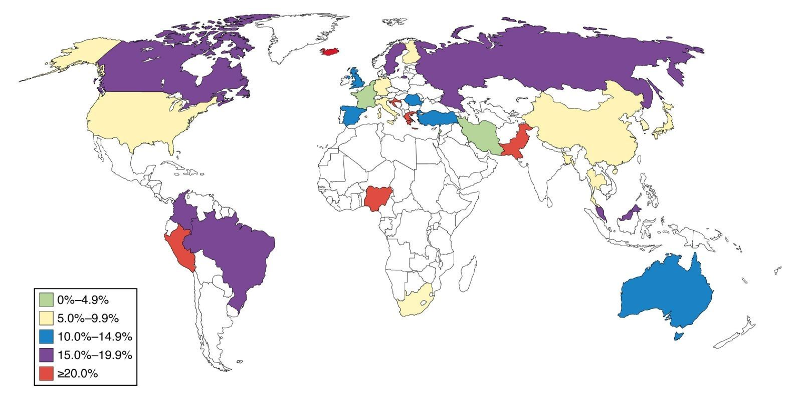
Prevalence of IBS globally
The epidemiology of irritable bowel syndrome Caroline Canavan, Joe West, and Timothy Card, Published online 2014 Feb 4.

Slide 12
Etiology of IBS
The causes of irritable bowel syndrome remain poorly defined but there are multiple factor play role in this disorder.
Possible etiologies for IBS include:
Stress and anxiety
Visceral hypersensitivity
Gastrointestinal infections
Neurohormonal stress response
Food sensitivity.
Psychological disorders.
Intestinal inflammation.
Notes:
Infection with Giardia lamblia has been shown to lead to an increased prevalence of IBS
excessive release of 5-HT in D-IBS, and relative deficiency C-IBS.
two-third of patients with IBS have psychological disorders
Intestinal inflammation
Theory that IBS represent a low grade inflammation not detected by test with raised number of mast cells (This theory supported by the improvement of the condition with mast cell stabilizers)
Alteration in fecal microflora
Both quantitative and qualitative alteration in intestinal bacterial contents have been reported

Slide 13
Classification of IBS:
IBS-C
IBS-M
IBS-D
IBS-U

Slide 14
Classification of IBS
IBS with constipation (IBS-C): hard or lumpy stools for ≥25% of bowel movements and loose (mushy) or watery stools for ≤25% of bowel movements.
IBS with diarrhoea (IBS-D): loose (mushy) or watery stools for ≥25% of bowel movements and hard or lumpy stool for ≤25% of bowel movements.
Mixed IBS (IBS-M): hard or lumpy stools for ≤25% of bowel movements and loose (mushy) or watery stools for ≤25% of bowel movements.
Unspecified IBS: insufficient abnormality of stool consistency to meet criteria for above subtypes.

Slide 15
Diagnostic approach A-History:
1. Initial assessment for IBS
if the person reports having had any of the following symptoms for at least 6 months:
1. Abdominal pain or discomfort
2. Bloating
3. Change in bowel habit.

Slide 16
Diagnostic approach
2-Assesment of risk factor:
Age < 50
Female gender
Previous enteric infection
3. Exclude alarm symptoms (red flags):
All people presenting with possible IBS symptoms should be assessed and clinically examined for red flag indicators and should be referred to secondary care for further investigation if any are present.

Slide 17
Diagnostic approach
4. Rome III diagnostic criteria:
Recurrent abdominal pain or discomfort for at least 3 days per month in the last 3 months, plus 2 or more of the following:
1. Improvement by defecation.
2. Onset associated with change in stool frequency.
3. Onset associated with change in form (appearance) of the stool.

Slide 18
Diagnostic approach
5. Symptoms support diagnosis of IBS
A diagnosis of IBS should be considered only if the person has abdominal pain or discomfort that is either relieved by defecation or altered bowel frequency.
This should be accompanied by at least two of the following four symptoms:
altered stool passage (straining, urgency, incomplete evacuation)
abdominal bloating, distension, tension or hardness
symptoms made worse by eating
passage of mucus.

Slide 19
Diagnostic tests B-Investigations:
No specific tests
In people who meet the IBS diagnostic criteria, the following tests should be undertaken to exclude other diagnoses:
CBC
ESR
CRP
Endomysial antibodies [EMA] and anti-tissue transglutaminase [TTG]

Slide 20
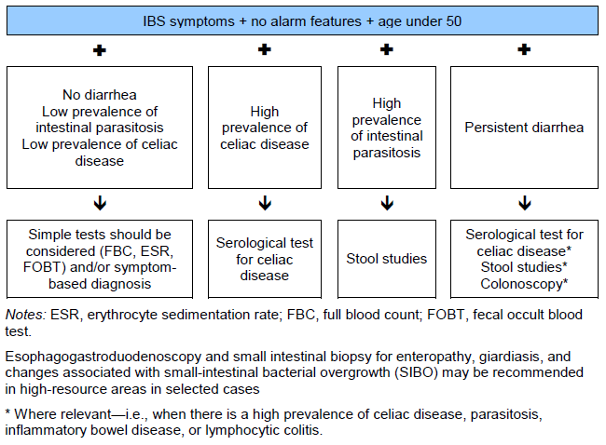
IBS diagnostic algorithm according to World Gastroenterology Organisation Global Guidelines

Slide 21
Alarming Sx
Weight loss
Rectal bleeding
Anemia
Nocturnal symptoms
+ve FHx Colorectal CA.
Notes:
As long you’re thinking of another disease, you have to excluded first as IBS is a diagnosis of exclusion

Slide 22
DDx
Inflammatory bowel disease. (crohn’s disease & Ulcerative colitis)
Celiac disease
Lactose intolerance
Colorectal Cancer
GI infection (Recent Antibiotic use)
Ischemic colitis

Slide 23
Rx
Lifestyle advice:
Relaxation techniques such as meditation.
Physical activities and exercise.
Dietary advice:
High fluid intake (8 cups per day)
soluble fiber supplementation.
Avoid high intake of fibers, starch and fruits (3 per day)
Following a low FODMAP [fermentable oligosaccharides, disaccharides,monosaccharides and polyols] diet) Done by a dietitian.
Notes:
Tell the patient yo watch what they eat to identify precipitating factors
To eat more Fibers but it might cause flatulance.
Fluids: especially water or other non-caffeinated drinks, for example herbal teas.

Slide 24
Symptoms persist?

Slide 25
Dietary management
include single food avoidance and exclusion diets (for example, a low FODMAP [fermentable oligosaccharides, disaccharides, monosaccharides and polyols] diet)
Done by dietitian.

Slide 26
Pharmacological therapy:
Constipation-predominant IBS | Diarrhea-predominant IBS
Laxative should be considered in C-IBS. Lactulose to be avoided. Consider linaclotide for people with IBS only if: Optimal or maximum tolerated doses of previous laxatives from different classes have not helped and they have had constipation for at least 12 months. Follow up people taking linaclotide after 3 months. | Loperamide (antimotility) should be the first choice.
People with IBS should be advised how to adjust their doses of laxative or antimotility agent according to the clinical response. The dose should be titrated according to stool consistency, with the aim of achieving a soft, well-formed stool.
Notes:
Phrmacological treatment is initiated along the dietary therapy

Slide 27
Cont.
Antispasmodic agents taken when required.
Consider TCA as second-line treatment
Switch to SSRI if not effective.
Follow up is required for possible side effect

Slide 28
No effect?
Do not respond to pharmacological treatments after 12 months.
Who develop a continuing symptom profile (described as refractory IBS).

Slide 29
Psychological intervention
Cognitive behavioural therapy [CBT]
Notes:
should be considered for people with IBS who do not respond to pharmacological treatments after 12 months and who develop a continuing symptom profile (described as refractory IBS).

Slide 30
Follow up
Notes:
Follow-up should be agreed between the healthcare professional and the person with IBS, based on the response of the person's symptoms to interventions. This should form part of the annual patient review. The emergence of any 'red flag' symptoms during management and follow-up should prompt further investigation and/or referral to secondary care. [2008]
No long-term monitoring is necessary. Patients with IBS should follow the standard recommendations for screening for colorectal cancer as well as for gynaecological and genitourinary malignancies.

Slide 31
When to refer to specialist?

Slide 32
Abdominal examination

Slide 33
History
- Remember…Red flag exclusion!

Slide 34
Abdominal Examination
1- Inspection
2- Palpation
3- Percussion
4- Auscultation

Slide 35
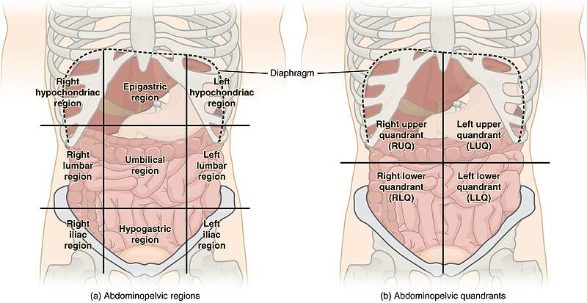
Abdominal Examination

Slide 36
PR Examination
Usually PR is done but there is indication when you have to do it
Assessment of the prostate (particularly symptoms of outflow obstruction).
When there has been rectal bleeding (prior to proctoscopy, sigmoidoscopy and colonoscopy).
Constipation.
Change of bowel habit.
Problems with urinary or faecal continence.
In exceptional circumstances, to detect uterus and cervix (when vaginal examination is not possible).

Slide 37
PR Examination
1-Inspection
Skin disease. For example, natal cleft dermatitis in seborrhoeic eczema.
Skin tags.
Pilonidal sinus.
Genital warts.
Anal fissures.
Anal fistula.
External haemorrhoids.
Rectal prolapse.
Skin discolouration with Crohn's disease.
External thrombosed piles.
2-Internal
Assessment of the prostate and the rectum

Slide 38
ROLE PLAY

Slide 39
Khalid is a 31 years old presenting to the clinic due to abdominal pain for the last 6 months
How to approach this patient?

Slide 40
Question 1
Passage of three or more loose or liquid stools per day is a definition of what ?
A-constipation
b- diharrea
C- hematochezia
D-tenesmus

Slide 41
Question 2
Which one of these symptom consider as red flag ?
A- Abdominal pain or discomfort
B-Bloating
C-Change in bowel habit.
D-rectal bleeding

Slide 42
Question 3
Which one of the following is clinically diagnostic of IBS ?
A- rebound tenderness
B-improvement with defecation
C-blood mixed with stool
D-pale stool

Slide 43
Question 5
According to rome iii criteria for what length of time must patients complain of symptom before they diagnosed with IBS ?
A- 6 months
B- 9 months
C- one year
D- tow years

Slide 44
Question 5
High intake of fibers is helpful in managing IBS patients ?

Slide 45
References
1- https://www.webmd.com/digestive-disorders/qa/how-is-constipation-defined
2- http://www.who.int/news-room/fact-sheets/detail/diarrhoeal-disease
3- https://emedicine.medscape.com/article/930844-overview
4-https://www.nice.org.uk/
5-https://patient.info/doctor/abdominal-examination

Slide 46
Thank you
Any questions?

