Slide 1
Done by:
Abdulaziz Alshalan Khalil Alduraibi Zeyad Alsalem

Slide 2
Objectives
- To define obesity and classify the degree of obesity based on BMI, waist circumference and waist-hip-ratio.
- The prevalence of obesity in Saudi Arabia.
- Methods to prevent obesity in the community.
- Common causes of obesity in the community.
- Common health problems associated with obesity.
- The evidence based approach to reducing weight (exercise, dieting, drug treatment, and bariatric surgical intervention)
- The roles of health team, medical students, and school health professionals in addressing the problems of obesity in the community

Slide 3
Introduction & epidemiology
- Obesity is a very common and widely spread disease worldwide.
- In KSA, the prevalence of Overweight is 32.3%, Class I obese is 20.7% , Class II and III is 15.5%.
- In 2017 it reached 38.2% among Saudi adult males
67.5% among Saudi adult females
- The disease prevalence is expected to grow in the coming years.

Slide 4
Introduction & epidemiology
- Obesity is one of the most important preventable diseases in the UK. It's associated with many health risks and diseases such as:
1- Type2 DM (BMI of 35 confers a 92x increased risk of DM
2- Dyslipidemia
3- Insulin resistance
What else?

Slide 5
What is obesity?
Excess accumulation of fat in the body 20% over the individuals ideal weight.
Obesity is classified using multiple parameters which are the followings;

Slide 6
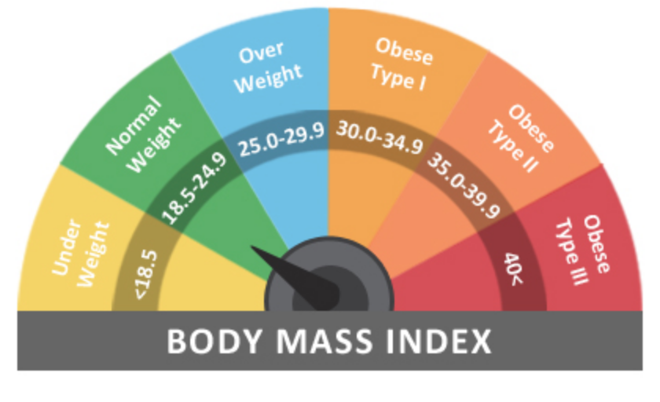
Obesity Classification
Body mass index (BMI): The best measure of obesity.
BMI= weight in kg ÷ (hight in meter)²

Slide 7
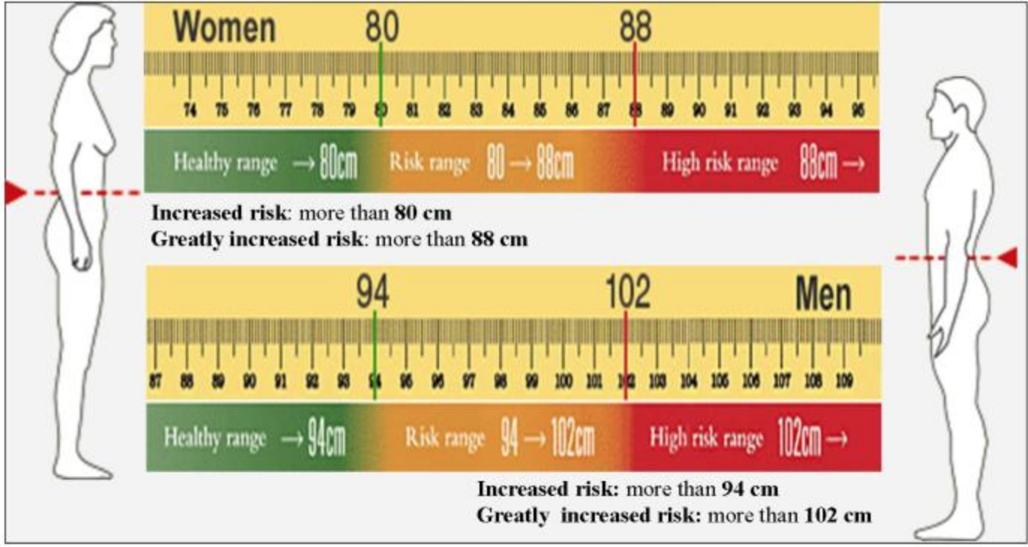
Obesity Classification
Waist circumference: An alternative measure of body fat, measured halfway between the superior iliac crest and the rib cage.
Waist circumference obesity classification (cm):

Slide 8
Obesity Classification
Waist circumference is correlated with CHD risk, DM and hyperlipidemia, used in addition to BMI to aid assessment of health risks.

Slide 9
Obesity Classification
Waist-hip ratio: WHO has defined obesity based on waist-hip ratio by < 0.85 in women and < 0.90 in men.
Assessing waist to hip ratio is important as it indicates the risk of diseases associated with central obesity.
According to WHO, risk of diseases increases with increase in the ratio :
Health risk | Men | Women
Low | 0.95 or lower | 0.80 or lower
Moderate | 0.95-1.0 | 0.81-0.85
High | > 1.0 | > 0.85

Slide 10
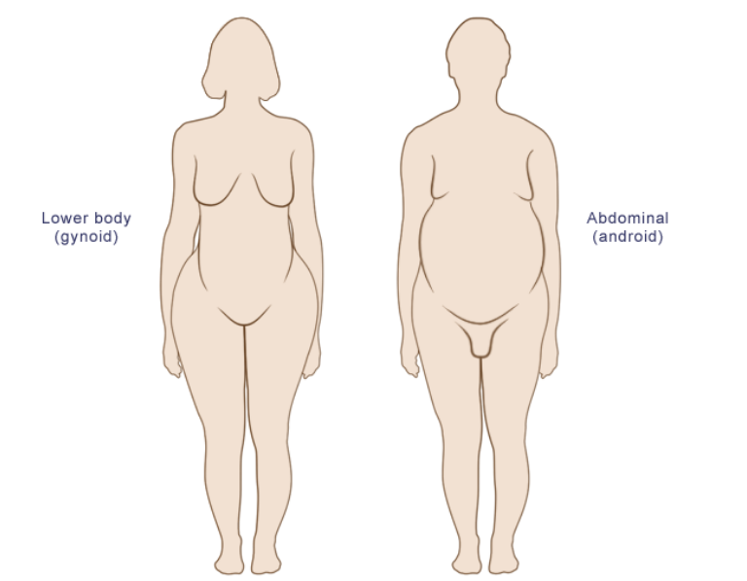
Obesity Types
Peripheral (lower body) obesity:
Gynoid shape.
Usually in women.
Fat is mostly concentrated in hip, thighs and buttocks.
Central obesity:
Android shape.
Usually seen in men.
Associated with insulin resistance and increased risk for cardiac diseases (e.g. CAD).
Assessed by waist circumference and waist to hip ratio.

Slide 11
Methods to prevent obesity in the community
The prevention begins in the childhood with healthy patterns of exercise and diet.
Health promotion:
Decreasing fat and sugar intake, and increasing consumption of fruits and vegetables.
Maintaining regular exercise activity
Either by organizing campaigns or individual education (e.g. physician to patient)
Setting regulations
Minimizing fat and sugar content as much as possible.
Ensuring the availability of healthy food in the market and in affordable prices.
Supporting and facilitating regular physical activity.
Implementing educational programs.

Slide 12
Common causes of obesity in the community
Behavioral factors (e.g. physical inactivity, smoking cessation).
Social factors.
Genetic factors.
Childbirth.
Notes:
Smoking cessation: mean weight ↑ 3–4kg
Cultural: عزايم
Genetic risk: ~1 in 3 obese people—more prone to obesity again after successful dieting, can be a disorder lie Prader Willi syndrome
Childbirth: gain weight due to pregnancy, keeps that weight afterward, especially if not breastfeeding.

Slide 13
Less common causes of obesity in the community
Drugs: steroids, antipsychotics (e.g. olanzapine), contraceptives, sulfonylureas, insulin, Beta blockers and TCAs.
Metabolic causes (rare): hypothyroidism, Cushing’s syndrome, PCOS, hypothalamic injury and Insulinoma.
Ongoing binge eating disorder.
Drugs:

Slide 14
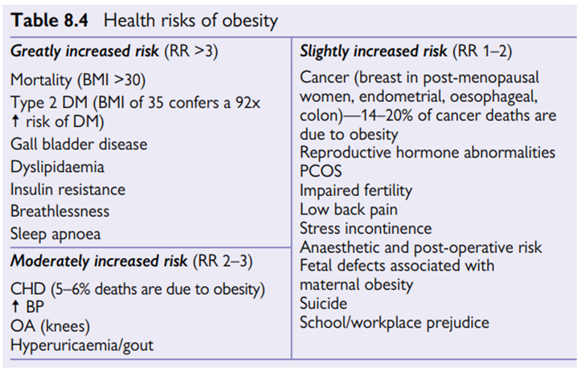
Common health problems associated with obesity
Notes:
FROM BMJ:
Obesity contributes to mortality from the three largest causes in the UK, namely, cardiovascular, cancer and respiratory disease. (NOTE: INCREASED RISK IN TOP 3 MORTALITY CAUSES)
1- Increased body mass = increase demand of body flow -> left ventricular hypertrophy.
2- Increased glucose intolerance
3- Dyslipidimia: low HDL, high TGs.
4- Malignancies ((GI, RCC, endometrial, cervical, ovarian and breast)
5- Respiratory : e.g. Sleep Apnea

Slide 15
Obesity Management
1. Dieting.
2. Exercise.
3. Pharmacotherapy.
4. Bariatric surgical intervention.

Slide 16
1. Diet
What does the ideal plate contain?
- Consume carbohydrates as a main dish.
- Fish “2x/week”.
- Lean meat “Remove excess fat”.
- Eat plenty of fibers.
- Eat plenty of fruits & vegetables “>5 portion”
1- Minimize the time between cutting & eating 2- Avoid overcooking
- Drink fluid“2-3L” 1- Water 2- Tea & coffee 3- Meal & Snacks.
- Avoid excess sugars “<50g” & salts “<6g” cut down processed food.

Slide 17
1. Diet
Which one is better, eating three large meals or six small meals daily?
- Avoid snacks but how?
- Ask yourself three questions;
1- Am I hungry? Wait 20min if unsure.
2- When was the last meal? <3h not real hunger.
3- Could a small snack tide me over till the next meal? Fruits & vegetables.

Slide 18
2. Exercise
- Recommended activity amount:
1- For adult > 30 min/day for at least 5 days/week.
2- For child > 1 h everyday.
- Exercise prevents weight gain but it is poor for weight loss alone.
- Reduce risk of: DM? / Obesity / CHD / Stroke / Osteoporosis / Hip fracture / Colon Cancer
- Treatment of: HTN? / DM? / Dyslipidemia? / HIV? / Mental problems? / Arthritis & Back pain?
Notes:
HTN; 10mmHg & delay the onset
DM; Glucose enter muscle independent of insulin effect
Increase HDL & Lower LDL & TG
HIV; CP fittness & Psychological effect
Mental; Reduce depression & Anxiety
Arthritis & Back pain; Maintain function

Slide 19
Which one is better to reduce weight, Diet or exercise?
- 120 Postmenopausal obese women,
- Diet Vs Diet & aerobic exercise Vs Diet & resistance exercise,
- Observe weight and lipid profiles regarding the CVD risk until a BMI of < 25 kg/m² was reached,
- Results, caloric restriction leading to significant weight loss with or without exercise training appears to be equally effective for reducing IAAT and CVD risk factors.

Slide 20
3. Pharmacotherapy
- Indications:
1- BMI > 30 Kg/m²
2- BMI > 27 Kg/m² + Comorbidity
- FDA approved Medications;
1- Orlistat: Reduce fat absorption through lipase inhibition.
2- Metformin.
3- Sympathomimetic .

Slide 21
4- Bariatric surgery
- Indications:
1- BMI > 40 Kg/m²
2- BMI > 35 Kg/m² + Comorbidity
- Restrictive Vs Malabsorptive?
- Three techniques (Laporoscopic OR open ?)
1- Adjustable gastric band procedure.
2- Sleeve gastrectomy.
3- Roux-en-Y gastric bypass procedure (Gold standard & Most complication).
Notes:
Restrictive; Early satiety
Malabsorptive; Overeating induce diarrhea
Laporoscopic; Reduce postoperative morbidity & mortality

Slide 22
4- Bariatric surgery

Slide 23
4- Bariatric surgery
- Complications:
1- Nutritional;
Vit.B12
Vit.D/ Ca⁺⁺ / Phosphate
Fat soluble vitamines; A, E, D, K
Thiamine “Vit.B1”
Folic acid
Iron

Slide 24
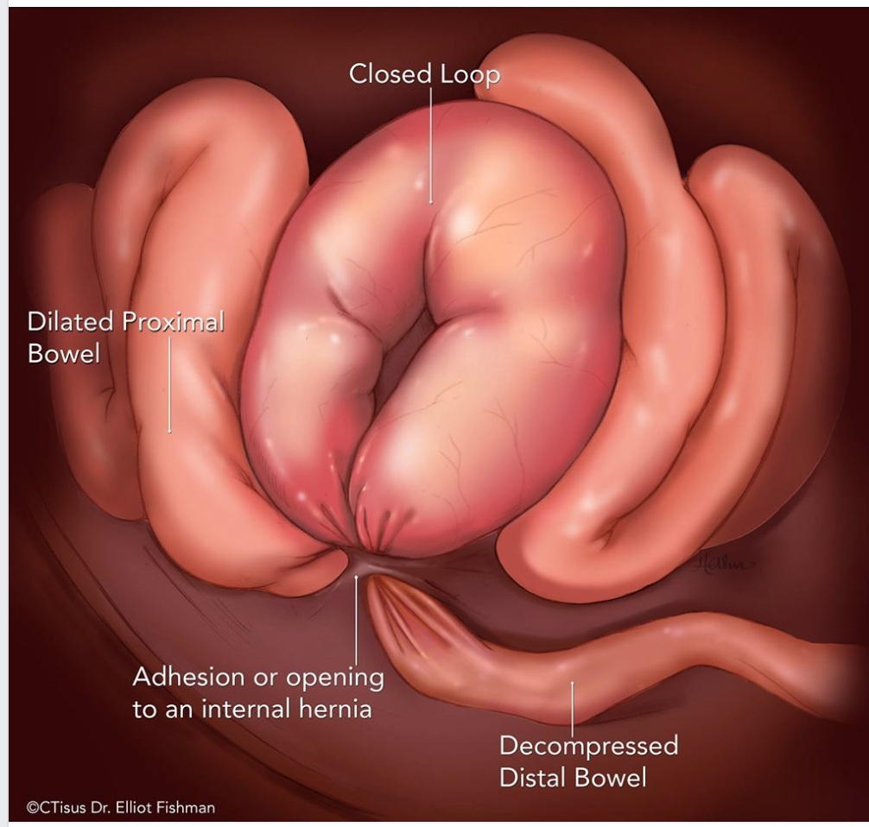
4- Bariatric surgery
- Complications:
2- Surgical:
Anastomotic leak; “HR>120 (How long?), Tachypnea, Hypoxia, Fever”, Risk?
DVT / PE / Respiratory distress/failure
RML; Risk?
Hernia / Closed loop bowel obstruction?
Bacterial overgrowth
Dumping Syndrome (Persistent diarrhea after excess carbs consumption)
Cholecystitis; some do prophylactic cholecystectomy.
Notes:
4 hours
Anastomotic leak; BMI increase & smaller bougie size
RML; Bypass > Banding & BMI increase

Slide 25
4- Bariatric surgery
- Follow-up:
- The frequency of follow up depends on the bariatric procedure performed and the severity of co-morbidities, but they were finding that <7 follow-up visits per year was associated with less loss of weight than with ≥7 follow-up visits per year.
- Significant weight gain/loss failure evaluation; Diet, Physical activity, Psychological problems, Procedure failure.
- Support group, The positive relationship between support group attendance and weight loss has been found.
- In 1 meta-analysis, found that postbariatric surgery patients participating in an exercise program experienced a standardized mean of 3.62 kg greater weight loss compared with minimal exercise groups.
Notes:
150min/week up to 300min/week + Strength training

Slide 26
4- Bariatric surgery
- Follow-up:
- Routine metabolic and nutritional monitoring.
- Routine screening of Vit.A, Vit.B12, Zinc.
- Supplementation of Vit.B12, Vit.D, Copper, Thiamine, Iron.
- Folic acid supplementation especially pregnant woman, Why? Prevent neural tube defect
- AVOID NSAIDs, Why? Anastomotic ulceration/perforation.
- Lipid lowering agents & anti-hypertensive should be repeatedly evaluated but not stopped.

Slide 27
4- Bariatric surgery
- Follow-up:
Anemia
No blood loss
Positive
Iron status
Negative
PO Fumarate, Sulfate OR Gluconate
+ Vit.C, Why? Increase absorption
Vit.B₁₂, folate, protein, copper, selenium, and zinc
Not tolerated Give IV
Treat accordingly

Slide 28
4- Bariatric surgery
- Follow-up:
- Anemia or fatigue, persistent diarrhea, cardiomyopathy, or metabolic bone disease
suggests Selenium deficiency, what the benefit? Antioxidant + Antidandruff
- Anemia, neutropenia, myeloneuropathy, and impaired wound healing suggests Copper deficiency.
- Bacterial overgrowth; Give metronidazole.

Slide 29
4- Bariatric surgery
- When to refer?
1- Persistent symptoms of GERD, regurgitation, chronic cough, or recurrent aspiration pneumonia after LAGB raise concern for the band being too tight or the development of an abnormally large gastric pouch above the band or esophageal dilation.
These symptoms should prompt immediate referral to a bariatric surgeon.
2- Severe malnutrition.
3- Any complication can not be managed medically.
4- Dumping Syndrome
Notes:
Laparoscopic Adjustable gastric band procedure “LAGB”

Slide 30
How to address obesity problems?
1- COMMUNITY-BASED
2- SCHOOL-BASED
3- HEALTH CARE PROFESSIONAL
4- MEDICAL STUDENT

Slide 31
1-COMMUNITY-BASED
- Awareness campaign about obesity risks and physical activity benefits.
- Provide activity areas “Tennis, Basketball, Volleyball, Football and walking yards” in every neighborhood.
- Educate people about the meanings of nutritional label components.
- Nutritional labels in restaurants meals as well as any food in the supermarket.

Slide 32
2-SCHOOL-BASED
- Provide all physical activities.
- Encourage students to participate in the free time and after the school time through giving rewards or even marks!
- Provide healthy diet in the school and educate the students about how to choose healthy diet.
- BMI and waist-circumference screening .
- Provide schedule for those obese students to help them reducing their weight and follow them up and give the rewards when the goal is achieved.

Slide 33
3-HEALTH CARE PROFESSIONAL
- Try to help the patient not to punish him.
- Address the risks behind having sedentary lifestyles.
- Refer obese patients to dietician to have a healthy diet.

Slide 34
4-MEDICAL STUDENT
- Aware family and friends about the benefits behind having healthy lifestyles.
- Try to be an example through having healthy lifestyle.

Slide 35
MCQs

Slide 36
1-MCQ: 27 Y-O man, his weight is 90Kg and height is 1.7 m. Calculate his BMI?
-A- 31 Kg/m²
-B- 32 Kg/m²
-C- 33 Kg/m²
-D- 34 Kg/m²

Slide 37
1-MCQ: 27 Y-O man, his weight is 90Kg and height is 1.7 m. Calculate his BMI?
-A- 31 Kg/m²
-B- 32 Kg/m²
-C- 33 Kg/m²
-D- 34 Kg/m²

Slide 38
2-MCQ: Which BMI range the patient fall in?
-A- Overweight
-B- Obese type I
-C- Obese type II
-D- Obese type III “Morbid obesity”

Slide 39
2-MCQ: Which BMI range the patient fall in?
-A- Overweight
-B- Obese type I
-C- Obese type II
-D- Obese type III “Morbid obesity”

Slide 40
3-MCQ: Most common cause of obesity?
-A- Diet habit
-B- Physical inactivity
-C- Genetics
-D- Social factors

Slide 41
3-MCQ: Most common cause of obesity?
-A- Diet habit
-B- Physical inactivity
-C- Genetics
-D- Social factors

Slide 42
4-MCQ: Which of the following is not an indication of Bariatric surgery?
-A- BMI > 40 Kg/m²
-B- BMI > 33 Kg/m² + 2 Comorbidities
-C- BMI > 35 Kg/m² + Comorbidity

Slide 43
4-MCQ: Which of the following is not the indication of Bariatric surgery?
-A- BMI > 40 Kg/m²
-B- BMI > 33 Kg/m² + 2 Comorbidities
-C- BMI > 35 Kg/m² + Comorbidity

Slide 44
5-MCQ: Which of the following diseases does obesity increase the risk of developing?
-A- Type II DM
-B- Cancer
-C- Sleep apnea
-D- All of the options given are correct

Slide 45
5-MCQ: Which of the following diseases does obesity increase the risk of developing?
-A- Type II DM
-B- Cancer
-C- Sleep apnea
-D- All of the options given are correct

Slide 46
6-MCQ: Patient come with Acne, Hirsutism, Amenorrhea and obesity. What is the most likely secondary cause of obesity?
-A- Hypothyroidism
-B- Drugs
-C- PCOS

Slide 47
6-MCQ: Patient come with Acne, Hirsutism, Amenorrhea and obesity. What is the most likely secondary cause of obesity?
-A- Hypothyroidism
-B- Drugs
-C- PCOS

Slide 48
References
Al-Ghamdi S, Prevalence of overweight and obesity based on the body mass index; a cross-sectional study in Alkharj, Saudi Arabia. Lipids Health Dis. 2018 Jun 5;17(1):134.
Juliano H. Borges, Stephen J. Carter, David R. Bryan, Gary R. Hunter, Exercise training and/or diet on reduction of intra-abdominal adipose tissue and risk factors for cardiovascular disease. European jounale of clinical nutrition. 2018 September 5.
Nucleus Medical Media, Treatment for Obesity | Medications | Bariatric Surgery | Nucleus Health. 2017 Dec 15 .
Assim A. Alfadda,The Saudi clinical practice guideline for the management of overweight and obesity in adults. Saudi Med J. 2016 Oct; 37(10): 1151–1162.

Slide 49
References
Saad Salman M Alqarni, A Review of Prevalence of Obesity in Saudi Arabia. 2016 October 25.
Simon Chantal, Chapter eight, Oxford handbook of clinical medicine.
American Association of Clinical Endocrinologists, The Obesity Society, and American Society for Metabolic & Bariatric Surgery, Clinical Practice Guidelines for the Perioperative Nutritional, Metabolic, and Nonsurgical Support of the Bariatric Surgery Patient. 2013 March.
Labib M. The investigation and management of obesity. Journal of Clinical Pathology. 2003;56(1):17-25.

Slide 50
Thank you for attention!
Any question ?

Slide 51
Roleplay

