Slide 1
ADOLESCENT HEALTH
Abdulelah almousa:435101610
Abdullah fahad alotaibi: 435100545
Abdulrahman alshehri :435100659

Slide 2
Objective :
Define adolescent age: World health organization definition.
Understand adolescent’s physiological and behavioral characteristics.
Recognize the importance of adolescent health.
Determine adolescent health problems: physical, psychological and social problems.
Recognize common adolescent health problems in Saudi Arabia: Retrieved from available evidence-based studies.
Understand the comprehensive approach to common adolescent health problems in primary health care.
Understand the role of family, school and community in adolescent health care.

Slide 4
Question:
ADOLESCENCE AGE IS BETWEEN:
a) 7-18
b)10-23
c) 10-19
d) 20-26

Slide 5
Question :
Adolescents represent ......... of the population of Saudi Arabia ?
A- 10%
B- 25%
C- 30%
D- 50%

Slide 6
Question:
The first sign of physical changes in girls is ?
A- Menarche.
B- Pubic hair.
C- Axillary hair.
D- Breast enlargement.

Slide 7
Question:
The leading cause of death in adolescence group of age is?
A- Road Traffic Accidents.
B- Self inflected injuries (e.g. suicide)
C- STDs.
D- Poverty.

Slide 8
Question:
Q5. What is the most common cause of obesity in adolescent?
a) Hormonal
b) Lack of physical activity and overeating
c)Genetic
d) Other

Slide 10
Who definition WHO Definition of adolescents the period in human growth and development that occurs after childhood ad before adulthood, aged between 10 to 19

Slide 12
Adolescents Physiological changes
Hormonal changes
Skeletal changes
Behavioral changes
Emotional changes
Dietary changes:

Slide 13
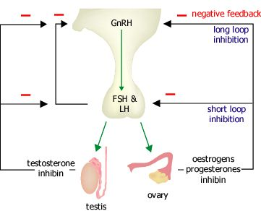
Hormonal
The GNRH release from hypothalamus which
act on anterior pituitary gland to release LH and FSH
Then the LH and FSH stimulate the
maturation of testis and ovary
they also play a major role in Sex steroid synthesis

Slide 14
Skeletal changes
Increased in sex hormone lead to increased bone growth in adolescence.
At the end of adolescence more than 95 percent of skeleton is formed
Increase in muscle growth in boys and fat deposition in hip and breast in girls is the cause of weight gaining

Slide 15
Physical changes (male)
For boys Physical changes usually start around 11 or 12 years, but they might start as young as 9 years or as old as 14 years
Physical changes include:
Growth of the penis and testes (testicles)
Change in voice.
Growth of body and facial hair
Erections with ejaculation
Changes in shape and height

Slide 16
Physical changes (female)
Early physical changes from about 10 or 11 years, but they might start as young as 8 years or as old as 13 years
Physical changes include:
Breast development) first change )
Growth of pubic and body hair
Axillary hair growth
Menarche

Slide 17
Behavioral changes
Social changes:
Searching for identity: young people are busy working out who they are and where they fit in the world, and this can be influenced by gender, peer group, cultural background, and family expectations.
Looking for new experiences and engaging in more risk.
Seeking more responsibility at home & school.
Concern about other people’s opinions
Seeking more independence: this is likely to influence the decisions your child makes and the relationship with his family and friends.

Slide 18
Emotional changes
Notes:
1-More self conscious specially about physical appearance.
2-Intense emotions at different times > unpredictable moods.
3-More emotional

Slide 19
Dietary changes:
Obesity
Decrease in appetite
physical inactivity

Slide 20
Why do we study ADOLESCENT HEALTH
They are at high risk of alcohol intake ,drug abuse, smoking
Which can cause many disease cancers, infertility, hypertension, heart disease and premature death so they should be taught about their ill effects .
Adolescents have significant needs for health services. Adequate care and support should be given to them so that they enter into their adulthood in good mental and physical health.

Slide 21
In Saudi Arabia adolescents accounts for 25%
Notes:
The papulation of adolcent in Saudi Arabia 25 of population

Slide 22
Adolescent health problems

Slide 23
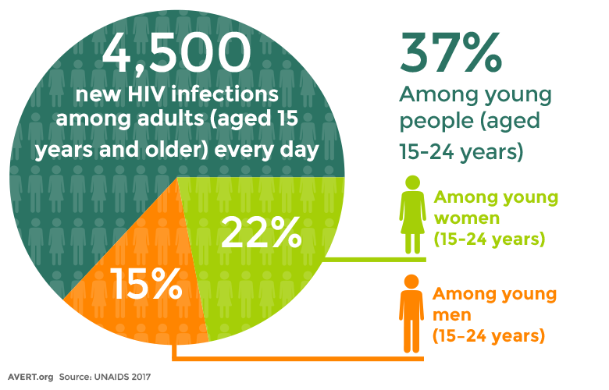
Hiv
More than 2 million adolescents are living with HIV
even when the number of HIV-related deaths is decrease into 30% , HIV deaths among adolescents are rising .
What should we do ?
strength of Islamic prohibition of extra martial sex
obtain condoms to prevent sexual transmission of the virus
clean needles for those who inject drugs

Slide 24
Other infectious diseases ?
Measles
Meningitis
Lower respiratory tract infections
Notes:
Measles
Meningitis
Lower respiratory tract infections

Slide 25
Violence
It is the most common cause of death in older adolescent males
Globally, 1 in 10 girls under the age of 20 years report experiencing sexual violence
What we should do ?
1-providing training in life skills.
2- Violence Laws
3-Promoting nurturing relationships between parents and children early in life.

Slide 26
Alcohol and drugs
Harmful drinking among adolescents is a major concern in many countries. It reduces self-control and increases risky behaviors such as : unsafe sex or dangerous driving.
is a primary cause of injuries (including those due to road traffic accidents), violence (especially by a partner) and premature deaths.
Drug use among 15–19 year olds is also an important global concern.
What we should do ?
Drug control
strength of Islamic prohibition of alcohol and drug abuse

Slide 27
5- Mental health
The third leading cause of illness and disability among adolescents is :
Depression
the thrid most common cause of death in older adolescents (15–19 years) is :
Suicide
Many factor increase risk of developing mental health problems:
Violence, poverty, humiliation and feeling devalued

Slide 28
- Tobacco use
The vast majority of people using tobacco today began doing so when they were adolescents.
Globally, at least 1 in 10 adolescents aged 13 to 15 years uses tobacco.
WHAT ARE THE CAUSES
1-media
2-misinformation
3-parental cause
4- stress relief
5-peer pressure

Slide 29
Injuries
Unintentional injuries that are the leading cause of death and disability among adolescents
Drowning is common among adolescent
Road traffic accident
over 115 000 adolescents died as a result of road traffic accidents .
most common injuries were falls (40.4%)

Slide 30
Early childbirth pregnancy
- complications from pregnancy and childbirth is The leading cause of death for 15– 19-year-old girls globally.
11% of all births worldwide are to girls aged 15 to 19 years old. The vast majority of these births are in low- and middle-income countries
What should we do ?
-strength of Islamic prohibition
-Laws that specify a minimum age of marriage at 18 and which are enforced can help
Better access to contraceptive information

Slide 31
8- Malnutrition and obesity
A study was carried out with the aim of identifying the health risk behaviors and health status of adolescents in Saudi Arabia, in 2015. It was a cross-sectional, school-based study was in all 13 regions of Saudi Arabia with a total of 12,575 adolescents participated. 28% of adolescents reported having a chronic health condition 14.3% reported having symptoms suggestive of depression 30.0% were overweight/obese 95.6% were vitamin D deficient ,Almost half of all adolescents did not engage in any physical exercise. Females reported complete absence of exercise much more than males
the most common cause of obesity in adolescent is Lack of physical activity and overeating

Slide 32
Chronic disorder and physical activity
Iron deficiency anemia .
adolescents should have …… minutes or more of physical activity daily
Notes:
60

Slide 33
Adolescent health problems in Saudi Arabia
Saudi society is different from western societies in many respects. It is conservative society with strong Islamic values. The pattern of adolescent’s problems is expected to be different from that in the west. For example illegitimate teenage pregnancies are common in western world, but it is not in KSA.

Slide 34
https://www.ncbi.nlm.nih.gov/pubmed/12883611
Dr Zahid Naeem MBBS, MCPS, DPH, FCPS, Medical and Behavioral Problems among Saudi Adolescents , Int J Health Sci (Qassim) 2013 Jun; 7(2): V–VI.
- Fadia S. AlBuhairan, M.D., Hani Tamim, Ph.D., Time for an Adolescent Health Surveillance System in Saudi Arabia: Findings From “Jeeluna”, Journal of Adolescent Health 57 (2015) 263:269

Slide 35
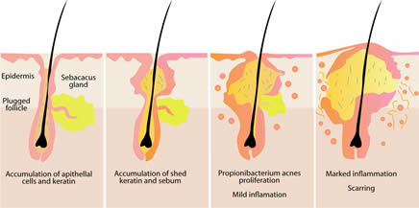
acne vulgaris
53.4% reported that they have suffered from acne.
51.5% of males and 55.6% of females were suffered from acne.
72.1% believe that diet is an etiologic factor of acne
15.9% reported that acne is an infectious disease
https://www.ncbi.nlm.nih.gov/pubmed/12883611
Notes:
Acne Vulgaris (AV) is an extremely prevalent skin condition-affecting adolescents of both genders.
Don on Five hundred and seventeen students.
There is no difference in the incidence of acne among the different age groups of the studied sample

Slide 36
road TRAFIC ACCEDENTS
Finding of the first study indicate that adolescents males who drive car 45% of them had a car accident.

Slide 37
Bullying and violence
- 25% reported exposure of Bullying in school
20% reported physical violence at school or community
TOBACCO AND SUBSTANCE ABUSE
16.5% cigarettes
10.5% sheesha
- 16% sniffing solvent also most common substance in females
7.2% prescription for non-medical purposes
1.4% Alcohol
Notes:
this study which was carried out with the aim of identifying the health risk behaviors and
health status of adolescents in Saudi Arabia in 2014
This cross-sectional, school-based study was carried out in all 13 regions of Saudi Arabia. In total of more than 12 thousand adolescents participated.

Slide 38
Mental illness
- Most prevalent being depression at 14%
Second is anxiety at 6.7%
Chronic health
- 28.6% overall prevalence
Most prevalent being bronchial asthma at 8.4%
- Indicators of health care status and others
- Overweight 14.1%
- Obese 15.9%
- Underweight 15.2%
- Vit D 95.6%
Car accidents representing 35.4%

Slide 39
How to approach adolescent health problems as family physicians?

Slide 40
Mental health:
Provides adolescents with psychosocial support in schools and other community settings
And building life Skiles can help promote a good mental health.
If problems arise, they should be detected and managed by competent and caring health workers and referred to psychiatry.
Programs to help strengthen the ties between adolescents and their families are also important.

Slide 41
Smoking:
Prohibiting the sale of tobacco products to minors.
Increase tobacco products price.
forbidding smoking advertising.
Ensuring smoke-free environments.
Warning ,explaining and educating about the danger of using illegal drugs.

Slide 42
Road Traffic Accident:
Obesity and physical inactivity:
1-Establish road safety regulations such as speed limits.
2-Forbidding adolescents aged less than 18 years from driving.
3-Young drivers need advice on driving safely.
Available access to healthy foods and opportunities to engage in physical activity.
Establishing healthy eating and exercise habits at adolescents are foundations for good health in adulthood.

Slide 43
Role of family, school, and community in adolescent health care

Slide 44
Family role:
Adolescents who have good communication and are bonded with an adult are less likely to engage in risky behaviors.
To promote a safe environment parents should supervise and involved with their adolescents' activities.
The children of families living in poverty are more likely to have health conditions and poorer health status, as well as less access to and utilization of health care.

Slide 45
School role:
character building and personality development of adolescents are mainly affected by School environment and behavior of teachers.
School health clinics for health education & counseling has important role.
The school social environment affects student’s attendance, academic achievement, and behavior.
A safe and healthy school environment protects against risky behaviors

Slide 46
Role of community
Establishing Antismoking program invoving prohibition of the sale and use of cigarettes in public places.
Application of firm traffic laws forbidding adolescents aged less than 18 years from driving.
Apply of firm traffic laws forbidding adolescents aged less than 18 years from driving
Raising awareness of health issues for young people among the general public and special groups.
Supervision over media content because, adolescents who are exposed to media portrayals of violence, sexual content, smoking, and drinking are at risk for adopting these behaviors.

Slide 47
Role play

Slide 48
Conclusion
Adolescent represent more than 25 of population
During Adolescent many phycological and psychological changes .
The family, school and community have a major role in improving adolescence healthcare
the Islamic values play a major role in controlling adolescent behaviors.

Slide 49
References
Adolescents: health risks and solutions: WHO 5 February 2018 website
http://www.who.int/mediacentre/factsheets/fs345/en/#
- Oxford handbook of General practice
- Fadia S. AlBuhairan, M.D., Hani Tamim, Ph.D., Time for an Adolescent Health Surveillance System in Saudi Arabia: Findings From “Jeeluna”, Journal of Adolescent Health 57 (2015) 263:269
- https://www.ncbi.nlm.nih.gov/pmc/articles/PMC3883599/
- Physical Activity Guidelines for Americans
Primary care booklet
- Alzahrani, Saeed G et al. "Patterns Of Clustering Of Six Health-Compromising Behaviours In Saudi Adolescents". BMC Public Health 14.1 (2014): n. pag. Web

